Slide 1
Predicting Game Success on the Steam Platform
Multiclass Classification of Steam Game Reception
Team 9 – Brewed Clusters
Satwik Kumar Lohani · Arpitha Shivaprasad Kori · Zubair Ashfaq · Beyza Ünlü · Muhammad Sameer Siddiqui · Esha Raheel
IE500 Data Mining | University of Mannheim | Spring 2026

Slide 2
Problem Statement
Why is predicting Steam game reception difficult?
• Steam hosts 50,000+ active titles — developers need early signals of reception before release
• Task: predict Good / Mixed / Bad reception using only pre-release metadata
– Good: review ratio ≥ 0.75 | Mixed: 0.50 – 0.74 | Bad: < 0.50
• Primary metric: Macro F1 — penalises poor minority-class performance equally
• Key challenge: 3 imbalanced classes (Good 63 %, Mixed 28 %, Bad 8 %)
– Good and Mixed games share nearly identical metadata; only review ratio differs
– Current features cannot encode execution quality, post-launch patches, or community sentiment
• Leakage constraint: must exclude post-release signals (playtime, Metacritic, Recommendations)
IE500 Data Mining | Team 9 – Brewed Clusters | 2/12

Slide 3
Dataset & Target Construction
Steam Games Dataset — Kaggle (FronkonGames, 2024)
• Raw CSV: 122,611 rows × 39 columns
– Price, genres, tags, categories, platform flags, achievements, DLC count
• Review-stability filter: keep games with ≥ 10 total reviews
– 56,655 rows retained
• Stratified 80 / 20 train–test split
– Train: 45,324 games | Test: 11,331 games
• Safe feature set: 147 columns (no post-release leakage)
Class Distribution (Train)
Good
ratio ≥ 0.75
28,671 (63.3 %)
Mixed
0.50 – 0.74
12,834 (28.3 %)
Bad
ratio < 0.50
3,819 (8.4 %)
IE500 Data Mining | Team 9 – Brewed Clusters | 3/12

Slide 4
Preprocessing Pipeline
9 steps applied identically to train and test splits
• Duplicate & validity checks — exact duplicates removed; negative prices/counts corrected
• Row-alignment fix — misaligned CSV rows corrected before any downstream processing
• Numeric conversion — price, positive/negative review counts, achievements cast to float
• Weak-column removal — AppIDs, URLs, review text, support links dropped
• Review-stability filter — games with < 10 reviews excluded (→ 56,655 rows)
• Multi-value parsing — genres, categories, tags binarised via MultiLabelBinarizer
– Top 50 tags by training-set frequency retained; 58 category flags; 28 genre flags
• Derived features — log_price, release era buckets (pre-2015 / 2015-2019 / 2020+), n_languages
• Leakage-aware split — avg_playtime, Recommendations, Metacritic excluded from safe feature set
• Scaling — StandardScaler fitted on train only; applied to all continuous features
IE500 Data Mining | Team 9 – Brewed Clusters | 4/12

Slide 5
Exploratory Data Analysis
Four modelling-relevant patterns in the safe training set
Class Imbalance
Sparse Features
Good (63.3%) dominates. Bad (8.4%) is the minority — limited training signal.
Most binary indicators are True for < 20% of games. Individual features have limited separating power.
Weak Numeric Correlations
Descriptor Patterns
Pearson correlations between safe numerics and Good-vs-rest are all below |0.15|. Non-linear combinations are required.
cat_Steam Cloud, cat_Full controller support, era_2020+ → higher good-reception rates. Monetisation-heavy categories trend lower.
IE500 Data Mining | Team 9 – Brewed Clusters | 5/12

Slide 6
Modelling Setup
7 models trained under identical nested cross-validation
• Nested cross-validation: 5 outer folds (unbiased performance) + 3 inner folds (GridSearchCV tuning)
• Primary metric throughout: Macro F1 — weights all three classes equally
• Class imbalance handled inside each model pipeline:
– class_weight="balanced" for RF, XGBoost, SVM, LR baseline
– SMOTE and Random Over-Sampling tested separately on LR
• Final model: GridSearchCV on full training set → evaluate on test set once
Models evaluated:
• Random Forest (RF)
• Logistic Regression (LR)
• K-Nearest Neighbours (KNN)
• XGBoost
• LR + SMOTE
• Linear SVM
• LR + Random Over-Sampling
• Majority-class baseline
IE500 Data Mining | Team 9 – Brewed Clusters | 6/12

Slide 7
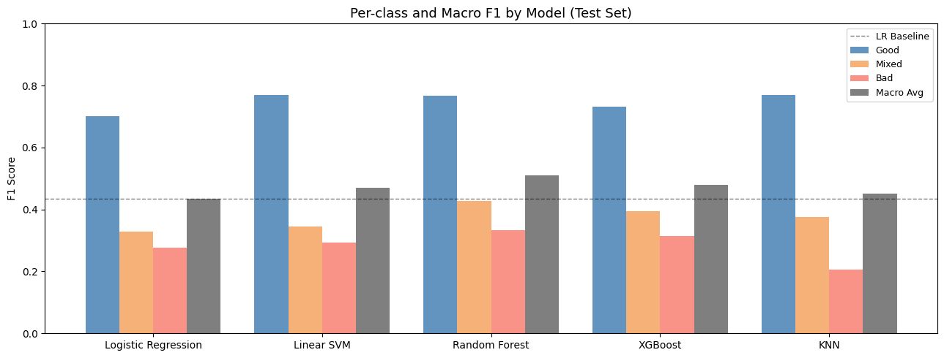
Model Comparison Results
Random Forest achieves the best Test Macro F1 = 0.5100
Test Macro F1 Summary
Random Forest
0.5100
XGBoost
0.4799
Linear SVM
0.4693
LR + SMOTE
0.4648
KNN
0.4516
LR baseline
0.4355
LR + ROS
0.4352
Majority class
0.2583
IE500 Data Mining | Team 9 – Brewed Clusters | 7/12

Slide 8
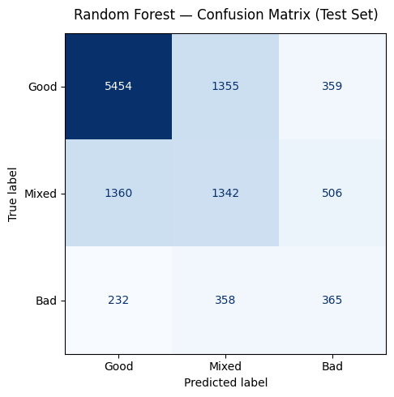
Best Model: Random Forest
Test Macro F1 = 0.5100 | n_estimators=200, max_depth=None, min_samples_leaf=4
• Good F1 = 0.77 | Mixed F1 = 0.43 | Bad F1 = 0.33
• Tree ensembles outperform linear models because feature interactions are non-linear
– e.g. tag_2D × era_2020+ is disproportionately Good — LR cannot model this directly
• RF beats XGBoost on balanced Macro F1:
– XGBoost recovers higher Bad recall (0.56) but lower Good F1 → net lower macro
• class_weight="balanced" with max_features="sqrt" gives best bias–variance trade-off
• Consistent performance: Nested CV F1 = 0.5093 ± 0.0073
IE500 Data Mining | Team 9 – Brewed Clusters | 8/12

Slide 9
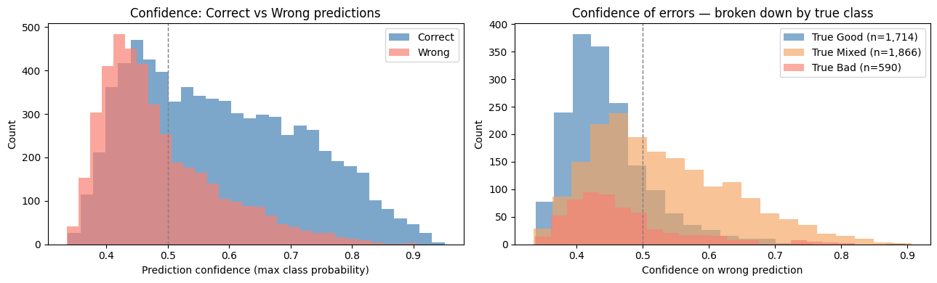
Error Analysis
Why do Mixed (F1=0.43) and Bad (F1=0.33) underperform?
Dominant error patterns
Mixed → Good
1,360
42.4 % of Mixed
Mixed → Bad
505
16.6 % of Mixed
Bad → Mixed
358
37.5 % of Bad
Bad → Good
229
24.0 % of Bad
• Correct predictions: median confidence = 0.570
• Wrong predictions: median confidence = 0.460
• 320 high-confidence errors (prob ≥ 0.70) — 75.9 % are Mixed→Good
• Root cause: Good and Mixed games are genuinely similar in feature space
– Only review ratio separates them — no pre-release metadata encodes this gap
IE500 Data Mining | Team 9 – Brewed Clusters | 9/12

Slide 10
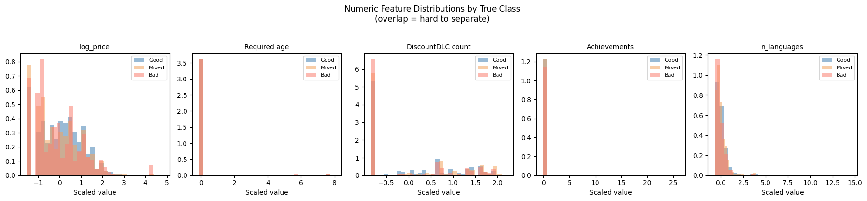
Feature Importance & Good–Mixed Separation
Even the strongest separating signal (+0.172) is modest
• Top Good − Mixed feature differences:
– tag_2D: +0.172
– era_2020+: +0.159
– cat_Steam Cloud: +0.145
– era_2015-2019: −0.144
– tag_Singleplayer: +0.128
– cat_Full controller: +0.122
• Implication: modern, polished, singleplayer 2D games trend Good
• But no single feature cleanly separates the classes — differences are modest
• LR symbolic analysis confirms: era_2020+, tag_2D, cat_Steam Cloud are top positive LR coefficients
IE500 Data Mining | Team 9 – Brewed Clusters | 10/12

Slide 11
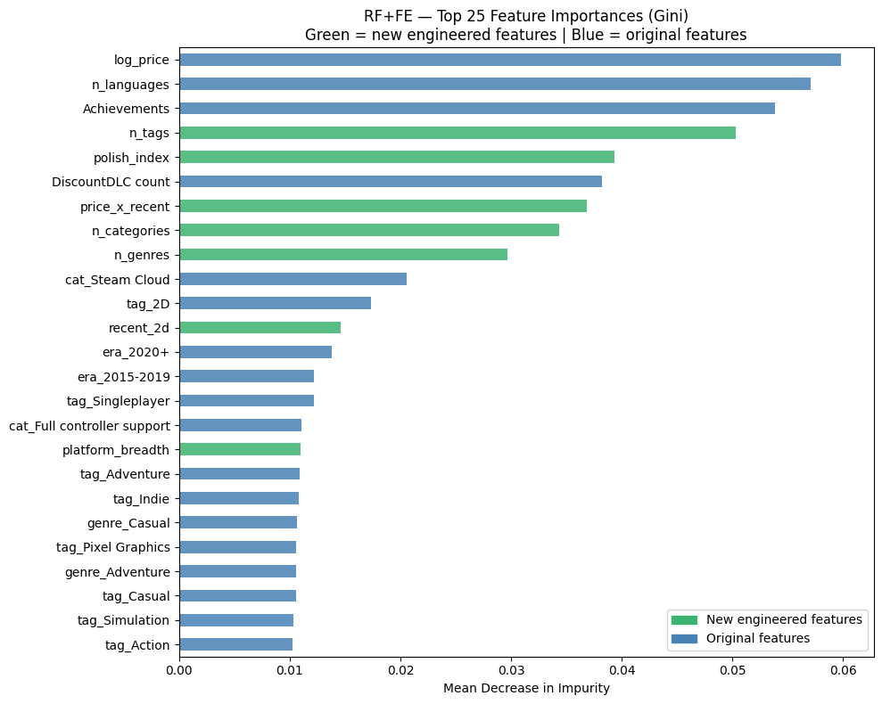
Feature Engineering Experiment
8 derived features added (147 → 155) — no meaningful improvement
New features
n_tags
(count)
n_categories
(count)
n_genres
(count)
polish_index
(composite)
recent_2d
(binary)
price_x_recent
(interaction)
solo_only
(binary)
platform_breadth
(count)
Result
• CV Macro F1: 0.5102 vs 0.5093 (+0.0009)
• Test Macro F1: 0.5093 vs 0.5100 (−0.0007)
• 7/8 new features in RF Top 25 — but redundant
• Ceiling is data ambiguity, not missing features
IE500 Data Mining | Team 9 – Brewed Clusters | 11/12

Slide 12
Conclusions & Future Work
Key Findings
Future Directions
• Random Forest is the best model — Test Macro F1 = 0.5100
• Non-linear methods (RF, XGBoost) outperform linear (LR, SVM) by +0.07
• SMOTE provides the only meaningful imbalance-handling gain (+0.029 on LR)
• Mixed→Good is the dominant error: 42.4 % of Mixed misclassified as Good
• Feature engineering (8 new features) adds no improvement — RF already captures count-level patterns
• Performance ceiling is inherent: Good and Mixed are genuinely similar in pre-release metadata space
• NLP on game descriptions — semantic signals beyond metadata tags
• Developer reputation features — prior game performance as prior
• Post-launch enrichment — community tags, early reviews, patch frequency
• Ensemble stacking — combine RF and XGBoost probability outputs
• Finer threshold exploration — reduce genuinely borderline cases in the label
• SHAP interaction values — quantify feature pair synergies (e.g. 2D × era)
IE500 Data Mining | Team 9 – Brewed Clusters | 12/12

