Slide 1
Hotel Booking Data Analysis: Customer Behaviour, Revenue & Cancellation Insights
Ayush Kumar Lohani
ayushlohani58@gmail.com

Slide 2
Introduction
This project analyzes hotel booking data to understand customer behavior, revenue patterns, and cancellation trends. The objective is to identify key insights across booking channels, room types, star ratings, and monthly trends to support better business decision-making.
Using Python, the dataset was processed and visualized through various charts to uncover meaningful patterns in bookings, revenue, and cancellations. These insights help in understanding what factors influence customer choices and overall business performance.
The analysis aims to provide actionable recommendations to reduce cancellations, optimize pricing strategies, and improve revenue and customer retention.

Slide 3
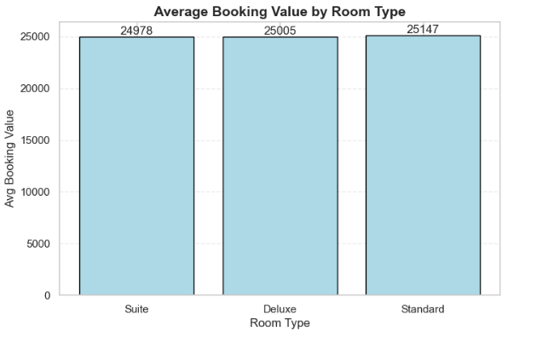
Meaningful Trends in the Data Average Booking Value Analysis
Average booking value is almost similar across room types (~25K), showing pricing is not strongly differentiated by room category.
Standard rooms slightly lead in value (~25.1K), suggesting they are booked more frequently rather than being premium-driven.

Slide 4
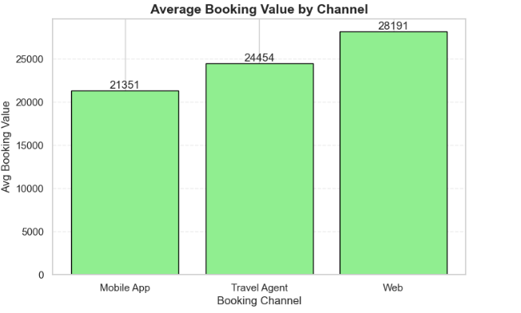
Meaningful Trends in the Data Average Booking Value Analysis
Web bookings generate the highest average booking value (~28.2K), indicating more premium and higher-spending customers.
Travel Agent bookings have lower value (~24.5K) despite high volume, suggesting they bring less profitable or more price-sensitive customers.

Slide 5
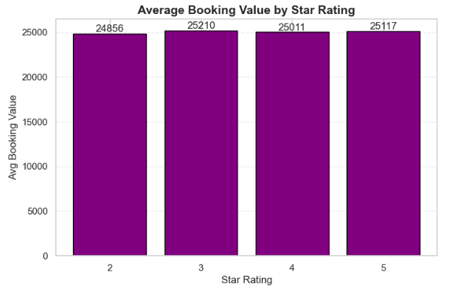
Meaningful Trends in the Data Average Booking Value Analysis
Average booking value is almost uniform across all star ratings (~24.8K–25.2K), showing minimal impact of star rating on spending behavior.
3-star hotels have the highest average value (~25.2K), slightly ahead of other categories, indicating balanced demand in mid-range properties.

Slide 6
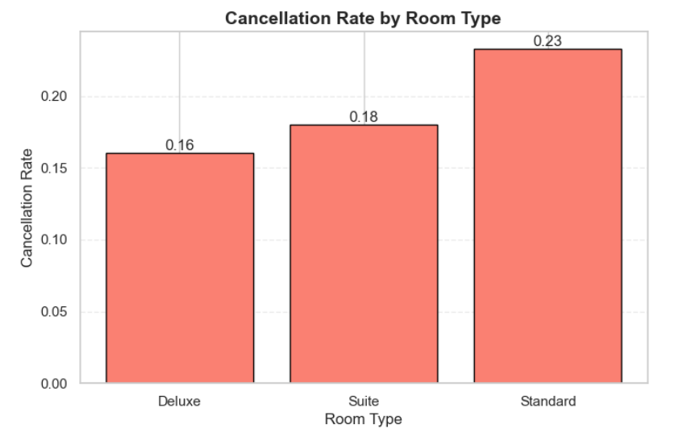
Meaningful Trends in the Data Cancellation Rate Analysis
Standard rooms have the highest cancellation rate (23.3%), indicating strong price sensitivity and higher booking uncertainty.
Deluxe rooms are the most stable (16.0%), suggesting more committed customers and better booking reliability.

Slide 7
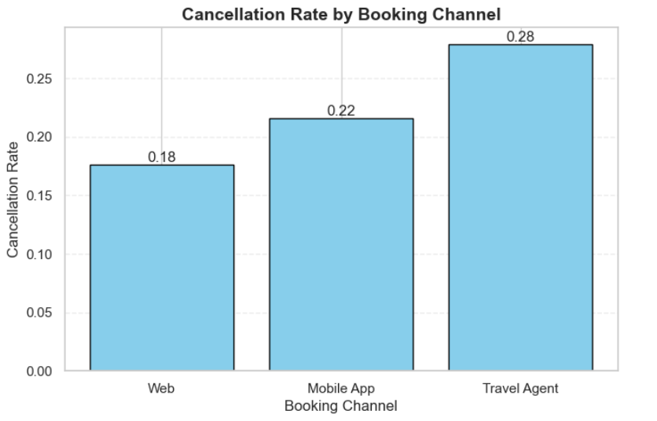
Meaningful Trends in the Data Cancellation Rate Analysis
Travel Agents have the highest cancellation rate (27.9%), indicating low booking commitment and higher “compare-and-hold” behavior.
Web bookings are most stable (17.6%), showing higher customer intent and stronger booking confirmation.

Slide 8
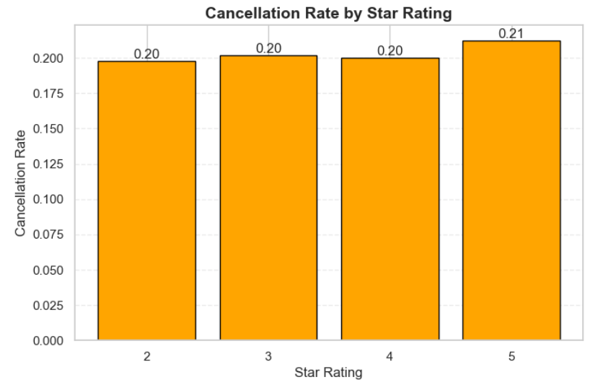
Meaningful Trends in the Data Cancellation Rate Analysis
5-star hotels have the highest cancellation rate (21.3%), showing that premium bookings are more flexible and prone to last-minute changes.
2, 3, and 4-star hotels have almost similar cancellation rates (~20%), indicating that cancellations are not strongly dependent on hotel rating.

Slide 9
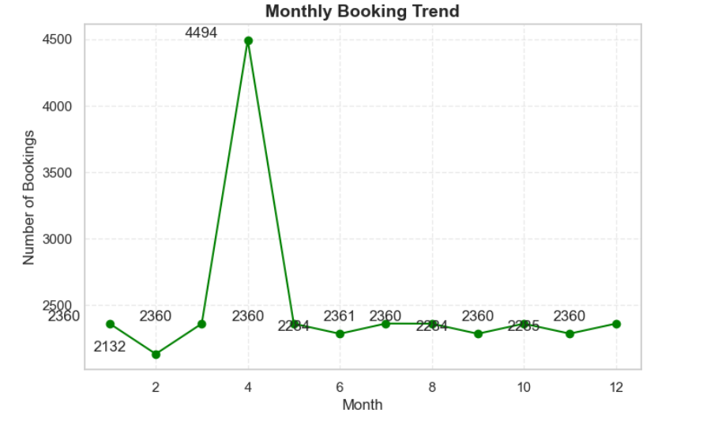
Meaningful Trends in the Data Seasonal Trend
April shows a clear booking spike (4494 bookings), indicating a strong seasonal or demand-driven peak compared to other months (~2100–2360 range).
Most other months have stable booking volumes, suggesting a consistent baseline demand throughout the year except for the April surge.

Slide 10
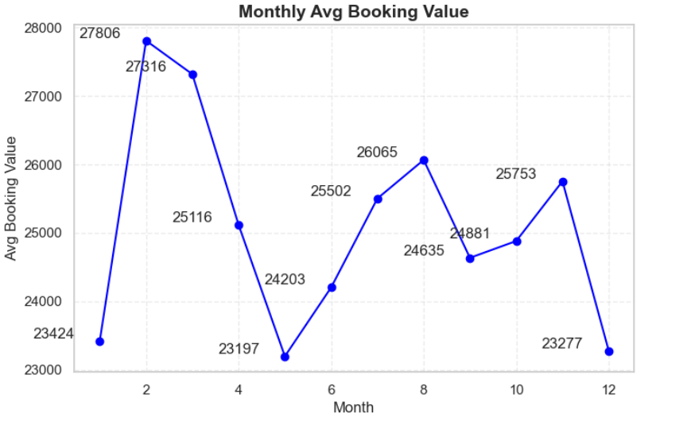
Meaningful Trends in the Data Seasonal Trend
February and March show the highest average booking value (~27.8K and ~27.3K), indicating peak spending during early-year travel demand.
May and December have the lowest booking values (~23.1K–23.2K), suggesting more budget-conscious or off-peak travel behavior.

Slide 11
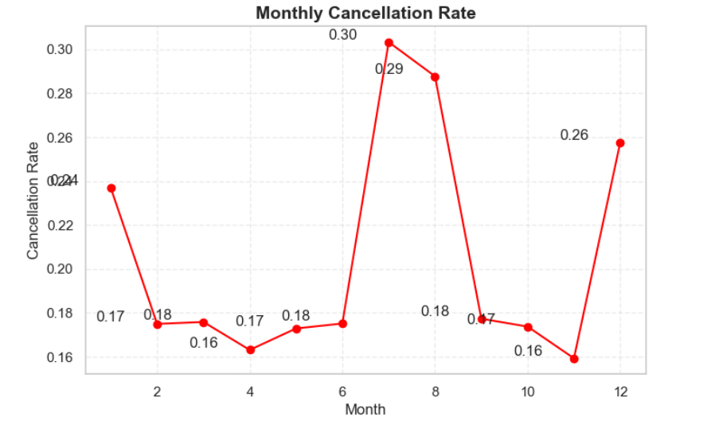
Meaningful Trends in the Data Seasonal Trend
July and August show the highest cancellation rates (~30% and ~28.8%), indicating peak seasonal instability during mid-year travel.
November has the lowest cancellation rate (~15.9%), suggesting more committed bookings and stable travel plans during this period.

Slide 12
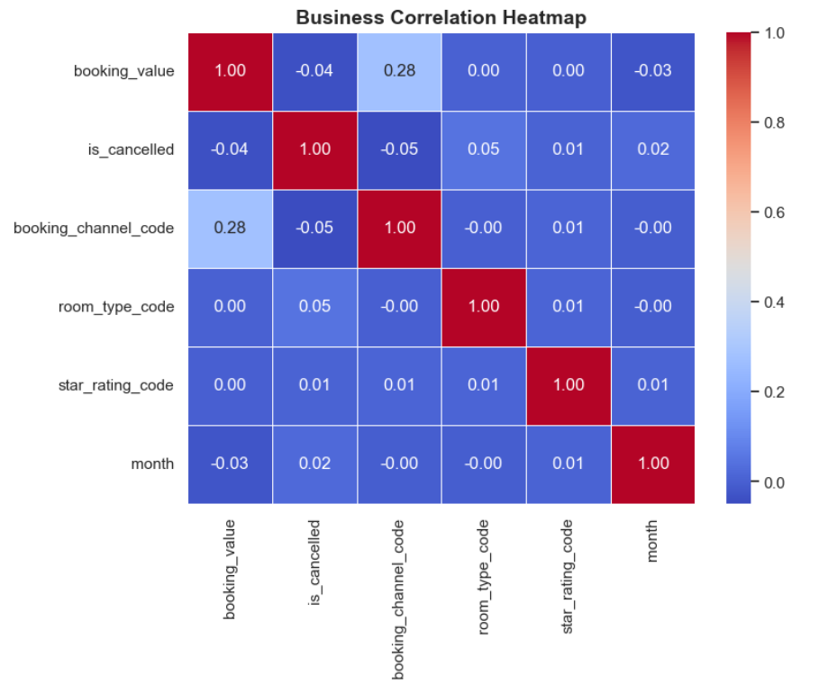
Correlation Between All Parameters
Booking channel has the strongest (but still weak) relationship with booking value (0.28), indicating that certain channels tend to generate slightly higher-value bookings than others.
Most variables show near-zero correlation with cancellations, suggesting that factors like booking value, room type, star rating, and month alone are not strong predictors of cancellation behavior.

Slide 13
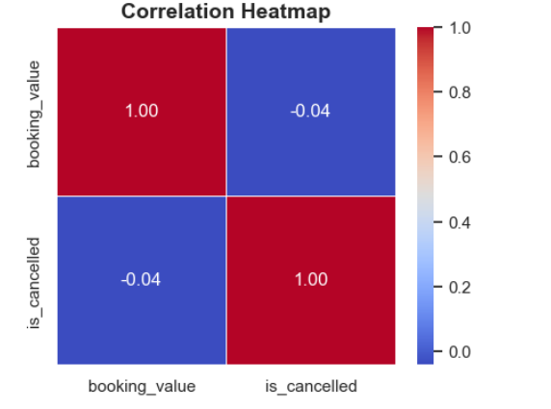
Correlation Booking Value vs Cancellation
Booking value has almost no impact on cancellations (correlation = -0.04), meaning high and low-value bookings are cancelled at similar rates.
Price alone is not a useful predictor of cancellation behavior, so other factors like channel, timing, or customer intent are more important.

