Slide 1

Topic: Analyzing In-Context Learning in Language Models Using Counterfactuals
Major Project :- ELD880
Supervisor:- Prof. Sougata Mukherjea
Name:- Animesh Lohar Entry No:- 2024EET2368
M.Tech in Computer Technology

Slide 2
Outlines | Slide No.
Introduction | 3 - 4
Problem Statement | 4 - 5
Related Work | 5 - 6
Methodology | 6 - 7
Results | 7 – 17
Conclusion & Future Works | 17-19
Reference | 19 - 20

Slide 3
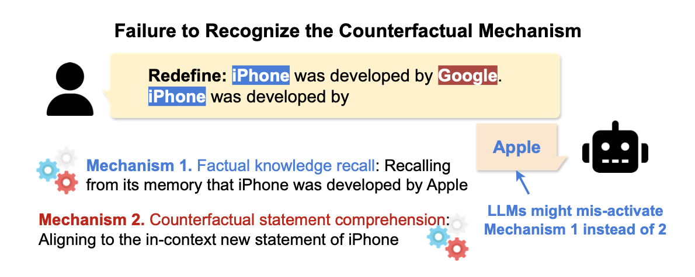
Introduction:-
The Dual Nature of Language Models
In Context Learning (ICL)
Pretrained Memory
Learn from Examples in the Prompt
Adapt to New Tasks Immediately
Follow Contextual Instructions
Vast World Knowledge from Training
Factual Consistency
Established Reasoning Patterns
Using Counterfactuals to Probe the Competition:
        Create direct conflict between context and memory
  Reveal which system dominates
  Test model robustness and reasoning
Core Question: When context contradicts knowledge, which wins?

Slide 4
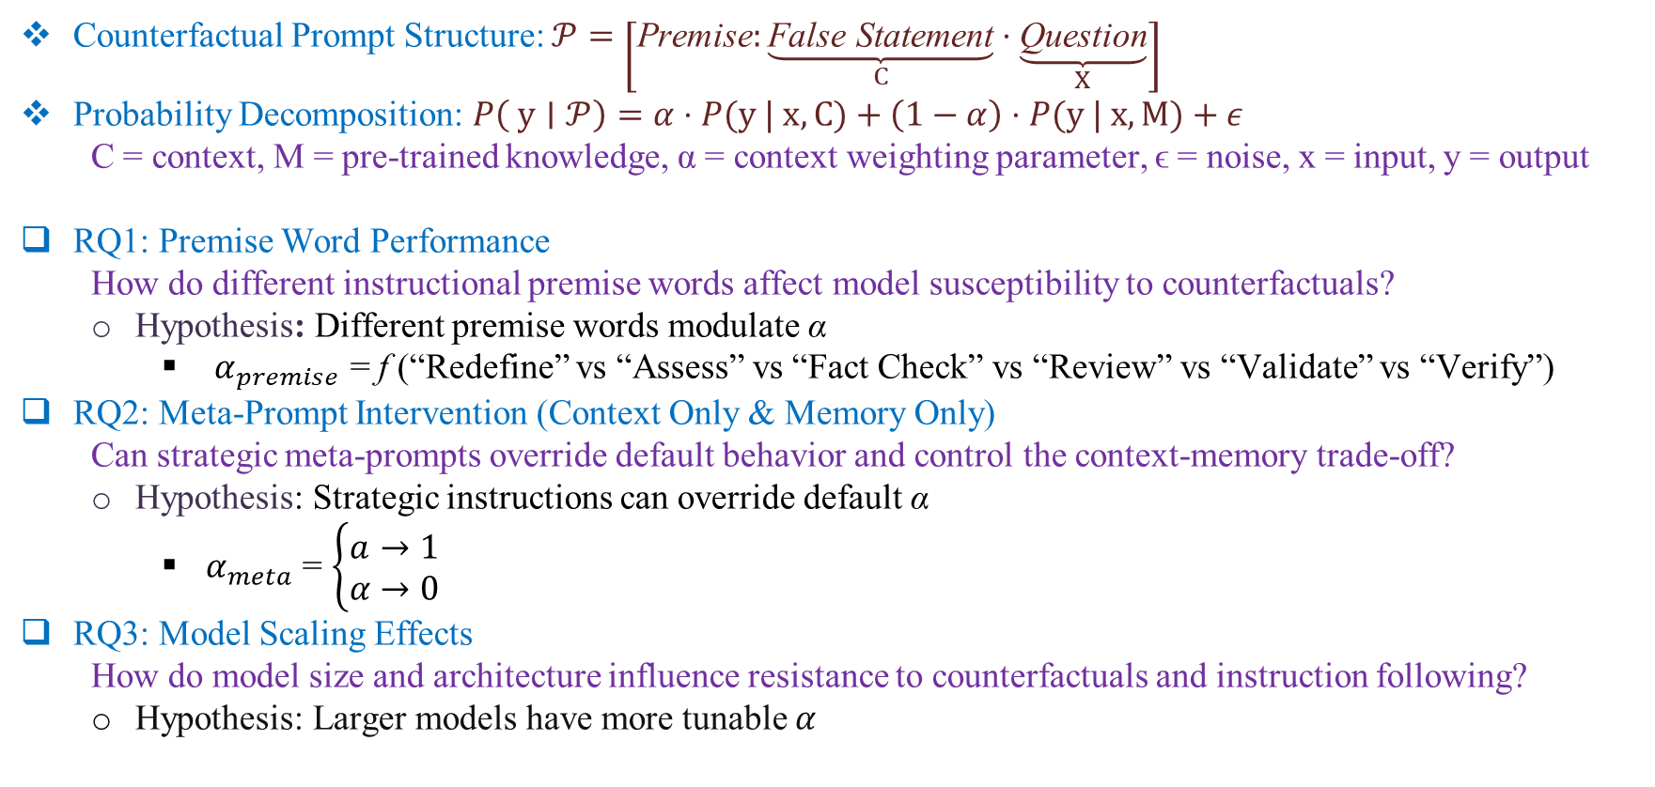
Problem Statement:-
Counterfactual Prompt Structure: $𝒫=\left[\text{Premise}:\underset{C}{\underbrace{\text{False} \text{Statement}}}⋅\underset{X}{\underbrace{\text{Question}}}\right]$
Probability Decomposition: $P\left( y∣𝒫\right)=α⋅P(y | x,C)+\left(1−α\right)⋅P(y | x, M)+ε$
  C = context, M = pre-trained knowledge, α = context weighting parameter, ϵ = noise, x = input, y = output
RQ1: Premise Word Performance
  How do different instructional premise words affect model susceptibility to counterfactuals?
  Hypothesis: Different premise words modulate α
    $α_{premise}$​ = f (“Redefine” vs “Assess” vs “Fact Check” vs “Review” vs “Validate” vs “Verify”)
RQ2: Meta-Prompt Intervention (Context Only & Memory Only)
  Can strategic meta-prompts override default behavior and control the context-memory trade-off?
  Hypothesis: Strategic instructions can override default α
    $α_{meta}$ = $\left\{\begin{matrix}a→1 \\ α→0\end{matrix}\right.$
RQ3: Model Scaling Effects
  How do model size and architecture influence resistance to counterfactuals and instruction following?
  Hypothesis: Larger models have more tunable $α$
(Context - Only)
(Memory - Only)

Slide 5
Related Work:-
On the Generalizability of “Competition of Mechanisms: Tracing How Language Models Handle Facts and Counterfactuals”
  Asen Dotsinski, Udit Thakur, Marko Ivanov, Mohammad Hafeez Khan, Maria Heuss
Explainability for Large Language Models: A Survey
  HAIYAN ZHAO, HANJIE CHEN, FAN YANG, NINGHAO LIU, HUIQI DENG, HENGYI CAI, SHUAIQIANG WANG and DAWEI YIN, MENGNAN DU
Competition of Mechanisms: Tracing How Language Models Handle Facts and Counterfactuals
  Francesco Ortu, Zhijing Jin, Diego Doimo, Mrinmaya Sachan, Alberto Cazzaniga, Bernhard Scholkopf
The Atlas of In-Context Learning: How Attention Heads Shape In-Context Retrieval Augmentation
  Patrick Kahardipraja, Reduan Achtibat, Thomas Wiegand, Wojciech Samek, Sebastian Lapuschkin

Slide 6
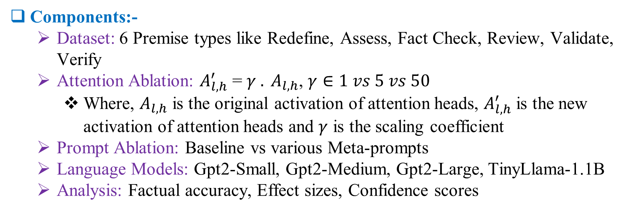
Methodology Overview:-
Dataset
Prompt Ablation Study
Language Models
Analysis
Components:-
  Dataset: 6 Premise types like Redefine, Assess, Fact Check, Review, Validate, Verify
  Attention Ablation: $A_{l,h}^{′}$ = $γ . A_{l,h}$, $γ∈1 vs 5 vs 50$
    Where, $A_{l,h}$ is the original activation of attention heads, $A_{l,h}^{′}$ is the new activation of attention heads and $γ$ is the scaling coefficient
  Prompt Ablation: Baseline vs various Meta-prompts
  Language Models: Gpt2-Small, Gpt2-Medium, Gpt2-Large, TinyLlama-1.1B
  Analysis: Factual accuracy, Effect sizes, Confidence scores

Slide 7
Results for RQ1:-
Attention Ablation For Various Premise Words
GPT2-Small | Baseline |  |  | Ablated (5x) |  |  | Ablated (50x)
Premise | #Fact | #Cfact | %Fact | #Fact | #Cfact | %Fact | #Fact | #Cfact | %Fact
Redefine | 2075 | 2254 | 47.9% | 2673 | 1656 | 61.7% | 2681 | 1648 | 61.9%
Assess | 285 | 4639 | 5.9% | 2491 | 2433 | 50.6% | 4197 | 727 | 85.2%
Fact Check | 103 | 4813 | 2.1% | 1883 | 3033 | 38.3% | 4001 | 915 | 81.4%
Review | 69 | 4873 | 1.4% | 1797 | 3145 | 36.4% | 3802 | 1140 | 76.9%
Validate | 235 | 4680 | 4.8% | 2178 | 2737 | 44.3% | 3986 | 929 | 81.1%
Verify | 125 | 4802 | 2.5% | 1865 | 3062 | 37.9% | 4004 | 923 | 81.3%

Slide 8
Results for RQ2:-
First Meta Prompt With Premise Words:
  Context Only : “Answer based on the context provided above, ignoring your prior knowledge.\n \n{original_prompt}”
  Memory Only: “Answer based on your memory, not the context.\n\n{original_prompt}”
GPT2-Small | Baseline | Context Only | Memory Only
Premise
Redefine | 47.1% | 44.7% | 45.1%
Assess | 16.7% | 29.4% | 29.6%
Fact Check | 8.6% | 16.2% | 15.6%
Review | 7.7% | 21.0% | 16.5%
Validate | 15.9% | 31.5% | 33.0%
Verify | 10.3% | 26.2% | 27.6%

Slide 9
Results for RQ2:-
Second Meta Prompt With Premise Words:
  Context Only: “IMPORTANT: Use ONLY the information from the text. IGNORE your prior knowledge.\n\nText: {original_prompt}”
  Memory Only: “IMPORTANT: Use ONLY your own knowledge. IGNORE the provided text.\n \nQuestion: {question}\nAnswer:”
GPT2-Small | Baseline | Context Only | Memory Only
Premise
Redefine | 48.9% | 46.0% | 95.6%
Assess | 18.4% | 18.3% | 95.2%
Fact Check | 9.0% | 16.0% | 93.8%
Review | 7.2% | 8.7% | 94.9%
Validate | 17.9% | 23.9% | 93.3%
Verify | 9.5% | 14.3% | 92.5%

Slide 10
Results for RQ2:-
Third Meta Prompt With Premise Words:
  Context Only: “IMPORTANT: You MUST answer using ONLY the information provided in the passage below. Do NOT use your own knowledge.Do NOT correct the passage even if it contradicts reality. Treat the passage as fully true. \nText: {original_prompt}\nAnswer:”
  Memory Only: "IMPORTANT: You MUST answer using ONLY your own factual world knowledge. Do NOT use any statements in the prompt as evidence or facts.If the prompt contains incorrect or fictional statements, IGNORE them.\nText: {original_prompt}\n:Answer:”
GPT2-Small | Baseline | Context Only | Memory Only
Premise
Redefine | 48.9% | 46.0% | 50.4%
Assess | 18.4% | 18.3% | 29.9%
Fact Check | 9.0% | 16.0% | 25.7%
Review | 7.2% | 8.7% | 15.2%
Validate | 17.9% | 23.9% | 29.1%
Verify | 9.5% | 14.3% | 23.8%

Slide 11
Results for RQ2:-
Fourth Meta Prompt Without Premise Words:
  Context Only: “IMPORTANT: You MUST answer using ONLY the information provided in the passage below. Do NOT use your own knowledge.Do NOT correct the passage even if it contradicts reality. Treat the passage as fully true. \nText: {original_prompt}\nAnswer:”
  Memory Only: "IMPORTANT: You MUST answer using ONLY your own factual world knowledge. Do NOT use any statements in the prompt as evidence or facts.If the prompt contains incorrect or fictional statements, IGNORE them.\nText: {original_prompt}\n:Answer:”
GPT2-Small | Baseline | Context Only | Memory Only
 | 16.7% | 19.1% | 88.4%

Slide 12
Results for RQ3:-
Attention Ablation For Various Premise Words: Difference between GPT2-small & GPT2-Medium
GPT2-Medium | Baseline |  |  | Ablated (5x) |  |  | Ablated (50x)
Premise | #Fact | #Cfact | %Fact | #Fact | #Cfact | %Fact | #Fact | #Cfact | %Fact
Redefine | +462 | -462 | +10.7% | -359 | +359 | -8.2% | -433 | +433 | -10.0%
Assess | +51 | -51 | +1.0% | -2100 | +2100 | -42.7% | -2986 | +2986 | -60.6%
Fact Check | +211 | -211 | +4.3% | -1525 | +1525 | -31.0% | -2864 | +2864 | -58.3%
Review | -11 | +11 | -0.2% | -1689 | +1689 | -34.2% | -2888 | +2888 | -58.4%
Validate | +141 | -141 | +2.9% | -1777 | +1777 | -36.1% | -2768 | +2768 | -56.3%
Verify | +238 | -238 | +4.9% | -1439 | +1439 | -29.3% | -2800 | +2800 | -56.9%

Slide 13
Results for RQ3:-
Attention Ablation For Various Premise Words: Difference between GPT2-small & GPT2-Large
GPT2-Large | Baseline |  |  | Ablated (5x) |  |  | Ablated (50x)
Premise | #Fact | #Cfact | %Fact | #Fact | #Cfact | %Fact | #Fact | #Cfact | %Fact
Redefine | -662 | -662 | -15.3% | -1399 | +1399 | -32.3% | -354 | +354 | -8.1%
Assess | +311 | -311 | +6.3% | -1927 | +1927 | -39.1% | -3380 | +3380 | -68.6%
Fact Check | +174 | -174 | +3.5% | -1617 | +1617 | -32.9% | -2335 | +2335 | -47.5%
Review | +104 | -104 | +2.1% | -1649 | +1649 | -33.4% | -3096 | +3096 | -62.6%
Validate | +454 | -454 | +9.2% | -1530 | +1530 | -31.1% | -2953 | +2953 | -60.1%
Verify | +568 | -568 | +11.6% | -1183 | +1183 | -24.1% | -2263 | +2263 | -46.0%

Slide 14
Results for RQ3:-
Attention Ablation For Various Premise Words: GPT2-Small VS TinyLlama Model
TinyLlama-1.1B | Baseline | Ablated (5x) |  | Ablated (50x)
Premise | %Facts |  | %Facts |  | %Facts
Redefine | +10.7% |  | +34.8% |  | +36.4%
Assess | +23.7% |  | +45.3% |  | +12.9%
Fact Check | +21.8% |  | +59.3% |  | +17.1%
Review | +28.0% |  | +60.7% |  | +21.3%
Validate | +29.9% |  | +52.6% |  | +17.2%
Verify | +26.7% |  | +59.1% |  | +16.8%

Slide 15
Results for RQ3:-
Third Meta Prompt With Premise Words:
  Context Only: “IMPORTANT: You MUST answer using ONLY the information provided in the passage below. Do NOT use your own knowledge.Do NOT correct the passage even if it contradicts reality. Treat the passage as fully true. \nText: {original_prompt}\nAnswer:”
  Memory Only: "IMPORTANT: You MUST answer using ONLY your own factual world knowledge. Do NOT use any statements in the prompt as evidence or facts.If the prompt contains incorrect or fictional statements, IGNORE them.\nText: {original_prompt}\n:Answer:”
Difference Between GPT2-Small Model & TinyLlama-1.1B:
TinyLlama-1.1B | Baseline | Context Only | Memory Only
Premise Words
Redefine | +3.1% | -13.9% | +16.7%
Assess | -7.3% | -8.6% | +33.4%
Fact Check | +0.2% | -10.2% | +37.6%
Review | +2.6% | +1.3% | +48.26%
Validate | -4.3% | -11.2% | +34.2%
Verify | +1.3% | -2.6% | +39.5%

Slide 16
Results for RQ3:-
Fourth Meta Prompt Without Premise Words:
  Context Only: “IMPORTANT: You MUST answer using ONLY the information provided in the passage below. Do NOT use your own knowledge.Do NOT correct the passage even if it contradicts reality. Treat the passage as fully true. \nText: {original_prompt}\nAnswer:”
  Memory Only: "IMPORTANT: You MUST answer using ONLY your own factual world knowledge. Do NOT use any statements in the prompt as evidence or facts.If the prompt contains incorrect or fictional statements, IGNORE them.\nText: {original_prompt}\n:Answer:”
Difference Between Gpt2 – Small & TinyLlama-1.1B:
  For TinyLama: Baseline: +1.2%, Context Only: -6.0%, Memory Only: -20.1%
TinyLLama-1.1B | Baseline | Context Only | Memory Only
 | 17.9% | 13.1% | 68.3%

Slide 17
Conclusion:-
Summary: LLMs dynamically balance context and memory, with balance point influenced by instructions, model size, and specific computational circuits
  Systematic Framework: First comprehensive counterfactual analysis of ICL-memory competition
  Multi-Method Approach: Behavioral testing + mechanistic interventions + strategic control
  Scalable Findings: Clear patterns across model sizes and architectures
  Practical Insights: Effective premise words and intervention strategies
RQ1: Instructional framing matters, premise words create different reasoning modes in LLMs, with ‘Redefine’ triggering the most factual reasoning behavior
RQ2: Strategic interventions can effectively control the context-memory trade-off , simple ablation restores factual reasoning by reducing counterfactual influence.
RQ3: Modern LLMs possess robust factual knowledge, the challenge is managing contextual interference, not knowledge gaps.
Project Report Link: Click Here
GitHub Code Link: Click Here

Slide 18
Future Works:-
Test larger models (GPT-3, GPT-4, LLaMA 2)
More diverse counterfactual types
Map complete fact-checking
Improve prompt engineering
Robust AI systems
More sophisticated interventions
Cross-domain generalization
Real-world application testing

Slide 19
References:-
T. B. Brown, et al. Language models are few-shot learners. In NeurIPS 2020 — Advances in Neural Information Processing Systems, 2020.
S. M. Xie, et al. An explanation of in-context learning as implicit Bayesian inference. In ICLR 2022 — International Conference on Learning Representations, 2021.
C. Olsson, et al. In-context learning and induction heads. In Transformer Circuits Thread / Anthropic Research Reports, 2022.
M. Ortu, et al. Mechanistic analysis of fact-checking in LLMs. In arXiv Preprint, 2024.
S. Min, et al. Rethinking the role of demonstrations in in-context learning. In EMNLP 2022 — Proceedings of the 2022 Conference on Empirical Methods in Natural Language Processing, 2022.

Slide 20
Thank You

