Slide 1
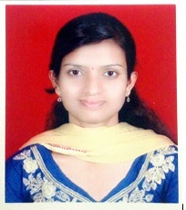


Aishwarya Mahadeo Lohar
Analyst/Software Engineer
Bachelor of Engineering, Computer Science : 2016 - 2020
Skills
Mumbai
aishwarya.mahadeo-lohar@capgemini.com
C# | C# Basics, OOPS, Exception Handling, Collections & Generics, Delegates , Events, File IO and Serialization
.NET Framework | Architecture which includes CTS,CLS , FCL , BCL and CLR
Database | SQL Server , SQL Basics
Java | Java Basics, OOPS, Constructor, Arrays, Loops
UI Technology | HTML 5 & CSS
Tools | Git, IDE
Add On skills | Peer learning
+91 8788578312
A4
Practical understanding of RDBMS concepts using SQL Server
Hands on experience on C#, ADO.NET, LINQ, Entity framework, SQL Server
Understanding of Core Java Concepts.
Understanding of HTML,CSS and Angular.
Understanding of Git and GitHub
Online Flight Booking System
Completed Case Study on Flight Booking System which is a Web Based System .This System used for Booking the flight and also user can login and search the flights and booked the flight. This System along with API Gateway,Swagger ,responsive UI with HTML5,CSS ,Bootstrap and Angular used as User Interface.
Check out my work on GitHub

