Slide 1
PROJECT : STATISTICS ON WEBPAGES - TEAM PLAN
Group : 3
Lohit Gandham
Yashwanth gopinath
Notes:
CESE 4050 : MASTI

Slide 2
GOAL
Measuring statistics of webpages, mainly focusing on the following broad metrics:
Webpage sizes → HTTP Archive, keyCDN
Ad sizes on webpages → Adblock plus
Webpages using QUIC vs TCP → QUIC trackers and custom network trackers
AMP (Google’s accelerated mobile project) → Getting BW, Loadtimes for AMP and non-AMP pages.
Webpages using different standards like robot.txt and system.txt.
(last slide)
Notes:
https://www.keycdn.com/support/the-growth-of-web-page-size → ver good article to understand what is webpage size and its impacts
Basically studying and measuring protocols

Slide 3
QUIC vs tcp protocols
Both these protocols are used for transmitting data across the internet, establishing good connection between the sender and receiver.
QUIC is taking over TCP in most the latest web applications, therefore necessary to gauge its impact on webpages using and not using it.
QUIC → Quick User Datagram Protocol Internet connection ; TCP → Transmission control protocol.
Reliability: TCP ensures that data packets are delivered in order and without errors. It achieves this through error checking, data retransmission in case of loss, and sequence control. Connection-Oriented: TCP establishes a connection before data can be sent through a three-way handshake process. This connection remains open until the transfer is complete, ensuring a reliable communication channel. Flow Control and Congestion Control: TCP has built-in mechanisms to prevent overwhelming the network or the receiving device. It adjusts the rate of data transmission based on the network capacity (congestion control) and the receiver's ability to process the data (flow control). Widely Used: TCP is utilized by major protocols such as HTTP, HTTPS, FTP, SMTP, and more, making it a foundational technology of the Internet. However, TCP can exhibit higher latency in establishing connections and recovering from packet loss due to its connection setup, error recovery procedures, and congestion control algorithms.
Built on UDP: QUIC is implemented on top of UDP (User Datagram Protocol), which does not require a connection to be established before sending data. This can reduce connection establishment time and improve the speed of data transfer.Multiplexed Streams without Head-of-Line Blocking: QUIC supports multiple streams of data in a single connection without one stream affecting the delivery of another. This is an improvement over TCP, where packet loss in one stream can block others due to its in-order delivery requirement.Improved Security: QUIC incorporates encryption by default, similar to TLS/SSL, but with reduced latency because key exchange is part of the initial connection setup. Faster Connection Establishment: QUIC can establish connections with lower latency, particularly when resuming previous connections or when TLS is involved, as it combines transport and cryptographic handshakes. Better Performance Over Lossy Connections: QUIC's loss recovery mechanisms are designed to be more efficient than TCP's, reducing the time to recover from packet loss and thus improving performance on unreliable networks.
Notes:
Key Differences and Considerations
Protocol Overhead: QUIC aims to reduce the overhead associated with connection establishment, encryption, and stream multiplexing compared to TCP, which can improve performance, especially in mobile networks or on lossy connections.
Deployment and Support: TCP is universally supported and is the backbone of current Internet communications. QUIC, being newer, is supported by modern web browsers and some web servers, but its adoption is increasing, especially with HTTP/3, which uses QUIC as its underlying transport protocol.
Network Middleboxes: Some network devices (firewalls, NATs, proxies) are optimized for TCP and might not handle UDP-based protocols like QUIC effectively, potentially leading to issues with QUIC traffic.
In summary, TCP is a proven, reliable, and widely used protocol for ensuring data integrity and order in communications over the Internet. QUIC, on the other hand, introduces innovations aimed at reducing latency, improving security, and solving some of TCP's limitations, especially in the context of modern web applications and services.

Slide 4
Robot.txt and security.txt
robots.txt` and `security.txt` are two different files that web administrators can use to communicate specific policies to external agents (like web crawlers or security researchers) regarding their websites. Both files serve different purposes and are part of the broader web standards aimed at improving the web's functioning and security.
robots.txt
Purpose: The `robots.txt` file is used to give instructions about their site to web robots; these instructions include which areas of the site should not be processed or scanned by web crawlers or search engines. It's a way for website owners to control what parts of their site should be indexed by search engines or accessed by automated bots.
Location: This file is placed in the root directory of the website (e.g., `https://example.com/robots.txt`).
Content: It contains "Disallow" or "Allow" directives that specify paths (directories or files) that web crawling software should or should not access. Additionally, it can specify different directives for different user agents (the software accessing the site).
Limitations: Compliance with `robots.txt` is voluntary; well-behaved crawlers follow its directives, but it cannot enforce the exclusion of malicious bots. Moreover, it's publicly accessible, which means anyone can see which parts of a site you might prefer to keep private.
security.txt
Purpose: The `security.txt` file aims to standardize how organizations can offer security researchers clear guidelines for securely reporting security vulnerabilities. It's part of an effort to make the internet safer by facilitating the responsible disclosure of security issues.
Location: Like `robots.txt`, `security.txt` is placed in a well-known location on a website, typically under the `/.well-known/` path (e.g., `https://example.com/.well-known/security.txt`), although it can sometimes be found in the site's root directory.
Content: The file includes contact information (such as an email address), encryption keys for secure communication, acknowledgment pages for those who have reported vulnerabilities, and policies around vulnerability disclosure (like timelines and whether a bug bounty exists).
Benefits: Having a `security.txt` file helps to reduce the time security researchers spend looking for ways to report vulnerabilities, potentially leading to faster remediation of issues. It demonstrates an organization's commitment to security and responsible disclosure practices.
Both `robots.txt` and `security.txt` play significant roles in the operational and security aspects of managing a website. While `robots.txt` focuses on controlling access by automated agents to prevent overloading servers or indexing sensitive content, `security.txt` is about establishing a clear, standardized communication channel for reporting security vulnerabilities, thereby improving the overall security posture of the web.

Slide 5
Tools and Measurements
1. Web Page Sizes and Content Breakdown
Why Measure: Understanding web page sizes and their content breakdown helps identify trends in web design and optimization, impact on user experience (e.g., load times), and potential areas for optimization.
Tools Options:
HTTP Archive: Offers historical data on page sizes and breakdowns by content type, useful for trend analysis.
WebPageTest: Allows for detailed performance testing of web pages, including size breakdowns.
Custom Web Scraping Scripts (Python/R): Flexible for targeted analysis of specific sites or content types.
Best Tool & Why: HTTP Archive, for its comprehensive historical dataset and ease of use for broad trend analysis. Custom scripts can complement this for targeted, deep-dive investigations.
2. Advertisement Proportions
Why Measure: Quantifying ad proportions can highlight their impact on page size, load times, and overall user experience, guiding optimizations.
Tools Options:
Browser Developer Tools (e.g., Chrome DevTools): Identify and measure resources loaded by ads.
AdBlock Plus or similar browser extensions: Helpful in identifying ad requests specifically.
Wireshark: For a more technical, network-level view of ad content.
Best Tool & Why: Browser Developer Tools combined with AdBlock Plus, as they offer a straightforward way to distinguish ad content and its performance impact without requiring deep technical network analysis.
Notes:
Inspiration from Existing Studies and Reports
The selection of tools and measurements is inspired by existing literature and reports, such as those from ACM conferences and HTTP Archive. These sources demonstrate the importance of comprehensive, longitudinal data analysis for understanding web trends, as well as the need for detailed, technical analysis of specific technologies (like QUIC or AMP) to grasp their real-world implications. The tools chosen reflect a balance between breadth of data (e.g., HTTP Archive for trends) and depth of technical insight (e.g., Wireshark for protocol analysis), aiming to provide a holistic view of web performance and standards adherence.

Slide 6
Tools and Measurements
3. Usage of QUIC vs. TCP
Why Measure: Understanding the adoption and performance of QUIC compared to TCP can inform decisions on web performance optimization and the future direction of web protocols.
Tools Options:
Wireshark: For detailed protocol analysis and comparison at the network level.
Online Services (e.g., SSL Labs, QUIC-Tracker)**: To check server support for QUIC.
Chrome DevTool: To observe protocol usage in real-time for specific sites.
Best Tool & Why: Wireshark, for its comprehensive capabilities in analyzing and comparing network protocols in detail, offering deep insights into performance and behavior differences. (more tools will see later in paper)
4. AMP Adoption and Impact
Why Measure: Assessing AMP's adoption and its impact on performance can help understand its effectiveness in improving mobile web experiences and guide decisions on its implementation.
Tools Options:
Google's AMP Test: Verifies the presence and correctness of AMP pages.
WebPageTest: Compare performance metrics between AMP and non-AMP pages.
Custom Scripts: For scraping and analyzing the prevalence and performance impacts of AMP across a broad set of sites.
Best Tool & Why: WebPageTest, due to its ability to provide detailed performance comparisons and its support for testing mobile page loads, directly addressing AMP's primary use case. (more tools will see in paper later). Google also has their own amp test website.
Notes:
https://www.webpagetest.org/
https://search.google.com/test/amp

Slide 7
Tools and Measurements
5. Standards Adherence (robots.txt, security.txt)
Why Measure: Evaluating adherence to these standards can shed light on a website's approach to search engine indexing and security practices, impacting visibility and security posture.
Tools Options:
Custom Scripts (Python/R): Automate checks for the presence and correctness of these files across multiple websites.
Online Validators (for robots.txt and security.txt): Provide a quick check of the files' validity.
Best Tool & Why: Custom scripts, as they allow for scalability in analysis across many sites and provide flexibility in assessing adherence to best practices beyond mere presence. (more tools given in paper)

Slide 8
PAPER : It’s Over 9000: Analyzing Early QUIC Deployments with the Standardization on the Horizon
The tools used in this research for analyzing QUIC and TCP deployments include:
ZMap: Used for scanning both IPv4 and IPv6 addresses to identify potential QUIC-capable targets.
DNS Scans: Employed to detect SVCB and HTTPS records, aiding in the discovery of servers supporting QUIC.
TLS over TCP Scan: Utilized to compare TLS configurations over TCP, highlighting differences or similarities with QUIC deployments.
QScanner: A custom-developed, stateful QUIC scanner capable of performing detailed analyses by completing QUIC handshakes and investigating various aspects of QUIC deployment, including protocol versions, transport parameters, and more.
These tools enabled the comprehensive evaluation of QUIC's deployment, adoption rates, and configuration variations across the Internet.
ZMap, DNS scans, TLS over TCP scans, and QScanner—are specifically designed and utilized to identify websites that use TCP and QUIC protocols. These tools can scan and analyze network addresses and configurations to detect support for both protocols, enabling researchers to compare and understand the deployment and configuration of QUIC in relation to traditional TCP-based connections across the Internet.

Slide 9
PAPER: AMP up your Mobile Web Experience: Characterizing the Impact of Google’s Accelerated Mobile Pages Project
This paper explores the effectiveness of Accelerated Mobile Pages (AMP) in enhancing the mobile web browsing experience. It analyzes over 2100 AMP pages and their non-AMP counterparts across common web quality of experience metrics like Page Load Time, Time to First Byte, and SpeedIndex.
The study finds AMP significantly improves SpeedIndex by an average of 60% and even more with prefetching, though it incurs additional data costs, which might affect users with limited data plans.
The tools used for this analysis include a web crawler and scraper with Selenium for collecting AMP page URLs from Google search results, and WebPageTest for evaluating web page performance under different network conditions.
AMP, short for Accelerated Mobile Pages, is an open-source project designed to improve the loading speed and overall performance of web content on mobile devices. It aims to provide a better user experience by enabling web pages to load instantly.

Slide 10
PAPER: Who You Gonna Call? An Empirical Evaluation of Website security.txt Deployment
This paper presents a comprehensive analysis of how websites implement the security.txt standard, aimed at improving vulnerability disclosure.
Over 15 months, the researchers crawled the Alexa Top 100K websites to monitor security.txt adoption, examining the content and compliance of the files found.
They discovered growing adoption among top-ranked sites, yet inconsistencies in required fields like Contact and Expires.
The study used a wget-based crawler to systematically retrieve security.txt files, analyzing their content to assess adherence to the proposed standard and the practical implications for vulnerability reporting.
Notes:
In the context of the security.txt standard, "Contact" is a required field that specifies how to reach the website's security team, typically via an email address or a web page. This information is crucial for reporting security vulnerabilities. "Expires" indicates when the security.txt file should be considered stale and is used to ensure the information remains up-to-date. It's a date or datetime indicating the validity period of the security.txt file, encouraging regular review and renewal by the site's administrators.

Slide 11
Quantification Methodologies
Statistical Analysis: Use means, medians, percentiles to describe data distributions. Apply regression analysis or correlation coefficients to explore relationships between variables.
Comparative Analysis: Compare data across different dimensions (time, website category, technology used) to identify trends or differences.
Visualization: Employ graphs and charts to visualize trends, comparisons, and distributions, making insights accessible to a broader audience.

Slide 12
QUESTIONS
How many websites to compare ? (any thumb rule or limit ?) (like a representative sample of websites)
Any recommended tools to analyze ?
Scope in goal mentioned ? (goals)

Slide 13
ACTIVE AND PASSIVE MEASUREMENTS
Active and passive measurements are two fundamental approaches in network research and analysis, each with distinct methodologies and implications for data collection. Understanding these concepts is crucial for designing and executing a comprehensive web measurement project like the one discussed. Here’s how each applies to the various components of the proposed research:
### Active Measurements
Active measurements involve sending test traffic through the network or to a web server and observing how it behaves or performs under certain conditions. This method directly interacts with the network or system to collect data.
**In the Context of the Proposed Research**:
1. **Web Page Performance and AMP Impact**: Using tools like WebPageTest to simulate page loads and measure performance metrics (e.g., load times, time to first byte) for both AMP and non-AMP pages. This involves actively requesting web pages from servers and measuring the response.
2. **QUIC vs. TCP Performance**: Actively testing website loading or data transfer performance over both protocols. This could involve setting up controlled experiments where a client requests data from a server supporting both protocols under similar conditions to compare performance metrics like latency, throughput, and connection establishment time.
3. **Ad Proportions**: Actively loading web pages with and without ad-blocking tools or extensions to measure the difference in data transferred, number of requests, and loading times, thus quantifying the impact of advertisements.
### Passive Measurements
Passive measurements involve observing and recording traffic or data without manipulating the traffic flow or injecting additional traffic. This method relies on existing traffic and behaviors, providing insights without influencing system performance.
**In the Context of the Proposed Research**:
1. **Web Page Sizes and Content Composition**: Analyzing datasets from HTTP Archive, which collects data passively by archiving web pages and tracking how web technologies are used without actively interacting with the sites beyond normal web crawling.
2. **Standards Adherence (robots.txt and security.txt)**: Crawling websites to check for the existence and content of `robots.txt` and `security.txt` without altering the site's behavior. This can be considered a form of passive analysis, as it involves collecting information available through normal web access methods.
3. **Protocol Usage (QUIC vs. TCP)**: Using network protocol analyzers like Wireshark to capture traffic passively on a network to identify whether QUIC or TCP is being used. This does not involve generating new traffic but rather analyzing existing traffic flows.
### Why These Measurements are Made
- **Active Measurements** are crucial for understanding how web technologies perform under specific conditions or how changes (like implementing AMP or switching to QUIC) can affect user experience and performance. They help simulate user interactions and measure outcomes, providing data on how web optimizations can impact loading times, efficiency, and user satisfaction.
- **Passive Measurements** are essential for gaining insights into the current state of the web, including trends in web page size, content distribution, and adherence to standards. They allow for the observation of real-world data and behaviors without influencing them, offering a snapshot of the web's current practices and technologies.
Both active and passive measurements provide complementary perspectives on web performance, standards adherence, and optimization practices. Active measurements offer controlled experiments to test specific hypotheses or compare technologies, while passive measurements provide a broad view of the web's existing state and natural behaviors. Together, they form a comprehensive approach to web measurement and analysis.

Slide 14
WEEK 2
PROJECT : STATISTICS ON WEBPAGES
Group : 3
Lohit Gandham
Yashwanth Gopinath

Slide 15
Research Statement: IS AMP DEAD ?
This research aims to explore the differential impact of Accelerated Mobile Pages (AMP) versus non-AMP web pages on mobile web performance, user engagement, and search engine optimization (SEO) rankings. It seeks to quantify the benefits and potential drawbacks of AMP implementation under various network conditions and user interactions.

Slide 16
Research Approach:
Metrics:
- QoE (Quality of Experience) metrics : PageLoad Time, Time to First byte and Speed Index.
- Google’s Core Web Vitals metrics (SEO Metrics) : Largest Contentful Paint (LCP), First Input Delay (FID) and Cummulative Layout Shift (CLS)
Tools:
- WebPageTest (https://www.webpagetest.org/)
- PageSpeedInsights (https://pagespeed.web.dev/)
Data Collection :
- Wappalyzer → it gives the list of 5000 AMP Websites (https://www.wappalyzer.com/)
- Building a web crawler and scraper with Selenium that collects AMP page URLs from Google search results based on certain trending keywords.

Slide 17
POINTERS SO FAR
AMP (Accelerated Mobile Pages) was introduced in 2016 by Google as HTML framework which aimed to reduce load times and bounce rates.
But this was an era of low internet data rates and low power mobile phones. Over the years mobile computing power and data rates increased which may render AMP of no use [1].
This research aims to find out whether AMP is dead, or can it be still used for core web vital optimization ?
Notes:
[1] https://www.18thdigitech.com/blog/is-google-amp-still-a-thing-in-2023/#:~:text=The%20short%20answer%20is%20No,have%20it%20in%20mobile%20searches.
[2] https://dl.acm.org/doi/abs/10.1145/3300061.3300137

Slide 18
Methodology
1. Data Collection:
2. Data Analysis and EDA (Exploratory Data Analysis)
3. Quantifying and Infererring emerging patter from data to answer research problem.
Identification of key performance differentiators between AMP and non-AMP websites, insights into AMP's effectiveness across various web sectors, and recommendations for web developers regarding AMP implementation.
Expected Outcome

Slide 19
WEEK 3
PROJECT : STATISTICS ON WEBPAGES
Group : 3
Lohit Gandham
Yashwanth Gopinath

Slide 20
Recap and research question
Recap: Is AMP dead? Differential impact of Accelerated Mobile Pages (AMP) versus non-AMP web pages on mobile web performance, user engagement, and search engine optimization (SEO) rankings.
Focusing on “Above the fold” loading times- The time taken to load the the portion of a webpage that is visible without scrolling.
This research aims to explore the differential impact of Accelerated Mobile Pages (AMP) versus non-AMP web pages using “Above the fold” loading times and Co2 emission of websites.

Slide 21
Research Approach:
Metrics:
- Above the fold content on websites are used heavily for SEO.
- All metrics chosen are related to above the fold load time: Critical rendering path, Start render time, Image aspect ratio consistency (Impact on Cumulative Layout Shift), Above the fold critical CSS/JS load performance, network statistics
- User analytics and its dependency on above metrics
Tools:
- Google trends- Identify keywords to use for web scraping and data collection
- Detailed metrics- WebPageTest (https://www.webpagetest.org/), PageSpeedInsights (https://pagespeed.web.dev/), Google Lighthouse
- Wappalyzer (https://www.wappalyzer.com/): Create lists based on technology and type of website
- WebPage Carbon site to be carbon related metrics.

Slide 22
METRIC DATA COLLECTION
From Website Carbon:
1. CO2 Emissions per Page Load: The total estimated emissions for a single page load. This metric takes into account the amount of data transferred and the energy source for the data center.
2. CO2 Emissions per Visit: Estimate average page views per visit, you can calculate the emissions per user session.
3. Data Transfer Amount: The amount of data (in KB or MB) that is transferred to fully load the page, which can be correlated to CO2 emissions.
4. Renewable Energy Usage: Whether the hosting servers use renewable energy, which can significantly affect the CO2 calculations.

Slide 23
METRIC DATA COLLECTION
WebPageTest:
1. Load Time: The time it takes for the page to fully load. This is a standard metric for both AMP and non-AMP pages.
2. Start Render Time: The time until the first content appears on the screen. This can be a proxy for AtF content loading time.
3. Speed Index : A performance index that indicates how quickly the content is visually displayed during page load. Lower scores are better and can indirectly inform about AtF performance.
4. Time to Interactive (TTI): The time it takes for a page to become fully interactive. This can be important for understanding user experience for both AMP and non-AMP pages.
5. First Contentful Paint (FCP): The time from navigation to when the browser renders the first bit of content from the DOM. This is important for AtF analysis.
6. Largest Contentful Paint (LCP): The render time of the largest content element visible within the viewport, relating directly to AtF.
7. Cumulative Layout Shift (CLS): Measures the sum of all individual layout shift scores for every unexpected layout shift during the entire lifespan of the page. Important for AtF stability.

Slide 24
Plan for upcoming week:
Complete the AMP filter for the web crawler
Run script to collect AMP webpage URLs
Collect performance data using above the fold time as the key metrics
Future work: Performance testing and analysis for AMP vs non-AMP webpages
Notes:
NOTE: CO2 Emissions (gCO2)=Total Data Transferred (GB)×Energy Intensity (kWh/GB)×Carbon Intensity (gCO2/kWh)CO2 Emissions (gCO2)

Slide 25
References:
1. https://www.conductor.com/academy/accelerated-mobile-pages/
2. https://mangools.com/blog/google-amp-seo/ 3.https://www.researchgate.net/publication/347262341_Evaluate_the_performance_of_AMP_and_non_AMP_websites_using_machine_learning_algorithms_MSc_Research_Project_Data_Analytics
4. https://dl.acm.org/doi/10.1145/3300061.3300137
5. https://www.wmtips.com/top/umbrella-rank
6. https://validator.ampproject.org/
7. https://gtmetrix.com/top1000.html

Slide 26
WEEK 4
PROJECT : STATISTICS ON WEBPAGES
Group : 3
Lohit Gandham
Yashwanth Gopinath

Slide 27
Recap and research question
Recap: Discussion between “Above the fold” metrics and carbon footprint metrics of pages
Research question: How can we reliably measure the carbon footprints of various webpages across different domains by recording all relevant metrics?
Carbon emissions of the internet are due to production and usage of massive electronic equipment. The goal is to accurately calculate the digital CO2 emissions (in grams of CO2) by calculating the energy consumption of the webpage from various sources.
We decided to use the Sustainable Web Design (SWD) model for calculating digital emissions.

Slide 28
Website carbon and swd model
For obtaining metrics related to carbon footprint, we decided to use website carbon https://www.websitecarbon.com/, which utilises the SWD model and uses data from the green web foundation.
SWD model considers 4 major weighted factors and their impact on overall CO2 emissions
Production energy (19%)
Datacenter energy (15%)
Network energy (14%)
End user energy (52%)
This breakdown is taken from the 2020 study titled New perspectives on internet electricity use in 2030
The Sustainable Web Design model considers returning users and carbon intensity of electricity production based on the location.

Slide 29
Formula for calculating carbon emissions
E = [Data Transfer per Visit (new visitors) in GB x 0.81 kWh/GB x 0.75] + [Data Transfer per Visit (returning visitors) in GB x 0.81 kWh/GB x 0.25 x 0.02] C = E x 442 g/kWh E = Energy per visit (in kWh) C = CO2 emissions per visit (in grams) Annual Internet Energy / Annual End User Traffic = 0.81 kWh/GB Carbon factor = 442 g/kwh Scaling factor = 0.02

Slide 30
WHY WEBSITE CARBON ?
All models have inherent biases that skew their results one way or the other. There will always be a part of a model that cannot accurately capture the complexity or reality of what it is trying to measure.
For instance we looked into DIMPACT, GreenFrame, and Sustainable Web Design all of which have assumptions baked into their calculation methodologies which in turn impact their outputs in different ways.
Measuring actual energy usage along the entire tech stack is the only way to get truly accurate website carbon emissions figures. By doing that, you no longer rely on models and the assumptions they make.
Even if updated versions of those models were to land, they’d still have their shortcomings. What’s important is that we understand these and communicate them effectively when we do use these models in our work.
Notes:
DIMPACT : time the service is used rather than data transfer volume.

Slide 31
METRICs WE WILL USE
1. Data Transfer per Visit: Measured in gigabytes (GB), this metric quantifies the amount of data transferred from the server to the user for each page load. It serves as the foundation for calculating energy use and emissions, as it directly correlates to the amount of work data centers, networks, and devices must perform.
2. Energy Intensity of Web Data (kWh/GB): This represents the average amount of energy (in kilowatt-hours, kWh) required to transmit one gigabyte of data across the internet, including the energy consumed by data centers, network infrastructure, and end-user devices. It is a critical metric for understanding the energy demand of digital activities.
3. Carbon Intensity of Electricity (gCO2/kWh): This measures the average emissions (in grams of CO2) produced to generate one kilowatt-hour of electricity. It varies depending on the energy mix (renewable vs. non-renewable sources) used by the data center and the national grid, affecting the carbon footprint of web hosting and data transmission.

Slide 32
4. Website Traffic (Monthly Visitors): The number of page views a website receives. This metric is multiplied by the emissions and energy consumption per page view to estimate the total impact of a website over time, allowing for the assessment of its overall environmental footprint.
5. System Segmentation Percentages: These are specific percentages assigned to different segments of the system (consumer device use, network use, data center use, and hardware production) based on their contribution to the total energy consumption and emissions. They are essential for distributing the total calculated energy and emissions across the different components involved in digital activities.

Slide 33
WEEK 5
PROJECT : STATISTICS ON WEBPAGES
Group : 3
Lohit Gandham
Yashwanth Gopinath

Slide 34
Recap and research question
Research question: How can we reliably measure the carbon footprints of various webpages across different domains by recording all relevant metrics?
Collected the list of 1000 most popular websites to analyse CO2 emissions
We decided to obtain CO2 emission data from multiple sources and analyse the differences in data.

Slide 35
DATA WE HAVE
The website list used has been sourced from the Tranco list of 1 million most popular websites. This is a list which uses averaged data from four other ranking providers (Alexa, Cisco Umbrella, Majestic and Quantcast).
The main dataset used for analysis has been collected by using the Website Carbon API. It contains information about the 50,034 most popular websites on the internet which was collected earlier.

Slide 36
INITIAL EDA
A website’s size might affect the time it will take to load it and the amount of CO2 it will generate.
The collected websites vary greatly in range.
There are 50,034 usable websites in the final dataset. From those, 27,873 have the “.com” top-level domain, 3868 have “.org “, and 2065 have “.net “ as the domain. Overall, there are 716 different top-level domains. Keeping only those which occur more than 100 times leaves us with exactly 40 domains. The distribution is heavily skewed towards the first 3 TLD’s which account for 67.5% of the entire dataset.

Slide 37
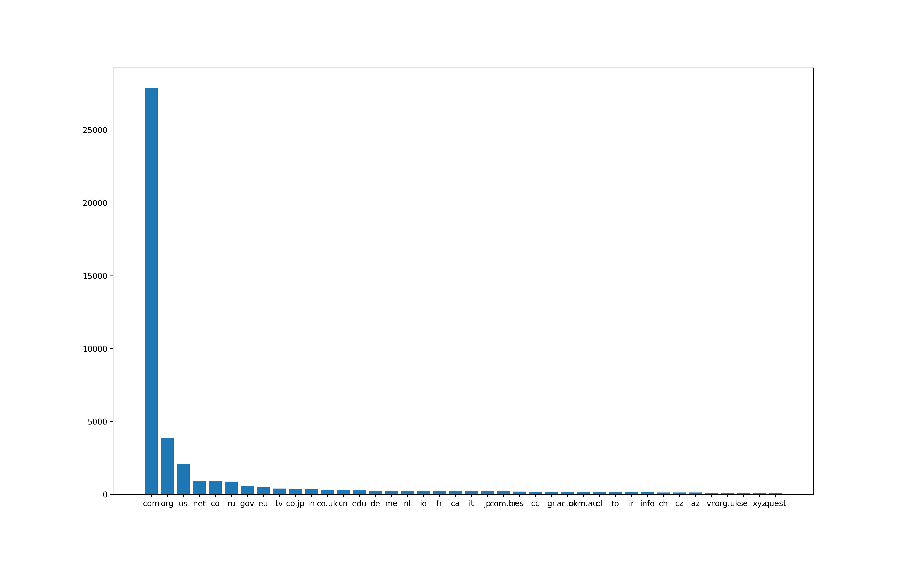
Notes:
-- Only top 1000 used as generating reports took considerable amount of time

Slide 38
Metric used for comparison
For the collected data, we chose to obtain data on grams of CO2 per page view. There are multiple sites to obtain this data. We chose 4 different websites- website emmsions.com, website carbon, ecograder, digital beacon
Each website uses its own methods to calculate grams in CO2 per page view. Website carbon and digital beacon consider returning users and adjusts the calculations.
Grams of CO2 per visit is calculated using data transfer per visit (in GB), energy intensity of web data (kwh/GB) and carbon intensity of electricity (gCO2/kwh)
Notes:
1. Data Transfer per Visit: Measured in gigabytes (GB), this metric quantifies the amount of data transferred from the server to the user for each page load. It serves as the foundation for calculating energy use and emissions, as it directly correlates to the amount of work data centers, networks, and devices must perform.
2. Energy Intensity of Web Data (kWh/GB): This represents the average amount of energy (in kilowatt-hours, kWh) required to transmit one gigabyte of data across the internet, including the energy consumed by data centers, network infrastructure, and end-user devices. It is a critical metric for understanding the energy demand of digital activities.
3. Carbon Intensity of Electricity (gCO2/kWh): This measures the average emissions (in grams of CO2) produced to generate one kilowatt-hour of electricity. It varies depending on the energy mix (renewable vs. non-renewable sources) used by the data center and the national grid, affecting the carbon footprint of web hosting and data transmission.

Slide 39
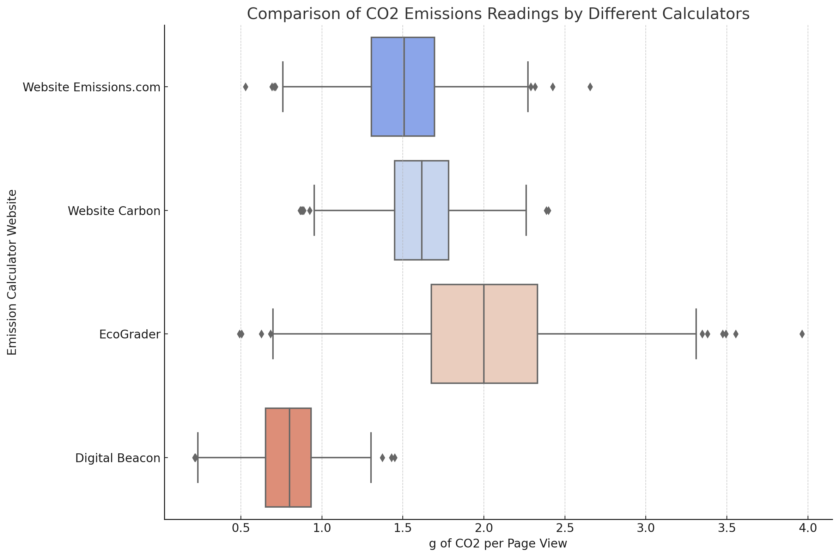
Notes:
Each reading takes about 5 mins to load → therefore 1000 websites taked around 5000 mins (83 hrs)

Slide 40
The graph above compares CO2 emissions readings from four different calculators for 1000 websites. It illustrates how each calculator provides different readings for the same websites tested.
Notably, "Website Emissions.com" and "Website Carbon" show somewhat similar results, with their distributions closely aligned, indicating their methodologies or underlying assumptions might be similar.
"EcoGrader" shows higher emissions readings on average, suggesting a more conservative or different approach to calculating emissions. "Digital Beacon" reports the lowest emissions, which might reflect a different calculation method or criteria.

Slide 41
PLAN FOR NEXT WEEK
Applying filters for AMP and non-AMP data.
Inference from collected metrics.
Notes:
For next week, our analysis will include a focused review on the top and bottom 1000 sites by size, energy, and CO2 output, highlighting the influence of outliers on the overall dataset's environmental footprint
For next week, we will explore the prevalence of green hosting among websites, assessing the space occupied and CO2 emissions reduced by those opting for environmentally friendly hosting solutions.

Slide 42
WEEK 6
PROJECT : STATISTICS ON WEBPAGES
Group : 3
Lohit Gandham
Yashwanth Gopinath

Slide 43
Recap and research question
Research question: How can we reliably measure the carbon footprints of various webpages across different domains by recording all relevant metrics for AMP and Non-AMP websites?
Collected the list of around 50,000 websites to analyse CO2 emissions.
We decided to obtain CO2 emission data from multiple sources carbon calculator websites and analyse the differences in data.
For the collected data, we chose to obtain data on grams of CO2 per page view.
There are multiple sites to obtain this data. We chose 4 different websites- website emmsions.com, website carbon, ecograder, digital beacon
Notes:
The website list used has been sourced from the Tranco list of 1 million most popular websites. This is a list which uses averaged data from four other ranking providers (Alexa, Cisco Umbrella, Majestic and Quantcast).

Slide 44
This week
Increased website count and gauged for outliers (~ 10,000 websites).
Applied AMP vs Non-AMP .
Checked if outliers are the same for all websites / all different APIs (Outlier comparison).
Notes:
Metric used : grams of CO2 per page view (g CO2_per_Page_View_g)
We will say we tested for few sites which gave outliers for website carbon and in other calculators, and results say some were in the average range and other were in the outlier range and there is no pattern.
Clipped few values as boxes were not seen properly

Slide 45
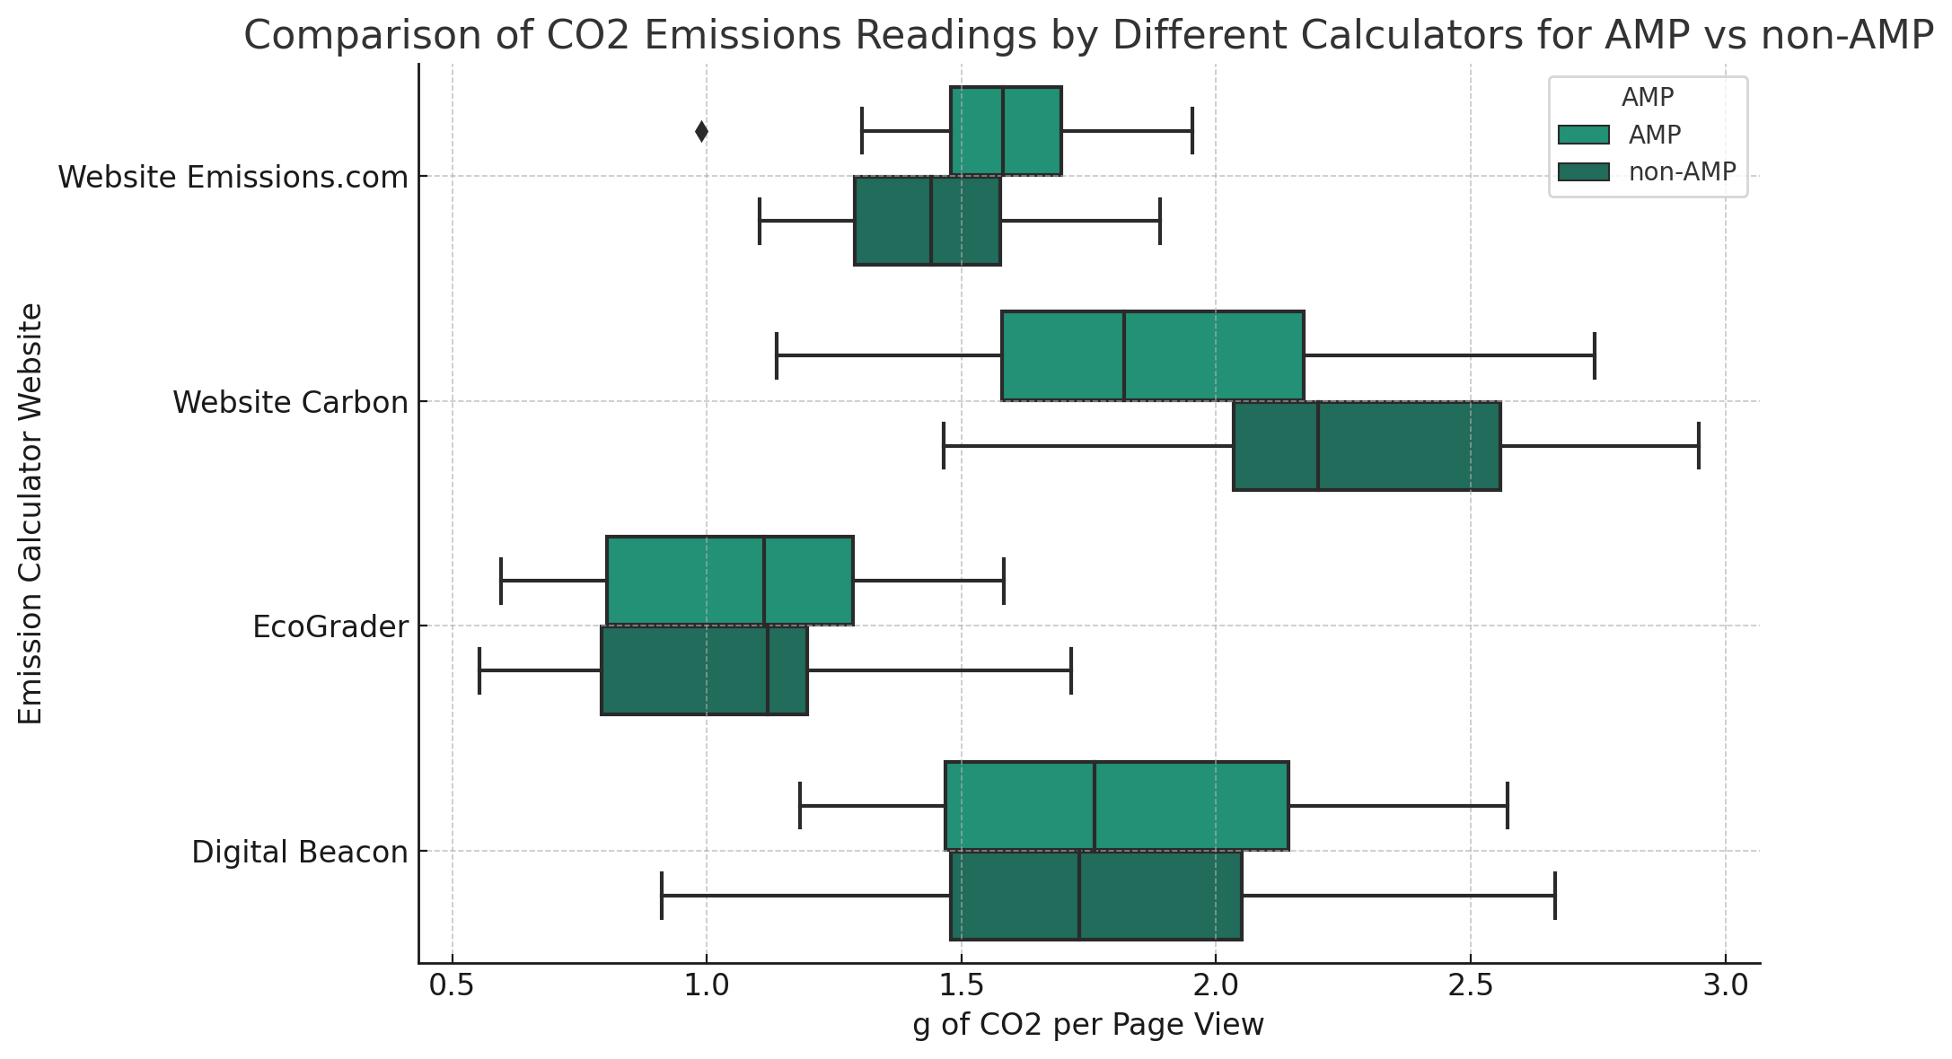
Notes:
Amp vs Non-Amp tags were filtered using a certain HTML tag present in the website <html amp>.
To scrape AMP pages using their identifying tags, you would typically use a web scraping tool or library that can parse HTML, such as Beautiful Soup in Python. Here's a high-level overview of the steps you'd take:
1. **Send a HTTP Request**: Use a library like `requests` in Python to send an HTTP GET request to fetch the content of the webpage you're interested in.
2. **Parse the HTML Content**: Once you have the HTML content, you can use Beautiful Soup to parse it and search for the specific AMP HTML tags.
3. **Identify AMP Pages**: Check for the `<html amp>` or `<html ⚡>` tag near the beginning of the HTML document. You can also look for other AMP-specific tags like `<script async src="https://cdn.ampproject.org/v0.js"></script>`.
4. **Extract Information**: After confirming a page is an AMP page, you can proceed to extract the data you're interested in using CSS selectors or XPath expressions.
5. **Respect `robots.txt`**: It's important to check the website's `robots.txt` file before scraping, to ensure you're allowed to scrape their pages and to follow any rules they've set out regarding scraping frequency and allowed pages.
6. **Handle Pagination**: If you're scraping multiple pages, you'll need to handle pagination. This might involve finding the link to the next page and repeating the request and parse process.
Here's an example of Python code that uses `requests` and `BeautifulSoup` to check if a given URL is an AMP page:
```python
import requests
from bs4 import BeautifulSoup
# URL of the page to check
url = 'https://example.com'
# Send the GET request
response = requests.get(url)
# Parse the HTML content
soup = BeautifulSoup(response.content, 'html.parser')
# Check for the AMP tag
is_amp = bool(soup.find('html').get('amp')) or bool(soup.find('html').get('⚡'))
print(f'The page is an AMP page: {is_amp}')
```
Make sure that you're following the website's terms of service and legal considerations when scraping content, and manage the request frequency to avoid overloading the server.

Slide 46
1. Understanding the Boxplot:
- Each box represents the interquartile range (IQR) of the CO2 readings for a website, showing the middle 50% of the data.
- The horizontal line within the box is the median value of the data.
- The whiskers extend to the rest of the distribution, except for points that are considered outliers, which are plotted individually.
2. AMP vs. Non-AMP Efficiency:
- Efficiency here refers to lower CO2 emissions readings.
- Based on the boxplot, for 'Website Carbon' and 'EcoGrader', the AMP versions tend to have lower emissions (the boxes and medians are lower), indicating that AMP versions are more efficient for these websites.
- For 'Website Emissions.com' and 'Digital Beacon', the AMP and non-AMP versions are almost similar in terms of CO2 emissions.

Slide 47
3. Disparities Across Websites:
- Different methodologies: Websites may use different algorithms or data sources to calculate emissions.
- Varying benchmarks: They may have different benchmarks for what constitutes average emissions.
- Technical differences: Different websites may be optimized differently, leading to variations in energy consumption and CO2 emissions.
4. Differences Between AMP and Non-AMP Readings:
- AMP (Accelerated Mobile Pages) is designed to be a more efficient way to build web pages for mobile devices, which can lead to reduced CO2 emissions due to better optimization and less data use.
- Non-AMP sites might be heavier with more scripts, images, and other elements, which take more energy to load and thus can result in higher CO2 emissions.
5. Outliers Analysis:
- Outliers represent readings that are significantly higher or lower than the majority of the data.
- If outliers are not consistent across different APIs (calculators), this may point to occasional peaks in energy use specific to the site's content or structure at the time of measurement.

Slide 48
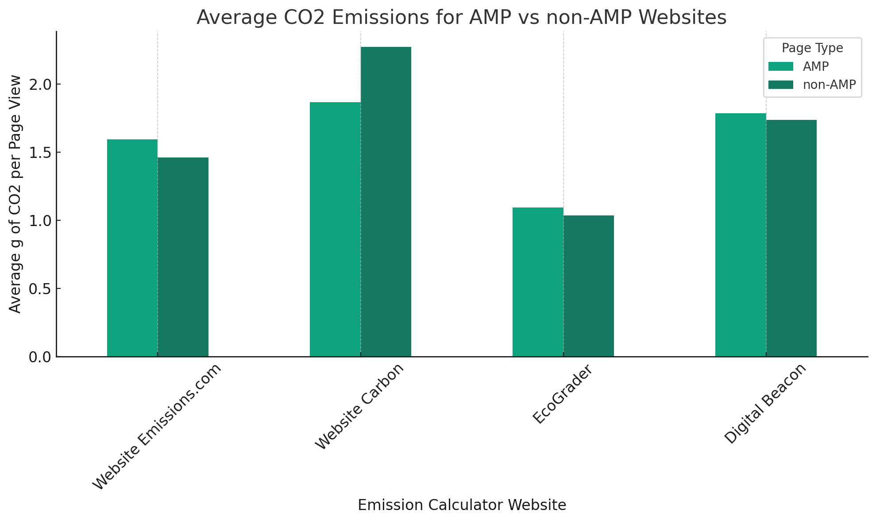

Slide 49
Key Insights from CO2 Emissions Data
1. Consistency in Readings: Sites with less variation in the boxplot indicate more consistent CO2 emissions readings. Shorter whiskers equate to reliability in emissions data.
2. AMP Advantages: AMP versions of 'Website Carbon' and 'EcoGrader' show notably lower median CO2 emissions than non-AMP, suggesting better efficiency of AMP in these cases.
3. Methodological Differences: Disparities in CO2 readings across different calculators may be due to diverse calculation methods, reflecting variations in data usage and energy consumption metrics.
4. Impact of Content and Design: Similar emissions for AMP and non-AMP on some sites imply that AMP benefits might be content-dependent, while outliers suggest that certain design aspects can lead to higher emissions.

Slide 50
PLAN FOR NEXT WEEK
Train and infer from more data.
Starting report (Deadline ?)

Slide 51
References:
1. https://www.conductor.com/academy/accelerated-mobile-pages/
2. https://mangools.com/blog/google-amp-seo/ 3.https://www.researchgate.net/publication/347262341_Evaluate_the_performance_of_AMP_and_non_AMP_websites_using_machine_learning_algorithms_MSc_Research_Project_Data_Analytics
4. https://dl.acm.org/doi/10.1145/3300061.3300137
5. https://www.wmtips.com/top/umbrella-rank
6. https://validator.ampproject.org/
7. https://gtmetrix.com/top1000.html
8. https://www.thegreenwebfoundation.org
9. https://sustainablewebdesign.org/calculating-digital-emissions/

