Slide 1
The Intelligent Multi-Chain Auditing & Security Oracle
PROJECT
WEB3 GUARD
Built for Stellar & Soroban by
LOHIT MISHRA

Slide 2
Smart Contract
Security is Broken
Manual Audits are Slow: Traditional security audits take weeks and cost thousands of dollars.
Reactive, Not Proactive: Developers usually find out about vulnerabilities after code is merged or deployed.
Zero-Trust Accountability: Users have no verifiable way to prove a contract was actually audited before they connect their wallets.
Rimberio University

Slide 3
Autonomous,
On-Chain Security
AI-Powered: Uses Google Gemini to detect complex zero-day vulnerabilities in Soroban Rust and Solidity.
Cryptographically Anchored: Every audit is hashed and stored immutably on the Stellar blockchain via a native Soroban smart contract.
Real-Time Protection: Monitors live blockchain transactions using Stellar Horizon SSE to detect anomalies instantly.

Slide 4
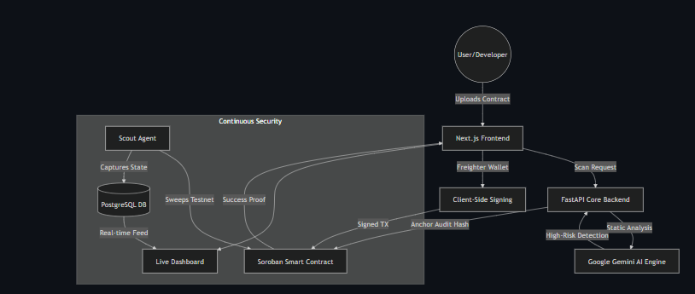
How It Works
(Architecture)
Developer pushes code → 2. GitHub App intercepts PR →
3. AI Engine scans for vulns → 4. Auto-Fixes injected →
5. Audit Proof anchored to Stellar.

Slide 5
Built for
Production Scale
Gasless Transactions: Implemented fee-bumps via Stellar SDK so users don't pay gas.
Auto-Fix PR Bot: Our native GitHub App actually writes secure code and opens fixing PRs for you.
Contextual AI Memory: Users can flag false positives, and our RAG engine dynamically learns to ignore them in the future.

Slide 6
Tested by
Real Users
35+ Verified Wallets: Successfully tested and interacted with by over 35 unique Stellar wallets.
Feedback Driven: We actively collected feedback from 22 beta testers via Google Forms.
Rapid Iteration: Directly implemented 6 major UX improvements based on user complaints (e.g., added real-time scanning progress bars and improved PDF reports).

Slide 7
What's Next for
Web3 Guard?
Stellar Mainnet Launch: Migrating our Soroban registry from Testnet to Mainnet.
Mobile Guard App: Native iOS/Android app for push notifications on security threats.
Decentralized Security DAO: Allowing security researchers to govern and contribute to our heuristic models.

Slide 8
THANK YOU
Web3 Guard
Verify everything. Trust the chain

