Slide 1
A Comparative Analysis of Structured and Object-Oriented Programming Methods

Slide 2
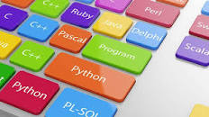
Object-Oriented Paradigm

Slide 3
What is a Programming Language?
A programming language is a formal language comprising a set of instructions that produce various kinds of output.
Programming languages are used in computer programming to implement algorithms.
Most programming languages consist of instructions for computers.
There are programmable machines that use a set of specific instructions, rather than general programming languages

Slide 4
What is a Programming Language?
Thousands of different programming languages have been created, and more are being created every year.
Many programming languages are written in an imperative* form (i.e., as a sequence of operations to perform) while other languages use the declarative** form (i.e. the desired result is specified, not how to achieve it)

Slide 5
What is a Programming Language?
*In computer science, imperative programming is a programming paradigm that uses statements that change a program's state. an imperative program consists of commands for the computer to perform. Imperative programming focuses on describing how a program operates.
**In computer science, declarative programming is a programming paradigm—a style of building the structure and elements of computer programs—that expresses the logic of a computation without describing its control flow.

Slide 6
Differences
Focus
Imperative: Tells the computer how to do something step by step.
Example: "Go to the store, take five steps forward, turn left, pick up milk, and come back home."
Declarative: Tells the computer what you want, and it figures out how to do it.
Example: "I need milk delivered to my house."

Slide 7
Control
Imperative: You control every detail of the process.
Example: Writing a loop to calculate the sum of numbers in a list.
Declarative: The system does the work for you.
Example: Using a built-in function like sum() to get the total.
Complexity
Imperative: More complex because you need to manage every step and the program's state.
Example: Writing out the logic for how data moves in and out of a database.
Declarative: Simpler because you focus on the result, not the steps.
Example: Writing a SQL query like SELECT * FROM users WHERE age > 30;.

Slide 8
Imperative programming is a programming paradigm that focuses on how a program operates. It describes a sequence of instructions that explicitly change the program's state. In this approach, the programmer writes code that specifies the steps the computer must take to achieve a desired result.
Characteristics:
Step-by-step Instructions: The programmer explicitly defines each step needed to perform a task.
State Management: The state of the program is modified using variables and control structures.
Control Structures: Common constructs include loops (for, while) and conditionals (if-else).
Examples:
Procedural programming (e.g., C, Pascal).
Low-level programming languages like Assembly.

Slide 9
# Imperative style:
finding the sum of a list numbers = [1, 2, 3, 4, 5]
total = 0
for number in numbers:
total += number
print(total)

Slide 10
Declarative programming focuses on what the program should accomplish, leaving the details of how it is accomplished to the underlying system or framework. The programmer describes the desired outcome, and the implementation is handled abstractly.
Characteristics:
Focus on Results: Emphasizes the end result rather than the step-by-step process.
High-Level Abstractions: Often uses domain-specific languages (DSLs) or frameworks.
State and Flow Hidden: The underlying mechanism is abstracted away from the programmer.
Examples:
SQL for database queries.
Functional programming (e.g., Haskell).
Logic programming (e.g., Prolog).
Some aspects of Python and JavaScript.

Slide 11
# Declarative style:
finding the sum of a list
numbers = [1, 2, 3, 4, 5]
total = sum(numbers)
print(total)

Slide 12
What is a Programming Language?
A Programming Language …
... provides an encoding for algorithms
…should express all possible algorithms
... must be decodable by an algorithm
... should support complex software
…should be easy to read and understand
... should support efficient algorithms
…should support rapid software development

Slide 13
Programming Domains
Scientific applications
Large number of floating point computations
Business applications
Produce reports, use decimal numbers and characters
Artificial intelligence
Symbols rather than numbers manipulated. Code = Data.
Systems programming
Need efficiency because of continuous use. Low-level control.
Scripting languages
Put a list of commands in a file to be executed. Glue apps.
Special-purpose languages
Simplest/fastest solution for a particular task.

Slide 14
Language Evaluation Criteria
Readability
Write-ability
Reliability
Cost
Others
The key to good language design consists of crafting the best possible compromise among these criteria

Slide 15
Language Evaluation Criteria Readability
Overall simplicity
Too many features is bad
Multiplicity of features is bad
Orthogonality
A relatively small set of primitive constructs can be combined in a relatively small number of ways

Slide 16
Language Evaluation Criteria Write-ability
Simplicity and orthogonality
Support for abstraction
Support for alternative paradigms
Expressiveness

Slide 17
Language Evaluation Criteria Reliability
Some PL features that impact reliability:
Type checking
Exception handling
Aliasing

Slide 18
Language Evaluation Criteria Cost
What is the cost involved in:
Training programmers to use language
Writing programs
Compiling programs
Executing programs
Using the language implementation system
Risk involved in using unreliable language
Maintaining programs

Slide 19
Language Evaluation Criteria Other
Portability
Generality
Well-definedness
Elegance
Availability
…

Slide 20
Some Language Design Trade-Offs
Reliability vs. cost of execution
Readability vs. writability
Flexibility vs. safety

Slide 21
Syntax & Semantics
A programming language's surface form is known as its syntax.
Most programming languages are purely textual; they use sequences of text including words, numbers, and punctuation, much like written natural languages.
On the other hand, there are some programming languages which are more graphical in nature, using visual relationships between symbols to specify a program.
The syntax of a language describes the possible combinations of symbols that form a syntactically correct program.

Slide 22
Syntax & Semantics
The meaning given to a combination of symbols is handled by semantics (either formal or hard-coded in a reference implementation)..
Programming language syntax is usually defined using a combination of regular expressions (for lexical structure)
This grammar specifies the following:
an expression is either an atom or a list;
an atom is either a number or a symbol;
a number is an unbroken sequence of one or more decimal digits, optionally preceded by a plus or minus sign;
a symbol is a letter followed by zero or more of any characters (excluding whitespace); and
a list is a matched pair of parentheses, with zero or more expressions inside it

Slide 23
Influences on Language Design Through the Years
Programming methodologies thru time:
1950s and early 1960s:
Simple applications; worry about machine efficiency
Late 1960s:
People efficiency became important;
readability, better control structures
Structured programming
Top-down design and step-wise refinement
Late 1970s: Process-oriented to data-oriented
data abstraction
Middle 1980s: Re-use, Moudularity
Object-oriented programming
Late 1990s: Portability, reliability, security
Java,C#

Slide 24
Some Programming Paradigms
Imperative
Central features are variables, assignment statements, and iteration
Examples: FORTRAN, C, Pascal
Functional
Main means of making computations is by applying functions to given parameters
Examples: LISP, Scheme
Logic
Rule-based
Rules are specified in no special order
Examples: Prolog
Object-oriented
Encapsulate data objects with processing
Inheritance and dynamic type binding
Grew out of imperative languages
Examples: C++, Java
Languages typically support more than one paradigm although not equally well

Slide 25
Virtual Machines (VM’s)
Type of Virtual Machine
Examples
Instruction Elements
Data Elements
Comments
Application Programs
Spreadsheet, Word Processor
Drag & Drop, GUI ops, macros
cells, paragraphs, sections
Visual, Graphical, Interactive
Application Specific Abstractions
Easy for Humans
Hides HLL Level
High-Level Language
C, C++, Java, FORTRAN, Pascal
if-then-else, procedures, loops
arrays, structures
Modular, Structured, Model Human Language/Thought
General Purpose Abstractions
Hides Lower Levels
Assembly-Level
SPIM, MASM
directives, pseudo-instructions, macros
registers, labelled memory cells
Symbolic Instructions/Data
Hides some machine details like alignment, address calculations
Exposes Machine ISA
Machine-Level
(ISA)
MIPS, Intel 80x86
load, store, add, branch
bits, binary addresses
Numeric, Binary
Difficult for Humans

Slide 26
Computing in Perspective
People
Computer Human Interaction, User Interfaces
Application Programs
Programming, Data Structures
High-Level Language
Programming Languages, Compilers
Assembly
Language
Computer Architecture
Machine
Language (ISA)
Each layer implements an
INTERPRETER
for some programming language
People
computers
Notes:
SA and Machine Language. The instruction set architecture (ISA) is a protocol that defines how a computing machine appears to a machine language programmer or compiler. The ISA describes the (1) memory model, (2) instruction format, types and modes, and (3) operand registers, types, and data addressing.

Slide 27
Implementation Methods Compilation
Translate high-level program to machine code
Slow translation
Fast execution
Trivia: Who developed the first compiler?

Slide 28
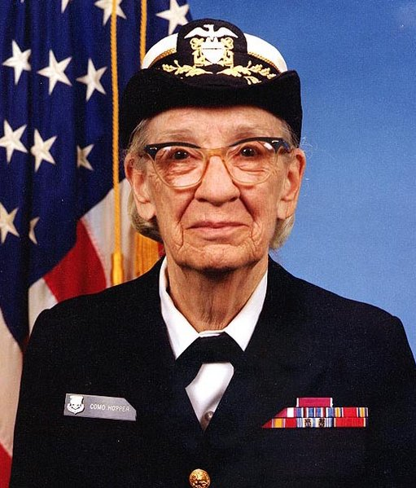
Answer: Computing Pioneer Grace Murray Hopper developed the first compiler ever
1984 picture
Learn more about Grace Murray Hopper @ wikipedia.org

Slide 29
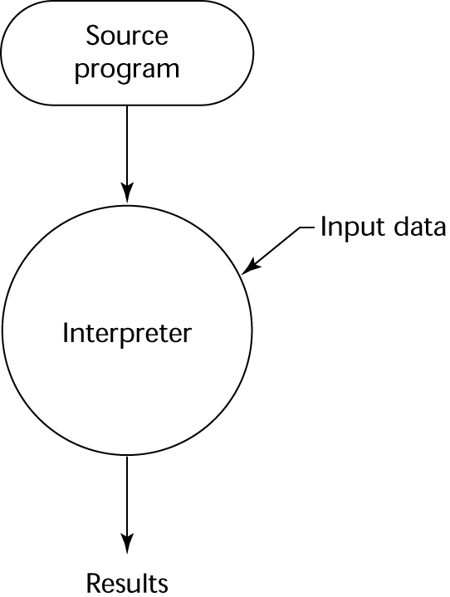
Implementation Methods Interpretation
No translation
Slow execution
Common in Scripting Languages

Slide 30
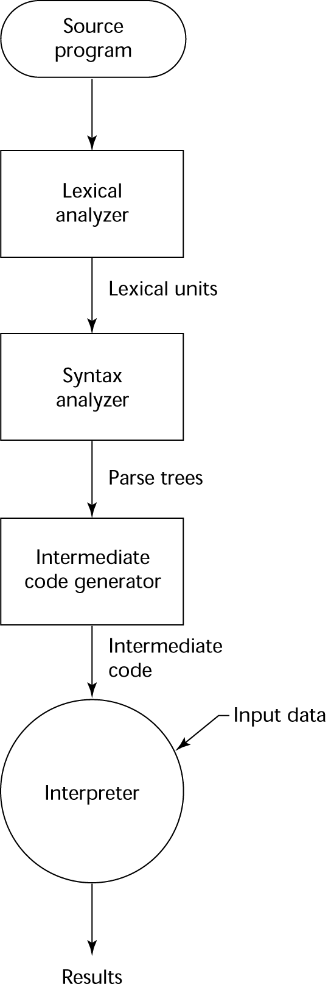
Implementation Methods Hybrid Approaches
Small translation cost
Medium execution speed
Portability
Examples of Intermediate Languages:
Java Bytecodes
.NET MSIL
Java VM

Slide 31
Machine Code – Computer’s Native Language
Address
I Bit
Opcode
(binary)
X
(base 10)
Binary encoded instruction sequence
Architecture specific
Interpreted by the processor
Hard to read and debug
0
0
00 110
0
2
0
00 111
12
4
0
00 100
1000
6
0
00 110
0
8
Machine Code Instruction:
0001110000001100₂
1C0C₁₆
0
00 111
4
10
0
00 100
1004
12
0
00 110
0
14
0
00 100
1008
16
0
00 101
1004
18
0
00 000
unused
20
0
00 111
1
22
1
00 111
1000
int a = 12;
int b = 4;
int result = 0;
main () {
if (a >= b) {
while (a > 0) {
a = a - b;
result ++;
}
}
}
24
0
00 010
46
26
0
00 101
1000
28
0
00 010
46
30
0
00 101
1004
32
0
00 000
unused
34
0
00 111
1
36
0
00 100
1000
38
0
00 101
1008
40
0
00 111
1
42
0
00 100
1008
44
0
00 011
26

Slide 32
Assembly Language
Improvements
Symbolic names for each machine instruction
Symbolic addresses
Macros
But
Requires translation step
Still architecture specific
0: andi 0 # AC = 0
addi 12
storei 1000 # a = 12 (a stored @ 1000)
andi 0 # AC = 0
addi 4
storei 1004 # b = 4 (b stored @ 1004) andi 0 # AC = 0
storei 1008 # result = 0 (result @ 1008)
main: loadi 1004 # compute a – b in AC
comp # using 2’s complement add
addi 1
add 1000
brni exit # exit if AC negative
loop: loadi 1000
brni endloop
loadi 1004 # compute a – b in AC
comp # using 2’s complement add
addi 1
add 1000 # Uses indirect bit I = 1
storei 1000
loadi 1008 # result = result + 1
addi 1
storei 1008
jumpi loop
endloop:
exit:

Slide 33
0: andi 0 # AC = 0
addi 12
storei 1000 # a = 12 (a stored @ 1000)
andi 0 # AC = 0
addi 4
storei 1004 # b = 4 (b stored @ 1004) andi 0 # AC = 0
storei 1008 # result = 0 (result @ 1008)
main: loadi 1004 # compute a – b in AC
comp # using 2’s complement add
addi 1
add 1000
brni exit # exit if AC negative
loop: loadi 1000
brni endloop
loadi 1004 # compute a – b in AC
comp # using 2’s complement add
addi 1
add 1000 # Uses indirect bit I = 1
storei 1000
loadi 1008 # result = result + 1
addi 1
storei 1008
jumpi loop
endloop:
exit:
int a = 12;
int b = 4;
int result = 0;
main () {
if (a >= b) {
while (a > 0) {
a = a - b;
result ++;
}
}
}

Slide 34
C
Although numerous computer languages are used for writing computer applications, the computer programming language, C, is the most popular language worldwide.
Everything from microcontrollers to operating systems is written in C since it’s very flexible and versatile, allowing maximum control with minimal commands.
Programming in C is fairly easy because it uses basic commands in English. However C is a compiled language so after you type your commands, in order to execute your program, you need to run it through a compiler to transform the human-readable form into machine-readable language. There are many C compilers available today.

Slide 35

C++ (1985)
Developed at Bell Labs by Bjarne Stroustrup
Evolved from C and SIMULA 67
Facilities for object-oriented programming, taken partially from SIMULA 67, were added to C
Also has exception handling
A large and complex language, in part because it supports both procedural and OO programming
Rapidly grew in popularity, along with OOP
ANSI standard approved in November, 1997

Slide 36
C++ Related Languages
Eiffel - a related language that supports OOP
(Designed by Bertrand Meyer - 1992)
Not directly derived from any other language
Smaller and simpler than C++, but still has most of the power
Delphi (Borland)
Pascal plus features to support OOP
More elegant and safer than C++

Slide 37
Java (1995)
Developed at Sun in the early 1990s
Based on C++
Significantly simplified (does not include struct, union, enum, pointer arithmetic, and half of the assignment coercions of C++)
Supports only OOP
No multiple inheritance
Has references, but not pointers
Includes support for applets and a form of concurrency
Portability was “Job #1”

Slide 38
Scripting Languages for the Web
JavaScript
Used in Web programming (client-side) to create dynamic HTML documents
Related to Java only through similar syntax
PHP
Used for Web applications (server-side); produces HTML code as output
Perl
JSP
Python

Slide 39
C#
Part of the .NET development platform
Based on C++ and Java
Provides a language for component-based software development
All .NET languages (C#, Visual BASIC.NET, Managed C++, J#.NET, and Jscript.NET) use Common Type System (CTS), which provides a common class library
Likely to become widely used

Slide 40
END OF LECTURE 1

