Slide 1
PharmaChain
Lohitaksha Patary
Undergraduate Student, Amrita Vishwa Vidyapeetham, Bangalore
02/04/2026

Slide 2
Pharmaceutical supply chain (Healthcare)
Hospitals, pharmacies, and patients needing verifiable batch-level provenance
• High counterfeit risk and patient safety impact
• Many parties (manufacturer → distributor → pharmacy/hospital → customer) need a shared source of truth
• Regulators require traceability and fast, targeted recalls
• Current ERP/track-and-trace data is siloed and hard to reconcile across organizations
• Blockchain provides tamper-evident audit trails, provenance, and cryptographic verification (hash chain + signatures)
• Merkle proofs enable efficient integrity checks without exposing all data

Slide 3
Approach:
• Desk research on pharma counterfeits, recalls, and serialization/track-and-trace regulations
• Stakeholder mapping (manufacturers, distributors, hospitals, pharmacies, customers, regulators)
• Process analysis of batch creation, custody transfer, and dispensing events
• Gap analysis of existing systems (ERP + EDI + centralized portals)
Key findings:
• Data fragmentation creates blind spots and disputes during recalls/investigations
• Last-mile verification for customers is weak (hard to prove authenticity)
• A permissioned, shared ledger with digital signatures improves trust and accountability
• Storing proofs (hashes, Merkle roots) gives integrity guarantees with minimal data sharing

Slide 4
Top competitors (examples):
1) MediLedger (Chronicled)
Strengths: Industry consortia, DSCSA alignment, strong network effects
Weaknesses: Adoption/governance complexity; integration effort
2) TraceLink
Strengths: Established pharma network; robust serialization & compliance tooling
Weaknesses: Primarily centralized; limited cryptographic, shared-ledger guarantees
3) SAP ATTP / SAP ICH for Life Sciences
Strengths: Deep ERP integration; enterprise-grade operations
Weaknesses: Vendor lock-in; cross-company transparency depends on integrations
PharmaChain differentiation: cryptographic provenance (hash chain + Merkle root + RSA signatures) + role-based dashboards with verification endpoints.

Slide 5
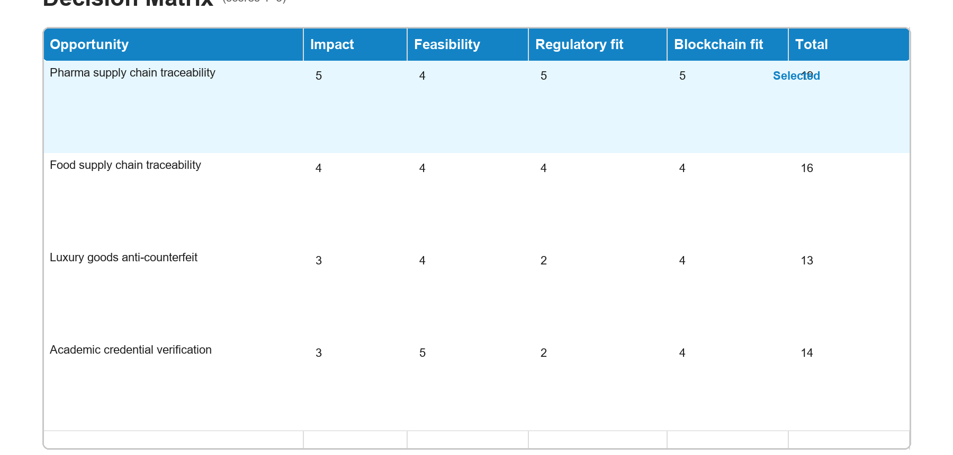

Slide 6
PharmaChain
• High-risk domain where tampering and counterfeits directly harm patients
• Multiple organizations must coordinate but don’t fully trust each other
• Immutable, signed events improve auditability and accountability
• Proof storage (hashes/Merkle roots) provides integrity guarantees with low data exposure
• Fits a permissioned governance model aligned with real-world compliance needs
PharmaChain is a blockchain-inspired pharmaceutical supply tracker that records medicine batch events (creation, transfer, dispensing) with cryptographic proofs.
It supports companies, hospitals, and customers to track and verify batch authenticity using hash chaining, Merkle-root integrity checks, and RSA digital signatures.

Slide 7
Patients, pharmacies, and hospitals lack a single trusted way to verify medicine authenticity and track batch custody across the full supply chain, leading to counterfeit risk, recall delays, and high reconciliation overhead.
PharmaChain provides a tamper-evident, verifiable provenance trail for each medicine batch so stakeholders can detect anomalies faster, improve recall precision, reduce disputes, and give customers confidence in what they purchased.

Slide 8
• Verifiable batch provenance across organizations
• Strong authenticity guarantees via RSA signatures
• Efficient integrity checks via Merkle proofs
• Faster, more targeted recalls and compliance reporting
• Customer-facing verification (track/verify endpoints + dashboard)
For manufacturers, hospitals, pharmacies, and customers who need trustworthy medicine provenance, PharmaChain is a permissioned traceability platform that records signed batch events and integrity proofs, enabling instant verification and audit-ready transparency across the supply chain.

Slide 9
PharmaChain positions an organization as a trusted, compliance-forward supply chain partner by providing verifiable provenance and faster response to recalls and counterfeit incidents.
Sustaining the positioning:
• Start with pilots (1 manufacturer + 1 distributor + 2 pharmacies/hospitals)
• Integrate with existing workflows (APIs, CSV import/export, ERP connectors)
• Establish governance and permissioning for who can write/verify events
• Use standards (serialization/GS1 identifiers) to reduce friction and scale

Slide 10
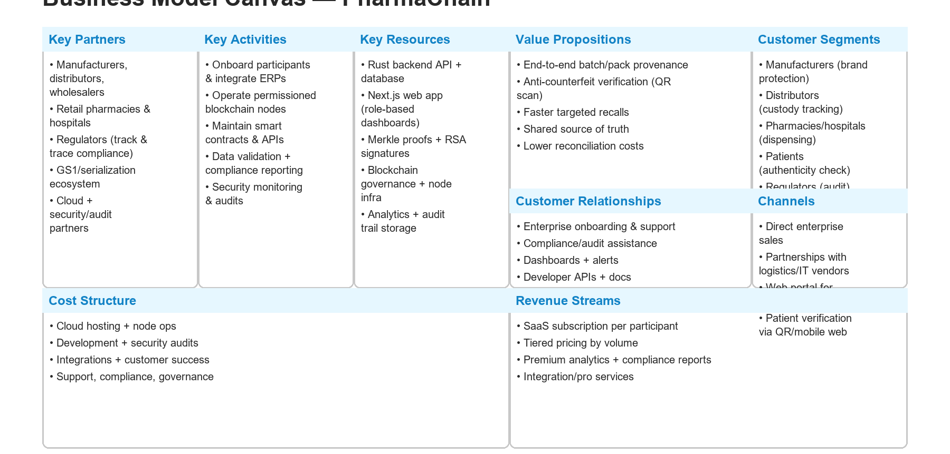

Slide 11
Key activities: participant onboarding, ERP/workflow integrations, blockchain/node operations, smart contract + API maintenance, and compliance reporting.
Cost structure: engineering, cloud + node hosting, security audits, support/customer success, and governance overhead.
Revenue streams: subscription pricing per participant (manufacturer/distributor/pharmacy), tiered by transaction volume, plus premium analytics/compliance reports and integration services.

Slide 12
Team needs:
• Blockchain/cryptography engineer (signatures, integrity proofs)
• Backend engineer (Rust/Axum, SQLx)
• Frontend engineer (Next.js, dashboards)
• Security engineer (key management, audits)
• Product/compliance lead (pharma workflows, regulation)
Partners & allies:
• Manufacturers and distributors for pilot deployments
• Pharmacies/hospitals for last-mile verification
• Regulators/industry bodies for traceability alignment
• GS1/serialization ecosystem + integration vendors
• Security/audit firms for assurance

Slide 13
Operational considerations / boundaries:
• Adoption risk: incentives and low-friction integration are critical
• Data quality: validate identifiers, timestamps, and role permissions
• Privacy: keep sensitive fields off-chain; store only hashes/proofs where needed
• Governance: permissioned membership, key management, and audit policies
• Performance: batch writes, async processing, and scalable verification endpoints
Mitigations: phased rollout, clear governance model, API-first integrations, and security reviews.

Slide 14
Thank you
Lohitaksha Patary
Undergraduate Student, Amrita Vishwa Vidyapeetham, Bangalore

