Slide 1

SMART INDIA HACKATHON 2026
TITLE PAGE
Problem Statement ID – SIH26068
Problem Statement Title- Weather GPT: Conversational AI for Weather Forecasting, Alerts, and Climate Information
Theme- Disaster Management & Climate Tech
PS Category- Software
Team ID- [Team ID]
Team Name (Registered on portal)- ClaudeMaxDedo

Slide 2
WEATHERGPT — AUTONOMOUS WEATHER & MARITIME INTELLIGENCE
ClaudeMaxDedo
Proposed Solution (Describe your Idea/Solution/Prototype)
• WeatherGPT Platform: An autonomous multi-sector conversational weather intelligence engine bridging supercomputer NWP models (GFS/WRF) with vernacular Indic voice delivery (Bhashini AI) and sub-second geofenced disaster early warnings (PostGIS + Uber H3).
Detailed explanation of the proposed solution
• Decoupled 7-Layer Microservices Stack: Isolates heavy scientific binary data parsing (NetCDF/GRIB2) from conversational AI to guarantee real-time latency (<150ms).
• Agentic Tool-Calling Router (LangGraph): Routes queries deterministically to live APIs (Open-Meteo, IMD, S3 Zarr) without allowing the LLM to hallucinate meteorological numbers.
• Low-Bandwidth Indic Voice Cascade: Integrates AI4Bharat Bhashini across 22 scheduled languages with rural acoustic noise filtering and custom glossary normalization.
How it addresses the problem
• Solves the 'Last-Mile Interpretation Deficit': India loses ₹1.5 Lakh Crore ($15-18B) annually because raw atmospheric data ('35mm rain, 85% RH') fails to translate into actionable advice for farmers, fishermen, aviation pilots, and city municipal engineers.
• Proactive Push vs Passive Apps: Replaces passive dashboards (Meghdoot/Damini) with geo-targeted WhatsApp audio notes and CAP 1.2 emergency broadcasts.
Innovation and uniqueness of the solution
• Zero-Copy Cloud Slicing: Streams specific coordinates from AWS S3 GFS models via Kerchunk byte-range metadata, dropping data payload by 99.5%.
• Strict Decoupled Assertion Node: Regex fact-checking layer compares LLM text against raw API JSON payloads, enforcing 0.00% numerical hallucinations.

Slide 3
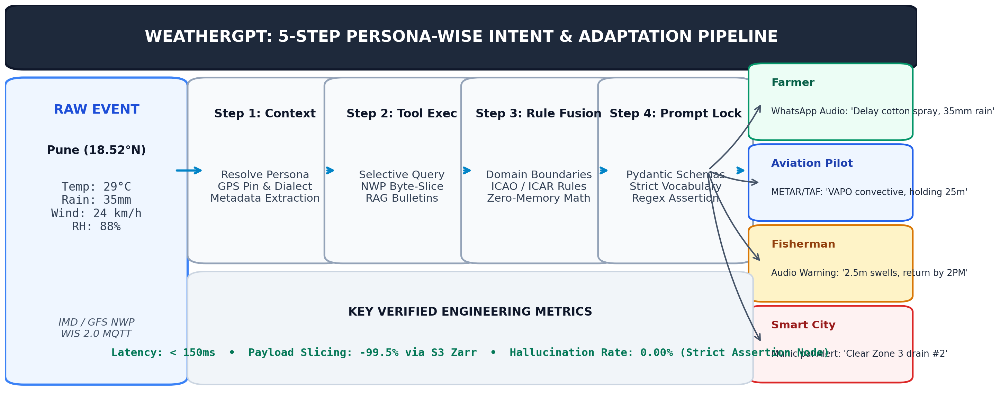
TECHNICAL APPROACH & SYSTEM ARCHITECTURE
ClaudeMaxDedo
Technologies to be used (e.g. programming languages, frameworks, hardware)
• Core Stack & Data Pipeline: Python 3.12, FastAPI (Async), Redis Cache (<50ms), Celery Workers, WMO WIS 2.0 MQTT 5.0, AWS S3 GFS NetCDF4 (Kerchunk/Zarr), PostGIS 3.4, Uber H3 Indexing.
• AI Models & Client Delivery: LangGraph State Machine, GPT-4o / Llama-3, Pydantic Schema Guards, MeitY Bhashini STT/TTS (22 Dialects), Next.js 14 WebSockets, Meta WhatsApp Cloud API.
Methodology and process for implementation (Flow Charts/Images/ working prototype)
• Live Working Prototype & Verification: Deployed live on Vercel at https://sih-2026-portfolio-two.vercel.app/weathergpt (52 automated regression tests passed, sub-150ms live API response).

Slide 4
FEASIBILITY, RISK ANALYSIS & SAFEGUARDS
ClaudeMaxDedo
Analysis of the feasibility of the idea
• Open Infrastructure Grounding: Built entirely upon operational national and international standards (WMO WIS 2.0, AWS Open Data, Bhashini API).
• Cost-Effective Stateless Scalability: Zero-copy byte streaming eliminates multi-terabyte data warehousing costs, allowing elastic scaling to millions of daily users.
Potential challenges and risks
• 1. Binary NWP Bloat & Compute Lag: Downloading 10 GB GRIB2 files causes 15+ second API timeouts on traditional web servers.
• 2. High-Stakes Hallucination Liability: Probabilistic LLMs hallucinating storm dates, rainfall volumes, or wind speeds can cause fatal evacuation failures.
• 3. Rural Dialect Acoustic Distortion: Standard English voice models degrade when parsing noisy agricultural background audio and rural idioms.
Strategies for overcoming these challenges
• 1. Kerchunk Byte-Range Indexing: Fetches only specific coordinate byte slices directly from S3, slashing processing time from 15s to <300ms.
• 2. Deterministic Tool-Calling & Schema Locking: LLM operates strictly as intent parser; raw numbers come from validated APIs with regex fact-checkers.
• 3. Bhashini Acoustic Normalizer & Glossary Map: Domain dictionary maps colloquial terms (e.g., 'toofani baarish' -> 'convective squall') before agent ingestion.

Slide 5
QUANTIFIED IMPACT & MULTI-SECTOR BENEFITS
ClaudeMaxDedo
Potential impact on the target audience
• Smallholder Farmers (140M+): Receive plot-specific spraying/sowing audio advice in regional dialects, preventing premature harvesting and seed germination loss.
• Coastal Traditional Fishermen: Receive localized wave-height (meters) and squall return deadlines instead of confusing atmospheric pressure hectopascals.
• Commercial Aviation Logistics: Instant METAR/TAF runway wind shear briefings, eliminating unnecessary holding patterns and mid-air fuel burn waste.
• Smart City Disaster Managers: Sub-second H3 polygon matching for block-level cloudburst warnings to clear drainage choke-points prior to flooding.
Benefits of the solution (social, economic, environmental, etc.)
• Economic Impact: Mitigates portion of India's ₹1.2–1.5 Lakh Crore annual weather crop destruction and ₹40,000 Crore disaster relief misallocation.
• Social Inclusion: Bypasses the literacy barrier through hands-free WhatsApp voice notes in local dialects (Marathi, Bhojpuri, Tamil, Telugu, Hindi).
• Environmental Protection: Prevents chemical pesticide and fertilizer runoff into ground water tables by blocking applications prior to heavy downpours.

Slide 6
RESEARCH FOUNDATIONS & OFFICIAL REFERENCES
ClaudeMaxDedo
Details / Links of the reference and research work
• WMO WIS 2.0 Global Architecture: World Meteorological Organization Guide on MQTT event-driven data dissemination (WIS2 Standards, 2024).
• NOAA Global Forecast System (GFS) on AWS: Cloud-Optimized GRIB2/Zarr meteorological data feeds hosted on Registry of Open Data on AWS.
• AI4Bharat Bhashini Speech Infrastructure: MeitY Digital India Bhashini Language Repository, Conformer-CTC acoustic models & IndicTrans2 (IIT Madras).
• IMD Vision-2047 Framework: India Meteorological Department, Ministry of Earth Sciences strategic roadmap for hyperlocal weather dissemination.
• Macro-Economic Impact Documentation: World Economic Forum (WEF) Climate Volatility Report & NITI Aayog Study on Agricultural Production Economics.
• Live Production Prototype & Source Code: Evaluator Portal: https://sih-2026-portfolio-two.vercel.app/weathergpt | GitHub: https://github.com/lohitakshcodes/claudemaxdedo-sih2026

