Slide 1

Predicting Electricity Generation Behavior at Georgia Power Company’s Generating Units
Problem Set Solution
Shweta Patil

Slide 2
Summary
Data Manipulation
Visualizations
Pre-Processing
Modeling
Results
Conclusion

Slide 3
Data Manipulation
Loading the datasheets to MySQL workbench
Creating relevant tables
Data insertion from datasets
Performing SQL operations for column matching
(Matching NameplateCapacity to Plant Codes)
Data type issue – mixed data types in columns which hold pure numbers
Searching for mixed type values.
E.g – 1245.60 written as 1,245.60 – due to the “,” this was initially fed as varchar
Resultant dataset, thus consisted for “string” type even for the numbers
Conversion of datatype was still an issue due to the “,”

Slide 4
Data Manipulation Results
Clean data set with correct data types assigned for each attribute.
Missing values in fields like –Summer Capacity(MW) substituted with “0” so that these can be interpreted/dealt with, appropriately in the modeling phase.
Extraction:
Dataset with ~ 35Lakh records after matching Nameplate Capacity (MWh) and the Plant Codes.
Inclusion of attributes/measures like – Summer Capacity(MW), Winter Capacity(MW), Nameplate Power Factor (MW) and Utility Names for easy plotting of graphs and finding interesting trends in the data and figure out what factors affect the Electricity Generation (besides Nameplate Capacity)

Slide 5
Data Visualizations in Tableau & matplotlib(python)

Slide 6
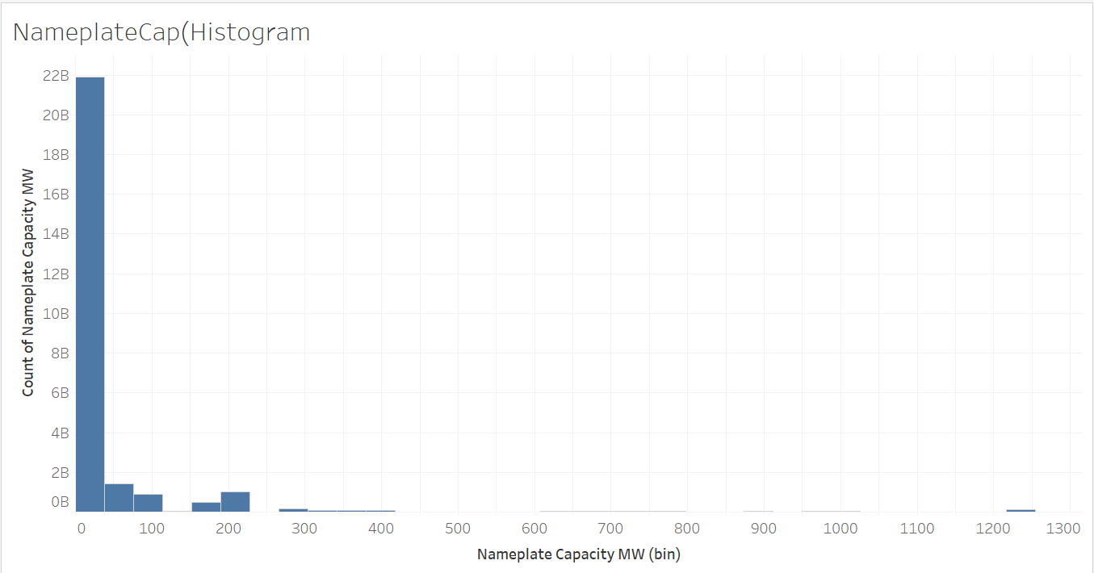
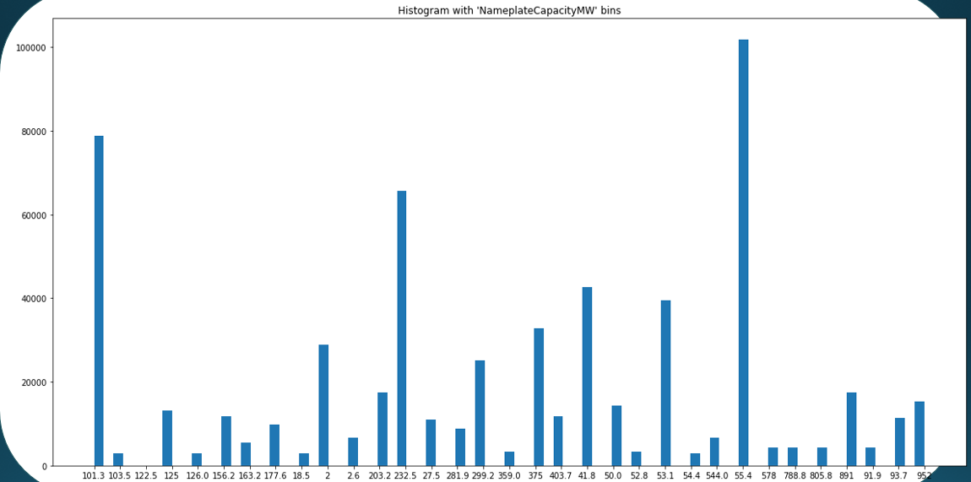
Histograms
NameplateCapacity
matplotlib

Slide 7
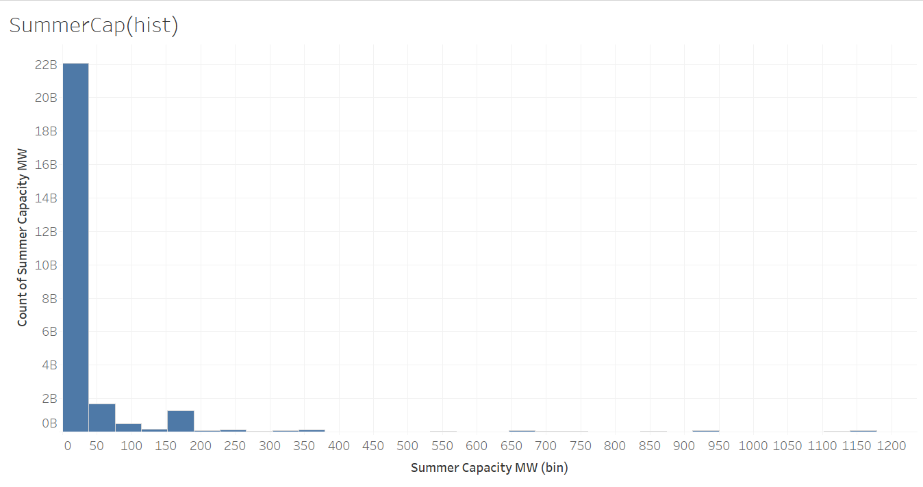
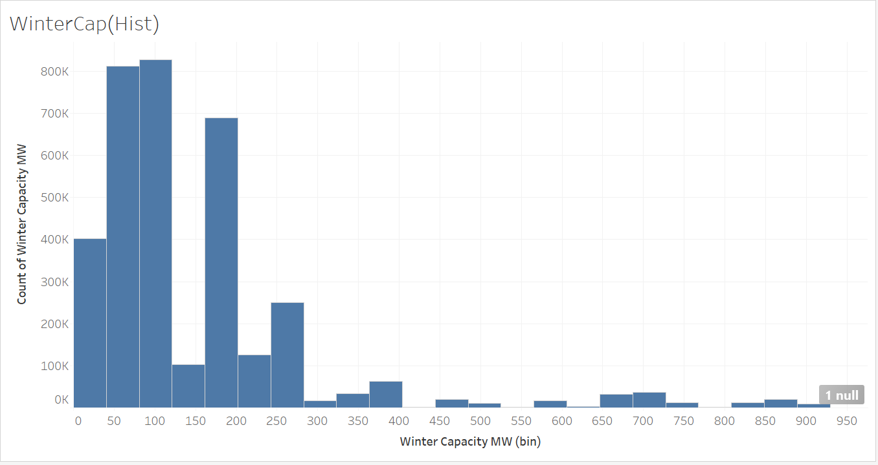
Histograms
SummerCapacity
WinterCapacity

Slide 8
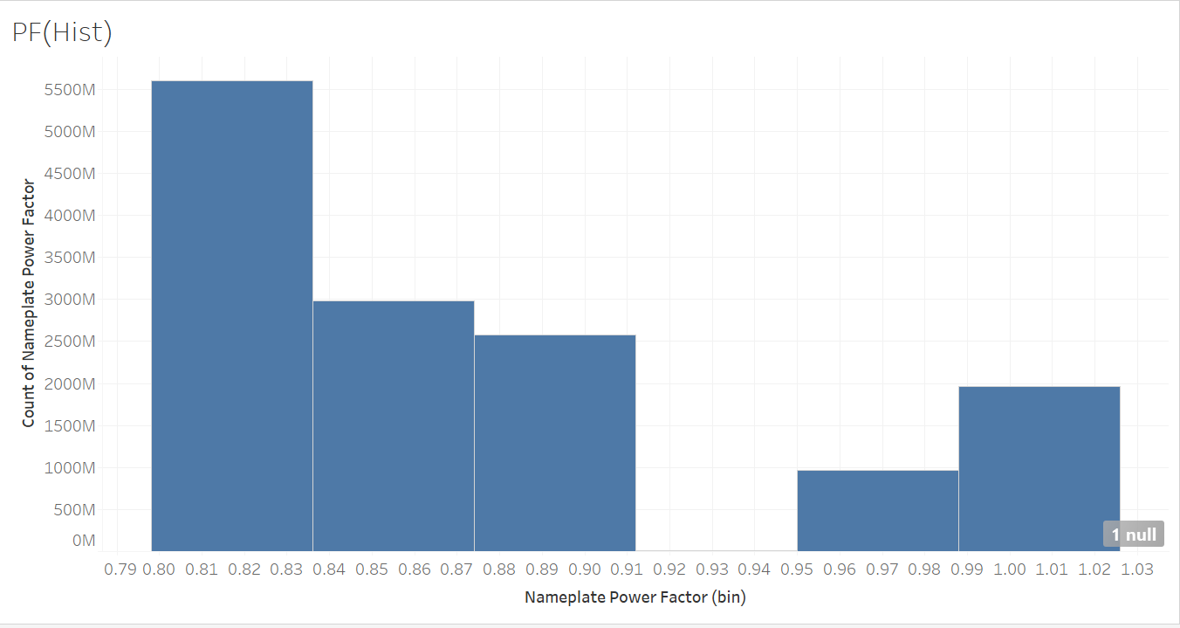
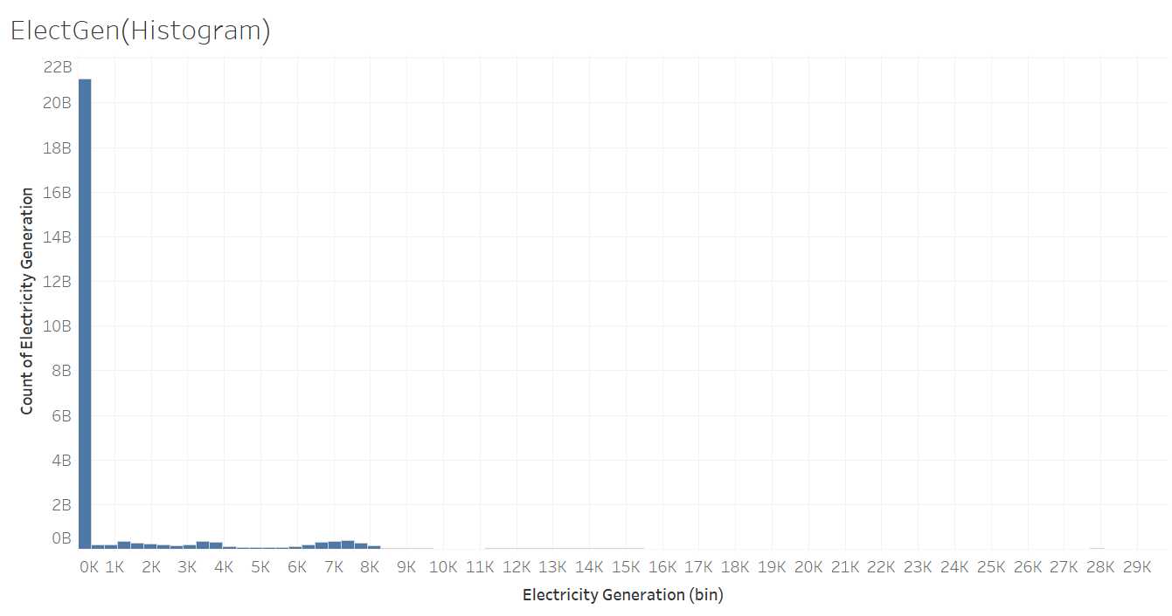
Histograms
NameplatePowerFactor(Tableu)
Electricity Generation

Slide 9
Why Normalization is not really necessary here!
Regression on something like dollars gives you a meaningful outcome. Regression on proportion-of-maximum-dollars-in-sample might not.
When the units on the features are meaningful – such as Nameplate capacity and other capacities, we would rathe not scale them

Slide 10
Visualization Trends

Slide 11
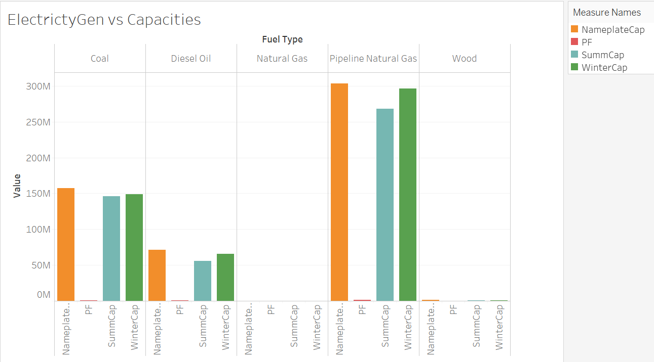
Electricity Generation vs Capacities of fuel types
We can see that the Electricity Generation using Pipeline Natural Gas are the highest among all the fuel types while wood holds the lowest of the values.
Notes:
Nameplate capacity, also known as the rated capacity, nominal capacity, installed capacity, or maximum effect, is the intended full-load sustained output of a facility such as a power plant, a chemical plant, fuel plant, metal refinery, mine, and many others.

Slide 12
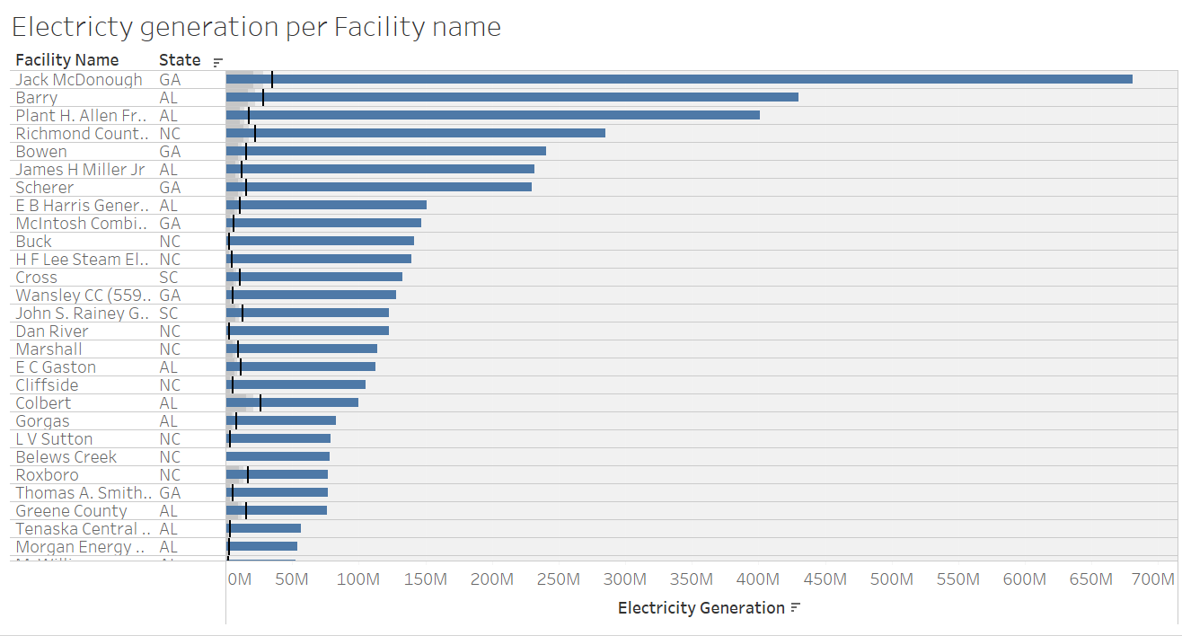
Electricity Generation per Facility Name
The above graph shows the distribution of electricity generation over all the facilities and the states recorded in the data

Slide 13
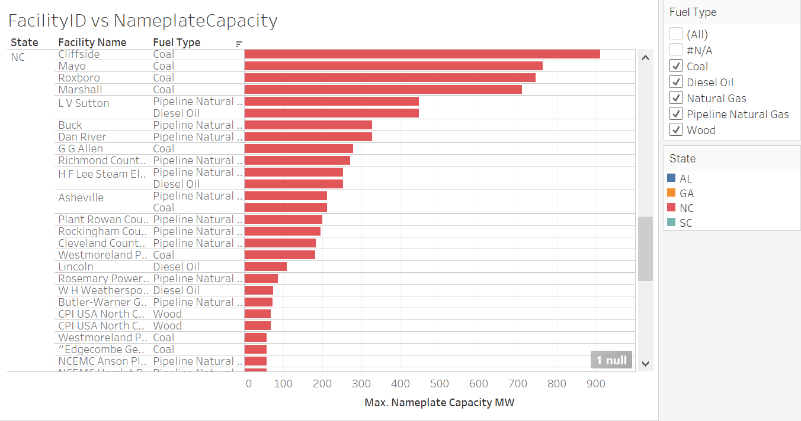

Slide 14
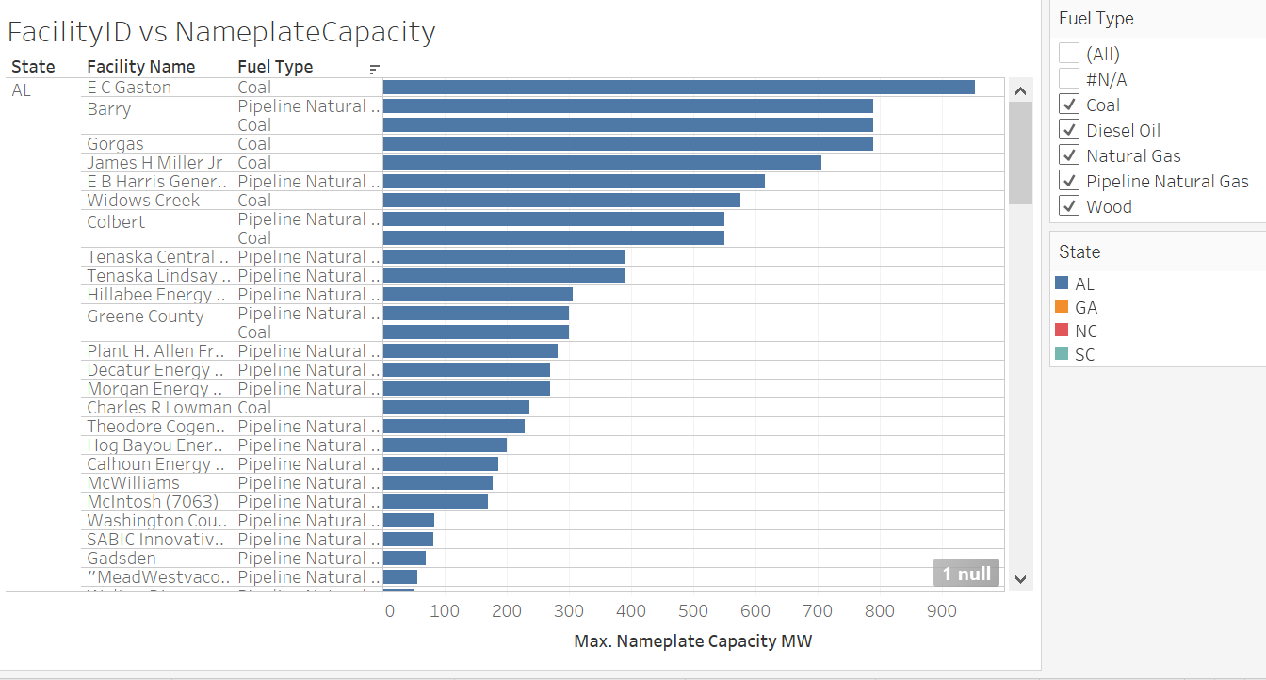
Facility Names vs Nameplate Capacity - AL
Coal has the highest Nameplate Capacity followed by Pipelined Natural Gas.
Pipeline natural gas is widely used as the energy source in Alabama.

Slide 15
Facility Names vs Nameplate Capacity - NC
Coal has the highest Nameplate Capacity followed by Pipelined Natural Gas and Diesel Oil, wood has the least.
North Carolina uses Pipeline Natural gas and Diesel oil mostly.

Slide 16
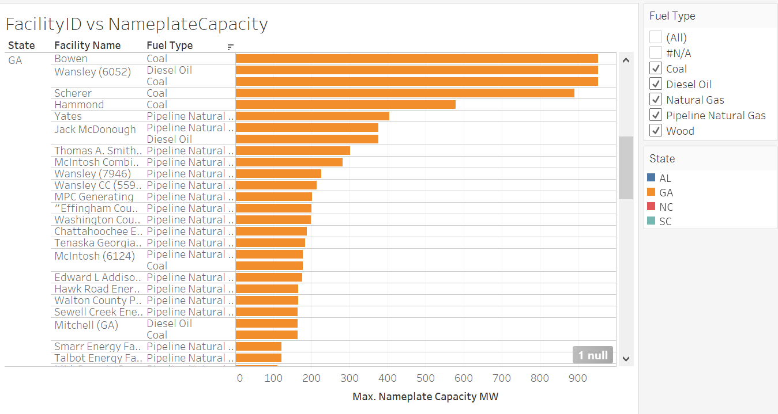
Facility Names vs Nameplate Capacity - GA
Georgia widely uses Pipeline Natural gas as a fuel in their power plants.

Slide 17
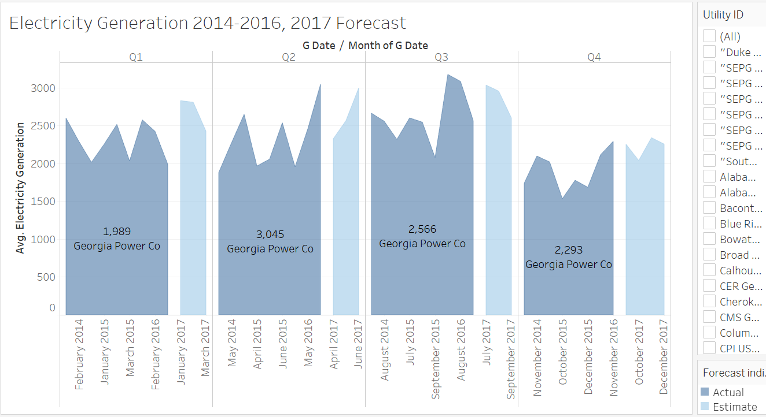
Forecast for Georgia Power Company - 2017

Slide 18
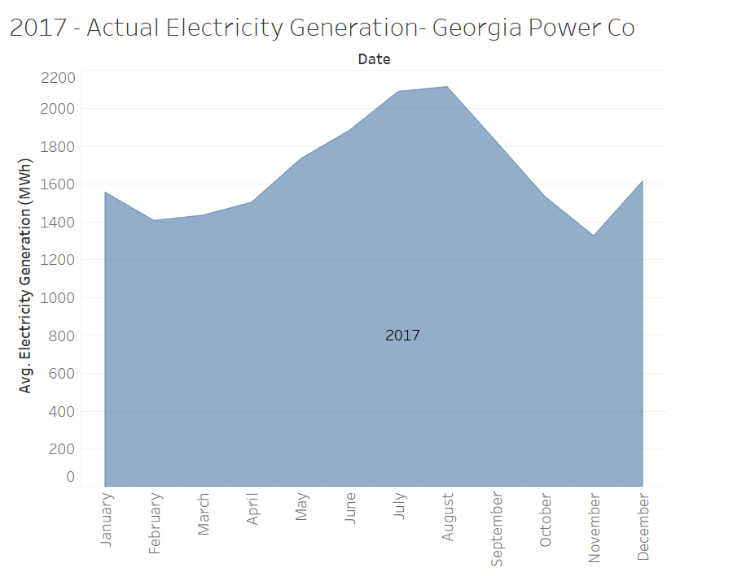
Actual distribution of Georgia Power Company’s Electricity Generation for the 2017.

Slide 19
Data Preprocessing
Missing values
Encoding Text
Splitting the data into train and test sets
K-fold splits
Data type conversion as per the demand of the models

Slide 20
Dealing with missing values
Final dataset contains missing values
Small section of the dataset, would not impact if deleted, hence chosen to drop records with missing values.

Slide 21
Predictive Modeling
Linear regression
Multivariate regression
Regression using Artificial Neural Networks
Regression using NN with L1 and l2 Regularization
Regression using NN with L1 and l2 Regularization
Bayesian Ridge Regression

Slide 22
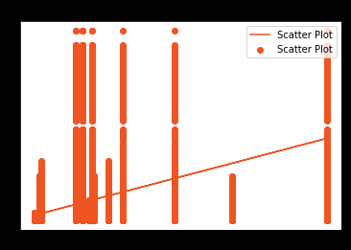
1. Linear Regression
Rationale:
This was an obvious choice given that the target variable is a continuous value variable.
Since Nameplate Capacity was being matched with the daily electricity generation file, this could be an important factor contributing to the Electricity Generation.
RMSE: 15487087.74
Plot:

Slide 23
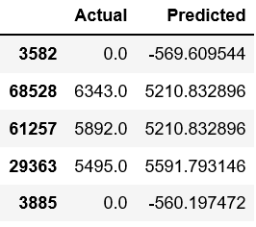
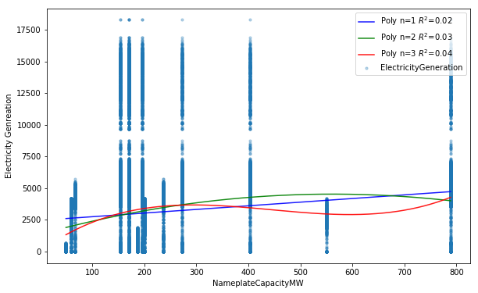
Multivariate/ Multiple linear regression
Rationale
This was an obvious choice given that the target variable is a continuous value variable.
Since Nameplate Capacity was being matched with the daily electricity generation file, this could be an important factor contributing to the Electricity Generation.
RMSE: 2660

Slide 24
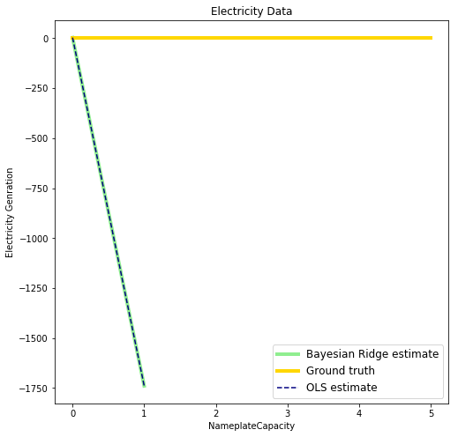
Bayesian Ridge Regression
When the regression model has errors that have a *normal* distribution, and if a particular form of prior distribution is assumed, explicit results are available for the posterior probability distributions of the model's parameters.
Since our data is not normalized, the result is somewhat similar to the Multivariate regression
RMSE: 2660

Slide 25
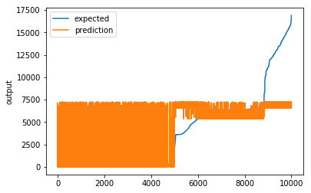
Regression using artificial neural networks ( with L1/L2 Regularization)
Rationale:
Since neural networks have been famous for their ability to learn from the data and show better predictions
L1 – Lasso
L2 - Ridge
Epoch 100/100
3s - loss: 10692145.1558
Score (RMSE): 3276.54
The model has performed poorer than MLR , perhaps dropout regularization could help!

Slide 26

Regression using artificial neural networks ( with L1/L2 and Dropout Regularization
Rationale
Dropout ignores the randomly selected neurons for training.
Their contribution to the activation of downstream neurons is temporarily removed on the forward propagation and weight manipulations are not applied to the neuron on the backward propagation.
4s - loss: 10665665.9997
Score (RMSE): 3265.18
- Hardly any difference!

Slide 27
Regression K-fold = L1 + L2 + dropout
Rationale
5 folds used for cross validation
compare the performance on the same data set.
Can use different algorithms for each fold, but the data remains consistent over long intervals and hence randomizing the data could be of no help.
Fold score has still reduced as compared the rest of the models.
Some manipulations may help.
Epoch 00035: early stopping
Fold score (RMSE): 2165.05078125
Final, out of sample score (RMSE): 3566.14

Slide 28
Comparison
Linear Regression
RMSE: 15487087.74
MLR
RMSE: 2660
Bayesian Ridge Regression
RMSE: 2660
Regression using ANN with L1 and L2 Reg
RMSE: 3276.54
Loss: 10692145.1558
With dropout
RMSE: 3265.18
Loss: 10665665.9
K-folds
Fold score RMSE: 2165.05
Out of sample RMSE: 3566.14

Slide 29
What more could be done
Normalization:
Without normalization, gradient-based optimization algorithms(such as Linear regressions) have a very hard time to graze through the weight vectors towards the target, algorithms also do much better and diverge less.
This is certainly the case for linear models and especially the ones whose cost function is a measure of divergence of the model's output and the target - linear regression with MSE cost function.
LSTM Models
Boosting

