Slide 1
Product Recommendation System Using Amazon Data Team Members : Omkar Bapat Aabir Kumar Datta Lohitaksh Yogi

Slide 2
E-commerce Content Based Collaborative Filtering
Introduction

Slide 3
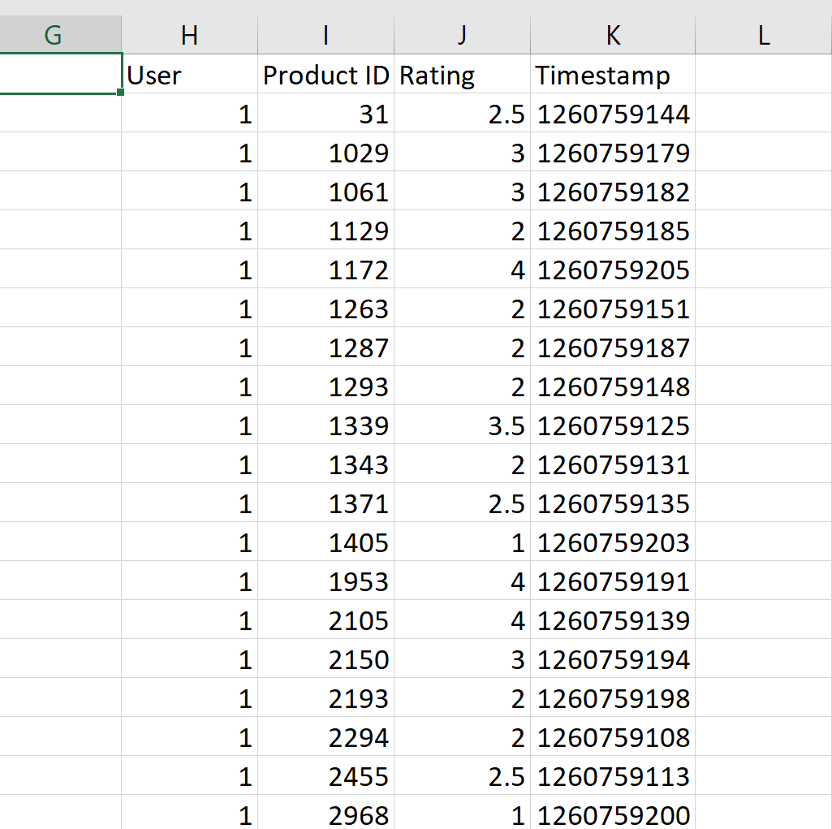
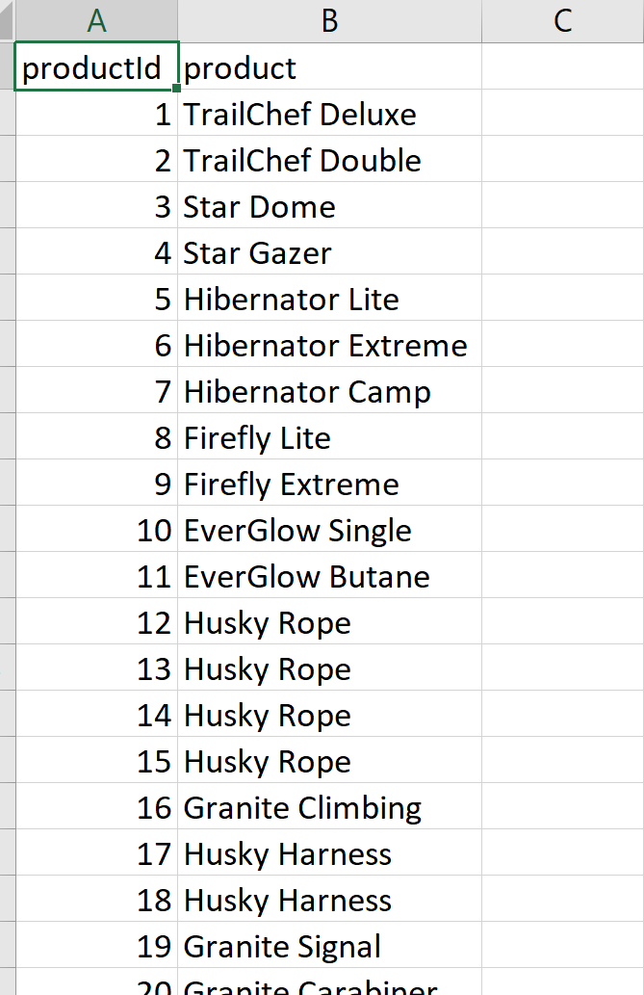
Dataset
Amazon Product Dataset

Slide 4
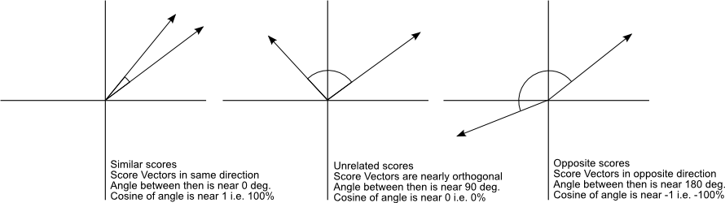
Cosine Similarity
Cosine Similarity will generate a metric that says how related are two documents by looking at the angle instead of magnitude.

Slide 5
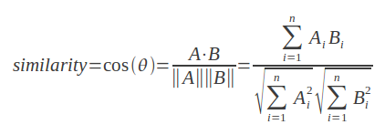
Formula
For our task, we have to find Cosine Similarity between two users based on the products they have both seen and rated.

Slide 6

User based neighbourhood models
In order to determine the neighborhood of the target user i, her similarity to all the other users is computed. Therefore, a similarity function needs to be defined between the ratings specified by users.

Slide 7
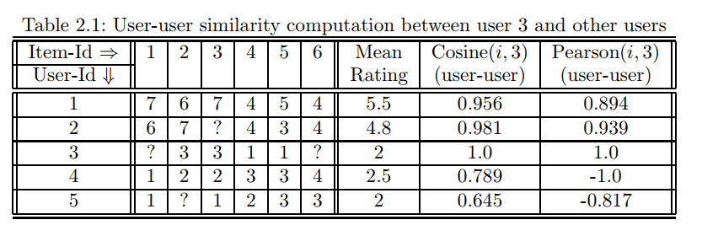

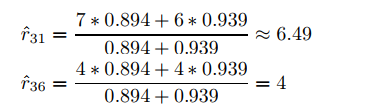
Example
Reference:
https://www.google.com/url?sa=t&rct=j&q=&esrc=s&source=web&cd=1&cad=rja&uact=8&ved=0ahUKEwjmk9ban4bYAhWtYd8KHS_8BugQFggnMAA&url=http%3A%2F%2Fwww.springer.com%2Fcda%2Fcontent%2Fdocument%2Fcda_downloaddocument%2F9783319296579-c1.pdf%3FSGWID%3D0-0-45-1554478-p179516130&usg=AOvVaw15tMwXNsAAp8kp7_GlelXI
The top-2 closest users using both measures of similarity are 1,2 to 3.

Slide 8
Implementation
Created a matrix by taking cartesian product of the list of users.
Filtered all values below diagonal to get user-user pairs.
For user-user pair filtered products both user have rated.
Computed cosine similarity for above pairs.

Slide 9
Implementation Continued
Grouped by user-id and in descending order of similarities.
Filtered the top K neighbors for each user (Did not consider users with less than 10 products common for top K neighbors)
Using the similarity rating formula, calculated the ratings for products not seen by the users but seen by at least one of his neighbors.
Gave top 5 predictions for inputted User-ID

Slide 10

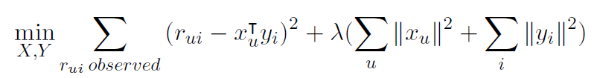
ALS Implementation of product Recommended System
ALS algorithm goal is to estimate the complete ratings matrix
In particular, we aim to minimize the least squares error of the observed ratings.

Slide 11
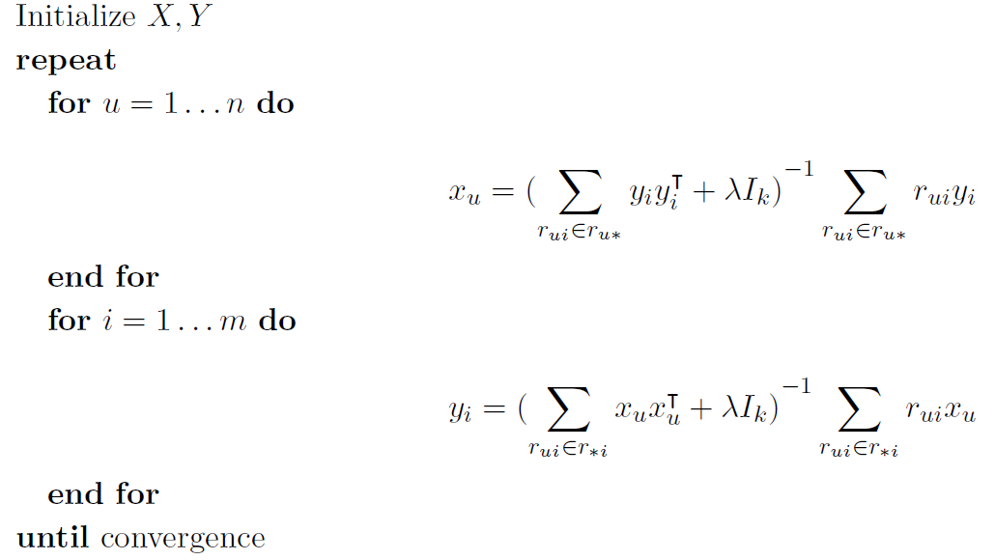
ALS Approach
Approach is to Fix Y and optimize X and then Fix X and optimize Y until it converges.

Slide 12
Implementation
Created an initial rating matrix by assigning 0.0 rating for unrated product.
In rating matrix rows represents the user id and column represents the product id.
Randomly initialize the user matrix (u*k) and product matrix (m*k) with factor k.
Iterate for evaluating user matrix by fixing product matrix and vice versa until it converges.

Slide 13

Rating Prediction
Calculate the RMSE for each iteration to check for convergence and evaluate the Model.
Also calculating the average value for RMSE after convergence.
The final rating output is evaluated by the formulae.
Predicting the product id for each user id and the predicted rating value.

Slide 14
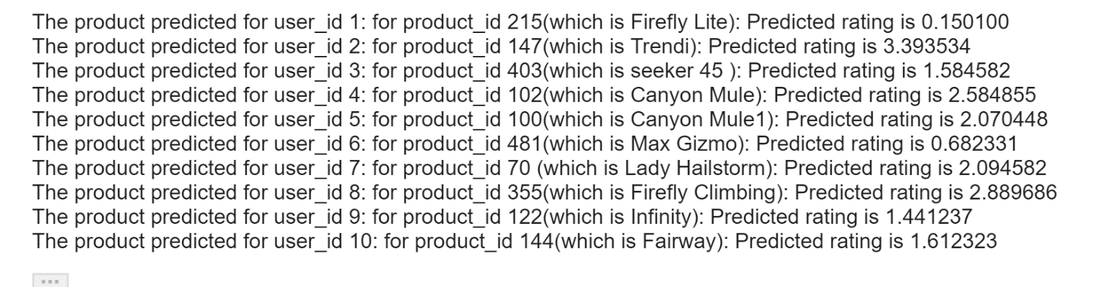
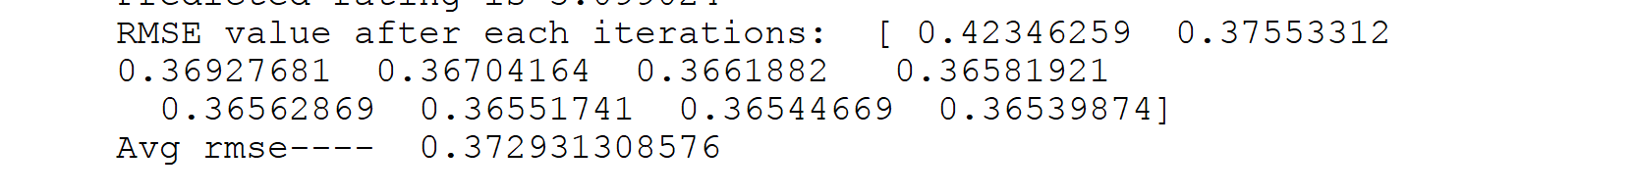
The Result
Evaluated the final rate changing the number of iteration and check for convergence

Slide 15
RMSE
Root of the Mean Square Error (RMSE) is a popular method for scoring an algorithm. If pi, j is the predicted rating for user i over item j, and vi, j is the true rating, and K = {(i, j)} is the set of hidden user-item ratings then the RMSE is defined as:
s = ∑((i, j)∈K(pi, j −vi, j)^2)/n
RMSE is calculated as a measure of goodness of value fit
RMSE value is introduced in our program implemented on training data as an objective function.
Preferred over mean absolute error as it performs well for user held out user ratings and achieves a good fit for them.

Slide 16
ALS and Cosine Similarity
For Alternating least squares, RMSE value is an error function and is the squared diiference between the observed and the calulated ratings.
The RMSE value is calculated for each iteration for the user and product matrix.
In the cosine similarity approach, the rmse value is calculated over increasing neighbours in the dataset from 10 to 200
Both the rmse plots are decreasing functions over the number of iterations or the increasing neighbours thereby increasing rating similarity.

Slide 17
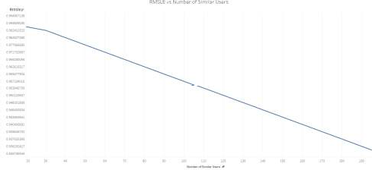
Cosine Similarity RMSE plot

Slide 18
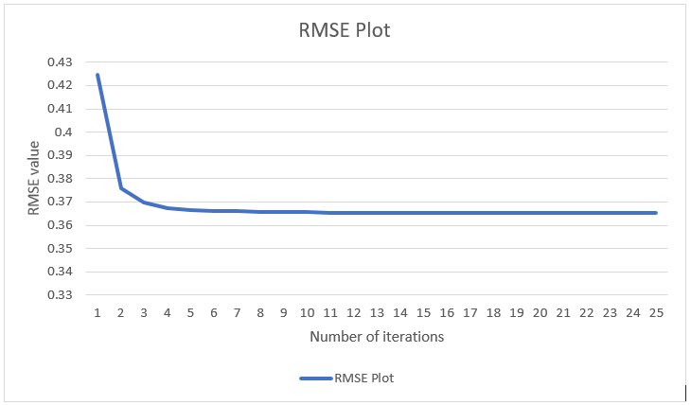
ALS RMSE plot

Slide 19
Problems
1. Choosing the Dataset
We have sampled the dataset values again after a certain number of rows.
2. Fixing Latent Factor
For the matrix factorization we have used a factor k intead of calculating the same using Jaccard or any other mathematical formulation which were difficult to understand and translate into code.

