Slide 1


CLOUD SECURITY
AZURE
Azure Key Vault: Secret & Certificate Management
Cloud Security Project — Secure storage, access control, and automated lifecycle management for credentials, keys, and certificates in Azure.
ID NAME
2400031099 -R.LEELAROHITH
2400031147 -K.LOHITH
2400031100 -SHAIK OMAIRA ANJUM
2400031137 -P.RAJESH

Slide 2
SECURITY FOUNDATION
Abstract
Modern cloud applications rely on sensitive credentials — API keys, passwords, connection strings, and TLS certificates — to function. Storing these in code or configuration files creates critical security gaps. Azure Key Vault provides a hardened, cloud-native solution for securely storing, accessing, and rotating secrets and certificates, integrated with Microsoft Entra ID for identity-based access control.
Secrets
Passwords, connection strings, API keys
Keys
Cryptographic keys for encryption
Certificates
TLS/SSL certs with auto-renewal

Slide 3

Problem Statement
The Credential Crisis
Hardcoded credentials in source code and config files are among the top causes of cloud security breaches. Developers frequently commit secrets to version control, exposing them to unauthorized access.
Hardcoded Credentials
Certificate Complexity
No Audit Trail
Secrets in code are exposed via repos, logs, and backups
Manual renewal leads to expiration outages and compliance gaps
Uncontrolled access without logging or alerting

Slide 4
Project Objectives
This project addresses three core goals for enterprise-grade secret and certificate management in Azure.
1
2
3
Secure Credential Storage
Automated Certificate Renewal
Access Control & Auditing
Eliminate hardcoded secrets by centralizing all credentials in Azure Key Vault with encryption at rest and in transit.
Enforce least-privilege access via RBAC and Managed Identity, with full audit logging through Azure Monitor.
Leverage Key Vault's certificate policies to auto-renew TLS certificates, preventing expiration-related outages.

Slide 5
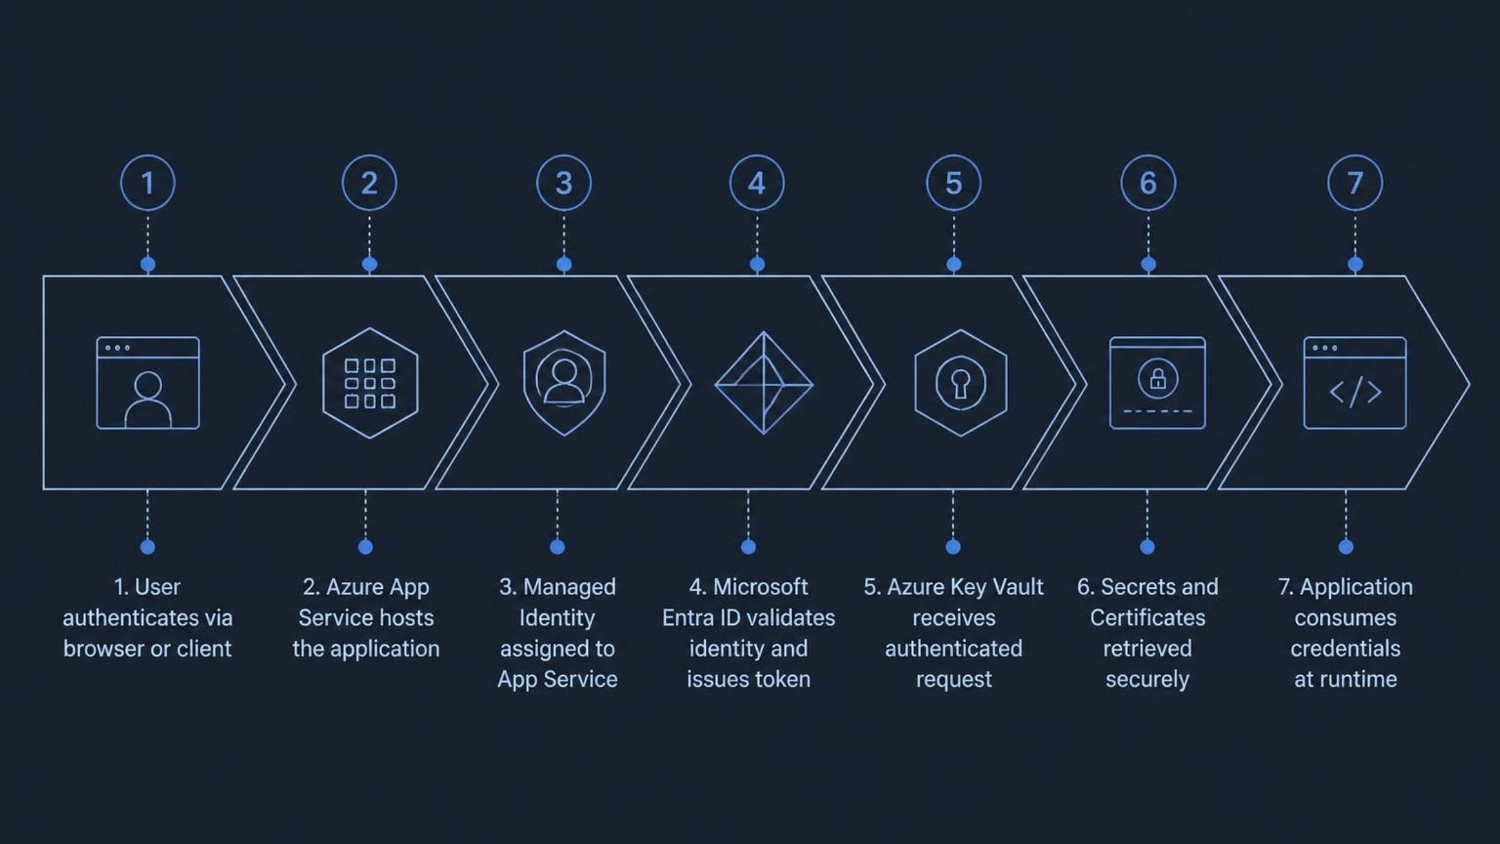

Solution Architecture
End-to-end flow from user authentication through secure secret retrieval — with zero credentials in application code.
Key principle: The application never stores credentials. Managed Identity provides passwordless, token-based access to Key Vault.

Slide 6
Azure Services Used
Azure Key Vault
Microsoft Entra ID
Centralized HSM-backed storage for secrets, keys, and certificates with FIPS 140-2 compliance.
Identity provider for authentication, token issuance, and conditional access policies.
Managed Identity
Azure App Service
Auto-managed Azure AD identity for services — eliminates embedded credentials.
PaaS hosting for web apps and APIs, integrated natively with Key Vault references.
Azure Monitor
Azure Activity Log
Real-time telemetry, diagnostic logs, and alerting for Key Vault access events.
Subscription-level audit trail for compliance reporting and forensic analysis.

Slide 7

Working Process
Managed Identity
Secret Retrieval
Cert Management
User Auth
The entire flow is credential-free from the application's perspective. Managed Identity handles authentication transparently, and Key Vault enforces access policies before releasing any secret or certificate.

Slide 8

Use Cases
Eliminate Hardcoded Credentials
Secure API Authentication
Replace connection strings and API keys in code with Key Vault references — secrets never touch source control.
Store OAuth client secrets, signing keys, and service-to-service credentials centrally with rotation support.
Automated Certificate Renewal
Configure certificate policies with integrated CAs (e.g., DigiCert, Let's Encrypt) for hands-free TLS renewal.

Slide 9
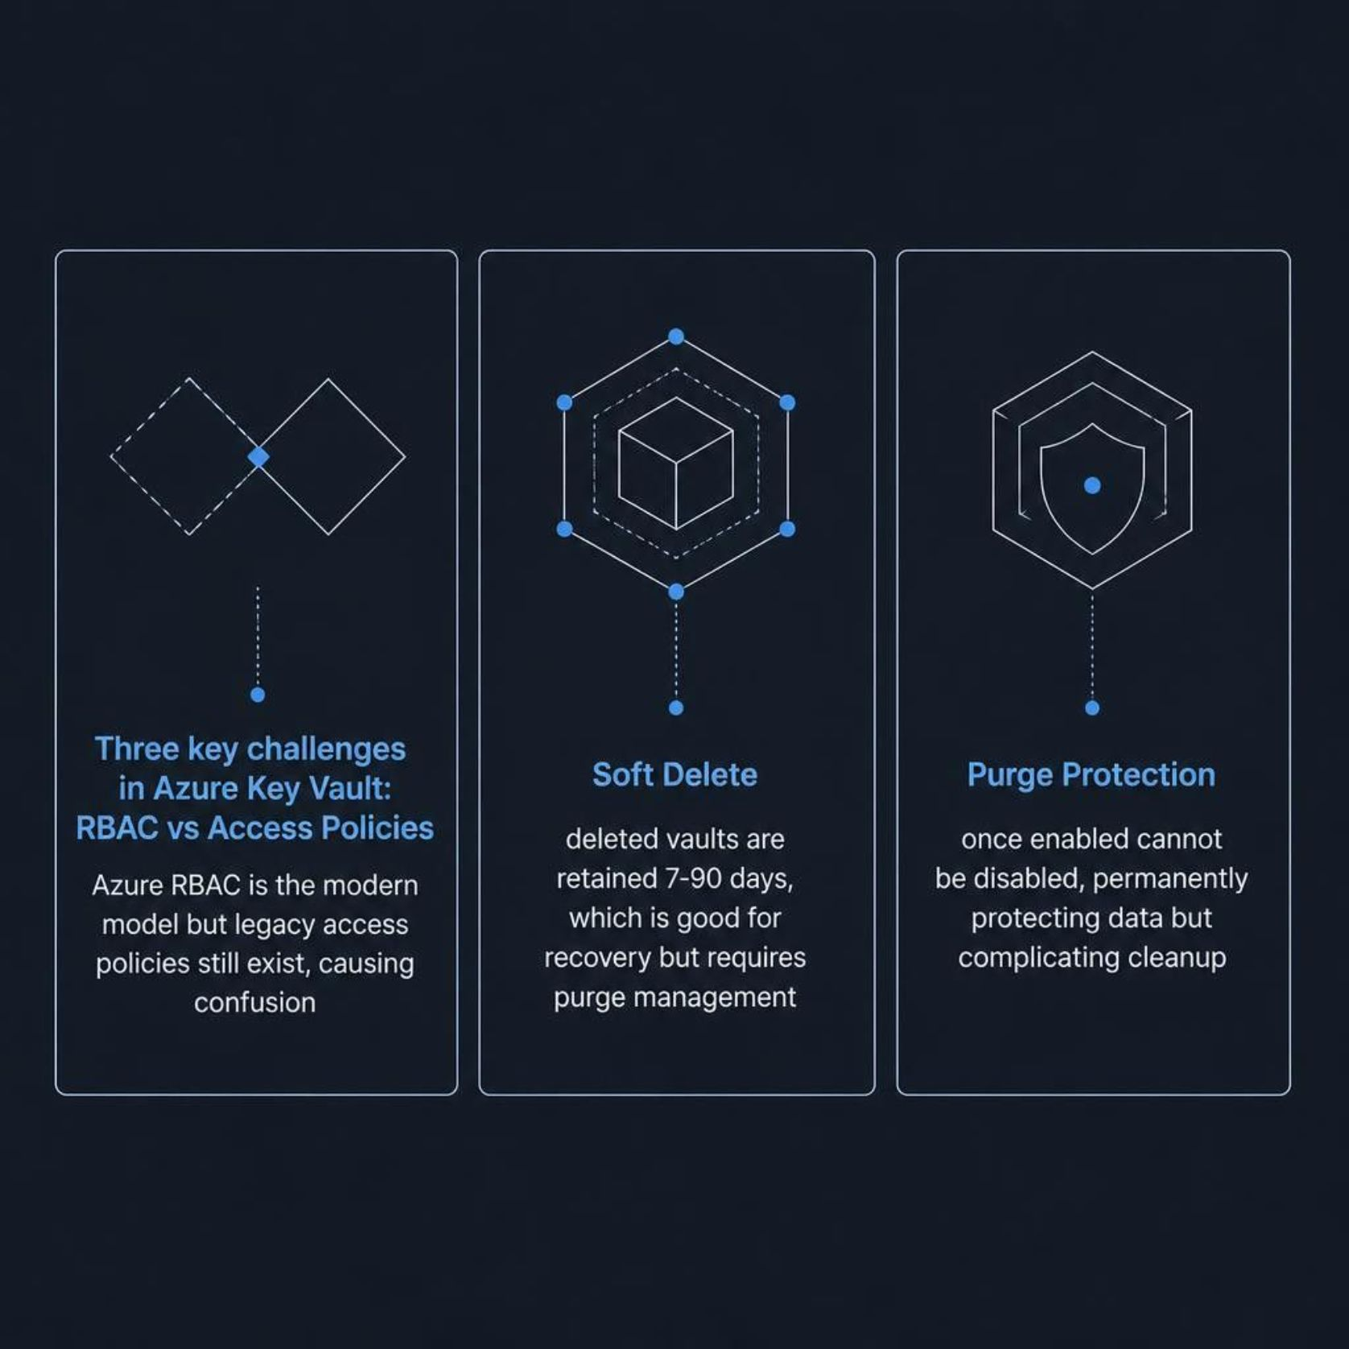
Challenges & Considerations
Navigating Key Vault Complexity
While Key Vault is powerful, teams must understand its operational nuances to avoid misconfiguration.
RBAC vs. Access Policies
Soft Delete Retention
Purge Protection
Azure RBAC is recommended; legacy access policies create conflicting permission models.
Deleted vaults are retained 7–90 days — plan retention windows carefully.
Once enabled, purge protection cannot be disabled — a deliberate design for compliance.

Slide 10


Advantages & Conclusion
99.9%
256-bit
SLA Uptime
Encryption
Enterprise-grade availability for production workloads
AES-256 encryption at rest with HSM-backed keys
0
Hardcoded Secrets
Eliminate embedded credentials across all applications
High Security
HSM-backed, FIPS-compliant, zero-trust architecture
Scalability
Supports thousands of secrets across global deployments
Compliance
Meets SOC 2, ISO 27001, HIPAA, and GDPR requirements
Monitoring
Full audit logs, alerts, and integration with Sentinel
Key Takeaway: Azure Key Vault, combined with Managed Identity and Entra ID, delivers a zero-trust credential management model — eliminating hardcoded secrets, automating certificate lifecycles, and providing full auditability for compliance.

