Slide 1


Don Bosco Institute Of Technology
Collaboration With
SAMSUNG INNOVATION CAMPUS
CAPSTONE PROJECT:
SPEECH EMOTION DETECTION
External Guide
Mr. Prasad K
Trainer
SIC
Internal Guide
Dr. Venugeetha Y
Professor, Coordinator - SIC
Dept. Of CSE DBIT, Bangalore
By :
Lohith Kumar A
Rakshitha S Hiremath

Slide 2
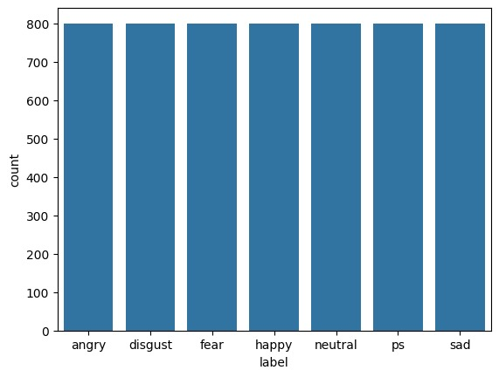
DATASET
There are several datasets available for speech emotion recognition models including RAVDESS Emotional speech audio, Toronto emotional speech set (TESS), CREMA-D,SAVE.
We have used TESS dataset which contains about 7 classes and about 5600 audio files.Using these dataset can ensure that the model can recognize a emotion conveyed within the audio.

Slide 3
ALGORITHM

Slide 4

RNN (Recurrent Neural Network)
A Recurrent Neural Network(RNN) is a type of artificial neural network (ANN) that is designed to work with sequential data such as time series or natural language text.
The basic idea behind RNNs is to use feedback loops to propagate information from one time step to the next with the output of each time step serving as input to the next.
RNNs have found numerous applications in areas such as speech emotion recognition, language translation, and time series forecasting.

Slide 5
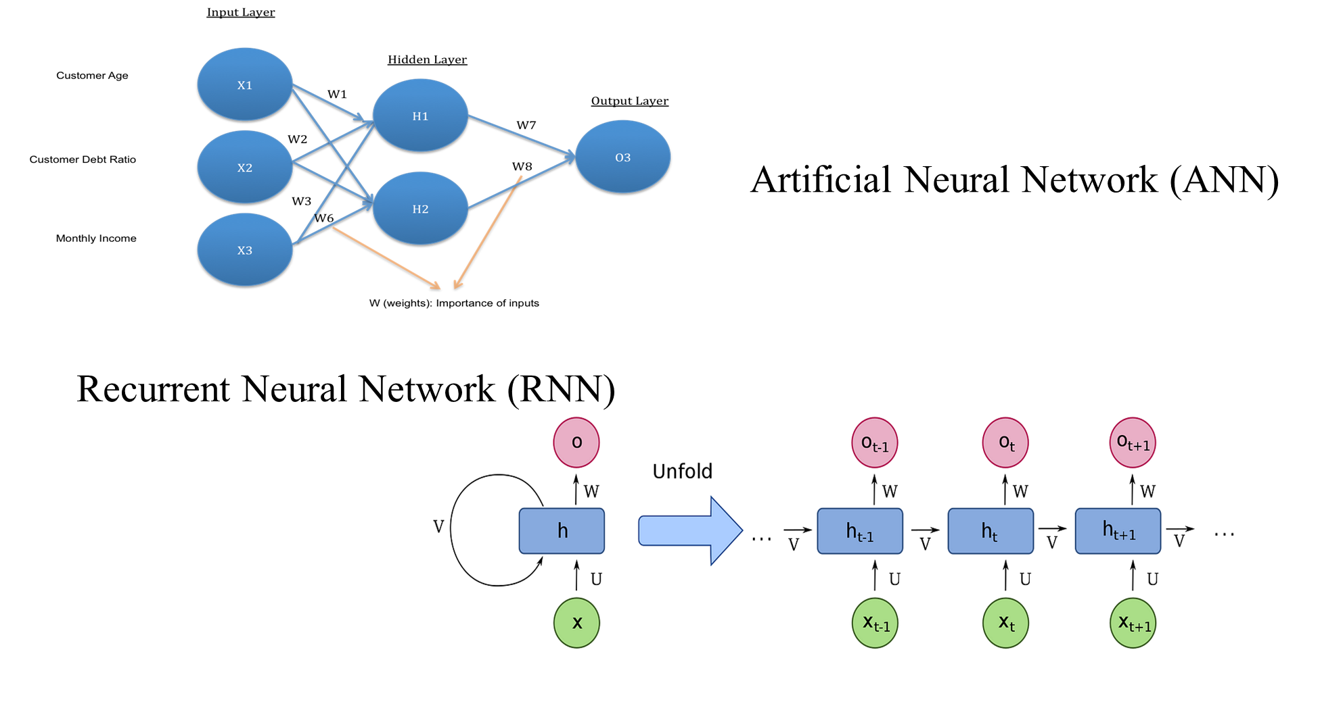

Slide 6
Drawbacks of RNN
Vanishing Gradient Problem :
When training an RNN, the gradient of the loss function with respect to the parameters of the network needs to be propagated back through time, which can lead to the problem of vanishing gradients.
This occurs when the gradient becomes very small as they are backpropagated through many time steps, making it difficult to update the parameters of the network efficiently.

Slide 7
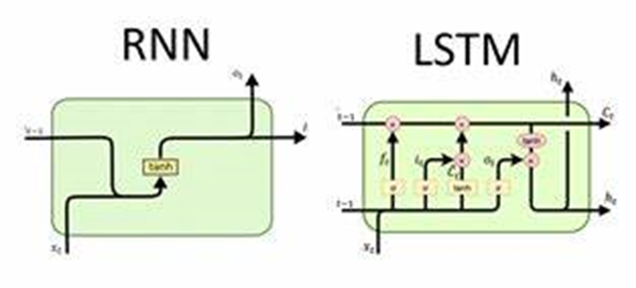
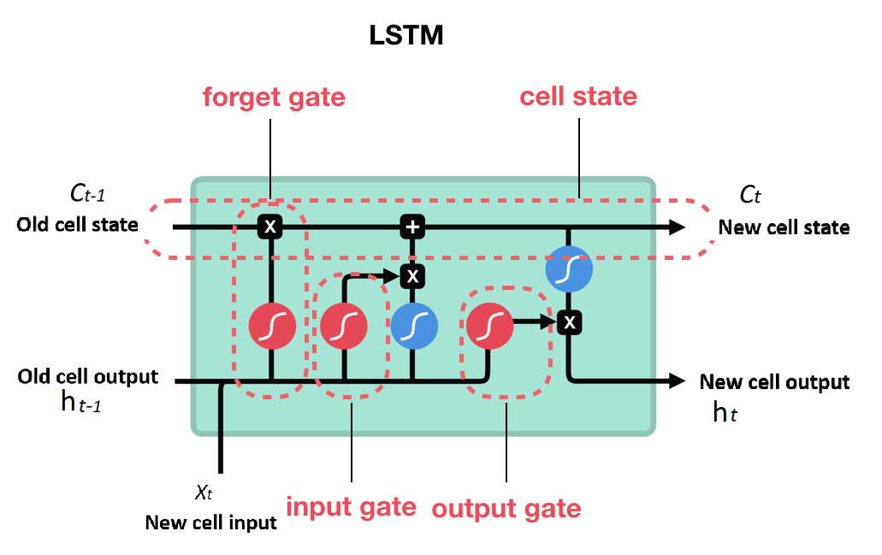
LSTM (LONG SHORT TERM MEMORY)
To solve the problem of Vanishing and Exploding Gradients in a Recurrent Neural Network(RNN).
One of the famous model used is LSTM.
LSTM stands for Long Short Term Memory Networks, used in the field of Deep Learning.
It is a variety of recurrent neural networks (RNNs) that are capable of learning long term dependencies, especially in sequence prediction.

Slide 8
MODULES
Pandas: Pandas are used for data manipulation and analysis. It provides data structures like DataFrames that make it easy to work with structured data.
Numpy: NumPy is used for numerical and mathematical operations. It offers powerful arrays and functions for scientific computing.
OS: The OS module is used for interacting with the operating system, and allows us to perform tasks like file and directory operations.
Seaborn: Seaborn is a data visualization library built on top of Matplotlib. It provides a high-level interface for creating informative and attractive statistical graphics.
Matplotlib.pyplot: Matplotlib is a versatile plotting library. The pyplot submodule is commonly used for creating static, animated, or interactive plots and graphs.
Librosa: Librosa is primarily used for audio and music analysis. It offers tools for feature extraction, analysis, and manipulation of audio data.

Slide 9
MODULES
Audio: It is used to play audio files.
Warnings: The warnings module helps control how warning messages are displayed or handled in your Python code, allowing you to manage unexpected behaviors or issues.
Scikit-Learn (sklearn): Scikit-Learn is a machine learning library that provides tools for various machine learning tasks, including classification, regression, clustering, and more. We have used it to encode the label of the audio files(OneHotEncoding).
Keras(Sequential, Dense, LSTM,Dropout): Keras is a high-level neural networks API. We have used it to build neural network models.
Sequential is used to create a linear stack of layers.
Dense defines fully connected layers in neural networks.
LSTM is used for building Long Short-Term Memory networks, which are a type of recurrent neural network (RNN).
Dropout is a regularization technique used to prevent overfitting in neural networks.

Slide 10
Data Flow Diagrams

Slide 11
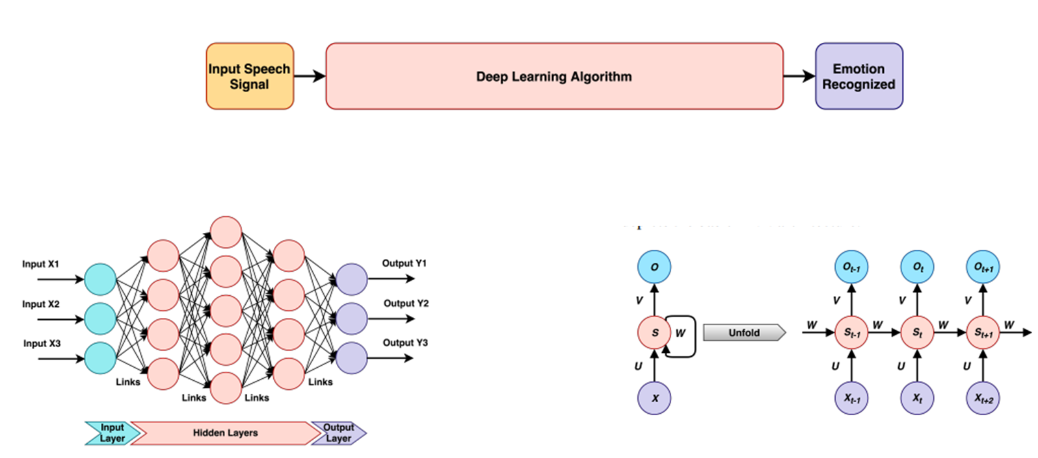
DL PROCESS OVERVIEW

Slide 12
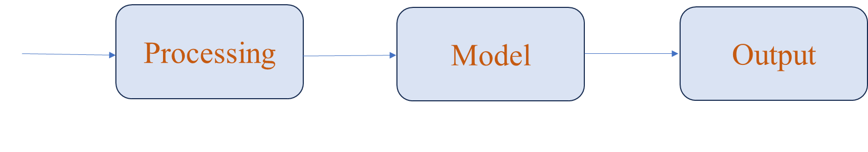

Slide 13
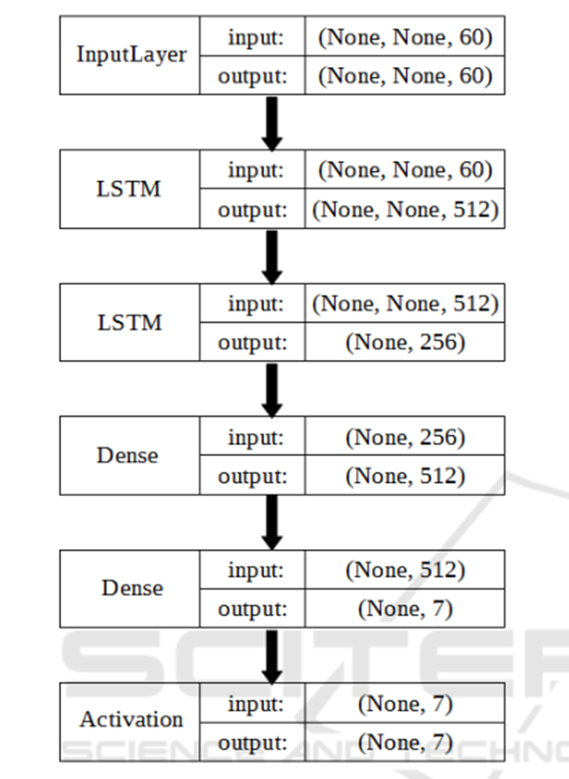
MODEL OVERVIEW

Slide 14


