Slide 1
FedEx Logistics Performance Analysis - Delivery History Dataset
Exploratory Data Analysis (EDA)

Slide 2
INTRODUCTION
This project analyzes the SCMS Delivery History dataset to understand shipment patterns, freight costs, and delivery performance in a global supply chain.
The analysis focuses on identifying key cost drivers such as shipment mode, weight, quantity, and delivery timelines.
Exploratory Data Analysis (EDA) techniques were used to uncover trends, distributions, and relationships within logistics data.
Multiple visualization methods were applied to support data-driven insights and business decision-making.
The goal of the project is to provide actionable insights that can help optimize logistics efficiency, reduce costs, and improve delivery reliability.

Slide 3
DATASET OVERVIEW
The dataset used is the SCMS (Supply Chain Management System) Delivery History dataset, which contains real-world logistics and shipment records.
It consists of 10,000+ rows and 33 columns, representing detailed information about global shipments.
The data includes key attributes such as Country, Shipment Mode, Vendor, Fulfill Via, Weight, Freight Cost, and Line Item Value.

Slide 4
PROBLEM STATEMENT
Global logistics operations generate large volumes of shipment data, but key cost drivers and inefficiencies are often not clearly understood.
Freight costs and delivery delays vary across shipment modes, countries, and vendors, making it difficult to identify optimal logistics strategies.
Organizations lack clear visibility into which factors most influence freight cost and delivery performance.
Without proper analysis, it becomes challenging to optimize shipment modes, control logistics expenses, and improve delivery reliability.

Slide 5
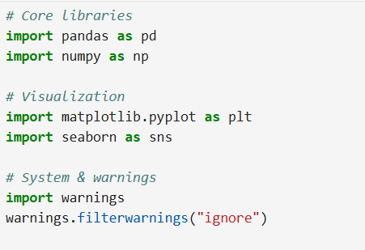
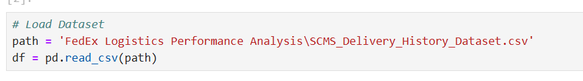
READING DATASET
The dataset was loaded into Python using the Pandas library (read_csv), which allows efficient handling and analysis of large tabular data.

Slide 6
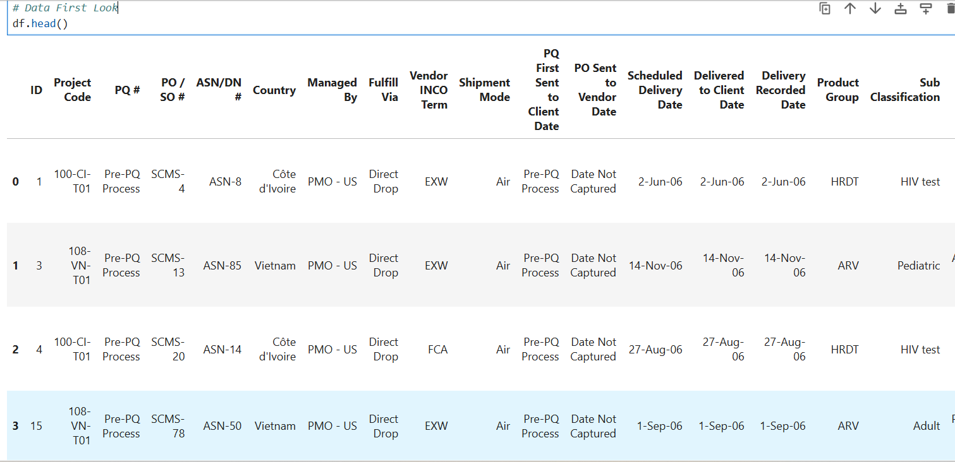
DATA SET

Slide 7
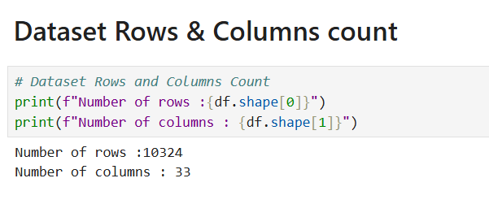
Dataset Rows and Columns Count
Number of rows: 10,324
Number of columns: 33

Slide 8
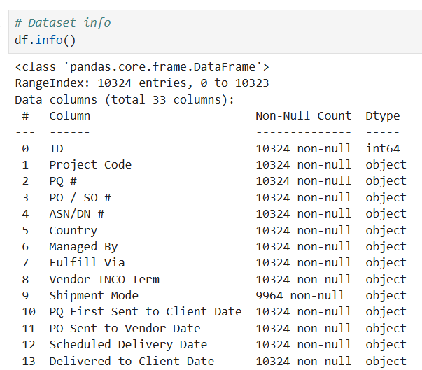
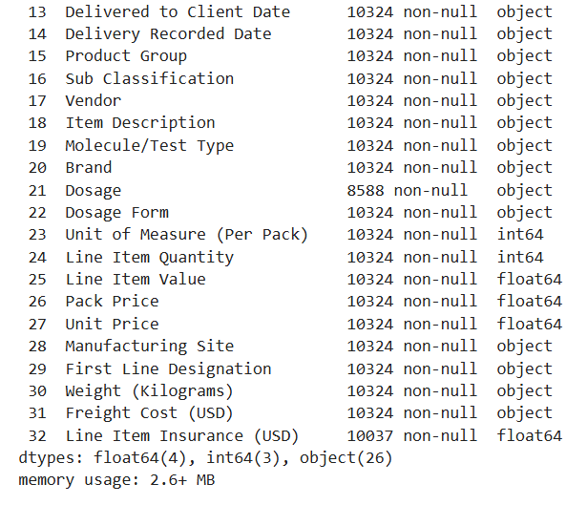
CHECK DATA STRUCTURE

Slide 9
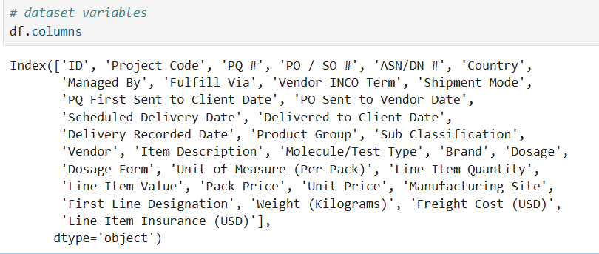
CLEANING VARIABLES

Slide 10
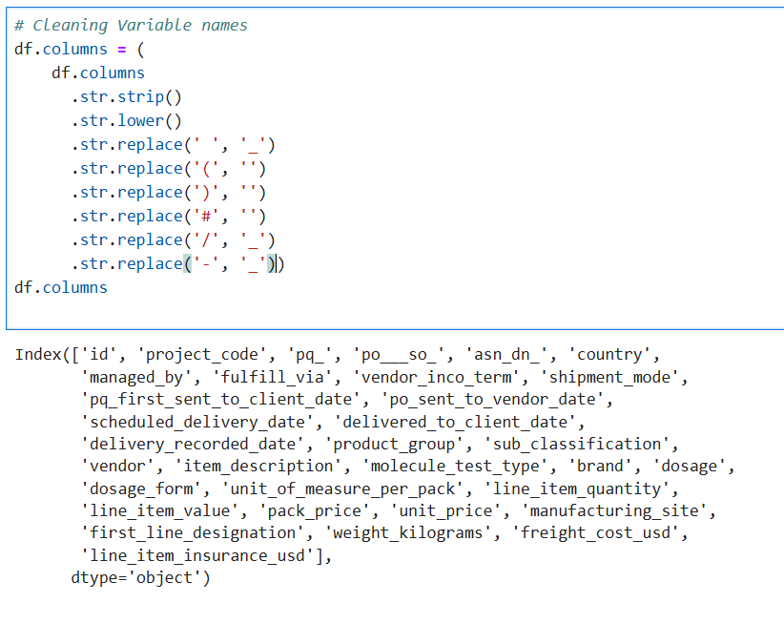

Slide 11
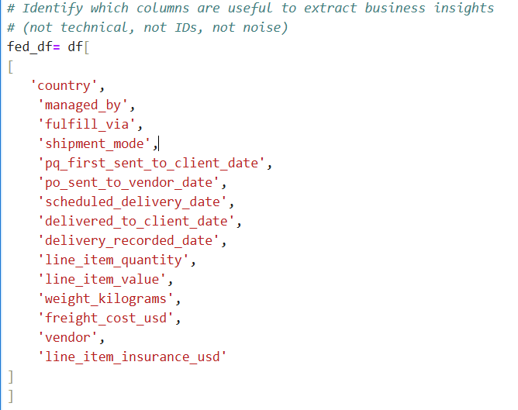
DATA WRANGLING

Slide 12
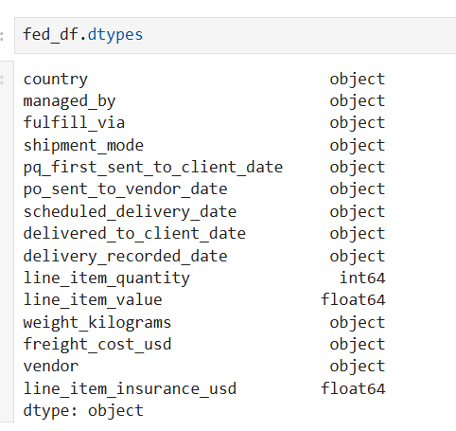
CLEANING DATATYPES

Slide 13
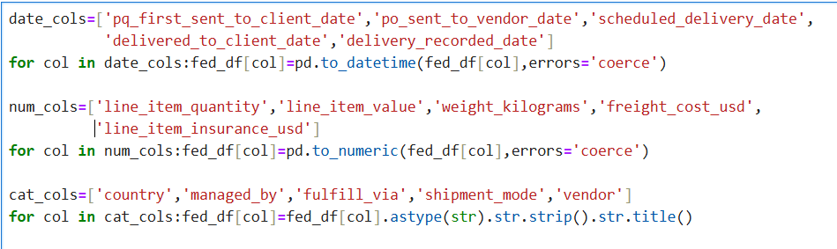
Date, numeric, and categorical columns were converted to their appropriate data types to ensure accurate analysis and prevent calculation errors.
Categorical values were cleaned by removing extra spaces and standardizing text format, improving consistency across the dataset.

Slide 14
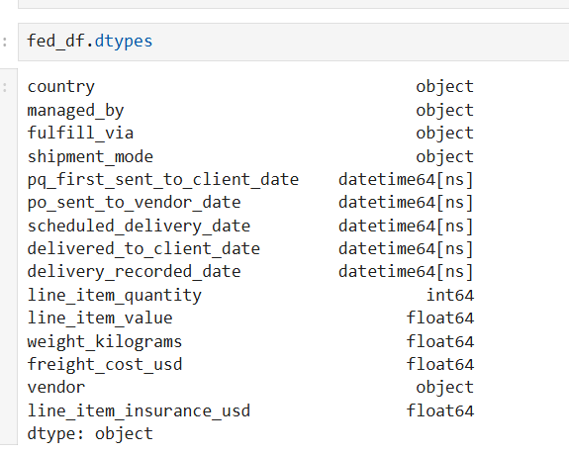

Slide 15
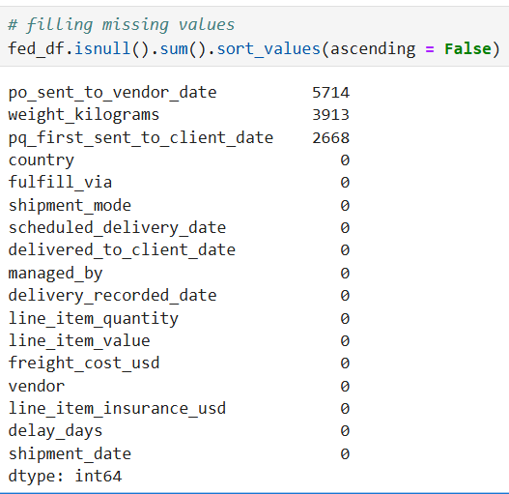
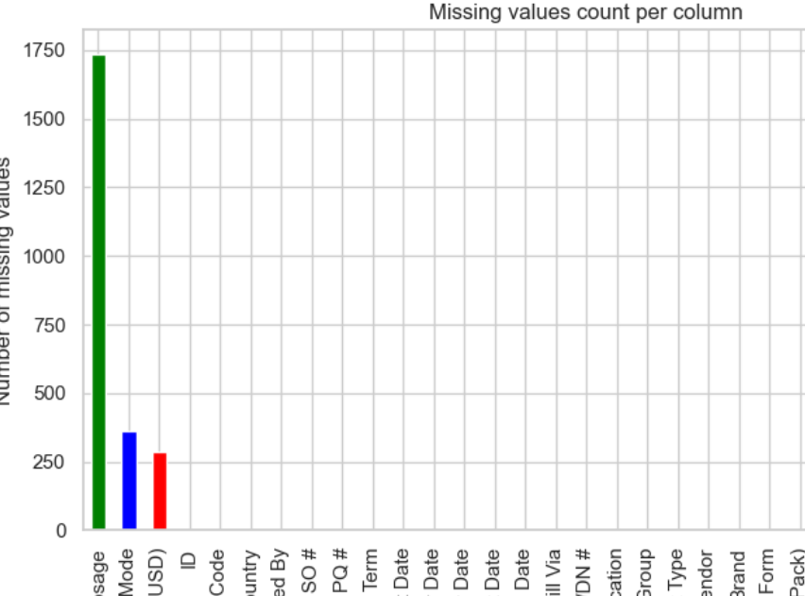
IDENTIFY MISSING VALUES

Slide 16
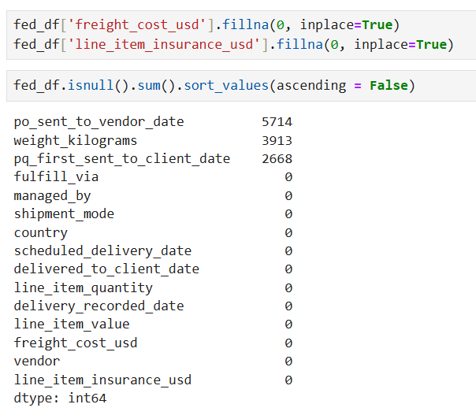
Date and weight columns were intentionally left untreated to avoid creating incorrect timelines or unrealistic shipment values.
Selective handling of missing values ensured data accuracy and reliable business insights, rather than introducing misleading information.

Slide 17
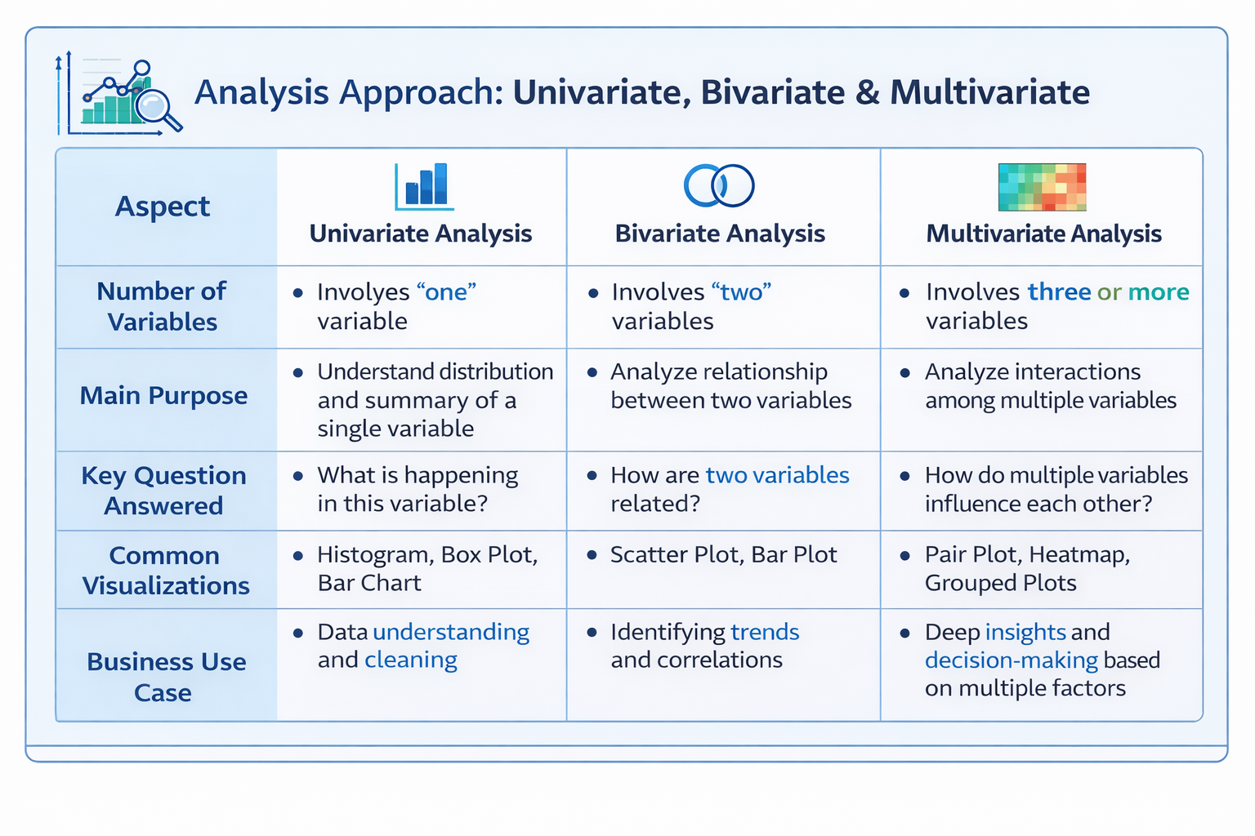
Analysis Approach: Univariate, Bivariate & Multivariate

Slide 18
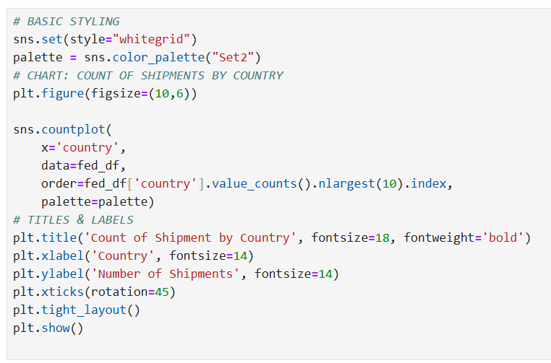
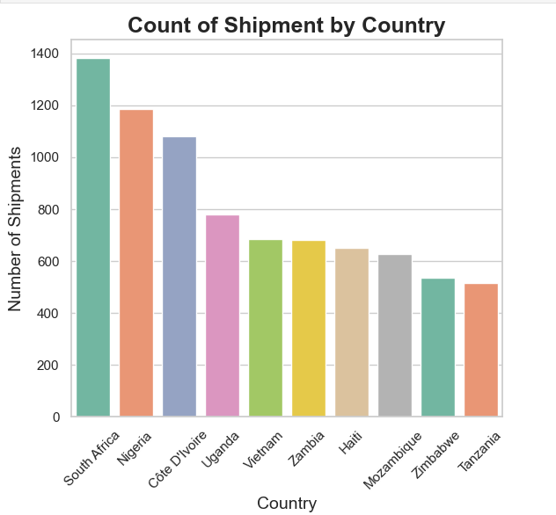
Univariate Analysis: Count Of Shippment By Country

Slide 19
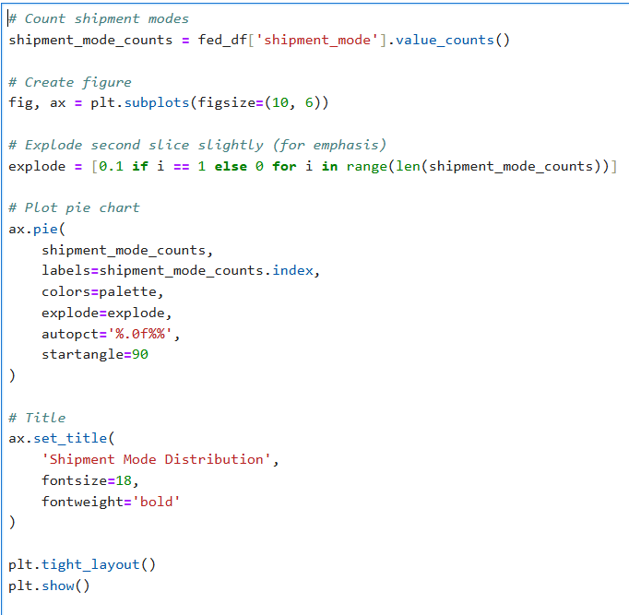
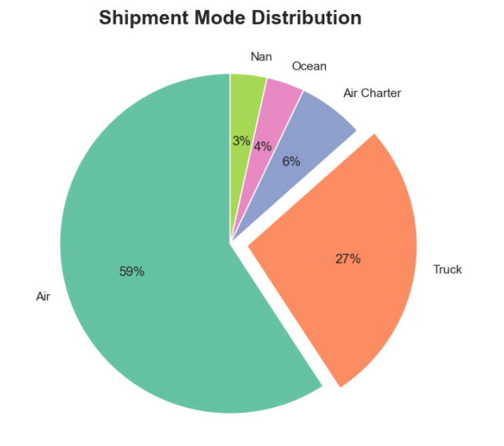
Univariate Analysis: Distribution Of Shippment Modes

Slide 20
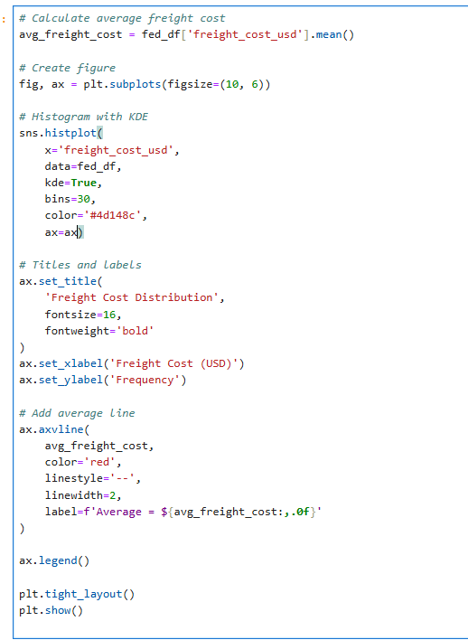
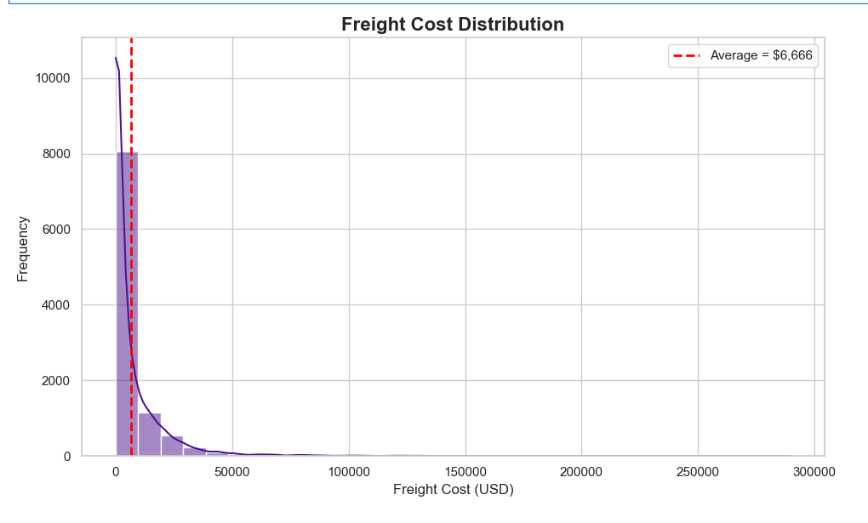
Univariate Analysis: Average Freight Cost

Slide 21
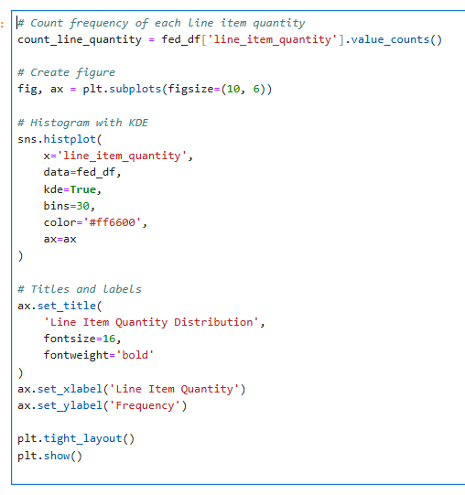
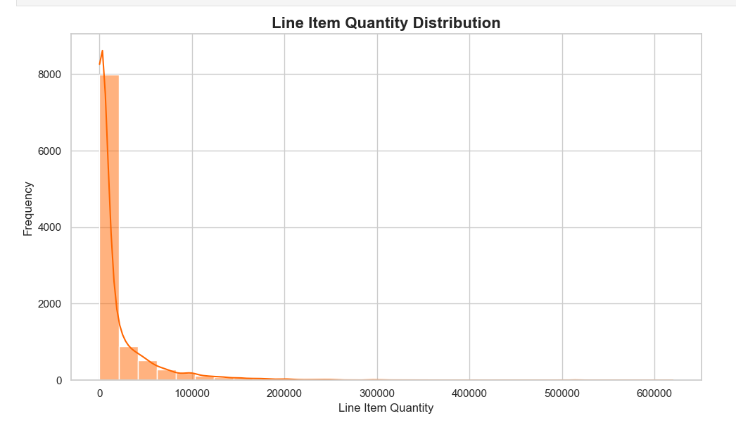
Univariate Analysis: Line Item Quantity Distribution

Slide 22
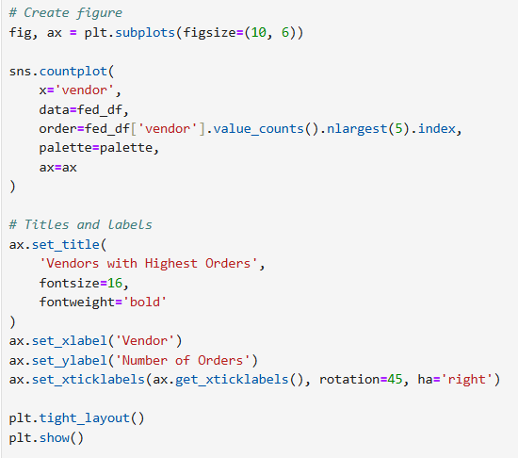
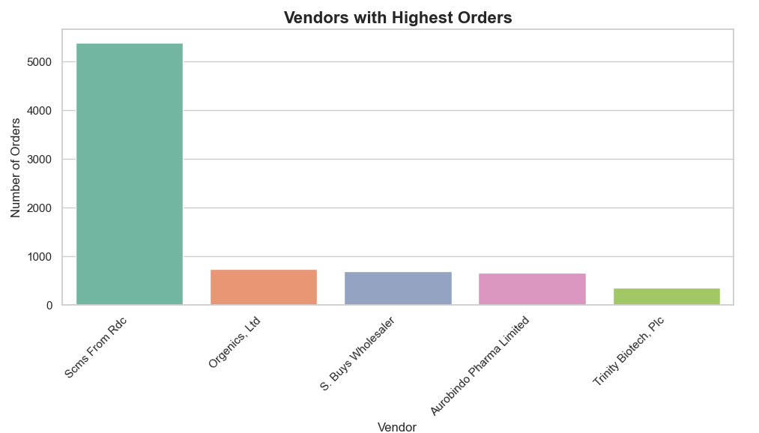
Univariate Analysis: Vendors With Highest Orders

Slide 23
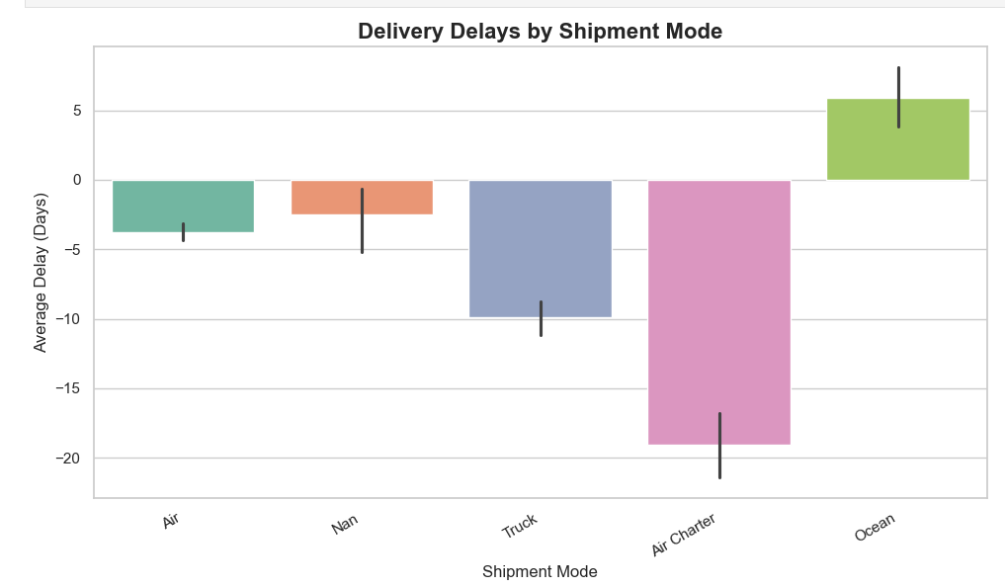
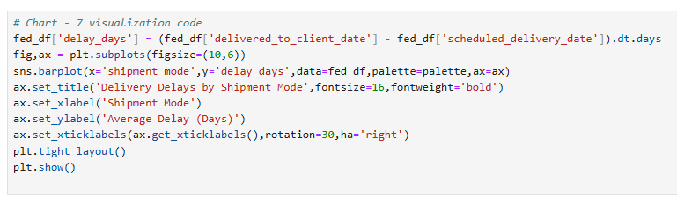
Bivariate Analysis: Delivery Delay By Shipment Mode

Slide 24
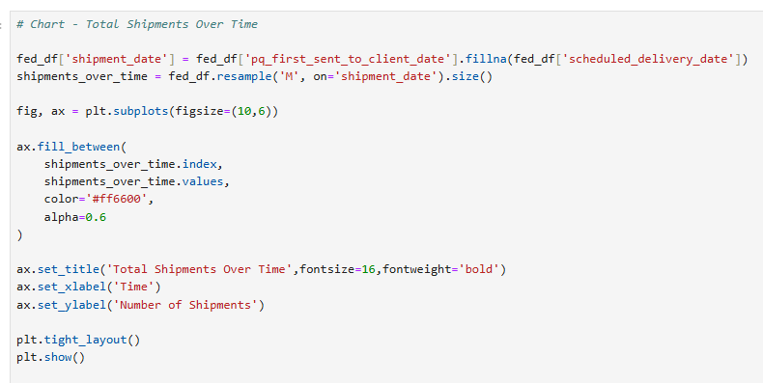
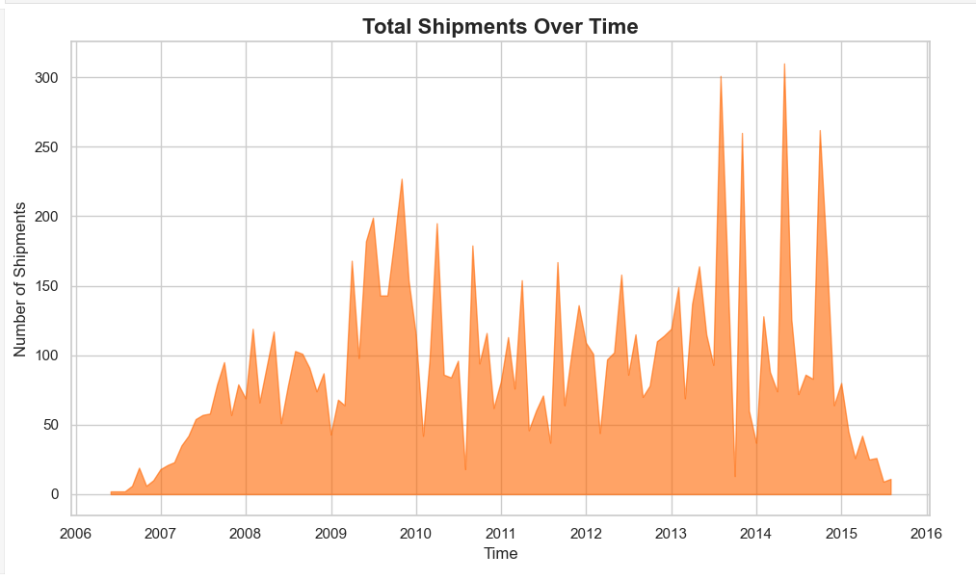
Bivariate Analysis: Total Shipments Over Time

Slide 25
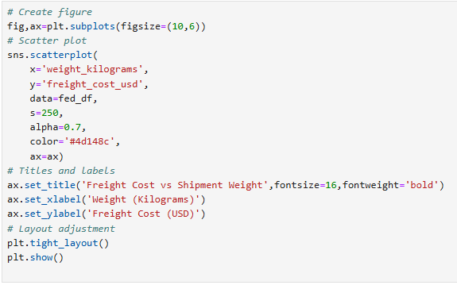
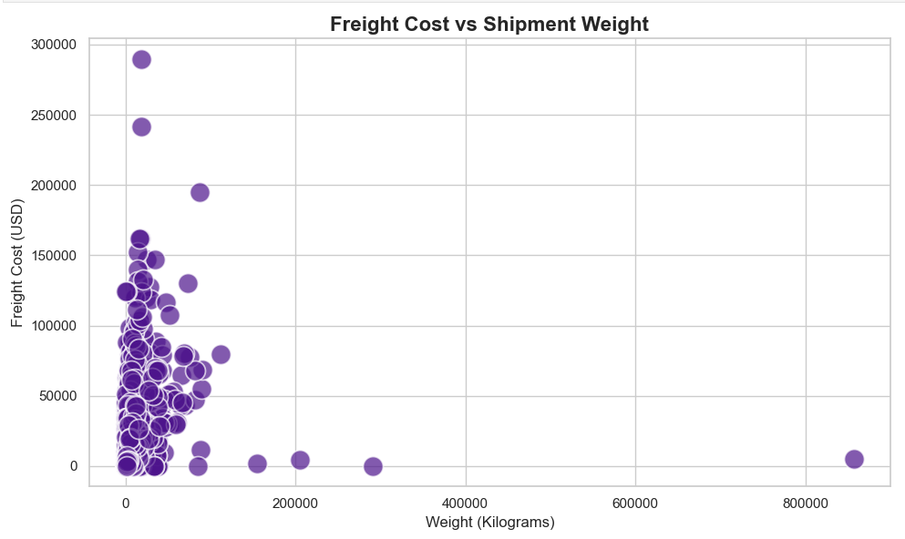
Bivariate Analysis: Freight Cost In Comparison To Weight

Slide 26
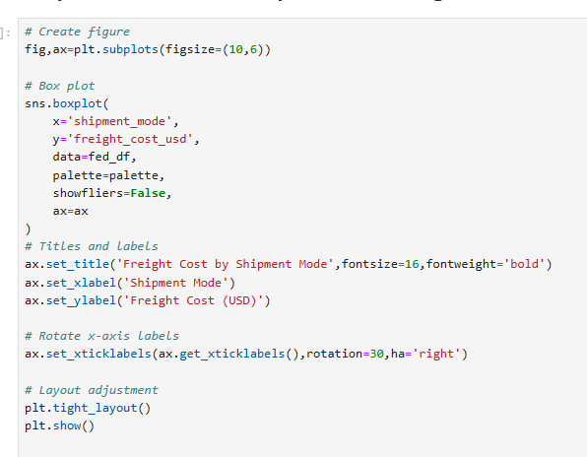
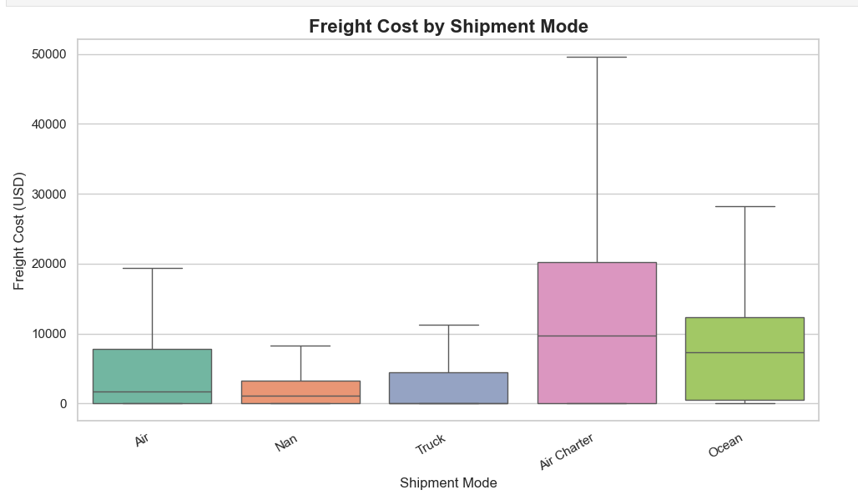
Bivariate Analysis: Shipment Mode In Comparison To Freight Cost

Slide 27
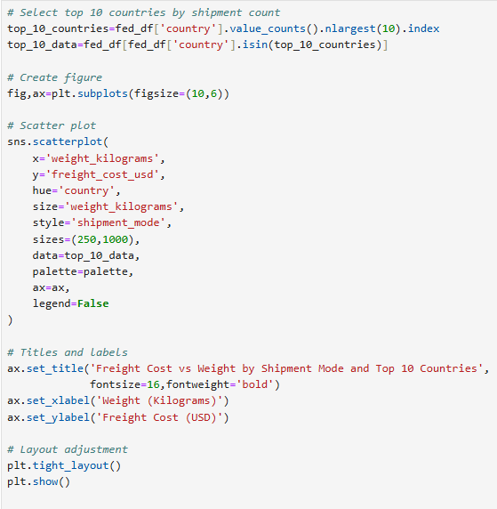
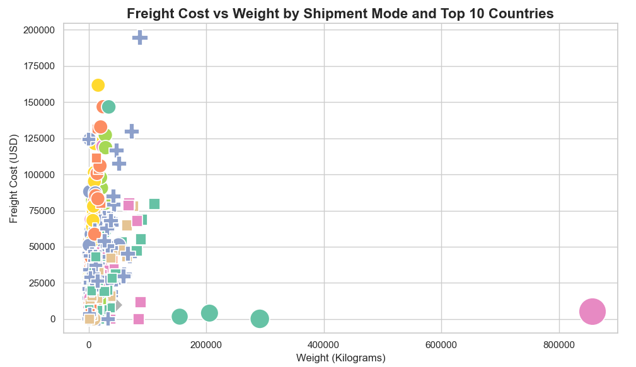
Multivariate Analysis: Freight Cost by Country, Mode & Vendor

Slide 28
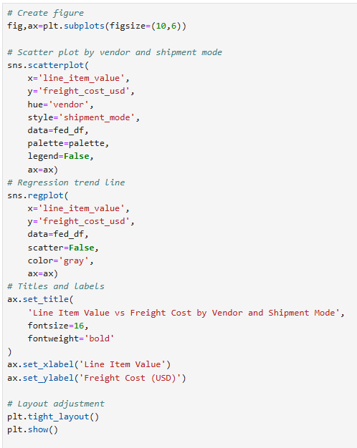
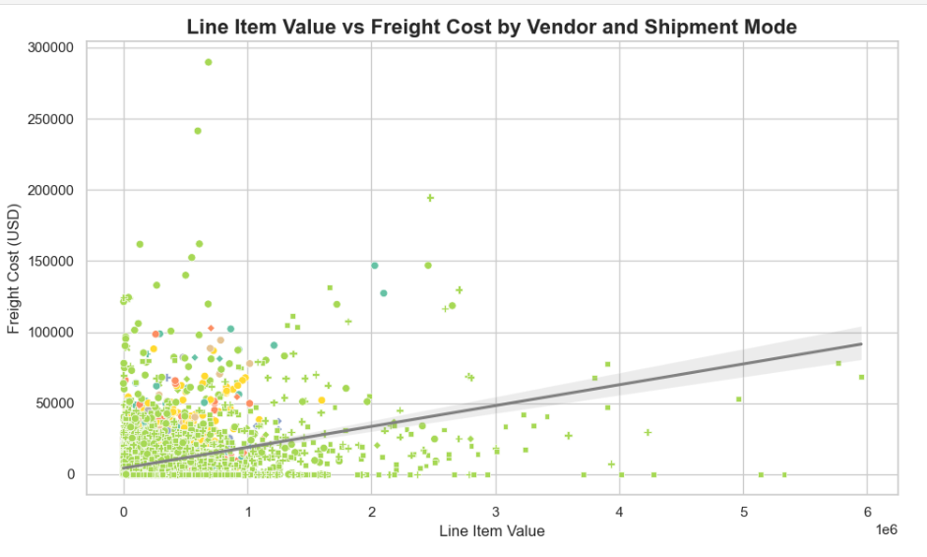
Multivariate Analysis: Line Item Value In Comparison With Freight Cost By Vendor And Shipment Mode

Slide 29

Business Objective
To leverage exploratory data analysis and insights from FedEx delivery history to:
• Identify patterns in shipment volumes and delivery performance
• Optimize freight costs across different transportation modes
• Enhance resource allocation based on geographic and operational factors
• Develop data-driven recommendations for improving logistics efficiency
• Enable strategic decision-making for vendor management and cost reduction

Slide 30

Conclusion
This comprehensive analysis provides FedEx Logistics with actionable insights into their operations. By identifying the key factors driving costs, delays, and vendor performance, the company can implement targeted improvements to optimize its global supply chain. The univariate, bivariate, and multivariate analyses collectively offer a holistic understanding of the logistics landscape, enabling FedEx to enhance efficiency, reduce costs, and improve customer satisfaction across its operations.

Slide 31


