Slide 1

Retail Data Analysis
PROJECT -1
Exploratory Data Analysis – Retail Dataset
S.Lohith
Batch 370

Slide 2
Problem Statement
The objective is to build a predictive model to forecast the sales of each product at a particular store. This model will assist BigMart in identifying key product and store characteristics that significantly impact sales, enabling strategies to enhance sales performance.
Libraries
NumPy
Pandas
Matplotlib
Seaborn

Slide 3
Key Insights from the Retail Dataset
1. Top-Selling Product Categories
We'll find the product categories with the highest total sales.
2. Top Countries by Transaction Volume
Determine which countries have the most transactions.
3. Preferred Payment Methods
Identifying which payment methods customers use most.
4. Most Common Shipping Methods
Highlighting the most selected shipping options.
5. Customer Ratings
Analyzing how customers rate their purchases overall.
6. Customer Feedback
Breakdown of feedback types (Excellent, Average, Bad, etc.)
7. Order Status Overview
See the distribution of orders (Shipped, Processing, etc.)

Slide 4
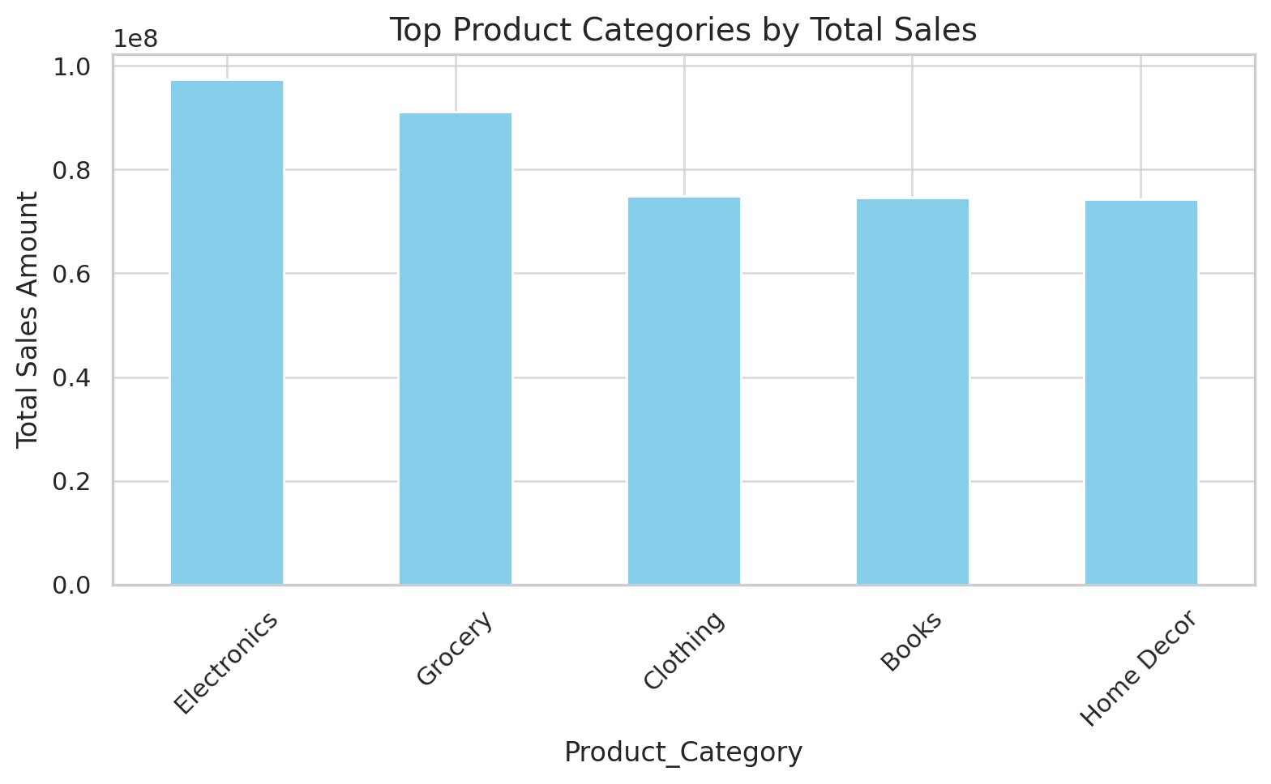
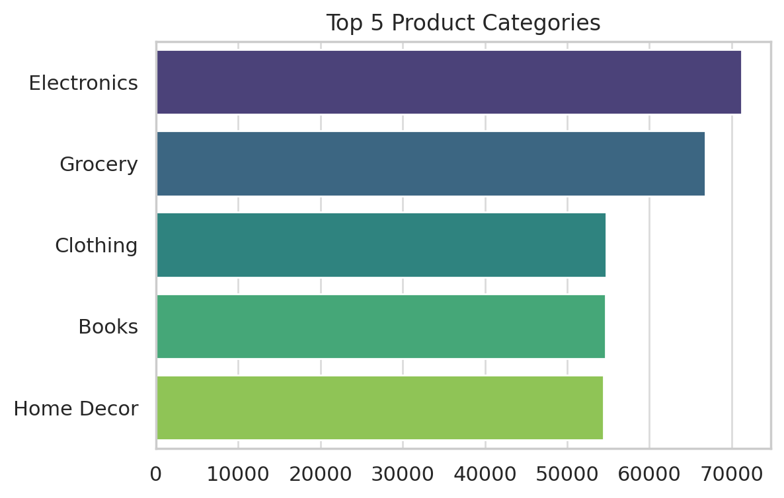
Top Product Categories by Total sales
Observation:
Electronics and Grocery are among the top-selling product categories.

Slide 5
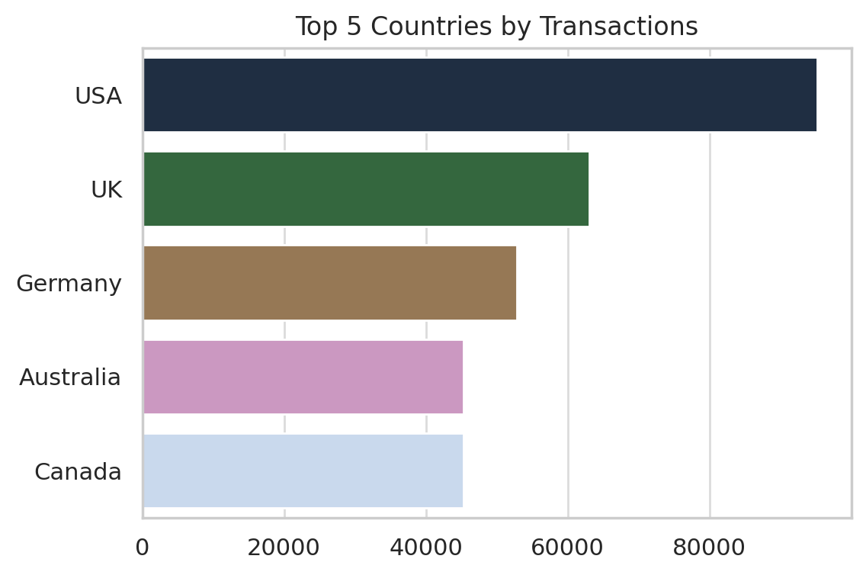
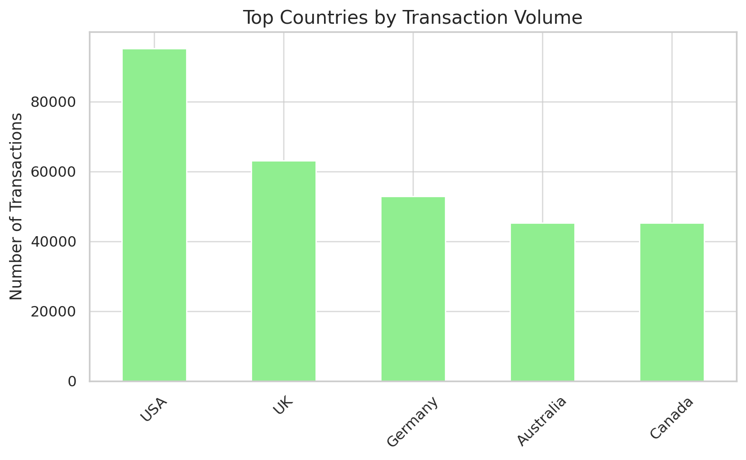
Top Countries by Transaction Volume
Observation:
USA, UK, and Germany lead in the number of transactions.

Slide 6
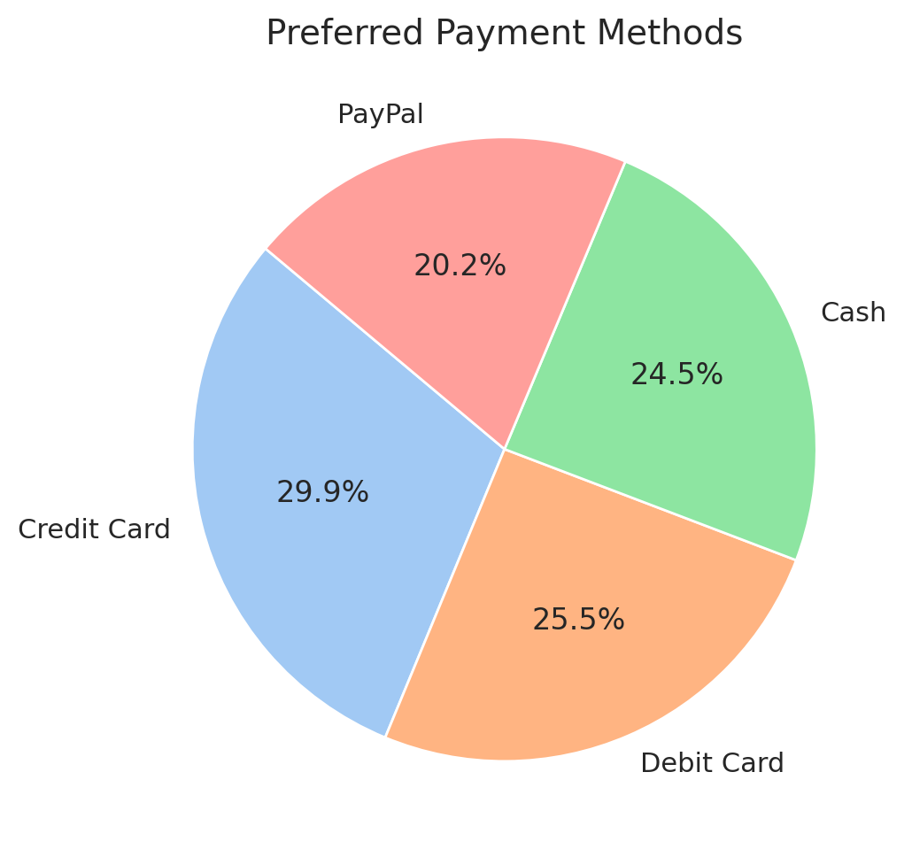
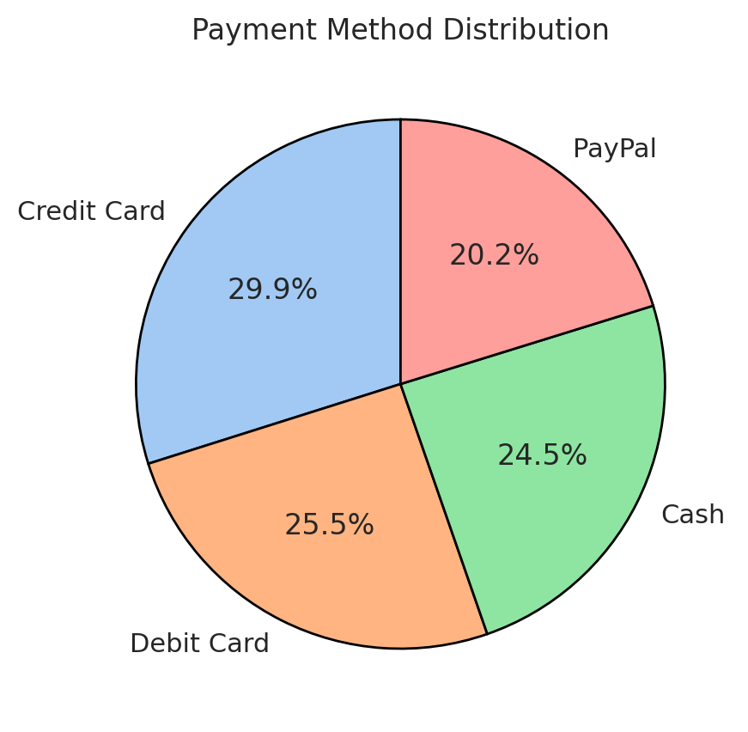
Preferred Payment Method
Observation:
Credit Card and Debit Card are the most preferred payment options.

Slide 7
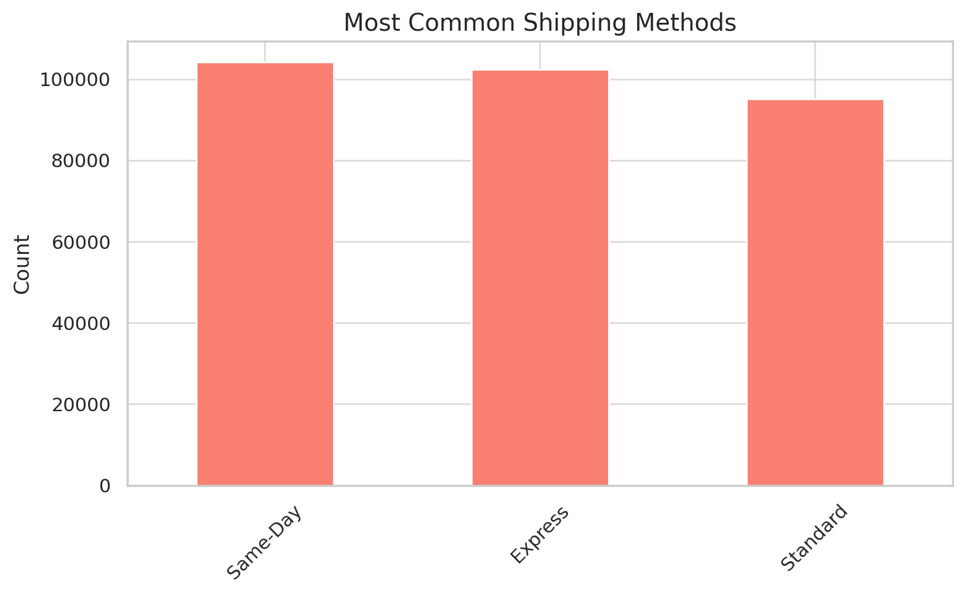
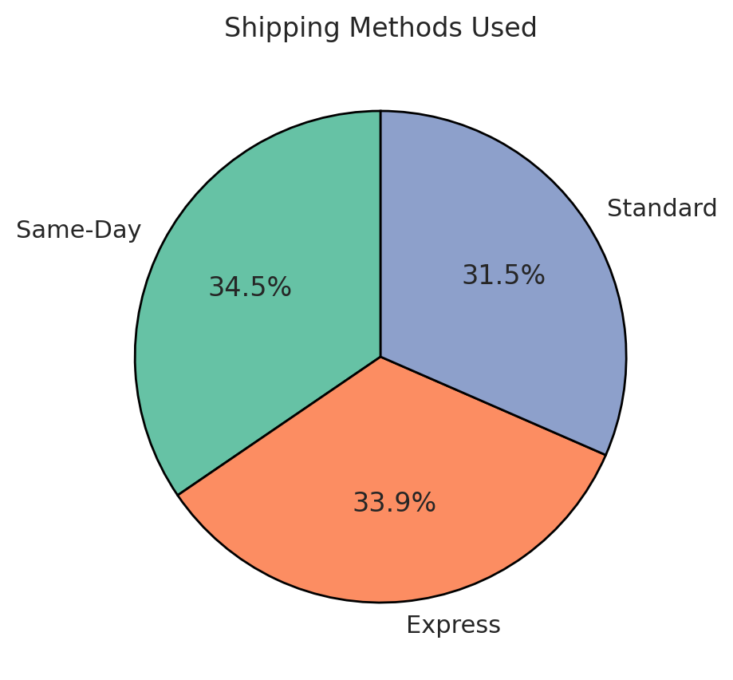
Most Common Shipping Methods
Observation:
Standard shipping is the most common method among customers.

Slide 8
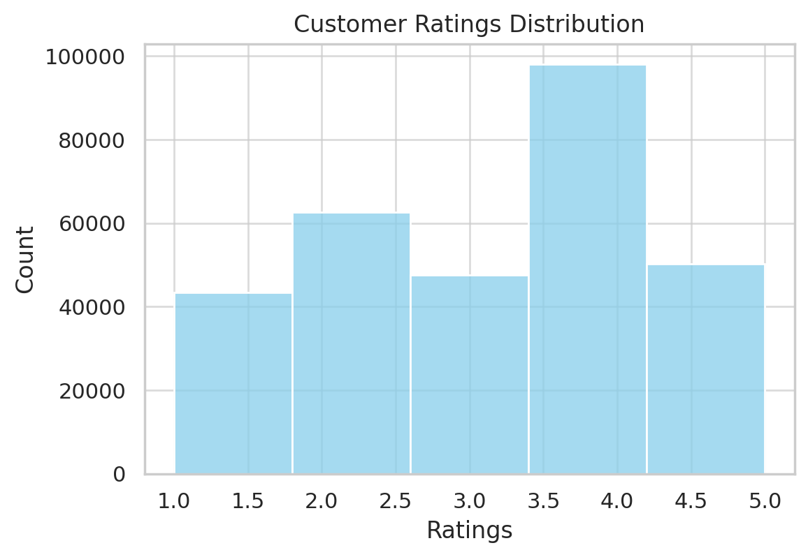
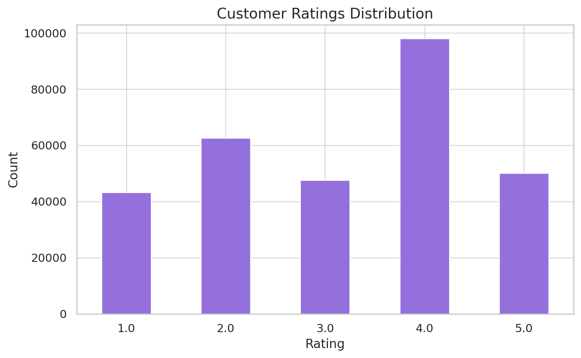
Customer Ratings Distribution
Observation:
Most customers rate products positively, with many giving 4 stars.

Slide 9
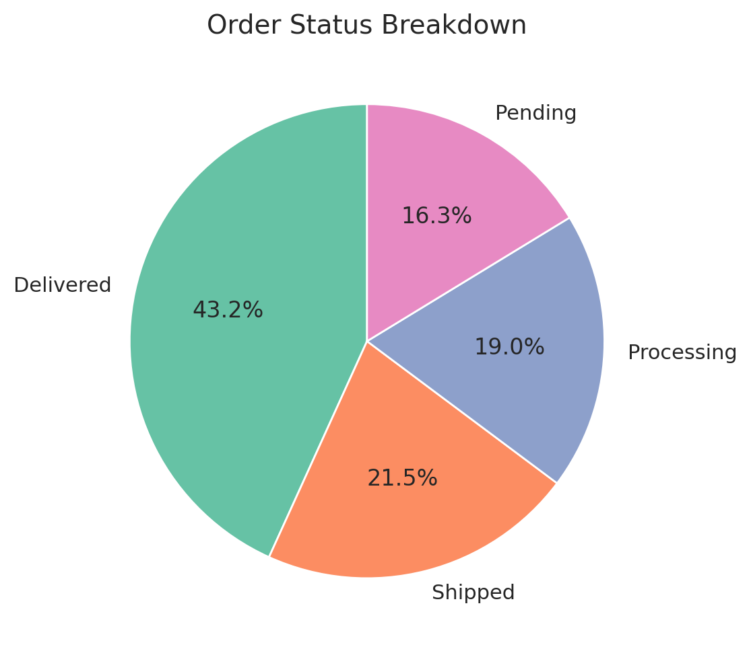
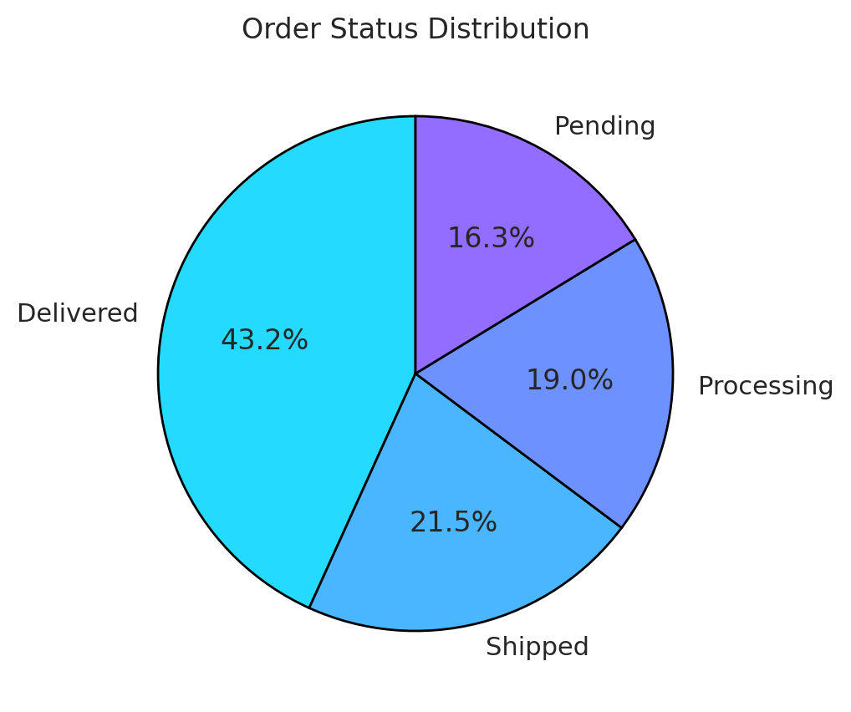
Order Status Breakdown
Observation:
Majority of the orders are either in 'Shipped' or 'Processing' status.

Slide 10
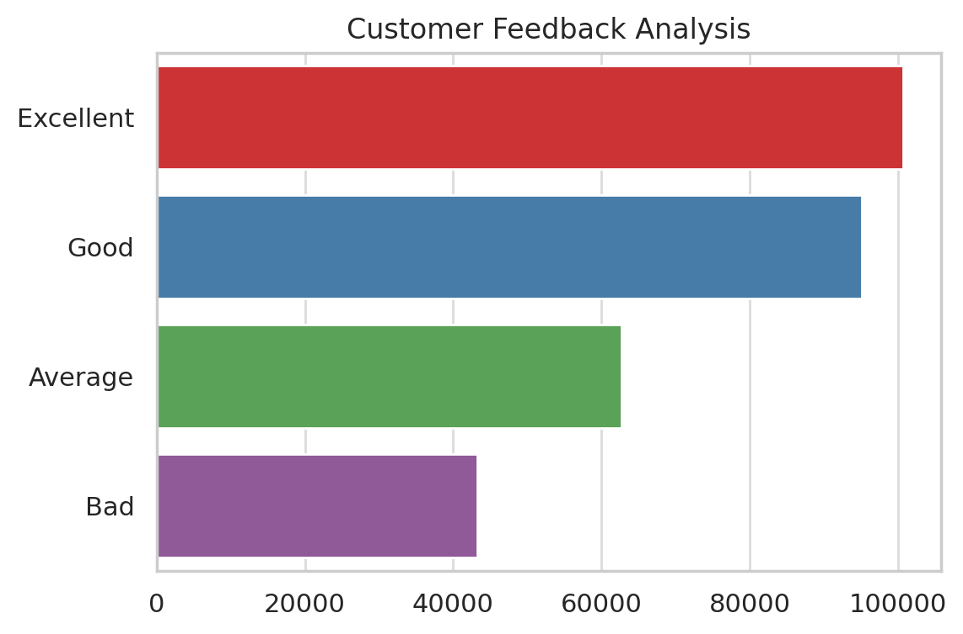
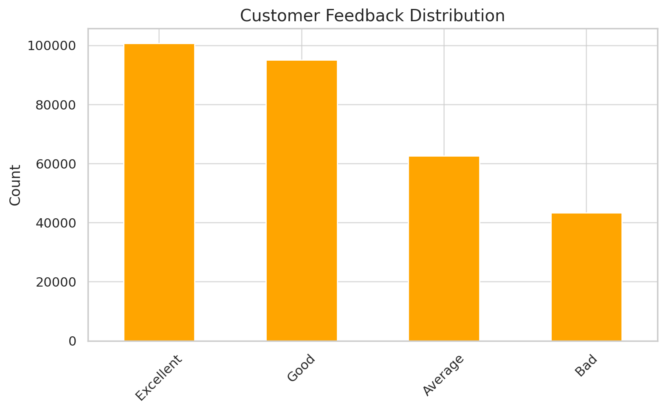
Customer Feedback Distribution
Observation:
Most feedbacks are 'Excellent', but there are notable instances of 'Bad' and 'Average'.

Slide 11
Conclusion & Recommendations
Focus marketing on top product categories like Clothing and Electronics.
Prioritize standard shipping logistics to handle volume.
Improve customer service where feedback is 'Bad' or 'Average'.
Encourage use of digital payment methods.
Target high-rating customers for loyalty programs.

Slide 12

THANK YOU

