Slide 1
DELIVERABLE 3
GROUP 10
Lohith Kumar Velkuri
Vynatheya Reddy Vuppunutula
Kiran Kumar Raju Ganga Raju
Srikanth Reddy Ettem

Slide 2
REQUIREMENTS
  Homepage with List of Events
  Selecting an Event
  Selecting Number of Tickets
  Booking Tickets
  Booking Page
  Confirmation Page

Slide 3
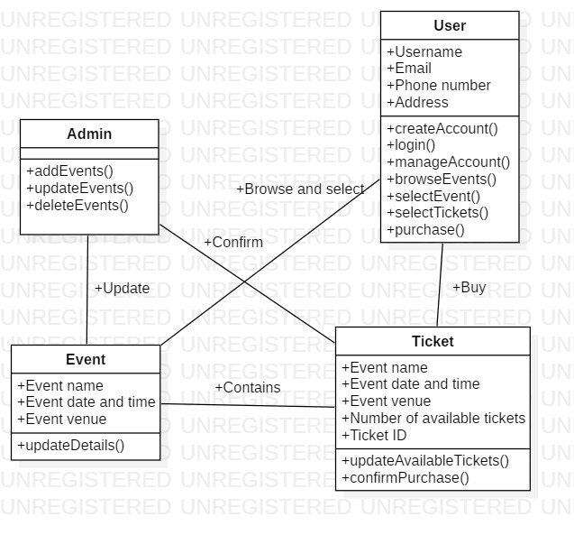
CLASS DIAGRAM

Slide 4
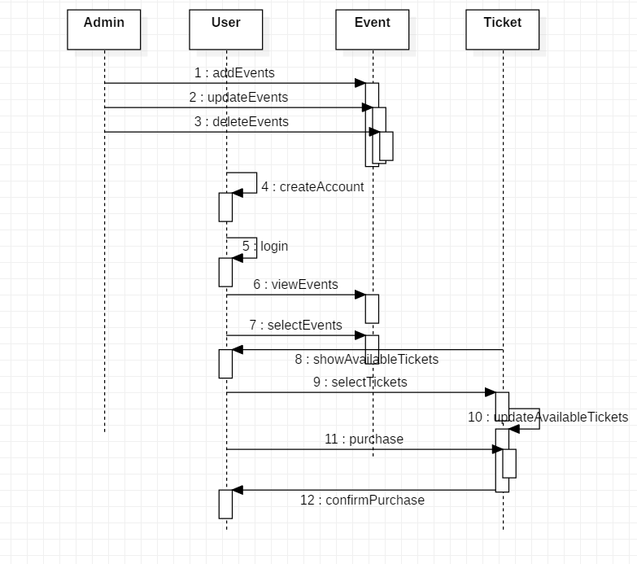
SEQUENCE DIAGRAM

Slide 5
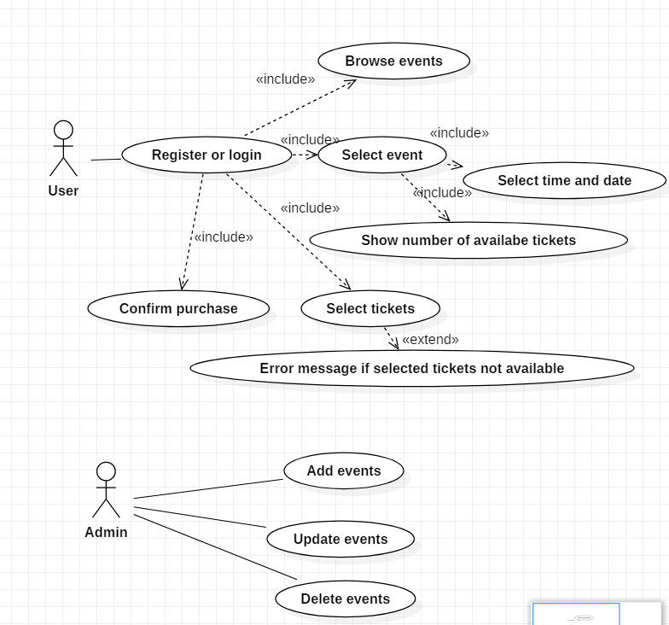
USE CASE DIAGRAM

Slide 6
DEMO

