Slide 1
Fast Image/Video Contrast Enhancement Based on Weighted Thresholded Histogram Equalization
EECS 740 Digital Image Processing Project
Lohith

Slide 2
Outline:
Introduction
1.A. Histogram
1.B. Histogram Equalization
1.C. Types of HE
Technical discussion
Results
Summary & Conclusions
References
Questions & Answers

Slide 3
1. Introduction.
1.A. Histogram:
A Histogram of an image gives information about the distribution of intensity levels.
A histogram doesn’t provide any information about the spatial distribution of pixels.
1.B. Histogram Equalization:
Histogram equalization is used to enhance contrast.
The level mapping equation is H_{k}=(K-1) x C(k) where H_{k} is output level, K is range of gray levels, C(k) is the cumulative distribution function.
The increment in the output level ΔH_{k} =H_{k} – H_{k-1} = (K-1).P(k)
1.C. Drawbacks:
It cannot be controlled.
Unpleasant visual effects such as, over enhancing and increase in noise.

Slide 4
1. Introduction
1.C. Types of HE:
1.C.1 Adaptive:
In AHE, equalization is based on the histogram and statistics obtained from the neighbourhood around each pixel.
Adaptive methods provide greater enhancement than global methods but are computationally intensive.
1.C.2 Improved Global methods:
In the improved global methods, various constraints are added to the global equalization or the modification procedures to achieve better performance.
Global methods are computationally feasible and provide images with acceptable quality.

Slide 5
Outline:
Introduction
1.A. Histogram
1.B. Histogram Equalization
1.C. Types of HE
Technical discussion
Results
Summary & Conclusions
References
Questions & Answers

Slide 6

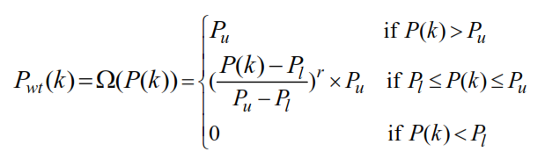
2. Technical discussion
The proposed weighted thresholded(WTHE) enhancement method performs histogram equalization based on a modified histogram.[1]
Each original probability density value P(k) is replaced by a weighted and thresholded PDF value P_{wt}(k)
P_{wt}(k) is obtained by applying a transformation function Ω(.) to P(k),
The original PDF is clamped at an upper threshold P_{u} and at a lower threshold P_{l} and all other values between upper and lower thresholds are transformed using a normalized power law function with index r>0.

Slide 7
2. Technical discussion
The increment for each intensity level can be controlled by adjusting the index r of the power law transformation function.
Ex: When r<1, higher weights are given to low probabilities than the high probabilities. i.e, the less-probable levels are protected and over-enhancement is less likely to occur.
Also, there is an upper limit P_{u} as a result, all levels whose PDF values are higher then P_{u} will have the increment clamped at a max. Δ_{max} =(K-1).P_{u}
The value of P_{u} is decided by P_{u}=v.P_{max} , 0≤v≤1. v is a real number which defines the upper threshold normalized to P_{max} .
The lower threshold P_{l} is only used to cut out the levels whose probabilities are too low( little visual importance).
We can also observe that when r=1, P_{u}=1 and P_{l}=0, the WTHE method reduces to traditional HE.

Slide 8

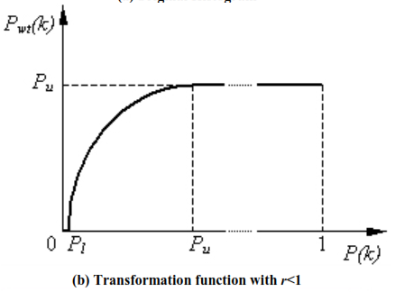
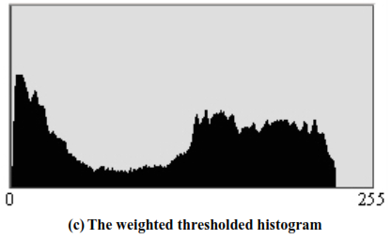
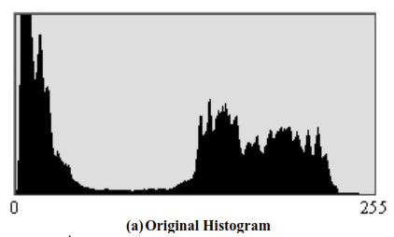
2. Technical discussion
After the weighted thresholded PDF is obtained the cumulative distribution function(CDF) is obtained by
The HE procedure is, F_{hat} (i,j) = W_{out} x C_{wt}(F(i,j))+M_{adj}
W_{out} is the dynamic range of output image, M_{adj} is the mean luminance level after enhancement.

Slide 9
2. Technical discussion
Video Enhancement:
The proposed WTHE enhancement method is applied to the luminance component of the video, leaving chrominance components unchanged.
The equation for WTHE introduces enhancement gain control that constraints the ratio between the output and input dynamic range.
W_{out} =min(255,G_{max} x W_{in} )
W_{in} is the dynamic range of the input image and G_{max} is a pre-set maximum gain of dynamic range. M_{adj} is the mean adjustment quantity that reduces the luminance changes after enhancement. For M_{adj}, we first calculate the mean of the enhanced image F_{hat}(i,j) assuming M_{adj} =0.
Then the difference between it and the mean of the original image is calculated. M_{adj} is set equal to the value closest to this mean difference such that it does not cause serious level saturation (clipping).

Slide 10
Outline:
Introduction
1.A. Histogram
1.B. Histogram Equalization
1.C. Types of HE
Technical discussion
Results
Summary & Conclusions
References
Questions & Answers

Slide 11

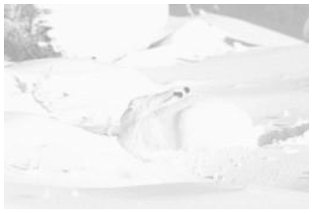
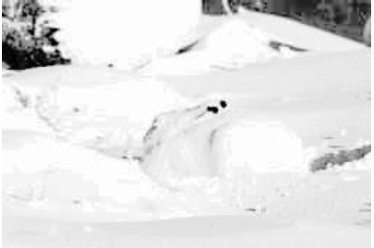
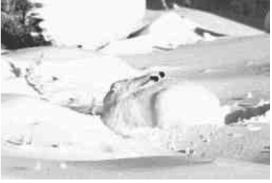
3. Results
a b
c d
Original Arctic hare
Gray scale image
Enhanced by
MMBEBHE[5]
WTHE with r=0.5
v=0.5

Slide 12
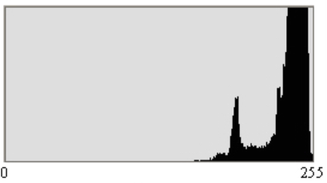
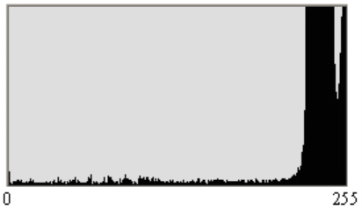
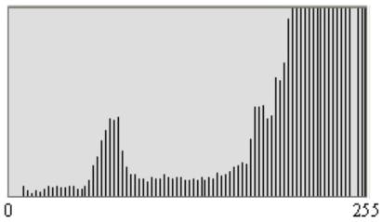
3. Results
a b
c
Original
MMBEBHE
WTHE

Slide 13
Outline:
Introduction
1.A. Histogram
1.B. Histogram Equalization
1.C. Types of HE
Technical discussion
Results
Summary & Conclusions
References
Questions & Answers

Slide 14
4. Summary & Conclusions
Histogram.
Histogram Equalization.
Adaptive Histogram Equalization.
Improvised Global Histogram Equalization.
Weighted Thresholded Histogram Equalization.
The proposed WTHE method is found to achieve visually pleasant enhancement effects.
The control mechanism in WTHE is convenient and smooth by mainly being able to adjust the power factor r. It is also computationally simple and suitable for processor based implementation.
For future work, I want to add the process of automatically adjusting the r,v values based on the dynamic range in the image.

Slide 15
Outline:
Introduction
1.A. Histogram
1.B. Histogram Equalization
1.C. Types of HE
Technical discussion
Results
Summary & Conclusions
References
Questions & Answers

Slide 16
5. References
Fast Image/Video Contrast Enhancement Based on Weighted Thresholded Histogram Equalization-Qing Wang, Rabab K. Ward.
Adaptive Image Contrast Enhancement Using Generalizations of Histogram Equalization- J.Alex Stark. IEEE trasactions on image processing-May 2000
Contrast enhancement using histogram equalization with bin underflow and bin overflow-Seungjoon Yang, Jae Hwan Oh and Yungjun Park, ICIP 2003.
Dynamic contrast enhancement based on Histogram Specification- Chi-Chia Sun, Shanq-Jang Ruan, Mon-Chau Shie, Tun-Wei Pai. IEEE transactions on Consumer electronics Nov 2005
Digital Image processing- R. Gonzalez, Richard Woods.

Slide 17

6. Questions & Answers

