Slide 1
Hessian based Mesh adaptivity
Lohith

Slide 2

What is HBA?
For normal adaptation we find the error between the exact value and the approximated value in some norm.
If this error involves the second order derivative of the exact solution then it is called Hessian Based Adaptivity.
E.g.
u-exact solution, Ω is domain, h-mesh size, u_{h} is the finite element approximation, C is a positive value independent of h and u but depends on the aspect ration of finite element.

Slide 3
Why Hessian based adaptivity?[1]
It is independent of the specific problem being solved.
It provides stretched meshes to capture boundary and internal layers
The idea of governing the mesh generation process by an auxiliary non Euclidean metric, which does not obtuse angles, results in that the meshes can indeed be built automatically.
The ability to adapt the size, shape, and orientation of mesh elements according to certain quantities of interest can signiﬁcantly improve the accuracy of the solution and enhance the computational eﬃciency.

Slide 4
How is it done?
Recovery methods:
QLS: Quadratic least squares fitting.
DLF: Double Linear least squares fitting.
LLS: Linear least squares fitting.
WF: variational method/ Weak Formulation.

Slide 5
Recovery Methods:
Quadratic Least Squares fitting:
Involves the ﬁtting of a quadratic polynomial to given function nodal values and the subsequent diﬀerentiation. First the input data is smoothed using quadratic regression, then the differentiation is applied.
The original purpose of QLS is the gradient recovery. However, the method is easily adopted for the needs of the Hessian recovery by simply diﬀerentiating the obtained ﬁtting polynomial twice.
For a given node, at least ﬁve nodes from its direct neighbourhood (patch) are selected. The original function is then approximated on the selected patch by ﬁtting a polynomial of degree two to the function values at the selected nodes in the least square sense.

Slide 6
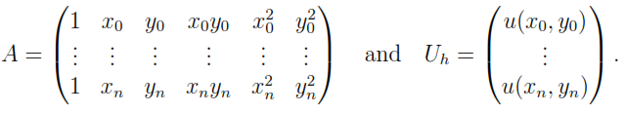

Recovery Methods:
Node N₀(x₀,y₀), patch is rep as N_{i}(x_{i},y_{i}) i=1,2,..n for n ≥ 5.
u_{h}-approximated function.
Polynomial p₂: p₂ (x,y;N₀)=a₁+a₂x+a₃y+a₄xy+a₅x²+a₆y²
Coeff. vector a=(a₁ a₂ a₃ a₄ a₅ a₆)^{T} is computed by solving system of equations A^{T}Aa=A^{T}U_{h}.
In order to have a unique solution the matrix A should have full rank, which is satisfied if mesh nodes are reasonably distributed.

Slide 7
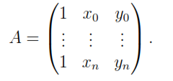
Recovery Methods:
Double Linear Least squares fitting:
Double linear least squares ﬁtting computes the derivatives by smoothing the linear approximation of a given function before computing derivatives.
The process is similar to the smoothing process described for the quadratic least squares ﬁtting except for the order of the ﬁtting polynomial. Here, a linear regression is applied to smooth the points.
Again for node N₀(x₀,y₀), let n be the number of direct mesh neighbours N_{i}(x_{i},y_{i}) i=1,2,..n for n>=5.
The local linear approximation p₁(x,y;N₀) over patch of N₀ is given by,
p₁(x,y;N₀)=a₁+a₂x+a₃y

Slide 8
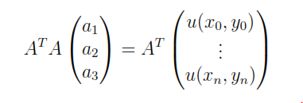

Recovery Methods:
Since every node has at least 2 non-collinear neighbours, the matrix A always has full rank and system is well defined.
The recovered gradient is given by,
Second-order derivatives are obtained by subsequent application of the described algorithm to the calculated ﬁrst order derivatives.

Slide 9
Recovery methods:
Linear Least Squares fitting:
Same as DLF except for the reverse order of the smoothing and derivation steps.
First-order derivatives of a given piecewise linear function are computed at the element centres and smoothed afterwards by means of linear least squares ﬁtting.
Second-order derivatives are computed in the same way from the nodal approximation of the ﬁrst-order derivatives.

Slide 10
Recovery Methods:
Variational Method using Weak Formulation:
This approach recovers the Hessian, which does not exists in the classical sense for piecewise linear functions, by means of a variational formulation.
The nodal approximation to the second-order derivative of u at N(x_{i},y_{i}) is defined as,
In the same way u_{xy}, u_{yy} are approximated.
⏀_{i} are piecewise linear basis functions.
This method is quite simple, fast and widely used in practice

Slide 11
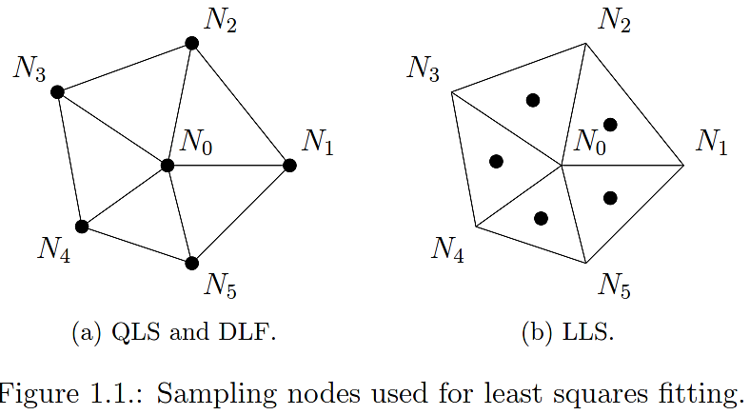

Slide 12
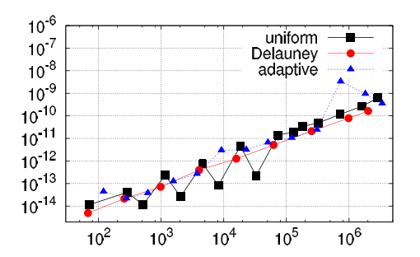
Numerical Comparison:
We will consider the lagrangian interpolation.
The Hessian is recovered from the exact nodal values of a given test function and compared with the exact analytical Hessian.
We will also compare the behaviour in relation to the mesh type.
QLS:
The QLS recovery is exact for quadratic functions independent of the mesh type.
QLS hessian recovery on diff. mesh types:
L² recovery error vs # of mesh elements.
u_{Q}(x,y)=x²+y²

Slide 13
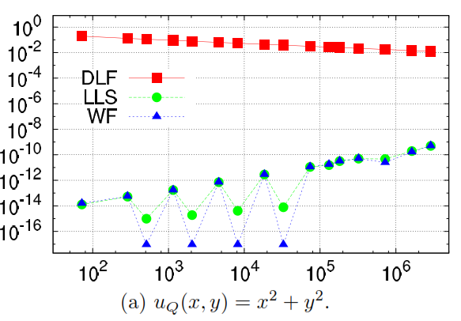
Numerical Comparison: Uniform Meshes:
L²-Norm of the relative recovery error vs the number of elements on uniform meshes is studied. Results obtained for different test functions can be summarised as shown.
Quadratic Function:
LLS and WF methods both provide exact hessian recovery with error smaller than 10⁻⁸.
DLF is inexact on uniform meshes for quadratic function. Fig: a.

Slide 14
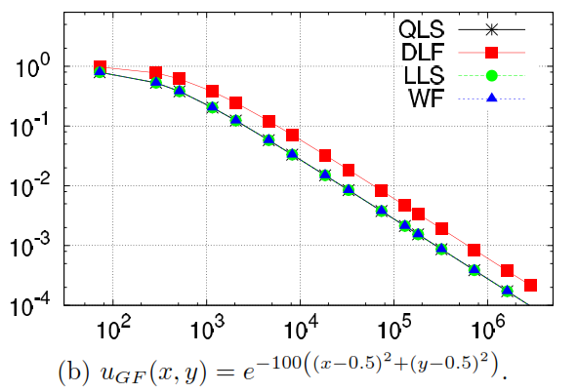
Numerical Comparison: Uniform Meshes:
Gaussian Function:
Plot b shows recovery of Gaussian function, which is dominated by error in domain interior, since the test function is zero on boundary.
All four methods show similar convergence results( n⁻¹≈h²), but DLF has a slightly larger error.

Slide 15
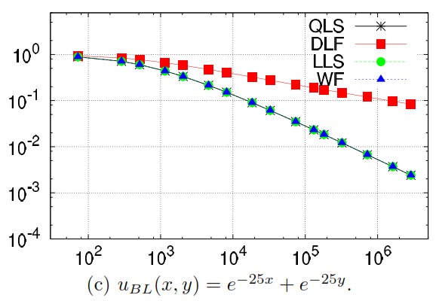
Numerical Comparison: Uniform Meshes:
Boundary Layer:
Figure below presents relative recovery errors of boundary layer functions.
The recovery error is dominated by the error near boundaries.
Again QLS, LLS, WF provide similar results, but experience accuracy losses.
DLF is less accurate with error O(n^{-1/4})≈O(h^{1/2}).

Slide 16
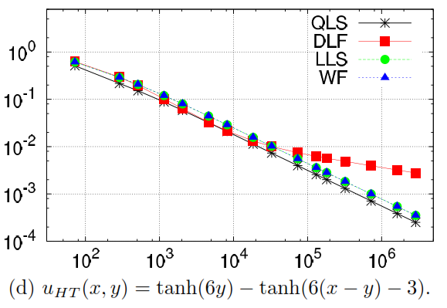
Numerical Comparison: Uniform Meshes:
Anisotropic Function:
Figure presents the results,
The convergence rates for QLS, LLS and WF are about n^{-3/4} ≈h^{3/2}
DLF once again is not as good as other methods, even less accurate on finer meshes.

Slide 17
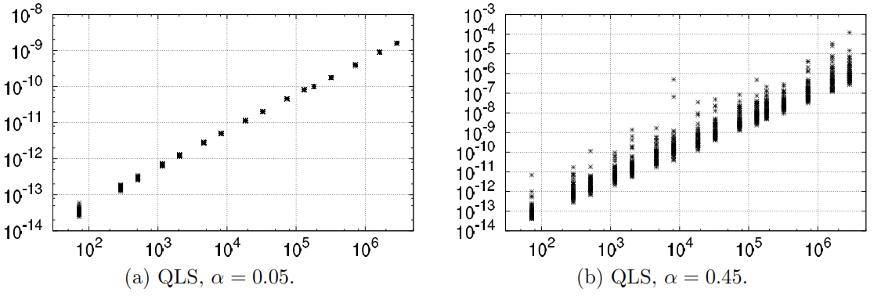
Numerical comparison; Randomly Perturbed Uniform Meshes:
QLS Hessian Recovery:
The QLS Hessian recovery is exact for the quadratic function despite the irregular mesh shape.
It performs very well for other functions also. The order of convergence is n⁻¹≈h² in the domain interior in mildly perturbed meshes.
A convergence rate of n^{-2/3}≈h^{4/3} can be achieved for boundary layer and anisotropic functions.
Notes:
Perturbed uniform meshes are generated by perturbing the coordinates of each point
of a given uniform mesh by a random number in the range [-a · h, a · h]. where h is the
step size of the underlying uniform mesh and 0 < ∝ < 0.5.

Slide 18
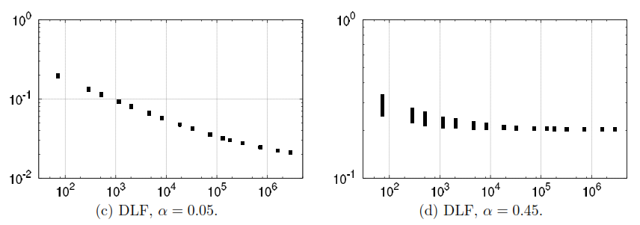
Numerical comparison; Randomly Perturbed Uniform Meshes:
DLF, LLS and WF methods:
While the QLS hessian recovery is decreasing with the increasing number of elements, no improvement is achieved by these methods after a few initial steps.
The difference becomes more clear on random meshes with larger co-ordinate perturbations.
For the function u_{Q}(x,y)=x²+y².

Slide 19
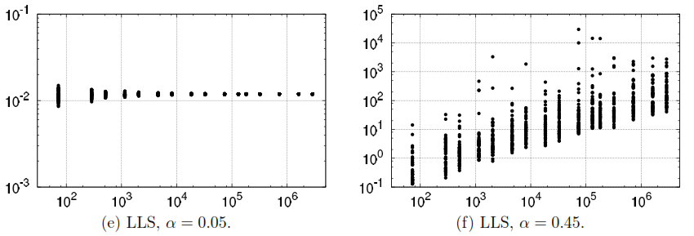
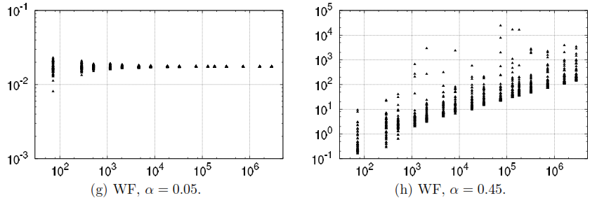
Numerical comparison; Randomly Perturbed Uniform Meshes:

Slide 20
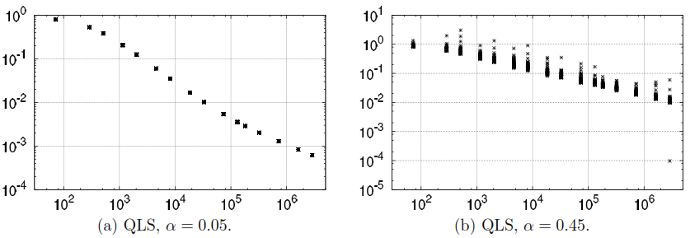
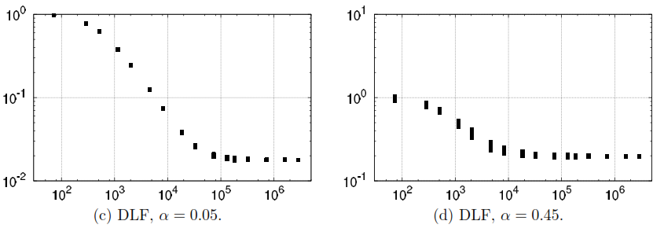
Numerical comparison; Randomly Perturbed Uniform Meshes:
For function u_{GF}(x,y)=e^{-100((x-0.5)^2+(y-0.5)^2)}.

Slide 21
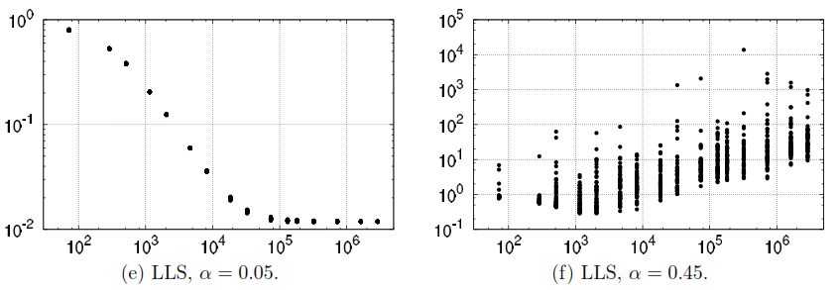
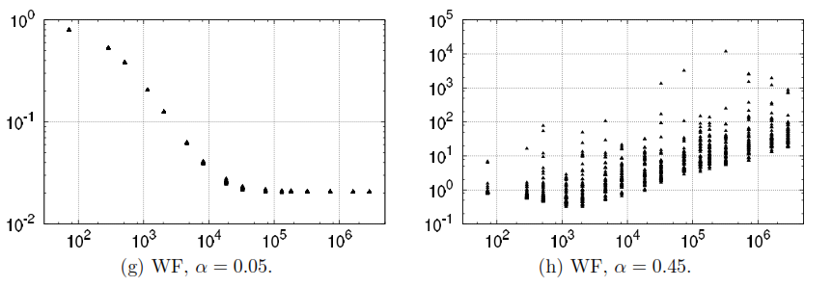
Numerical comparison; Randomly Perturbed Uniform Meshes:

Slide 22
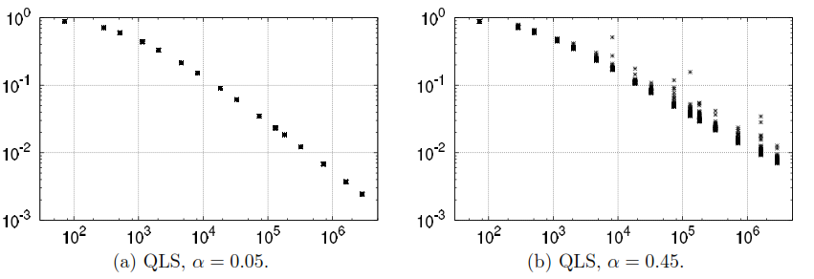
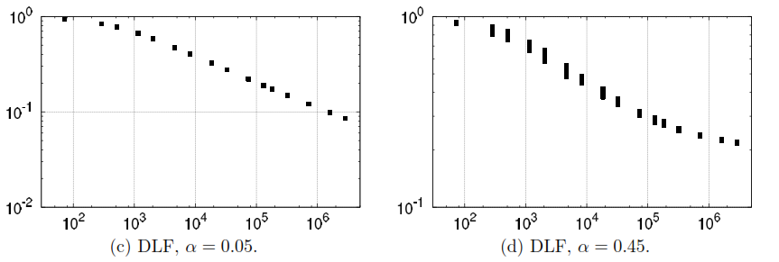
Numerical comparison; Randomly Perturbed Uniform Meshes:
For the test function: u_{BL}(x,y)=e^{-25x}+e^{-25y}.

Slide 23
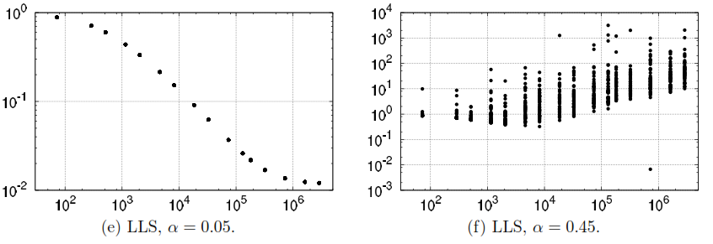
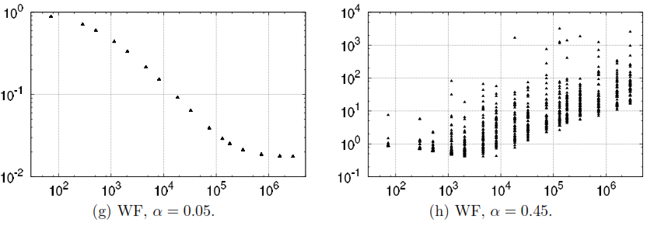
Numerical comparison; Randomly Perturbed Uniform Meshes:

Slide 24
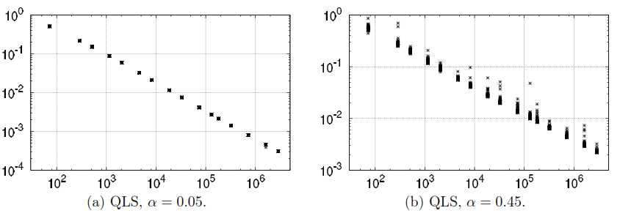
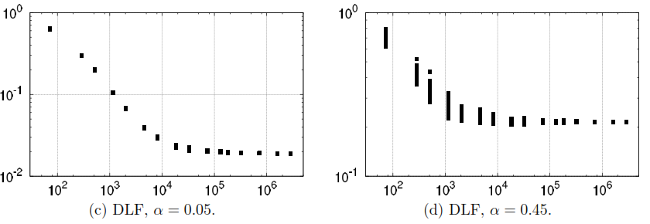
Numerical comparison; Randomly Perturbed Uniform Meshes:
For the test function: u_{HT}(x,y)=tanh(6y)-tanh(6(x-y)-3).

Slide 25
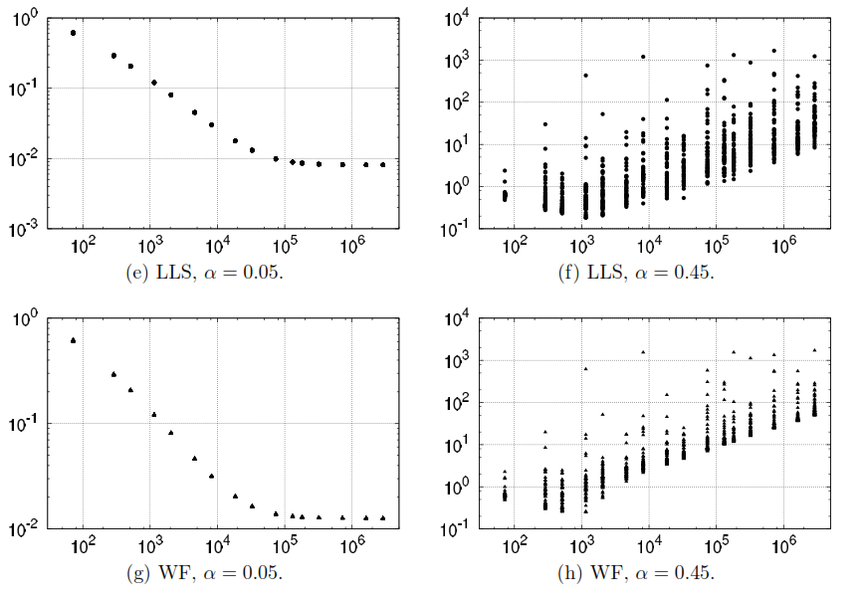
Numerical comparison; Randomly Perturbed Uniform Meshes:

Slide 26
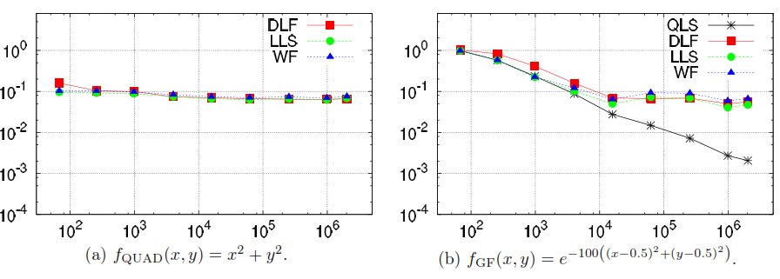
Numerical comparison; Delaunay Meshes:
It can be observed that Hessian recovery results for Delaunay meshes are identical to results obtained on mildly perturbed meshes. Delaunay meshes as well as 5% randomly perturbed meshes are both non-uniform but still well-shaped.
QLS is the only method to converge with an approximate convergence rate of O(n^{-2/3}) ≈ O(h^{4/3}).
For other methods no improvement is achieved after some initial steps.

Slide 27
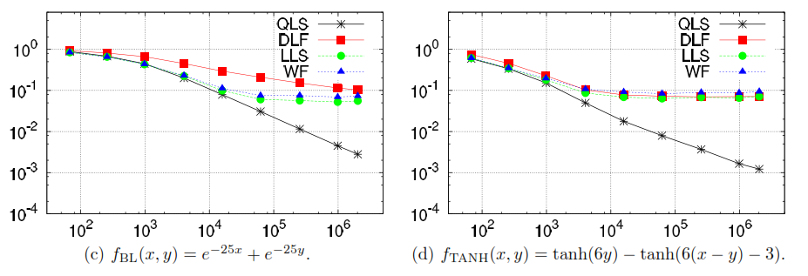
Numerical comparison; Delaunay Meshes:

Slide 28
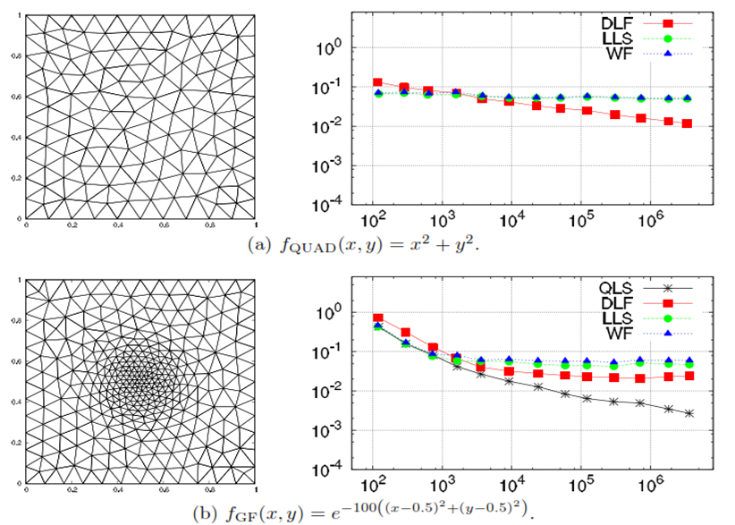
Numerical comparison; Adaptive Meshes:
QLS is exact for quadratic function. For other functions, QLS provides a convergent recovery and a smaller error than on Delaunay meshes(specially for boundary layer and anisotropic function).

Slide 29
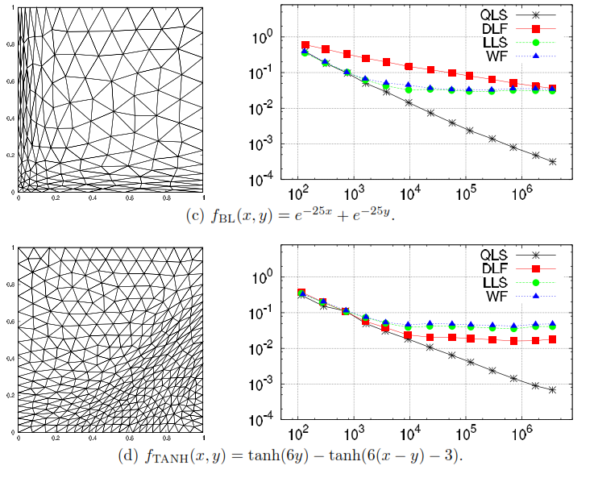
Numerical comparison; Adaptive Meshes:

Slide 30
Conclusions:
QLS method for Hessian recovery is very robust and performs best, it is exact for quadratic functions independent of mesh type.
It’s the only method to provide convergent Hessian recovery on arbitrary meshes with quadratic convergence in domain interior.
DLF, LLS and WF are only convergent only for uniform meshes. For non-uniform meshes they fail to provide convergent Hessian recovery.
However, the relative error of DLF, LLS and WF is quite low, which can be sufficient for mesh adaptation because if is often unnecessary to compute the mesh to a very high accuracy for the approximation of function or solution of DE.

Slide 31
References:
On Hessian Recovery and Anisotropic Adaptivity.
Anisotropic Mesh Adaptation Based on Hessian recovery and a posteriori error estimates.

