Slide 1
SMART CITY PROJECT
Smart City is a application based software developed in Java programming language to store the details of a city. The main purpose of this project to help the tourists and other visitors to the city by providing information about hotels, city attractions, etc.
Everyday a large number of people are coming to all the cities seeking job, higher studies, tourism, etc. Initially all the system of the city are unknown to the new comers of the city. They don’t know much about booking hotel, transportation, shopping, etc. But implementation of Smart City Java Project provides the complete solution package for new comers. One can see all the necessary information about city through this application.

Slide 2
OBJECTIVES
Using this project, the details of city can be accessed from anywhere at any time. With the help of this application software, students can look for the academic institutes located in the city.
To provide GUI interface for the above objectives.

Slide 3
LIST OF CLASSES
Admin:- It is class which deal with Function like update city, add city, remove city.
Login:- It has attributes userid and password of string datatypes. It has method of student login, Tourists login, change password.
Person:- It is base class of student and Tourists and having attributes first name, last name, address, and mobile number and method get data and set data.
Student:- It is a class which will use login class and have method of view college and view library
Tourist:- It is a class which will use login class and have method of view hotels and view city guide.
Registration:- It is class where user needs to provide registration details to sign up and has a relationship with person.

Slide 4
LIST OF CLASSES
Hotel:- It is class which has attributes name, description, and method display data and update data.
College:- It is class which has attributes name, description, and method display data and update data
Tourist attractions:- It is class which has attributes name, description, and method display data and update data
Library:- It is class which has attributes name, description, and method display data and update data.

Slide 5
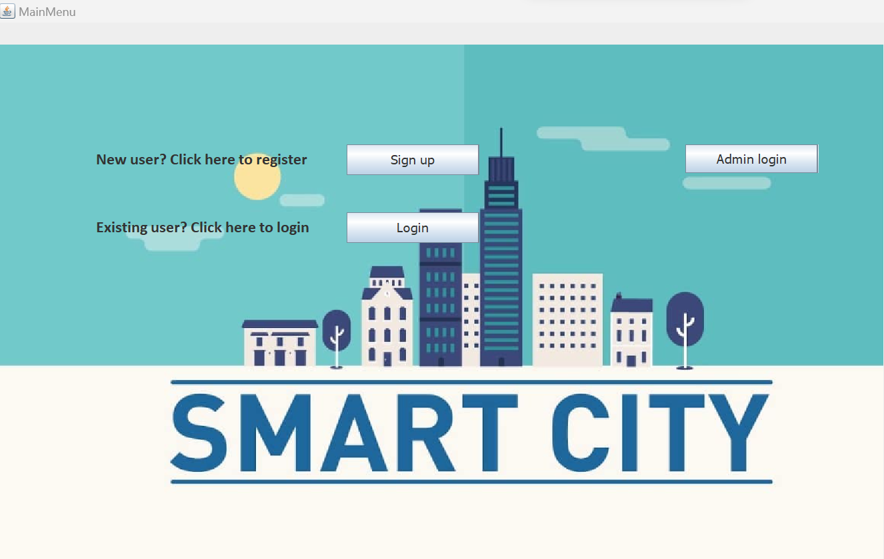
GUI INTERFACE

Slide 6
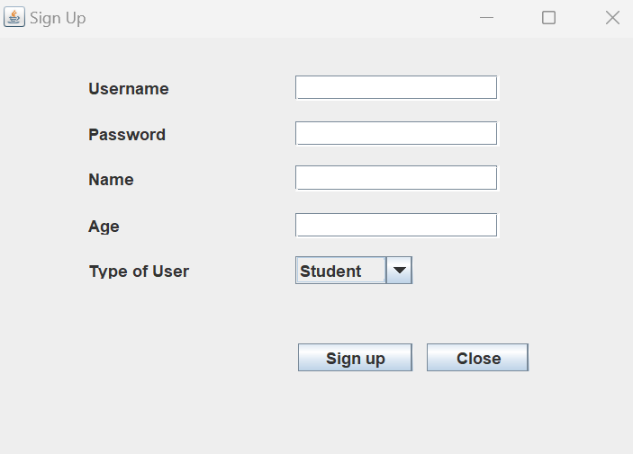
SIGN UP:

Slide 7
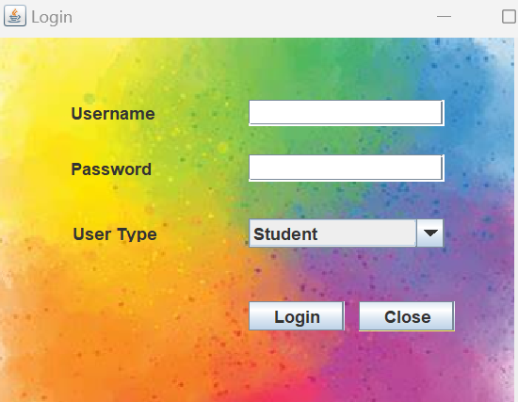
LOGIN :

Slide 8
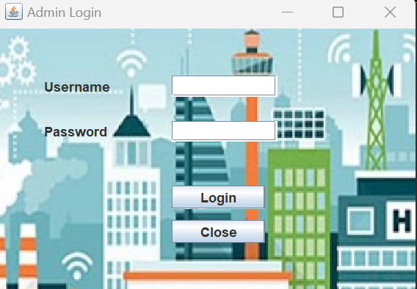
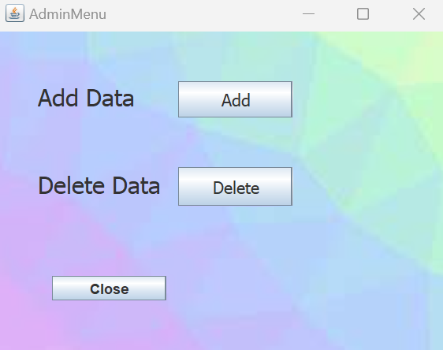
ADMIN:

Slide 9
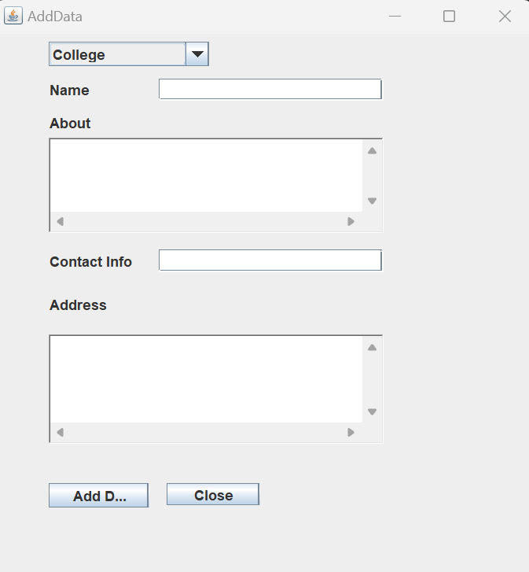
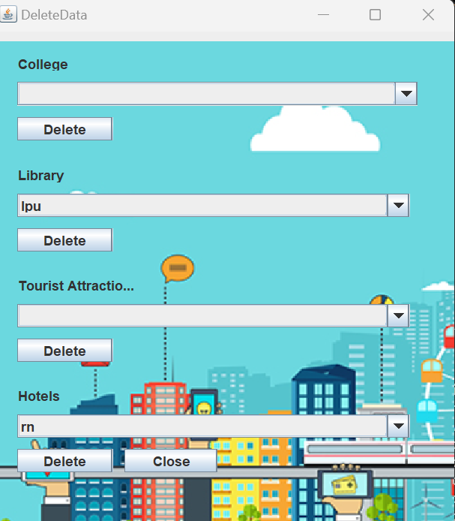
ADD,DELETE DATA:

Slide 10
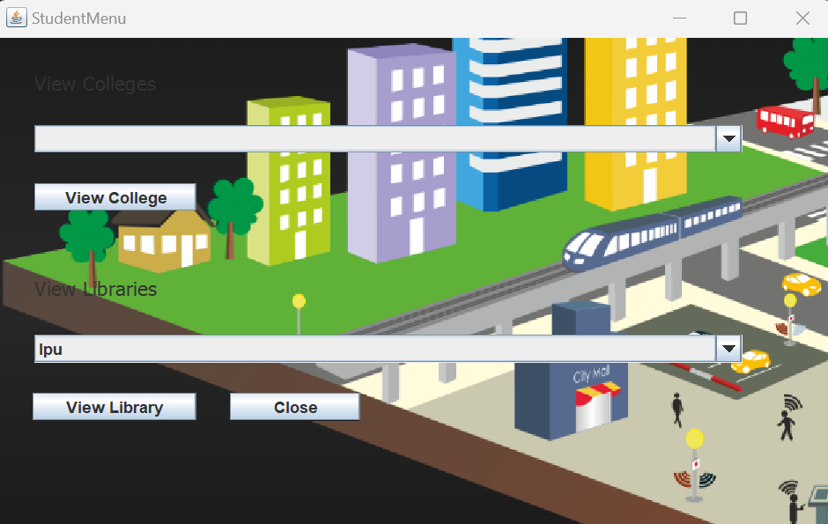
STUDENT MENU:

Slide 11
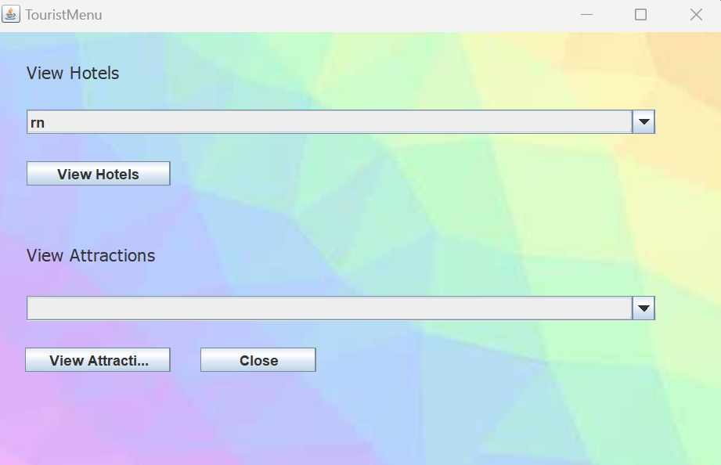
TOURIST MENU:

Slide 12
GITHUB LINK:
https://github.com/lohitha6/Smart-city-project-

