Slide 1
Apache Hue

Slide 2




Team Members
Poojitha Singam
Lohitha
Gangadhar Adusumalli
Divya Harshini

Slide 3
Contents
Introduction
How Hue works
Why UI for Hadoop
Infrastructure
Basic components
Demo

Slide 4

Introduction
Hue = Hadoop User Experience
An open source Hadoop GUI
Developed by Cloudera
Interacts with both HDFS and MapReduce applications
Poojitha Singam
Notes:
Users do not have to use command line interface to use Hadoop ecosystem if he will use Hue.

Slide 5
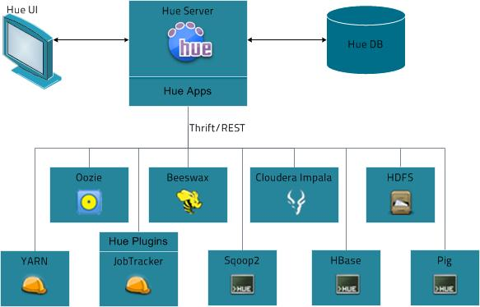
Notes:
Hue is a suite of applications that provide web-based access to CDH components and a platform for building custom applications.The following figure illustrates how Hue works. Hue Server is a "container" web application that sits in between your CDH installation and the browser. It hosts the Hue applications and communicates with various servers that interface with CDH components.

Slide 6
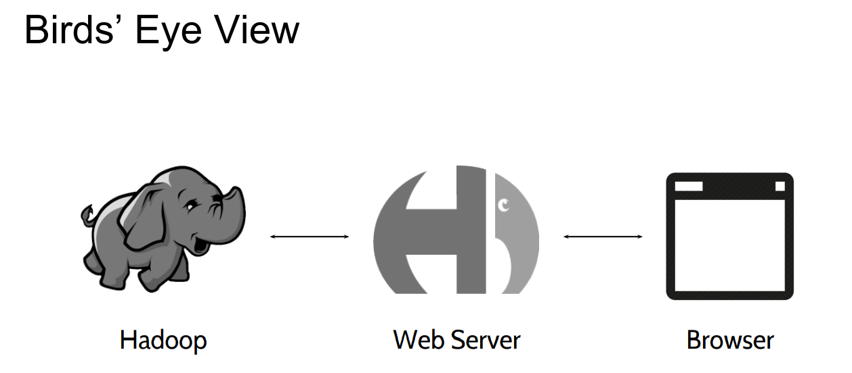
Poojitha Singam

Slide 7
Why UI for Hadoop??
User who are not engineers.
Makes Hadoop easier to use
Presents the power of big data to basic users
User who use or know Command Line Interface
Poojitha Singam
Notes:
If we have large amount of datasets hue has many applications which helps us as they are interconnected
It makes us use many of the components in hadoop ecosystem

Slide 8
Features
Wizards to import data into Hadoop
Hadoop API Access
Sqoop2, Oozie workflows Editors
HDFS File Browser
Editor for Pig/Hive
Poojitha Singam

Slide 9
Infrastructure
Front End
Mako Templates
JQuery
KnockoutJS
Back End
Python + Django driven
Thrift + Web Clients for Hadoop Components
Spawning/CherryPy
SDK
Make your own App!
“build/env/bin/hue Create_desktop_app <name>”
Divyaharshini Bheemireddy

Slide 10
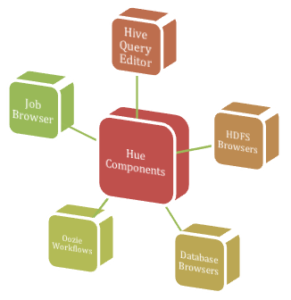
Hue Components
Divyaharshini Bheemireddy

Slide 11
Hue Components
HDFS Browser
Job Browser
HIVE Query Editor
Database Browsers
Oozie Workflows
Divyaharshini Bheemireddy

Slide 12
Hue: The UI for Hadoop
2000+ commits
Open source : http://cloudera.github.io/hue/
Website : gethue.com
Divyaharshini Bheemireddy

Slide 13
DEMO

Slide 14


