Slide 1
Feature extraction for classifying students based on their academic performance

Slide 2
Bhoj Reddy Engineering College for Women: Hyderabad Department of Information Technology IV B. Tech. II Sem. A Sec. Project Seminar Presentation Academic year 2019-20 Date:18/05/2020
FEATURE EXTRACTION FOR CLASSIFYING STUDENTS BASED ON THEIR ACADEMIC PERFORMANCE
Internal guide : Mrs E Nitya
Co-ordinator : Mrs Sandhya Rani
HOD : Mr Murugamani
By:
J Kavya(16321A1226)
T Manisha(16321A1245)
P N K Lohitha(16321A1248)

Slide 3
CONTENTS
Objective
Existing system
Proposed system
Functional Requirements
System Architecture
Technical Architecture
Design
Module implementation
Input and Output Screen Shots
Pseudo code
Testcases
Conclusion
Future scope

Slide 4
OBJECTIVE
The objective is to predict or classify student performance based on their previous academic performance. Using this we will concentrate more on poor performance students by extracting grade features from their past performance records.

Slide 5
EXISTING SYSTEM
We investigate the problem of predicting the performance of a student in the end of the semester before he/she actually takes the course.
The prediction problem is formulated as a classification task.
We essentially identify two complementary groups(Pass and Fail) of students
The binary classification has been used to classify the data of students.

Slide 6
DISADVANTAGES:
Usually, these models tend to be over-optimistic for the performance of students, as the majority of the students do well, or have satisfactory enough performance.
These studies are applied only to a limited number of students and courses.

Slide 7
PROPOSED SYSTEM
Here the user can give a test on specific educational or subject categories. The system will suggest to the teacher that on which topics the user is weak or need to study again.
This record is also seen by teacher for analyzing the performance of student and they can take a suitable action to improve the student performance before the student in the critical area.
This technique will monitor and evaluate the student academic performance at different year levels.

Slide 8
Teacher can play the role of admin who have authority to adding subjects, topics and questions for test purpose.
We propose an application that will provide a working environment that will be flexible and will provide ease of work and will reduce the time for report generation and other paper works.

Slide 9
ADVANTAGES:
It focuses on analysis student academic performance by using advantage of data mining techniques model.
The main advantage is that it can be evaluation of answers can be fully automated for all questions and other essay type questions can be evaluated manually or through automated system.

Slide 10
FUNCTIONAL REQUIREMENTS
UPLOAD DATA SET:
Here we upload data of any university or the college.
An instance refers to the performance of a student, s, in a course, c, at the end of the semester.
If a student withdraws from a course it is denoted by the letter ‘W’.
We remove any instances with a letter grade not in the A-F grading scale(A, A-, B+, B, -􀀀, C+, C, C-, D+, D, F).

Slide 11
FEATURE EXTRACTION
The features can be separated into three distinct categories:
Student-specific (independent from course c)
Course-specific features (independent from students)
Student- and course-specific features (they are a function of both s and c).
Features are grouped together into eight different subcategories (grades, status, load, course difficulty, course familiarity, prerequisites, course specific, course performance).
Every set of features {s, t, c} where student s took course c in semester t, we generate a different set of features.
These features are either numerical, categorical or indicator variables. For indicator features, we use the values of 0 or 1.

Slide 12
CLASSIFICATION PROBLEMS
We considered the following four ways for labelling, resulting to these absolute and relative classification tasks:
Failing student performance(grades D and F).
The letter grade W(Drop out).
Student performance that is worse than expected.
Student performance that is worse than expected while taking into consideration the difficulty of the course

Slide 13
SYSTEM ARCHITECTURE
A System Architecture is a conceptual model that defines the structure, behavior and other aspects of a system.
An architecture description is a formal description and representation of a system, organized in a way that supports reasoning about the structures and behaviors of the system.

Slide 14
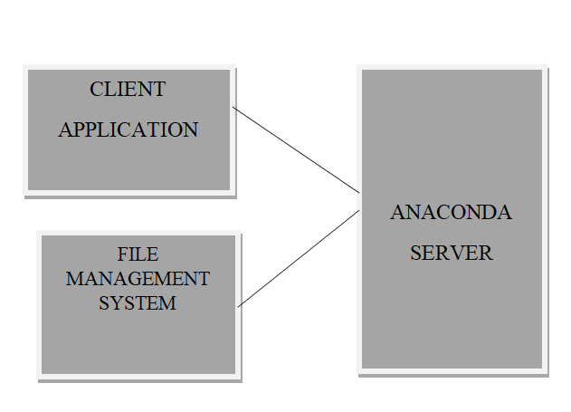
System Architecture

Slide 15
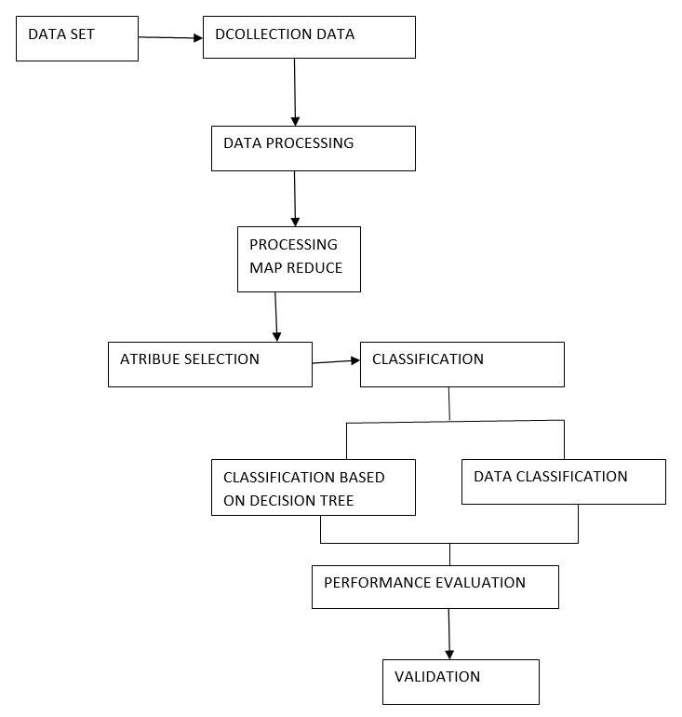
TECHNICAL ARCHITECTURE

Slide 16
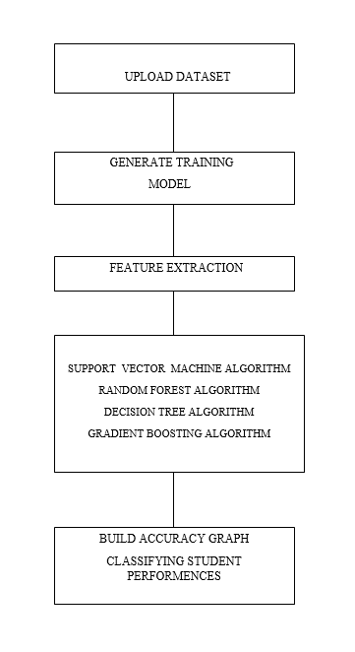
DESIGN

Slide 17
MODULES
UPLOAD DATASET
Here we upload data of any university or the college.
An instance refers to the performance of a student, s, in a course, c, at the end of the semester.
If a student withdraws from a course it is denoted by the letter ‘W’.
We remove any instances with a letter grade not in the A-F grading scale(A, A-, B+, B, -􀀀, C+, C, C-, D+, D, F).
GENERATE TRAINING MODEL
On ‘Generate Training Model’ button to read dataset and build array for training purpose

Slide 18
FEATURE EXTRACTION
The features can be separated into three distinct categories:
Student-specific (independent from course c)
Course-specific features (independent from students)
Student- and course-specific features (they are a function of both s and c).
Features are grouped together into eight different subcategories (grades, status, load, course difficulty, course familiarity, prerequisites, course specific, course performance).
Every set of features {s, t, c} where student s took course c in semester t, we generate a different set of features.
These features are either numerical, categorical or indicator variables. For indicator features, we use the values of 0 or 1.

Slide 19
CLASSIFY STUDENT PERFOMANCE REASON
We considered the following four ways for labelling, resulting to these absolute and relative classification tasks:
Failing student performance(grades D and F).
The letter grade W(Drop out).
Student performance that is worse than expected.
Student performance that is worse than expected while taking into consideration the difficulty of the course

Slide 20
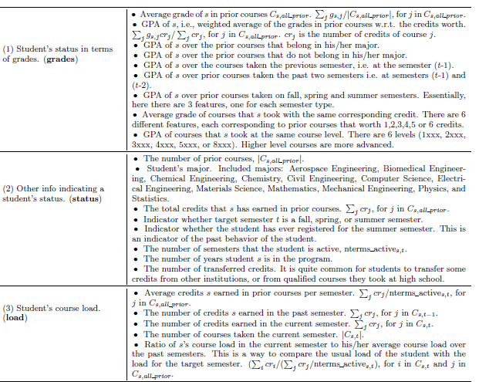

Slide 21
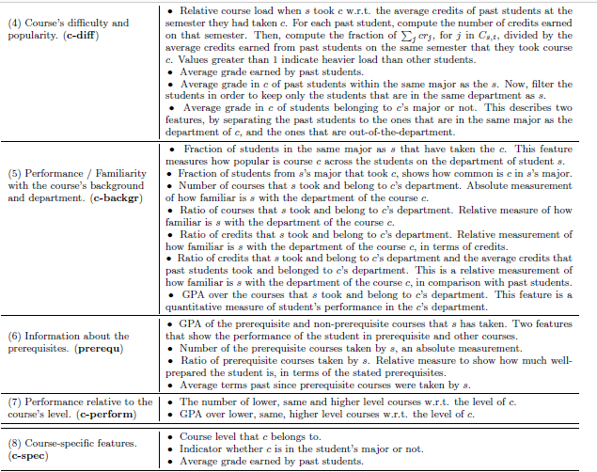
Feature groups describing the target student.

Slide 22
SUPPORT VECTOR MACHINE ALGORITHM
Support Vector Machine or SVM is one of the most popular Supervised Learning algorithms, which is used for Classification as well as Regression problems.
The goal of the SVM algorithm is to create the best line or decision boundary that can segregate n-dimensional space into classes so that we can easily put the new data point in the correct category in the future. This best decision boundary is called a hyperplane.
SVM chooses the extreme points/vectors that help in creating the hyperplane. These extreme cases are called as support vectors, and hence algorithm is termed as Support Vector Machine.

Slide 23
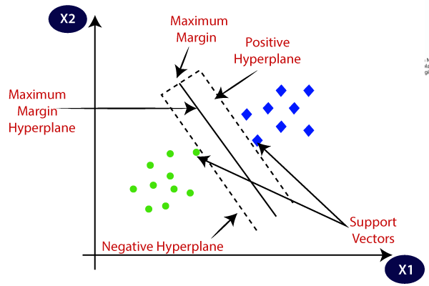
Consider the below diagram in which there are two different categories that are classified using a decision boundary or Hyperplane:

Slide 24
Random Forest Algorithm
"Random Forest is a classifier that contains a number of decision trees on various subsets of the given dataset and takes the average to improve the predictive accuracy of that dataset." .
The Working process can be explained in the below steps and diagram:
Step-1: Select random K data points from the training set.
Step-2: Build the decision trees associated with the selected data points (Subsets).
Step-3: Choose the number N for decision trees that you want to build.
Step-4: Repeat Step 1 & 2.
Step-5: For new data points, find the predictions of each decision tree, and assign the new data points to the category that wins the majority votes

Slide 25
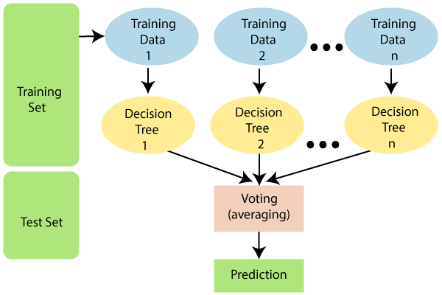
Random Forest Example

Slide 26
Advantages of Random Forest
Random Forest is capable of performing both Classification and Regression tasks.
It is capable of handling large datasets with high dimensionality.
It enhances the accuracy of the model and prevents the overfitting issue.
Disadvantages of Random Forest
Although random forest can be used for both classification and regression tasks, it is not more suitable for Regression tasks.

Slide 27
DECISION TREE CLASSIFICATION ALGORITHM
Decision Tree is a Supervised learning technique that can be used for both classification and Regression problems, but mostly it is preferred for solving Classification problems.
It is a tree-structured classifier, where internal nodes represent the features of a dataset, branches represent the decision rules and each leaf node represents the outcome
Why use Decision Trees?
Decision Trees usually mimic human thinking ability while making a decision, so it is easy to understand.
The logic behind the decision tree can be easily understood because it shows a tree-like structure.

Slide 28
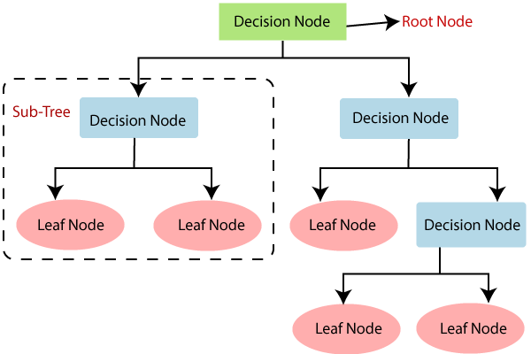
Decision Tree Classification Algorithm Representation

Slide 29
The complete process can be better understood using the below algorithm:
Step-1: Begin the tree with the root node, says S, which contains the complete dataset.
Step-2: Find the best attribute in the dataset using Attribute Selection Measure (ASM).
Step-3: Divide the S into subsets that contains possible values for the best attributes.
Step-4: Generate the decision tree node, which contains the best attribute.
Step-5: Recursively make new decision trees using the subsets of the dataset created in step -3. Continue this process until a stage is reached where you cannot further classify the nodes and called the final node as a leaf node.

Slide 30
Advantages of the Decision Tree
It is simple to understand as it follows the same process which a human follow while making any decision in real-life.
It can be very useful for solving decision-related problems.
It helps to think about all the possible outcomes for a problem.
There is less requirement of data cleaning compared to other algorithms.
Disadvantages of the Decision Tree
The decision tree contains lots of layers, which makes it complex.
It may have an overfitting issue, which can be resolved using the Random Forest algorithm.
For more class labels, the computational complexity of the decision tree may increase.

Slide 31
GRADIENT BOOSTING ALGORITHM:
Boosting is a method of converting weak learners into strong learners. In boosting, each new tree is a fit on a modified version of the original data set. The gradient boosting algorithm (gbm) can be most easily explained by first introducing the AdaBoost Algorithm
Step 1-The AdaBoost Algorithm begins by training a decision tree in which each observation is assigned an equal weight.
Step 2-We increase the weights of those observations that are difficult to classify and lower the weights for those that are easy to classify. The second tree is therefore grown on this weighted data. Here, the idea is to improve upon the predictions of the first tree. Our new model is therefore Tree 1 + Tree 2.

Slide 32
Step 3- We then compute the classification error from this new 2-tree ensemble model and grow a third tree to predict the revised residuals.
Step 4-We repeat this process for a specified number of iterations. Subsequent trees help us to classify observations that are not well classified by the previous trees.

Slide 33
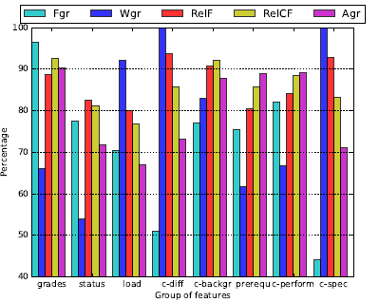
ACCURACY GRAPH
A graph is generated based on students performance showing them along with the group of features.

Slide 34
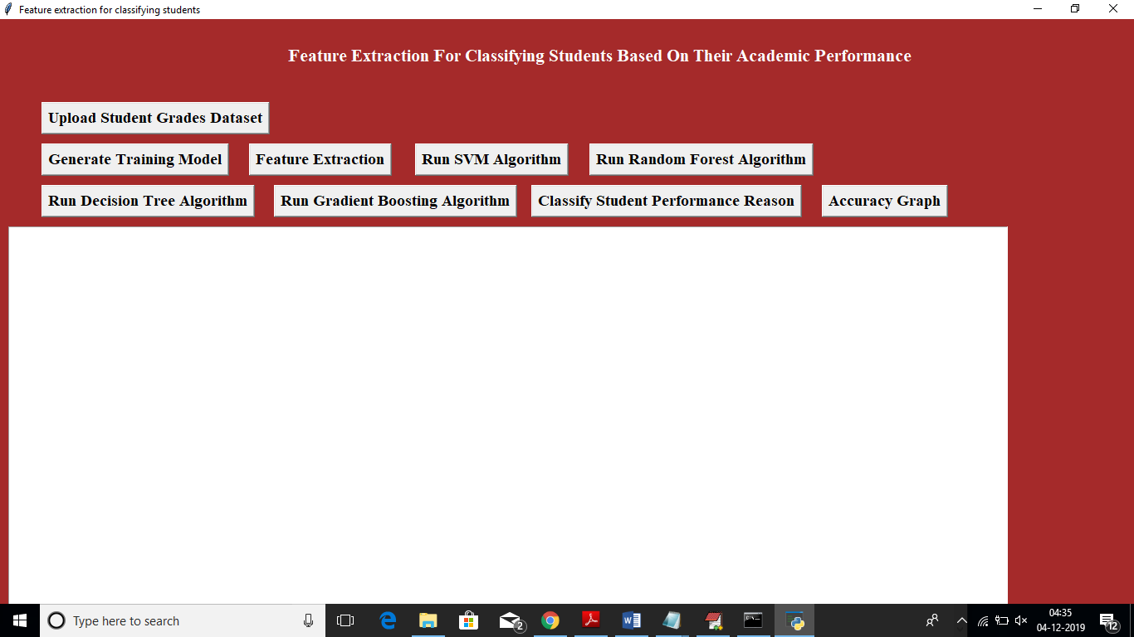
SCREENSHOTS
In above screen click on ‘Upload Student Grades Dataset’ button to upload dataset..

Slide 35
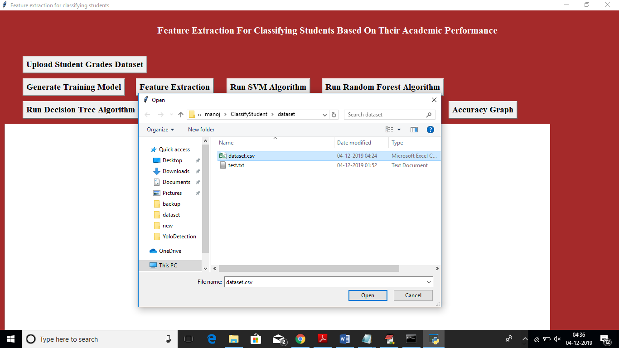

Slide 36
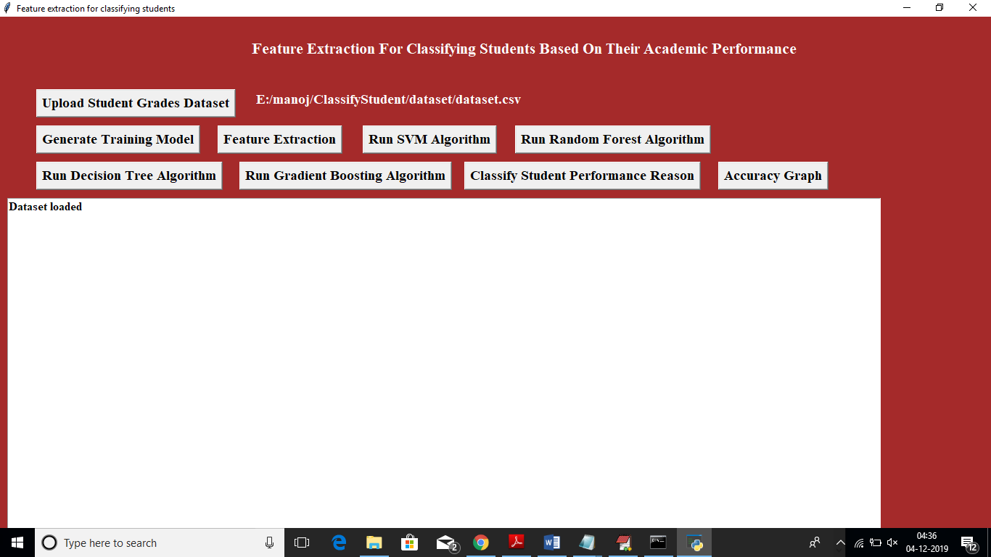
Dataset is loaded

Slide 37
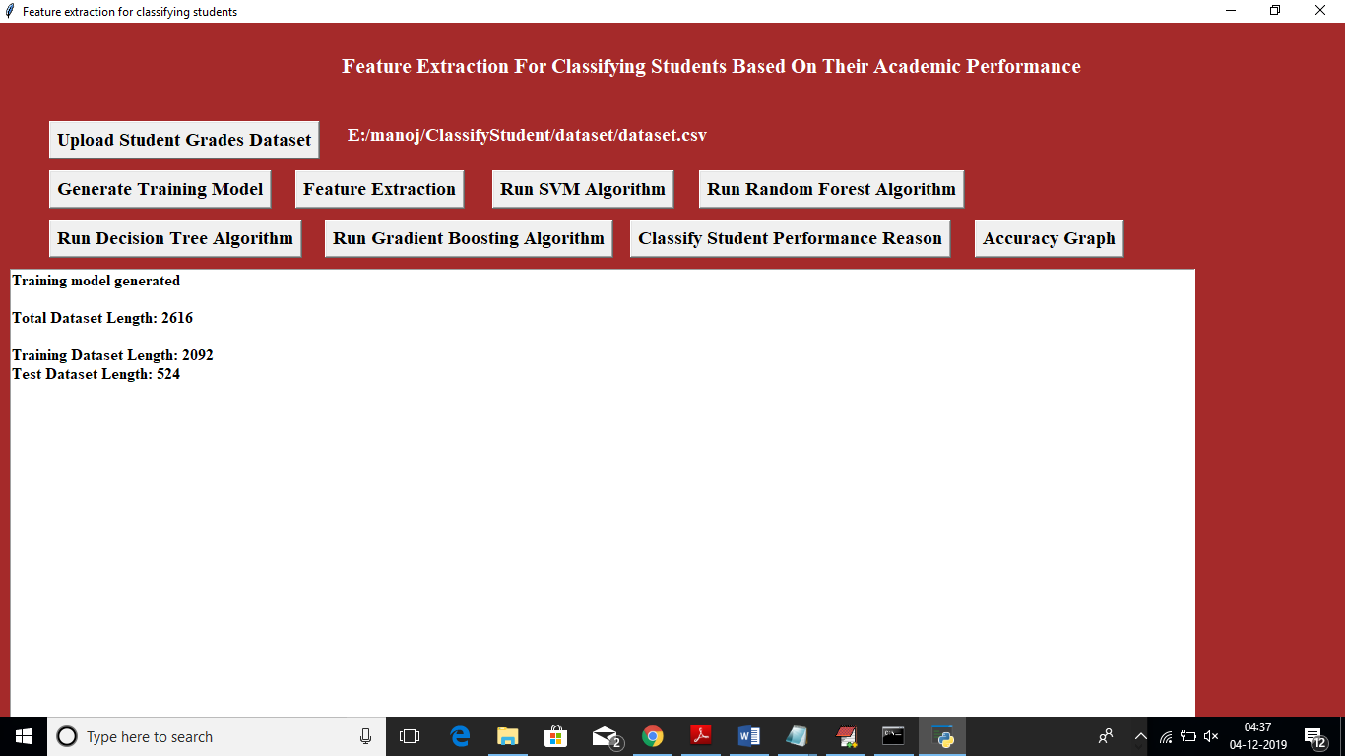
Now click on ‘Generate Training Model’ button to read dataset and build array for training purpose..

Slide 38
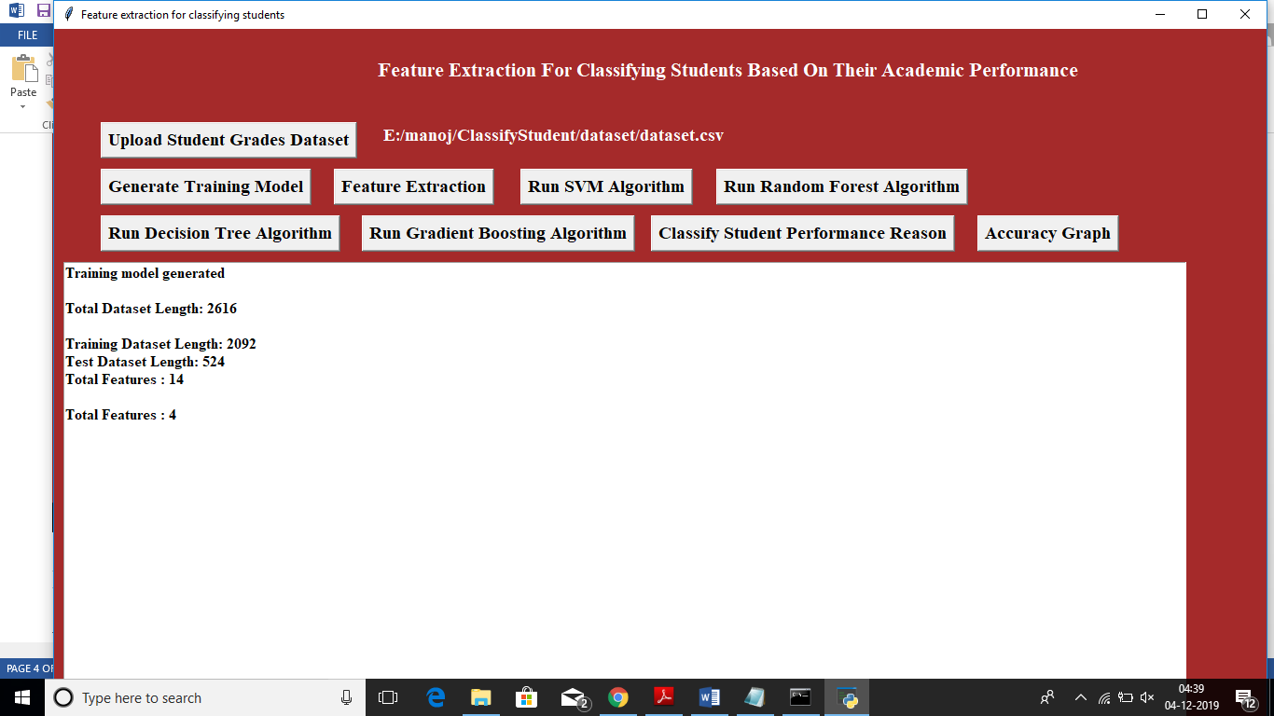
In below screen we can see total number of records in dataset and then displaying algorithm chooses how many records for training and testing purpose. Now click on ‘Features Extraction’ button to extract features and assign as class label to the classifier algorithms...

Slide 39
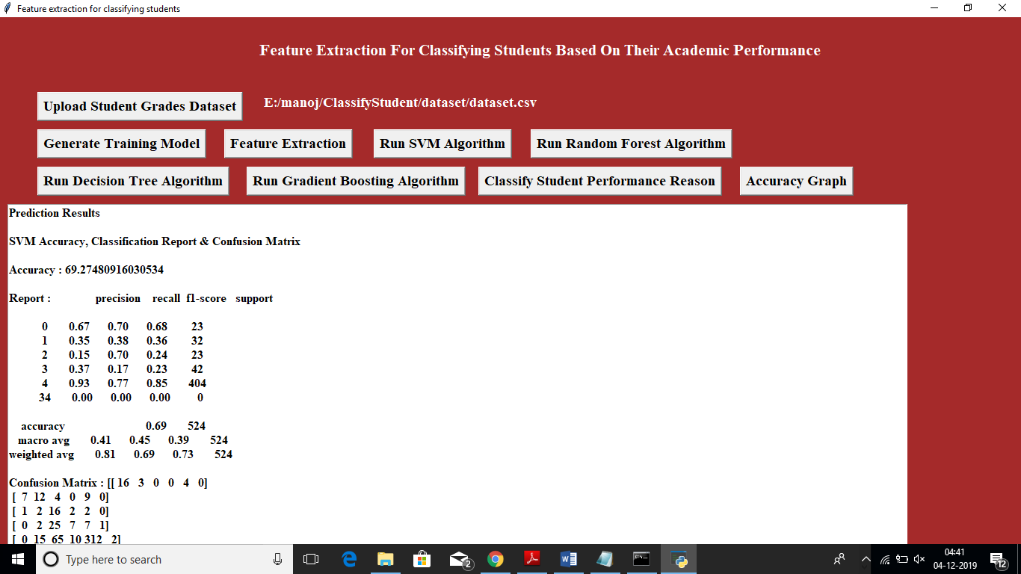
In below screen we can see SVM accuracy is 69% and we can see FSCORE value also. Now click on ‘Run Random Forest Algorithm’ to build its model..

Slide 40
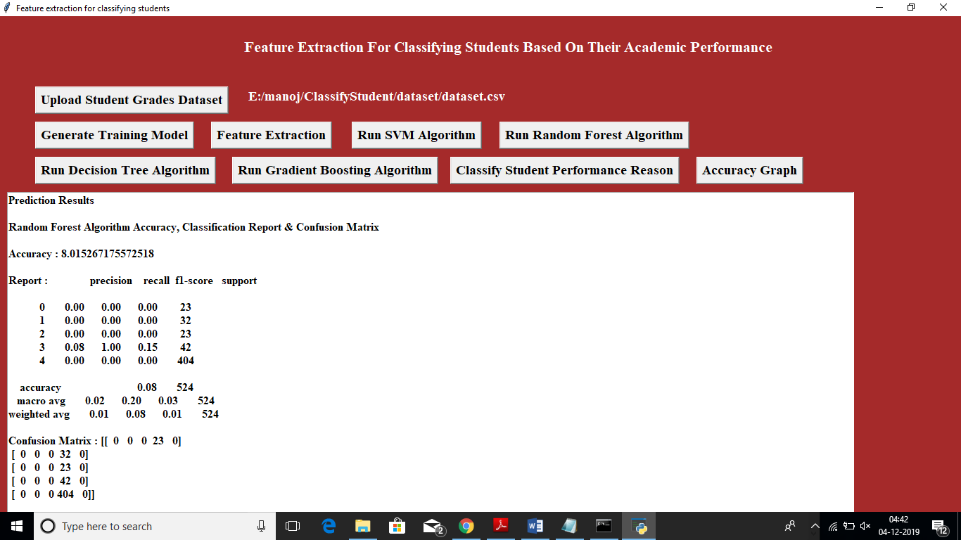
In below screen random forest got only 8% of accuracy. Now click on ‘Run Decision Tree Algorithm’ button to build tree model

Slide 41

In below screen decision tree got 89% accuracy, now click on ‘Run Gradient Boosting Algorithm’.

Slide 42

In below screen gradient boosting got 87% accuracy and decision tree got high accuracy but its FSCORE is less compare to gradient boosting. Now click on ‘Accuracy Graph’ button to get below accuracy graph..

Slide 43
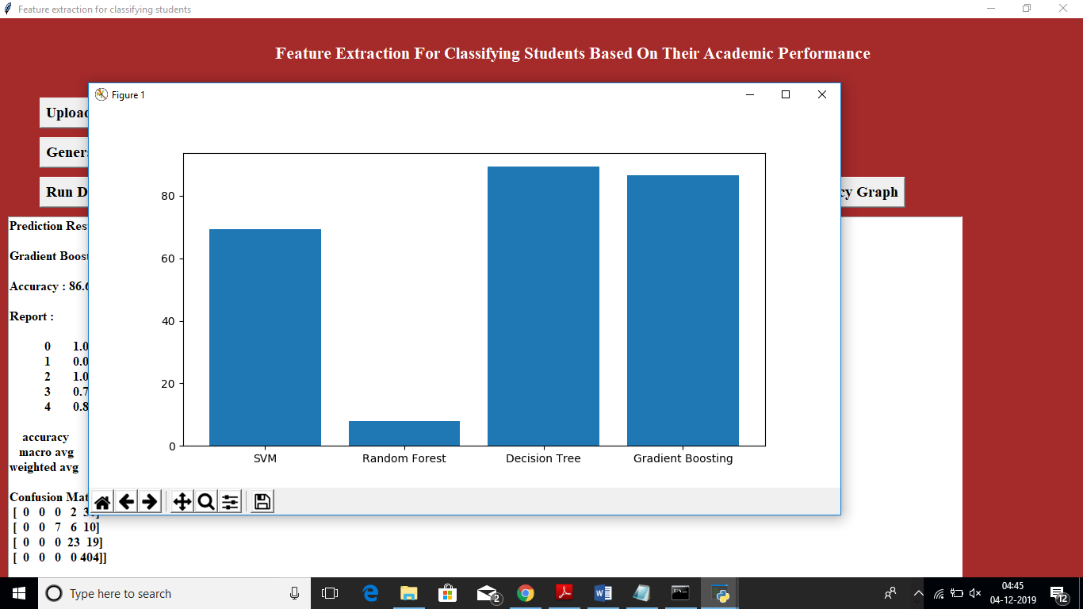
In below screen x-axis represents algorithm name and y-axis represents accuracy of that algorithm. Now we can test new student records on this train model to predict or classify new student performance. To check new student we need to upload ‘text.txt’ test dataset from dataset folder and this dataset contains below data..

Slide 44
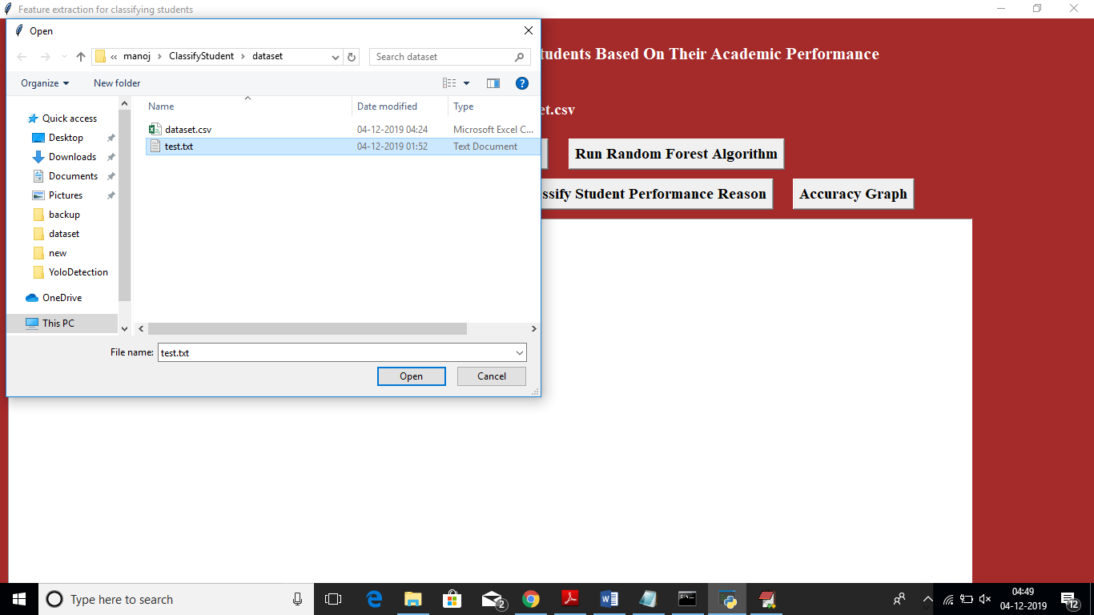
After uploading test data will get below classification result..

Slide 45
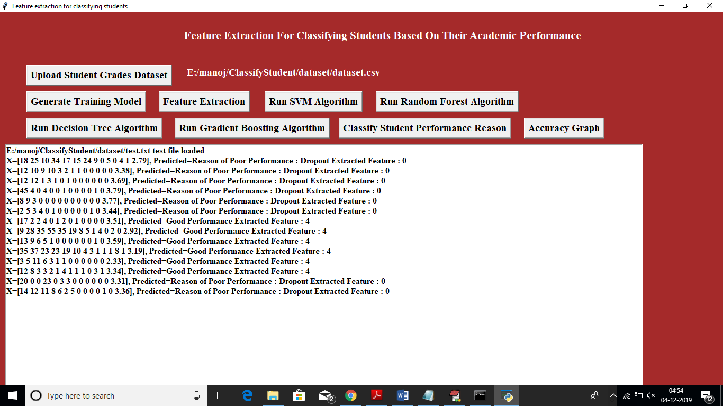
In below screen based on grades values application has given result as poor performance due to drop out or good performance ..

Slide 46
PSEUDO CODE
Step 1:Importing the file
def importdata():
global balance_data
balance_data = pd.read_csv(filename)
return balance_data
Step 2: Spliting the dataset into balanced values and test samples
def splitdataset(balance_data):
X = balance_data.values[:, 4:18]
Y = balance_data.values[:, 18]
Y = Y.astype('int')
X_train, X_test, y_train, y_test = train_test_split(
X, Y, test_size = 0.2, random_state = 0)
return X, Y, X_train, X_test, y_train, y_test

Slide 47
Step 3: uploading the dataset
def upload():
global filename
text.delete('1.0', END)
filename = askopenfilename(initialdir = "dataset")
pathlabel.config(text=filename)
text.insert(END,"Dataset loaded\n\n")
Step 4:Generarting the model to know the extracted features Dataset length
def generateModel():
global X, Y, X_train, X_test, y_train, y_test
data = importdata()
X, Y, X_train, X_test, y_train, y_test = splitdataset(data)
text.delete('1.0', END)
text.insert(END,"Training model generated\n\n")
text.insert(END,"Total Dataset Length: "+str(len(X))+"\n\n")
text.insert(END,"Training Dataset Length: "+str(len(X_train))+"\n")
text.insert(END,"Test Dataset Length: "+str(len(X_test))+"\n")

Slide 48
Step 5:Extracting features with train and test samples through KBest classification technique
def featureExtraction():
global X, Y, X_train, X_test, y_train, y_test
print(X_train)
print(y_train)
total = X_train.shape[1];
text.insert(END,"Total Features : "+str(total)+"\n\n")
X_train1 = SelectKBest(chi2, k=10).fit_transform(X_train, y_train)
X_test1 = SelectKBest(chi2, k=10).fit_transform(X_test,y_test)
text.insert(END,"Total Features : "+str(total - X_train1.shape[1])+"\n\n")
Step 6:Predicting the values for test Dataset
def prediction(X_test, cls):
y_pred = cls.predict(X_test)
for i in range(len(X_test)):
print("X=%s, Predicted=%s" % (X_test[i], y_pred[i]))
return y_pred

Slide 49
Step 7:Function to calculate accuracy
def cal_accuracy(y_test, y_pred, details, index):
cm = confusion_matrix(y_test, y_pred)
accuracy = accuracy_score(y_test,y_pred)*100
if index == 1:
accuracy = 98
text.insert(END,details+"\n\n")
text.insert(END,"Accuracy : "+str(accuracy)+"\n\n")
text.insert(END,"Report : "+str(classification_report(y_test, y_pred))+"\n")
text.insert(END,"Confusion Matrix : "+str(cm)+"\n\n\n\n\n")
return accuracy
Step 8:Run Support Vector Machine algorithm
def runSVM():
global svm_acc
global classifier
global X, Y, X_train, X_test, y_train, y_test
text.delete('1.0', END)
cls=svm.SVC(C=2.0,gamma='scale',kernel='rbf',random_state=
2,class_weight='balanced')
cls.fit(X_train, y_train)
text.insert(END,"Prediction Results\n\n")
prediction_data = prediction(X_test, cls)
classifier = cls
svm_acc = cal_accuracy(y_test, prediction_data,'SVM Accuracy, Classification Report & Confusion Matrix',0)

Slide 50
Step 9: Run Random Forest Algorithm
def runRandomForest():
global random_acc
global X, Y, X_train, X_test, y_train, y_test
text.delete('1.0', END)
cls = RandomForestClassifier(n_estimators=1,max_depth=0.9,random_state=None,class_weight='balanced')
cls.fit(X_train, y_train)
text.insert(END,"Prediction Results\n\n")
prediction_data = prediction(X_test, cls)
random_acc = cal_accuracy(y_test, prediction_data,'Random Forest Algorithm Accuracy, Classification Report & Confusion Matrix',0)
Step 10:Run Decision Tree Algorithm
def runDecisionTree():
global decision_acc
global X, Y, X_train, X_test, y_train, y_test
text.delete('1.0', END)
cls = tree.DecisionTreeClassifier(class_weight='balanced')
cls.fit(X_train, y_train)
text.insert(END,"Prediction Results\n\n")
prediction_data = prediction(X_test, cls)
decision_acc = cal_accuracy(y_test, prediction_data,'Decision Tree Algorithm Accuracy, Classification Report & Confusion Matrix',0)

Slide 51
Step 11:Run Boosting Algorithm
def runBoosting():
global boosting_acc
global X, Y, X_train, X_test, y_train, y_test
text.delete('1.0', END)
cls = GradientBoostingClassifier(n_estimators=10, learning_rate=0.2, max_features=2, max_depth=2, random_state=0)
cls.fit(X_train, y_train)
text.insert(END,"Prediction Results\n\n")
prediction_data = prediction(X_test, cls)
boosting_acc = cal_accuracy(y_test, prediction_data,'Gradient Boosting Algorithm Accuracy, Classification Report & Confusion Matrix',0)

Slide 52
Step 12:Predicting performance based on extracted feature
def predictPerformance():
text.delete('1.0', END)
filename = filedialog.askopenfilename(initialdir="dataset")
test = pd.read_csv(filename)
test = test.values[:, 4:18]
text.insert(END,filename+" test file loaded\n");
y_pred = classifier.predict(test)
for i in range(len(test)):
if str(y_pred[i]) == '0':
text.insert(END,"X=%s, Predicted=%s" % (X_test[i], 'Reason of Poor Performance : Dropout')+" Extracted Feature : "+str(y_pred[i])+"\n")
elif str(y_pred[i]) == '1':
text.insert(END,"X=%s, Predicted=%s" % (X_test[i], 'Reason of Poor Performance : Failing Subject')+" Extracted Feature : "+str(y_pred[i])+"\n")

Slide 53
elif str(y_pred[i]) == '2':
text.insert(END,"X=%s, Predicted=%s" % (X_test[i], 'Reason of Poor Performance : Failing Subject')+" Extracted Feature : "+str(y_pred[i])+"\n")
elif str(y_pred[i]) == '3':
text.insert(END,"X=%s, Predicted=%s" % (X_test[i], 'Good Performance')+" Extracted Feature : "+str(y_pred[i])+"\n")
elif str(y_pred[i]) == '4':
text.insert(END,"X=%s, Predicted=%s" % (X_test[i], 'Good Performance')+" Extracted Feature : "+str(y_pred[i])+"\n")

Slide 54
Step 13:Representing result in form of graph
def graph():
height = [svm_acc,random_acc,decision_acc, boosting_acc]
bars = ('SVM', 'Random Forest','Decision Tree','Gradient Boosting')
y_pos = np.arange(len(bars))
plt.bar(y_pos, height)
plt.xticks(y_pos, bars)
plt.show()

Slide 55
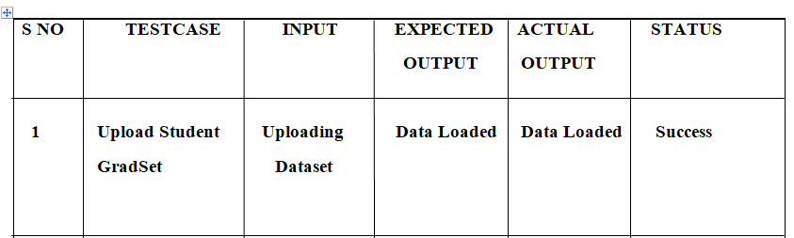
Test Cases
TestCase for Upload Student Dataset

Slide 56
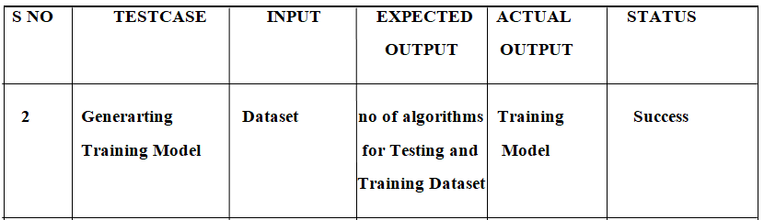
TestCase for Generarting Training Model

Slide 57
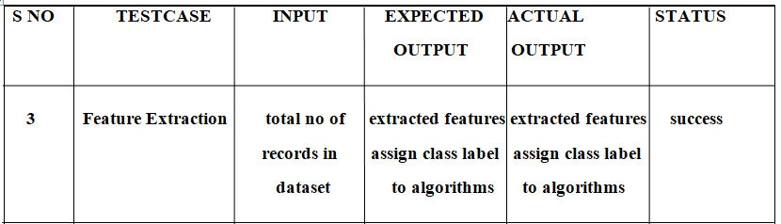
TestCase for Feature Extraction

Slide 58
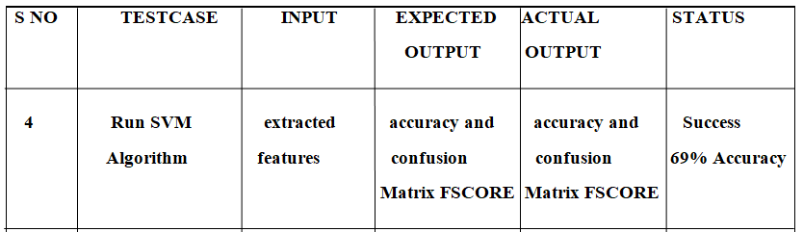
4 Support Vector Machine algorithm

Slide 59
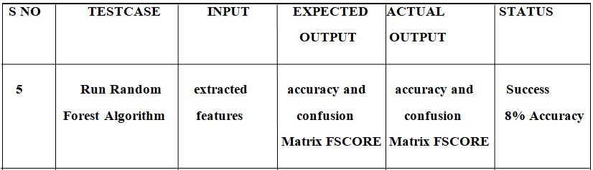
TestCase for Random Forest Algorithm

Slide 60
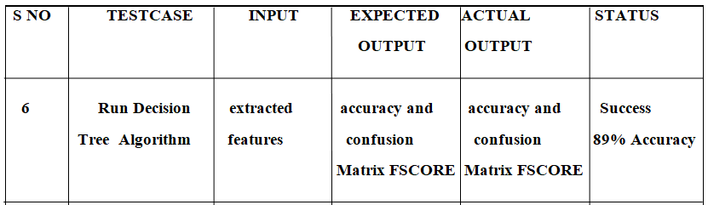
TestCase for Run Decision Tree Algorithm

Slide 61

TestCase for Run Gradient Boost Algorithm

Slide 62
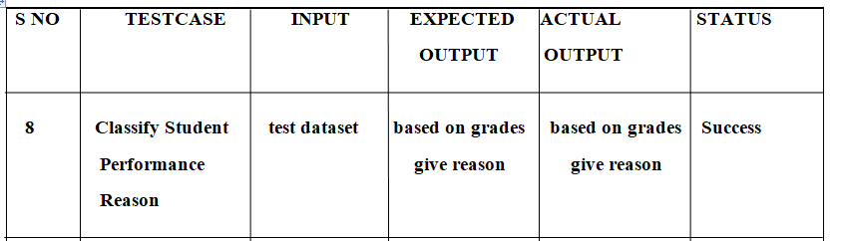
TestCase for Classification

Slide 63
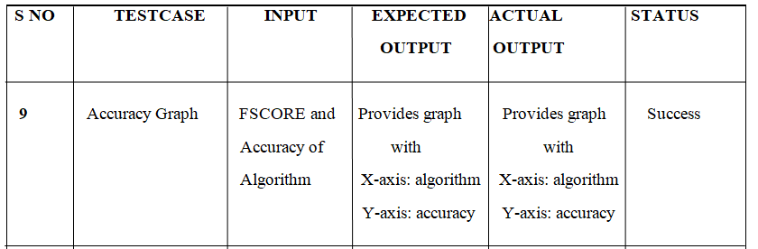
TestCase for Accuracy Graph

Slide 64
Conclusion
The purpose of this project is to accurate identify students that are at risk. These students might fail the class, drop it, or perform worst than they usually do. We extracted features from historical grading data, in order to test different simple and sophisticated classification methods based on big data approaches.
The best performing methods are the Gradient Boosting and Random Forest classifiers, based on AUC and F1 score metrics. We also got interesting findings that can explain the student performance.

Slide 65
Future Scope
“Success” and “Failure” can be relative. In order to gain more insight into the learning process and to focus on the poor-performing students, who are the ones that need these systems the most .This project will be more useful to all universities and colleges to identify the student performance when we include Student case sheets from starting of his/her schooling and their personal interest.

Slide 66
References
[1] L. Breiman. Random forests. Machine learning, 45(1):5{32, 2001.
[2] L. Breiman, J. Friedman, C. J. Stone, and R. A. Olshen. Classi_cation and regression trees. CRC press, 1984.
[3] C. Cortes and V. Vapnik. Support-vector networks.Machine learning, 20(3):273{297, 1995.
[4] J. H. Friedman. Greedy function approximation: a gradient boosting machine. Annals of statistics, pages 1189{1232, 2001.
[5] Z. Iqbal, J. Qadir, A. N. Mian, and F. Kamiran. Machine learning based student grade prediction: A case study. arXiv preprint arXiv:1708.08744, 2017.

Slide 67


Slide 68


