Slide 1
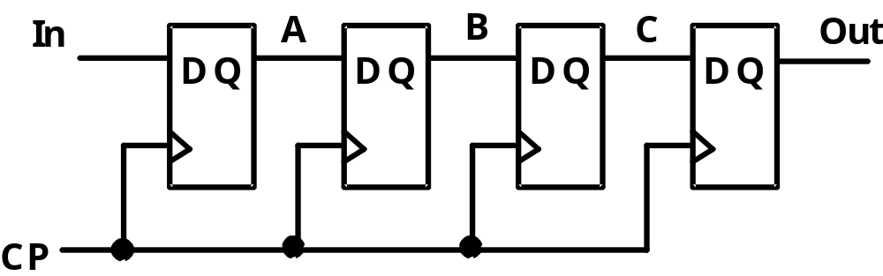
Shift Registers
Shift Registers move data laterally within the register toward its MSB or LSB position
In the simplest case, the shift register is simply a set of
D flip-flops connected in a row like this:
Data input, In, is called a serial input or the shift right input.
Data output, Out, is often called the serial output.
The vector (A, B, C, Out) is called the parallel output.

Slide 2
Shift Registers (continued)
The behavior of the
serial shift register
is given in the listing
on the lower right
T0 is the register
state just before
the first clock
pulse occurs
T1 is after the
first pulse and
before the second.
Initially unknown
states are denoted by “?”
Complete the last three
rows of the table
In
A
B
C
Out
D
Q
D
Q
D
Q
D
Q
Clock CP
CP
In
A
B
C
Out
T0
0
?
?
?
?
T1
1
0
?
?
?
T2
1
1
0
?
?
T3
0
1
1
0
?
T4
1
T5
1
T6
1
Notes:
ROW T4: 10110
Row T5: 11011
Row T6: 11101

Slide 3
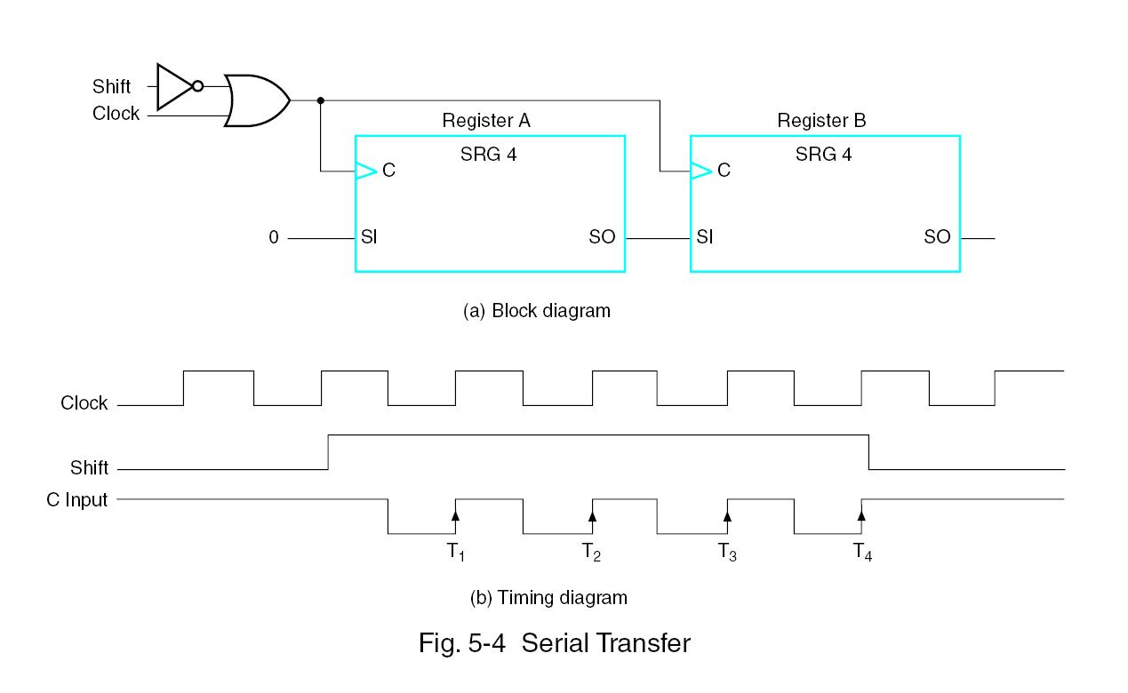
Time and Shift Controlled Structure

Slide 4
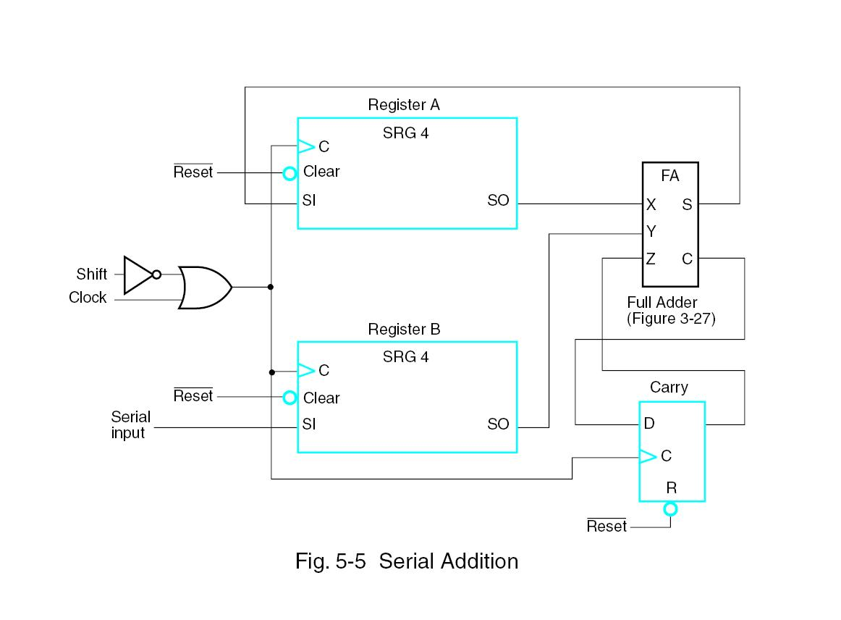
Serial Addition
Serial operations: slower, smaller
Parallel operations: faster but requires more chip area
Perform:
  A+B → A

Slide 5
Serial Adder
Load/Right Shift Registers
The circuit shown uses two shift
registers for operands A(3:0)
and B(3:0).
A full adder, and one more
flip flop (for the carry) is used
to compute the sum.
The result is stored in the
A register and the final
carry in the flip-flop
With the operands and the
result in shift registers, a tree of full adders can be
used to add a large number of operands. Used as a common digital signal processing technique.
Serial
In
A
FA
A3 A2 A1 A0
B
Sum
Parallel Load
Cin
Serial
Cout
In
B3 B2 B1 B0
Parallel Load
Q
D
(Clock and Load/Shift
CP
Control not shown)

Slide 6
Parallel Load Shift Registers
D_{A}
D_{B}
By adding a mux
between each shift register
stage, data can be
shifted or loaded
If SHIFT is low,
A and B are
replaced by the data on D_{A} and D_{B} lines, else data shifts right on each clock.
By adding more bits, we can make n-bit parallel load shift registers.
A parallel load shift register with an added “hold” operation that stores data unchanged is given in Figure 7-10 of the text.
A
B
IN
D
Q
D
Q
SHIFT
CP

Slide 7
Shift Registers with Additional Functions
By placing a 4-input multiplexer in front of each D flip-flop in a shift register, we can implement a circuit
with shifts right, shifts left, parallel load, hold.
Shift registers can also be designed to shift more than a single bit position right or left
Shift register can be designed to shift a variable number of bit positions specified by a variable called a shift amount.

Slide 8
Counters
Counters are sequential circuits which "count" through a specific state sequence. They can count up, count down, or count through other fixed sequences. Two distinct types are in common usage:
Ripple Counters
  Clock is connected to the flip-flop clock input on the LSB bit flip-flop
  For all other bits, a flip-flop output is connected to the clock input, thus circuit is not truly synchronous
  Output change is delayed more for each bit toward the MSB.
  Resurgent because of low power consumption
Synchronous Counters
  Clock is directly connected to the flip-flop clock inputs
  Logic is used to implement the desired state sequencing

Slide 9
Ripple Counter
How does it work?
  When there is a positive
  edge on the clock input
  of A, A complements
  The clock input for flip-
  flop B is the complemented
  output of flip-flop A
  When flip A changes
  from 1 to 0, there is a
  positive edge on the
  clock input of B
  causing B to
  complement
D
A
Clock
C_{R}
D
B
C_{R}
Reset
CP
A
B
0
1
2
3
0
1

Slide 10
Ripple Counter (continued)
The arrows show the
cause-effect relation-
ship from the prior
slide =>
The corresponding
sequence of states =>
(B,A) = (0,0),
Each additional bit, C, D, …behaves like bit B, changing half as frequently as the bit before it.
For 3 bits: (C,B,A) = (0,0,0), (0,0,1), (0,1,0), (0,1,1),
(1,0,0), (1,0,1), (1,1,0), (1,1,1), (0,0,0), …
CP
A
B
0
1
2
3
0
1
(0,1),
(1,0),
(1,1),
(0,0),
(0,1), …

Slide 11
Ripple Counter (continued)
These circuits are called ripple counters because each edge sensitive transition (positive in the example) causes a change in the next flip-flop’s state.
The changes “ripple” upward through the chain of flip-flops, i. e., each transition occurs after a clock-to-output delay from the stage before.
To see this effect in detail look at the waveforms on the next slide.

Slide 12
Ripple Counter (continued)
Starting with C = B = A = 1, equivalent to (C,B,A) = 7 base 10, the next clock increments the count to (C,B,A) = 0 base 10. In fine timing detail:
  The clock to output delay
  t_{PHL} causes an increasing
  delay from clock edge for
  each stage transition.
  Thus, the count “ripples”
  from least to most
  significant bit.
  For n bits, total worst case
  delay is n t_{PHL}.
t_{PHL}
CP
t_{PHL}
A
t_{pHL}
B
C

Slide 13
Synchronous Counters
To eliminate the "ripple" effects, use a common clock for each flip-flop and a combinational circuit to generate the next state.
For an up-counter,
use an incrementer =>
Incre-menter
A3
S3
D3
Q3
A2
S2
D2
Q2
A1
S1
D1
Q1
A0
S0
D0
Q0
Clock

Slide 14
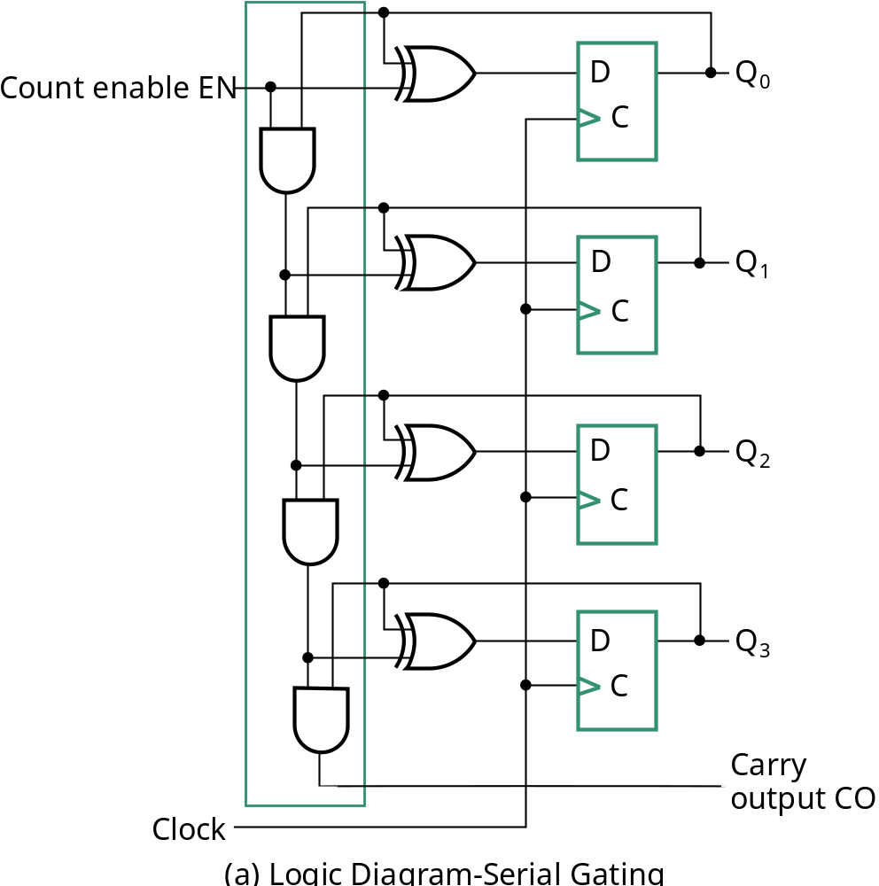
Synchronous Counters (continued)
Incrementer
Internal details =>
Internal Logic
  XOR complements each bit
  AND chain causes complement
  of a bit if all bits toward LSB
  from it equal 1
Count Enable
  Forces all outputs of AND
  chain to 0 to “hold” the state
Carry Out
  Added as part of incrementer
  Connect to Count Enable of
  additional 4-bit counters to
  form larger counters

Slide 15
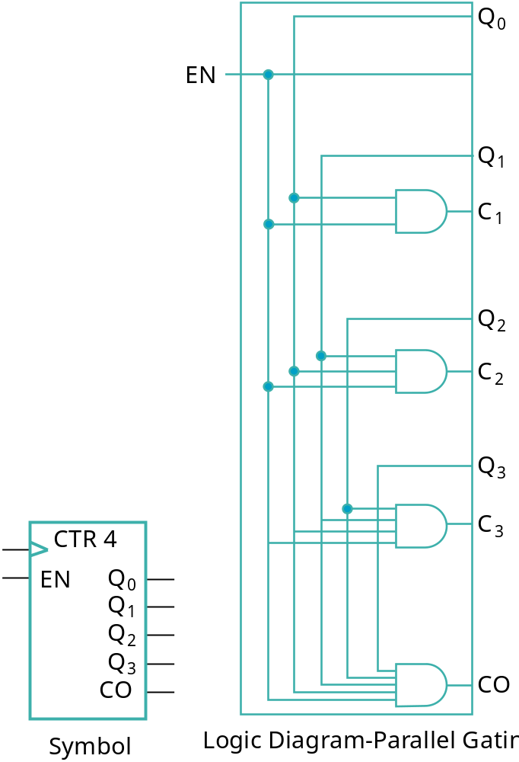
Synchronous Counters (continued)
Carry chain
  series of AND gates through which the
  carry “ripples”
  Yields long path delays
  Called serial gating
Replace AND carry chain with ANDs =>
in parallel
  Reduces path delays
  Called parallel gating
  Like carry lookahead
  Lookahead can be used on COs
  and ENs to prevent long paths in
  large counters
Symbol for Synchronous Counter

Slide 16
Other Counters
See text for:
  Down Counter - counts downward instead of upward
  Up-Down Counter - counts up or down depending on value a control input such as Up/Down
  Parallel Load Counter - Has parallel load of values available depending on control input such as Load
Divide-by-n (Modulo n) Counter
  Count is remainder of division by n which n may not be a power of 2 or
  Count is arbitrary sequence of n states specifically designed state-by-state
  Includes modulo 10 which is the BCD counter

Slide 17
Counter with Parallel Load
Load
Count
D
0
D
Q
0
Add path for input data
  enabled for Load = 1
Add logic to:
  disable count logic for Load = 1
  disable feedback from outputs
  for Load = 1
  enable count logic for Load = 0
  and Count = 1
The resulting function table:
C
D
1
D
Q
1
C
D
2
D
Q
2
C
Load | Count | Action
0 | 0 | Hold Stored Value
0 | 1 | Count Up Stored Value
1 | X | Load D
D
3
D
Q
3
C
Carry
Clock
Output CO

Slide 18
Design Example: Synchronous BCD
Use the sequential logic model to design a synchronous BCD counter with D flip-flops
State Table =>
Input combinations
1010 through 1111
are don’t cares
Current State
Next State
Q8 Q4 Q2 Q1
Q8 Q4 Q2 Q1
0 0 0 0
0 0 0 1
0 0 0 1
0 0 1 0
0 0 1 0
0 0 1 1
0 0 1 1
0
1 0 0
0 1 0 0
0 1 0 1
0 1 0 1
0 1 1 0
0 1 1 0
0 1 1 1
0 1 1 1
1 0 0 0
1 0 0 0
1 0 0 1
1 0 0 1
0 0 0 0

Slide 19
Synchronous BCD (continued)
Use K-Maps to two-level optimize the next state equations and manipulate into forms containing XOR gates:
D1 = Q1
D2 = Q2 + Q1Q8
D4 = Q4 + Q1Q2
D8 = Q8 + (Q1Q8 + Q1Q2Q4)
The logic diagram can be draw from these equations
  An asynchronous or synchronous reset should be added
What happens if the counter is perturbed by a power disturbance or other interference and it enters a state other than 0000 through 1001?

Slide 20
Synchronous BCD (continued)
Find the actual values of the six next states for the don’t care combinations from the equations
Find the overall state diagram to assess behavior for the don’t care states (states in decimal)
0
Present State | Next State
Q8 Q4 Q2 Q1 | Q8 Q4 Q2 Q1
1 0 1 0 | 1 0 1 1
1 0 1 1 | 0 1 1 0
1 1 0 0 | 1 1 0 1
1 1 0 1 | 0 1 0 0
1 1 1 0 | 1 1 1 1
1 1 1 1 | 0 0 1 0
9
1
14
8
2
15
12
7
11
13
3
6
10
4
5

Slide 21
Synchronous BCD (continued)
For the BCD counter design, if an invalid state is entered, return to a valid state occurs within two clock cycles
Is this adequate? If not:
  Is a signal needed that indicates that an invalid state has been entered? What is the equation for such a signal?
  Does the design need to be modified to return from an invalid state to a valid state in one clock cycle?
  Does the design need to be modified to return from a invalid state to a specific state (such as 0)?
The action to be taken depends on:
  the application of the circuit
  design group policy
See pages 278 - 279 of the text.
Notes:
Error = Q8 Q4 + Q8 Q2

Slide 22
Counting Modulo N
The following techniques use an n-bit binary counter with asynchronous or synchronous clear and/or parallel load:
  Detect a terminal count of N in a Modulo-N count sequence to asynchronously Clear the count to 0 or asynchronously Load in value 0 (These lead to counts which are present for only a very short time and can fail to work for some timing conditions!)
  Detect a terminal count of N - 1 in a Modulo-N count sequence to Clear the count synchronously to 0
  Detect a terminal count of N - 1 in a Modulo-N count sequence to synchronously Load in value 0
  Detect a terminal count and use Load to preset a count of the terminal count value minus (N - 1)
Alternatively, custom design a modulo N counter as done for BCD

Slide 23
Counting Modulo 7: Detect 7 and Asynchronously Clear
D3
Q3
A synchronous 4-bit binary counter
with an asynchronous Clear is
used to make a Modulo
7 counter.
Use the Clear feature to
detect the count 7 and
clear the count to 0. This
gives a count of 0, 1, 2, 3, 4,
5, 6, 7(short)0, 1, 2, 3, 4, 5,
6, 7(short)0, etc.
DON’T DO THIS! Referred to as a “suicide” counter! (Count “7” is “killed,” but the designer’s job may be dead as well!)
D2
Q2
D1
Q1
D0
Q0
Clock
CP
0
LOAD
CLEAR

Slide 24
Counting Modulo 7: Synchronously Load on Terminal Count of 6
A synchronous 4-bit binary
counter with a synchronous
load and an asynchronous
clear is used to make a
Modulo 7 counter
Use the Load feature to
detect the count "6" and
load in "zero". This gives
a count of 0, 1, 2, 3, 4, 5, 6,
0, 1, 2, 3, 4, 5, 6, 0, ...
Using don’t cares for states
above 0110, detection of 6 can be done with Load = Q4 Q2
0
D3
Q3
0
D2
Q2
0
D1
Q1
0
D0
Q0
Clock
CP
LOAD
Reset
CLEAR

Slide 25
Counting Modulo 6: Synchronously Preset 9 on Reset and Load 9 on Terminal Count 14
A synchronous, 4-bit binary
counter with a synchronous
Load is to be used to make a
Modulo 6 counter.
Use the Load feature to
preset the count to 9 on
Reset and detection of
count 14.
This gives a count of 9, 10, 11, 12, 13, 14, 9, 10, 11, 12, 13, 14, 9, …
If the terminal count is 15 detection is usually built in as Carry Out (CO)
1
D3
Q3
0
D2
Q2
0
D1
Q1
1
D0
Q0
Clock
CP
Reset
LOAD
1
CLEAR

