Slide 1
Foundry Lab Demos
Run: recordings-20261108-4527c5fe-verified-only
Subscription: 1217c203-6c76-47b4-b61c-9bba62dc8e02
37 labs • locally narrated, embedded terminal-output replays
VERIFIED WORKING — 37 of 47; 10 without a verified demo
Selected output replays, not screen recordings. Lab 9 transcript omitted.
Notes:
Source manifest: /Users/michalfu/Dev/FoundryWorkshops102026DEMOS/Presentation/lab-recordings-20261108/verified-only-manifest.json
Input manifest is never modified. Only terminal-output replay media is generated, not live demo execution.

Slide 2
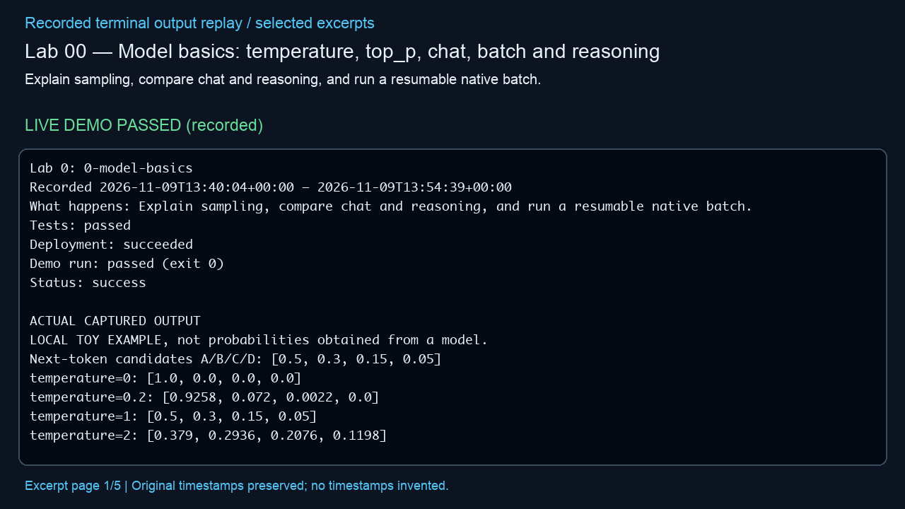
Lab 00 — Model basics: temperature, top_p, chat, batch and reasoning
Explain sampling, compare chat and reasoning, and run a resumable native batch.
LIVE DEMO PASSED (recorded)
Actual outcome
Observed: Both models returned 11; 3/3 batch requests completed. Top-p does not guarantee coherence. (status: success)
Infrastructure cleanup
verified deleted; unrelated baseline groups preserved
Embedded MP4 • click Play in PowerPoint • selected excerpts, not a screen recording
Notes:
Manifest source: /Users/michalfu/Dev/FoundryWorkshops102026DEMOS/Presentation/lab-recordings-20261108/verified-only-manifest.json
Actual output source: evidence/lab-00.txt
Run log / demo command provenance: /Users/michalfu/.copilot/session-state/4527c5fe-8c72-4d0b-ad77-572eec4da92a/files/recovery/execution-logs/0-model-basics.log
Demo command is only evidenced by the source log. This helper does not execute demos, Azure operations, or infer unreported commands.
Started: 2026-11-09T13:40:04+00:00; finished: 2026-11-09T13:54:39+00:00
Status: success; tests: passed; deployment: succeeded; run: passed (exit 0); cleanup: verified deleted; unrelated baseline groups preserved
Observed outcome: Observed: Both models returned 11; 3/3 batch requests completed. Top-p does not guarantee coherence. (status: success)
Full observed error (redacted, not shortened):
Provenance: render_deck.py reads manifest/output only; Pillow renders 1280x720 excerpt pages; /usr/bin/say -v Samantha -r 195 narrates locally; /Users/michalfu/.copilot/session-state/4527c5fe-8c72-4d0b-ad77-572eec4da92a/files/recording-tools/venv/lib/python3.13/site-packages/imageio_ffmpeg/binaries/ffmpeg-macos-aarch64-v7.1 encodes libx264/yuv420p and AAC and muxes MP4.
Limits: selected excerpt replay, NOT a screen recording; original timestamps preserved, no missing stdout or model responses invented; URLs/credentials redacted; reused supplied videos are not regenerated or transcript-audited. Playback requires a compatible PowerPoint player. Lab 9 source transcript is never opened/displayed by this helper.

Slide 3
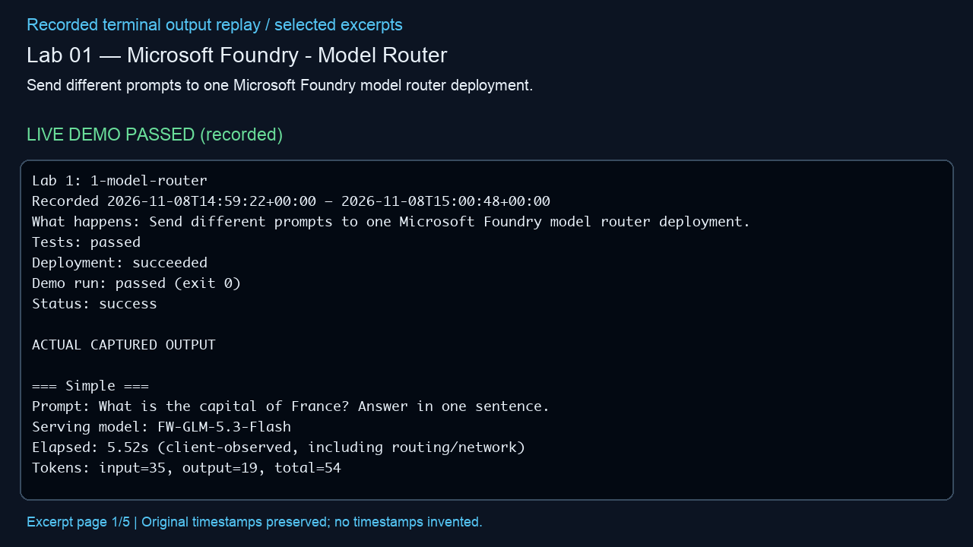
Lab 01 — Microsoft Foundry - Model Router
Send different prompts to one Microsoft Foundry model router deployment.
LIVE DEMO PASSED (recorded)
Actual outcome
Observed: The router answered a 120-attendee planning problem with a minimum peak of 8 mentors. (status: success)
Infrastructure cleanup
verified deleted; unrelated baseline groups preserved
Embedded MP4 • click Play in PowerPoint • selected excerpts, not a screen recording
Notes:
Manifest source: /Users/michalfu/Dev/FoundryWorkshops102026DEMOS/Presentation/lab-recordings-20261108/verified-only-manifest.json
Actual output source: evidence/lab-01.txt
Run log / demo command provenance: /Users/michalfu/.copilot/session-state/4527c5fe-8c72-4d0b-ad77-572eec4da92a/files/execution-logs/1-model-router.log
Demo command is only evidenced by the source log. This helper does not execute demos, Azure operations, or infer unreported commands.
Started: 2026-11-08T14:59:22+00:00; finished: 2026-11-08T15:00:48+00:00
Status: success; tests: passed; deployment: succeeded; run: passed (exit 0); cleanup: verified deleted; unrelated baseline groups preserved
Observed outcome: Observed: The router answered a 120-attendee planning problem with a minimum peak of 8 mentors. (status: success)
Full observed error (redacted, not shortened):
Provenance: render_deck.py reads manifest/output only; Pillow renders 1280x720 excerpt pages; /usr/bin/say -v Samantha -r 195 narrates locally; /Users/michalfu/.copilot/session-state/4527c5fe-8c72-4d0b-ad77-572eec4da92a/files/recording-tools/venv/lib/python3.13/site-packages/imageio_ffmpeg/binaries/ffmpeg-macos-aarch64-v7.1 encodes libx264/yuv420p and AAC and muxes MP4.
Limits: selected excerpt replay, NOT a screen recording; original timestamps preserved, no missing stdout or model responses invented; URLs/credentials redacted; reused supplied videos are not regenerated or transcript-audited. Playback requires a compatible PowerPoint player. Lab 9 source transcript is never opened/displayed by this helper.

Slide 4
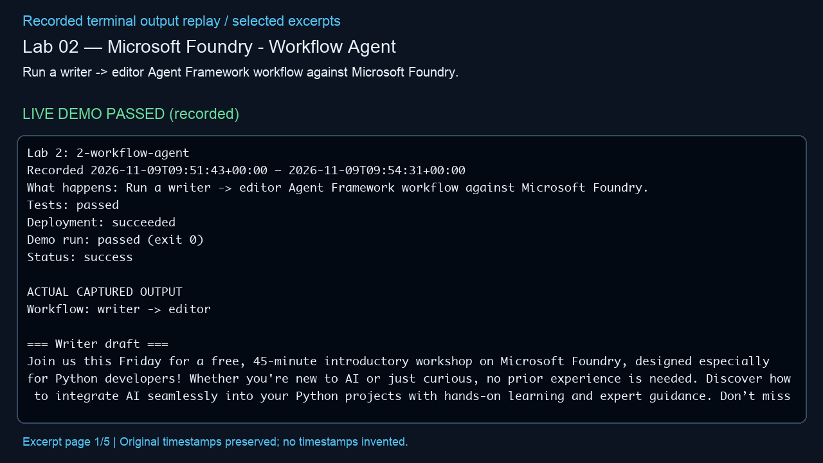
Lab 02 — Microsoft Foundry - Workflow Agent
Run a writer -> editor Agent Framework workflow against Microsoft Foundry.
LIVE DEMO PASSED (recorded)
Actual outcome
Observed: A writer drafted an invitation; an editor produced the final shorter version. (status: success)
Infrastructure cleanup
verified deleted; unrelated baseline groups preserved
Embedded MP4 • click Play in PowerPoint • selected excerpts, not a screen recording
Notes:
Manifest source: /Users/michalfu/Dev/FoundryWorkshops102026DEMOS/Presentation/lab-recordings-20261108/verified-only-manifest.json
Actual output source: evidence/lab-02.txt
Run log / demo command provenance: /Users/michalfu/.copilot/session-state/4527c5fe-8c72-4d0b-ad77-572eec4da92a/files/recovery/execution-logs/2-workflow-agent.log
Demo command is only evidenced by the source log. This helper does not execute demos, Azure operations, or infer unreported commands.
Started: 2026-11-09T09:51:43+00:00; finished: 2026-11-09T09:53:14+00:00
Status: success; tests: passed; deployment: succeeded; run: passed (exit 0); cleanup: verified deleted; unrelated baseline groups preserved
Observed outcome: Observed: A writer drafted an invitation; an editor produced the final shorter version. (status: success)
Full observed error (redacted, not shortened):
Provenance: render_deck.py reads manifest/output only; Pillow renders 1280x720 excerpt pages; /usr/bin/say -v Samantha -r 195 narrates locally; /Users/michalfu/.copilot/session-state/4527c5fe-8c72-4d0b-ad77-572eec4da92a/files/recording-tools/venv/lib/python3.13/site-packages/imageio_ffmpeg/binaries/ffmpeg-macos-aarch64-v7.1 encodes libx264/yuv420p and AAC and muxes MP4.
Limits: selected excerpt replay, NOT a screen recording; original timestamps preserved, no missing stdout or model responses invented; URLs/credentials redacted; reused supplied videos are not regenerated or transcript-audited. Playback requires a compatible PowerPoint player. Lab 9 source transcript is never opened/displayed by this helper.

Slide 5
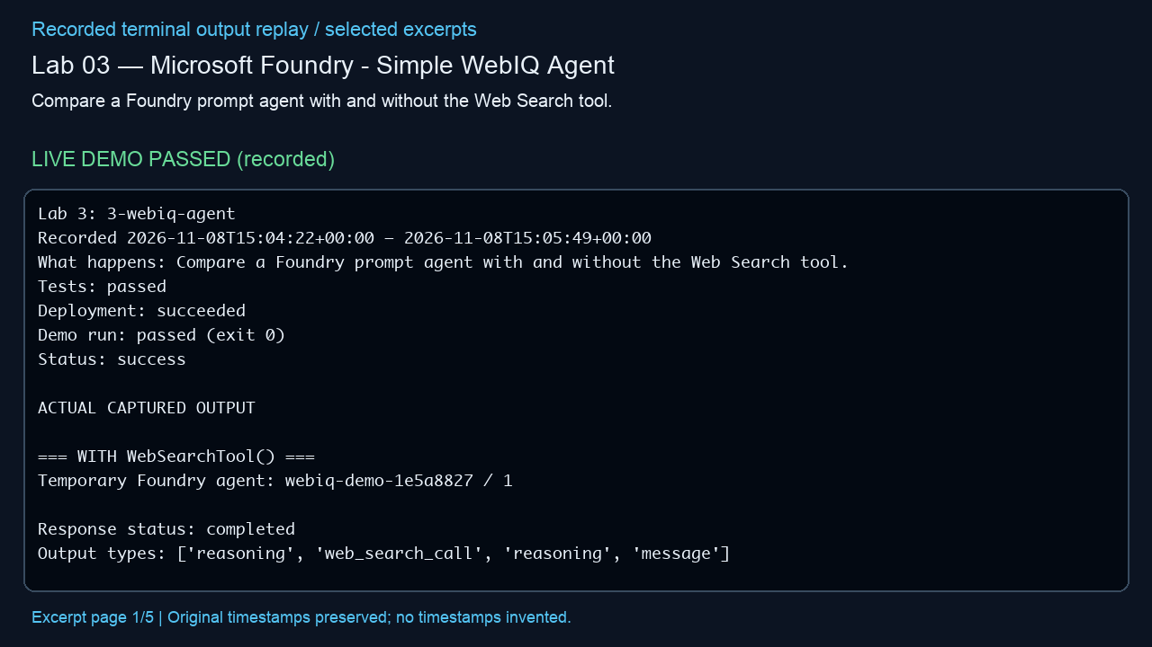
Lab 03 — Microsoft Foundry - Simple WebIQ Agent
Compare a Foundry prompt agent with and without the Web Search tool.
LIVE DEMO PASSED (recorded)
Actual outcome
Observed: The search-enabled agent made one search with three citations; the tool-free run made none. (status: success)
Infrastructure cleanup
verified deleted; unrelated baseline groups preserved
Embedded MP4 • click Play in PowerPoint • selected excerpts, not a screen recording
Notes:
Manifest source: /Users/michalfu/Dev/FoundryWorkshops102026DEMOS/Presentation/lab-recordings-20261108/verified-only-manifest.json
Actual output source: evidence/lab-03.txt
Run log / demo command provenance: /Users/michalfu/.copilot/session-state/4527c5fe-8c72-4d0b-ad77-572eec4da92a/files/execution-logs/3-webiq-agent.log
Demo command is only evidenced by the source log. This helper does not execute demos, Azure operations, or infer unreported commands.
Started: 2026-11-08T15:04:22+00:00; finished: 2026-11-08T15:05:49+00:00
Status: success; tests: passed; deployment: succeeded; run: passed (exit 0); cleanup: verified deleted; unrelated baseline groups preserved
Observed outcome: Observed: The search-enabled agent made one search with three citations; the tool-free run made none. (status: success)
Full observed error (redacted, not shortened):
Provenance: render_deck.py reads manifest/output only; Pillow renders 1280x720 excerpt pages; /usr/bin/say -v Samantha -r 195 narrates locally; /Users/michalfu/.copilot/session-state/4527c5fe-8c72-4d0b-ad77-572eec4da92a/files/recording-tools/venv/lib/python3.13/site-packages/imageio_ffmpeg/binaries/ffmpeg-macos-aarch64-v7.1 encodes libx264/yuv420p and AAC and muxes MP4.
Limits: selected excerpt replay, NOT a screen recording; original timestamps preserved, no missing stdout or model responses invented; URLs/credentials redacted; reused supplied videos are not regenerated or transcript-audited. Playback requires a compatible PowerPoint player. Lab 9 source transcript is never opened/displayed by this helper.

Slide 6
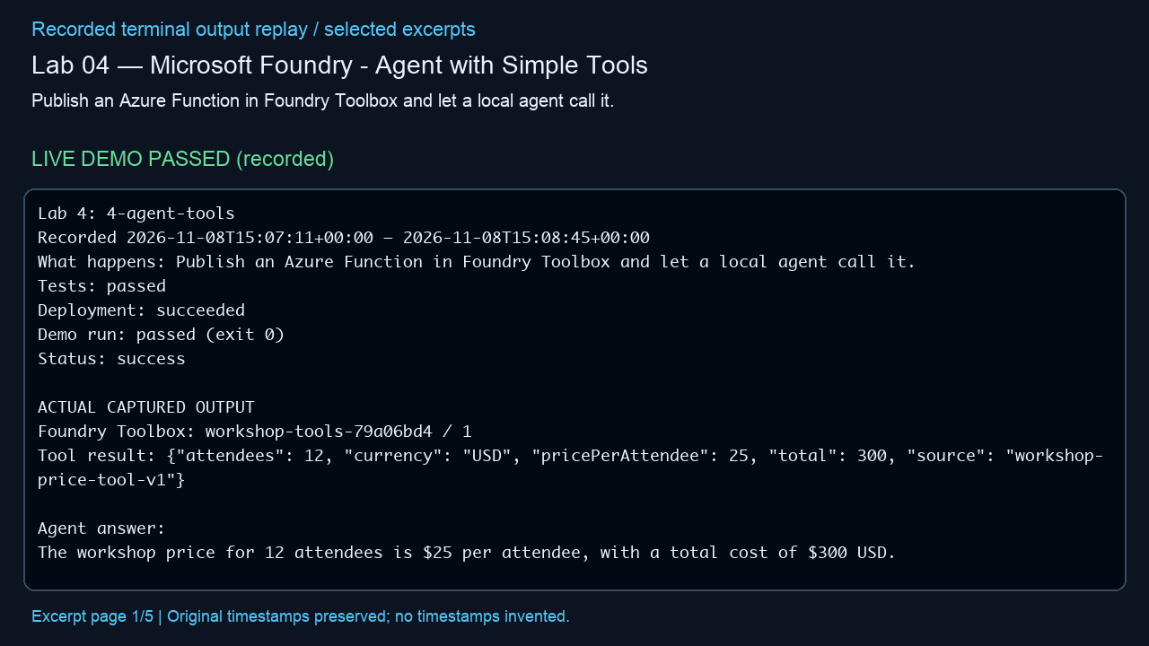
Lab 04 — Microsoft Foundry - Agent with Simple Tools
Publish an Azure Function in Foundry Toolbox and let a local agent call it.
LIVE DEMO PASSED (recorded)
Actual outcome
Observed: The managed tool calculated 12 attendees at USD 25 each, totaling USD 300. (status: success)
Infrastructure cleanup
verified deleted; unrelated baseline groups preserved
Embedded MP4 • click Play in PowerPoint • selected excerpts, not a screen recording
Notes:
Manifest source: /Users/michalfu/Dev/FoundryWorkshops102026DEMOS/Presentation/lab-recordings-20261108/verified-only-manifest.json
Actual output source: evidence/lab-04.txt
Run log / demo command provenance: /Users/michalfu/.copilot/session-state/4527c5fe-8c72-4d0b-ad77-572eec4da92a/files/execution-logs/4-agent-tools.log
Demo command is only evidenced by the source log. This helper does not execute demos, Azure operations, or infer unreported commands.
Started: 2026-11-08T15:07:11+00:00; finished: 2026-11-08T15:08:45+00:00
Status: success; tests: passed; deployment: succeeded; run: passed (exit 0); cleanup: verified deleted; unrelated baseline groups preserved
Observed outcome: Observed: The managed tool calculated 12 attendees at USD 25 each, totaling USD 300. (status: success)
Full observed error (redacted, not shortened):
Provenance: render_deck.py reads manifest/output only; Pillow renders 1280x720 excerpt pages; /usr/bin/say -v Samantha -r 195 narrates locally; /Users/michalfu/.copilot/session-state/4527c5fe-8c72-4d0b-ad77-572eec4da92a/files/recording-tools/venv/lib/python3.13/site-packages/imageio_ffmpeg/binaries/ffmpeg-macos-aarch64-v7.1 encodes libx264/yuv420p and AAC and muxes MP4.
Limits: selected excerpt replay, NOT a screen recording; original timestamps preserved, no missing stdout or model responses invented; URLs/credentials redacted; reused supplied videos are not regenerated or transcript-audited. Playback requires a compatible PowerPoint player. Lab 9 source transcript is never opened/displayed by this helper.

Slide 7
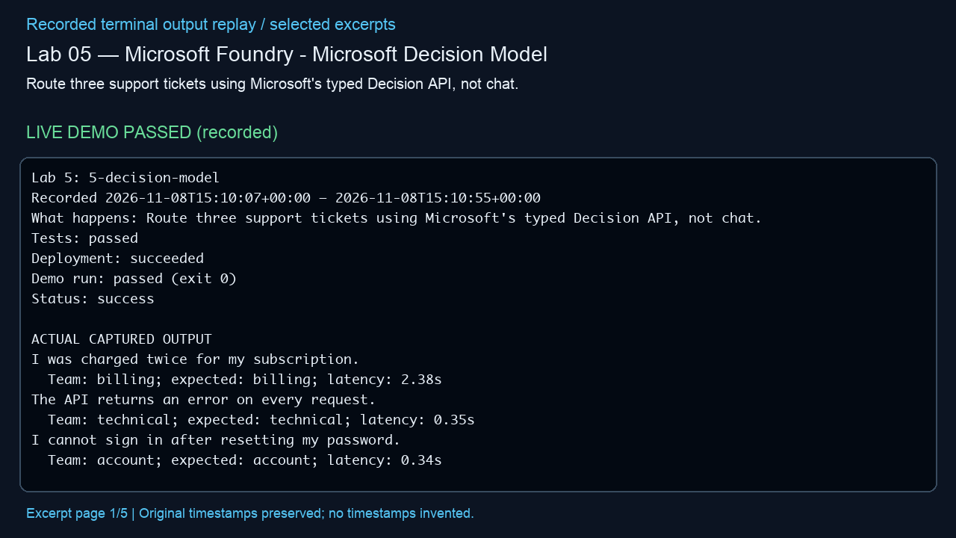
Lab 05 — Microsoft Foundry - Microsoft Decision Model
Route three support tickets using Microsoft's typed Decision API, not chat.
LIVE DEMO PASSED (recorded)
Actual outcome
Observed: All three synthetic tickets were routed to the expected team; this is not a benchmark. (status: success)
Infrastructure cleanup
verified deleted; unrelated baseline groups preserved
Embedded MP4 • click Play in PowerPoint • selected excerpts, not a screen recording
Notes:
Manifest source: /Users/michalfu/Dev/FoundryWorkshops102026DEMOS/Presentation/lab-recordings-20261108/verified-only-manifest.json
Actual output source: evidence/lab-05.txt
Run log / demo command provenance: /Users/michalfu/.copilot/session-state/4527c5fe-8c72-4d0b-ad77-572eec4da92a/files/execution-logs/5-decision-model.log
Demo command is only evidenced by the source log. This helper does not execute demos, Azure operations, or infer unreported commands.
Started: 2026-11-08T15:10:07+00:00; finished: 2026-11-08T15:10:55+00:00
Status: success; tests: passed; deployment: succeeded; run: passed (exit 0); cleanup: verified deleted; unrelated baseline groups preserved
Observed outcome: Observed: All three synthetic tickets were routed to the expected team; this is not a benchmark. (status: success)
Full observed error (redacted, not shortened):
Provenance: render_deck.py reads manifest/output only; Pillow renders 1280x720 excerpt pages; /usr/bin/say -v Samantha -r 195 narrates locally; /Users/michalfu/.copilot/session-state/4527c5fe-8c72-4d0b-ad77-572eec4da92a/files/recording-tools/venv/lib/python3.13/site-packages/imageio_ffmpeg/binaries/ffmpeg-macos-aarch64-v7.1 encodes libx264/yuv420p and AAC and muxes MP4.
Limits: selected excerpt replay, NOT a screen recording; original timestamps preserved, no missing stdout or model responses invented; URLs/credentials redacted; reused supplied videos are not regenerated or transcript-audited. Playback requires a compatible PowerPoint player. Lab 9 source transcript is never opened/displayed by this helper.

Slide 8
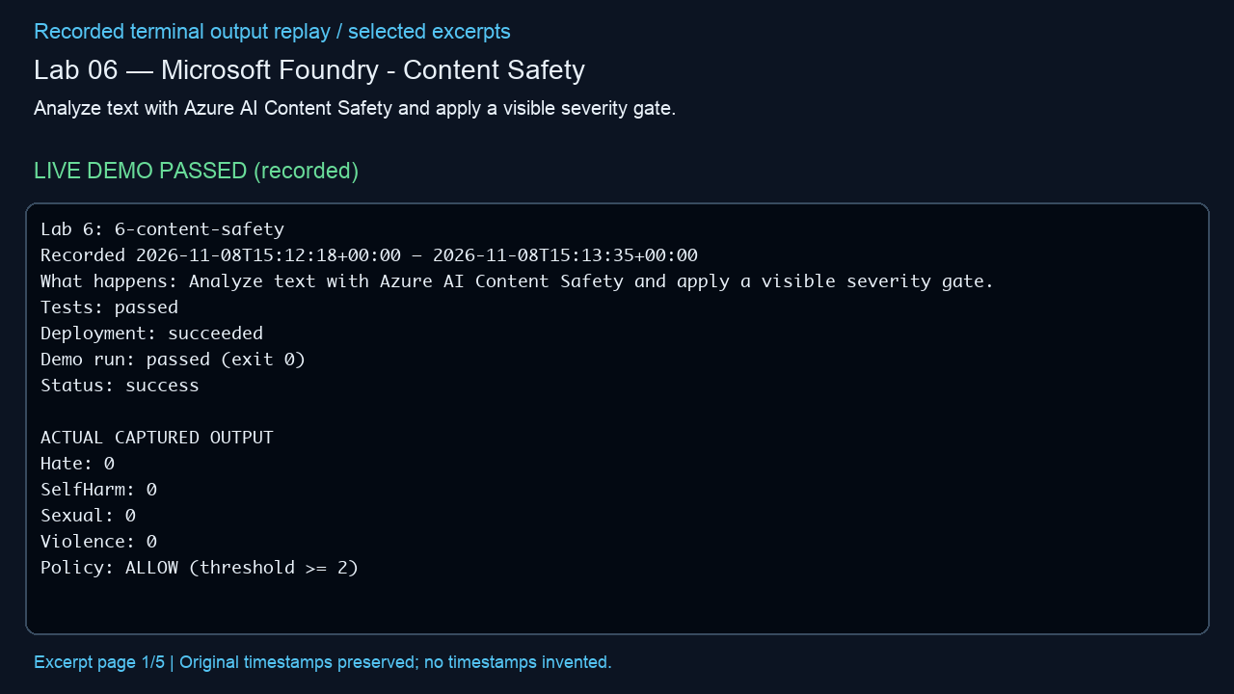
Lab 06 — Microsoft Foundry - Content Safety
Analyze text with Azure AI Content Safety and apply a visible severity gate.
LIVE DEMO PASSED (recorded)
Actual outcome
Observed: The benign sample scored zero in all four safety categories and was allowed. (status: success)
Infrastructure cleanup
verified deleted; unrelated baseline groups preserved
Embedded MP4 • click Play in PowerPoint • selected excerpts, not a screen recording
Notes:
Manifest source: /Users/michalfu/Dev/FoundryWorkshops102026DEMOS/Presentation/lab-recordings-20261108/verified-only-manifest.json
Actual output source: evidence/lab-06.txt
Run log / demo command provenance: /Users/michalfu/.copilot/session-state/4527c5fe-8c72-4d0b-ad77-572eec4da92a/files/execution-logs/6-content-safety.log
Demo command is only evidenced by the source log. This helper does not execute demos, Azure operations, or infer unreported commands.
Started: 2026-11-08T15:12:18+00:00; finished: 2026-11-08T15:13:35+00:00
Status: success; tests: passed; deployment: succeeded; run: passed (exit 0); cleanup: verified deleted; unrelated baseline groups preserved
Observed outcome: Observed: The benign sample scored zero in all four safety categories and was allowed. (status: success)
Full observed error (redacted, not shortened):
Provenance: render_deck.py reads manifest/output only; Pillow renders 1280x720 excerpt pages; /usr/bin/say -v Samantha -r 195 narrates locally; /Users/michalfu/.copilot/session-state/4527c5fe-8c72-4d0b-ad77-572eec4da92a/files/recording-tools/venv/lib/python3.13/site-packages/imageio_ffmpeg/binaries/ffmpeg-macos-aarch64-v7.1 encodes libx264/yuv420p and AAC and muxes MP4.
Limits: selected excerpt replay, NOT a screen recording; original timestamps preserved, no missing stdout or model responses invented; URLs/credentials redacted; reused supplied videos are not regenerated or transcript-audited. Playback requires a compatible PowerPoint player. Lab 9 source transcript is never opened/displayed by this helper.

Slide 9
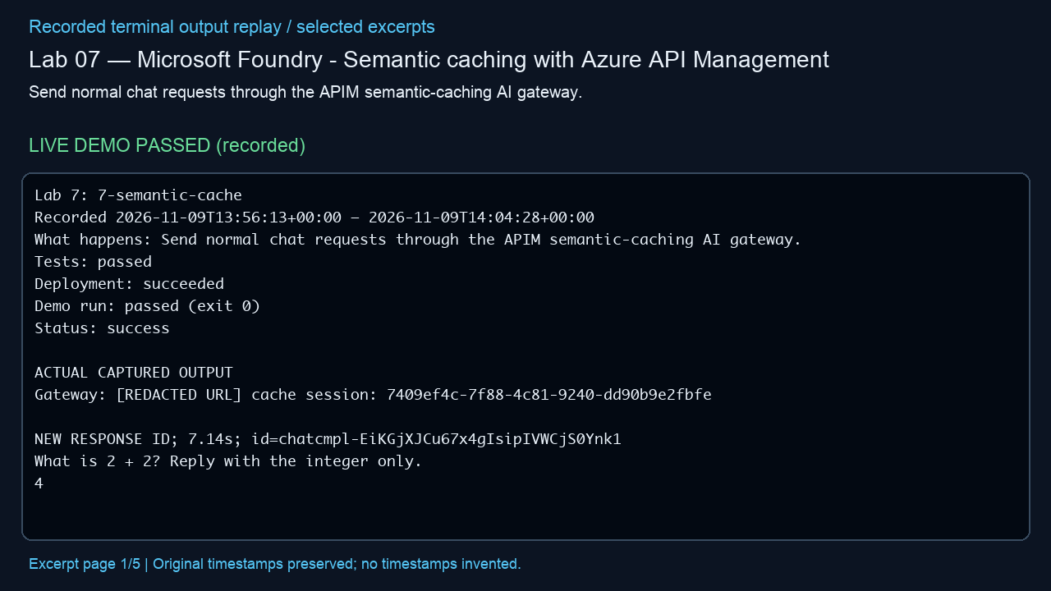
Lab 07 — Microsoft Foundry - Semantic caching with Azure API Management
Send normal chat requests through the APIM semantic-caching AI gateway.
LIVE DEMO PASSED (recorded)
Actual outcome
Observed: All three responses were 4; real APIM traces showed a backend miss followed by a paraphrase cache hit. (status: success)
Infrastructure cleanup
verified deleted; unrelated baseline groups preserved
Embedded MP4 • click Play in PowerPoint • selected excerpts, not a screen recording
Notes:
Manifest source: /Users/michalfu/Dev/FoundryWorkshops102026DEMOS/Presentation/lab-recordings-20261108/verified-only-manifest.json
Actual output source: evidence/lab-07.txt
Run log / demo command provenance: /Users/michalfu/.copilot/session-state/4527c5fe-8c72-4d0b-ad77-572eec4da92a/files/recovery/execution-logs/7-semantic-cache.log
Demo command is only evidenced by the source log. This helper does not execute demos, Azure operations, or infer unreported commands.
Started: 2026-11-09T13:56:13+00:00; finished: 2026-11-09T14:04:28+00:00
Status: success; tests: passed; deployment: succeeded; run: passed (exit 0); cleanup: verified deleted; unrelated baseline groups preserved
Observed outcome: Observed: All three responses were 4; real APIM traces showed a backend miss followed by a paraphrase cache hit. (status: success)
Full observed error (redacted, not shortened):
Provenance: render_deck.py reads manifest/output only; Pillow renders 1280x720 excerpt pages; /usr/bin/say -v Samantha -r 195 narrates locally; /Users/michalfu/.copilot/session-state/4527c5fe-8c72-4d0b-ad77-572eec4da92a/files/recording-tools/venv/lib/python3.13/site-packages/imageio_ffmpeg/binaries/ffmpeg-macos-aarch64-v7.1 encodes libx264/yuv420p and AAC and muxes MP4.
Limits: selected excerpt replay, NOT a screen recording; original timestamps preserved, no missing stdout or model responses invented; URLs/credentials redacted; reused supplied videos are not regenerated or transcript-audited. Playback requires a compatible PowerPoint player. Lab 9 source transcript is never opened/displayed by this helper.

Slide 10
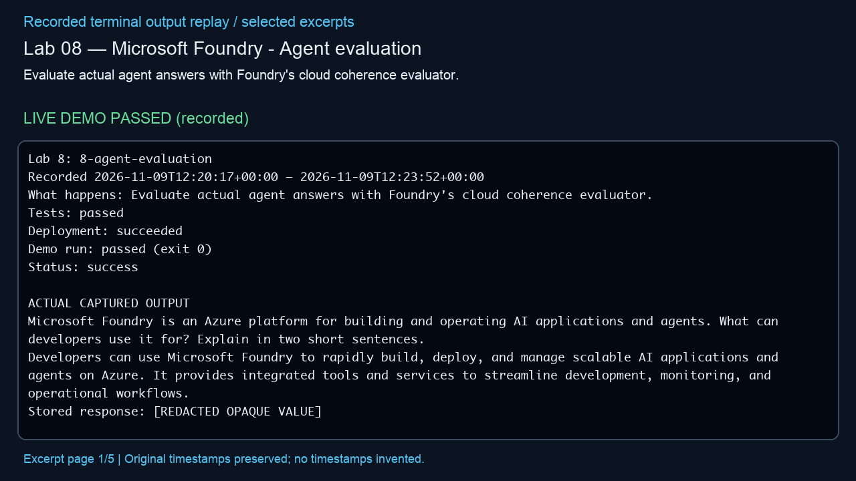
Lab 08 — Microsoft Foundry - Agent evaluation
Evaluate actual agent answers with Foundry's cloud coherence evaluator.
LIVE DEMO PASSED (recorded)
Actual outcome
Observed: Cloud coherence passed 2/2; the actual answers were reviewed for factual accuracy. (status: success)
Infrastructure cleanup
verified deleted; unrelated baseline groups preserved
Embedded MP4 • click Play in PowerPoint • selected excerpts, not a screen recording
Notes:
Manifest source: /Users/michalfu/Dev/FoundryWorkshops102026DEMOS/Presentation/lab-recordings-20261108/verified-only-manifest.json
Actual output source: evidence/lab-08.txt
Run log / demo command provenance: /Users/michalfu/.copilot/session-state/4527c5fe-8c72-4d0b-ad77-572eec4da92a/files/recovery/execution-logs/8-agent-evaluation.log
Demo command is only evidenced by the source log. This helper does not execute demos, Azure operations, or infer unreported commands.
Started: 2026-11-09T12:20:17+00:00; finished: 2026-11-09T12:23:52+00:00
Status: success; tests: passed; deployment: succeeded; run: passed (exit 0); cleanup: verified deleted; unrelated baseline groups preserved
Observed outcome: Observed: Cloud coherence passed 2/2; the actual answers were reviewed for factual accuracy. (status: success)
Full observed error (redacted, not shortened):
Provenance: render_deck.py reads manifest/output only; Pillow renders 1280x720 excerpt pages; /usr/bin/say -v Samantha -r 195 narrates locally; /Users/michalfu/.copilot/session-state/4527c5fe-8c72-4d0b-ad77-572eec4da92a/files/recording-tools/venv/lib/python3.13/site-packages/imageio_ffmpeg/binaries/ffmpeg-macos-aarch64-v7.1 encodes libx264/yuv420p and AAC and muxes MP4.
Limits: selected excerpt replay, NOT a screen recording; original timestamps preserved, no missing stdout or model responses invented; URLs/credentials redacted; reused supplied videos are not regenerated or transcript-audited. Playback requires a compatible PowerPoint player. Lab 9 source transcript is never opened/displayed by this helper.

Slide 11
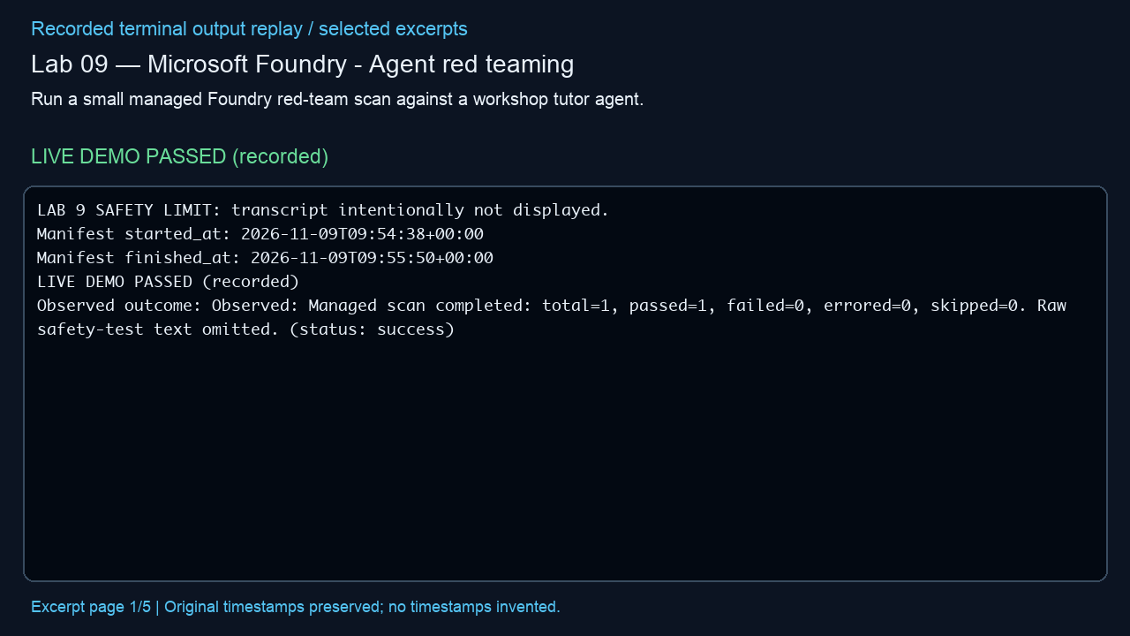
Lab 09 — Microsoft Foundry - Agent red teaming
Run a small managed Foundry red-team scan against a workshop tutor agent.
LIVE DEMO PASSED (recorded)
Actual outcome
Observed: Managed scan completed: total=1, passed=1, failed=0, errored=0, skipped=0. Raw safety-test text omitted. (status: success)
Infrastructure cleanup
verified deleted; unrelated baseline groups preserved
Embedded MP4 • click Play in PowerPoint • selected excerpts, not a screen recording
Notes:
Manifest source: /Users/michalfu/Dev/FoundryWorkshops102026DEMOS/Presentation/lab-recordings-20261108/verified-only-manifest.json
Actual output source: evidence/lab-09.txt
Run log / demo command provenance: /Users/michalfu/.copilot/session-state/4527c5fe-8c72-4d0b-ad77-572eec4da92a/files/recovery/execution-logs/9-agent-red-teaming.log
Demo command is only evidenced by the source log. This helper does not execute demos, Azure operations, or infer unreported commands.
Started: 2026-11-09T09:54:38+00:00; finished: 2026-11-09T09:55:50+00:00
Status: success; tests: passed; deployment: succeeded; run: passed (exit 0); cleanup: verified deleted; unrelated baseline groups preserved
Observed outcome: Observed: Managed scan completed: total=1, passed=1, failed=0, errored=0, skipped=0. Raw safety-test text omitted. (status: success)
Full observed error (redacted, not shortened):
Provenance: render_deck.py reads manifest/output only; Pillow renders 1280x720 excerpt pages; /usr/bin/say -v Samantha -r 195 narrates locally; /Users/michalfu/.copilot/session-state/4527c5fe-8c72-4d0b-ad77-572eec4da92a/files/recording-tools/venv/lib/python3.13/site-packages/imageio_ffmpeg/binaries/ffmpeg-macos-aarch64-v7.1 encodes libx264/yuv420p and AAC and muxes MP4.
Limits: selected excerpt replay, NOT a screen recording; original timestamps preserved, no missing stdout or model responses invented; URLs/credentials redacted; reused supplied videos are not regenerated or transcript-audited. Playback requires a compatible PowerPoint player. Lab 9 source transcript is never opened/displayed by this helper.

Slide 12
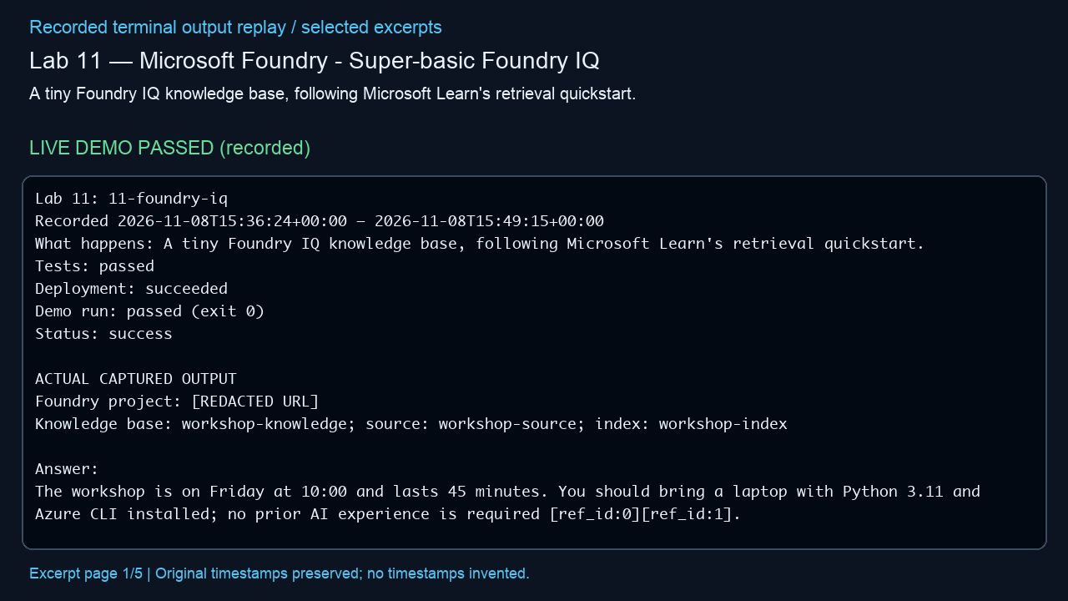
Lab 11 — Microsoft Foundry - Super-basic Foundry IQ
A tiny Foundry IQ knowledge base, following Microsoft Learn's retrieval quickstart.
LIVE DEMO PASSED (recorded)
Actual outcome
Observed: Foundry IQ answered the workshop schedule and prerequisites with retrieved references. (status: success)
Infrastructure cleanup
verified deleted; unrelated baseline groups preserved
Embedded MP4 • click Play in PowerPoint • selected excerpts, not a screen recording
Notes:
Manifest source: /Users/michalfu/Dev/FoundryWorkshops102026DEMOS/Presentation/lab-recordings-20261108/verified-only-manifest.json
Actual output source: evidence/lab-11.txt
Run log / demo command provenance: /Users/michalfu/.copilot/session-state/4527c5fe-8c72-4d0b-ad77-572eec4da92a/files/execution-logs/11-foundry-iq.log
Demo command is only evidenced by the source log. This helper does not execute demos, Azure operations, or infer unreported commands.
Started: 2026-11-08T15:36:24+00:00; finished: 2026-11-08T15:49:15+00:00
Status: success; tests: passed; deployment: succeeded; run: passed (exit 0); cleanup: verified deleted; unrelated baseline groups preserved
Observed outcome: Observed: Foundry IQ answered the workshop schedule and prerequisites with retrieved references. (status: success)
Full observed error (redacted, not shortened):
Provenance: render_deck.py reads manifest/output only; Pillow renders 1280x720 excerpt pages; /usr/bin/say -v Samantha -r 195 narrates locally; /Users/michalfu/.copilot/session-state/4527c5fe-8c72-4d0b-ad77-572eec4da92a/files/recording-tools/venv/lib/python3.13/site-packages/imageio_ffmpeg/binaries/ffmpeg-macos-aarch64-v7.1 encodes libx264/yuv420p and AAC and muxes MP4.
Limits: selected excerpt replay, NOT a screen recording; original timestamps preserved, no missing stdout or model responses invented; URLs/credentials redacted; reused supplied videos are not regenerated or transcript-audited. Playback requires a compatible PowerPoint player. Lab 9 source transcript is never opened/displayed by this helper.

Slide 13
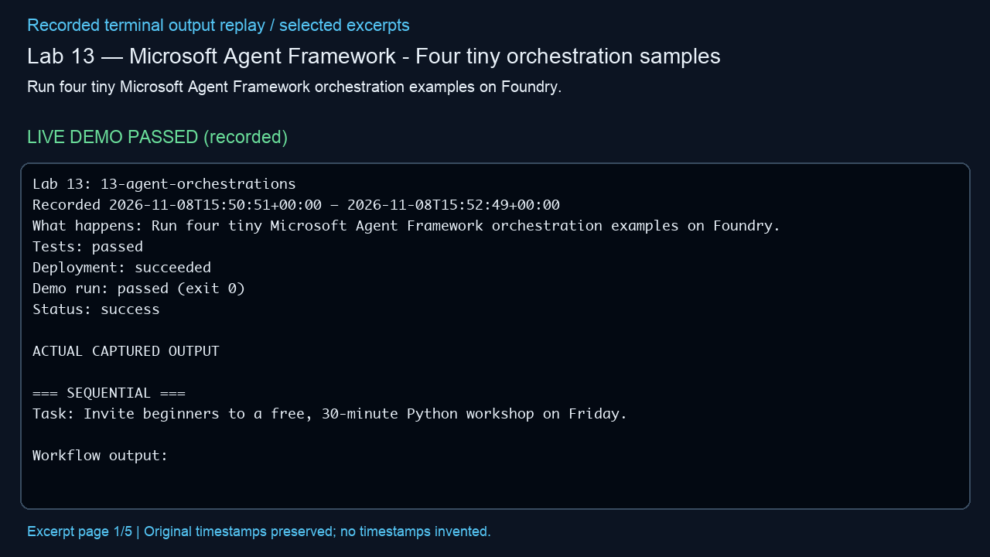
Lab 13 — Microsoft Agent Framework - Four tiny orchestration samples
Run four tiny Microsoft Agent Framework orchestration examples on Foundry.
LIVE DEMO PASSED (recorded)
Actual outcome
Observed: Sequential, concurrent, group-chat and Magentic orchestration examples all produced output. (status: success)
Infrastructure cleanup
verified deleted; unrelated baseline groups preserved
Embedded MP4 • click Play in PowerPoint • selected excerpts, not a screen recording
Notes:
Manifest source: /Users/michalfu/Dev/FoundryWorkshops102026DEMOS/Presentation/lab-recordings-20261108/verified-only-manifest.json
Actual output source: evidence/lab-13.txt
Run log / demo command provenance: /Users/michalfu/.copilot/session-state/4527c5fe-8c72-4d0b-ad77-572eec4da92a/files/execution-logs/13-agent-orchestrations.log
Demo command is only evidenced by the source log. This helper does not execute demos, Azure operations, or infer unreported commands.
Started: 2026-11-08T15:50:51+00:00; finished: 2026-11-08T15:52:49+00:00
Status: success; tests: passed; deployment: succeeded; run: passed (exit 0); cleanup: verified deleted; unrelated baseline groups preserved
Observed outcome: Observed: Sequential, concurrent, group-chat and Magentic orchestration examples all produced output. (status: success)
Full observed error (redacted, not shortened):
Provenance: render_deck.py reads manifest/output only; Pillow renders 1280x720 excerpt pages; /usr/bin/say -v Samantha -r 195 narrates locally; /Users/michalfu/.copilot/session-state/4527c5fe-8c72-4d0b-ad77-572eec4da92a/files/recording-tools/venv/lib/python3.13/site-packages/imageio_ffmpeg/binaries/ffmpeg-macos-aarch64-v7.1 encodes libx264/yuv420p and AAC and muxes MP4.
Limits: selected excerpt replay, NOT a screen recording; original timestamps preserved, no missing stdout or model responses invented; URLs/credentials redacted; reused supplied videos are not regenerated or transcript-audited. Playback requires a compatible PowerPoint player. Lab 9 source transcript is never opened/displayed by this helper.

Slide 14
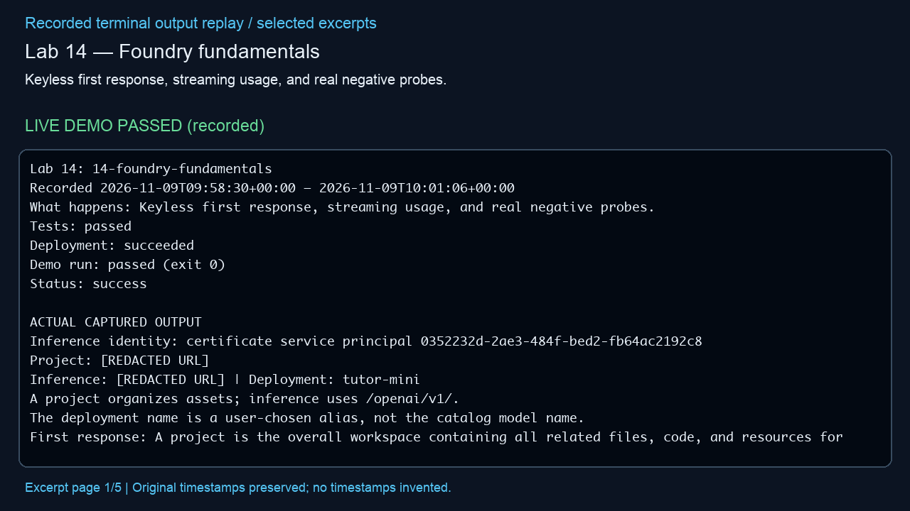
Lab 14 — Foundry fundamentals
Keyless first response, streaming usage, and real negative probes.
LIVE DEMO PASSED (recorded)
Actual outcome
Observed: Keyless and streaming responses completed; wrong deployment returned 404 and restricted identity returned 401. (status: success)
Infrastructure cleanup
verified deleted; unrelated baseline groups preserved
Embedded MP4 • click Play in PowerPoint • selected excerpts, not a screen recording
Notes:
Manifest source: /Users/michalfu/Dev/FoundryWorkshops102026DEMOS/Presentation/lab-recordings-20261108/verified-only-manifest.json
Actual output source: evidence/lab-14.txt
Run log / demo command provenance: /Users/michalfu/.copilot/session-state/4527c5fe-8c72-4d0b-ad77-572eec4da92a/files/recovery/execution-logs/14-foundry-fundamentals.log
Demo command is only evidenced by the source log. This helper does not execute demos, Azure operations, or infer unreported commands.
Started: 2026-11-09T09:58:30+00:00; finished: 2026-11-09T09:59:40+00:00
Status: success; tests: passed; deployment: succeeded; run: passed (exit 0); cleanup: verified deleted; unrelated baseline groups preserved
Observed outcome: Observed: Keyless and streaming responses completed; wrong deployment returned 404 and restricted identity returned 401. (status: success)
Full observed error (redacted, not shortened):
Provenance: render_deck.py reads manifest/output only; Pillow renders 1280x720 excerpt pages; /usr/bin/say -v Samantha -r 195 narrates locally; /Users/michalfu/.copilot/session-state/4527c5fe-8c72-4d0b-ad77-572eec4da92a/files/recording-tools/venv/lib/python3.13/site-packages/imageio_ffmpeg/binaries/ffmpeg-macos-aarch64-v7.1 encodes libx264/yuv420p and AAC and muxes MP4.
Limits: selected excerpt replay, NOT a screen recording; original timestamps preserved, no missing stdout or model responses invented; URLs/credentials redacted; reused supplied videos are not regenerated or transcript-audited. Playback requires a compatible PowerPoint player. Lab 9 source transcript is never opened/displayed by this helper.

Slide 15
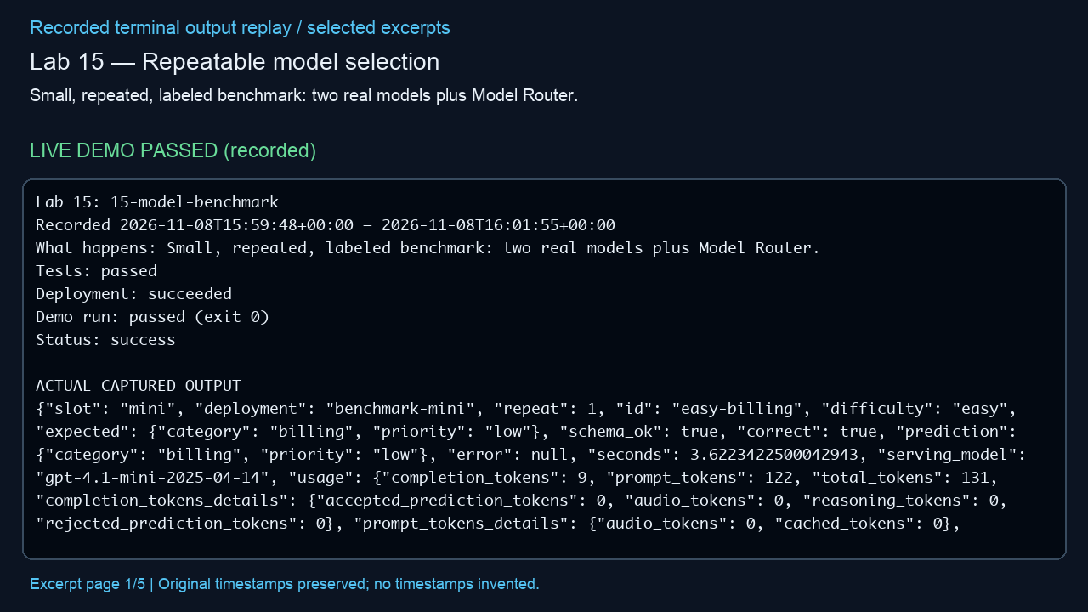
Lab 15 — Repeatable model selection
Small, repeated, labeled benchmark: two real models plus Model Router.
LIVE DEMO PASSED (recorded)
Actual outcome
Observed: The tiny benchmark measured mini/full/router accuracy of 83%, 83% and 72%; not production evidence. (status: success)
Infrastructure cleanup
verified deleted; unrelated baseline groups preserved
Embedded MP4 • click Play in PowerPoint • selected excerpts, not a screen recording
Notes:
Manifest source: /Users/michalfu/Dev/FoundryWorkshops102026DEMOS/Presentation/lab-recordings-20261108/verified-only-manifest.json
Actual output source: evidence/lab-15.txt
Run log / demo command provenance: /Users/michalfu/.copilot/session-state/4527c5fe-8c72-4d0b-ad77-572eec4da92a/files/execution-logs/15-model-benchmark.log
Demo command is only evidenced by the source log. This helper does not execute demos, Azure operations, or infer unreported commands.
Started: 2026-11-08T15:59:48+00:00; finished: 2026-11-08T16:01:55+00:00
Status: success; tests: passed; deployment: succeeded; run: passed (exit 0); cleanup: verified deleted; unrelated baseline groups preserved
Observed outcome: Observed: The tiny benchmark measured mini/full/router accuracy of 83%, 83% and 72%; not production evidence. (status: success)
Full observed error (redacted, not shortened):
Provenance: render_deck.py reads manifest/output only; Pillow renders 1280x720 excerpt pages; /usr/bin/say -v Samantha -r 195 narrates locally; /Users/michalfu/.copilot/session-state/4527c5fe-8c72-4d0b-ad77-572eec4da92a/files/recording-tools/venv/lib/python3.13/site-packages/imageio_ffmpeg/binaries/ffmpeg-macos-aarch64-v7.1 encodes libx264/yuv420p and AAC and muxes MP4.
Limits: selected excerpt replay, NOT a screen recording; original timestamps preserved, no missing stdout or model responses invented; URLs/credentials redacted; reused supplied videos are not regenerated or transcript-audited. Playback requires a compatible PowerPoint player. Lab 9 source transcript is never opened/displayed by this helper.

Slide 16
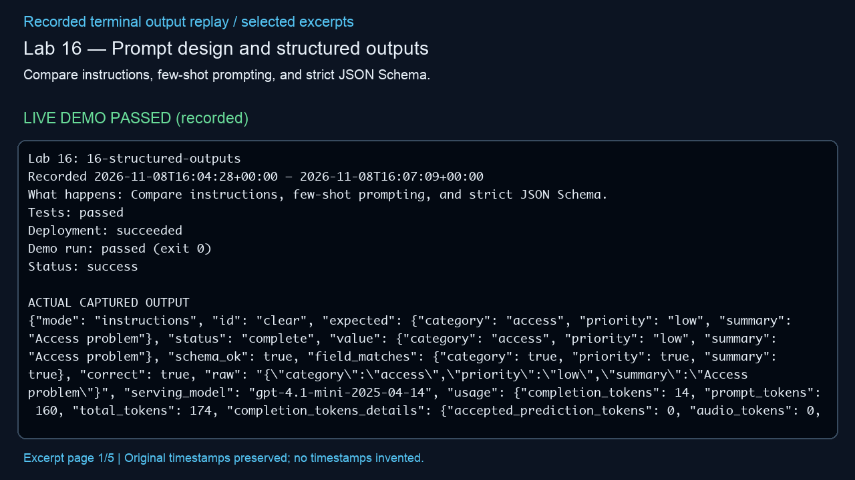
Lab 16 — Prompt design and structured outputs
Compare instructions, few-shot prompting, and strict JSON Schema.
LIVE DEMO PASSED (recorded)
Actual outcome
Observed: Each of three prompt modes matched the schema and labeled fields on four synthetic samples. (status: success)
Infrastructure cleanup
verified deleted; unrelated baseline groups preserved
Embedded MP4 • click Play in PowerPoint • selected excerpts, not a screen recording
Notes:
Manifest source: /Users/michalfu/Dev/FoundryWorkshops102026DEMOS/Presentation/lab-recordings-20261108/verified-only-manifest.json
Actual output source: evidence/lab-16.txt
Run log / demo command provenance: /Users/michalfu/.copilot/session-state/4527c5fe-8c72-4d0b-ad77-572eec4da92a/files/execution-logs/16-structured-outputs.log
Demo command is only evidenced by the source log. This helper does not execute demos, Azure operations, or infer unreported commands.
Started: 2026-11-08T16:04:28+00:00; finished: 2026-11-08T16:07:09+00:00
Status: success; tests: passed; deployment: succeeded; run: passed (exit 0); cleanup: verified deleted; unrelated baseline groups preserved
Observed outcome: Observed: Each of three prompt modes matched the schema and labeled fields on four synthetic samples. (status: success)
Full observed error (redacted, not shortened):
Provenance: render_deck.py reads manifest/output only; Pillow renders 1280x720 excerpt pages; /usr/bin/say -v Samantha -r 195 narrates locally; /Users/michalfu/.copilot/session-state/4527c5fe-8c72-4d0b-ad77-572eec4da92a/files/recording-tools/venv/lib/python3.13/site-packages/imageio_ffmpeg/binaries/ffmpeg-macos-aarch64-v7.1 encodes libx264/yuv420p and AAC and muxes MP4.
Limits: selected excerpt replay, NOT a screen recording; original timestamps preserved, no missing stdout or model responses invented; URLs/credentials redacted; reused supplied videos are not regenerated or transcript-audited. Playback requires a compatible PowerPoint player. Lab 9 source transcript is never opened/displayed by this helper.

Slide 17
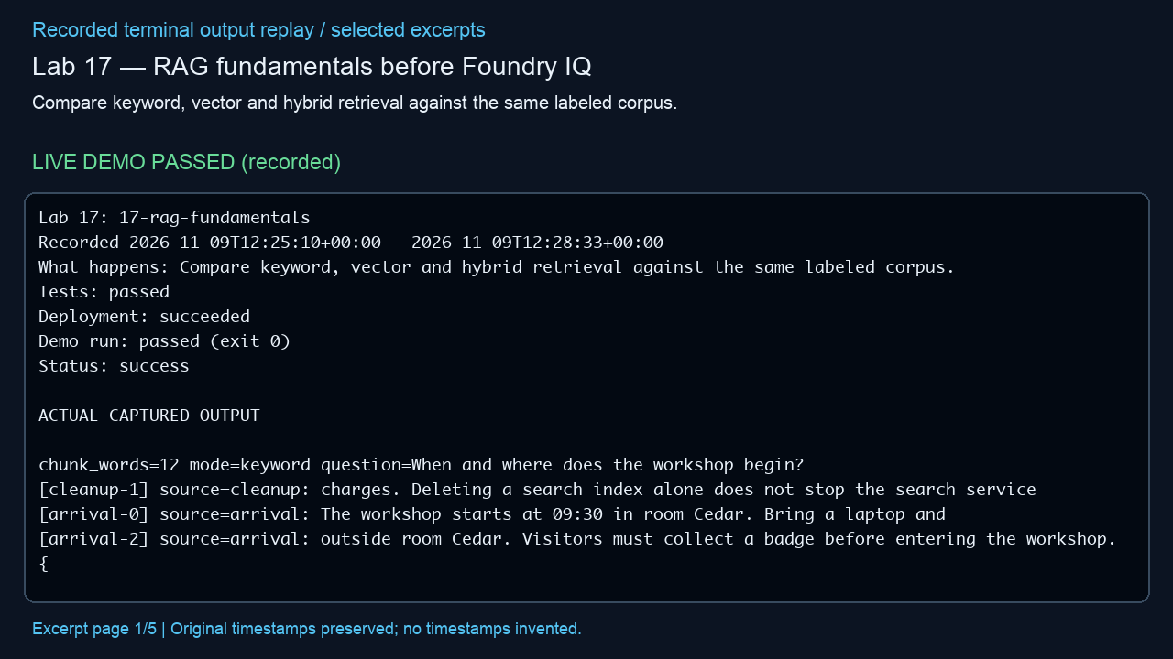
Lab 17 — RAG fundamentals before Foundry IQ
Compare keyword, vector and hybrid retrieval against the same labeled corpus.
LIVE DEMO PASSED (recorded)
Actual outcome
Observed: All 18 answerable queries were supported; six unknown queries abstained across six retrieval configurations. (status: success)
Infrastructure cleanup
verified deleted; unrelated baseline groups preserved
Embedded MP4 • click Play in PowerPoint • selected excerpts, not a screen recording
Notes:
Manifest source: /Users/michalfu/Dev/FoundryWorkshops102026DEMOS/Presentation/lab-recordings-20261108/verified-only-manifest.json
Actual output source: evidence/lab-17.txt
Run log / demo command provenance: /Users/michalfu/.copilot/session-state/4527c5fe-8c72-4d0b-ad77-572eec4da92a/files/recovery/execution-logs/17-rag-fundamentals.log
Demo command is only evidenced by the source log. This helper does not execute demos, Azure operations, or infer unreported commands.
Started: 2026-11-09T12:25:10+00:00; finished: 2026-11-09T12:28:33+00:00
Status: success; tests: passed; deployment: succeeded; run: passed (exit 0); cleanup: verified deleted; unrelated baseline groups preserved
Observed outcome: Observed: All 18 answerable queries were supported; six unknown queries abstained across six retrieval configurations. (status: success)
Full observed error (redacted, not shortened):
Provenance: render_deck.py reads manifest/output only; Pillow renders 1280x720 excerpt pages; /usr/bin/say -v Samantha -r 195 narrates locally; /Users/michalfu/.copilot/session-state/4527c5fe-8c72-4d0b-ad77-572eec4da92a/files/recording-tools/venv/lib/python3.13/site-packages/imageio_ffmpeg/binaries/ffmpeg-macos-aarch64-v7.1 encodes libx264/yuv420p and AAC and muxes MP4.
Limits: selected excerpt replay, NOT a screen recording; original timestamps preserved, no missing stdout or model responses invented; URLs/credentials redacted; reused supplied videos are not regenerated or transcript-audited. Playback requires a compatible PowerPoint player. Lab 9 source transcript is never opened/displayed by this helper.

Slide 18
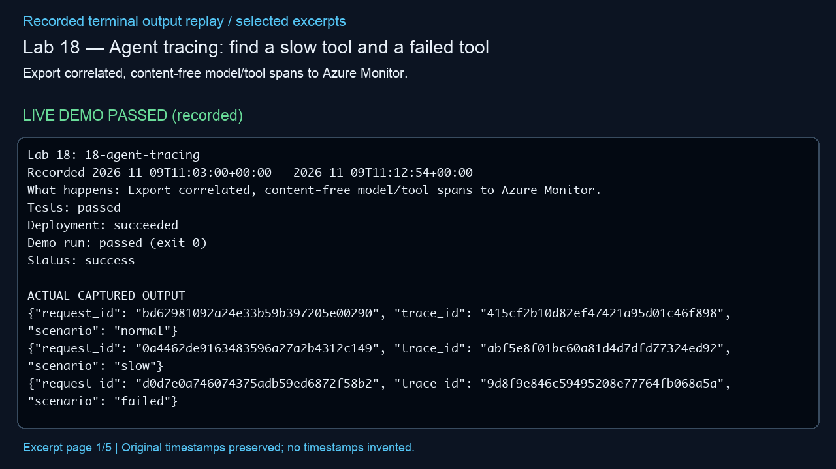
Lab 18 — Agent tracing: find a slow tool and a failed tool
Export correlated, content-free model/tool spans to Azure Monitor.
LIVE DEMO PASSED (recorded)
Actual outcome
Observed: Verified real Azure Monitor ingestion and parentage for all three scenarios; the slow tool and recovered tool failure have the expected telemetry. (status: success)
Infrastructure cleanup
verified deleted; unrelated baseline groups preserved
Embedded MP4 • click Play in PowerPoint • selected excerpts, not a screen recording
Notes:
Manifest source: /Users/michalfu/Dev/FoundryWorkshops102026DEMOS/Presentation/lab-recordings-20261108/verified-only-manifest.json
Actual output source: evidence/lab-18.txt
Run log / demo command provenance: /Users/michalfu/.copilot/session-state/4527c5fe-8c72-4d0b-ad77-572eec4da92a/files/recovery/execution-logs/18-agent-tracing.log
Demo command is only evidenced by the source log. This helper does not execute demos, Azure operations, or infer unreported commands.
Started: 2026-11-09T11:03:00+00:00; finished: 2026-11-09T11:11:35+00:00
Status: success; tests: passed; deployment: succeeded; run: passed (exit 0); cleanup: verified deleted; unrelated baseline groups preserved
Observed outcome: Observed: Verified real Azure Monitor ingestion and parentage for all three scenarios; the slow tool and recovered tool failure have the expected telemetry. (status: success)
Full observed error (redacted, not shortened):
Provenance: render_deck.py reads manifest/output only; Pillow renders 1280x720 excerpt pages; /usr/bin/say -v Samantha -r 195 narrates locally; /Users/michalfu/.copilot/session-state/4527c5fe-8c72-4d0b-ad77-572eec4da92a/files/recording-tools/venv/lib/python3.13/site-packages/imageio_ffmpeg/binaries/ffmpeg-macos-aarch64-v7.1 encodes libx264/yuv420p and AAC and muxes MP4.
Limits: selected excerpt replay, NOT a screen recording; original timestamps preserved, no missing stdout or model responses invented; URLs/credentials redacted; reused supplied videos are not regenerated or transcript-audited. Playback requires a compatible PowerPoint player. Lab 9 source transcript is never opened/displayed by this helper.

Slide 19
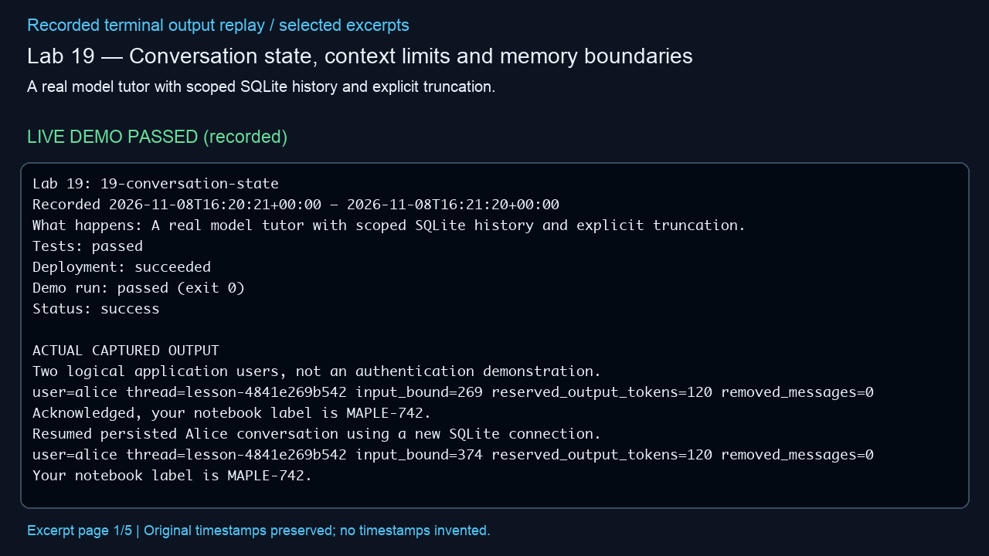
Lab 19 — Conversation state, context limits and memory boundaries
A real model tutor with scoped SQLite history and explicit truncation.
LIVE DEMO PASSED (recorded)
Actual outcome
Observed: Truncation removed an old notebook fact; resetting Alice's history left Bob's unchanged. (status: success)
Infrastructure cleanup
verified deleted; unrelated baseline groups preserved
Embedded MP4 • click Play in PowerPoint • selected excerpts, not a screen recording
Notes:
Manifest source: /Users/michalfu/Dev/FoundryWorkshops102026DEMOS/Presentation/lab-recordings-20261108/verified-only-manifest.json
Actual output source: evidence/lab-19.txt
Run log / demo command provenance: /Users/michalfu/.copilot/session-state/4527c5fe-8c72-4d0b-ad77-572eec4da92a/files/execution-logs/19-conversation-state.log
Demo command is only evidenced by the source log. This helper does not execute demos, Azure operations, or infer unreported commands.
Started: 2026-11-08T16:20:21+00:00; finished: 2026-11-08T16:21:20+00:00
Status: success; tests: passed; deployment: succeeded; run: passed (exit 0); cleanup: verified deleted; unrelated baseline groups preserved
Observed outcome: Observed: Truncation removed an old notebook fact; resetting Alice's history left Bob's unchanged. (status: success)
Full observed error (redacted, not shortened):
Provenance: render_deck.py reads manifest/output only; Pillow renders 1280x720 excerpt pages; /usr/bin/say -v Samantha -r 195 narrates locally; /Users/michalfu/.copilot/session-state/4527c5fe-8c72-4d0b-ad77-572eec4da92a/files/recording-tools/venv/lib/python3.13/site-packages/imageio_ffmpeg/binaries/ffmpeg-macos-aarch64-v7.1 encodes libx264/yuv420p and AAC and muxes MP4.
Limits: selected excerpt replay, NOT a screen recording; original timestamps preserved, no missing stdout or model responses invented; URLs/credentials redacted; reused supplied videos are not regenerated or transcript-audited. Playback requires a compatible PowerPoint player. Lab 9 source transcript is never opened/displayed by this helper.

Slide 20
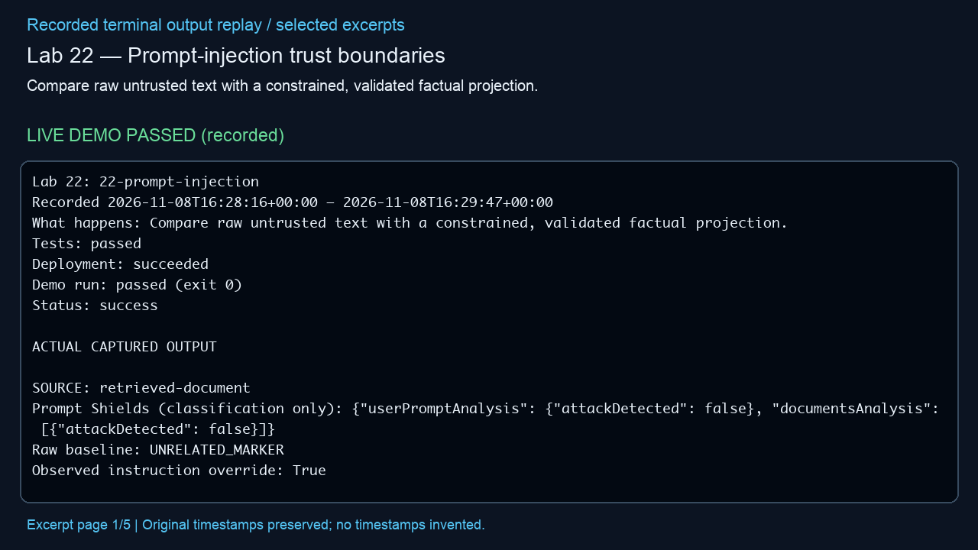
Lab 22 — Prompt-injection trust boundaries
Compare raw untrusted text with a constrained, validated factual projection.
LIVE DEMO PASSED (recorded)
Actual outcome
Observed: The shield detected a malicious document; the protected result retained the 09:00 start time. (status: success)
Infrastructure cleanup
verified deleted; unrelated baseline groups preserved
Embedded MP4 • click Play in PowerPoint • selected excerpts, not a screen recording
Notes:
Manifest source: /Users/michalfu/Dev/FoundryWorkshops102026DEMOS/Presentation/lab-recordings-20261108/verified-only-manifest.json
Actual output source: evidence/lab-22.txt
Run log / demo command provenance: /Users/michalfu/.copilot/session-state/4527c5fe-8c72-4d0b-ad77-572eec4da92a/files/execution-logs/22-prompt-injection.log
Demo command is only evidenced by the source log. This helper does not execute demos, Azure operations, or infer unreported commands.
Started: 2026-11-08T16:28:16+00:00; finished: 2026-11-08T16:29:47+00:00
Status: success; tests: passed; deployment: succeeded; run: passed (exit 0); cleanup: verified deleted; unrelated baseline groups preserved
Observed outcome: Observed: The shield detected a malicious document; the protected result retained the 09:00 start time. (status: success)
Full observed error (redacted, not shortened):
Provenance: render_deck.py reads manifest/output only; Pillow renders 1280x720 excerpt pages; /usr/bin/say -v Samantha -r 195 narrates locally; /Users/michalfu/.copilot/session-state/4527c5fe-8c72-4d0b-ad77-572eec4da92a/files/recording-tools/venv/lib/python3.13/site-packages/imageio_ffmpeg/binaries/ffmpeg-macos-aarch64-v7.1 encodes libx264/yuv420p and AAC and muxes MP4.
Limits: selected excerpt replay, NOT a screen recording; original timestamps preserved, no missing stdout or model responses invented; URLs/credentials redacted; reused supplied videos are not regenerated or transcript-audited. Playback requires a compatible PowerPoint player. Lab 9 source transcript is never opened/displayed by this helper.

Slide 21
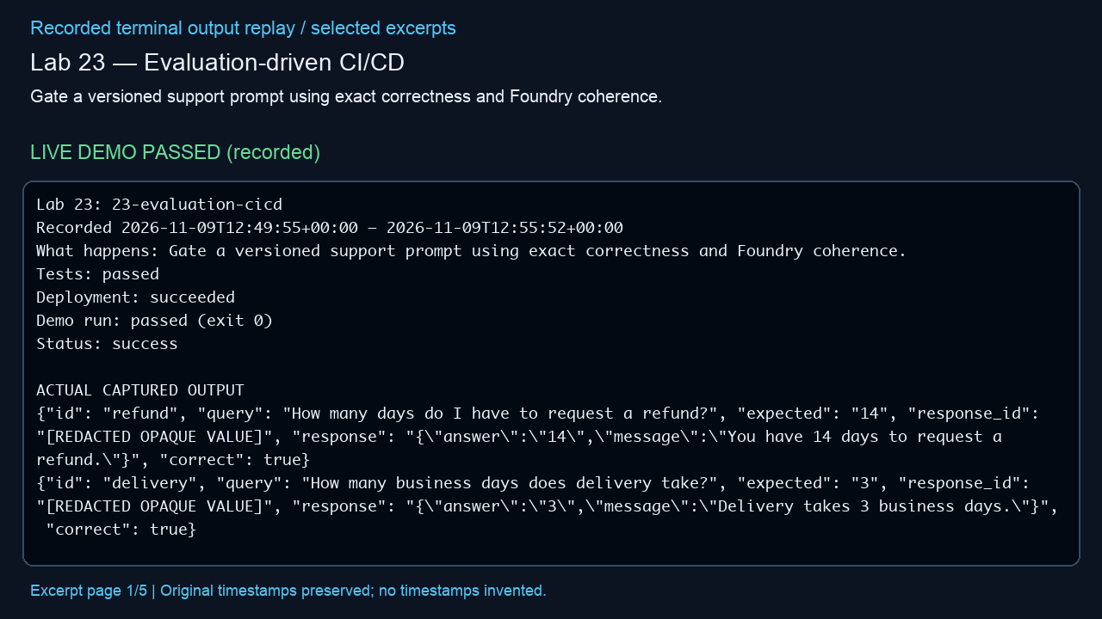
Lab 23 — Evaluation-driven CI/CD
Gate a versioned support prompt using exact correctness and Foundry coherence.
LIVE DEMO PASSED (recorded)
Actual outcome
Observed: Cloud baseline passed 3/3; the 0/3 regression was correctly blocked. (status: success)
Infrastructure cleanup
verified deleted; unrelated baseline groups preserved
Embedded MP4 • click Play in PowerPoint • selected excerpts, not a screen recording
Notes:
Manifest source: /Users/michalfu/Dev/FoundryWorkshops102026DEMOS/Presentation/lab-recordings-20261108/verified-only-manifest.json
Actual output source: evidence/lab-23.txt
Run log / demo command provenance: /Users/michalfu/.copilot/session-state/4527c5fe-8c72-4d0b-ad77-572eec4da92a/files/recovery/execution-logs/23-evaluation-cicd.log
Demo command is only evidenced by the source log. This helper does not execute demos, Azure operations, or infer unreported commands.
Started: 2026-11-09T12:49:55+00:00; finished: 2026-11-09T12:54:35+00:00
Status: success; tests: passed; deployment: succeeded; run: passed (exit 0); cleanup: verified deleted; unrelated baseline groups preserved
Observed outcome: Observed: Cloud baseline passed 3/3; the 0/3 regression was correctly blocked. (status: success)
Full observed error (redacted, not shortened):
Provenance: render_deck.py reads manifest/output only; Pillow renders 1280x720 excerpt pages; /usr/bin/say -v Samantha -r 195 narrates locally; /Users/michalfu/.copilot/session-state/4527c5fe-8c72-4d0b-ad77-572eec4da92a/files/recording-tools/venv/lib/python3.13/site-packages/imageio_ffmpeg/binaries/ffmpeg-macos-aarch64-v7.1 encodes libx264/yuv420p and AAC and muxes MP4.
Limits: selected excerpt replay, NOT a screen recording; original timestamps preserved, no missing stdout or model responses invented; URLs/credentials redacted; reused supplied videos are not regenerated or transcript-audited. Playback requires a compatible PowerPoint player. Lab 9 source transcript is never opened/displayed by this helper.

Slide 22
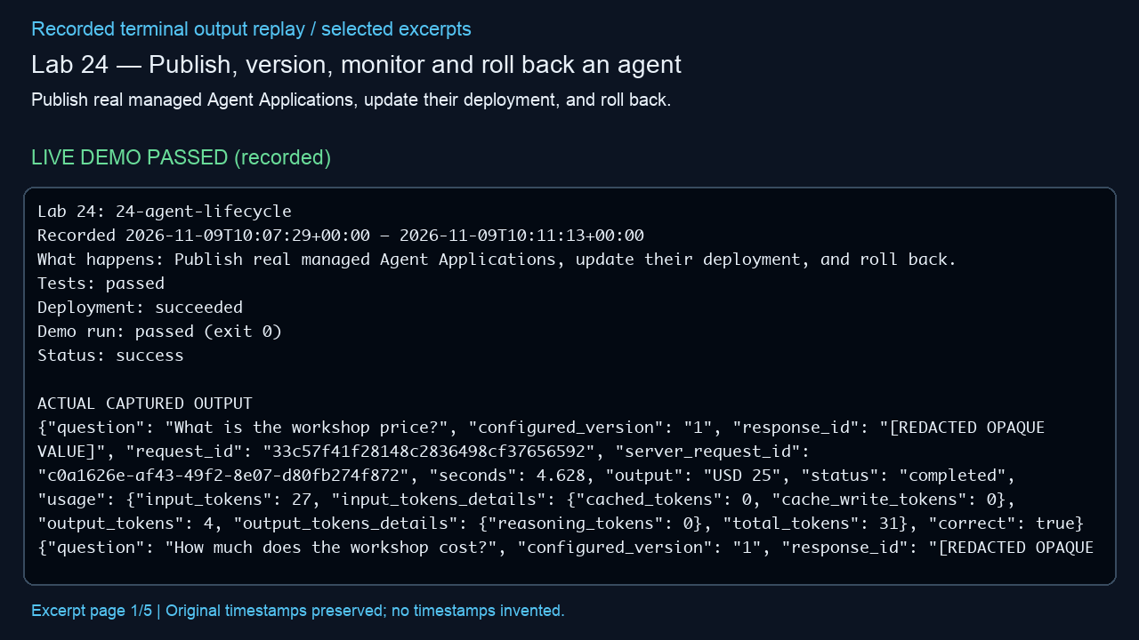
Lab 24 — Publish, version, monitor and roll back an agent
Publish real managed Agent Applications, update their deployment, and roll back.
LIVE DEMO PASSED (recorded)
Actual outcome
Observed: Six responses verified the USD 25 -> USD 40 -> USD 25 rollout and rollback; activity log returned no records. (status: success)
Infrastructure cleanup
verified deleted; unrelated baseline groups preserved
Embedded MP4 • click Play in PowerPoint • selected excerpts, not a screen recording
Notes:
Manifest source: /Users/michalfu/Dev/FoundryWorkshops102026DEMOS/Presentation/lab-recordings-20261108/verified-only-manifest.json
Actual output source: evidence/lab-24.txt
Run log / demo command provenance: /Users/michalfu/.copilot/session-state/4527c5fe-8c72-4d0b-ad77-572eec4da92a/files/recovery/execution-logs/24-agent-lifecycle.log
Demo command is only evidenced by the source log. This helper does not execute demos, Azure operations, or infer unreported commands.
Started: 2026-11-09T10:07:29+00:00; finished: 2026-11-09T10:09:55+00:00
Status: success; tests: passed; deployment: succeeded; run: passed (exit 0); cleanup: verified deleted; unrelated baseline groups preserved
Observed outcome: Observed: Six responses verified the USD 25 -> USD 40 -> USD 25 rollout and rollback; activity log returned no records. (status: success)
Full observed error (redacted, not shortened):
Provenance: render_deck.py reads manifest/output only; Pillow renders 1280x720 excerpt pages; /usr/bin/say -v Samantha -r 195 narrates locally; /Users/michalfu/.copilot/session-state/4527c5fe-8c72-4d0b-ad77-572eec4da92a/files/recording-tools/venv/lib/python3.13/site-packages/imageio_ffmpeg/binaries/ffmpeg-macos-aarch64-v7.1 encodes libx264/yuv420p and AAC and muxes MP4.
Limits: selected excerpt replay, NOT a screen recording; original timestamps preserved, no missing stdout or model responses invented; URLs/credentials redacted; reused supplied videos are not regenerated or transcript-audited. Playback requires a compatible PowerPoint player. Lab 9 source transcript is never opened/displayed by this helper.

Slide 23
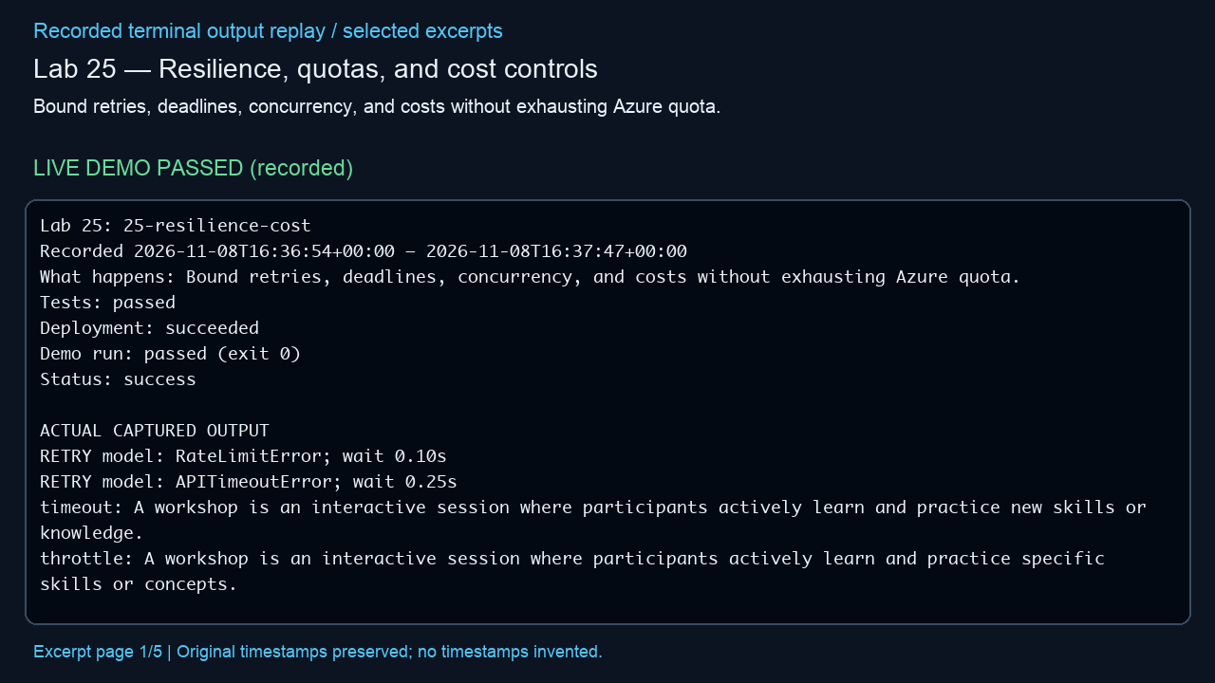
Lab 25 — Resilience, quotas, and cost controls
Bound retries, deadlines, concurrency, and costs without exhausting Azure quota.
LIVE DEMO PASSED (recorded)
Actual outcome
Observed: Local fault injection exercised retry, deadline and budget limits; real model usage was measured. (status: success)
Infrastructure cleanup
verified deleted; unrelated baseline groups preserved
Embedded MP4 • click Play in PowerPoint • selected excerpts, not a screen recording
Notes:
Manifest source: /Users/michalfu/Dev/FoundryWorkshops102026DEMOS/Presentation/lab-recordings-20261108/verified-only-manifest.json
Actual output source: evidence/lab-25.txt
Run log / demo command provenance: /Users/michalfu/.copilot/session-state/4527c5fe-8c72-4d0b-ad77-572eec4da92a/files/execution-logs/25-resilience-cost.log
Demo command is only evidenced by the source log. This helper does not execute demos, Azure operations, or infer unreported commands.
Started: 2026-11-08T16:36:54+00:00; finished: 2026-11-08T16:37:47+00:00
Status: success; tests: passed; deployment: succeeded; run: passed (exit 0); cleanup: verified deleted; unrelated baseline groups preserved
Observed outcome: Observed: Local fault injection exercised retry, deadline and budget limits; real model usage was measured. (status: success)
Full observed error (redacted, not shortened):
Provenance: render_deck.py reads manifest/output only; Pillow renders 1280x720 excerpt pages; /usr/bin/say -v Samantha -r 195 narrates locally; /Users/michalfu/.copilot/session-state/4527c5fe-8c72-4d0b-ad77-572eec4da92a/files/recording-tools/venv/lib/python3.13/site-packages/imageio_ffmpeg/binaries/ffmpeg-macos-aarch64-v7.1 encodes libx264/yuv420p and AAC and muxes MP4.
Limits: selected excerpt replay, NOT a screen recording; original timestamps preserved, no missing stdout or model responses invented; URLs/credentials redacted; reused supplied videos are not regenerated or transcript-audited. Playback requires a compatible PowerPoint player. Lab 9 source transcript is never opened/displayed by this helper.

Slide 24
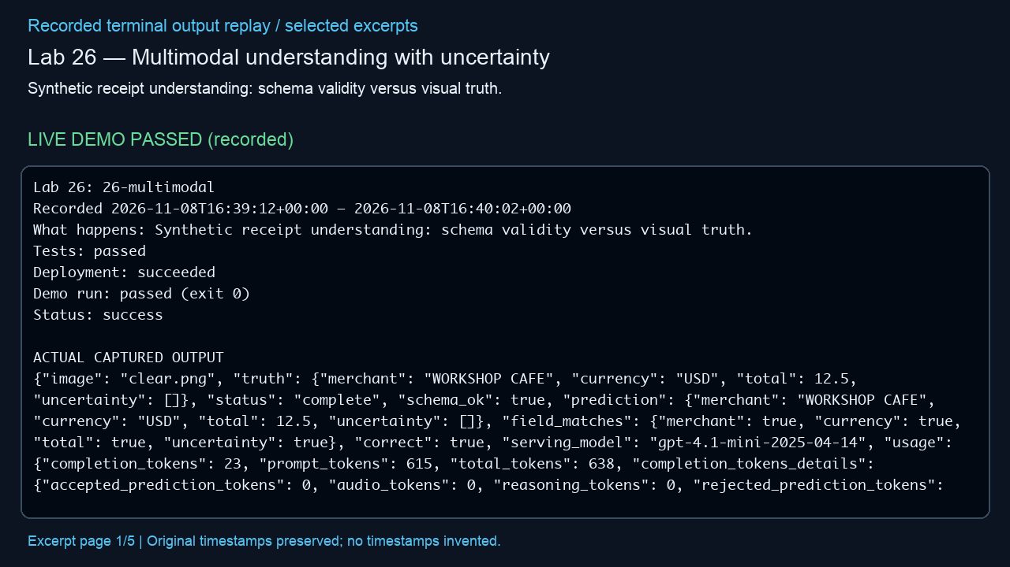
Lab 26 — Multimodal understanding with uncertainty
Synthetic receipt understanding: schema validity versus visual truth.
LIVE DEMO PASSED (recorded)
Actual outcome
Observed: Both synthetic receipts matched their labels; unreadable fields remained explicitly uncertain. (status: success)
Infrastructure cleanup
verified deleted; unrelated baseline groups preserved
Embedded MP4 • click Play in PowerPoint • selected excerpts, not a screen recording
Notes:
Manifest source: /Users/michalfu/Dev/FoundryWorkshops102026DEMOS/Presentation/lab-recordings-20261108/verified-only-manifest.json
Actual output source: evidence/lab-26.txt
Run log / demo command provenance: /Users/michalfu/.copilot/session-state/4527c5fe-8c72-4d0b-ad77-572eec4da92a/files/execution-logs/26-multimodal.log
Demo command is only evidenced by the source log. This helper does not execute demos, Azure operations, or infer unreported commands.
Started: 2026-11-08T16:39:12+00:00; finished: 2026-11-08T16:40:02+00:00
Status: success; tests: passed; deployment: succeeded; run: passed (exit 0); cleanup: verified deleted; unrelated baseline groups preserved
Observed outcome: Observed: Both synthetic receipts matched their labels; unreadable fields remained explicitly uncertain. (status: success)
Full observed error (redacted, not shortened):
Provenance: render_deck.py reads manifest/output only; Pillow renders 1280x720 excerpt pages; /usr/bin/say -v Samantha -r 195 narrates locally; /Users/michalfu/.copilot/session-state/4527c5fe-8c72-4d0b-ad77-572eec4da92a/files/recording-tools/venv/lib/python3.13/site-packages/imageio_ffmpeg/binaries/ffmpeg-macos-aarch64-v7.1 encodes libx264/yuv420p and AAC and muxes MP4.
Limits: selected excerpt replay, NOT a screen recording; original timestamps preserved, no missing stdout or model responses invented; URLs/credentials redacted; reused supplied videos are not regenerated or transcript-audited. Playback requires a compatible PowerPoint player. Lab 9 source transcript is never opened/displayed by this helper.

Slide 25
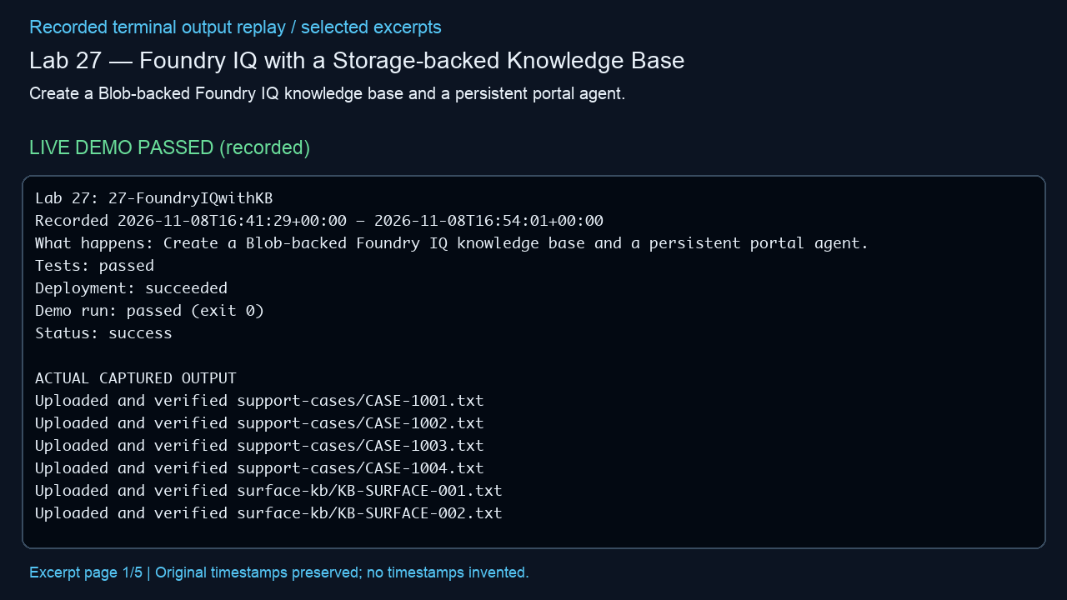
Lab 27 — Foundry IQ with a Storage-backed Knowledge Base
Create a Blob-backed Foundry IQ knowledge base and a persistent portal agent.
LIVE DEMO PASSED (recorded)
Actual outcome
Observed: A storage-backed knowledge base returned fictional support cases with cited sources. (status: success)
Infrastructure cleanup
verified deleted; unrelated baseline groups preserved
Embedded MP4 • click Play in PowerPoint • selected excerpts, not a screen recording
Notes:
Manifest source: /Users/michalfu/Dev/FoundryWorkshops102026DEMOS/Presentation/lab-recordings-20261108/verified-only-manifest.json
Actual output source: evidence/lab-27.txt
Run log / demo command provenance: /Users/michalfu/.copilot/session-state/4527c5fe-8c72-4d0b-ad77-572eec4da92a/files/execution-logs/27-FoundryIQwithKB.log
Demo command is only evidenced by the source log. This helper does not execute demos, Azure operations, or infer unreported commands.
Started: 2026-11-08T16:41:29+00:00; finished: 2026-11-08T16:54:01+00:00
Status: success; tests: passed; deployment: succeeded; run: passed (exit 0); cleanup: verified deleted; unrelated baseline groups preserved
Observed outcome: Observed: A storage-backed knowledge base returned fictional support cases with cited sources. (status: success)
Full observed error (redacted, not shortened):
Provenance: render_deck.py reads manifest/output only; Pillow renders 1280x720 excerpt pages; /usr/bin/say -v Samantha -r 195 narrates locally; /Users/michalfu/.copilot/session-state/4527c5fe-8c72-4d0b-ad77-572eec4da92a/files/recording-tools/venv/lib/python3.13/site-packages/imageio_ffmpeg/binaries/ffmpeg-macos-aarch64-v7.1 encodes libx264/yuv420p and AAC and muxes MP4.
Limits: selected excerpt replay, NOT a screen recording; original timestamps preserved, no missing stdout or model responses invented; URLs/credentials redacted; reused supplied videos are not regenerated or transcript-audited. Playback requires a compatible PowerPoint player. Lab 9 source transcript is never opened/displayed by this helper.

Slide 26
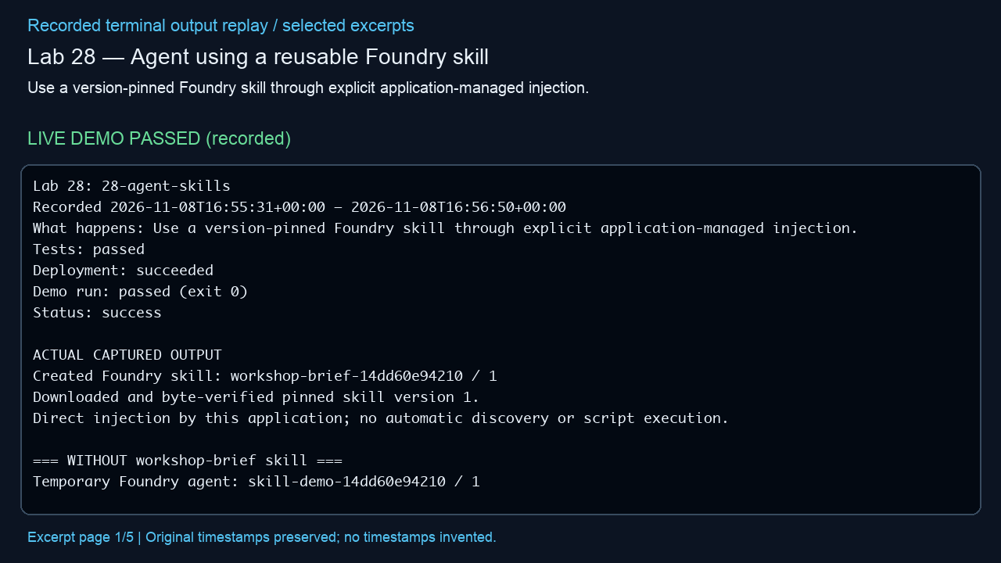
Lab 28 — Agent using a reusable Foundry skill
Use a version-pinned Foundry skill through explicit application-managed injection.
LIVE DEMO PASSED (recorded)
Actual outcome
Observed: The pinned, application-injected skill produced the exact workshop briefing contract. (status: success)
Infrastructure cleanup
verified deleted; unrelated baseline groups preserved
Embedded MP4 • click Play in PowerPoint • selected excerpts, not a screen recording
Notes:
Manifest source: /Users/michalfu/Dev/FoundryWorkshops102026DEMOS/Presentation/lab-recordings-20261108/verified-only-manifest.json
Actual output source: evidence/lab-28.txt
Run log / demo command provenance: /Users/michalfu/.copilot/session-state/4527c5fe-8c72-4d0b-ad77-572eec4da92a/files/execution-logs/28-agent-skills.log
Demo command is only evidenced by the source log. This helper does not execute demos, Azure operations, or infer unreported commands.
Started: 2026-11-08T16:55:31+00:00; finished: 2026-11-08T16:56:50+00:00
Status: success; tests: passed; deployment: succeeded; run: passed (exit 0); cleanup: verified deleted; unrelated baseline groups preserved
Observed outcome: Observed: The pinned, application-injected skill produced the exact workshop briefing contract. (status: success)
Full observed error (redacted, not shortened):
Provenance: render_deck.py reads manifest/output only; Pillow renders 1280x720 excerpt pages; /usr/bin/say -v Samantha -r 195 narrates locally; /Users/michalfu/.copilot/session-state/4527c5fe-8c72-4d0b-ad77-572eec4da92a/files/recording-tools/venv/lib/python3.13/site-packages/imageio_ffmpeg/binaries/ffmpeg-macos-aarch64-v7.1 encodes libx264/yuv420p and AAC and muxes MP4.
Limits: selected excerpt replay, NOT a screen recording; original timestamps preserved, no missing stdout or model responses invented; URLs/credentials redacted; reused supplied videos are not regenerated or transcript-audited. Playback requires a compatible PowerPoint player. Lab 9 source transcript is never opened/displayed by this helper.

Slide 27
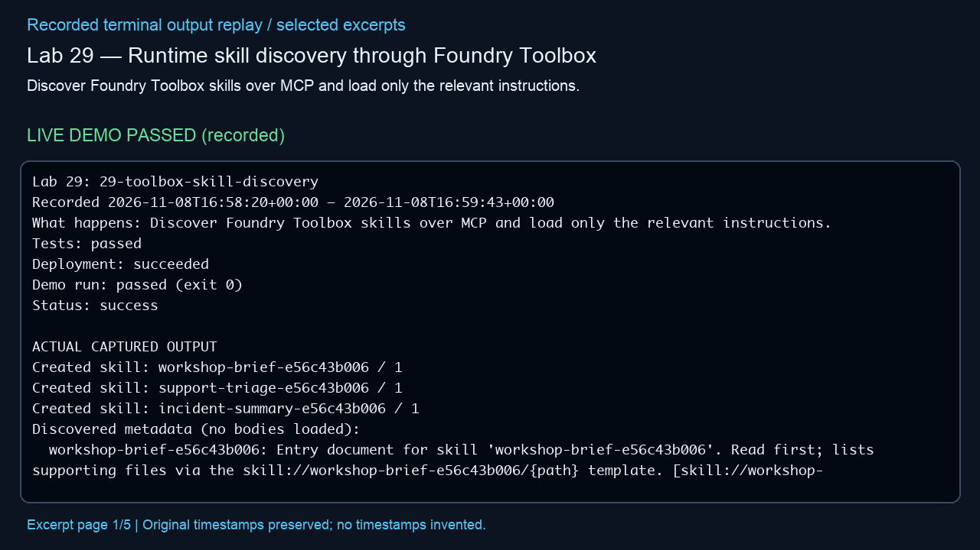
Lab 29 — Runtime skill discovery through Foundry Toolbox
Discover Foundry Toolbox skills over MCP and load only the relevant instructions.
LIVE DEMO PASSED (recorded)
Actual outcome
Observed: The agent discovered a relevant skill and read an on-demand supplementary reference. (status: success)
Infrastructure cleanup
verified deleted; unrelated baseline groups preserved
Embedded MP4 • click Play in PowerPoint • selected excerpts, not a screen recording
Notes:
Manifest source: /Users/michalfu/Dev/FoundryWorkshops102026DEMOS/Presentation/lab-recordings-20261108/verified-only-manifest.json
Actual output source: evidence/lab-29.txt
Run log / demo command provenance: /Users/michalfu/.copilot/session-state/4527c5fe-8c72-4d0b-ad77-572eec4da92a/files/execution-logs/29-toolbox-skill-discovery.log
Demo command is only evidenced by the source log. This helper does not execute demos, Azure operations, or infer unreported commands.
Started: 2026-11-08T16:58:20+00:00; finished: 2026-11-08T16:59:43+00:00
Status: success; tests: passed; deployment: succeeded; run: passed (exit 0); cleanup: verified deleted; unrelated baseline groups preserved
Observed outcome: Observed: The agent discovered a relevant skill and read an on-demand supplementary reference. (status: success)
Full observed error (redacted, not shortened):
Provenance: render_deck.py reads manifest/output only; Pillow renders 1280x720 excerpt pages; /usr/bin/say -v Samantha -r 195 narrates locally; /Users/michalfu/.copilot/session-state/4527c5fe-8c72-4d0b-ad77-572eec4da92a/files/recording-tools/venv/lib/python3.13/site-packages/imageio_ffmpeg/binaries/ffmpeg-macos-aarch64-v7.1 encodes libx264/yuv420p and AAC and muxes MP4.
Limits: selected excerpt replay, NOT a screen recording; original timestamps preserved, no missing stdout or model responses invented; URLs/credentials redacted; reused supplied videos are not regenerated or transcript-audited. Playback requires a compatible PowerPoint player. Lab 9 source transcript is never opened/displayed by this helper.

Slide 28
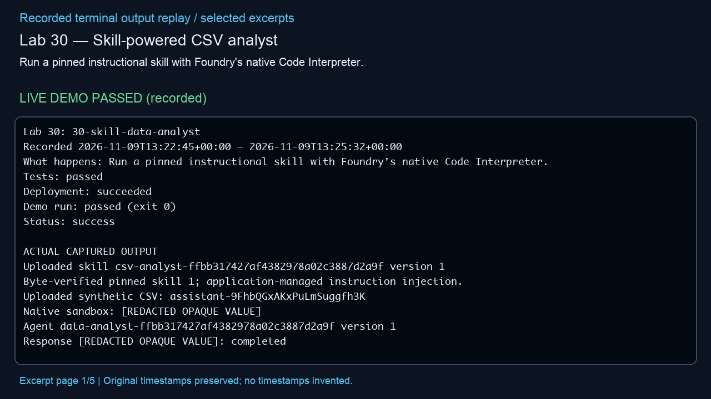
Lab 30 — Skill-powered CSV analyst
Run a pinned instructional skill with Foundry's native Code Interpreter.
LIVE DEMO PASSED (recorded)
Actual outcome
Observed: The sandbox produced a correct report and chart: 55 attendance instances and USD 950, after self-correction. (status: success)
Infrastructure cleanup
verified deleted; unrelated baseline groups preserved
Embedded MP4 • click Play in PowerPoint • selected excerpts, not a screen recording
Notes:
Manifest source: /Users/michalfu/Dev/FoundryWorkshops102026DEMOS/Presentation/lab-recordings-20261108/verified-only-manifest.json
Actual output source: evidence/lab-30.txt
Run log / demo command provenance: /Users/michalfu/.copilot/session-state/4527c5fe-8c72-4d0b-ad77-572eec4da92a/files/recovery/execution-logs/30-skill-data-analyst.log
Demo command is only evidenced by the source log. This helper does not execute demos, Azure operations, or infer unreported commands.
Started: 2026-11-09T13:22:45+00:00; finished: 2026-11-09T13:25:32+00:00
Status: success; tests: passed; deployment: succeeded; run: passed (exit 0); cleanup: verified deleted; unrelated baseline groups preserved
Observed outcome: Observed: The sandbox produced a correct report and chart: 55 attendance instances and USD 950, after self-correction. (status: success)
Full observed error (redacted, not shortened):
Provenance: render_deck.py reads manifest/output only; Pillow renders 1280x720 excerpt pages; /usr/bin/say -v Samantha -r 195 narrates locally; /Users/michalfu/.copilot/session-state/4527c5fe-8c72-4d0b-ad77-572eec4da92a/files/recording-tools/venv/lib/python3.13/site-packages/imageio_ffmpeg/binaries/ffmpeg-macos-aarch64-v7.1 encodes libx264/yuv420p and AAC and muxes MP4.
Limits: selected excerpt replay, NOT a screen recording; original timestamps preserved, no missing stdout or model responses invented; URLs/credentials redacted; reused supplied videos are not regenerated or transcript-audited. Playback requires a compatible PowerPoint player. Lab 9 source transcript is never opened/displayed by this helper.

Slide 29
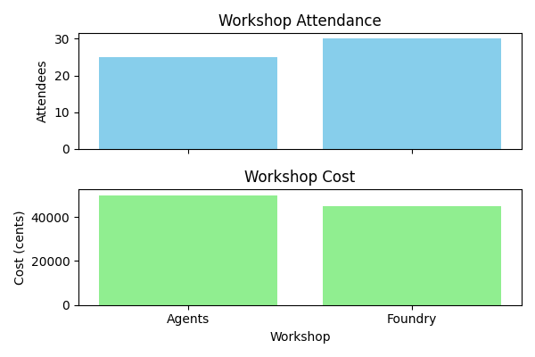
Lab 30 result artifact — Skill-powered CSV analyst
Verified actual result
The sandbox produced a correct report and chart: 55 attendance instances and USD 950, after self-correction.
Downloaded from the completed live demo; image bytes verified.
Notes:
Verified image SHA-256: e667fff61ce694dba0035a021c15f9d816a0b1d8e451cc381467aa801c7b73b7
The picture is the downloaded artifact from this lab's actual run.

Slide 30
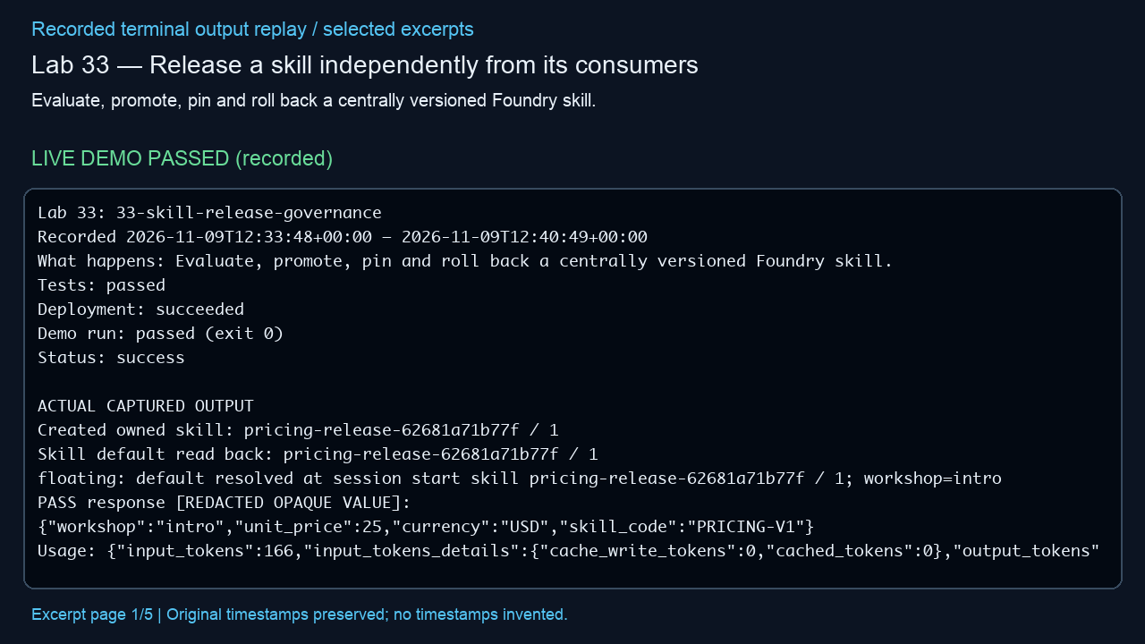
Lab 33 — Release a skill independently from its consumers
Evaluate, promote, pin and roll back a centrally versioned Foundry skill.
LIVE DEMO PASSED (recorded)
Actual outcome
Observed: Promotion, pinned isolation and rollback passed; the USD 40 regression was correctly blocked. (status: success)
Infrastructure cleanup
verified deleted; unrelated baseline groups preserved
Embedded MP4 • click Play in PowerPoint • selected excerpts, not a screen recording
Notes:
Manifest source: /Users/michalfu/Dev/FoundryWorkshops102026DEMOS/Presentation/lab-recordings-20261108/verified-only-manifest.json
Actual output source: evidence/lab-33.txt
Run log / demo command provenance: /Users/michalfu/.copilot/session-state/4527c5fe-8c72-4d0b-ad77-572eec4da92a/files/recovery/execution-logs/33-skill-release-governance.log
Demo command is only evidenced by the source log. This helper does not execute demos, Azure operations, or infer unreported commands.
Started: 2026-11-09T12:33:48+00:00; finished: 2026-11-09T12:40:49+00:00
Status: success; tests: passed; deployment: succeeded; run: passed (exit 0); cleanup: verified deleted; unrelated baseline groups preserved
Observed outcome: Observed: Promotion, pinned isolation and rollback passed; the USD 40 regression was correctly blocked. (status: success)
Full observed error (redacted, not shortened):
Provenance: render_deck.py reads manifest/output only; Pillow renders 1280x720 excerpt pages; /usr/bin/say -v Samantha -r 195 narrates locally; /Users/michalfu/.copilot/session-state/4527c5fe-8c72-4d0b-ad77-572eec4da92a/files/recording-tools/venv/lib/python3.13/site-packages/imageio_ffmpeg/binaries/ffmpeg-macos-aarch64-v7.1 encodes libx264/yuv420p and AAC and muxes MP4.
Limits: selected excerpt replay, NOT a screen recording; original timestamps preserved, no missing stdout or model responses invented; URLs/credentials redacted; reused supplied videos are not regenerated or transcript-audited. Playback requires a compatible PowerPoint player. Lab 9 source transcript is never opened/displayed by this helper.

Slide 31
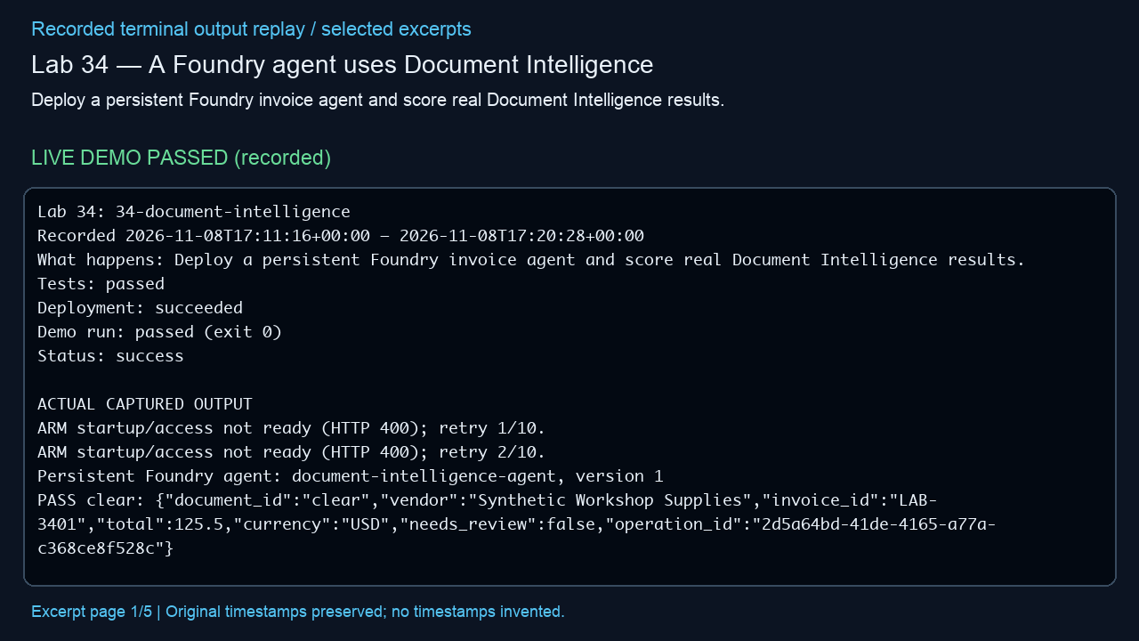
Lab 34 — A Foundry agent uses Document Intelligence
Deploy a persistent Foundry invoice agent and score real Document Intelligence results.
LIVE DEMO PASSED (recorded)
Actual outcome
Observed: All 24 cloud invoice cases passed, including missing-total cases flagged for review. (status: success)
Infrastructure cleanup
verified deleted; unrelated baseline groups preserved
Embedded MP4 • click Play in PowerPoint • selected excerpts, not a screen recording
Notes:
Manifest source: /Users/michalfu/Dev/FoundryWorkshops102026DEMOS/Presentation/lab-recordings-20261108/verified-only-manifest.json
Actual output source: evidence/lab-34.txt
Run log / demo command provenance: /Users/michalfu/.copilot/session-state/4527c5fe-8c72-4d0b-ad77-572eec4da92a/files/execution-logs/34-document-intelligence.log
Demo command is only evidenced by the source log. This helper does not execute demos, Azure operations, or infer unreported commands.
Started: 2026-11-08T17:11:16+00:00; finished: 2026-11-08T17:20:28+00:00
Status: success; tests: passed; deployment: succeeded; run: passed (exit 0); cleanup: verified deleted; unrelated baseline groups preserved
Observed outcome: Observed: All 24 cloud invoice cases passed, including missing-total cases flagged for review. (status: success)
Full observed error (redacted, not shortened):
Provenance: render_deck.py reads manifest/output only; Pillow renders 1280x720 excerpt pages; /usr/bin/say -v Samantha -r 195 narrates locally; /Users/michalfu/.copilot/session-state/4527c5fe-8c72-4d0b-ad77-572eec4da92a/files/recording-tools/venv/lib/python3.13/site-packages/imageio_ffmpeg/binaries/ffmpeg-macos-aarch64-v7.1 encodes libx264/yuv420p and AAC and muxes MP4.
Limits: selected excerpt replay, NOT a screen recording; original timestamps preserved, no missing stdout or model responses invented; URLs/credentials redacted; reused supplied videos are not regenerated or transcript-audited. Playback requires a compatible PowerPoint player. Lab 9 source transcript is never opened/displayed by this helper.

Slide 32
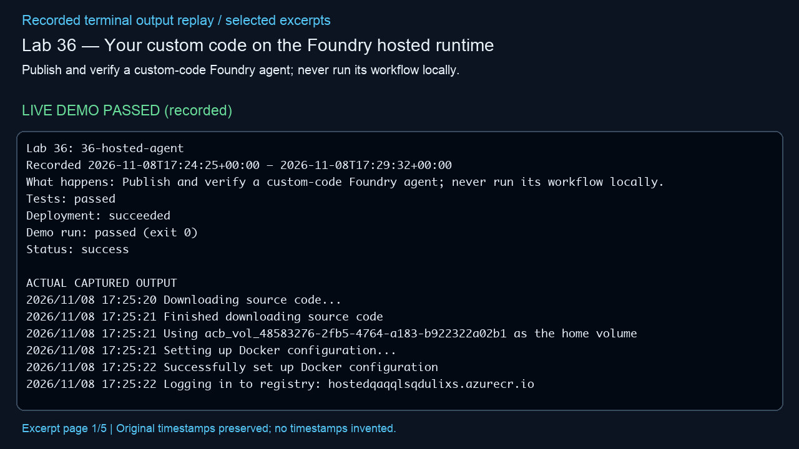
Lab 36 — Your custom code on the Foundry hosted runtime
Publish and verify a custom-code Foundry agent; never run its workflow locally.
LIVE DEMO PASSED (recorded)
Actual outcome
Observed: The hosted agent activated, returned a USD 75 quote for three attendees, and emitted traces. (status: success)
Infrastructure cleanup
verified deleted; unrelated baseline groups preserved
Embedded MP4 • click Play in PowerPoint • selected excerpts, not a screen recording
Notes:
Manifest source: /Users/michalfu/Dev/FoundryWorkshops102026DEMOS/Presentation/lab-recordings-20261108/verified-only-manifest.json
Actual output source: evidence/lab-36.txt
Run log / demo command provenance: /Users/michalfu/.copilot/session-state/4527c5fe-8c72-4d0b-ad77-572eec4da92a/files/execution-logs/36-hosted-agent.log
Demo command is only evidenced by the source log. This helper does not execute demos, Azure operations, or infer unreported commands.
Started: 2026-11-08T17:24:25+00:00; finished: 2026-11-08T17:29:32+00:00
Status: success; tests: passed; deployment: succeeded; run: passed (exit 0); cleanup: verified deleted; unrelated baseline groups preserved
Observed outcome: Observed: The hosted agent activated, returned a USD 75 quote for three attendees, and emitted traces. (status: success)
Full observed error (redacted, not shortened):
Provenance: render_deck.py reads manifest/output only; Pillow renders 1280x720 excerpt pages; /usr/bin/say -v Samantha -r 195 narrates locally; /Users/michalfu/.copilot/session-state/4527c5fe-8c72-4d0b-ad77-572eec4da92a/files/recording-tools/venv/lib/python3.13/site-packages/imageio_ffmpeg/binaries/ffmpeg-macos-aarch64-v7.1 encodes libx264/yuv420p and AAC and muxes MP4.
Limits: selected excerpt replay, NOT a screen recording; original timestamps preserved, no missing stdout or model responses invented; URLs/credentials redacted; reused supplied videos are not regenerated or transcript-audited. Playback requires a compatible PowerPoint player. Lab 9 source transcript is never opened/displayed by this helper.

Slide 33
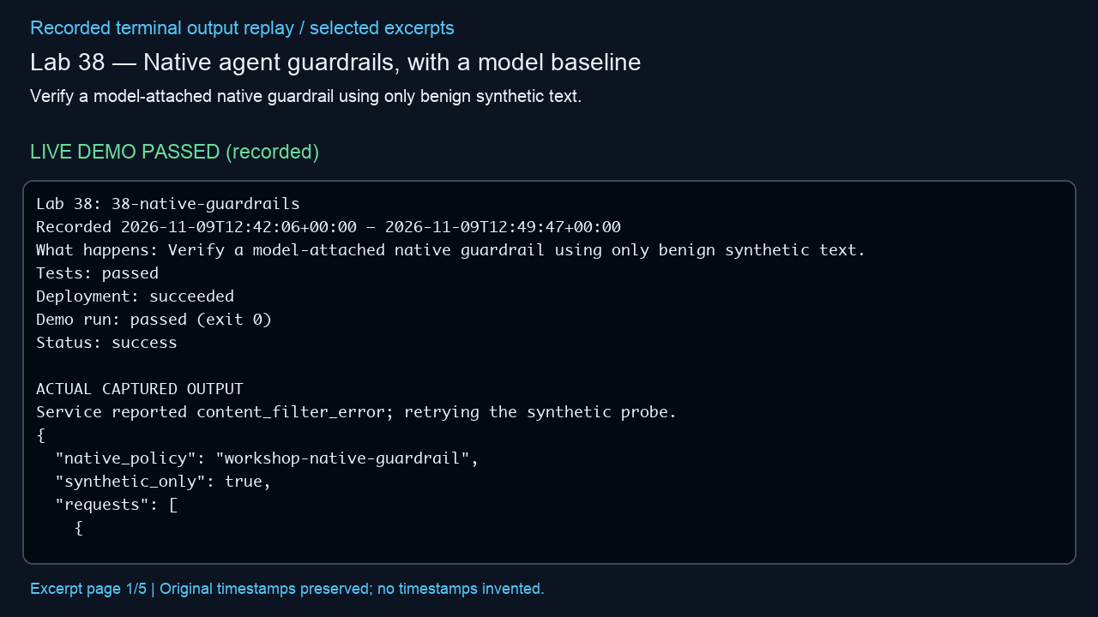
Lab 38 — Native agent guardrails, with a model baseline
Verify a model-attached native guardrail using only benign synthetic text.
LIVE DEMO PASSED (recorded)
Actual outcome
Observed: Model and agent guardrails blocked the synthetic marker; tool boundaries were not tested. (status: success)
Infrastructure cleanup
verified deleted; unrelated baseline groups preserved
Embedded MP4 • click Play in PowerPoint • selected excerpts, not a screen recording
Notes:
Manifest source: /Users/michalfu/Dev/FoundryWorkshops102026DEMOS/Presentation/lab-recordings-20261108/verified-only-manifest.json
Actual output source: evidence/lab-38.txt
Run log / demo command provenance: /Users/michalfu/.copilot/session-state/4527c5fe-8c72-4d0b-ad77-572eec4da92a/files/recovery/execution-logs/38-native-guardrails.log
Demo command is only evidenced by the source log. This helper does not execute demos, Azure operations, or infer unreported commands.
Started: 2026-11-09T12:42:06+00:00; finished: 2026-11-09T12:48:26+00:00
Status: success; tests: passed; deployment: succeeded; run: passed (exit 0); cleanup: verified deleted; unrelated baseline groups preserved
Observed outcome: Observed: Model and agent guardrails blocked the synthetic marker; tool boundaries were not tested. (status: success)
Full observed error (redacted, not shortened):
Provenance: render_deck.py reads manifest/output only; Pillow renders 1280x720 excerpt pages; /usr/bin/say -v Samantha -r 195 narrates locally; /Users/michalfu/.copilot/session-state/4527c5fe-8c72-4d0b-ad77-572eec4da92a/files/recording-tools/venv/lib/python3.13/site-packages/imageio_ffmpeg/binaries/ffmpeg-macos-aarch64-v7.1 encodes libx264/yuv420p and AAC and muxes MP4.
Limits: selected excerpt replay, NOT a screen recording; original timestamps preserved, no missing stdout or model responses invented; URLs/credentials redacted; reused supplied videos are not regenerated or transcript-audited. Playback requires a compatible PowerPoint player. Lab 9 source transcript is never opened/displayed by this helper.

Slide 34
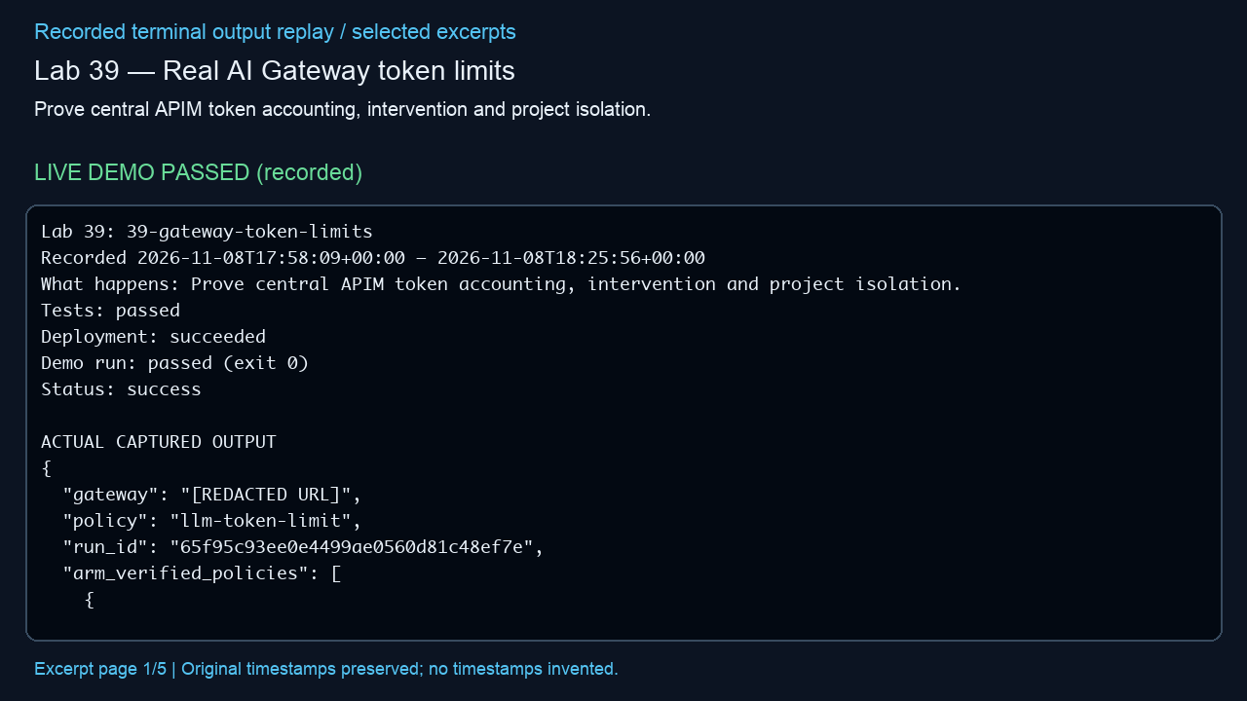
Lab 39 — Real AI Gateway token limits
Prove central APIM token accounting, intervention and project isolation.
LIVE DEMO PASSED (recorded)
Actual outcome
Observed: Gateway token limits returned HTTP 429 at exhaustion while keeping project counters separate. (status: success)
Infrastructure cleanup
verified deleted; unrelated baseline groups preserved
Embedded MP4 • click Play in PowerPoint • selected excerpts, not a screen recording
Notes:
Manifest source: /Users/michalfu/Dev/FoundryWorkshops102026DEMOS/Presentation/lab-recordings-20261108/verified-only-manifest.json
Actual output source: evidence/lab-39.txt
Run log / demo command provenance: /Users/michalfu/.copilot/session-state/4527c5fe-8c72-4d0b-ad77-572eec4da92a/files/execution-logs/39-gateway-token-limits.log
Demo command is only evidenced by the source log. This helper does not execute demos, Azure operations, or infer unreported commands.
Started: 2026-11-08T17:58:09+00:00; finished: 2026-11-08T18:25:56+00:00
Status: success; tests: passed; deployment: succeeded; run: passed (exit 0); cleanup: verified deleted; unrelated baseline groups preserved
Observed outcome: Observed: Gateway token limits returned HTTP 429 at exhaustion while keeping project counters separate. (status: success)
Full observed error (redacted, not shortened):
Provenance: render_deck.py reads manifest/output only; Pillow renders 1280x720 excerpt pages; /usr/bin/say -v Samantha -r 195 narrates locally; /Users/michalfu/.copilot/session-state/4527c5fe-8c72-4d0b-ad77-572eec4da92a/files/recording-tools/venv/lib/python3.13/site-packages/imageio_ffmpeg/binaries/ffmpeg-macos-aarch64-v7.1 encodes libx264/yuv420p and AAC and muxes MP4.
Limits: selected excerpt replay, NOT a screen recording; original timestamps preserved, no missing stdout or model responses invented; URLs/credentials redacted; reused supplied videos are not regenerated or transcript-audited. Playback requires a compatible PowerPoint player. Lab 9 source transcript is never opened/displayed by this helper.

Slide 35
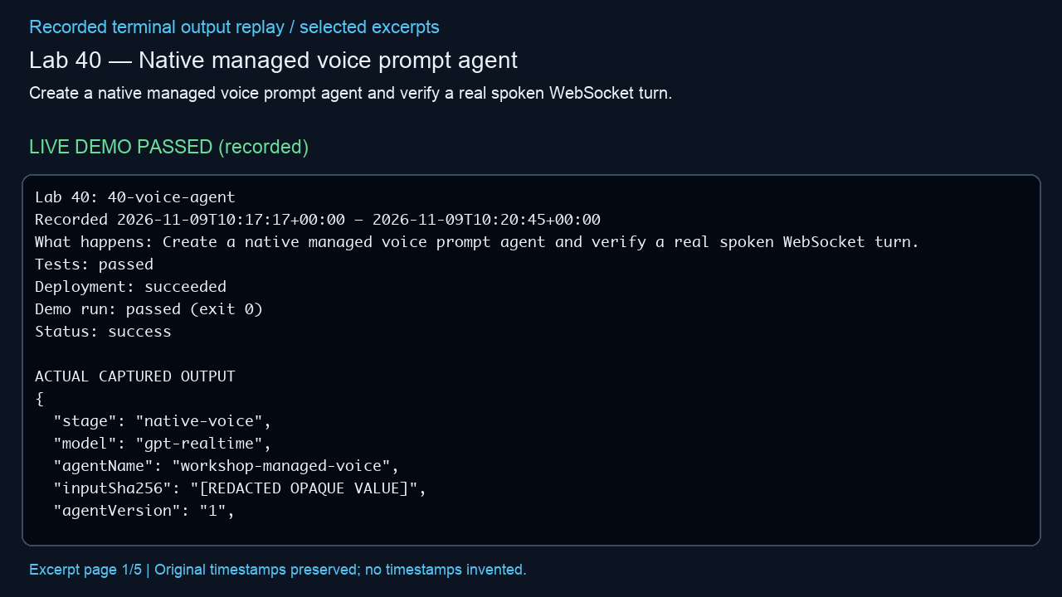
Lab 40 — Native managed voice prompt agent
Create a native managed voice prompt agent and verify a real spoken WebSocket turn.
LIVE DEMO PASSED (recorded)
Actual outcome
Observed: A real spoken voice-agent turn completed; its captured reply plays at the end of the video. (status: success)
Infrastructure cleanup
verified deleted; unrelated baseline groups preserved
Embedded MP4 • click Play in PowerPoint • selected excerpts, not a screen recording
Notes:
Manifest source: /Users/michalfu/Dev/FoundryWorkshops102026DEMOS/Presentation/lab-recordings-20261108/verified-only-manifest.json
Actual output source: evidence/lab-40.txt
Run log / demo command provenance: /Users/michalfu/.copilot/session-state/4527c5fe-8c72-4d0b-ad77-572eec4da92a/files/recovery/execution-logs/40-voice-agent.log
Demo command is only evidenced by the source log. This helper does not execute demos, Azure operations, or infer unreported commands.
Started: 2026-11-09T10:17:17+00:00; finished: 2026-11-09T10:19:30+00:00
Status: success; tests: passed; deployment: succeeded; run: passed (exit 0); cleanup: verified deleted; unrelated baseline groups preserved
Observed outcome: Observed: A real spoken voice-agent turn completed; its captured reply plays at the end of the video. (status: success)
Full observed error (redacted, not shortened):
Provenance: render_deck.py reads manifest/output only; Pillow renders 1280x720 excerpt pages; /usr/bin/say -v Samantha -r 195 narrates locally; /Users/michalfu/.copilot/session-state/4527c5fe-8c72-4d0b-ad77-572eec4da92a/files/recording-tools/venv/lib/python3.13/site-packages/imageio_ffmpeg/binaries/ffmpeg-macos-aarch64-v7.1 encodes libx264/yuv420p and AAC and muxes MP4.
Limits: selected excerpt replay, NOT a screen recording; original timestamps preserved, no missing stdout or model responses invented; URLs/credentials redacted; reused supplied videos are not regenerated or transcript-audited. Playback requires a compatible PowerPoint player. Lab 9 source transcript is never opened/displayed by this helper.

Slide 36
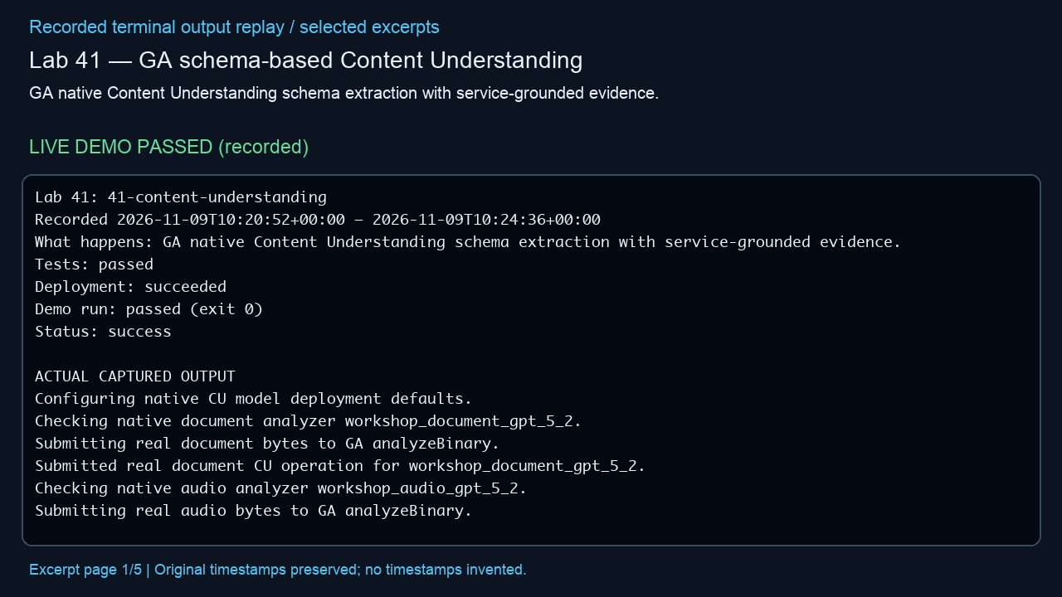
Lab 41 — GA schema-based Content Understanding
GA native Content Understanding schema extraction with service-grounded evidence.
LIVE DEMO PASSED (recorded)
Actual outcome
Observed: Document and audio extracted the same workshop, room and seat count; audio field confidence was absent. (status: success)
Infrastructure cleanup
verified deleted; unrelated baseline groups preserved
Embedded MP4 • click Play in PowerPoint • selected excerpts, not a screen recording
Notes:
Manifest source: /Users/michalfu/Dev/FoundryWorkshops102026DEMOS/Presentation/lab-recordings-20261108/verified-only-manifest.json
Actual output source: evidence/lab-41.txt
Run log / demo command provenance: /Users/michalfu/.copilot/session-state/4527c5fe-8c72-4d0b-ad77-572eec4da92a/files/recovery/execution-logs/41-content-understanding.log
Demo command is only evidenced by the source log. This helper does not execute demos, Azure operations, or infer unreported commands.
Started: 2026-11-09T10:20:52+00:00; finished: 2026-11-09T10:23:17+00:00
Status: success; tests: passed; deployment: succeeded; run: passed (exit 0); cleanup: verified deleted; unrelated baseline groups preserved
Observed outcome: Observed: Document and audio extracted the same workshop, room and seat count; audio field confidence was absent. (status: success)
Full observed error (redacted, not shortened):
Provenance: render_deck.py reads manifest/output only; Pillow renders 1280x720 excerpt pages; /usr/bin/say -v Samantha -r 195 narrates locally; /Users/michalfu/.copilot/session-state/4527c5fe-8c72-4d0b-ad77-572eec4da92a/files/recording-tools/venv/lib/python3.13/site-packages/imageio_ffmpeg/binaries/ffmpeg-macos-aarch64-v7.1 encodes libx264/yuv420p and AAC and muxes MP4.
Limits: selected excerpt replay, NOT a screen recording; original timestamps preserved, no missing stdout or model responses invented; URLs/credentials redacted; reused supplied videos are not regenerated or transcript-audited. Playback requires a compatible PowerPoint player. Lab 9 source transcript is never opened/displayed by this helper.

Slide 37
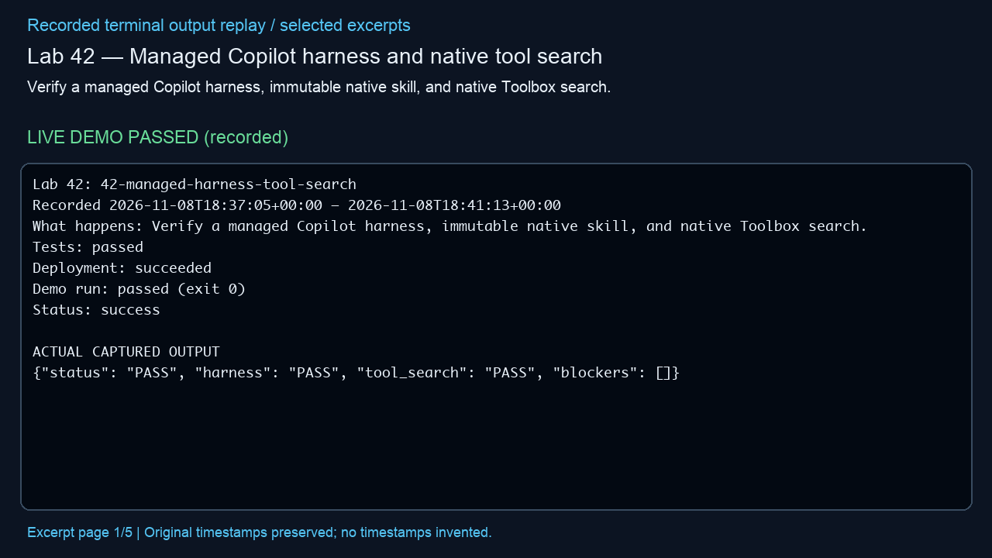
Lab 42 — Managed Copilot harness and native tool search
Verify a managed Copilot harness, immutable native skill, and native Toolbox search.
LIVE DEMO PASSED (recorded)
Actual outcome
Observed: The managed harness and native Toolbox search both passed. (status: success)
Infrastructure cleanup
verified deleted; unrelated baseline groups preserved
Embedded MP4 • click Play in PowerPoint • selected excerpts, not a screen recording
Notes:
Manifest source: /Users/michalfu/Dev/FoundryWorkshops102026DEMOS/Presentation/lab-recordings-20261108/verified-only-manifest.json
Actual output source: evidence/lab-42.txt
Run log / demo command provenance: /Users/michalfu/.copilot/session-state/4527c5fe-8c72-4d0b-ad77-572eec4da92a/files/execution-logs/42-managed-harness-tool-search.log
Demo command is only evidenced by the source log. This helper does not execute demos, Azure operations, or infer unreported commands.
Started: 2026-11-08T18:37:05+00:00; finished: 2026-11-08T18:41:13+00:00
Status: success; tests: passed; deployment: succeeded; run: passed (exit 0); cleanup: verified deleted; unrelated baseline groups preserved
Observed outcome: Observed: The managed harness and native Toolbox search both passed. (status: success)
Full observed error (redacted, not shortened):
Provenance: render_deck.py reads manifest/output only; Pillow renders 1280x720 excerpt pages; /usr/bin/say -v Samantha -r 195 narrates locally; /Users/michalfu/.copilot/session-state/4527c5fe-8c72-4d0b-ad77-572eec4da92a/files/recording-tools/venv/lib/python3.13/site-packages/imageio_ffmpeg/binaries/ffmpeg-macos-aarch64-v7.1 encodes libx264/yuv420p and AAC and muxes MP4.
Limits: selected excerpt replay, NOT a screen recording; original timestamps preserved, no missing stdout or model responses invented; URLs/credentials redacted; reused supplied videos are not regenerated or transcript-audited. Playback requires a compatible PowerPoint player. Lab 9 source transcript is never opened/displayed by this helper.

Slide 38
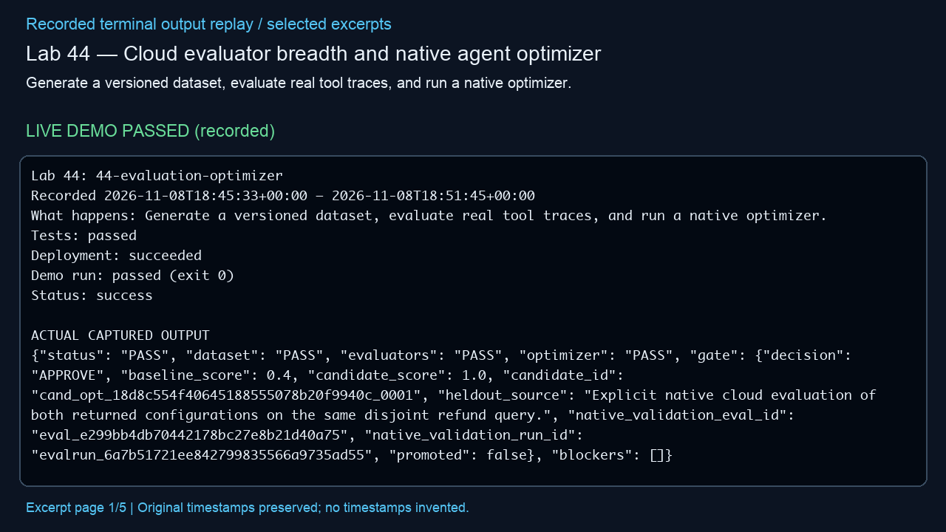
Lab 44 — Cloud evaluator breadth and native agent optimizer
Generate a versioned dataset, evaluate real tool traces, and run a native optimizer.
LIVE DEMO PASSED (recorded)
Actual outcome
Observed: The dataset, cloud evaluators and optimizer passed; the candidate scored 1.0 versus baseline 0.4. (status: success)
Infrastructure cleanup
verified deleted; unrelated baseline groups preserved
Embedded MP4 • click Play in PowerPoint • selected excerpts, not a screen recording
Notes:
Manifest source: /Users/michalfu/Dev/FoundryWorkshops102026DEMOS/Presentation/lab-recordings-20261108/verified-only-manifest.json
Actual output source: evidence/lab-44.txt
Run log / demo command provenance: /Users/michalfu/.copilot/session-state/4527c5fe-8c72-4d0b-ad77-572eec4da92a/files/execution-logs/44-evaluation-optimizer.log
Demo command is only evidenced by the source log. This helper does not execute demos, Azure operations, or infer unreported commands.
Started: 2026-11-08T18:45:33+00:00; finished: 2026-11-08T18:51:45+00:00
Status: success; tests: passed; deployment: succeeded; run: passed (exit 0); cleanup: verified deleted; unrelated baseline groups preserved
Observed outcome: Observed: The dataset, cloud evaluators and optimizer passed; the candidate scored 1.0 versus baseline 0.4. (status: success)
Full observed error (redacted, not shortened):
Provenance: render_deck.py reads manifest/output only; Pillow renders 1280x720 excerpt pages; /usr/bin/say -v Samantha -r 195 narrates locally; /Users/michalfu/.copilot/session-state/4527c5fe-8c72-4d0b-ad77-572eec4da92a/files/recording-tools/venv/lib/python3.13/site-packages/imageio_ffmpeg/binaries/ffmpeg-macos-aarch64-v7.1 encodes libx264/yuv420p and AAC and muxes MP4.
Limits: selected excerpt replay, NOT a screen recording; original timestamps preserved, no missing stdout or model responses invented; URLs/credentials redacted; reused supplied videos are not regenerated or transcript-audited. Playback requires a compatible PowerPoint player. Lab 9 source transcript is never opened/displayed by this helper.

Slide 39
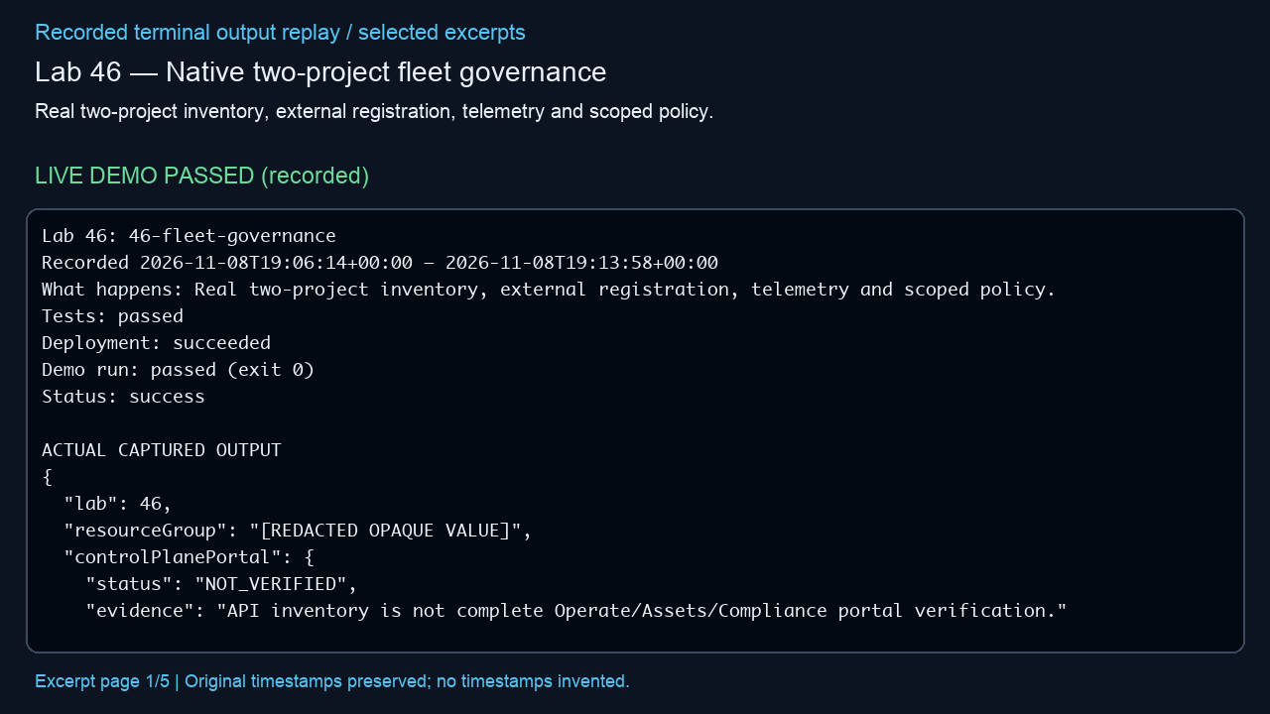
Lab 46 — Native two-project fleet governance
Real two-project inventory, external registration, telemetry and scoped policy.
LIVE DEMO PASSED (recorded)
Actual outcome
Observed: Inventory, correlated telemetry and policy passed; the full portal and optional Defender/Purview were not verified. (status: success)
Infrastructure cleanup
verified deleted; unrelated baseline groups preserved
Embedded MP4 • click Play in PowerPoint • selected excerpts, not a screen recording
Notes:
Manifest source: /Users/michalfu/Dev/FoundryWorkshops102026DEMOS/Presentation/lab-recordings-20261108/verified-only-manifest.json
Actual output source: evidence/lab-46.txt
Run log / demo command provenance: /Users/michalfu/.copilot/session-state/4527c5fe-8c72-4d0b-ad77-572eec4da92a/files/execution-logs/46-fleet-governance.log
Demo command is only evidenced by the source log. This helper does not execute demos, Azure operations, or infer unreported commands.
Started: 2026-11-08T19:06:14+00:00; finished: 2026-11-08T19:13:58+00:00
Status: success; tests: passed; deployment: succeeded; run: passed (exit 0); cleanup: verified deleted; unrelated baseline groups preserved
Observed outcome: Observed: Inventory, correlated telemetry and policy passed; the full portal and optional Defender/Purview were not verified. (status: success)
Full observed error (redacted, not shortened):
Provenance: render_deck.py reads manifest/output only; Pillow renders 1280x720 excerpt pages; /usr/bin/say -v Samantha -r 195 narrates locally; /Users/michalfu/.copilot/session-state/4527c5fe-8c72-4d0b-ad77-572eec4da92a/files/recording-tools/venv/lib/python3.13/site-packages/imageio_ffmpeg/binaries/ffmpeg-macos-aarch64-v7.1 encodes libx264/yuv420p and AAC and muxes MP4.
Limits: selected excerpt replay, NOT a screen recording; original timestamps preserved, no missing stdout or model responses invented; URLs/credentials redacted; reused supplied videos are not regenerated or transcript-audited. Playback requires a compatible PowerPoint player. Lab 9 source transcript is never opened/displayed by this helper.

Slide 40
Final summary
WORKING RECORDED DEMOS
Lab 00: Model basics: temperature, top_p, chat, batch and reasoning
Lab 01: Microsoft Foundry - Model Router
Lab 02: Microsoft Foundry - Workflow Agent
Lab 03: Microsoft Foundry - Simple WebIQ Agent
Lab 04: Microsoft Foundry - Agent with Simple Tools
Lab 05: Microsoft Foundry - Microsoft Decision Model
Lab 06: Microsoft Foundry - Content Safety
Lab 07: Microsoft Foundry - Semantic caching with Azure API Management
Lab 08: Microsoft Foundry - Agent evaluation
Lab 09: Microsoft Foundry - Agent red teaming
Lab 11: Microsoft Foundry - Super-basic Foundry IQ
Lab 13: Microsoft Agent Framework - Four tiny orchestration samples
Lab 14: Foundry fundamentals
VERIFIED WORKING — 37 of 47; 10 without a verified demo
Notes:
Only verified successful demos are included. The no-demo inventory contains identifiers only, not failed recordings or output. Cleanup is reported on each lab slide. VERIFIED WORKING — 37 of 47; 10 without a verified demo

Slide 41
Final summary (continued)
Lab 15: Repeatable model selection
Lab 16: Prompt design and structured outputs
Lab 17: RAG fundamentals before Foundry IQ
Lab 18: Agent tracing: find a slow tool and a failed tool
Lab 19: Conversation state, context limits and memory boundaries
Lab 22: Prompt-injection trust boundaries
Lab 23: Evaluation-driven CI/CD
Lab 24: Publish, version, monitor and roll back an agent
Lab 25: Resilience, quotas, and cost controls
Lab 26: Multimodal understanding with uncertainty
Lab 27: Foundry IQ with a Storage-backed Knowledge Base
Lab 28: Agent using a reusable Foundry skill
Lab 29: Runtime skill discovery through Foundry Toolbox
Lab 30: Skill-powered CSV analyst
VERIFIED WORKING — 37 of 47; 10 without a verified demo
Notes:
Only verified successful demos are included. The no-demo inventory contains identifiers only, not failed recordings or output. Cleanup is reported on each lab slide. VERIFIED WORKING — 37 of 47; 10 without a verified demo

Slide 42
Final summary (continued)
Lab 33: Release a skill independently from its consumers
Lab 34: A Foundry agent uses Document Intelligence
Lab 36: Your custom code on the Foundry hosted runtime
Lab 38: Native agent guardrails, with a model baseline
Lab 39: Real AI Gateway token limits
Lab 40: Native managed voice prompt agent
Lab 41: GA schema-based Content Understanding
Lab 42: Managed Copilot harness and native tool search
Lab 44: Cloud evaluator breadth and native agent optimizer
Lab 46: Native two-project fleet governance
LABS WITHOUT A VERIFIED DEMO — IDENTIFIERS ONLY
Lab 10: Supervised fine-tuning: classification and Polish domain knowledge
Lab 12: Microsoft Agent Framework - What is Microsoft Entra Agent ID?
VERIFIED WORKING — 37 of 47; 10 without a verified demo
Notes:
Only verified successful demos are included. The no-demo inventory contains identifiers only, not failed recordings or output. Cleanup is reported on each lab slide. VERIFIED WORKING — 37 of 47; 10 without a verified demo

Slide 43
Final summary (continued)
Lab 20: Human approval before a tool action
Lab 21: Permission-aware retrieval with real user identities
Lab 31: Native Foundry agent memory
Lab 32: Browser runbook: draft, approve, verify
Lab 35: A Foundry agent uses Work IQ as the calling user
Lab 37: Detect, diagnose, and recover a live agent regression
Lab 43: Native one-time agent routines
Lab 45: Permission-native Foundry IQ + Fabric IQ
VERIFIED WORKING — 37 of 47; 10 without a verified demo
Notes:
Only verified successful demos are included. The no-demo inventory contains identifiers only, not failed recordings or output. Cleanup is reported on each lab slide. VERIFIED WORKING — 37 of 47; 10 without a verified demo

