Slide 1
Project Status Report
IMPLEMENTATION OF Student Data Warehouse
Presented By,
Lohith 1PI09IS045
Subrahmanya 1PI09Is103
Narasegowda K.H 1PI10IS404
Department of ISE
PESIT,
Bangalore
Guided by ,
Dr. S Natarajan,
Professor,
Department of ISE
PESIT,
Bangalore
Notes:
This template can be used as a starter file to give updates for project milestones.
Sections
Right-click on a slide to add sections. Sections can help to organize your slides or facilitate collaboration between multiple authors.
Notes
Use the Notes section for delivery notes or to provide additional details for the audience. View these notes in Presentation View during your presentation.
Keep in mind the font size (important for accessibility, visibility, videotaping, and online production)
Coordinated colors
Pay particular attention to the graphs, charts, and text boxes.
Consider that attendees will print in black and white or grayscale. Run a test print to make sure your colors work when printed in pure black and white and grayscale.
Graphics, tables, and graphs
Keep it simple: If possible, use consistent, non-distracting styles and colors.
Label all graphs and tables.

Slide 2
ABSTRACT
The Student Data Warehouse (SDW) allows departments to query student data without having to request it from the University Registrar’s Office.
The warehouse acts as a hub, facilitating the exchange of information between the institute’s administrative information systems.
The basic vision for our data warehouse is to make information at PESIT more accessible and easier to use for a diverse group of users in the institute community.
Having information from several different sources allows people to create reports easily and use information in new and creative ways.

Slide 3

INTRODUCTION
Overall statistics of
department year by year
How many students
may going to be placed
In tier-1 and tier-2 jobs
Placement statics of
different batches ?
Has the dropout rates
Increased, decreased
Or stayed same
Passing percentage of student in particular subjects?

Slide 4
INTRODUCTION contd…
What is data warehouse?
It is a information repository maintained separately from the organization’s operational databases.
It is subject-oriented, time-variant , integrated and non-volatile
Why we need student data warehouse ?
To make the process of student data analysis and decision support easier for the management
Focus :
Analytic uses might include internal academic reviews, enrolment trends, distributions of marks or grades, marking trends, correlation of other college performance with university performance, completion rates, etc.
Available Techniques:
Preprocessing,ETL,Drill down, roll-up, drill-across,slicing,dicing

Slide 5
LITERATURE SURVEY
M.Sc students from Atilium university developed a data warehouse for decision support system.They used ER assistant tool for schema generation, Quella business intelligence solution for OLAP and charts and Oracle Warehouse builder(OWB) for ETL process[1].
Student data warehouse by Cornell university. They used pentaho buisiness tool for OLAP operations[2].
The MIT Data Warehouse[2] is a central data source which combines data from various Institute administrative systems. Access to the data is controlled by authorizations maintained within the ROLES Database[3].

Slide 6
REQUIREMENTS
Functional Requirements
Creating a Schema file
Generation of reports
Writing efficient MDX queries
SDW should help the management in analysis,querying the reports and decision making system
Software Requirements
Operating system : 64–bit linux 2.4/windows 7 or above
Database : MySql
Languages : Java, JSP ,MDX
Software : Mondrian OLAP engine, JDBC driver, Talend Data Integration Open Studio, Apache Tomcat Server, Mysql Server

Slide 7
REQUIREMENTS contd…
Hardware Requirements
Processor : Intel Core i3 and above
RAM : 3GB and above
Hard disk : 40GB and above

Slide 8
DESIGN
Fact tables and Dimension tables used in SDW
FACT TABLES | DIMENSION TABLES | FOREIGN KEYS OF THE FACT TABLES
ADMISSION_FACT | admission, department, college, batch | usn, Department Id, College Id, Batch Id
RESULT_FACT | result_cgpa_new, department, college, batch | usn, Department Id, College Id, Batch Id
PROJECT_FACT | projects, subject_info | usn, subject_code

Slide 9
DESIGN cont…
Data model for Result Cube
DEPARTMENT
Department Id
Department
College Id
RRESULT_CGPA
Usn
Name
Semester1
Semester2
Semester3
Semester4
Semester5
Semester6
Semester7
Semester8
RESULT_FACT
usn
Department Id
Batch Id
cgpa
BATCH
Batch Id
Batch
College Id

Slide 10
IMPLEMENTATION
Collect the data from different sources
Perform preprocessing and ETL operation on the collected data
Establish connection between jdbc driver and Mysql database inside jsp and mondrian properties pages.
Creation of Schema(catalog file).
Writing MDX queries
Run both Apache Tomcat server and Mysql server in localhost to run the application on standalone system
Run the application
Execute the queries having jpivot as a front end view
Apply OLAP operations with the help of MDX queries on the catalog file and analyze the output data.

Slide 11
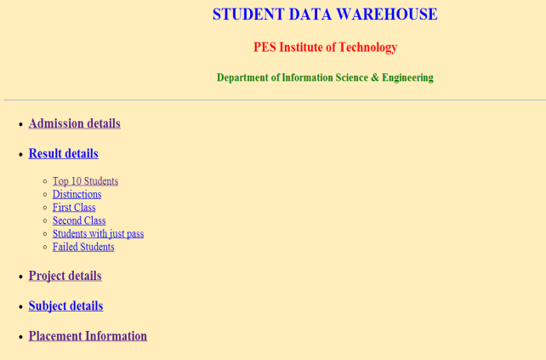
GRAPHICAL VIEW OF SDW
IMPLEMENTATION contd

Slide 12
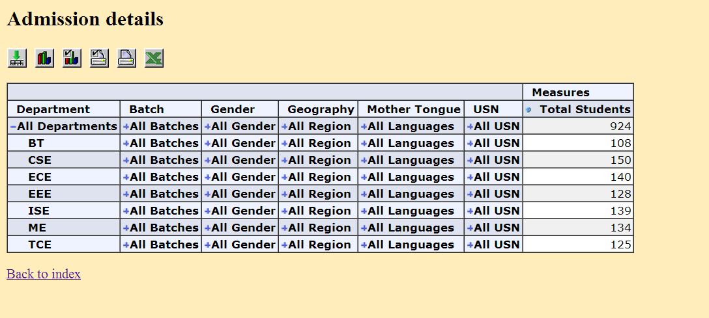
IMPLEMENTATION contd
Output of drill-down operation on Department dimension

Slide 13
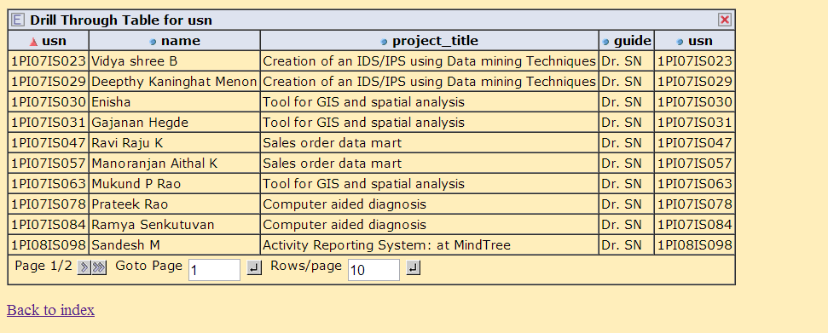
IMPLEMENTATION contd
Report generated for project data : SDW

Slide 14
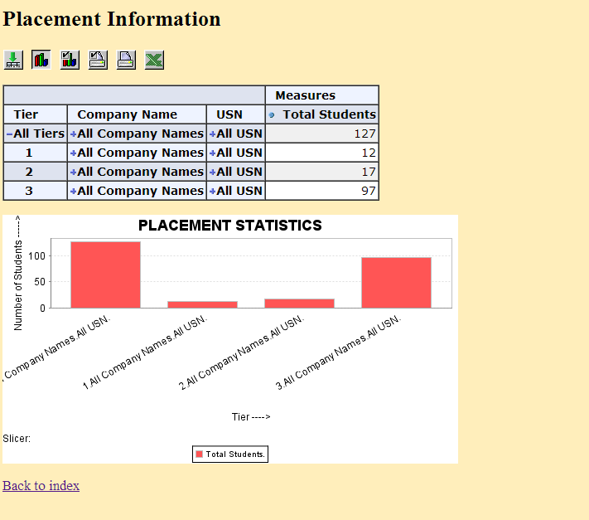
IMPLEMENTATION contd
Sample decision support system for placement statistics : SDW

Slide 15
CONCLUSION
The main objective of this work was to develop a SDW for PESIT in order to help in Reporting, Analysis and decision making. This objective has been accomplished. The Institution now has a better source of information on which to base reporting, analysis and decision-making. The major benefits of the proposed SDW can be listed as follows:
At one place whole intuitional Data can be accessed and analyzed.
Retrieving the historical data is quick so users will save time.
The system can answer multiple questions. The queries written in MDX can be varied upon the user needs.
Admission details, placement Details of a student can be accessed quickly as per the requirements of the user and same can be reported with the help the help of drill-through operation which is provided in the implemented Model.

Slide 16
FURTHER ENHANCEMENT
Future study of the proposed system includes the following:
Adopting a method which helps in handling privacy of student data
Enhancing the Reporting part in order to have better feel over the Generated report.
Developing SDW for whole University since our present work had been done for only one Institution
We have used synthetic data , since we couldn’t get actual institutional data because of security issue , so if the data loaded is real-time data then the results would be very good.
Enhancing the accessibility feature of data and enhancing front end view will helps in increasing the usability factor of the application

Slide 17
REFERENCES
[1] Developing a data warehouse for a university decision Support system by GÜZ_N TÜRKMEN, ATILIM UNIVERSITY, SEPTEMBER 2007
[2] Student Data Warehouse User Guide from Cornell University, 27-Apr-12, www.cmu.edu/es/forms/sdw.pdf
[3] “The Data Warehouse Keeping it Simple”, MIT shares valuable lessons learned from a successful data warehouse implementation by by Scott Thorne EDUCAUSE QUARTERLY, Number 3 2000
[4] Student Performance Analytics using Data Warehouse in EGovernance System By S S Suresh and Mugdha Mahale International Journal of Computer Applications (0975 – 8887) Volume 20– No.6, April 2011
[5] Thomas H. Davenport, Working Knowledge: How Organizations Manage What They Know, Harvard Business School Press, 1997.

Slide 18
REFERENCES contd..
[6] Kimball, Ralph, Reeves, Laura, Ross, Margy, and Thornthwaite Warren, The Data Warehouse Lifecycle Toolkit, New York, John Wiley and Sons, Inc.1998.
[7] http://en.wikipedia.org/wiki/Business_reporting
[8] http://en.wikipedia.org/wiki/Data_analysis
[9] http://www.etltools.net/etl-tools-comparison.html
[10] http://www.etltools.net/free-etl-tools.html
[11] http://www.cloveretl.com/sites/applicationcraft/files/files/case-studies/Comparison_CloverETL_vs_Talend_Pentaho.pdf
[13] http://en.wikipedia.org/wiki/Comparison_of_OLAP_Servers
[14] http://www.espsolutionsgroup.com/espweb/index.php
[15] https://www.bc.edu/offices/datawarehouse.html

Slide 19
THANK YOU

