Slide 1
RESUME MAKING AND CAREER PROGRESS

Slide 2
TEAM MEMBERS
LOHITH SOWMIYAN-19Z224
PRANAV VARTHAN-19Z232
RAKESH-19Z235
RASWANTH-19Z236
VENIGALLA AKHIL-19Z257
YOGESH KUMAAR-19Z262

Slide 3
INTRODUCTION
The project “Resume making and Progress analysis” was created with a purpose of creating a hassle free solution for creating a resume and provide guidance to students,teenagers and elders who work everyday for a better tomorrow.This project helps people get their resume once they provide details in our website about their qualifications,interests,hobbies.

Slide 4
PROBLEM STATEMENT
THE ENGINEERING COURSE IN ITSELF IS HARD AND TIME DEMANDING FOR ONE TO EXCEL IN HIS COURSE OF STUDY .THE ULTIMATE GOAL OF AN ENGINEER IS TO PLACE IN A WELL VERSED COMPANY AND PROVIDE TO THE SOCIETY IN THIS JOURNEY WE THOUGHT RESUME MAKING IS ONE OF THE THINGS A STUDENT BECOMES PERPLEXED WITH WHETHER TO FOLLOW A FORMAT OR ASK A FRIEND TO DO .WE THOUGHT WE WILL EASE HIS LIFE WITH OUR RESUME MAKING AND CAREER GUIDANCE PROJECT.

Slide 5

OBJECTIVE
THE OBJECTIVE OF THIS PROJECT IS TO CREATE A ONLINE PLATFORM WHERE A PERSON/STUDENT/PROFESSIONAL CAN VISIT AND GET A SATISFIABLE RESUME AND EVEN GIVING HIM CAREER GUIDANCE FOR THE FUTURE

Slide 6
REQUIREMENTS GATHERING
FUNCTIONAL REQUIREMENTS:-
REQ-1: Authentication
●Login- The user can login to the system with his/her username and password.
● Logout- The user can log out from the system.
Login failure- If the user does not exist in the database or the user has not yet been authorized by the system.
REQ-2: Authorization User role check-
After logging in, the user role will be checked from the database and the user interface will be displayed according to their role.

Slide 7
NON FUNCTIONAL REQUIREMENTS
The application is a web based application so the performance will be based on the respective web browser and its respective version all browsers that have support for css3 will be able to run the UI design smoothly.The web browser must support jquery version 3.5.0 and above.The web browsers recommended are :
Google Chrome 51+
Safari 9.0 +
Mozilla firefox 95.0+
Microsoft edge 45.0+5.2

Slide 8
SECURITY REQUIREMENTS
Users by creating a profile must agree to all terms and conditions provided on the policies regarding use of their data.Data will not be shared or viewed by any other external entity the data will be used for analytical purposes to provide guidance and miscellaneous features.The only entity that has permission to the access of the data will be the main server.Other security requirements : Users are prohibited from entering private data as a means of storage as the admin Will be not responsible for third party scrutiny On any of the data deemed impertinent

Slide 9
Software Quality Attributes:-
The application needs to be scalable for future uses.The cloud storage must be scalable in terms of both bandwidth and cluster storage spaces.If the application is deployed in a different platform in the future(mobile applications) the databases must still be interoperabile.
Business Rules:-
The following are the principles for the maintenance of the application:1.The application is responsible for the safety and integrity of user data assuming that the user followed all the usage norms .2.No member other than the user can view his/her data from the database.

Slide 10
DESIGN

Slide 11
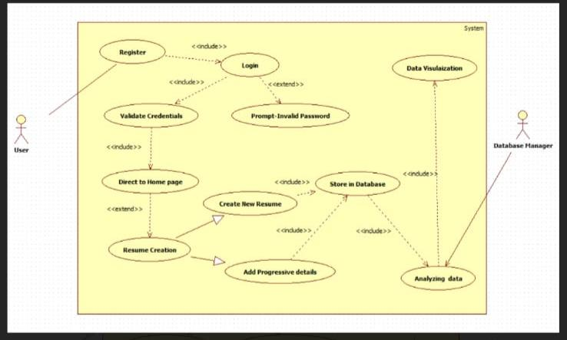
USE CASE DIAGRAM

Slide 12
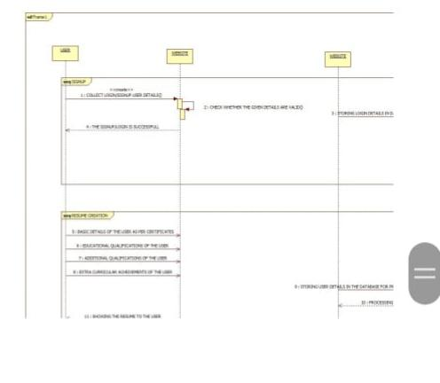
SEQUENCE DIAGRAM

Slide 13
SYSTEM REQUIREMENTS

Slide 14
FRONT END
BACKEND
SOFTWARE REQUIREMENTS
HTML,CSS,JAVASCRIPT
PHP ,MYSQL

Slide 15
HARDWARE REQUIREMENTS
consolidated view of awards and achievements profile building graphical Analysis resume generation

Slide 16
PROJECT CONTRIBUTION
RAKESH,RASWANTH-DASHBOARD,LOGIN,REGISTER
AKHIL-DATABASE DESIGN
PRANAV,YOGESH-HTML TO PDF CONVERSION
LOHITH-MORRIS.JS AND GETTING PROFILE DATA,REPRESNTATION OF DATA

Slide 17

Product demo

Slide 18
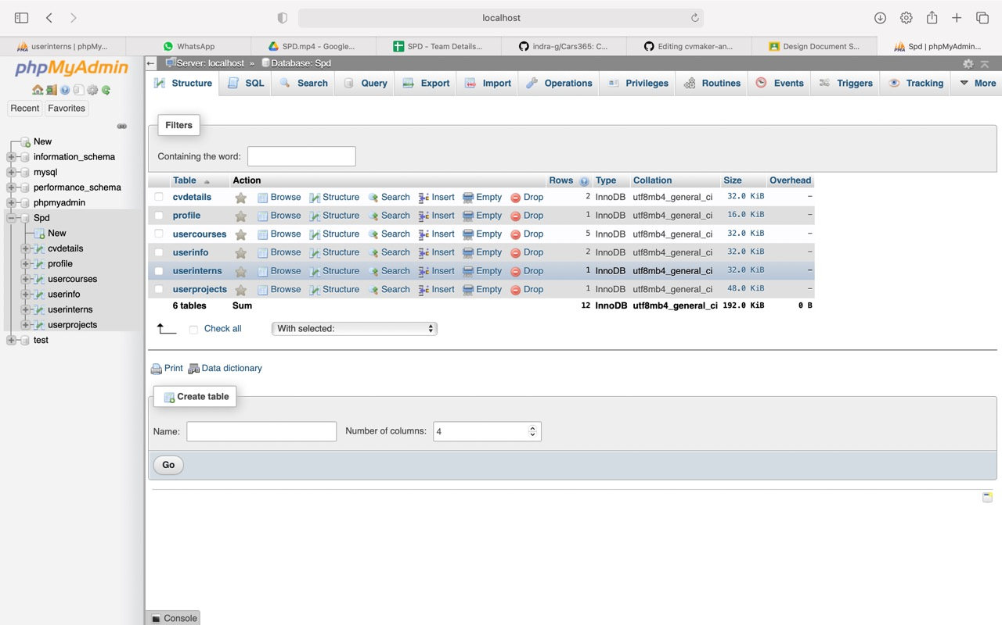

Slide 19
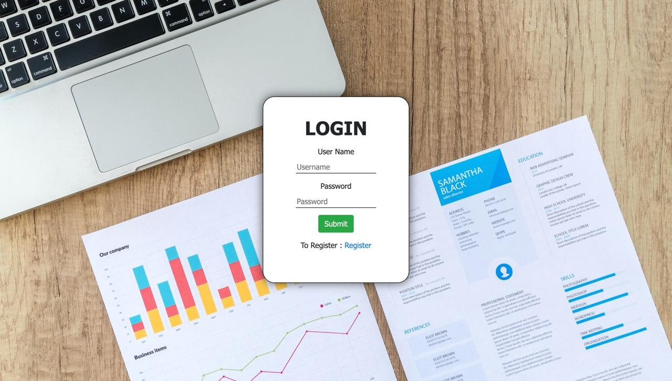

Slide 20
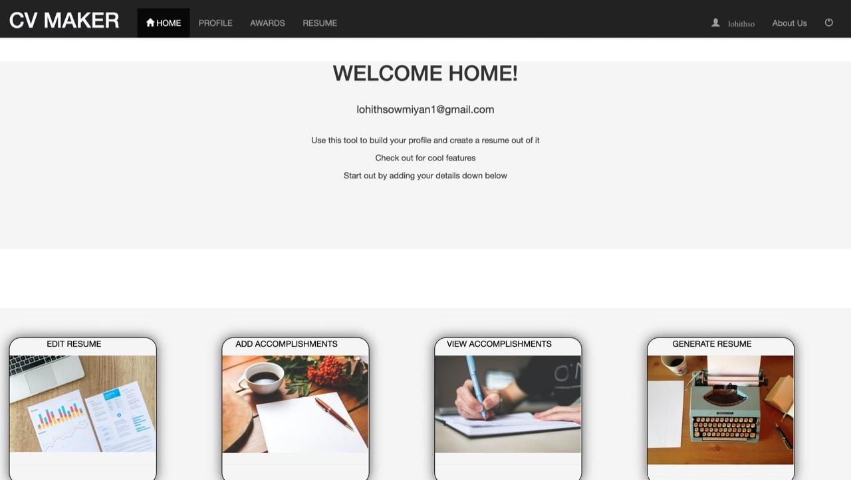

Slide 21
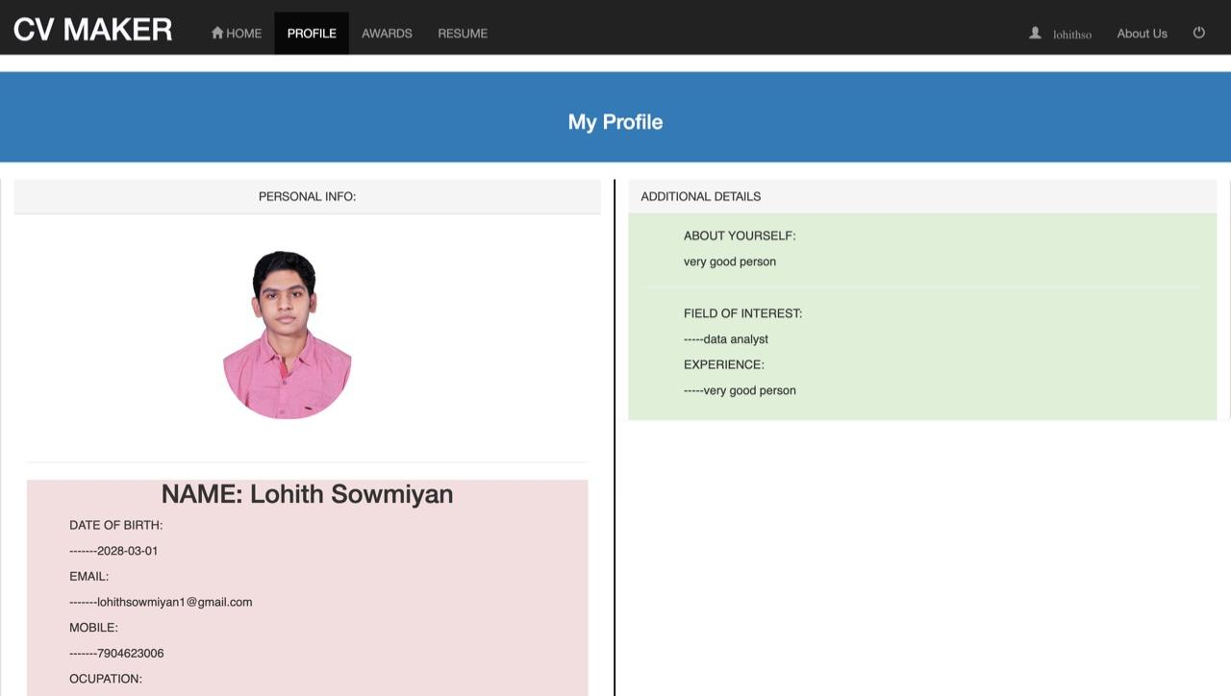

Slide 22
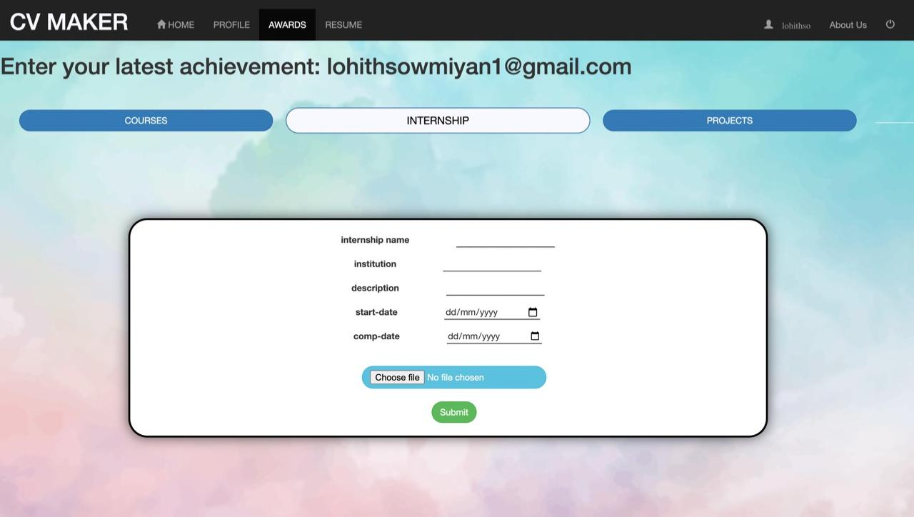

Slide 23
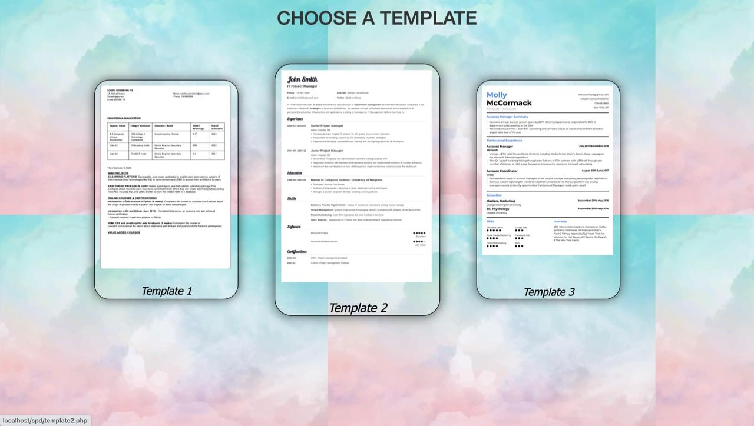

Slide 24
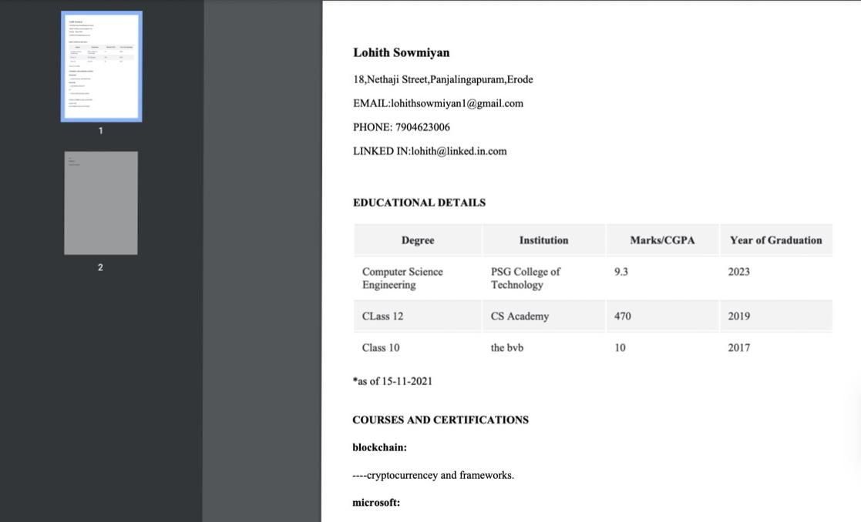

Slide 25
THANKS!!

