Slide 1

AI-Based Fake Review Detection System
Detect fraudulent reviews with a scalable platform that combines text mining, metadata analysis, and machine learning to protect trust across e-commerce and review platforms.
Ms. Sollangi Jayasree
324129510055

Slide 2
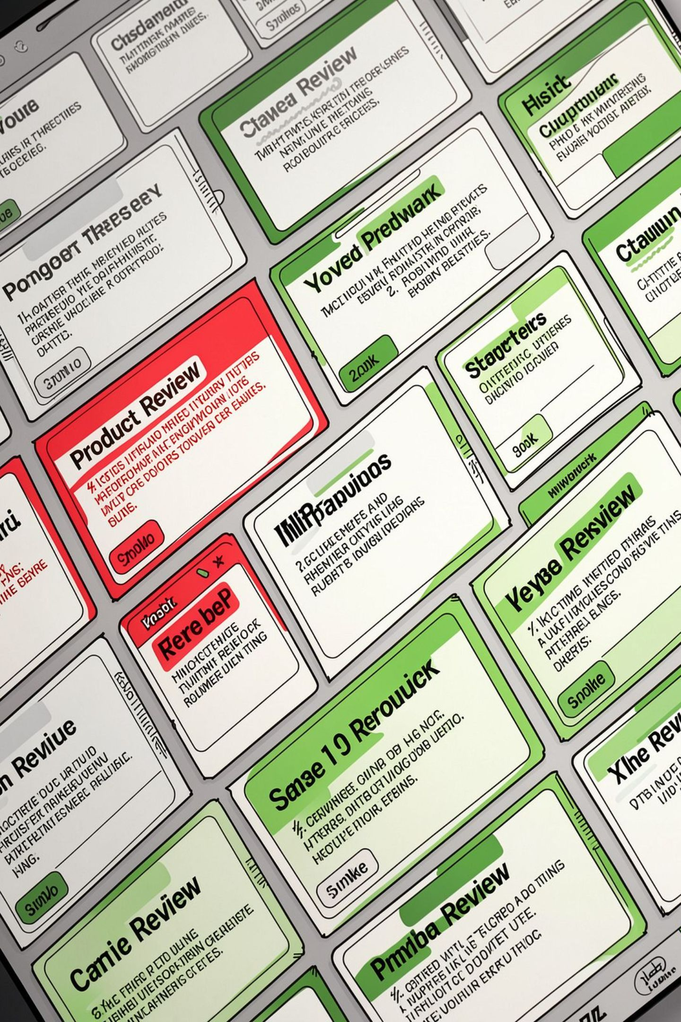

Why This Matters
Online reviews drive purchasing decisions and brand reputation. Sophisticated fake reviews erode trust, mislead customers, and distort analytics — creating regulatory and business risks for platforms and merchants.
Goal: Restore confidence in review systems through automated, explainable detection.

Slide 3

Core Challenges
High volume and velocity of user-generated reviews
Adversarial writing and coordinated campaigns
Limited labeled data for new fraud patterns
Need for explainability and low false positives

Slide 4
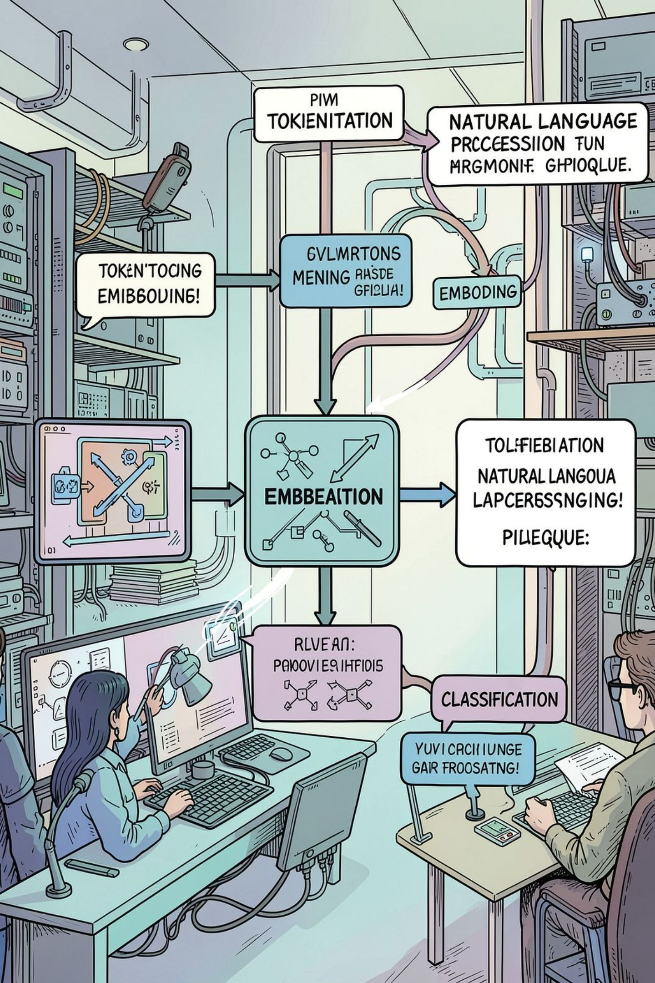
Solution Overview
Combine Python-based text preprocessing and NLP with metadata and behavioral analytics. Feed engineered features into supervised and ensemble ML classifiers to score reviews for authenticity and surface suspicious accounts and patterns.

Slide 5
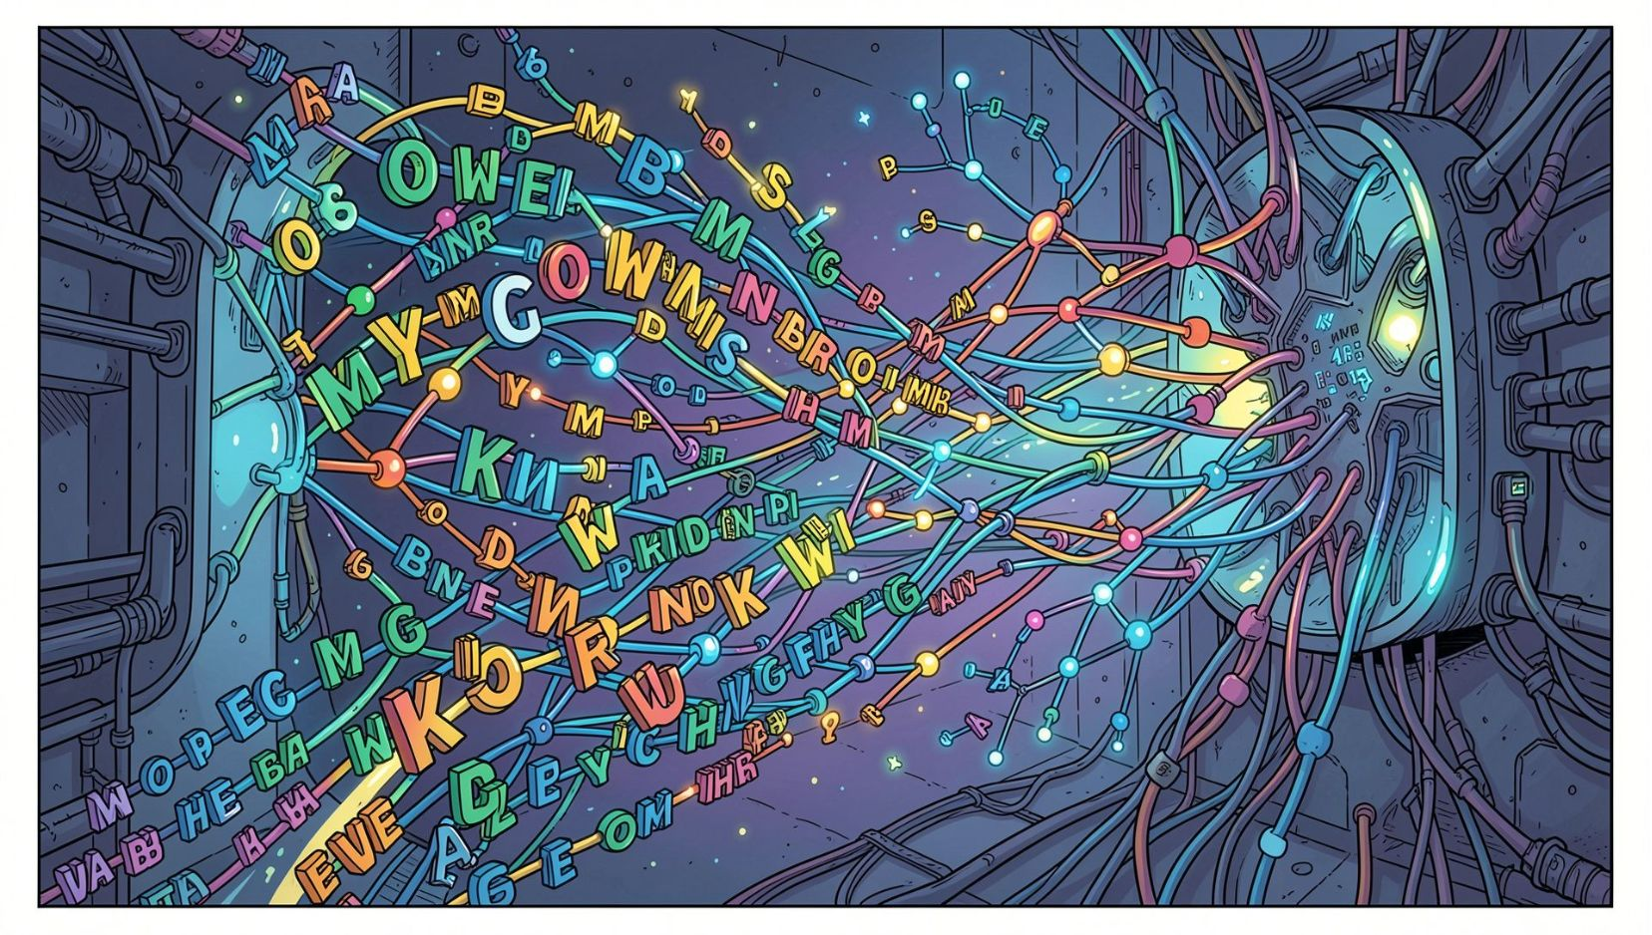
Text Mining & NLP Features
Tokenization, lemmatization, stop-word filtering
TF-IDF, n-grams, POS tags, readability metrics
Pretrained embeddings (BERT/RoBERTa) + fine-tuning
Sentiment polarity, emotion vectors, hallucination detection

Slide 6

Metadata & Behavioral Signals
Reviewer history, frequency, and burst posting patterns
Account age, device/agent fingerprint consistency
Rating distribution anomalies and temporal correlation
IP/geo clustering and cross-product activity graphs

Slide 7
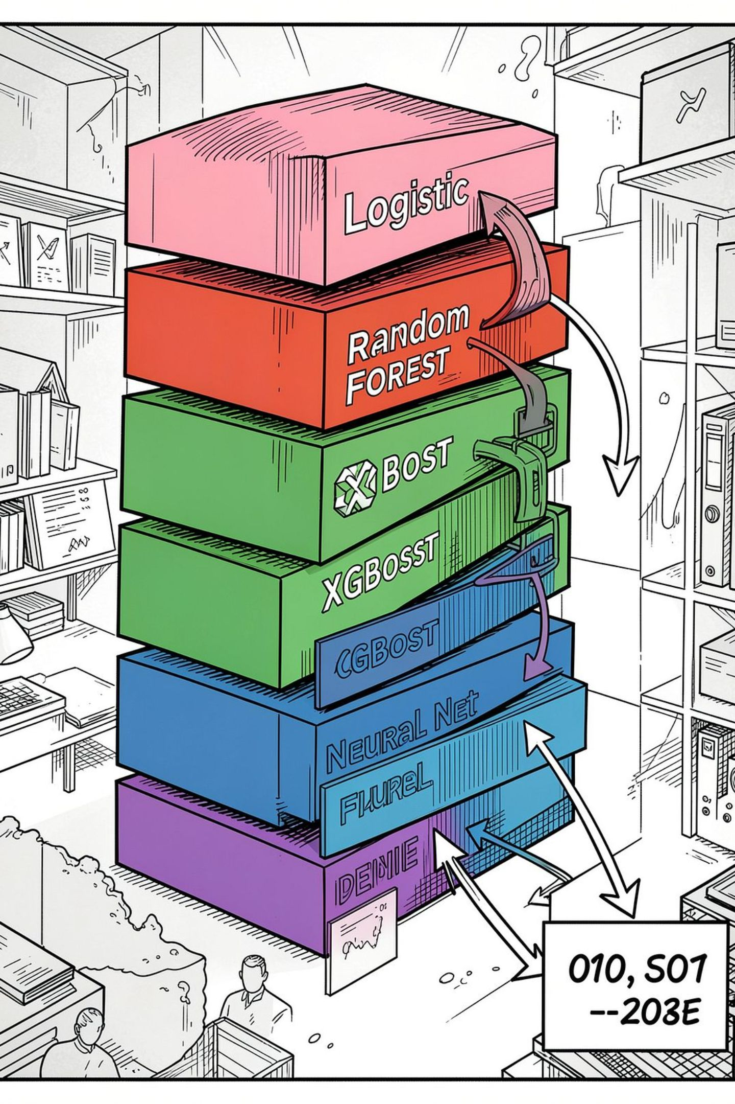
Modeling & Architecture
Use a hybrid modeling stack: feature-based classifiers (XGBoost, Random Forest), neural encoders (fine-tuned transformers), and anomaly detectors. Combine with calibration and an ensemble meta-learner to produce an explainable authenticity score.

Slide 8

Extract & Infer
Report & Review
Ingest Data
Pipeline ensures streaming ingestion, batch re-training, and real-time scoring with human-in-the-loop review for edge cases.

Slide 9
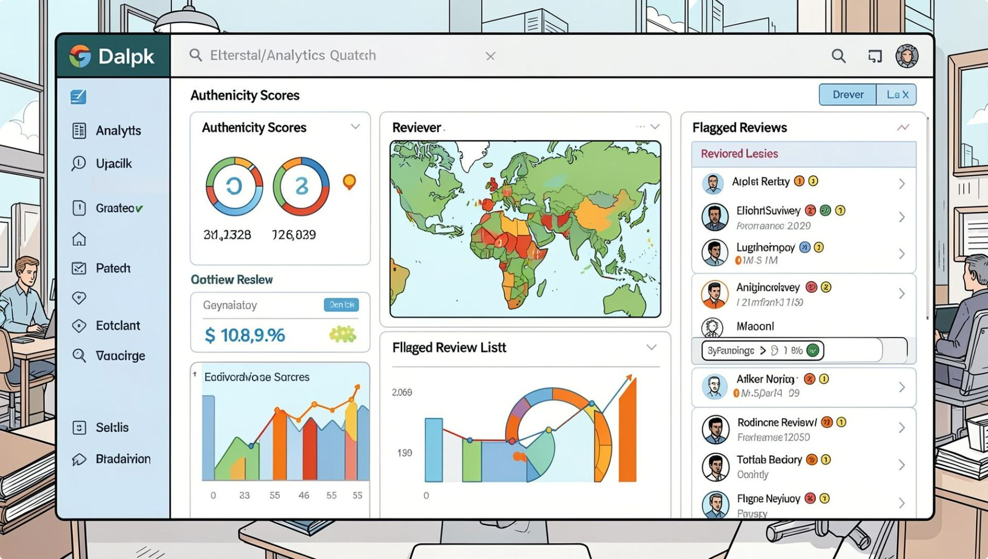
Outcomes & KPIs
Precision and recall on labeled fraud sets
Reduction in fraudulent reviews reaching product pages
Increase in user trust metrics and conversion lift
Operational metrics: latency, throughput, and false-positive rate
Include A/B tests and manual review loops for continuous validation.

Slide 10

Next Steps & Implementation Roadmap
1
2
3
Proof of Concept
Pilot Deployment
Scale & Monitor
Integrate ingestion, build baseline models, and validate on historical labeled data.
Run in shadow mode on live traffic, tune thresholds, and collect human review labels.
Automate retraining, add streaming scoring, and embed dashboards for ops and trust teams.
Prompt for Gamma.ai PPT generation: Provide these 10 slide contents (title + short bullets + visual guidance) as input to Gamma.ai to automatically create a professional deck for product managers and technical decision-makers.

