Slide 1

Customer Perception about Service Quality of Mobile Telecommunication: A Case of India

Slide 2
Introduction
India is the accounts for 12 per cent of the world’s total telephone subscribers. It is also one of the fastest growing in terms of telecom subscribers.
Mobile tariffs in India are the second lowest in the world after Bangladesh. Countries with the highest mobile tariffs include Austria, Venezuela, Greece, Portugal, Australia, Japan, Spain, Switzerland, France, and Brazil
Mobile phones accounts for nearly 96.6 per cent of the total telecom subscriptions, and more than 95 per cent of wireless connections are prepaid.
Around 431 million wireless subscribers in India subscribe to data services. This implies that 48.26 per cent of total wireless subscribers are capable of accessing data services/Internet on their mobile phones.
Wireless phones dominate the market in India and the wire-line phone segment constitutes merely 3.4 per cent of the total subscriber base.
The telecom sector has received on average 8.2 per cent of total inward FDI between 2000–01 and 2010–11. Most of the FDI has gone to the cellular mobile segment.

Slide 3
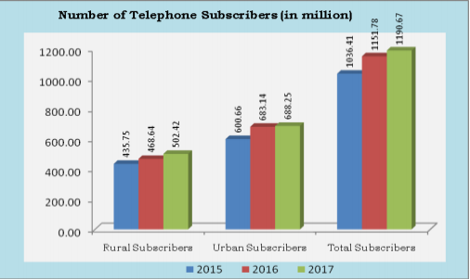
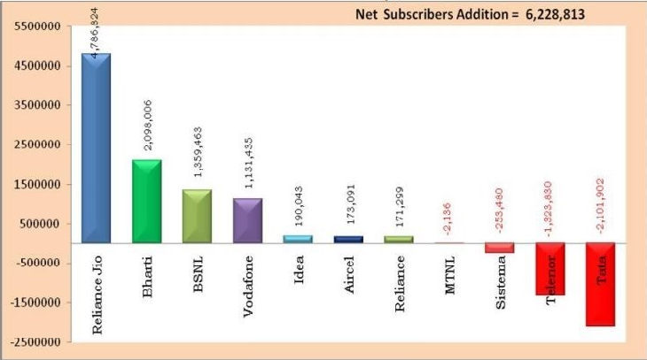
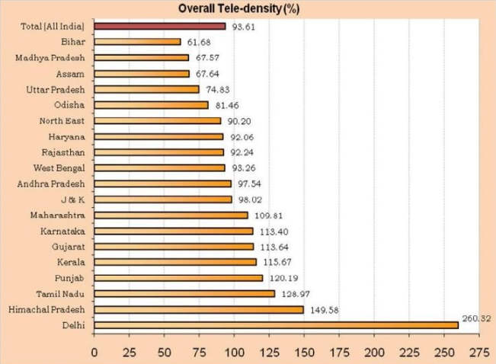

Slide 4
Objective
To analyse the perception about Indian Telecom services in retail segment.
To understand the impact of price on the service quality and customer support from the operator.
To understand the expectation of consumer from the Telecom operators.

Slide 5
Research Gap
The Impact of JIO disruption in Telecom domain
Analysis of the sentiments on the consumer after the price war
Understanding the related scope for improvement in telecom domain

Slide 6
Model Used
The original SERVQUAL instrument pertains 5 categories:
Reliability: The ability to perform the promised service dependably and accurately
Assurance: The knowledge and courtesy of employees and their ability to convey trust and confidence
Tangibles: The appearance of physical facilities, equipment, personnel and communication materials
Empathy: The provision of caring, individualized attention to customers
Responsiveness: The willingness to help customers and to provide prompt service

Slide 7
Research Design
Basic Research Characteristics
Design is generally based on a social constructivism perspective.
Research problems become research questions based on prior research experience.
Sample sizes in group discussion varies from 8- 12.
Data collection involves interview and focussed group discussion.
Open ended questionnaire in order to generate participant perspectives about ideas, opinions, and experiences.
Interpretation is based on a combination of researcher perspective and data collected.
The exploratory research design is considered for the insights and understanding.

Slide 8
Convenience Sampling Technique
The various retail segment users were selected from North India. The age of users varies between 18-60 years.
Element – Respondents includes few B. tech students, Teachers, Post Graduate students, retail store owner, Local people, etc.
Extent – NCR
Time – June 2018-July2018
Data Collection : The questionnaires for focused group discussion and interview were distributed among mobile users who have current prepaid or postpaid accounts with four major mobile phone service. All four mobile phone service providers from private sector-Vodafone Ltd., Jio Communications Ltd., Bharti Airtel Ltd. and Idea Cellular Ltd. will be selected.

Slide 9
Method of Inscription and Interpretation
Ethnography
Phenomenology
Grounded theory
Recording using electronic instruments
Converting speech to text
Sentiment analysis tools
Analysis Criteria
The grouping by of positive and negative sentiments on perception and expectation of users.

Slide 10
Exploratory Data Analysis

Slide 11
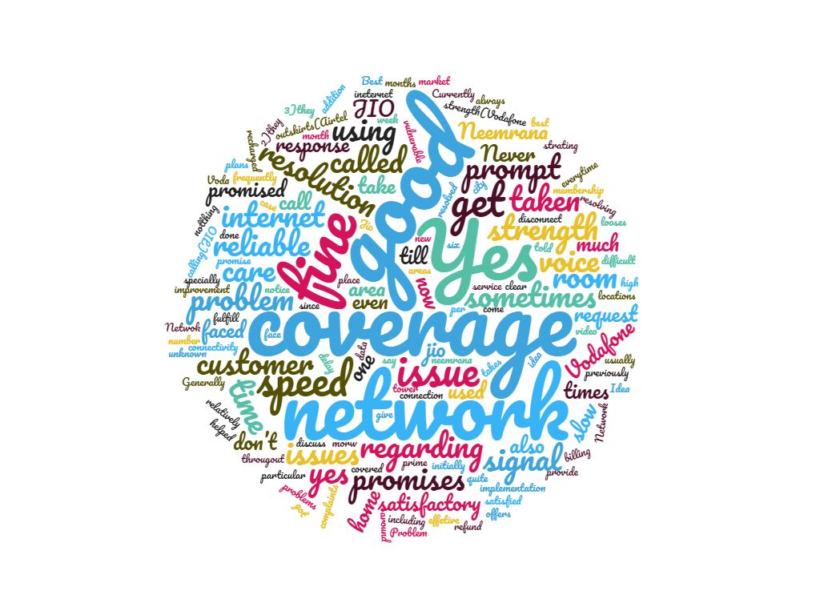
Reliability

Slide 12
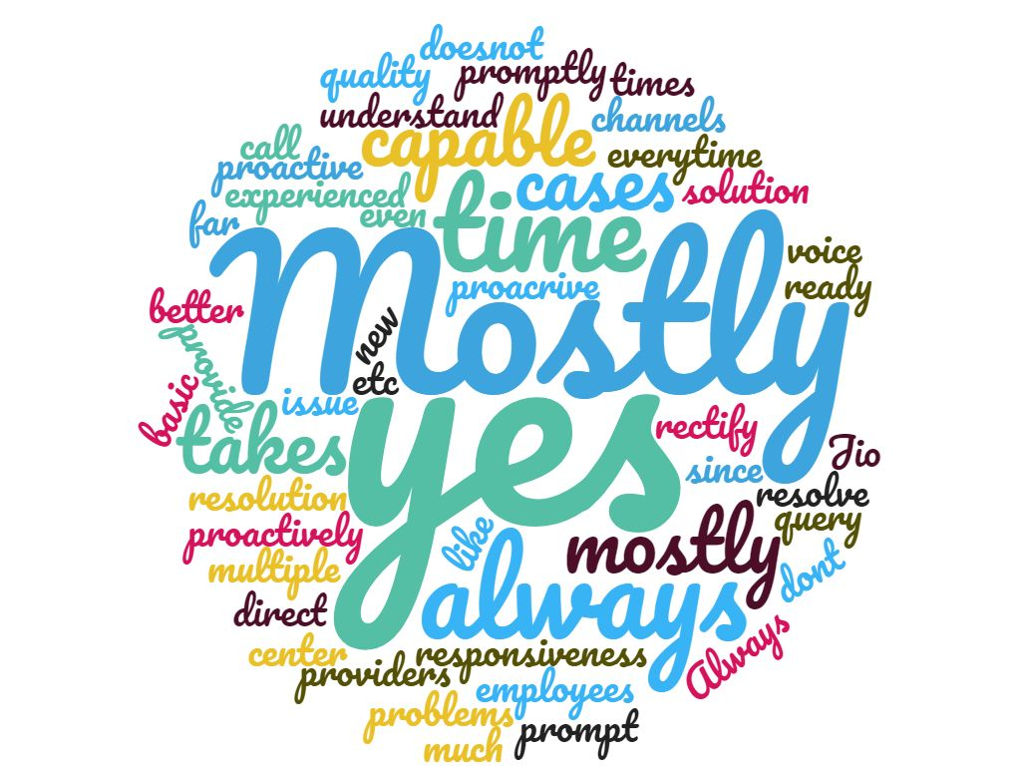
Assurance

Slide 13
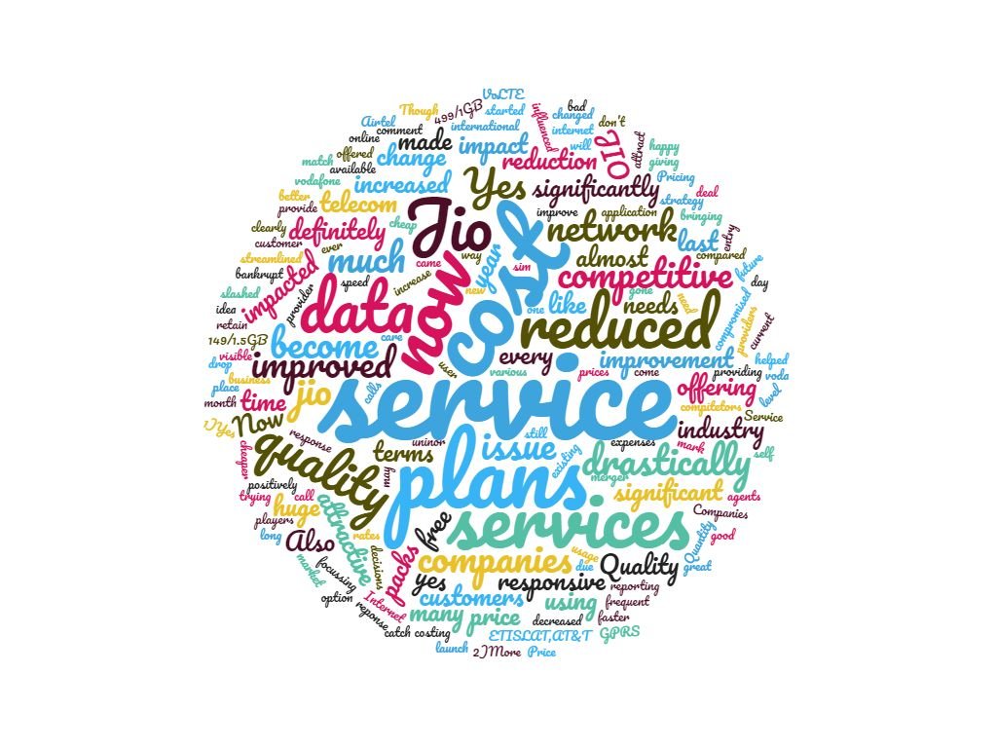
Impact of Price War

Slide 14
Focus Group Sentiment Analysis

Slide 15
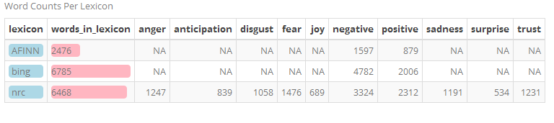
Sentiment Lexicons

Slide 16
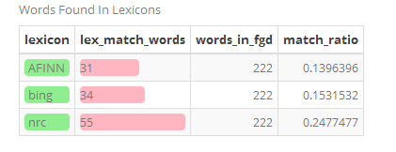
Determining Appropriate lexicon

Slide 17
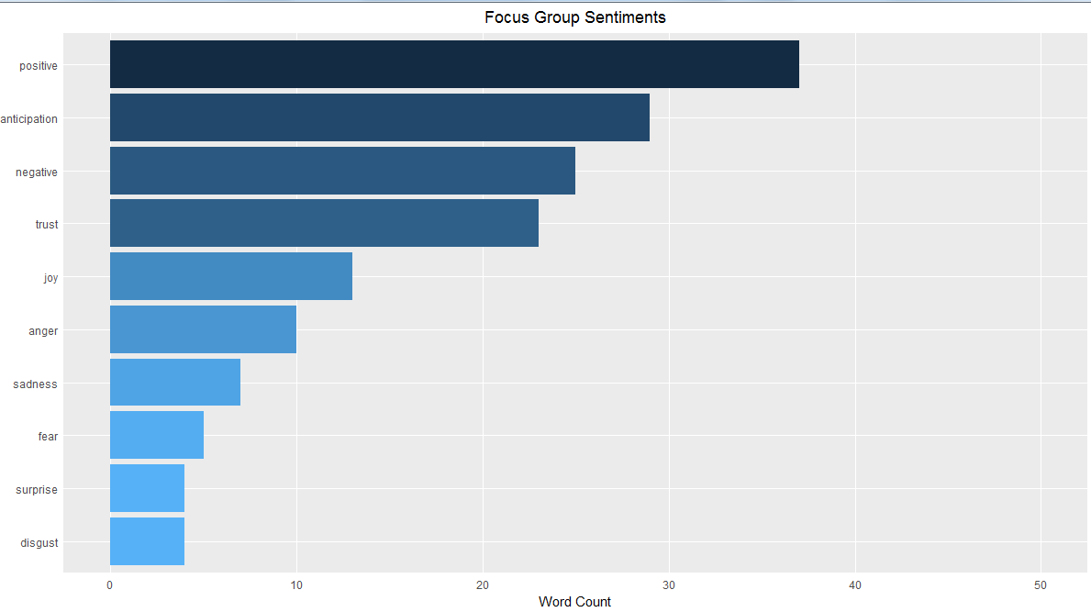
Focus Group Sentiments

Slide 18
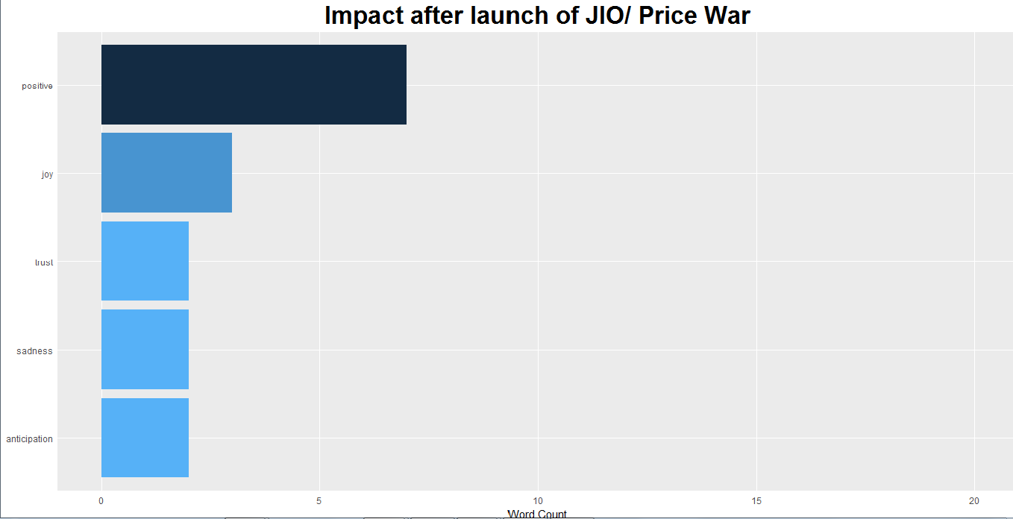
Impact after launch of Jio/Price War

Slide 19
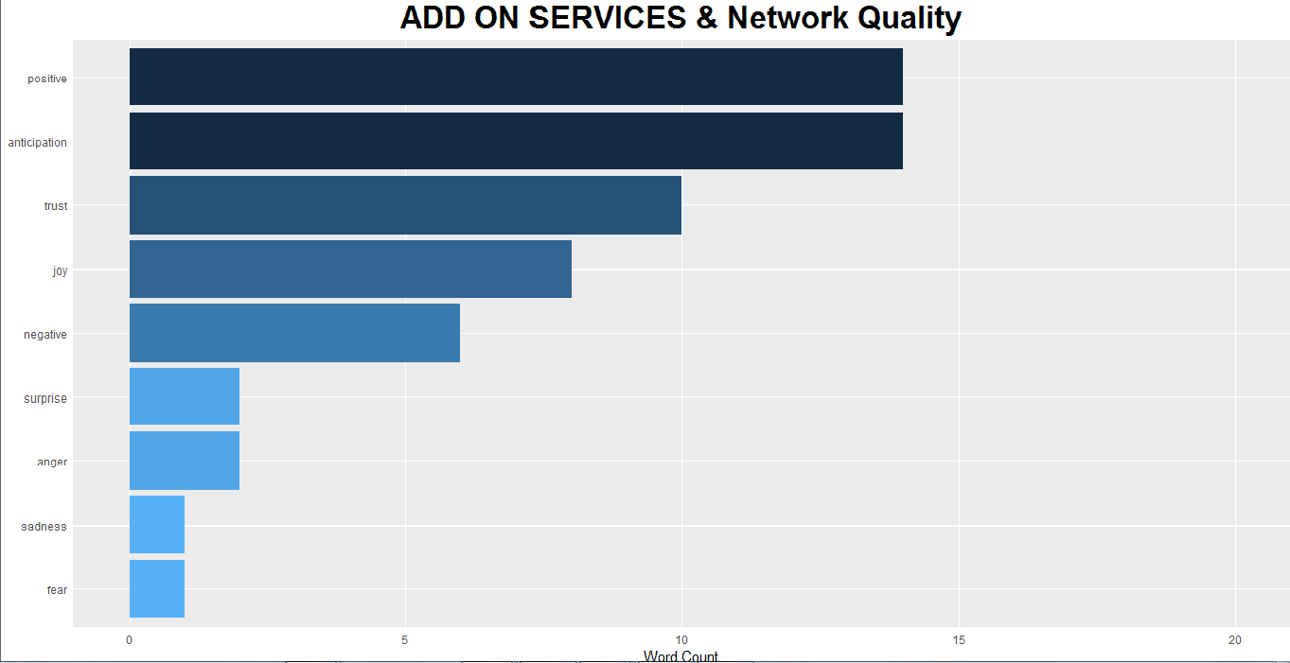
Add on Service and Network Quality

Slide 20
Interviews Sentiment Analysis

Slide 21
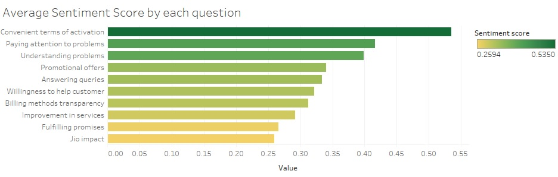
Sentiment analysis on interviews

Slide 22
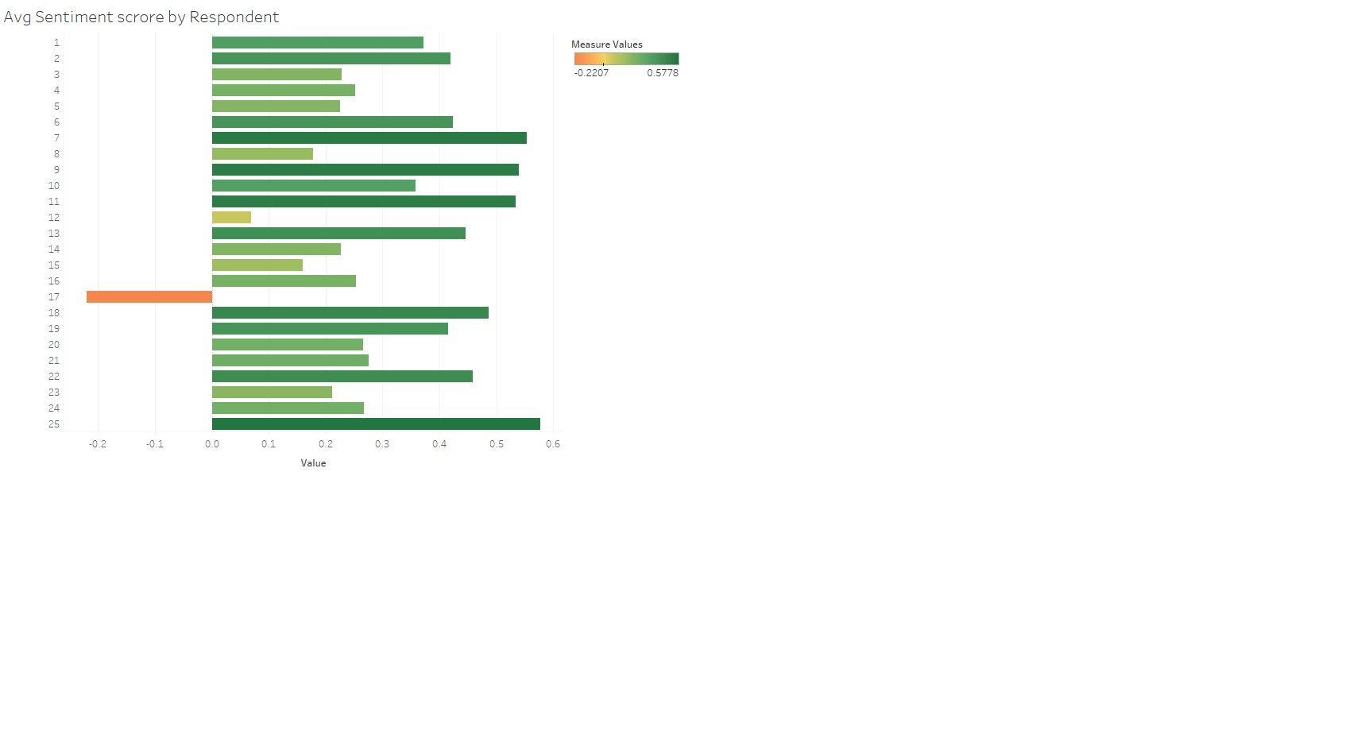
Sentiment analysis on interviews

Slide 23
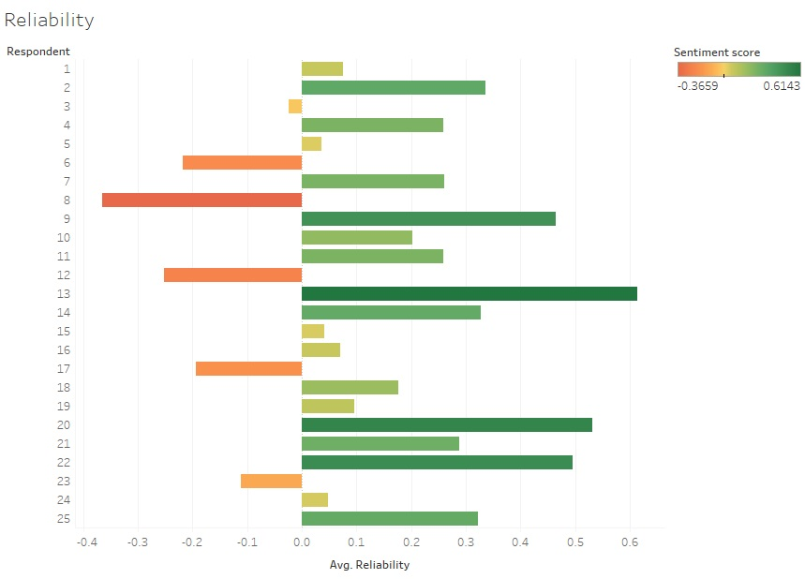
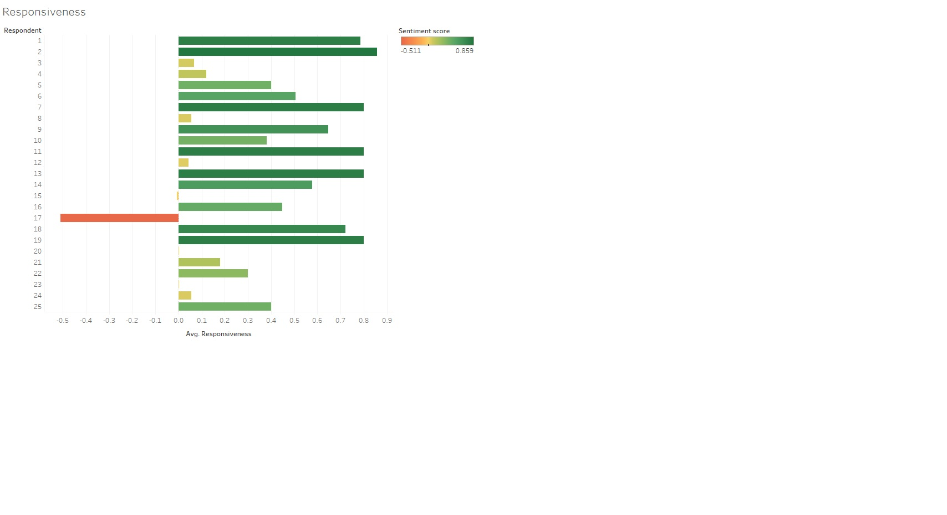
Sentiment analysis on interviews(SERVQUAL)

Slide 24
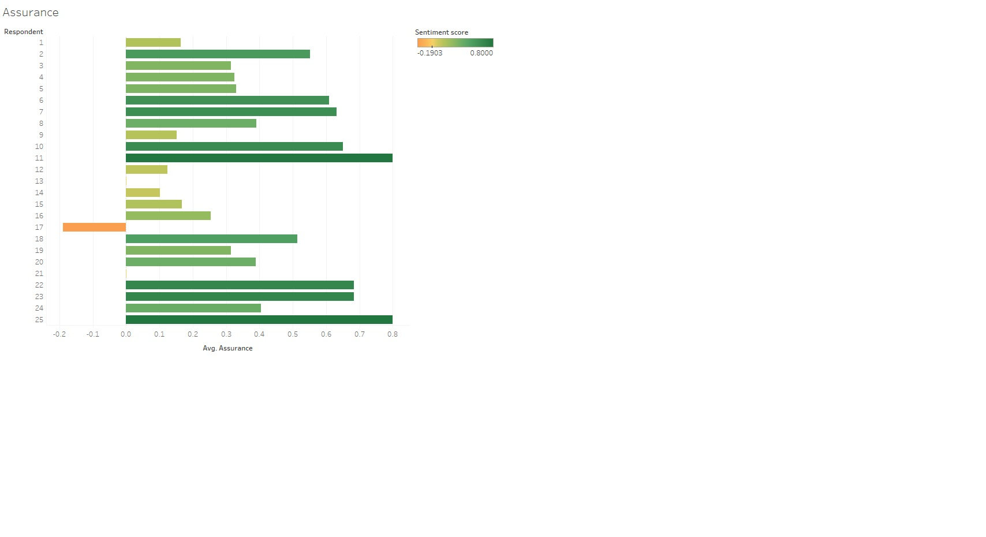
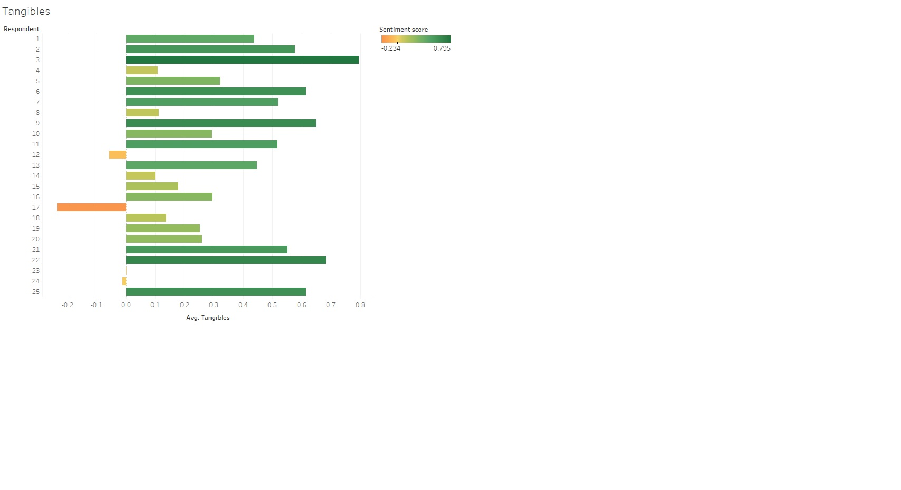
Sentiment analysis on interviews(SERVQUAL)

Slide 25
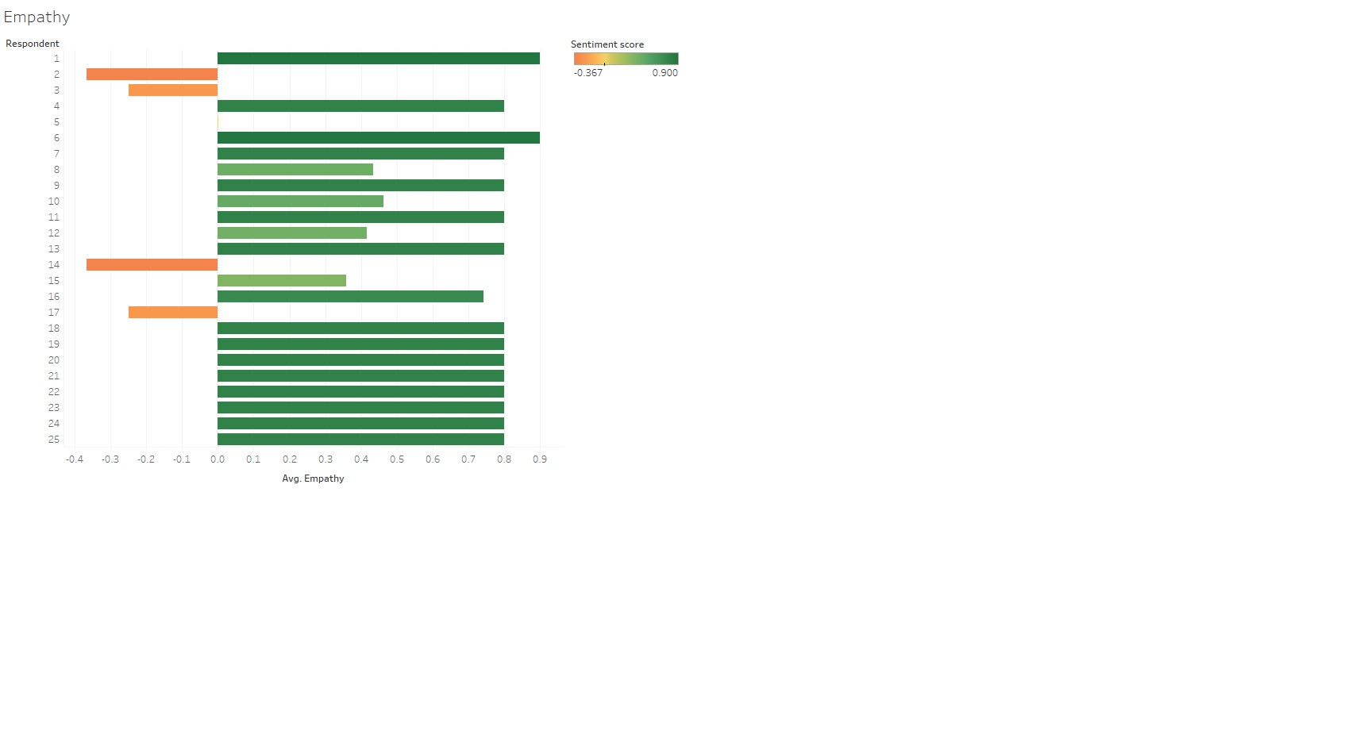
Sentiment analysis on interviews(SERVQUAL)

Slide 26
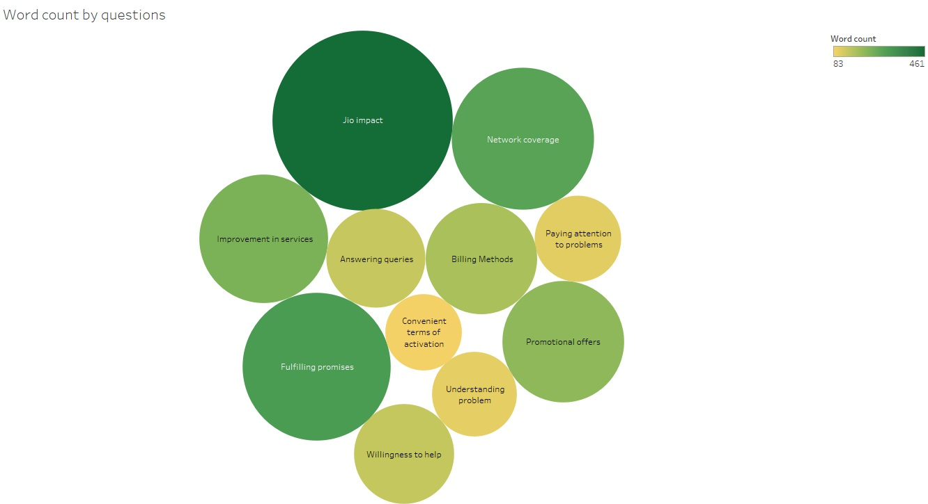
Sentiment analysis on interviews

Slide 27
Inferences
The results of Sentiment analysis on the quality of services in Telecom domain were mostly positive.
The Impact of JIO has positive sentiments amongst people regardless of issues pertinent voice and price war.
The improvement scope in network coverage is anticipated by users in coming years.

Slide 28
Limitations
The research can further be extended in other parts of India.
The sampling technique can be enhanced using random sampling and selecting people that represents the strata.
The diversity in Focused Group can be enhanced.
Social Media analytics can also be done on comments in order to take proper reviews from the users.

Slide 29
Recommendations
The network towers should be shared by all the service providers and should be government regulated.
Attractive bundled offers should be introduced by the service providers.
The service providers still fail to provide better service quality in terms of network coverage, Need to focus here.
Service providers should focus on improving response time.

Slide 30
References
Amit Chaudhary, I. U. (2013). Identification of Telecom Service Quality Dimensions in India with Fuzzy Analysis. Global Journal of Management and Business Studies.
Borah, N. (2014). The changing Indian telecommunication industry. SSRN electronical journal.
Gautam, V. (2015). Service Quality Perceptions of Customers About Mobile Telecommunication Services. Journal of Global Marketing.
Pankaj Sharma, D. J. (2017). Measuring Service Quality in the Telecom Industry in India. International Journal of Management Studies.
Rajkumar Paulrajan, H. R. (2011). Service Quality and Customers preference of Cellular Mobile Service Providers. Journal of Technology Management & Innovation vol.6 no.1 Santiago 2011.
Thomas Joy, S. B. (2018). Disruption by Reliance Jio in Telecom Industry. International Journal of Pure and Applied Mathematics.
Zahoor, Z. (2015). An overview of Indian telecom sector. Abhinav Publications.

Slide 31
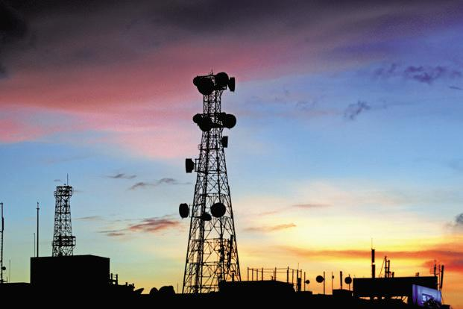
Thank You

