Slide 1
Object Detection Model with Real-Time Capabilities Using Python
Lohit Marla

Slide 2
Agenda
Introduction to Object Detection
Problem Statement
End-to-End Model Development Pipeline
Workflow
Python Modules & Libraries
Model Selection and Python Code
Pre-Trained Models
Custom Models
Real-Time Video Frame Analysis Architecture
Detecting Objects & Bounding Boxes

Slide 3

Introduction to Object Detection
Real-time object detection enables the identification and localization of objects within an image or video stream in real-time.
Example: Autonomous Vehicles, Surveillance Systems
Key Concepts
Object Detection
Bounding Boxes

Slide 4
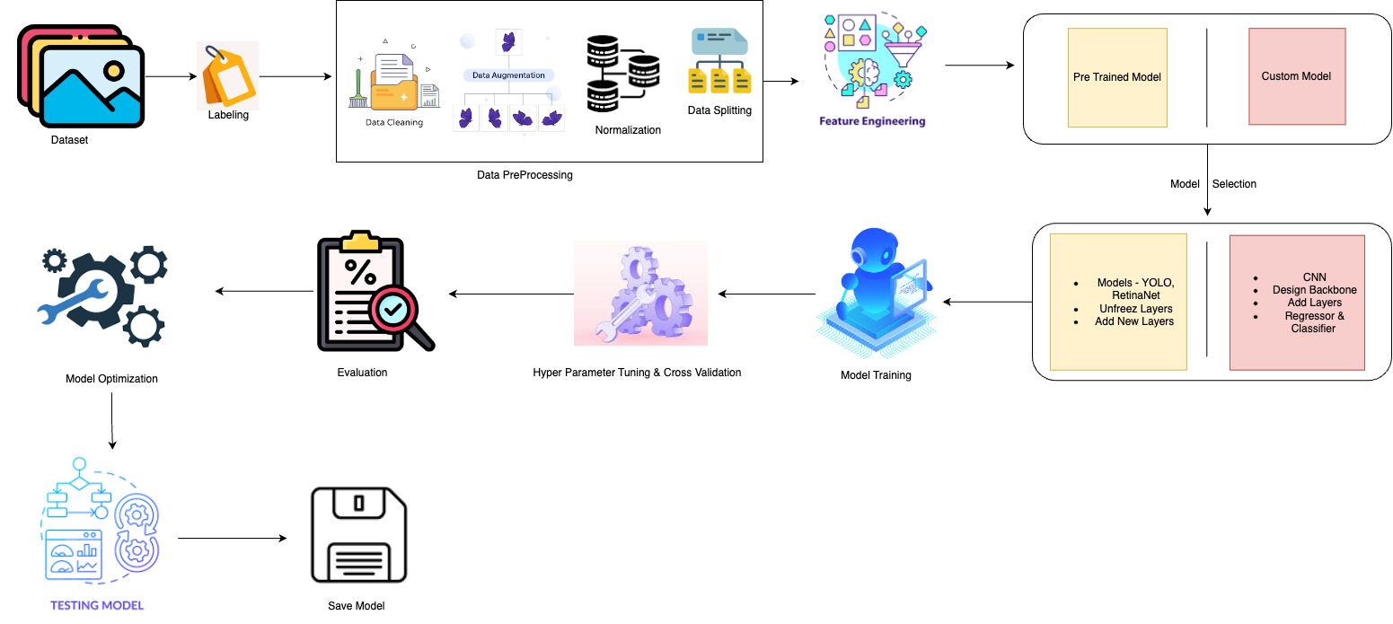
End-to-End Model Development Pipeline

Slide 5
Workflow
Dataset Preparation
The first step was to gather a dataset of images containing the objects of interest for the object detection model. For real-time object detection, we can leverage open datasets such as COCO & PASCAL VOC, which contain images annotated with bounding boxes and labels for various objects. Additionally, a small custom dataset can be created by manually labeling images relevant to the project.
Labeling
Since object detection requires not only class labels but also the precise coordinates of the bounding boxes around the objects, the labeling process was critical. Tools such as LabelImg to annotate the custom dataset, drawing bounding boxes and assigning corresponding labels. Pre-labeled data from the COCO dataset was also utilized for standard objects.
Data Preprocessing
The collected data was preprocessed by resizing the images to a uniform size, augmenting the dataset through transformations (such as flipping, rotation, and scaling) to increase the model's robustness. The bounding box coordinates were adjusted accordingly during augmentation. Additionally, the dataset should be normalized to ensure consistent input for the model.
Feature Engineering
In this phase, enhancing the dataset to improve the model's performance is crucial. The object detection model required extracting specific features such as edges, corners, and textures from the images. Using techniques like Histogram of Oriented Gradients (HOG) and applying convolutional layers, model could recognize patterns relevant to object detection.

Slide 6
Model Selection
For the real-time object detection task, several pre-trained models, including MobileNetV2 and YOLOv3, that are optimized for both speed and accuracy. MobileNetV2 was selected for the initial experiment due to its lightweight architecture and efficiency in real-time scenarios. The model was fine-tuned to adapt to the custom dataset.
Model Training
The selected model can be trained using the prepared dataset. During training, the transfer learning technique to leverage pre-trained weights from a general object detection task and applied them to a specific dataset. This significantly reduced training time while maintaining accuracy.
Hyperparameter Tuning
To improve model performance, hyperparameters such as learning rate, batch size, number of epochs, and dropout rates can be used. Experiments to identify the best combination of these parameters, ensuring the model’s optimal performance in real-time object detection scenarios.
Cross Validation
To ensure that the model was not overfitting, k-fold cross-validation can be implemented. The dataset was split into training and validation sets, and the model’s performance was evaluated on unseen data to ensure it generalizes well to new images.

Slide 7
Model Evaluation
The model's performance can be evaluated using metrics such as mean Average Precision (mAP), precision, recall, and Intersection over Union (IoU). The bounding boxes predicted by the model were compared with the ground truth labels, and the IoU score was calculated to assess the model's accuracy.
Model Optimization
Post-evaluation, the model can be optimized to enhance performance in real-time applications. Techniques such as model pruning and quantization can be applied to reduce the model size and inference time, allowing it to run efficiently on devices with limited computational resources.
Testing the Model
The model can be tested in real-time using a webcam feed. Integrating the trained object detection model with OpenCV to capture live video streams and display bounding boxes and object labels over detected objects. The testing process involved verifying the model's ability to detect objects accurately and rapidly in real-world scenarios.
Saving the Model
Once the model demonstrated satisfactory performance, it was saved for future use. The model's weights and architecture were stored using the TensorFlow/PyTorch save function, allowing it to be loaded and deployed for real-time object detection tasks at any time.

Slide 8
Python Modules & Libraries
1. Dataset Preparation
os: For handling directory paths and file operations.
cv2 (OpenCV): For loading, processing, and visualizing images.
numpy: For handling arrays and numerical computations.
2. Labeling
json: For handling JSON files (used for loading annotations in COCO or custom formats).
os: For file path management.
3. Data Preprocessing
tensorflow.keras.preprocessing.image.ImageDataGenerator: For image augmentation and preprocessing.
cv2 (OpenCV): For resizing and augmenting images.
4. Feature Engineering
tensorflow.keras.applications (VGG16, MobileNetV2, etc.): For loading pre-trained models and extracting features.
matplotlib.pyplot: For visualizing feature maps and other results.
tensorflow.keras.models: For building models.
5. Model Selection
tensorflow: For deep learning model construction, loading pre-trained models, and transfer learning.

Slide 9
Python modules and libraries
6. Model Training
tensorflow: For model training and compiling.
matplotlib.pyplot: For plotting training and validation curves.
7. Hyperparameter Tuning and Cross-Validation
sklearn.model_selection.KFold: For k-fold cross-validation.
tensorflow: For managing model training during cross-validation.
8. Model Evaluation
tensorflow: For model evaluation.
sklearn.metrics (precision_score, recall_score): For calculating precision, recall, and other evaluation metrics.
9. Model Optimization
tensorflow.keras.optimizers (Adam): For using different optimizers and adjusting learning rates during fine-tuning.
10. Testing Model
tensorflow: For loading and using the trained model on unseen data.
cv2 (OpenCV): For visualizing images with bounding boxes and class labels.
11. Saving Model
tensorflow: For saving and loading the trained model in .h5 or .pb format.

Slide 10
Model Selection Strategy Pre-Trained Models
Small Dataset
Utilize existing models trained on large datasets.
Examples: YOLO, SSD, Faster R-CNN, MobileNetV2.
Benefits:
Faster implementation.
High accuracy with minimal data.
Use Cases:
Quick prototyping.
Applications with limited data availability.

Slide 11

Dataset Preparation
import os import cv2 import numpy as np # Define dataset paths dataset_path = "path/to/dataset" train_images_path = os.path.join(dataset_path, 'train') test_images_path = os.path.join(dataset_path, 'test') # Load the images def load_images(image_dir): images = [] for img_file in os.listdir(image_dir): img = cv2.imread(os.path.join(image_dir, img_file)) if img is not None: images.append(img) return images train_images = load_images(train_images_path) test_images = load_images(test_images_path) # Dataset ready for processing print(f"Loaded {len(train_images)} training images and {len(test_images)} testing images.")

Slide 12

Labeling
# Assuming annotations are stored in JSON files in COCO format import json annotation_file = "path/to/annotations/train.json" def load_annotations(annotation_path): with open(annotation_path, 'r') as file: annotations = json.load(file) return annotations train_annotations = load_annotations(annotation_file) # Example of annotation structure for annotation in train_annotations['annotations']: print(annotation['bbox'], annotation['category_id'])

Slide 13


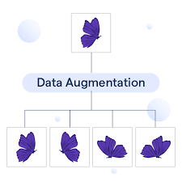
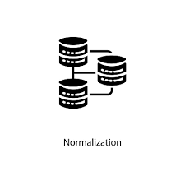
Data Preprocessing
from tensorflow.keras.preprocessing.image import ImageDataGenerator # Normalize and augment the data def preprocess_data(images): # Create an image data generator for augmentations datagen = ImageDataGenerator( rescale=1./255, # Normalize pixel values to [0, 1] rotation_range=10, zoom_range=0.2, horizontal_flip=True ) processed_images = [] for img in images: img = cv2.resize(img, (224, 224)) # Resize to match model input size img = datagen.random_transform(img) processed_images.append(img) return np.array(processed_images) train_images_preprocessed = preprocess_data(train_images)

Slide 14

Feature Engineering
# For object detection, feature extraction happens within the model's convolutional layers # This step is mostly handled during model training # However, we can visualize or extract feature maps from a pretrained model from tensorflow.keras.applications import VGG16 import matplotlib.pyplot as plt model = VGG16(weights='imagenet', include_top=False) layer_outputs = [layer.output for layer in model.layers] # Choose a specific image for feature map visualization sample_img = train_images_preprocessed[0:1] # Select one image from preprocessed # Get feature maps for a specific layer feature_model = tf.keras.Model(inputs=model.input, outputs=layer_outputs[5]) # 5th layer as an example feature_maps = feature_model.predict(sample_img) # Visualize the feature maps plt.imshow(feature_maps[0, :, :, 0]) plt.show()

Slide 15
Model Selection
import tensorflow as tf from tensorflow.keras.applications import MobileNetV2 # Load a pre-trained model for transfer learning base_model = MobileNetV2(input_shape=(224, 224, 3), include_top=False, weights='imagenet') # Add custom object detection head model = tf.keras.Sequential([ base_model, tf.keras.layers.GlobalAveragePooling2D(), tf.keras.layers.Dense(1024, activation='relu'), tf.keras.layers.Dense(80, activation='softmax') # Assuming 80 object classes ]) model.compile(optimizer='adam', loss='categorical_crossentropy', metrics=['accuracy'])

Slide 16
Steps to Unfreeze Pre-Trained Model Layers & Add New Ones
# Unfreeze all layers for layer in model.layers: layer.trainable = True # Add new layers x = base_model.output x = tf.keras.layers.Dense(1024, activation='relu')(x) x = tf.keras.layers.Dense(512, activation='relu')(x) predictions = tf.keras.layers.Dense(num_classes, activation='softmax')(x) # Create a new model new_model = tf.keras.models.Model(inputs=base_model.input, outputs=predictions) # Compile the model new_model.compile(optimizer='adam', loss='categorical_crossentropy', metrics=['accuracy']) # Summary of the new model new_model.summary()

Slide 17

Model Training
# Train the model on the dataset history = model.fit(train_images_preprocessed, train_labels, epochs=10, batch_size=32, validation_split=0.2) # Plot the training history (accuracy and loss) import matplotlib.pyplot as plt plt.plot(history.history['accuracy'], label='accuracy') plt.plot(history.history['val_accuracy'], label = 'val_accuracy') plt.xlabel('Epoch') plt.ylabel('Accuracy') plt.ylim([0, 1]) plt.legend(loc='lower right') plt.show()

Slide 18

Hyperparameter Tuning and Cross-Validation
from sklearn.model_selection import KFold kf = KFold(n_splits=5) for train_index, val_index in kf.split(train_images_preprocessed): model.fit(train_images_preprocessed[train_index], train_labels[train_index], validation_data=(train_images_preprocessed[val_index], train_labels[val_index]), epochs=10) # Evaluate performance scores = model.evaluate(test_images, test_labels) print(f"Fold accuracy: {scores[1]}")

Slide 19

Model Evaluation
# Evaluate the model on the test set test_loss, test_acc = model.evaluate(test_images, test_labels) # Use Precision, Recall, and IoU for object detection evaluation from sklearn.metrics import precision_score, recall_score predictions = model.predict(test_images_preprocessed) precision = precision_score(test_labels, predictions) recall = recall_score(test_labels, predictions) print(f"Test Accuracy: {test_acc}") print(f"Precision: {precision}") print(f"Recall: {recall}")

Slide 20

Model Optimization
# Example of fine-tuning the model # Freeze all layers except the last few layers for fine-tuning for layer in base_model.layers: layer.trainable = False # Compile the model with a lower learning rate for fine-tuning model.compile(optimizer=tf.keras.optimizers.Adam(learning_rate=1e-5), loss='categorical_crossentropy', metrics=['accuracy']) model.fit(train_images_preprocessed, train_labels, epochs=5, batch_size=32)

Slide 21

Testing Model
# Test the model on unseen data unseen_test_images = load_images('path/to/unseen/test') unseen_test_preprocessed = preprocess_data(unseen_test_images) predictions = model.predict(unseen_test_preprocessed) # Visualize predictions with bounding boxes and labels for i, pred in enumerate(predictions): display_image_with_boxes(unseen_test_preprocessed[i], pred)

Slide 22

Save Model
# Save the model to a file model.save('object_detection_model.h5') # Load the model later loaded_model = tf.keras.models.load_model('object_detection_model.h5')

Slide 23
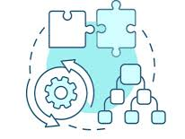
Model Selection Strategy Custom Model
Large Dataset:
Build and train models from scratch.
Steps:
Data Collection and Annotation.
Model Architecture Design.
Training and Validation.
Benefits:
Tailored to specific requirements.
Potential for higher accuracy with domain-specific data.
Use Cases:
Specialized applications.
Scenarios requiring high customization

Slide 24
Dataset Preparation
import os import cv2 import numpy as np # Define dataset path and initialize lists dataset_path = "/path/to/dataset" image_files = [] labels = [] # Loop through dataset directory to load images and annotations for filename in os.listdir(dataset_path): if filename.endswith(".jpg"): # Load the image image = cv2.imread(os.path.join(dataset_path, filename)) image_files.append(image) # Load corresponding label (assume label is a .txt file with the same name) label_file = filename.replace(".jpg", ".txt") with open(os.path.join(dataset_path, label_file), 'r') as f: labels.append(f.read().strip()) print(f"Loaded {len(image_files)} images and labels.")

Slide 25
Labeling
import json # Assuming labels are in COCO format (JSON) with open("/path/to/annotations.json", "r") as f: annotations = json.load(f) # Access image annotations for annotation in annotations['annotations']: image_id = annotation['image_id'] bbox = annotation['bbox'] # [x, y, width, height] category_id = annotation['category_id'] # Print annotation details print(f"Image ID: {image_id}, BBox: {bbox}, Category: {category_id}")

Slide 26
Data Preprocessing
from tensorflow.keras.preprocessing.image import ImageDataGenerator # Initialize image data generator for augmentation datagen = ImageDataGenerator( rescale=1./255, rotation_range=20, width_shift_range=0.2, height_shift_range=0.2, zoom_range=0.2, horizontal_flip=True, fill_mode='nearest' ) # Load a sample image and preprocess it image = cv2.imread("/path/to/sample_image.jpg") image = np.expand_dims(image, axis=0) # Expand dimensions to match model input augmented_image = datagen.flow(image) print("Image preprocessed and augmented.")

Slide 27
Feature Engineering
from tensorflow.keras.applications import VGG16 from tensorflow.keras.models import Model # Load VGG16 pre-trained model without the top classification layers base_model = VGG16(weights='imagenet', include_top=False, input_shape=(224, 224, 3)) # Create a new model for feature extraction model = Model(inputs=base_model.input, outputs=base_model.output) # Extract features for a batch of images features = model.predict(image_files) print("Features extracted from pre-trained VGG16.")

Slide 28
Model Selection
import tensorflow as tf from tensorflow.keras import layers, models # Define custom model architecture model = models.Sequential([ layers.Conv2D(32, (3, 3), activation='relu', input_shape=(224, 224, 3)), layers.MaxPooling2D((2, 2)), layers.Conv2D(64, (3, 3), activation='relu'), layers.MaxPooling2D((2, 2)), layers.Conv2D(128, (3, 3), activation='relu'), layers.Flatten(), layers.Dense(128, activation='relu'), layers.Dense(10, activation='softmax') # Assuming 10 object classes ]) print("Custom model defined.")

Slide 29
Backbone Feature Extractor
# Backbone feature extractor (could be ResNet, VGG, or custom CNN) def backbone_model(input_shape): input_layer = layers.Input(shape=input_shape) x = layers.Conv2D(32, (3, 3), activation='relu')(input_layer) x = layers.MaxPooling2D((2, 2))(x) x = layers.Conv2D(64, (3, 3), activation='relu')(x) x = layers.MaxPooling2D((2, 2))(x) x = layers.Conv2D(128, (3, 3), activation='relu')(x) x = layers.MaxPooling2D((2, 2))(x) return Model(inputs=input_layer, outputs=x)

Slide 30
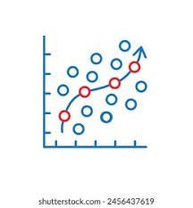
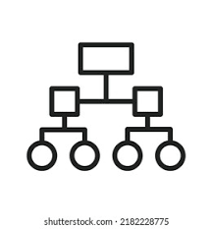
Regressor & Classifier
def bounding_box_regressor(feature_map): x = layers.Flatten()(feature_map) x = layers.Dense(256, activation='relu')(x) bbox_output = layers.Dense(4, name='bounding_box')(x) # Predict 4 coordinates (x_min, y_min, x_max, y_max) return bbox_output
def object_classifier(feature_map, num_classes): x = layers.Flatten()(feature_map) x = layers.Dense(256, activation='relu')(x) class_output = layers.Dense(num_classes, activation='softmax', name='class_label')(x) # Softmax for class prediction return class_output

Slide 31
Model Compilation
def object_detection_model(input_shape, num_classes): backbone = backbone_model(input_shape) # Pass the feature map to both regressor and classifier bbox_output = bounding_box_regressor(backbone.output) class_output = object_classifier(backbone.output, num_classes) return Model(inputs=backbone.input, outputs=[bbox_output, class_output]) # Example model creation input_shape = (224, 224, 3) # Input image shape num_classes = 10 # Number of object classes model = object_detection_model(input_shape, num_classes) # Compile the model with loss for both bounding boxes (regressor) and class labels (classifier) model.compile(optimizer='adam', loss={'bounding_box': 'mse', 'class_label': 'categorical_crossentropy'}, metrics={'bounding_box': 'mse', 'class_label': 'accuracy'})

Slide 32
Model Training
# Assuming X_train and y_train are your training images and labels history = model.fit(X_train, y_train, epochs=20, batch_size=32, validation_split=0.2) print("Model trained.")

Slide 33
Hyperparameter Tuning and Cross-Validation
from sklearn.model_selection import KFold # 5-fold cross-validation kf = KFold(n_splits=5) for train_index, val_index in kf.split(X_train): X_train_cv, X_val_cv = X_train[train_index], X_train[val_index] y_train_cv, y_val_cv = y_train[train_index], y_train[val_index] model.fit(X_train_cv, y_train_cv, validation_data=(X_val_cv, y_val_cv), epochs=20) print("Hyperparameter tuning and cross-validation completed.")

Slide 34
Model Evaluation
# Evaluate the model on the test dataset test_loss, test_acc = model.evaluate(X_test, y_test) print(f"Test Accuracy: {test_acc * 100:.2f}%")
Model Optimization
from tensorflow.keras.optimizers import Adam # Use a custom learning rate for Adam optimizer model.compile(optimizer=Adam(learning_rate=0.0001), loss='categorical_crossentropy', metrics=['accuracy']) model.fit(X_train, y_train, epochs=20, batch_size=32) print("Model optimization complete.")

Slide 35
Testing Model
# Predict on new data predictions = model.predict(X_test) # Show predictions with bounding boxes (visualization with OpenCV) for i, pred in enumerate(predictions): # Draw bounding boxes using OpenCV image = X_test[i] label = np.argmax(pred) cv2.rectangle(image, (x, y), (x+w, y+h), (0, 255, 0), 2) cv2.putText(image, f"Class: {label}", (x, y - 10), cv2.FONT_HERSHEY_SIMPLEX, 0.9, (36,255,12), 2) cv2.imshow("Detected objects", image) cv2.waitKey(0)
Save Model
# Save model to disk model.save("custom_object_detection_model.h5") print("Model saved.")

Slide 36
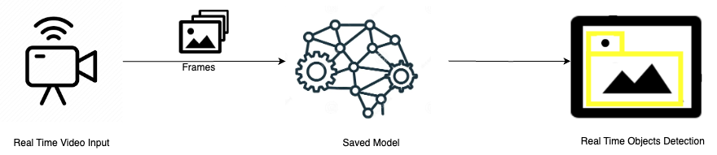
Real-Time Video Frame Analysis Architecture

Slide 37

Real-Time Video Capture Setup
import cv2 # Initialize the video capture object to capture real-time video from the webcam cap = cv2.VideoCapture(0) # '0' means the default webcam # Check if the video capture is opened successfully if not cap.isOpened(): print("Error: Could not open video stream.") exit() print("Video stream opened successfully.")

Slide 38

Loading the Pre-Trained Model
import tensorflow as tf # Load the saved pre-trained object detection model model = tf.keras.models.load_model('custom_object_detection_model.h5') print("Pre-trained model loaded.")

Slide 39

Real-Time Frame Processing
import numpy as np while True: # Capture each frame from the video ret, frame = cap.read() if not ret: print("Failed to capture video frame.") break # Preprocess the frame (resize and normalize) input_frame = cv2.resize(frame, (224, 224)) # Resize to the input size expected by the model input_frame = input_frame / 255.0 # Normalize the frame input_frame = np.expand_dims(input_frame, axis=0) # Expand dimensions for batch processing print("Frame captured and preprocessed.")

Slide 40

Object Detection on Frames
# Perform object detection by predicting the frame predictions = model.predict(input_frame) # Extract the predicted class and bounding boxes (assuming single object detection) predicted_class = np.argmax(predictions[0]) bbox = predictions[1] # [x, y, w, h] format for bounding box print(f"Predicted class: {predicted_class}, Bounding box: {bbox}")

Slide 41

Drawing Bounding Boxes
# Draw the bounding box and label on the original frame x, y, w, h = bbox cv2.rectangle(frame, (x, y), (x+w, y+h), (0, 255, 0), 2) # Draw the rectangle cv2.putText(frame, f"Class: {predicted_class}", (x, y - 10), cv2.FONT_HERSHEY_SIMPLEX, 0.9, (255, 0, 0), 2) # Add label # Display the frame with bounding box cv2.imshow('Real-Time Object Detection', frame) print("Bounding box and label added to frame.")

Slide 42
Exiting the Video Stream
# Break the loop on 'q' key press if cv2.waitKey(1) & 0xFF == ord('q'): break # Release the video capture and close all OpenCV windows cap.release() cv2.destroyAllWindows() print("Video stream ended.")

Slide 43
Thank You

