Slide 1


Team Details
  Team name: Friendly Neighbourhood Devs
  Team leader name: Keshav Lohiya
  Problem Statement: Sustainability & Social Impact
Build an AI-powered solution that addresses a meaningful environmental or societal challenge. Solutions may focus on improving resource efficiency, increasing accessibility, strengthening resilience, supporting communities, or enabling more informed and sustainable decision-making.

Slide 2
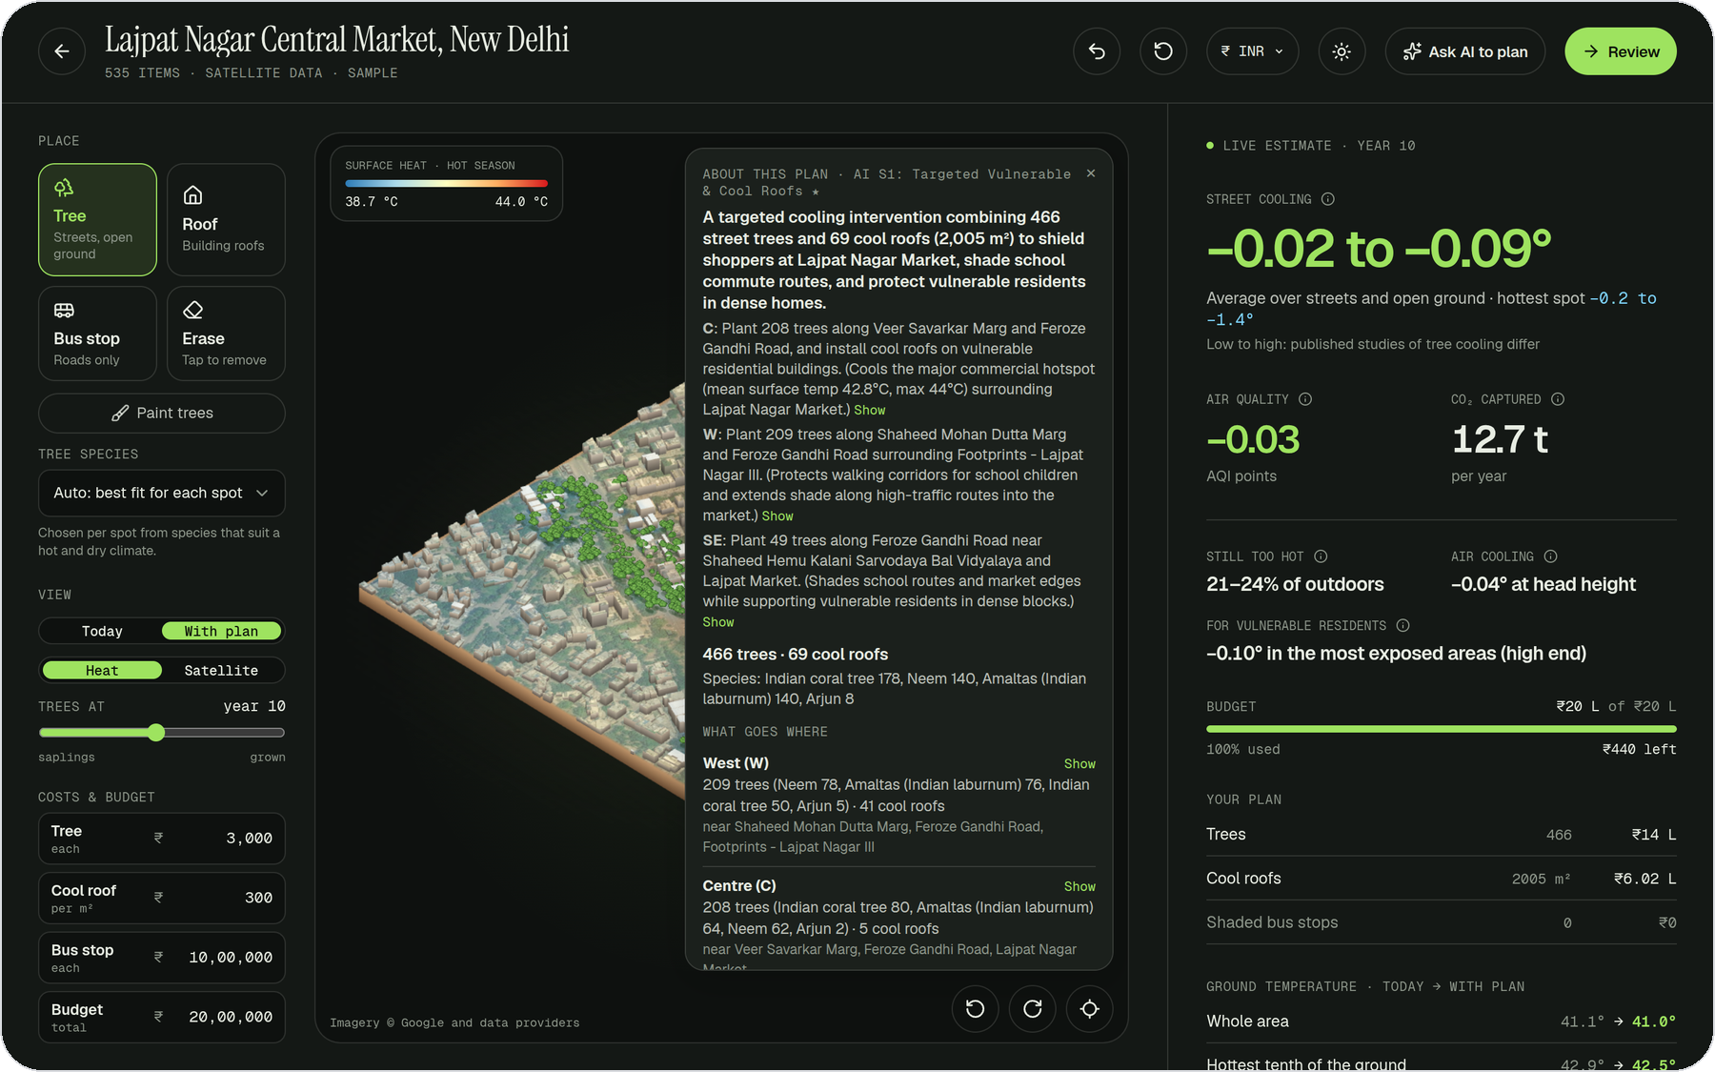



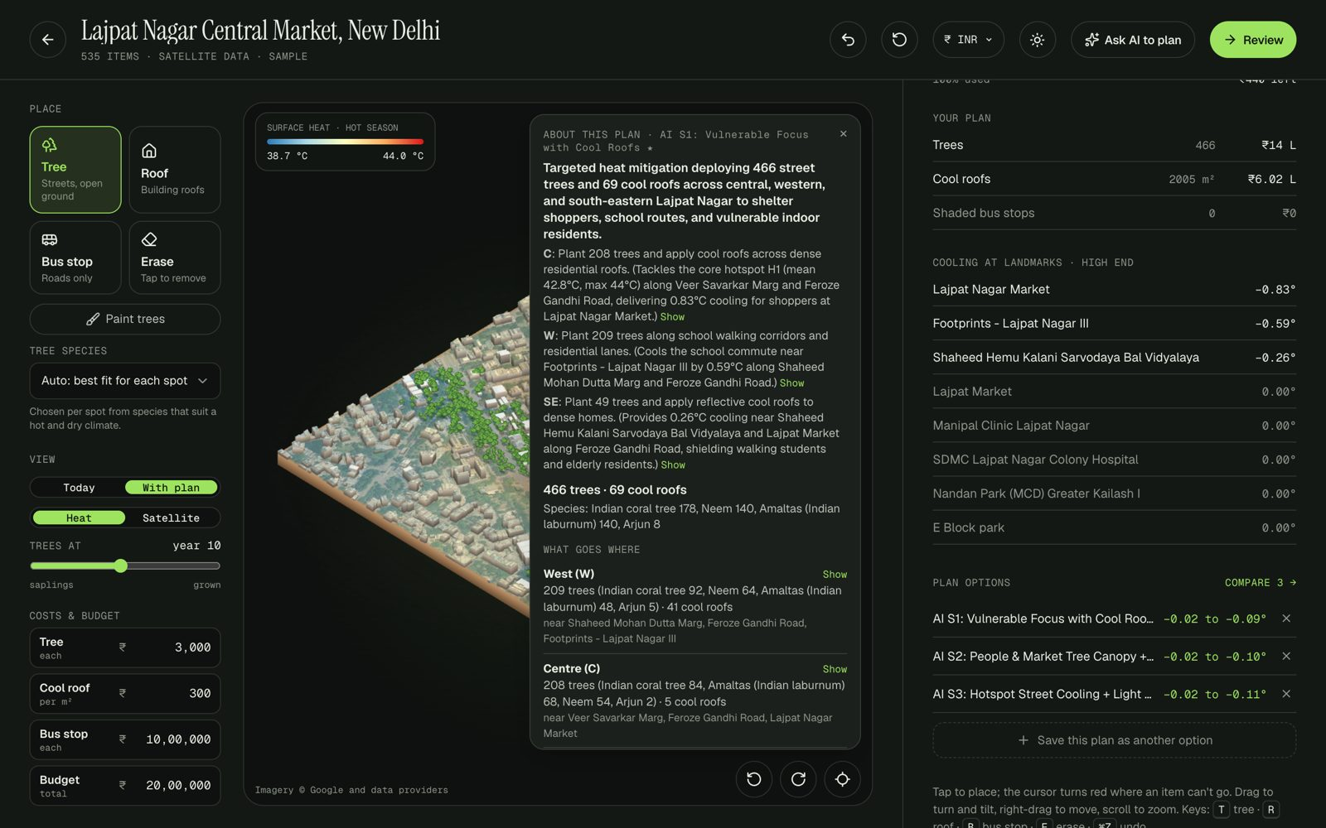
Brief about the idea
LeafIt turns a hot city block into a costed, people-first cooling plan, built on real satellite data and planned with Gemini.
See the real place
Mark any neighbourhood on Google's satellite map; LeafIt builds a 3D twin with its measured heat, trees, buildings and residents.
Plan in plain words
Place trees, cool roofs and shaded bus stops yourself, or give Gemini a brief and a budget and let it test the options.
Act on it
Before-and-after heat for each place, a bill of materials, a funding proposal and nearby vendors to quote.
Lajpat Nagar Central Market, New Delhi · Gemini's ₹20 lakh plan: 466 trees and 69 cool roofs
For residents' associations, ward officers, NGOs and CSR teams who fund cooling but can't test a plan before paying for it.

Slide 3



Opportunities
How it is different
How it solves the problem
What makes it unique
Heat maps show where a city is hot. LeafIt shows what to do about it: which mix of trees, cool roofs and shelters, where, for whom and at what cost.
From one sentence and a budget to a tested, costed plan in about a minute, then on to a funding proposal and vendor quotes.
Honest numbers. Every coefficient is cited, cooling is shown as a low-to-high range, and every figure Gemini writes is checked against the simulator.
Starts from the shade already there, so trees are not wasted.
Guesswork becomes a plan you can defend.
Gemini decides; the code calculates.

Slide 4





List of features offered by the solution
3D twin from real data
Design studio
Gemini planner
Satellite heat, existing trees, buildings, residents and roads, on 10-metre cells.
Place trees, cool roofs and bus shelters; the numbers update instantly.
Tests several plans, checks its own work and explains each zone.
People first
Before and after
Fund and build
Cooling where young children and older residents live, not just the average.
Measured heat today against the plan, place by place, in degrees.
Bill of materials, funding proposal and real local vendors with a ready quote.

Slide 5







Process flow diagram
USER JOURNEY
1 · Find
Search a place
2 · Mark
Drag a box
3 · Twin
Real data in 3D
4 · Plan
By hand or with Gemini
5 · Review
Before and after
6 · Act
Fund and build
ONE REAL RUN · LAJPAT NAGAR, NEW DELHI · ₹20 LAKH
The brief
Gemini works
The plan
The result
Ready to act
“Keep shoppers and school children cool, and protect elderly residents in dense homes.”
Reads the heat, trees and people; tests 3 plans; checks 2 of them itself.
466 trees and 69 cool roofs; 497 residents get a cooler roof.
Lajpat Nagar Market 42.7° → 41.9°
School 41.6° → 41.2°
Ground temperature, today → with plan
Bill of materials, funding proposal and local nurseries and contractors.

Slide 6
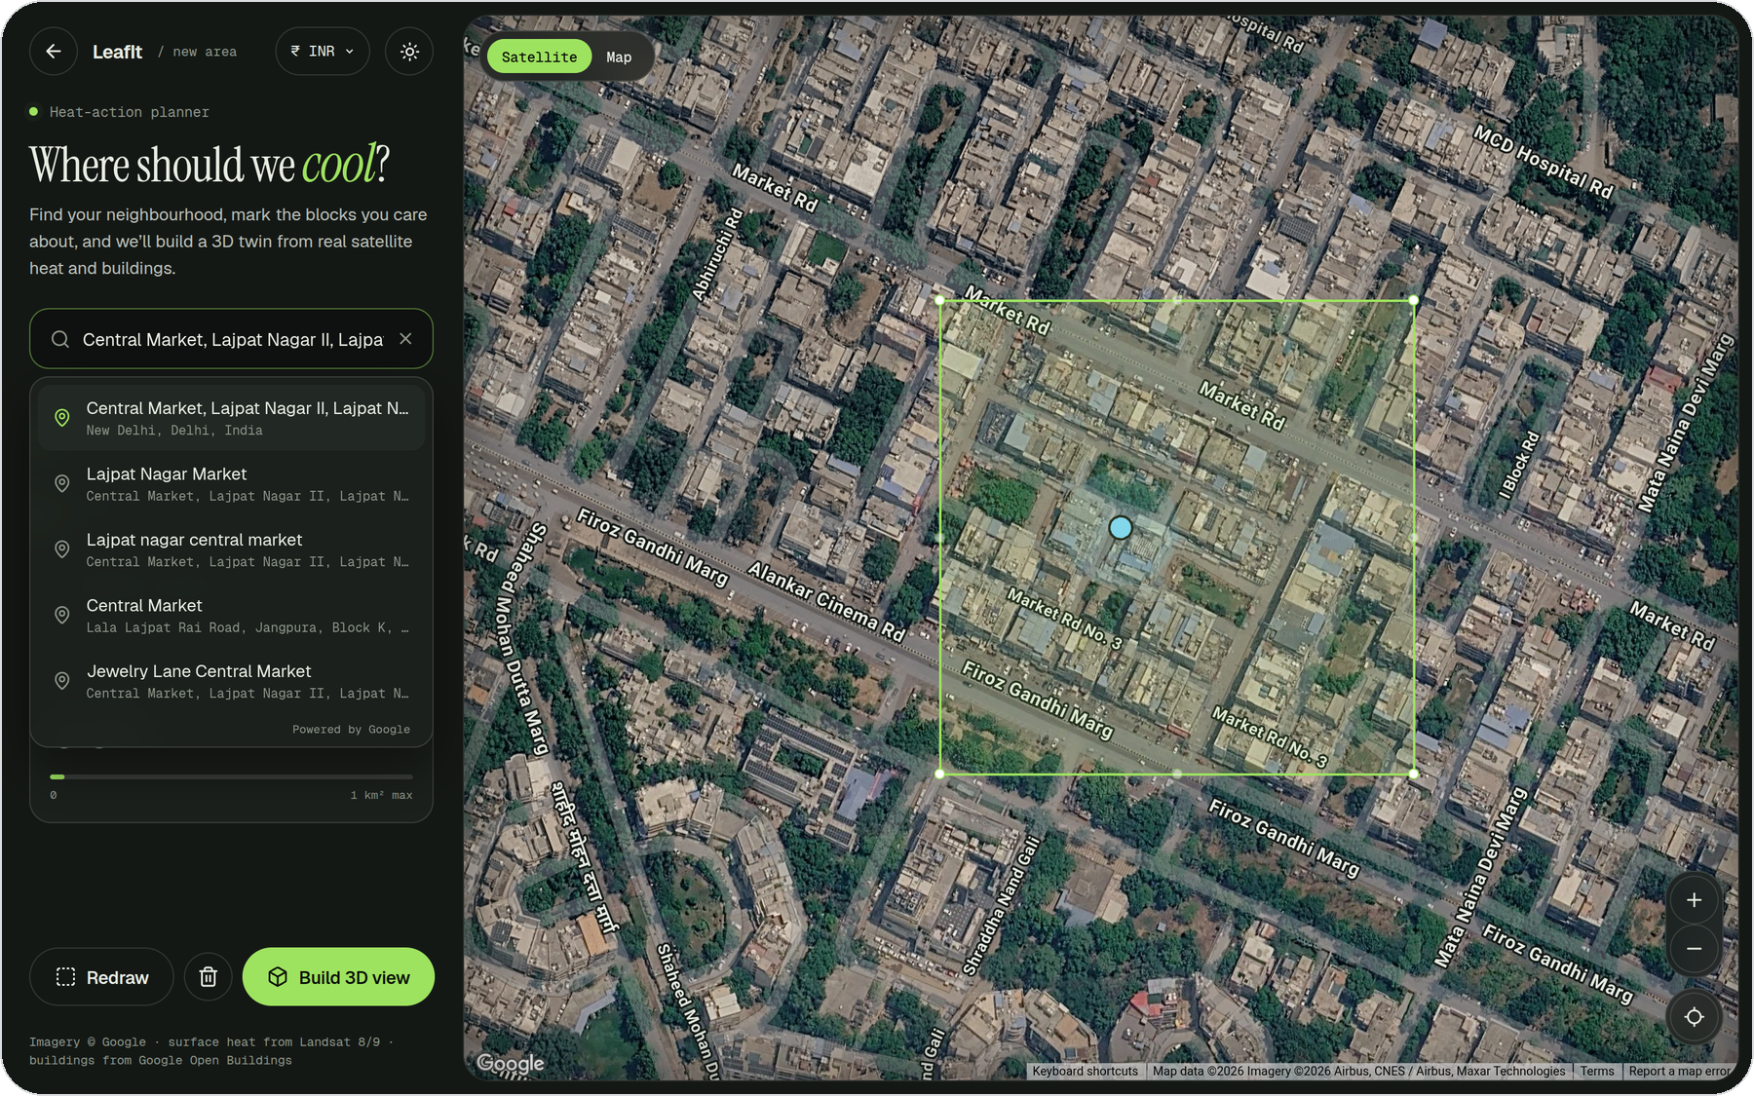
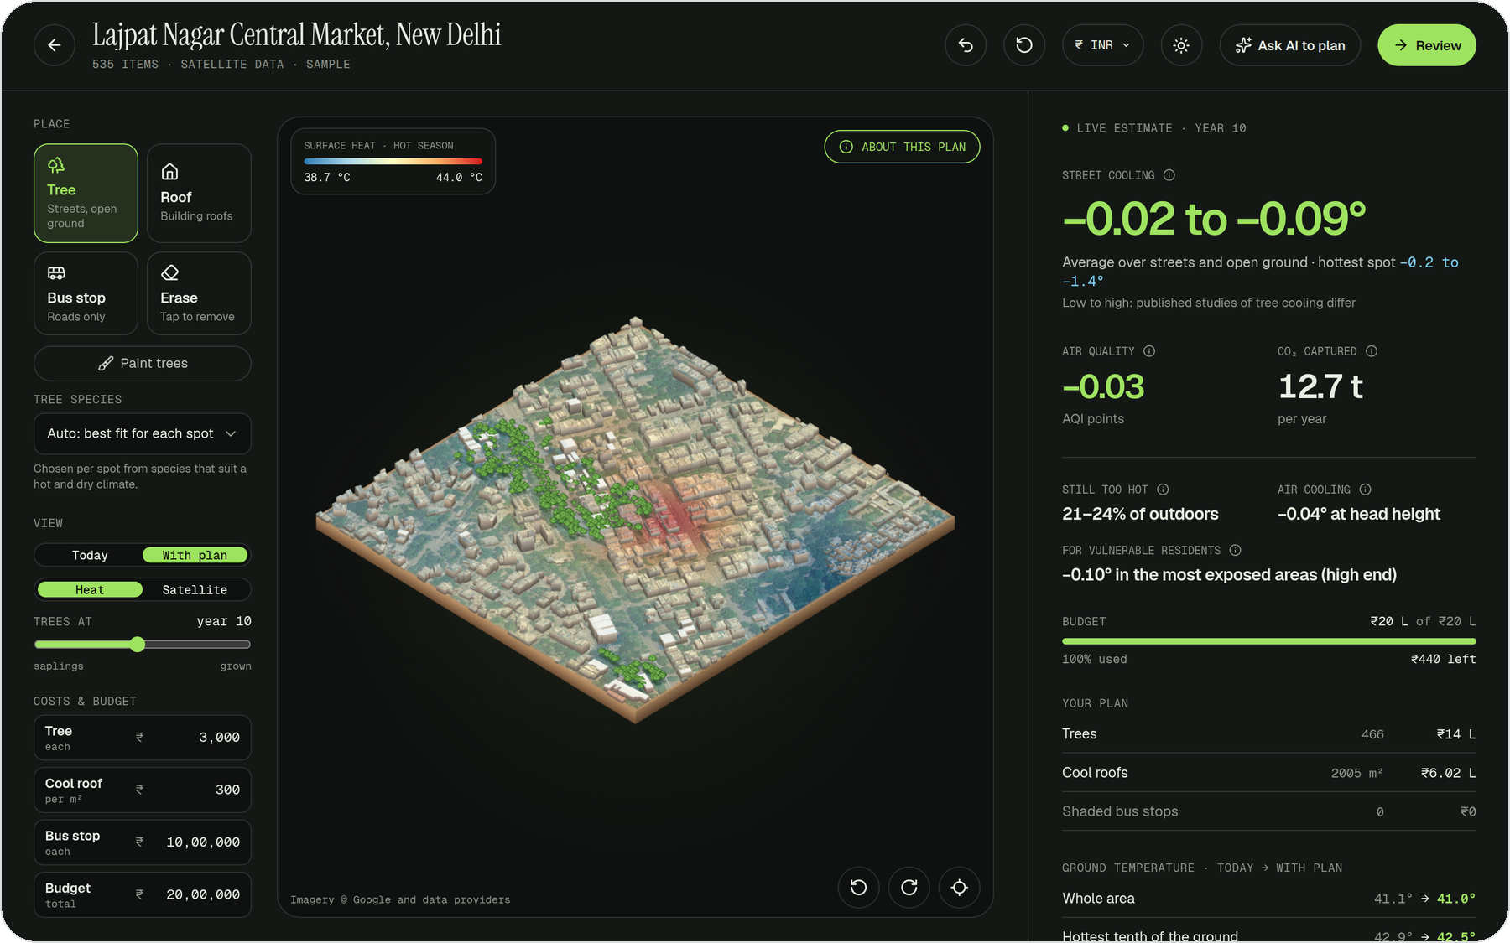
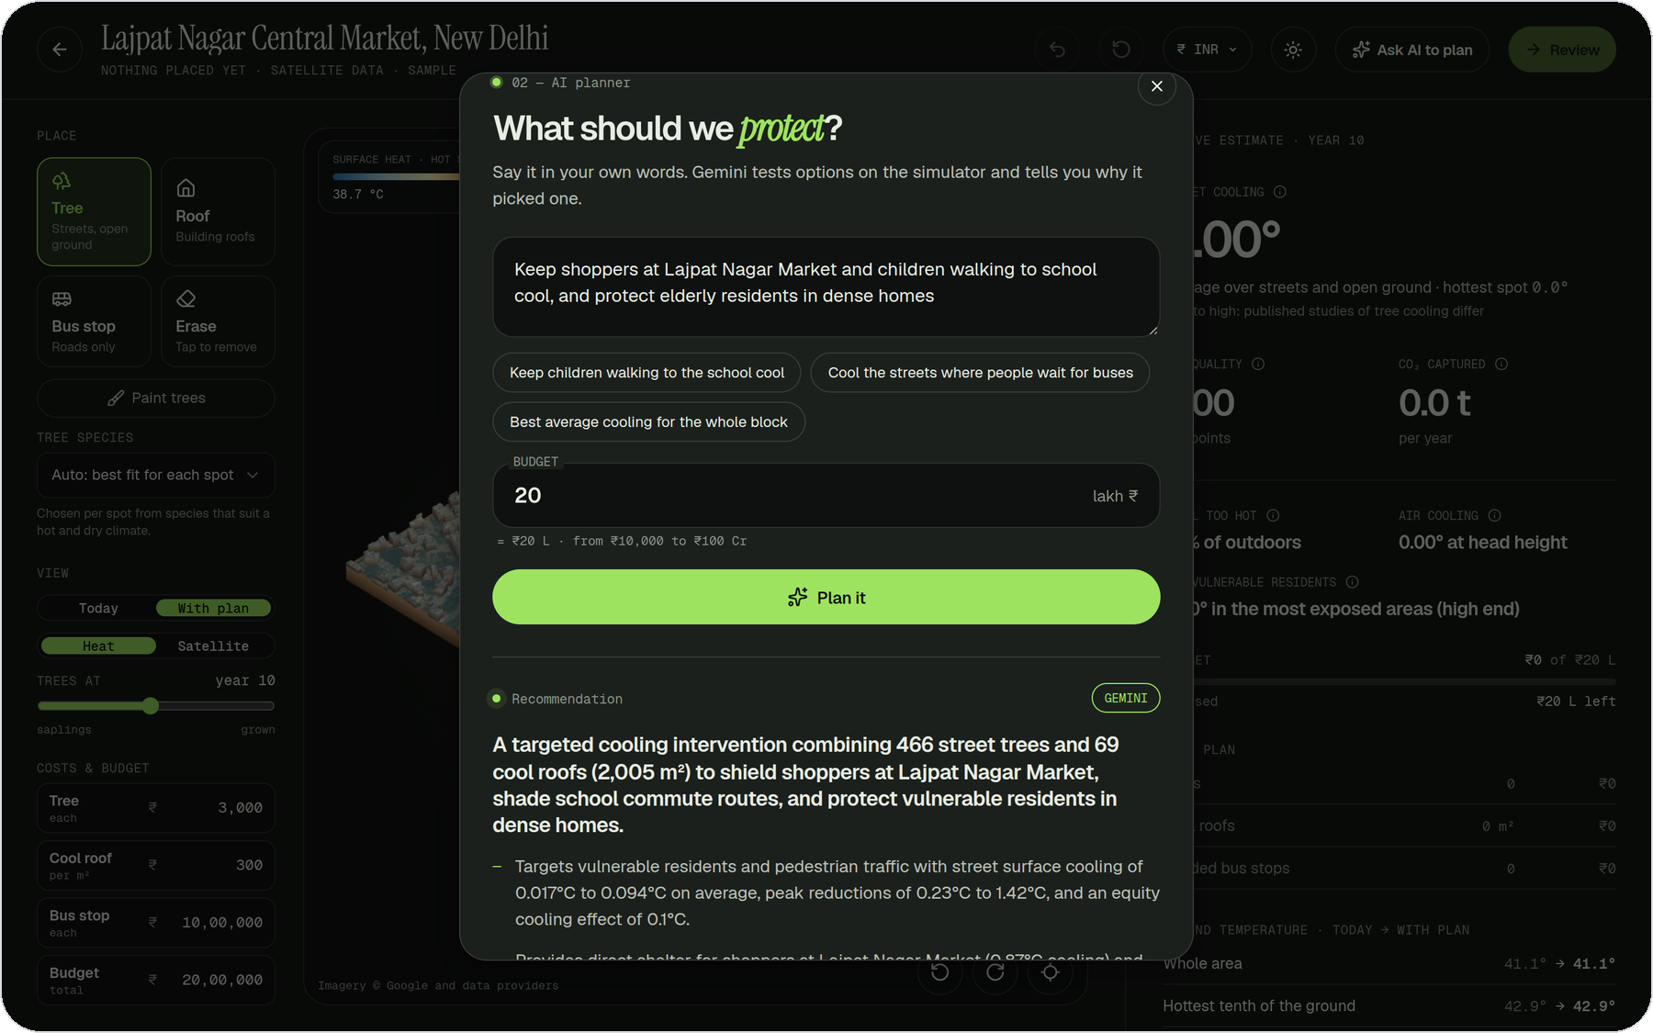
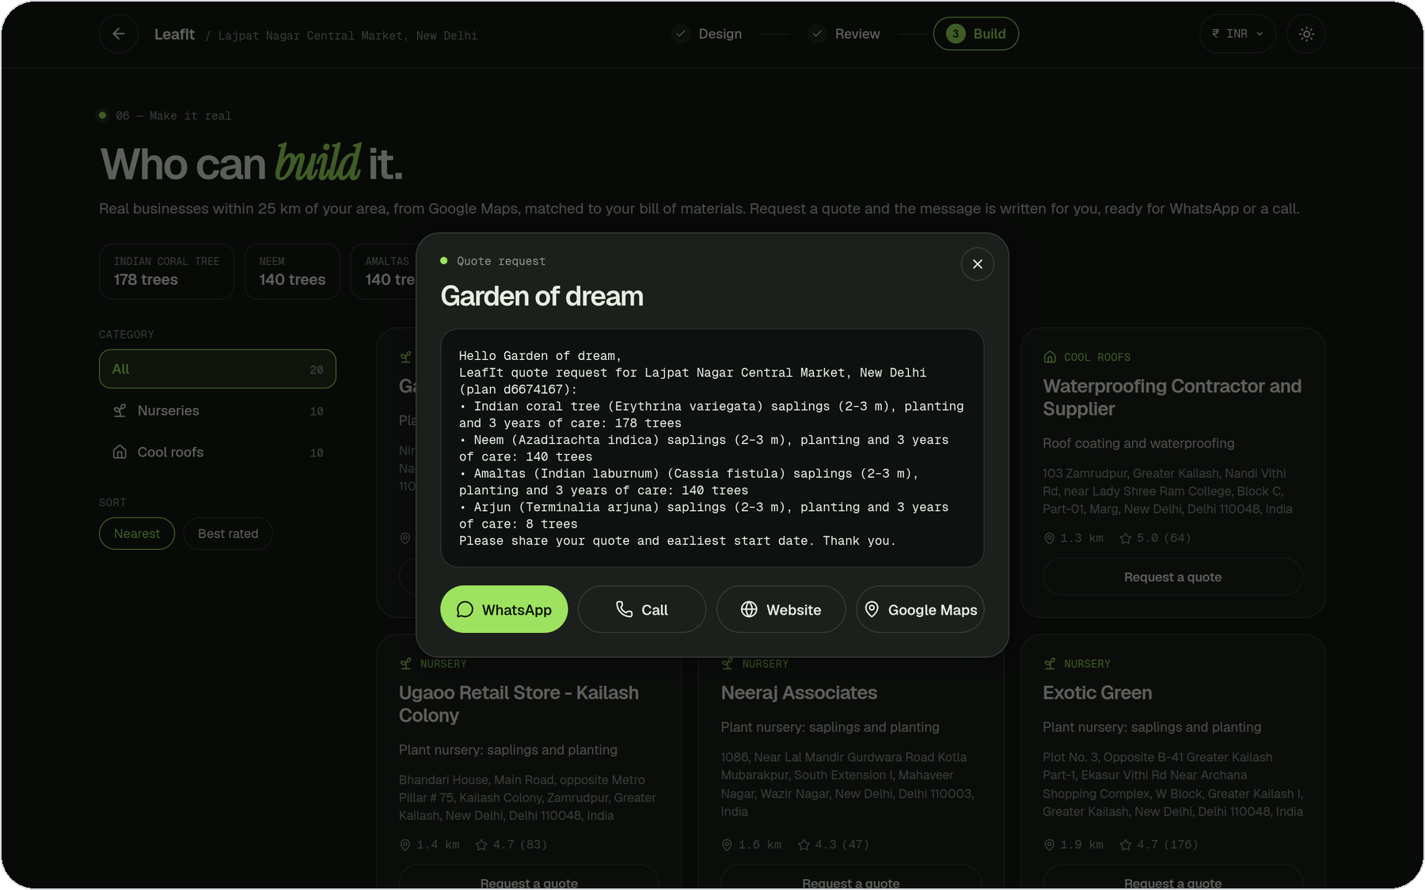
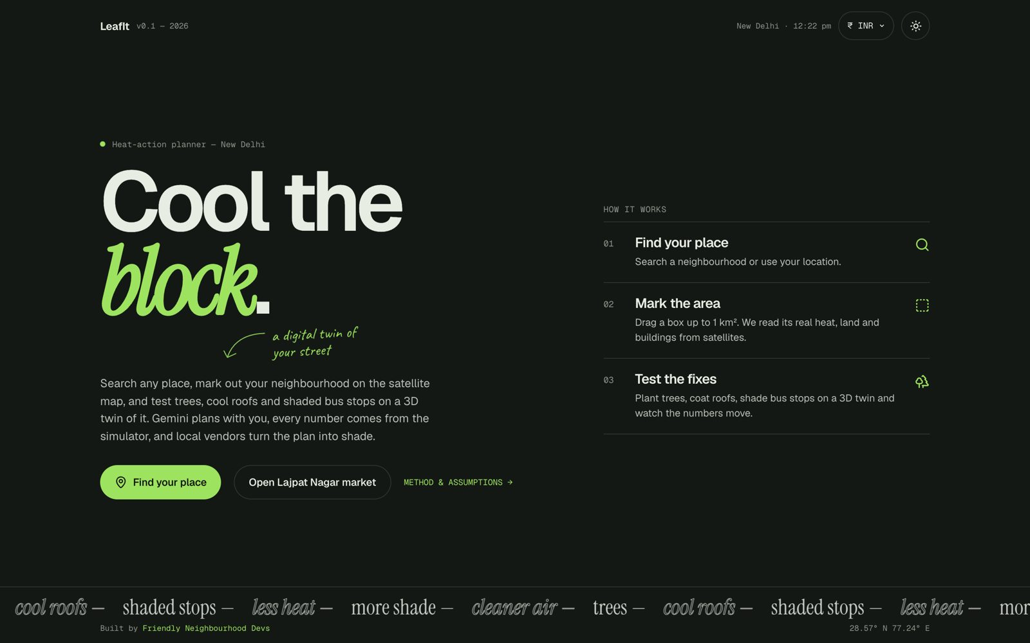
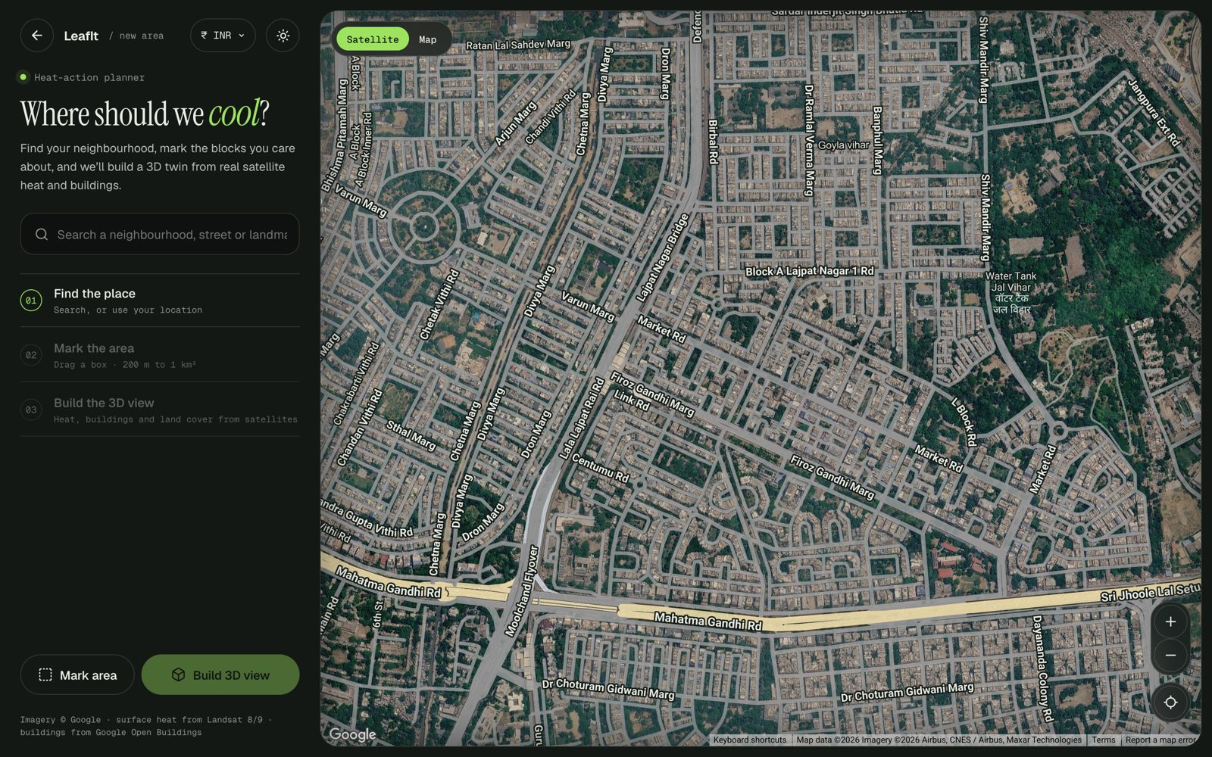
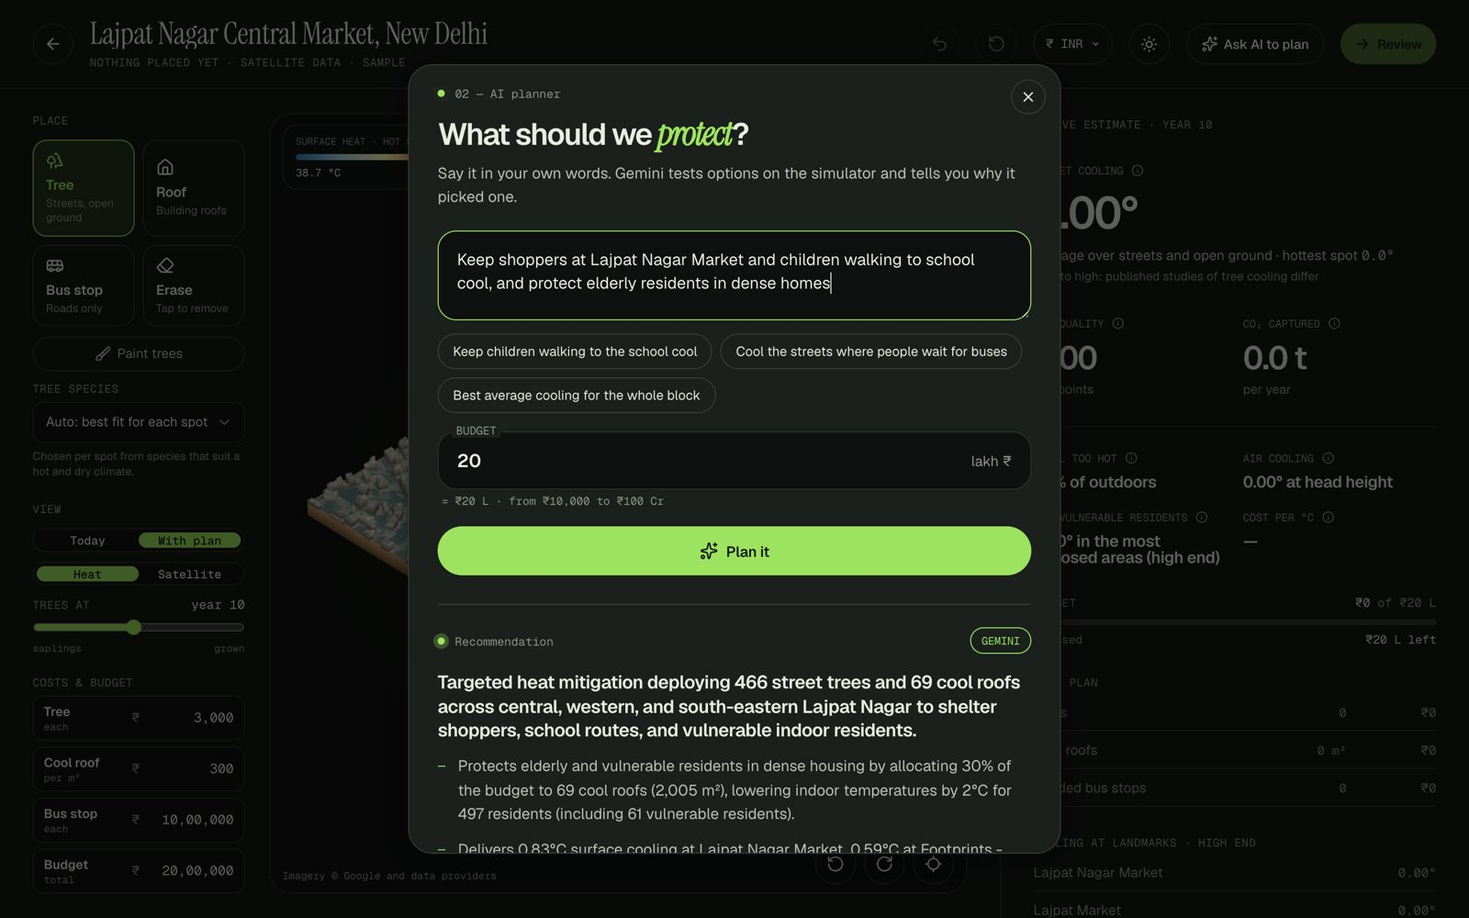
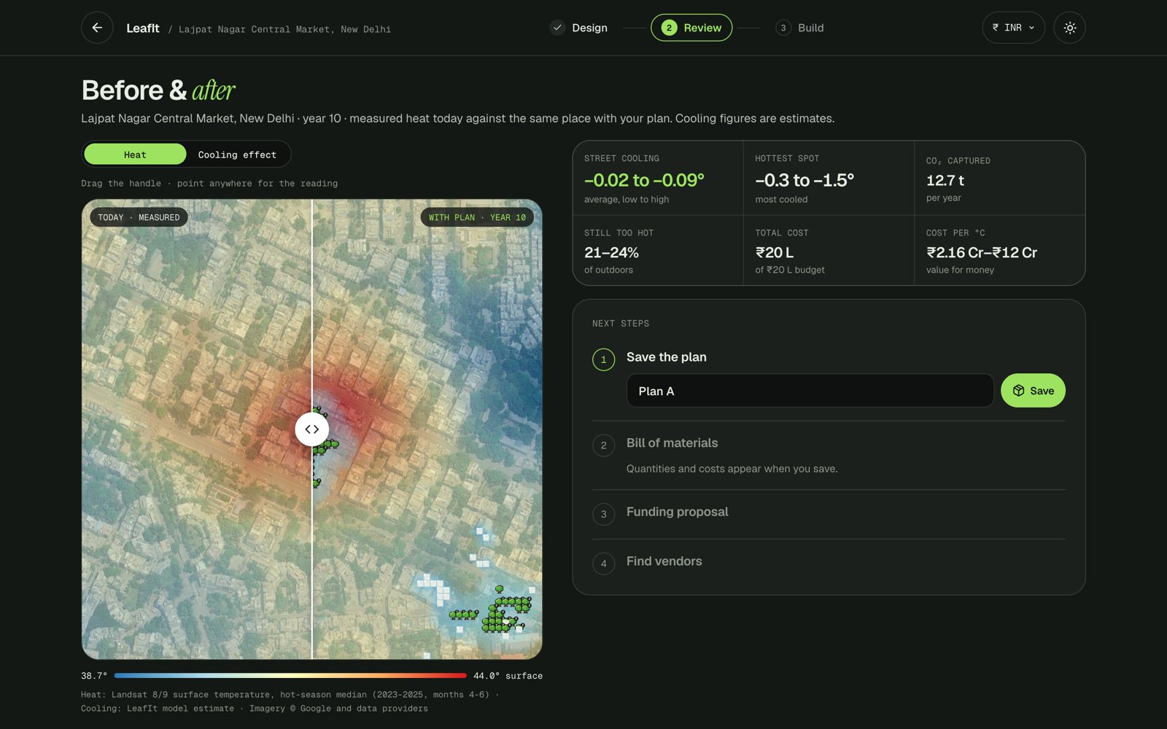
Wireframes and mock diagrams of the proposed solution
1 · Find and mark
Search a place and drag a box on the satellite map.
2 · Design in 3D
The area's real heat; place trees, roofs and shelters.
3 · Ask Gemini
A brief and a budget in; a tested, explained plan out.
4 · Fund and build
Real local vendors and a quote message, ready to send.

Slide 7







Architecture diagram of the proposed solution
LeafIt server
Google Cloud Run
Google Earth Engine
Satellite heat, tree canopy, buildings, population
People
Residents, RWAs, ward officers, NGOs
Builds the twin
Combines nine data sources for the marked area
Google Maps Platform
Search, satellite imagery, places, air quality
search, mark, ask
Plans with Gemini
Tests options, checks them, explains the choice
Gemini on Vertex AI
Reads the place, tests plans, explains
LeafIt web app
Map search, 3D twin, live numbers in the browser
area, brief
Checks every number
Simulator figures only; nothing invented
Open data
OpenStreetMap roads, Open-Meteo climate
plan, heat

Slide 8








Technologies used in the solution
GOOGLE AI
GOOGLE CLOUD
GOOGLE MAPS PLATFORM
Gemini
Vertex AI
Cloud Run
Cloud Build
Maps JS
Places
Earth Engine
Map Tiles
Air Quality
WEB APP
SERVER
OPEN DATA
React
three.js
Python
FastAPI
OpenStreetMap
Open-Meteo
Vite
Docker
WorldPop
WorldCover

Slide 9
Estimated implementation cost
Build once
Prototype to city pilot
Run · pilot
One city, ~300 AI plans and ~100 new areas a month
Run · city scale
~5,000 AI plans and ~30,000 visits a month
2 developers × 3 months
₹7–9 L
Cloud Run (free tier covers most of it)
₹0–500
Cloud Run
₹3–8 K
Urban-forestry and GIS advice, part-time
₹1 L
Gemini, about ₹2 per AI plan
₹600–1,500
Gemini
₹10–25 K
Design, testing, field visits
₹0.5–1 L
Maps Platform, inside free monthly limits
₹0
Maps Platform, past the free limits
₹25–45 K
Earth Engine, noncommercial civic use
₹0
Earth Engine Basic plan ($500)
₹48 K
₹8.5–11 L one time
₹0.6–2 K per month
₹0.9–1.3 L per month
Estimates from Google's public price lists (Oct 2026) at ₹95 per US$. One AI plan measured at 8 Gemini calls, ~51,000 tokens in and ~2,200 out. Trees, roofs and shelters themselves are paid from each plan's own budget.

Slide 10
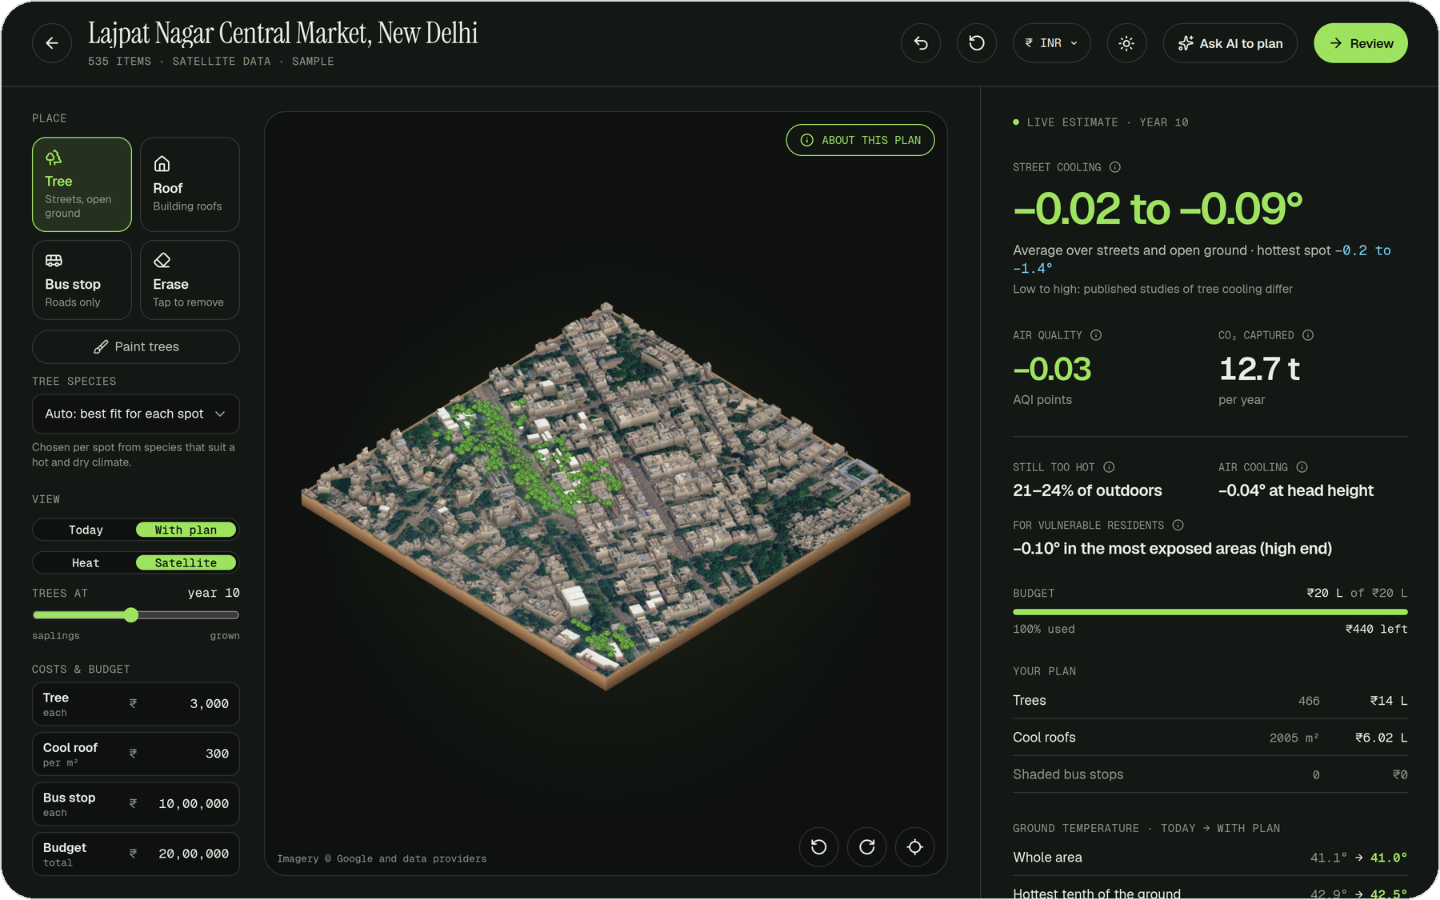
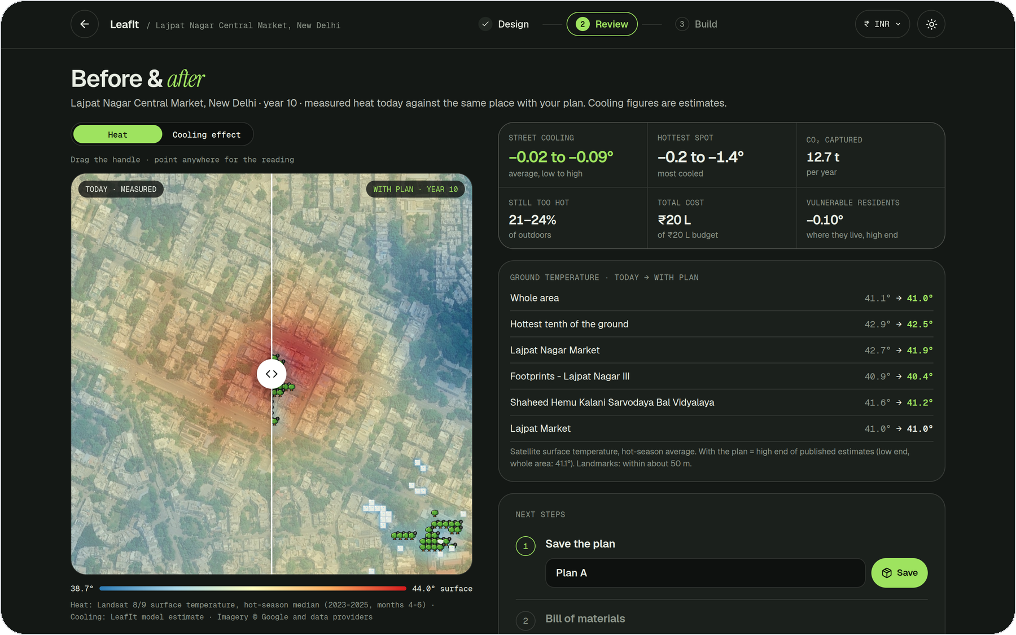
Snapshots of the prototype
Gemini's plan on the 3D twin
466 trees and 69 cool roofs on Lajpat Nagar's real satellite ground, with live numbers on the right.
Before and after
Measured heat today against the same place with the plan, and the temperature at each landmark.

Slide 11
Prototype performance and benchmarks
GEMINI'S THREE OPTIONS · ₹20 LAKH
4 ms
0.2 s
~1 min
Option
Trees · roofs
Market
Under cool roofs
to simulate a full plan
4,900 cells of 10 m
to optimise a plan
₹20 lakh of trees and roofs
for Gemini to plan
3 plans tested, 8 calls
S1 ★
466 · 69
41.9°
497
S2
533 · 46
41.9°
368
S3
600 · 30
41.8°
not checked
10–30 s
158
0
to build a new area
from live satellite data
automated tests pass
backend and web app
invented numbers
in Gemini's answer
★ Gemini's pick: the brief asked to protect elderly residents in dense homes, and it puts the most people under cool roofs. Market today: 42.7°.

Slide 12




Future development
Pilot with a Delhi ward
Plan, plant and measure one neighbourhood with a residents' association and the municipality.
Calibrate for Indian cities
Street sensors and afternoon thermal imagery to narrow today's cooling range.
Seasonal shade
Model leafless months for deciduous trees, using Indian growth data by species.
Track what gets planted
Record what is installed and its survival, then compare predicted and measured heat each summer.
More cities
Ready wherever Open Buildings has data: South and Southeast Asia, Africa and Latin America.
Mobile and local languages
A mobile app for field teams, with Hindi and regional languages.

Slide 13
Links
GitHub Public Repository
github.com/lohiyakeshav/LeafIt
Demo Video Link (3 Minutes)
To be added
Final Product Link
leafit.cloud.run

Slide 14


