Slide 1
Project3
第三組
電資二 108820001 羅羽軒
電資二 108820015 周雨柔

Slide 2
題目一

Slide 3
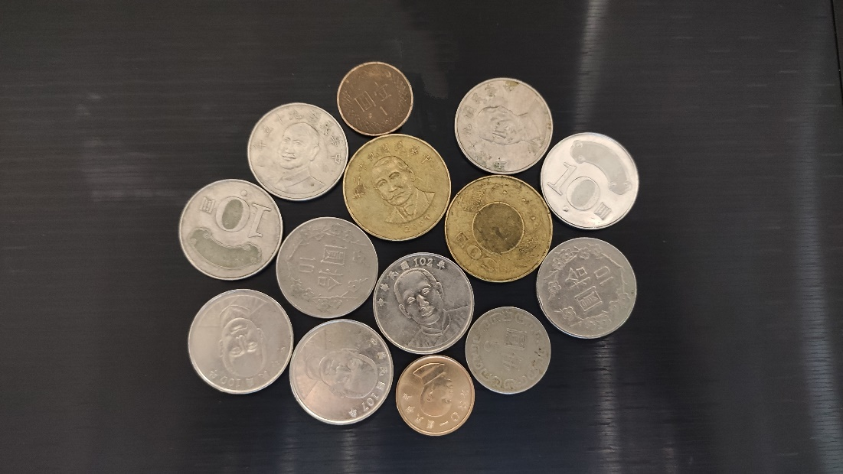
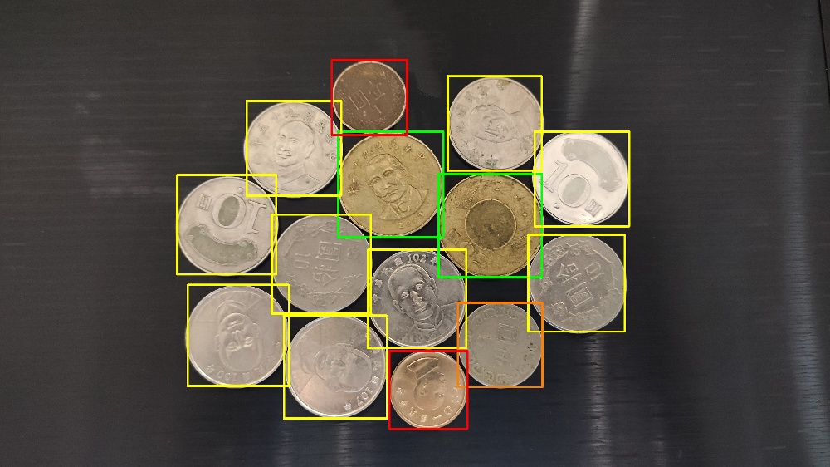
成果圖
Total money is: 197

Slide 4
coin.py演算法流程-1
circles = cv2.HoughCircles(img, cv2.HOUGH_GRADIENT, 1, 360, param1=100, param2=30,minRadius=180, maxRadius=300)
price = 0
if circles is not None:
circles = np.uint16(np.around(circles))
for i in circles[0, :]:
# draw rectangle
# 1
if(i[2]<190):
price += 1
cv2.rectangle(img_3, (i[0]-i[2], i[1]+i[2]), (i[0]+i[2], i[1]-i[2]), (0,0,255), 10)
# 5
elif(i[2] < 210):
price += 5
cv2.rectangle(img_3, (i[0]-i[2], i[1]+i[2]), (i[0]+i[2], i[1]-i[2]), (0, 125, 255), 10)

Slide 5
coin.py演算法流程-2
# 50
elif(i[2] > 248):
price += 50
cv2.rectangle(img_3, (i[0]-i[2], i[1]+i[2]), (i[0]+i[2], i[1]-i[2]), (0, 255, 0), 10)
# 10
else:
price += 10
cv2.rectangle(img_3, (i[0]-i[2], i[1]+i[2]),
(i[0]+i[2], i[1]-i[2]), (0, 255, 255), 10)
print("Total money is: " + str(price))
img_3 = cv2.resize(img_3, (int(width*0.25), int(height*0.25)), interpolation=cv2.INTER_CUBIC)

Slide 6
題目二

Slide 7
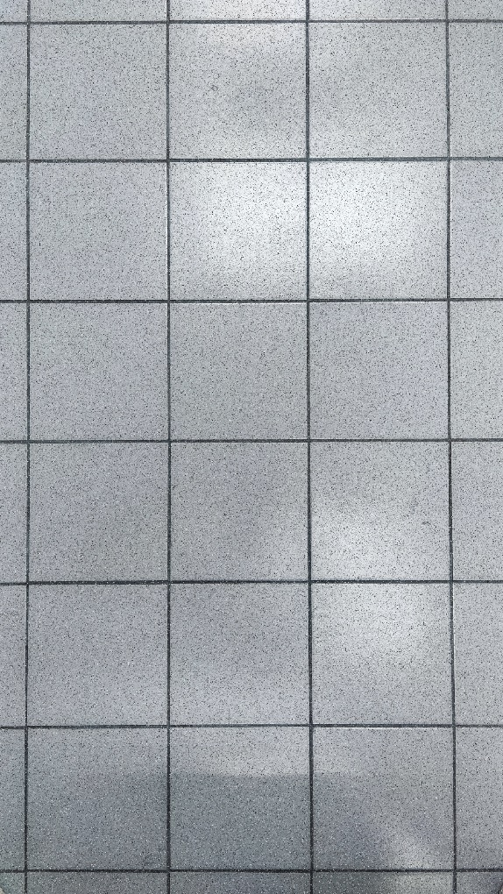
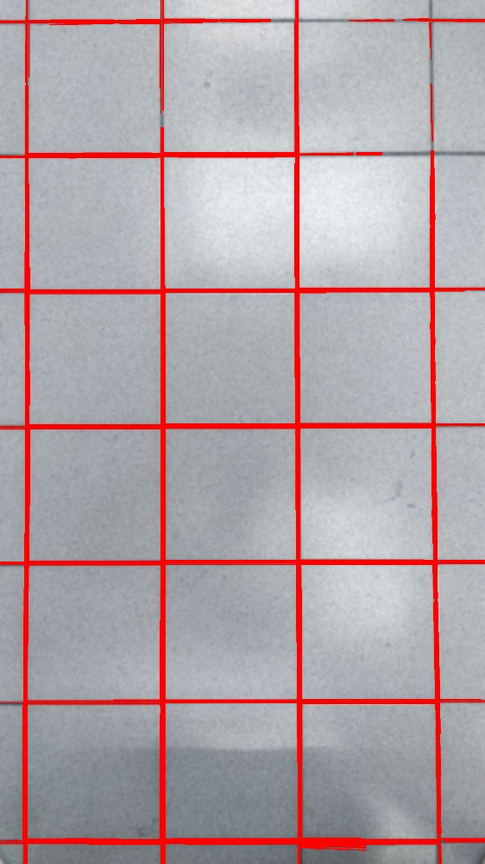
成果圖

Slide 8
floor.py演算法流程-1
img_blurred = cv2.GaussianBlur(img_3, (99, 99), 5)
ret, img = cv2.threshold(img, 100, 255, cv2.THRESH_BINARY)
img = cv2.GaussianBlur(img, (99, 99), 5)
ret, img = cv2.threshold(img, 200, 255, cv2.THRESH_BINARY)
img = 255 - img
lines = cv2.HoughLinesP(img, 1, np.pi/180, 800, 50, 100)
for i in lines [:, 0, :]:
img_3 = cv2.line(img_blurred, (i[0], i[1]), (i[2], i[3]), (0, 0, 255), 3)
img_3 = cv2.resize(img_3, (int(width*0.25), int(height*0.25)),interpolation=cv2.INTER_CUBIC)

Slide 9
題目三

Slide 10
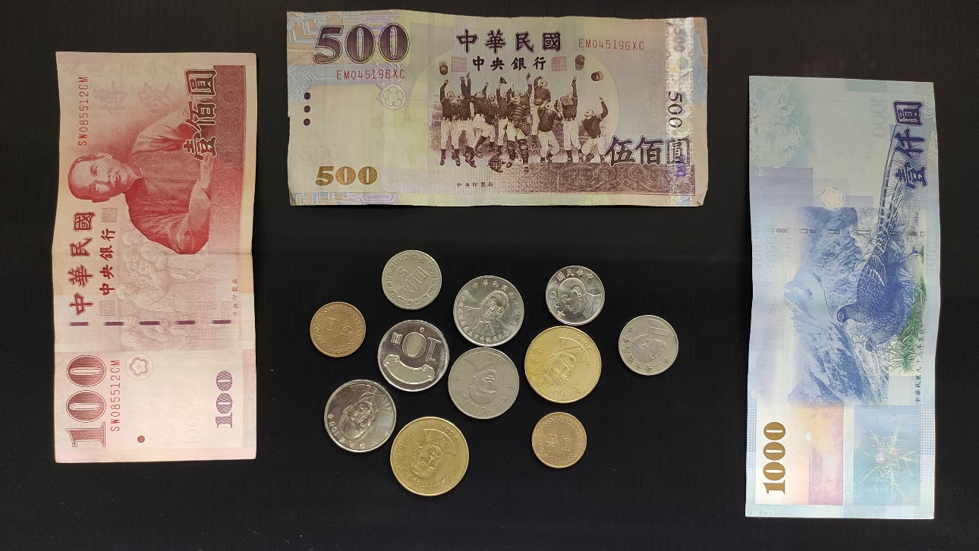
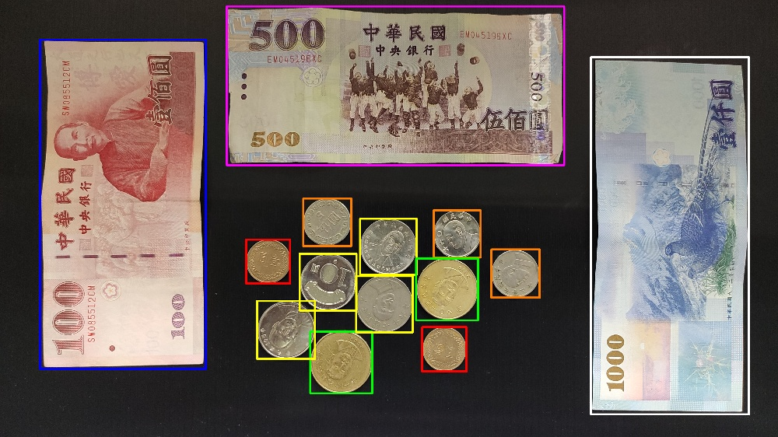
成果圖

Slide 11
coin2.py演算法流程-1
price = 0 img = cv2.GaussianBlur(img, (55, 55), 5)
ret, img = cv2.threshold(img, 50, 255, cv2.THRESH_BINARY) num_labels, labels, stats, centroids = cv2.connectedComponentsWithStats(img, connectivity=8) for i in stats[:, ]:
if(i[4] > 1000000 and i[4] < 2000000):
x1 = int(i[0])
y1 = int(i[1])
x2 = int(i[0] + i[2])
y2 = int(i[1] + i[3])
if(i[2] > 1000): #500
price += 500
cv2.rectangle(img_3, (x1, y1), (x2, y2), (255, 0, 255), 10) #purple
elif(i[4] > 1400000): #1000
price += 1000
cv2.rectangle(img_3, (x1, y1), (x2, y2), (255, 255, 255), 10) #white
else: #100
price += 100
cv2.rectangle(img_3, (x1, y1), (x2, y2), (255, 0, 0), 10) #blue

Slide 12
coin2.py演算法流程-2
# 5
elif(i[2] < 130):
price += 5
cv2.rectangle(img_3, (i[0]-i[2], i[1]+i[2]),
(i[0]+i[2], i[1]-i[2]), (0, 125, 255), 10)
# 50
elif(i[2] > 150):
price += 50
cv2.rectangle(img_3, (i[0]-i[2], i[1]+i[2]),
(i[0]+i[2], i[1]-i[2]), (0, 255, 0), 10)
# 10
else:
price += 10
cv2.rectangle(img_3, (i[0]-i[2], i[1]+i[2]),
(i[0]+i[2], i[1]-i[2]), (0, 255, 255), 10)
print("Total money is: " + str(price))
circles = cv2.HoughCircles(img_gray, cv2.HOUGH_GRADIENT, 1, 250, param1=700, param2=50,minRadius=100, maxRadius=160)
if circles is not None:
circles = np.uint16(np.around(circles))
for i in circles[0, :]:
center = (i[0], i[1])
radius = i[2]
# draw rectangle
# 1
if(i[2] < 120):
price += 1
cv2.rectangle(img_3, (i[0]-i[2], i[1]+i[2]),
(i[0]+i[2], i[1]-i[2]), (0, 0, 255), 10)

Slide 13
題目四

Slide 14
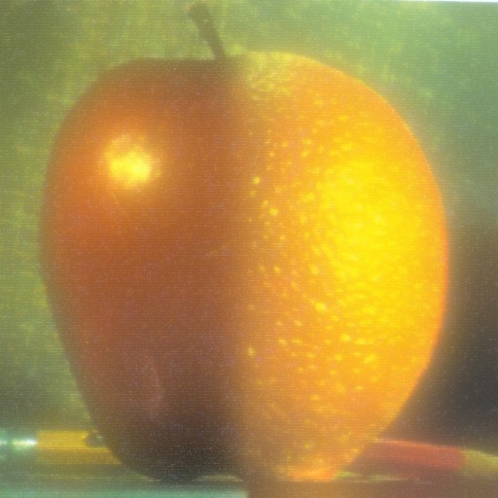
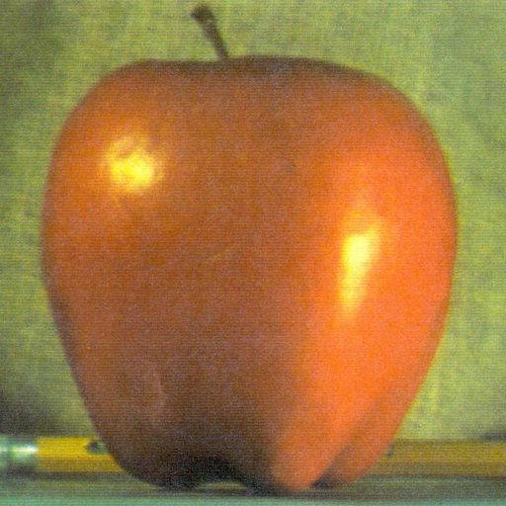
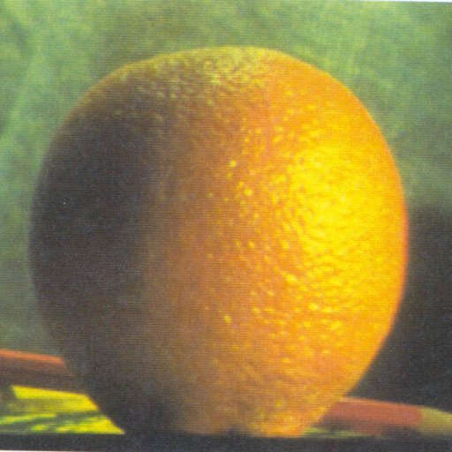
成果圖

Slide 15
fruit.py演算法流程-1
def getLplacianAdd(gauss, g):
gauss_width = gauss.shape[0]
gauss_height = gauss.shape[1]
g_width = g.shape[0]
g_height = g.shape[1]
d_width = g_width - gauss_width
d_height = g_height - gauss_height
if d_width != 0 or d_height != 0:
temp = cv2.copyMakeBorder(
gauss, d_width, 0, d_height, 0, cv2.BORDER_REPLICATE)
else:
temp = gauss
layer = cv2.add(temp, g)
return layer
def getLplacianSub(gauss, g):
gauss_width = gauss.shape[0]
gauss_height = gauss.shape[1]
g_width = g.shape[0]
g_height = g.shape[1]
d_width = g_width - gauss_width
d_height = g_height - gauss_height
if d_width != 0 or d_height != 0:
temp = cv2.copyMakeBorder(
gauss, d_width, 0, d_height, 0, cv2.BORDER_REPLICATE)
else:
temp = gauss
layer = cv2.subtract(temp, g)
return layer

Slide 16
fruit.py演算法流程-2
# apple
gpA = [apple]
for i in range(gpL):
g = cv2.pyrDown(gpA[i])
gpA.append(g)
# orange
gpO = [orange]
for i in range(gpL):
g = cv2.pyrDown(gpO[i])
gpO.append(g)
lpA = []
for i in range(gpL, 0, -1):
l = getLplacianSub(gpA[i - 1], cv2.pyrUp(gpA[i]))
lpA.append(l)
lpA[0] = gpA[-2]
lpO = []
def restoreXY(origin, present):
ori_row = origin.shape[0]
ori_col = origin.shape[1]
pre_row = present.shape[0]
pre_col = present.shape[1]
if ori_row != pre_row or ori_col != pre_col:
result = present[pre_row - ori_row:, pre_col - ori_col:]
else:
result = present
return result
apple = cv2.imread("./images/apple.jpg")
orange = cv2.imread("./images/orange.jpg")
gpL = 6

Slide 17
fruit.py演算法流程-3
for i in range(gpL, 0, -1):
l = getLplacianSub(gpO[i - 1], cv2.pyrUp(gpO[i]))
lpO.append(l)
lpO[0] = gpO[-2]
lpAO = []
for i in range(gpL):
rows, cols, bpt = lpA[i].shape
lp = np.hstack((lpA[i][:, :cols // 2, :], lpO[i][:, cols // 2:, :]))
lpAO.append(lp)
gao = lpAO[0]
for i in range(gpL - 1):
gao = cv2.pyrUp(gao)
gao = getLplacianAdd(lpAO[i + 1], gao)
gao = restoreXY(apple, gao)
cv2.imwrite("./outcome/fruit_out.jpg", gao)

Slide 18
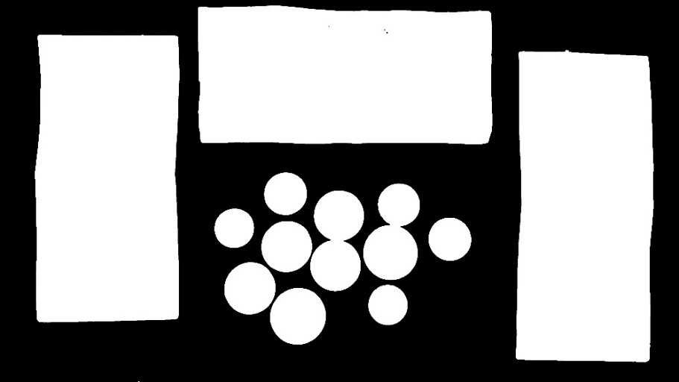
遇到的困難即解決方法
一開始，我們打算用連通物件來做第一題與第三題。在做連通前，為了消除硬幣表面不平滑的雜質，我們先使用侵蝕膨脹，卻發現硬幣間距離太近，造成兩個鄰近的硬幣在侵蝕膨脹後變成相連的(如右圖)。因為無法找到完美的參數讓硬幣分離又能讓雜質消除，所以，後來我們改變方式，靠著調整霍夫圓的參數，去找硬幣位置；而紙鈔的部分，因為外框並不是很直的直線，無法使用霍夫線尋找，但卻是三個明顯分離的物件，所以選擇使用連通物件並搭配面積參數來確定是哪個label並使用回傳參數畫上矩形。

Slide 19
演算法參數值與思路
利用霍夫圓找到硬幣的位置，其中圓的半徑都大於180，所以圓到圓之間的距離minDist參數給定360； param1=100, param2=30可以找到數量是最適合找到正確徒刑的數值；圓半徑位於180-300的區間，所以minRadius=180, maxRadius=300。
接下來是畫外框與算金額總合的部分，利用霍夫圓回傳的各個圓的大小，判斷出半徑小於190為1元； 190-210為5元； 大於248為50元； 其餘為10元硬幣。判斷出為己元硬幣後，畫上對應顏色的外框，並把金額加進去總和內。
最後，調整圖片大小將圖片縮小1/4，讓圖片不超過題目指定範圍。

