Slide 1

Lab 2 – Activity & Layout
KUAN - TING LAI
2018/ 9 / 17

Slide 2
Concept of Activities
Activity shows the UI components
One activity, one window (screen)
Enables one app to invoke another app
Use Intent to communicate
An activity can contain multiple fragments
https://developer.android.com/guide/components/activities/intro-activities#java

Slide 3
Declare Activity
Declare activity in manifest.xml
<manifest ... >
<application ... >
<activity android:name=".MainActivity" />
...
</application ... >
...
</manifest >

Slide 4
Activity Life Cycle

Slide 5
Managing the Activity Lifecycle
onCreate()
Must implement!
onStart()
Called after onCreate()
onResume()
APP regains focus
onPause()
APP loses focus
onDestroy()

Slide 6
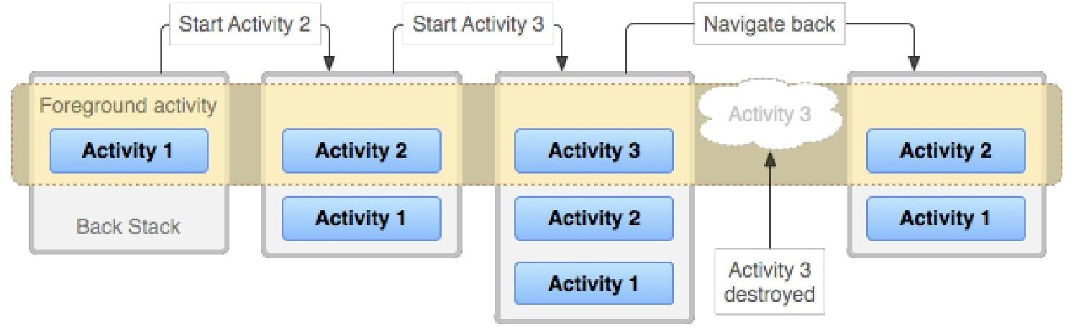
Tasks and Back Stack
Stack -> last in, first out

Slide 7
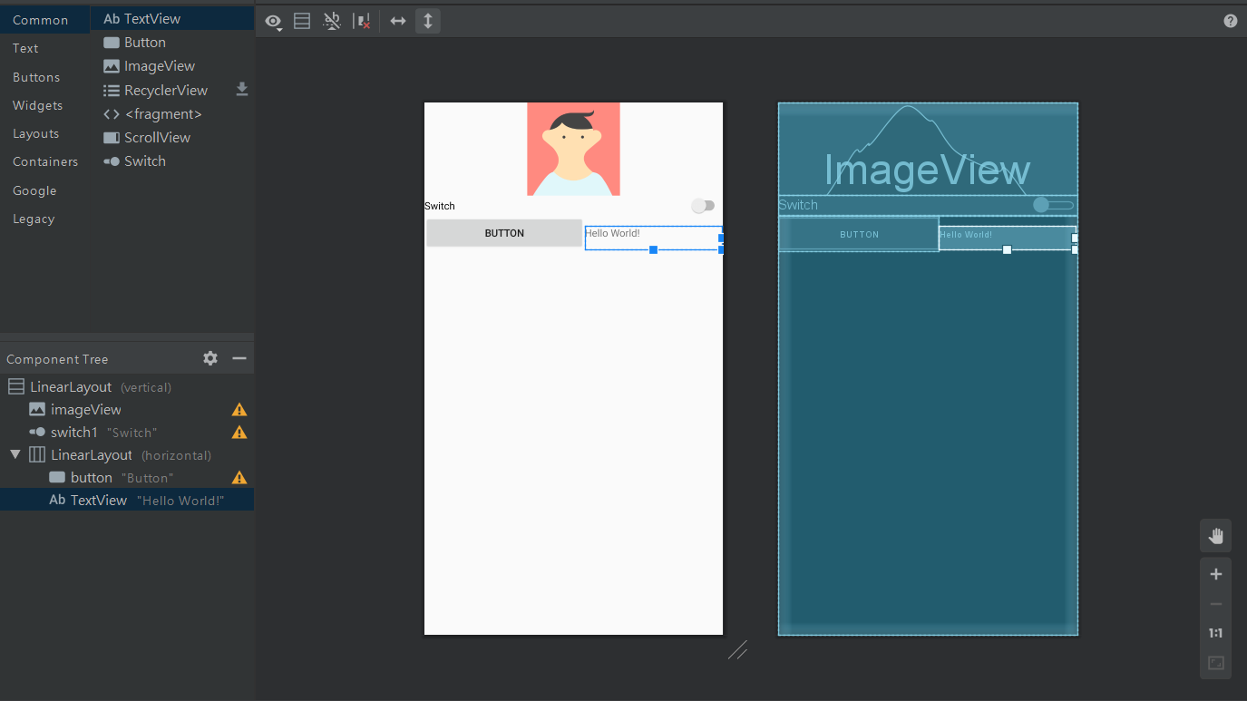
Layout
Linear layout

Slide 8
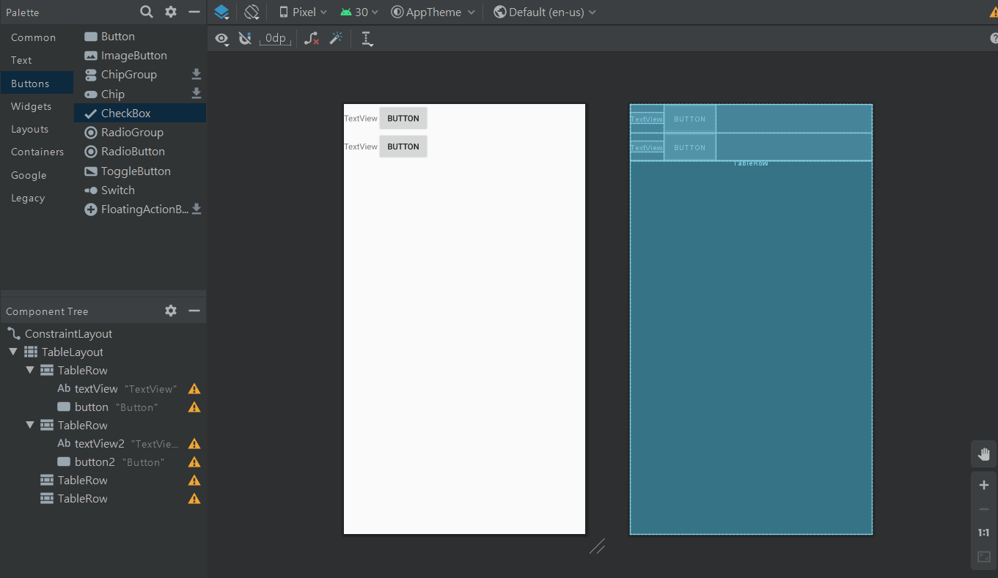
Layout
Table layout

Slide 9
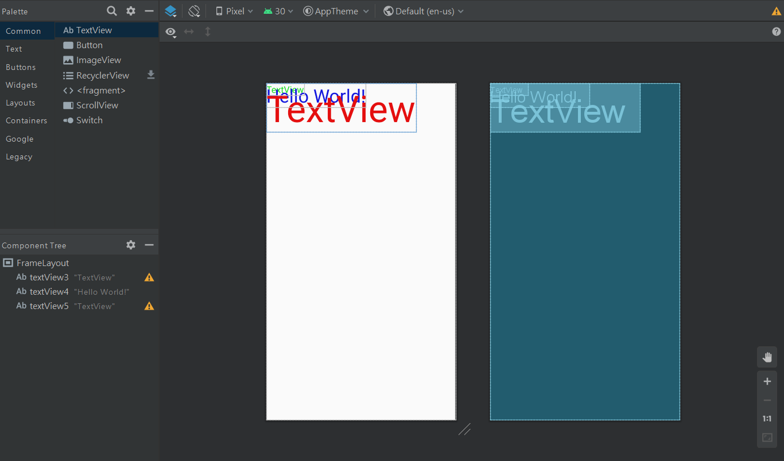
Layout
Frame layout

Slide 10
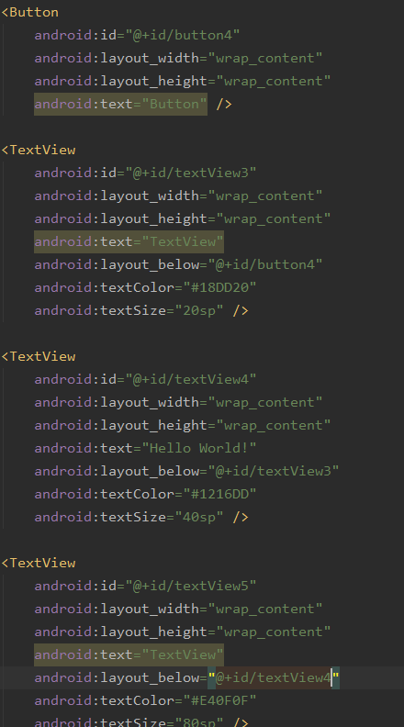
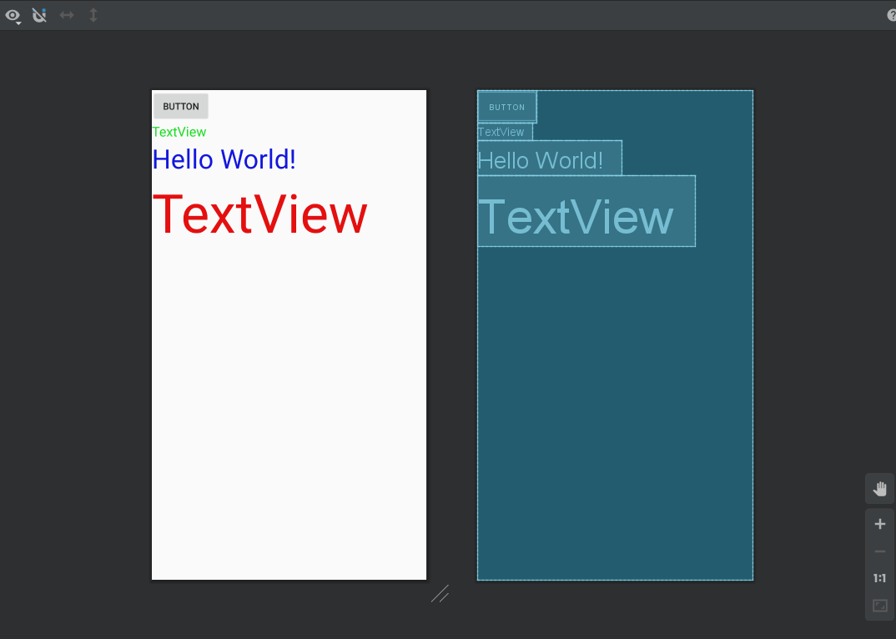
Layout
Relative layout

Slide 11
Layout
Relative layout
android:layout_above="@+id/[obj_id]”
android:layout_below="@+id/[obj_id]”
android:layout_toRightOf="@+id/[obj_id]"
android:layout_toLeftOf="@+id/[obj_id]"

Slide 12
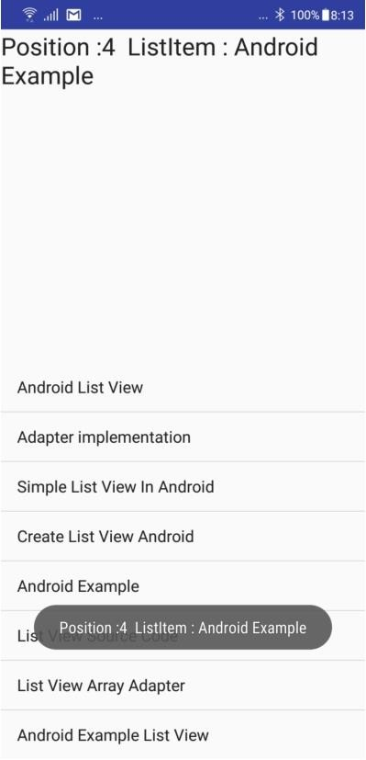
Today’s Lab
Top
TextView
TextView + ListView
Click item to show position and item name on Text View
Bottom
ListView
Ref: https://androidexample.com/Create_A_Simple_Listview_-_Android_Example/index.php?view=article_discription&aid=65

Slide 13
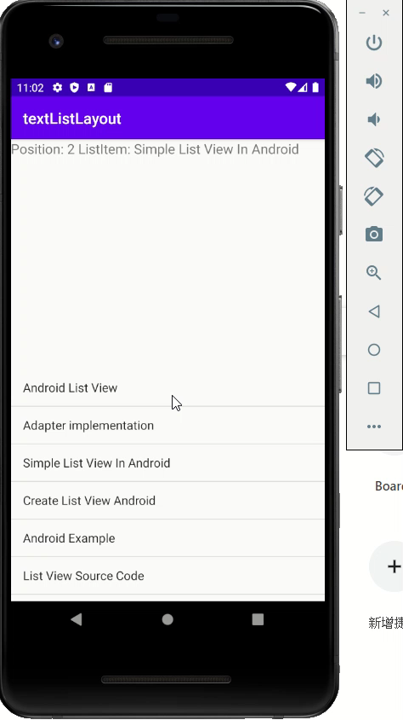
Demo

Slide 14
Create a New Project
Create a new project names TextListLayout
Use default API 16
Select Empty Activity
Use default class name “MainActivity”
Finish

Slide 15
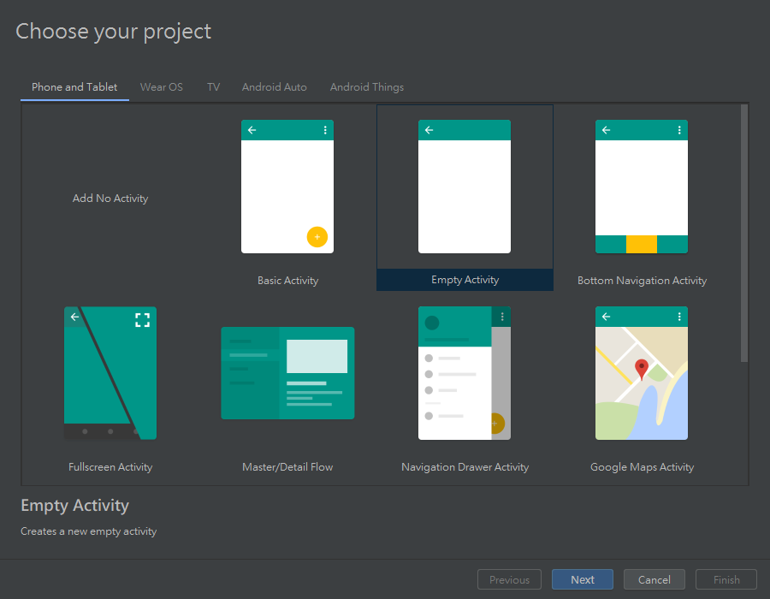


Slide 16
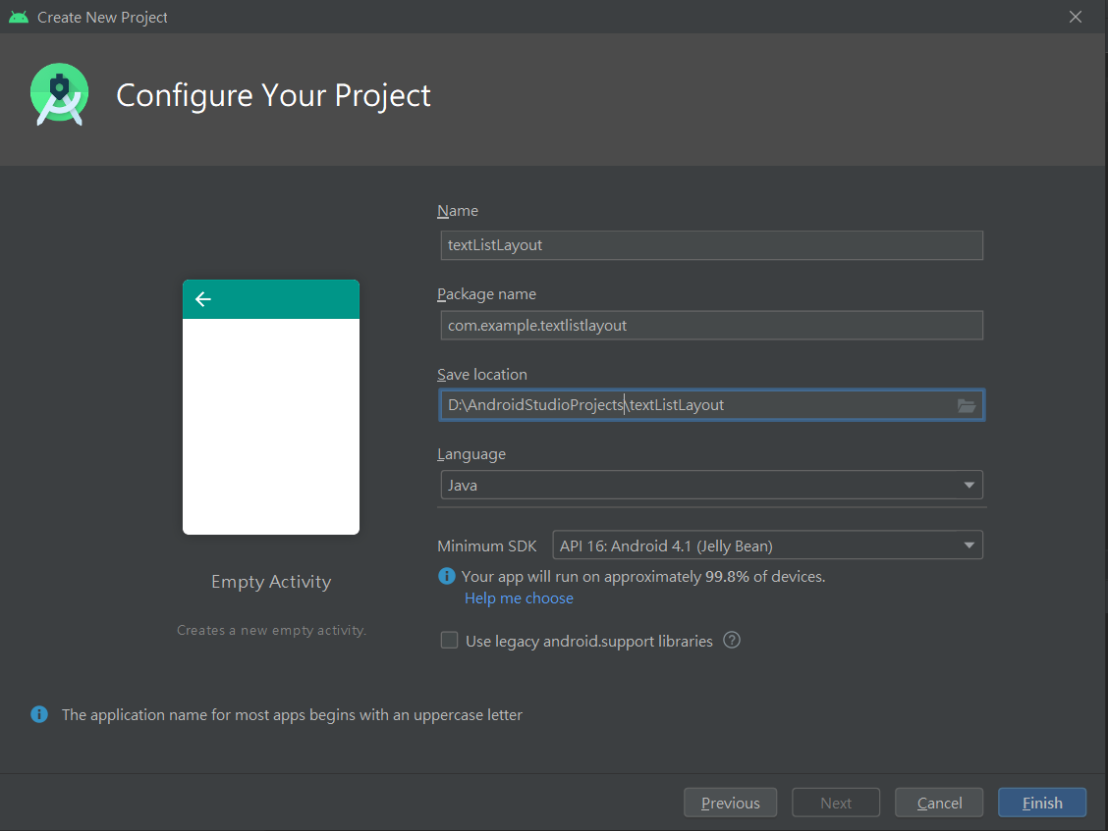


Slide 17
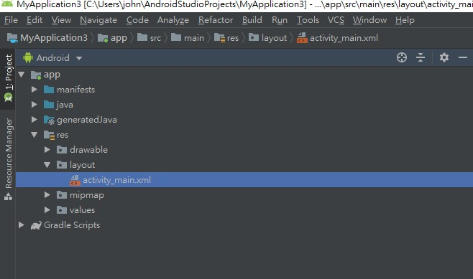



Slide 18
Modify activity_main.xml (1)
Change from default ContraintLayout to LinearLayout
<LinearLayout xmlns:android="http://schemas.android.com/apk/res/android" xmlns:tools="http://schemas.android.com/tools" android:layout_width="match_parent" android:layout_height="match_parent" android:orientation="vertical" tools:context=".MainActivity" > </LinearLayout>

Slide 19
Create Top Text View
Add FrameLayout, ScrollView, and a TextView
<FrameLayout android:layout_width="match_parent" android:layout_height="50dp"> <ScrollView android:layout_width="match_parent" android:layout_height="match_parent"> <TextView android:id="@+id/topTextView" android:layout_width="match_parent" android:layout_height="wrap_content" android:textSize="18sp" /> </ScrollView> </FrameLayout>

Slide 20
Create Bottom ListView
Insert ListView after </FrameLayout>
<ListView android:id="@+id/bottomListView" android:layout_width="match_parent" android:layout_height="wrap_content" />

Slide 21
Create Bottom ListView
Final activity_main.xml
<?xml version="1.0" encoding="utf-8"?> <LinearLayout xmlns:android="http://schemas.android.com/apk/res/android" xmlns:tools="http://schemas.android.com/tools" android:layout_width="match_parent" android:layout_height="match_parent" android:orientation="vertical" tools:context=".MainActivity" > <FrameLayout android:layout_width="match_parent" android:layout_height="50dp"> <ScrollView android:layout_width="match_parent" android:layout_height="match_parent"> <TextView android:id="@+id/topTextView" android:layout_width="match_parent" android:layout_height="wrap_content" android:textSize="18sp" /> </ScrollView> </FrameLayout> <ListView android:id="@+id/bottomListView" android:layout_width="match_parent" android:layout_height="wrap_content" /> </LinearLayout>

Slide 22
Create Bottom ListView
Add ListView Reference in MainActivity.java
public class MainActivity extends AppCompatActivity { ListView listView; @Override protected void onCreate(Bundle savedInstanceState) { super.onCreate(savedInstanceState); setContentView(R.layout.activity_main); listView = (ListView) findViewById(R.id.bottomListView); String[] values = new String[]{ "Android List View", "Adapter implementation", "Simple List View In Android", "Create List View Android", "Android Example", "List View Source Code", "List View Array Adapter", "test" }; ArrayAdapter<String> adapter = new ArrayAdapter<String>(this, android.R.layout.simple_list_item_1, android.R.id.text1, values); listView.setAdapter(adapter);

Slide 23
Add “setOnItemClickListener”
listView.setOnItemClickListener(new AdapterView.OnItemClickListener() { @Override public void onItemClick(AdapterView<?> adapterView, View view, int position, long id) { int itemPosition = position; String itemValue = (String) listView.getItemAtPosition(position); String posInfo = "Position: " + itemPosition + " ListItem: " + itemValue; Toast.makeText(getApplicationContext(), posInfo, Toast.LENGTH_LONG).show(); TextView topView = (TextView) findViewById(R.id.topTextView); topView.setText(posInfo); } });

