Slide 1

Lab 5 – Navigation Bar
KUAN - TING LAI

Slide 2
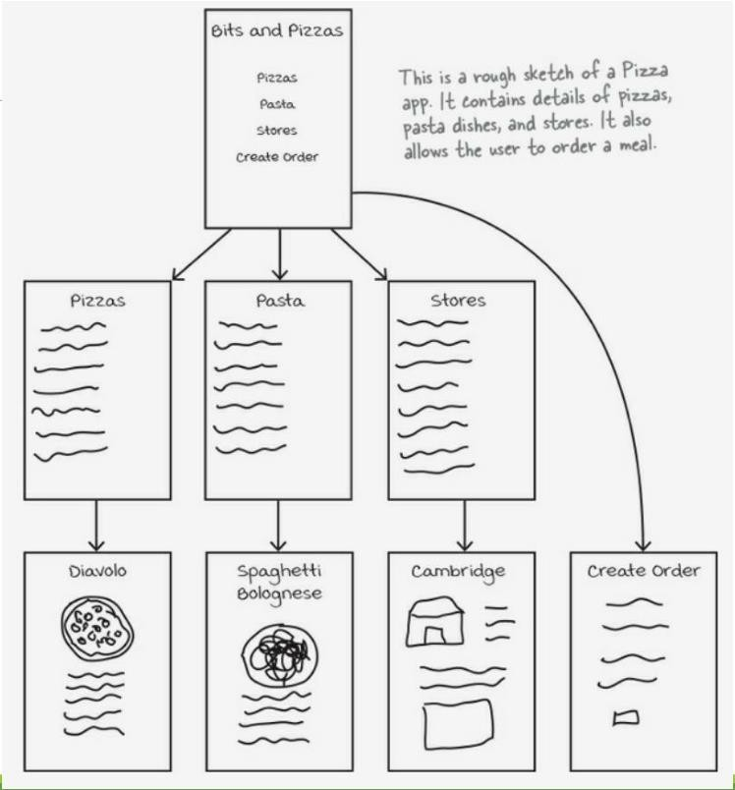
APP Design Example
General APP Hierarchy
Top -> Category -> Details
Need a shortcut to important activity
Shortcut!
2

Slide 3
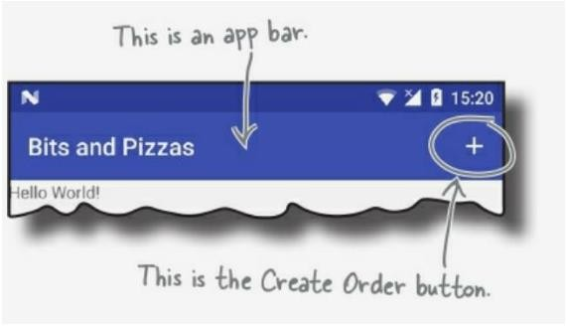
APP Bar
Use APP bar (navigation bar) to provide shortcut
3

Slide 4
Change the Style of APP Bar
Modify AndroidManifest.xml
<application
…
android:theme="@style/Theme.AppCompat.Light.DarkActionBar">
…
</application>
5

Slide 5
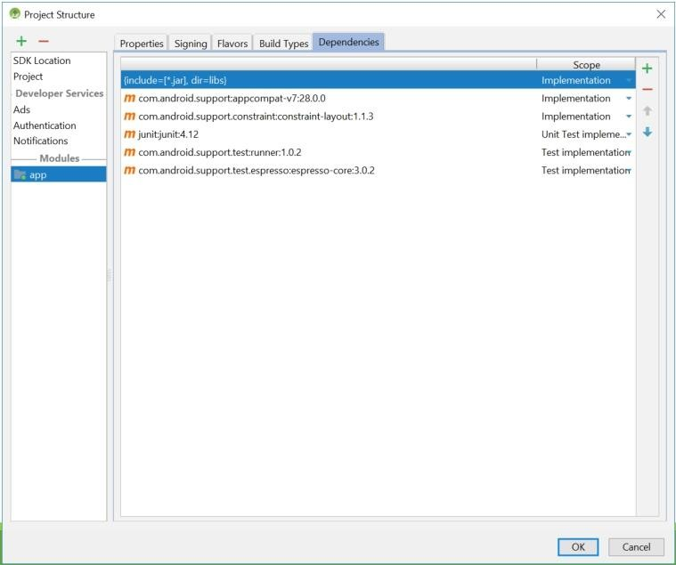
Manage Support Library
File -> Project Structure -> Dependencies
8

Slide 6
ActionBar vs. Toolbar
Toolbar supports latest features
How to add toolbar
Use AppCompat Support Library
Remove existing app bar
Add a toolbar to the layout
Set the toolbar as your APP’s new bar
9

Slide 7
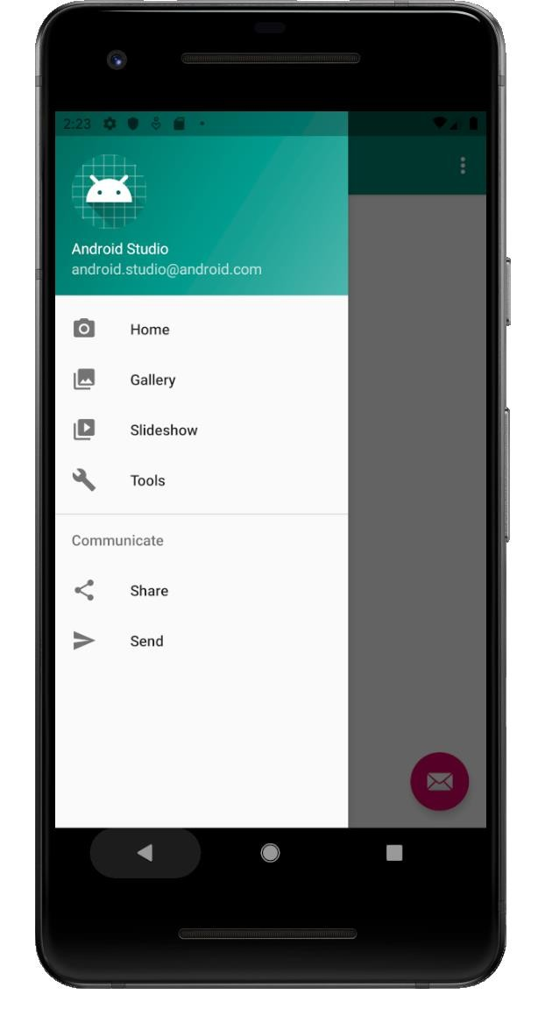
Today’s Lab
navigation_view
10

Slide 8
Install Android Design Support Library by used Gradle

Slide 9
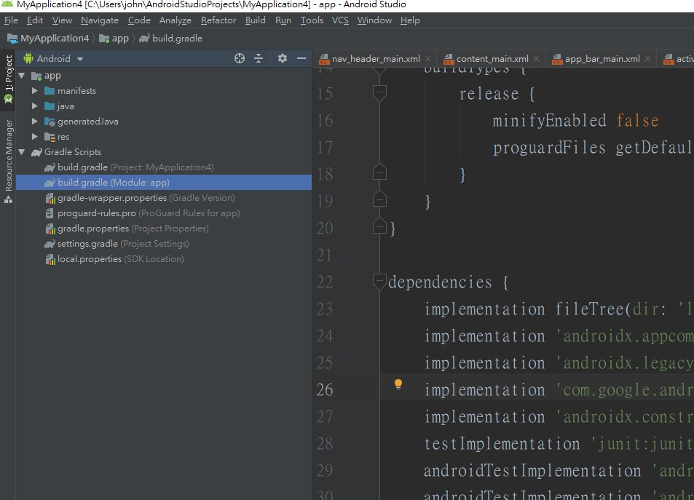

Slide 10
Bulid.gradle
dependencies { implementation fileTree(dir: "libs", include: ["*.jar"]) implementation 'androidx.appcompat:appcompat:1.1.0' implementation 'androidx.constraintlayout:constraintlayout:1.1.3' implementation 'com.google.android.material:material:1.1.0' implementation 'androidx.coordinatorlayout:coordinatorlayout:1.1.0' testImplementation 'junit:junit:4.12' androidTestImplementation 'androidx.test.ext:junit:1.1.1' androidTestImplementation 'androidx.test.espresso:espresso-core:3.2.0' }

Slide 11
Set layout

Slide 12
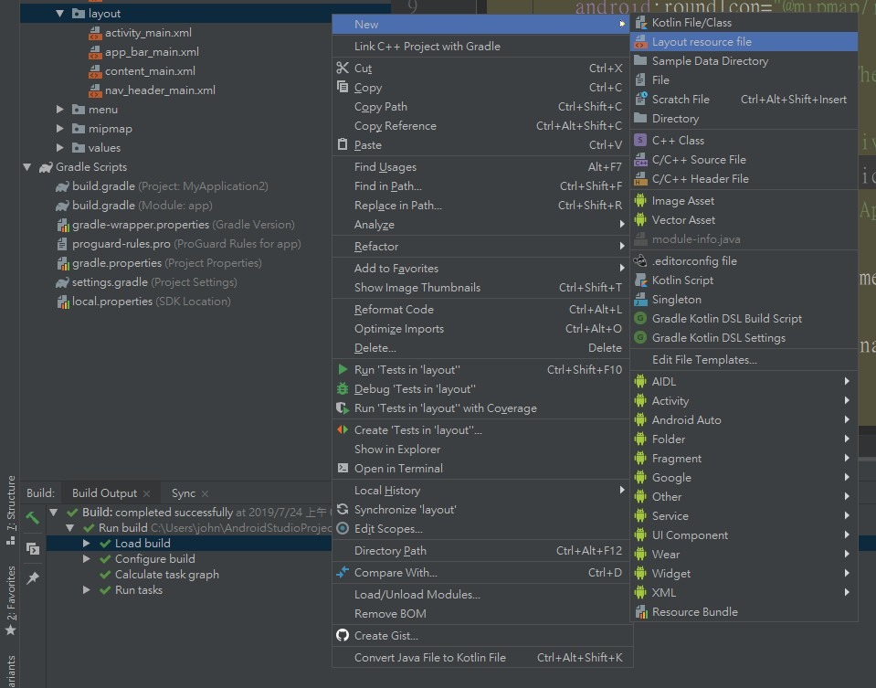


Slide 13
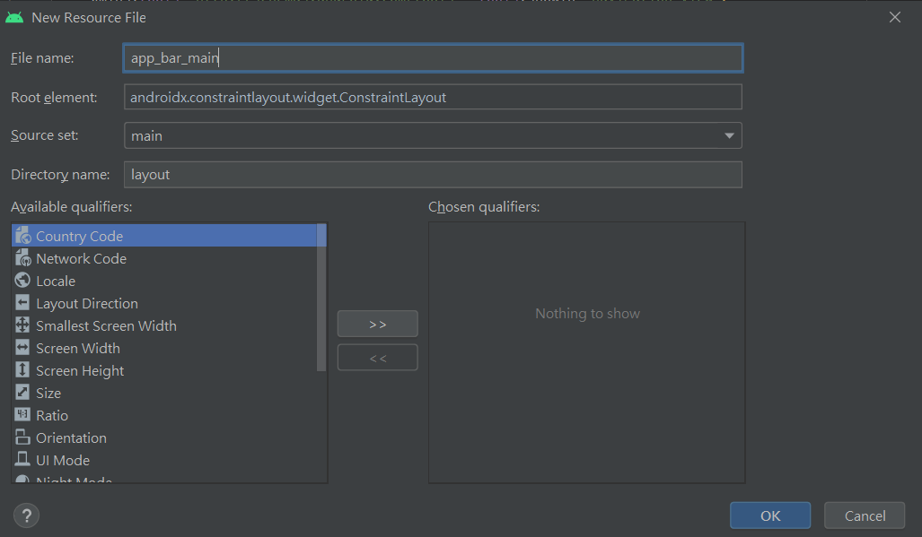

Slide 14
activity_main.xml
<?xml version="1.0" encoding="utf-8"?> <androidx.drawerlayout.widget.DrawerLayout xmlns:android="http://schemas.android.com/apk/res/android" xmlns:app="http://schemas.android.com/apk/res-auto" xmlns:tools="http://schemas.android.com/tools" android:id="@+id/drawer_layout" android:layout_width="match_parent" android:layout_height="match_parent" android:fitsSystemWindows="true" tools:openDrawer="start"> <include layout="@layout/app_bar_main" android:layout_width="match_parent" android:layout_height="match_parent" /> <com.google.android.material.navigation.NavigationView android:id="@+id/nav_view" android:layout_width="wrap_content" android:layout_height="match_parent" android:layout_gravity="start" android:fitsSystemWindows="true" app:headerLayout="@layout/nav_header_main" app:menu="@menu/activity_main_drawer" tools:ignore="MissingClass" /> </androidx.drawerlayout.widget.DrawerLayout>

Slide 15
app_bar_main.xml
<?xml version="1.0" encoding="utf-8"?> <androidx.coordinatorlayout.widget.CoordinatorLayout xmlns:android="http://schemas.android.com/apk/res/android" xmlns:app="http://schemas.android.com/apk/res-auto" xmlns:tools="http://schemas.android.com/tools" android:layout_width="match_parent" android:layout_height="match_parent" tools:context=".MainActivity"> <com.google.android.material.appbar.AppBarLayout android:layout_width="match_parent" android:layout_height="wrap_content" android:theme="@style/AppTheme.AppBarOverlay"> <androidx.appcompat.widget.Toolbar android:id="@+id/toolbar" android:layout_width="match_parent" android:layout_height="?attr/actionBarSize" android:background="?attr/colorPrimary" app:popupTheme="@style/AppTheme.PopupOverlay" /> </com.google.android.material.appbar.AppBarLayout> <include layout="@layout/content_main" /> <com.google.android.material.floatingactionbutton.FloatingActionButton android:id="@+id/fab" android:layout_width="wrap_content" android:layout_height="wrap_content" android:layout_gravity="bottom|end" android:layout_margin="@dimen/fab_margin" app:srcCompat="@android:drawable/ic_dialog_email" /> </androidx.coordinatorlayout.widget.CoordinatorLayout>

Slide 16
content_main.xml
<?xml version="1.0" encoding="utf-8"?> <androidx.constraintlayout.widget.ConstraintLayout xmlns:android="http://schemas.android.com/apk/res/android" xmlns:app="http://schemas.android.com/apk/res-auto" xmlns:tools="http://schemas.android.com/tools" android:layout_width="match_parent" android:layout_height="match_parent" app:layout_behavior="@string/appbar_scrolling_view_behavior" tools:context=".MainActivity" tools:showIn="@layout/app_bar_main"/>

Slide 17
nav_header_main.xml
<?xml version="1.0" encoding="utf-8"?> <LinearLayout xmlns:android="http://schemas.android.com/apk/res/android" xmlns:app="http://schemas.android.com/apk/res-auto" android:layout_width="match_parent" android:layout_height="@dimen/nav_header_height" android:background="@drawable/side_nav_bar" android:gravity="bottom" android:orientation="vertical" android:paddingLeft="@dimen/activity_horizontal_margin" android:paddingTop="@dimen/activity_vertical_margin" android:paddingRight="@dimen/activity_horizontal_margin" android:paddingBottom="@dimen/activity_vertical_margin" android:theme="@style/ThemeOverlay.AppCompat.Dark"> <ImageView android:id="@+id/imageView" android:layout_width="wrap_content" android:layout_height="wrap_content" android:contentDescription="@string/nav_header_desc" android:paddingTop="@dimen/nav_header_vertical_spacing" app:srcCompat="@mipmap/ic_launcher_round" /> <TextView android:layout_width="match_parent" android:layout_height="wrap_content" android:paddingTop="@dimen/nav_header_vertical_spacing" android:text="@string/nav_header_title" android:textAppearance="@style/TextAppearance.AppCompat.Body1" /> <TextView android:id="@+id/textView" android:layout_width="wrap_content" android:layout_height="wrap_content" android:text="@string/nav_header_subtitle" /> </LinearLayout>

Slide 18
Set menu

Slide 19
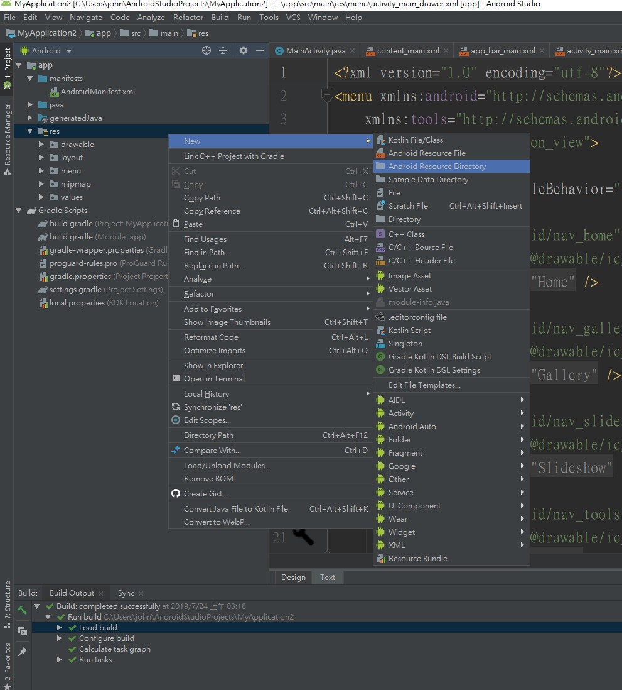
Create menu directory

Slide 20
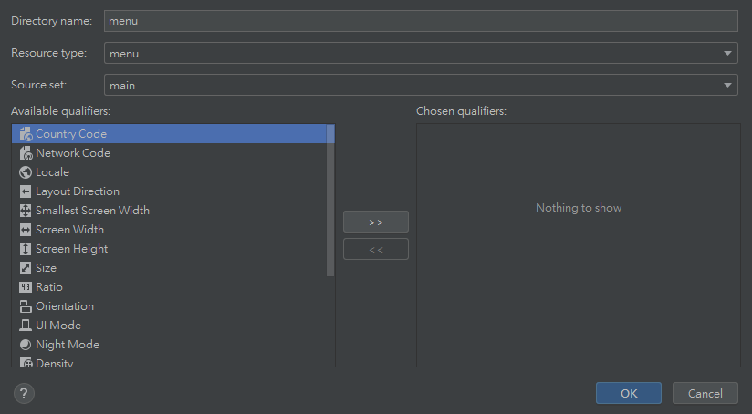


Slide 21
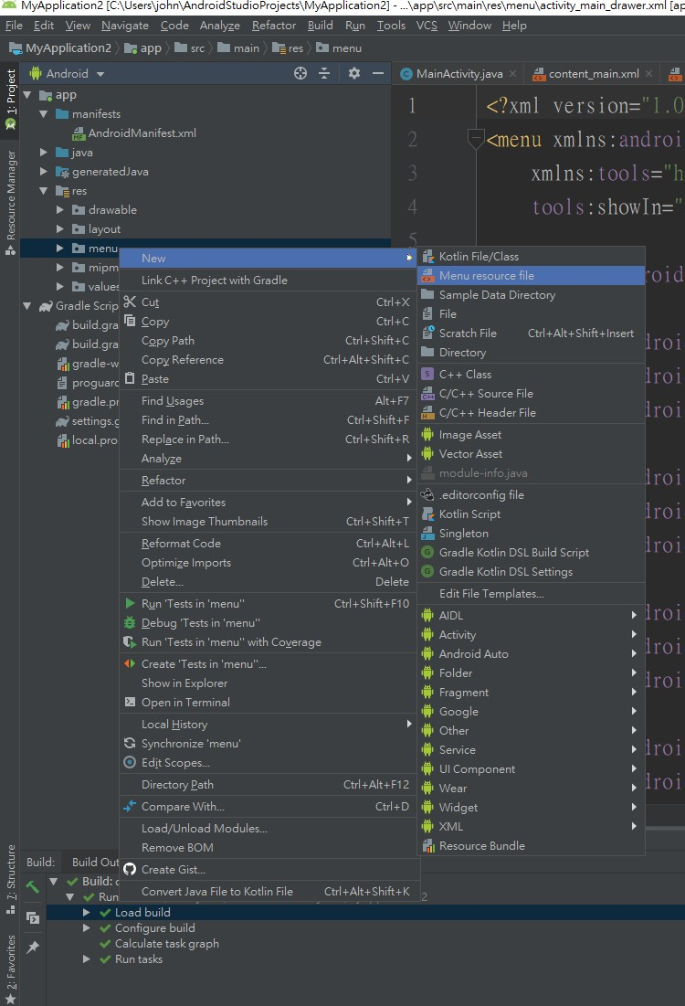
Create main.xml and activity_main_drawer.xml

Slide 22
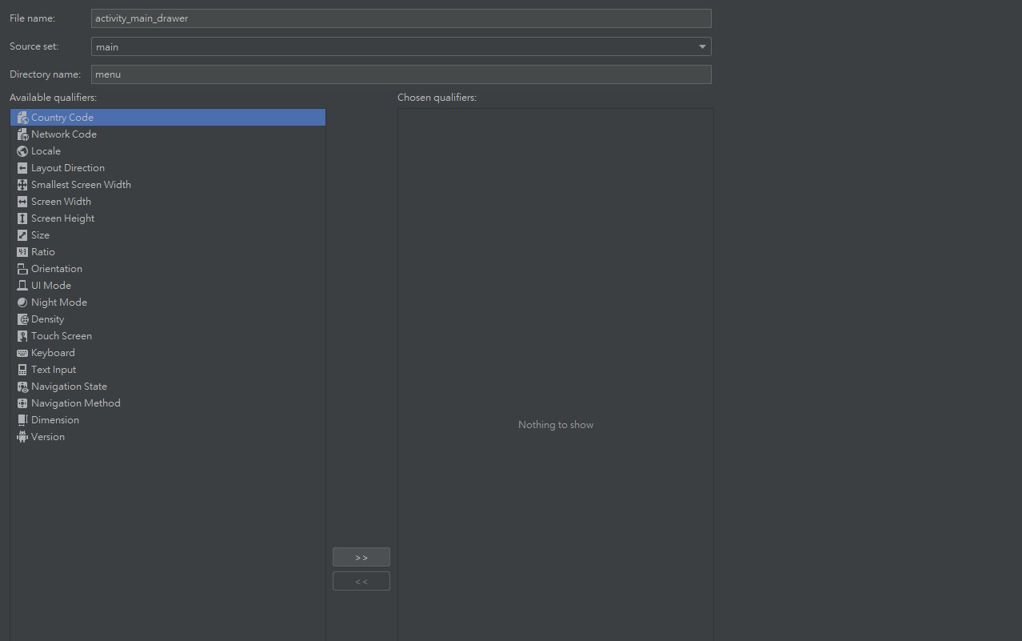


Slide 23
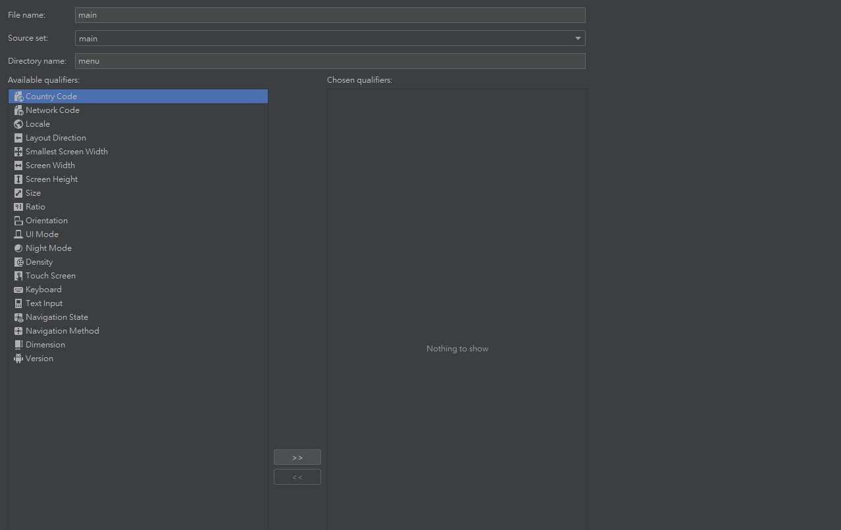


Slide 24
main.xml
<?xml version="1.0" encoding="utf-8"?>
<menu xmlns:android="http://schemas.android.com/apk/res/android"
xmlns:app="http://schemas.android.com/apk/res-auto">
<item
android:id="@+id/action_settings" android:orderInCategory="100" android:title="@string/action_settings" app:showAsAction="never" />
</menu>

Slide 25
activity_main_drawer.xml
<?xml version="1.0" encoding="utf-8"?> <menu xmlns:android="http://schemas.android.com/apk/res/android" xmlns:tools="http://schemas.android.com/tools" tools:showIn="navigation_view"> <group android:checkableBehavior="single"> <item android:id="@+id/nav_home" android:icon="@drawable/ic_menu_home" android:title="@string/menu_home" /> <item android:id="@+id/nav_gallery" android:icon="@drawable/ic_menu_gallery" android:title="@string/menu_gallery" /> <item android:id="@+id/nav_slideshow" android:icon="@drawable/ic_menu_slideshow" android:title="@string/menu_slideshow" /> <item android:id="@+id/nav_tools" android:icon="@drawable/ic_menu_manage" android:title="@string/menu_tools" /> </group> <item android:title="Communicate"> <menu> <item android:id="@+id/nav_share" android:icon="@drawable/ic_menu_share" android:title="@string/menu_share" /> <item android:id="@+id/nav_send" android:icon="@drawable/ic_menu_send" android:title="@string/menu_send" /> </menu> </item> </menu>

Slide 26
Set style

Slide 27
Styles.xml
<resources> <!-- Base application theme. --> <style name="AppTheme" parent="Theme.AppCompat.Light.DarkActionBar"> <!-- Customize your theme here. --> <item name="colorPrimary">@color/colorPrimary</item> <item name="colorPrimaryDark">@color/colorPrimaryDark</item> <item name="colorAccent">@color/colorAccent</item> </style> <style name="AppTheme.NoActionBar"> <item name="windowActionBar">false</item> <item name="windowNoTitle">true</item> </style> <style name="AppTheme.AppBarOverlay" parent="ThemeOverlay.AppCompat.Dark.ActionBar" /> <style name="AppTheme.PopupOverlay" parent="ThemeOverlay.AppCompat.Light" /> </resources>

Slide 28
dimens.xml
<resources>
<!-- Default screen margins, per the Android Design guidelines. -->
<dimen name="activity_horizontal_margin">16dp</dimen>
<dimen name="activity_vertical_margin">16dp</dimen>
<dimen name="nav_header_vertical_spacing">8dp</dimen>
<dimen name="nav_header_height">176dp</dimen>
<dimen name="fab_margin">16dp</dimen>
</resources>

Slide 29
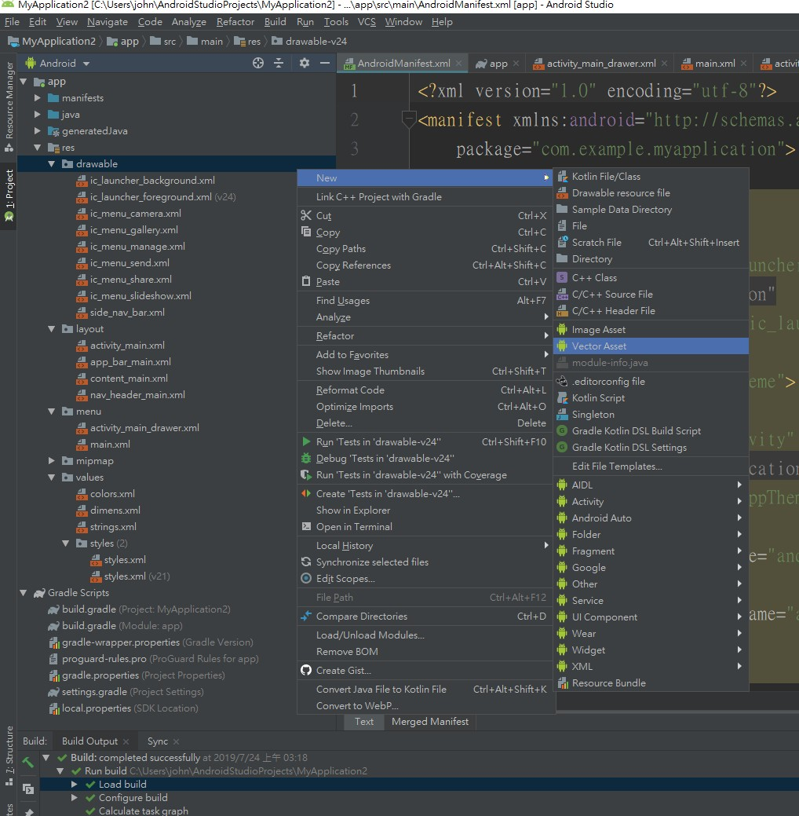

Slide 30
Add icon

Slide 31
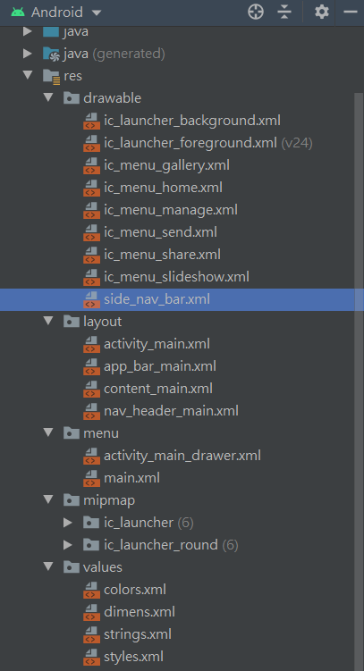

Slide 32
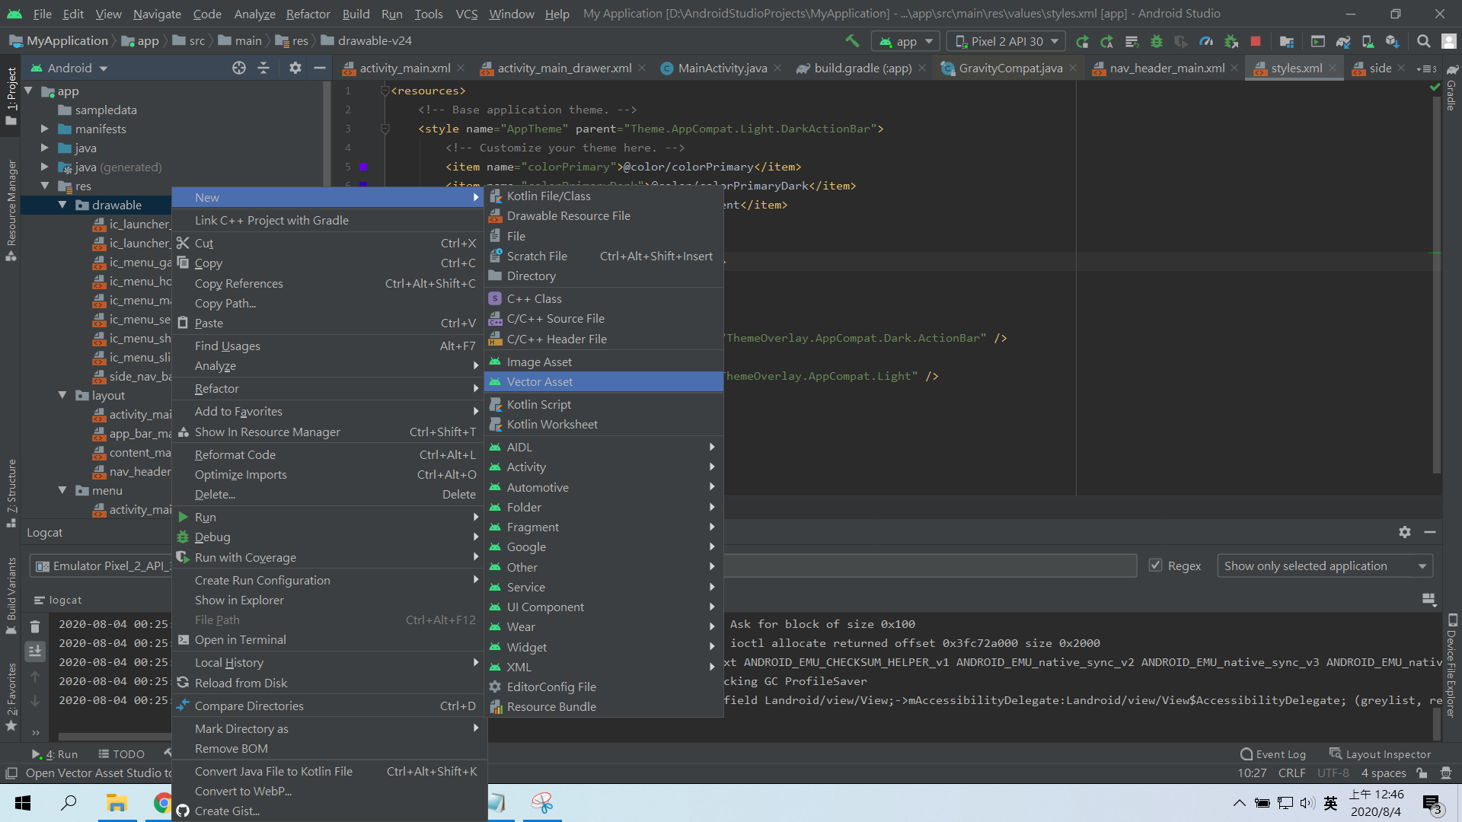

Slide 33
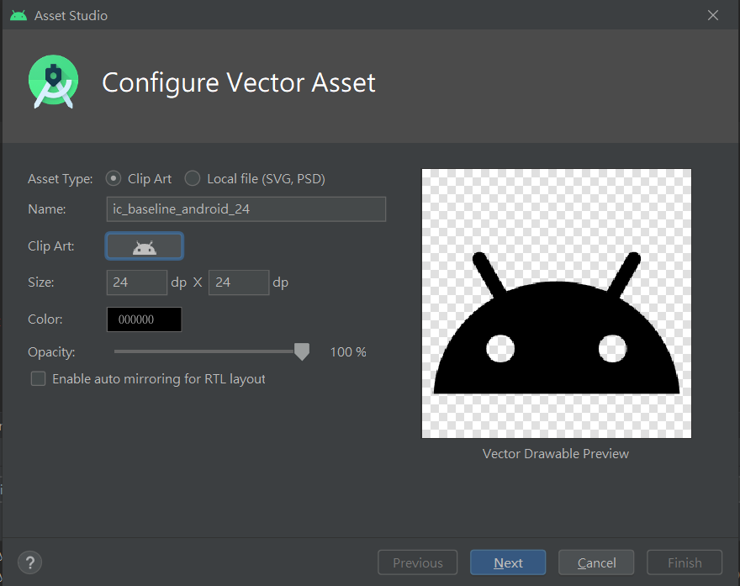

Slide 34
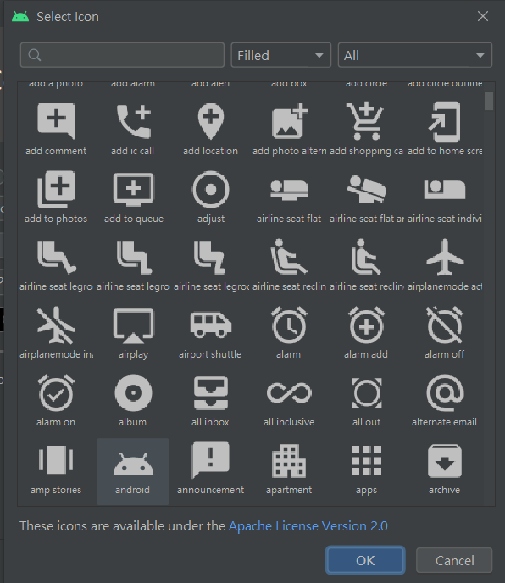
Select your icon

Slide 35
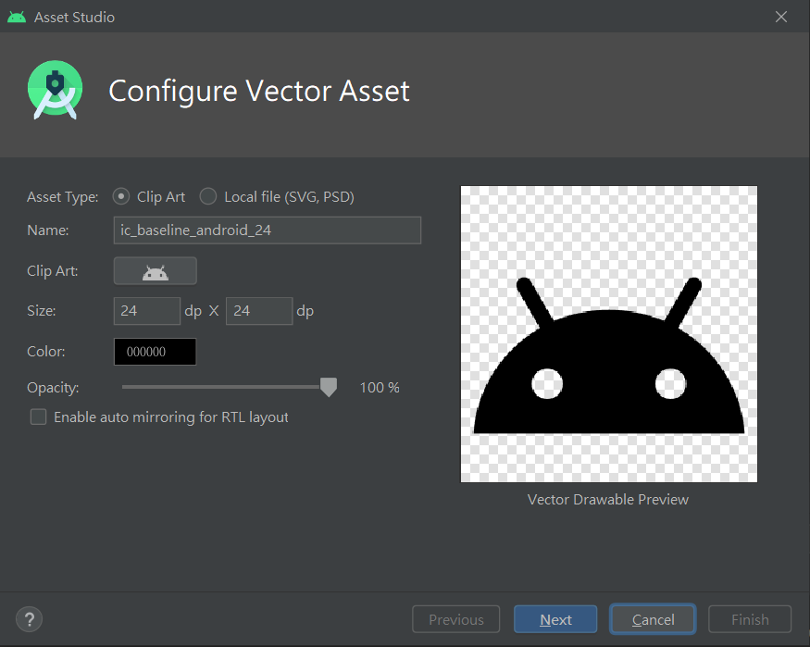
You can rename your icon

Slide 36
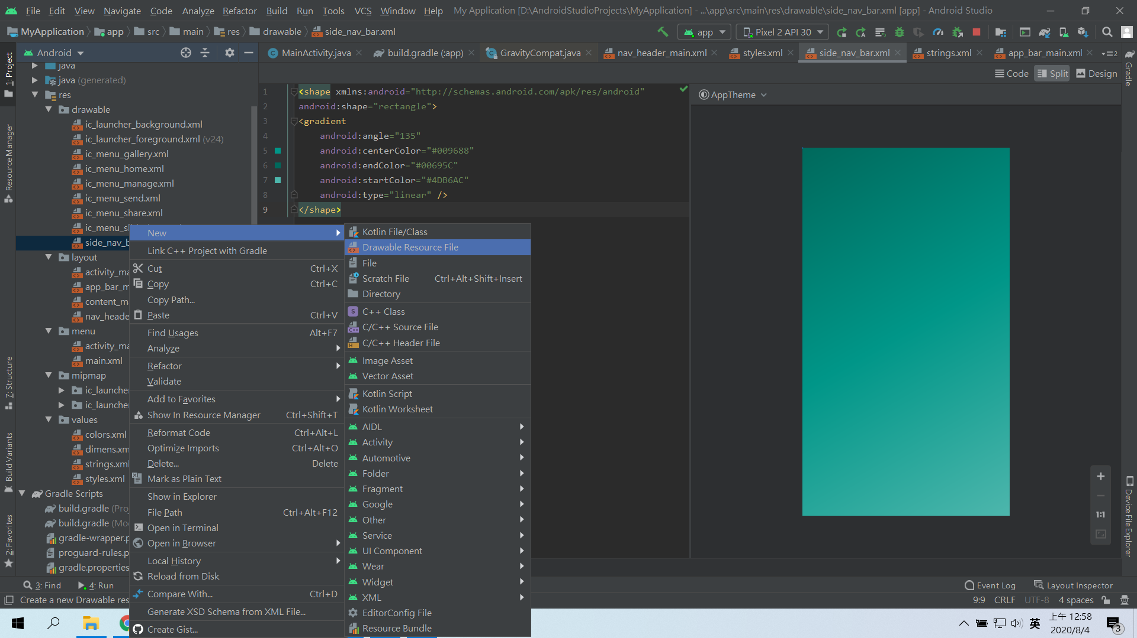
Create side_nav_bar.xml

Slide 37
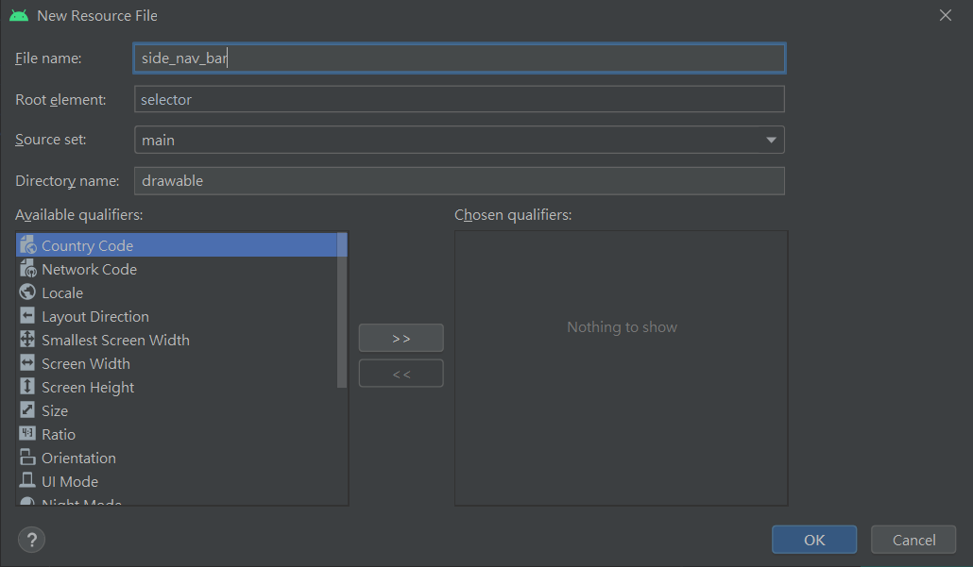
Create side_nav_bar.xml

Slide 38
side_nav_bar.xml
<shape xmlns:android="http://schemas.android.com/apk/res/android" android:shape="rectangle"> <gradient android:angle="135" android:centerColor="#009688" android:endColor="#00695C" android:startColor="#4DB6AC" android:type="linear" /> </shape>

Slide 39
string.xml
<resources>
<string name="app_name">My Application</string>
<string name="navigation_drawer_open">Open navigation drawer</string>
<string name="navigation_drawer_close">Close navigation drawer</string>
<string name="nav_header_title">Android Studio</string>
<string name="nav_header_subtitle">android.studio@android.com</string>
<string name="nav_header_desc">Navigation header</string>
<string name="action_settings">Settings</string>
<string name="menu_home">Home</string>
<string name="menu_gallery">Gallery</string>
<string name="menu_slideshow">Slideshow</string>
<string name="menu_tools">Tools</string>
<string name="menu_share">Share</string>
<string name="menu_send">Send</string>
<string name="text">text</string>
</resources>

Slide 40
AndroidManifest.xml
<?xml version="1.0" encoding="utf-8"?> <manifest xmlns:android="http://schemas.android.com/apk/res/android" package="com.example.myapplication"> <application android:allowBackup="true" android:icon="@mipmap/ic_launcher" android:label="@string/app_name" android:roundIcon="@mipmap/ic_launcher_round" android:supportsRtl="true" android:theme="@style/AppTheme"> <activity android:name=".MainActivity" android:label="@string/app_name" android:theme="@style/AppTheme.NoActionBar"> <intent-filter> <action android:name="android.intent.action.MAIN" /> <category android:name="android.intent.category.LAUNCHER" /> </intent-filter> </activity> </application> </manifest>

Slide 41
MainActivity.java
package com.example.myapplication; import androidx.appcompat.app.ActionBarDrawerToggle; import androidx.appcompat.app.AppCompatActivity; import androidx.appcompat.widget.Toolbar; import androidx.core.view.GravityCompat; import androidx.drawerlayout.widget.DrawerLayout; import android.os.Bundle; import android.util.Log; import android.view.Menu; import android.view.MenuItem; import android.view.View; import com.google.android.material.floatingactionbutton.FloatingActionButton; import com.google.android.material.navigation.NavigationView; import com.google.android.material.snackbar.Snackbar;

Slide 42
MainActivity.java
public class MainActivity extends AppCompatActivity implements NavigationView.OnNavigationItemSelectedListener{ @Override protected void onCreate(Bundle savedInstanceState) { super.onCreate(savedInstanceState); setContentView(R.layout.activity_main); Toolbar toolbar = findViewById(R.id.toolbar); setSupportActionBar(toolbar); FloatingActionButton fab = findViewById(R.id.fab); fab.setOnClickListener(new View.OnClickListener() { @Override public void onClick(View view) { Snackbar.make(view, "Replace with your own action", Snackbar.LENGTH_LONG) .setAction("Action", null).show(); } }); DrawerLayout drawer = findViewById(R.id.drawer_layout); NavigationView navigationView = findViewById(R.id.nav_view); ActionBarDrawerToggle toggle = new ActionBarDrawerToggle( this, drawer, toolbar, R.string.navigation_drawer_open, R.string.navigation_drawer_close); drawer.addDrawerListener(toggle); toggle.syncState(); navigationView.setNavigationItemSelectedListener(this); }

Slide 43
MainActivity.java
@Override public boolean onCreateOptionsMenu(Menu menu) { // Inflate the menu; this adds items to the action bar if it is present. getMenuInflater().inflate(R.menu.main, menu); return true; } @Override public boolean onOptionsItemSelected(MenuItem item) { // Handle action bar item clicks here. The action bar will // automatically handle clicks on the Home/Up button, so long // as you specify a parent activity in AndroidManifest.xml. int id = item.getItemId(); //noinspection SimplifiableIfStatement if (id == R.id.action_settings) { return true; } return super.onOptionsItemSelected(item); }

Slide 44
MainActivity.java
public boolean onNavigationItemSelected(MenuItem item) { // Handle navigation view item clicks here. int id = item.getItemId(); if (id == R.id.nav_home) { // Handle the home action } else if (id == R.id.nav_gallery) { } else if (id == R.id.nav_slideshow) { } else if (id == R.id.nav_tools) { } else if (id == R.id.nav_share) { } else if (id == R.id.nav_send) { } DrawerLayout drawer = findViewById(R.id.drawer_layout); drawer.closeDrawer(GravityCompat.START); return true; } }

Slide 45
