Slide 1
“Summer Vacation!” Library Scavenger Hunt
You are a parent that is about to go on a summer vacation with your spouse and 12 year-old son. You are taking a two-day road trip to visit your parents at their farm in Idaho. Their farm does not have Internet access, and cell reception is spotty. They have a TV/DVD player and CD player. You plan to borrow as much reading material, DVDs and CDs from the library to keep your family entertained in the car and over the summer.
To unlock the complete list of call numbers on your wish list, you must first successfully use the Peninsula Library System’s online catalog to find the call number of at least 1 item on each family member’s list. Your second task is to retrieve each item at your library.
Start

Slide 2



Billy gets to choose from a short list of assigned summer reading books. He really wants to read The Alchemyst: The Secrets of the Immortal Nicholas Flamel by Michael Scott. Help him find a copy.
Click on the image that shows the best way to search for this title.

Slide 3
Sorry, “Alchemyst” is the title of the book not the author’s name. Please try again.
✗
Try again.

Slide 4
Sorry. This is an incorrect spelling of the title. Using this search would bring up a list for the author Paulo Coelho, not Michael Scott.
✗
Try again.

Slide 5
Correct! You have now unlocked the rest of the call numbers on Billy’s summer reading list.
✔
Title | Format or Location in Library | Call Number
For Billy
Assigned Summer Reading
Better Nate Than Ever by Tim Federle | Children's Fiction | J FED
Bad Island by Doug TenNapel | Young Adult Graphic Novels | YA GN TEN
The Alchemyst: The Secrets of the Immortal Nicholas Flamel by Michael Scott | Young Adult Fiction | YA SCO
Bomb: The Race to Build—and Steal—the World’s Most Dangerous Weapon by Steve Sheinkin | Children's Non-Fiction | J 623.451 SHE
(For Fun)
Indiana Jones Trilogy | DVD | DVD IND
The Goonies | DVD | DVD GOO
Princess Bride | DVD | DVD PRI
Top Secret | DVD | DVD TOP
continue

Slide 6



Mom wants to start a few knitting projects with a Harry Potter theme. But she can’t remember the name of the book she saw at the craft store.
Click on the image that shows the best way to search for this title.
(Hint: There are 2 right answers.)

Slide 7
Sorry. Using a title search for “Harry Potter knitting” will result in 0 search results.
✗
Try again.

Slide 8
Correct! With a subject search, searching for both “Harry Potter” and “knitting” will result in the correct book – Charmed Knits by Alison Hansel
✔
Go back to question.
Continue to mom’s list

Slide 9
Correct! Using a keyword search for “knitting” and “Harry Potter” will give the correct search results - Charmed Knits by Alison Hansel
✔
Go back to question.
Continue to mom’s list

Slide 10
Congrats! You have unlocked Mom’s list of call numbers.
✔
Title | Format or Location in Library | Call Number
For Mom
Gone Girl by Gillian Flynn | Adult Fiction | F - FLY
Harry Potter Knitting book | Adult Non-Fiction | 746.432 HAN
Little Children by Tom Perrotta | CD Book Fiction | CD BOOK PER
Any David Sedaris book on CD | CD Book Non-Fiction | CD BOOK 814 or 817 SED
Continue to Dad’s list

Slide 11
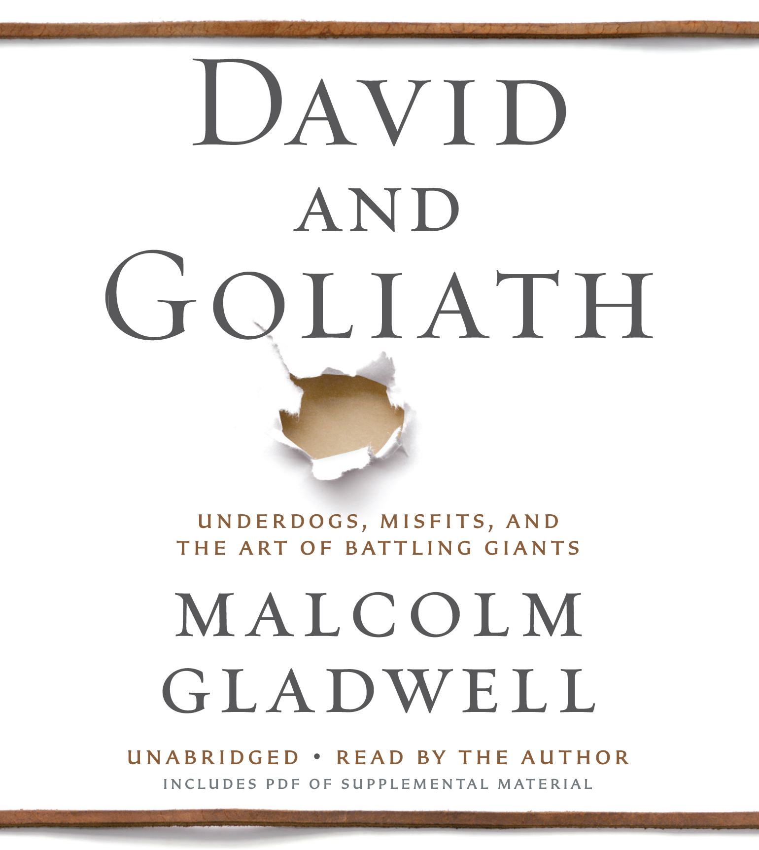
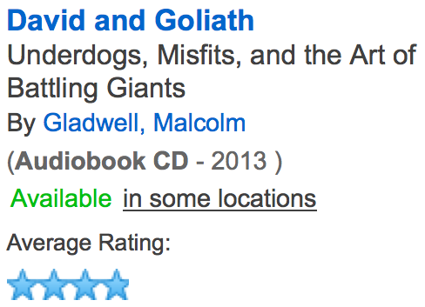
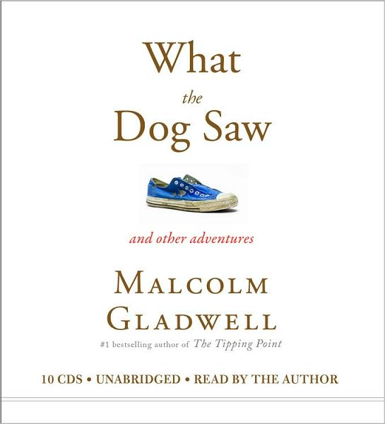
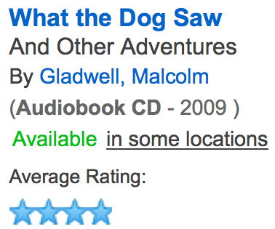
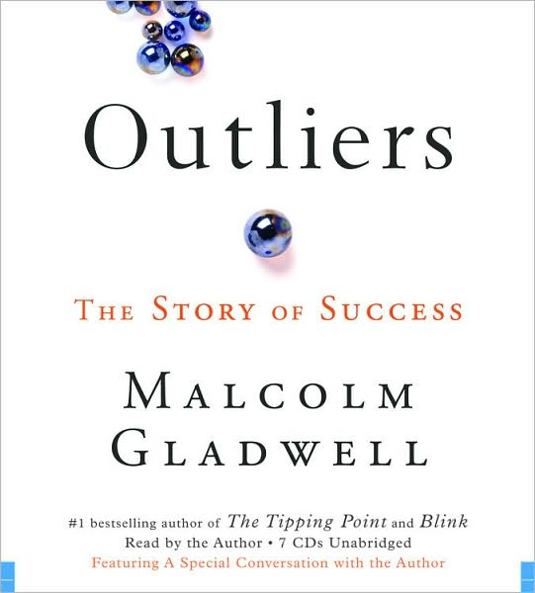
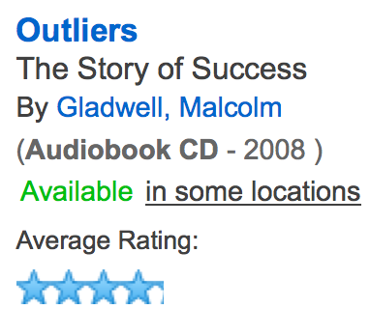

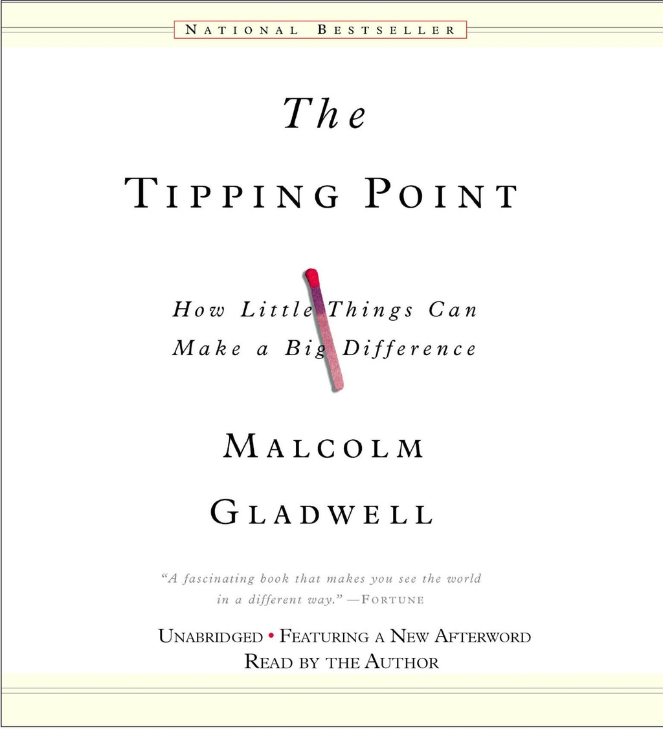
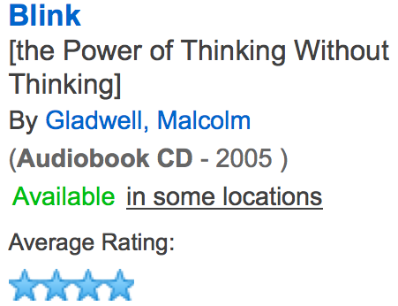
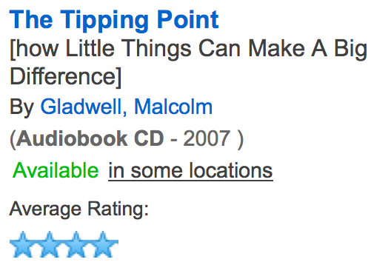
Dad wants to listen to “that one book” by Malcolm Gladwell while driving. He can’t remember the title but knows it has a picture of a matchstick on the cover. The following are the results of your search (edited for clarity). Click on the image of the title Dad is looking for.

Slide 12
Sorry. That book cover does not depict a matchstick.
✗
Try again.

Slide 13
Correct! Dad wants to listen to The Tipping Point on the road trip. You have now unlocked his list of call numbers.
✔
Title | Format or Location in Library | Call Number
For Dad
Gladwell Book with Match on Cover | CD Book Non-Fiction | CD Book 302 GLA
Guns, Germs and Steel | Non-Fiction Book | 303.4 DIA
First Game of Thrones Book | Adult Fiction | F MAR
Continue to library

Slide 14
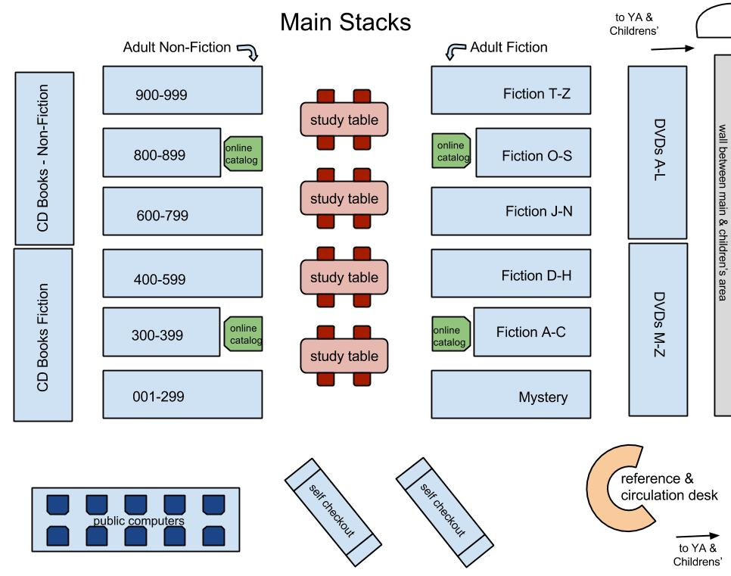
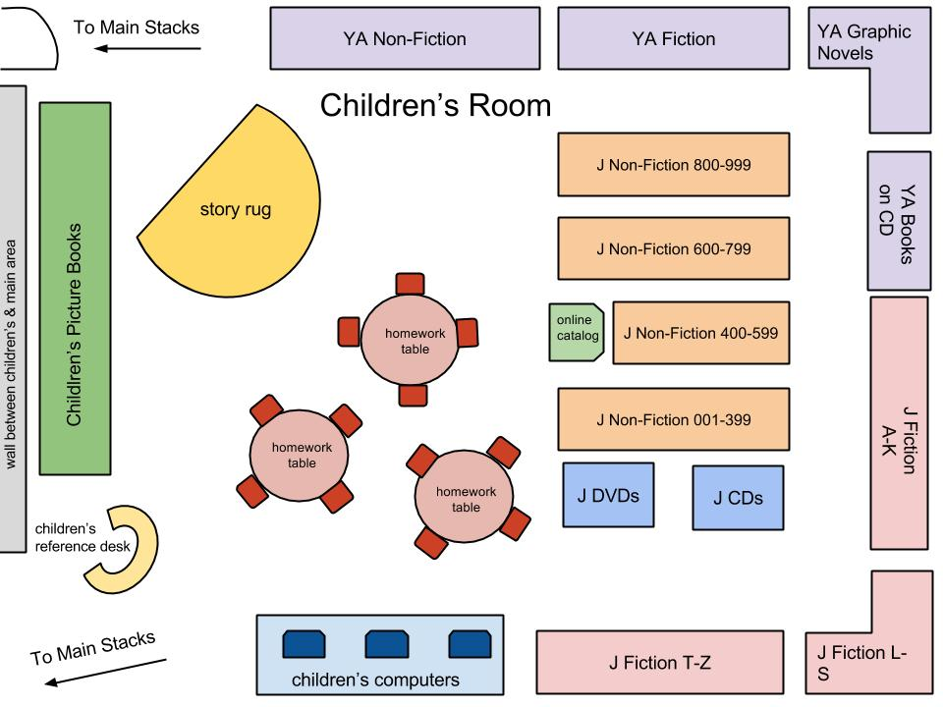
Welcome to the Burlingame Library
Each item and its call number will be listed at the top. A layout of the library will be underneath. Click on the shelf where you would expect to find the listed item.
start

Slide 15
Gone Girl by Gillian Flynn - Adult Fiction - F FLY

Slide 16
That is not the correct location.
✗
Try again.

Slide 17
You found it!
✔
Next item.

Slide 18
Harry Potter Knitting book - Adult Non-Fiction - 746.432 HAN Charmed Knits

Slide 19
That is not the correct location.
✗
Try again.

Slide 20
You found it!
✔
Next item.

Slide 21
Little Children by Tom Perrota Audiobook – CD BOOK Fiction – CD BOOK PER

Slide 22
That is not the correct location.
✗
Try again.

Slide 23
You found it!
✔
Next item.

Slide 24
Any David Sedaris Audiobook - CD BOOK 814 or 817 SED

Slide 25
That is not the correct location.
✗
Try again.

Slide 26
You found it!
✔
Next item.

Slide 27
Gladwell Book with Match on Cover Audiobook - CD Book 302 GLA The Tipping Point – Malcolm Gladwell

Slide 28
That is not the correct location.
✗
Try again.

Slide 29
You found it!
✔
Next item.

Slide 30
Guns, Germs and Steel by Jared Diamond – Non-Fiction 303.4 DIA

Slide 31
That is not the correct location.
✗
Try again.

Slide 32
You found it!
✔
Next item.

Slide 33
First Game of Thrones Book - Adult Fiction - F MAR Game of Thrones: A Song of Ice and Fire

Slide 34
That is not the correct location.
✗
Try again.

Slide 35
You found it! In fact, you found all the items on Mom and Dad’s list! Please move to the children’s area to find Billy’s materials.
✔
To the Children’s Room!

Slide 36
Better Nate Than Ever by Tim Federle - Children's Fiction - J FED

Slide 37
That is not the correct location.
✗
Try again.

Slide 38
You found it!
✔
Next item.

Slide 39
Bad Island by Doug TenNapel - Young Adult Graphic Novels - YA GN TEN

Slide 40
That is not the correct location.
✗
Try again.

Slide 41
You found it!
✔
Next item.

Slide 42
The Alchemyst: The Secrets of the Immortal Nicholas Flamel by Michael Scott – Young Adult Fiction - YA SCO

Slide 43
That is not the correct location.
✗
Try again.

Slide 44
You found it!
✔
Next item.

Slide 45
Bomb: The Race to Build—and Steal—the World’s Most Dangerous Weapon by Steve Sheinkin Children's Non-Fiction - J 623.451 SHE

Slide 46
That is not the correct location.
✗
Try again.

Slide 47
You found it!
✔
Next item.

Slide 48
Indiana Jones Trilogy - DVD - DVD IND

Slide 49
Oops! That item is found in the Main Stacks.
✗
Exit the Children’s Room.

Slide 50
Indiana Jones Trilogy - DVD - DVD IND

Slide 51
That is not the correct location.
✗
Try again.

Slide 52
You found it!
✔
Next item.

Slide 53
The Goonies - DVD - DVD GOO

Slide 54
That is not the correct location.
✗
Try again.

Slide 55
You found it!
✔
Next item.

Slide 56
Princess Bride - DVD - DVD PRI

Slide 57
That is not the correct location.
✗
Try again.

Slide 58
You found it!
✔
Next item.

Slide 59
Top Secret! - DVD - DVD TOP

Slide 60
That is not the correct location.
✗
Try again.

Slide 61


Congratulations!!!!
You found all of the items you were looking for!
Have a save trip and fun vacation to Idaho!!!

Slide 62

Thank you for playing
“Summer Vacation” Library Scavenger Hunt!
1 Player
Target Audience: 12 years +
Game Player Type: Achiever
Game Type: Simulated Scavenger Hunt
Learning Objectives:
Searching an Online Card Catalog
Sections of a library
Problem Solving
Attention to Detail
Lorena Saria-Huertas September 23, 2014 LIBR 287-15

