Slide 1
Principles of Big Data Processing
Lab 1 – CSCI E-88(15417)

Slide 2
Administrative Notes
Practical examples to supplement theoretical lectures
Examples/ Guidance for Home works
Labs are more of a presentation, Please post your questions on Piazza
Labs will be mostly on Wednesdays and will be recorded, so you can view it later
Assignment 1 is available now on canvas. Due on Sep 10, Tuesday, noon EST
Lowest assignment grade is not considered. Try to complete all assignments especially the first ones, they tend to be easier
Bonus points in all assignments
Submission Template for the assignments
Please complete the survey after each assignment

Slide 3
CONTENTS
Introduction – Docker
Images and Containers
Docker Registry
Installation
Some useful commands
Hello-world
Run commands
Docker compose
Redis and Postgres

Slide 4
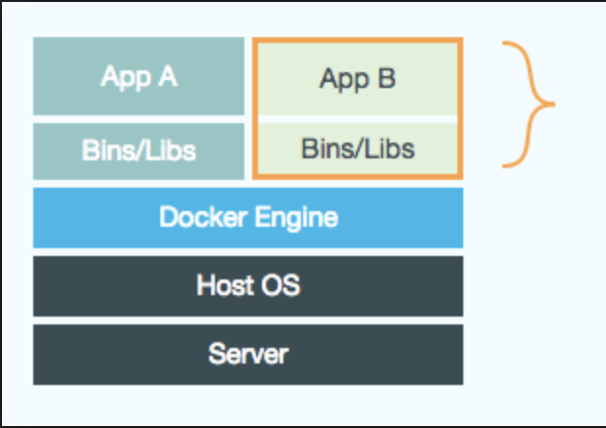
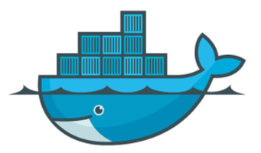
Docker
Software Containerization Platform – packages applications & dependencies together in the form of containers
Docker logo – “Moby Dock”
https://docs.docker.com/get-started/
Notes:
Moby Dock

Slide 5
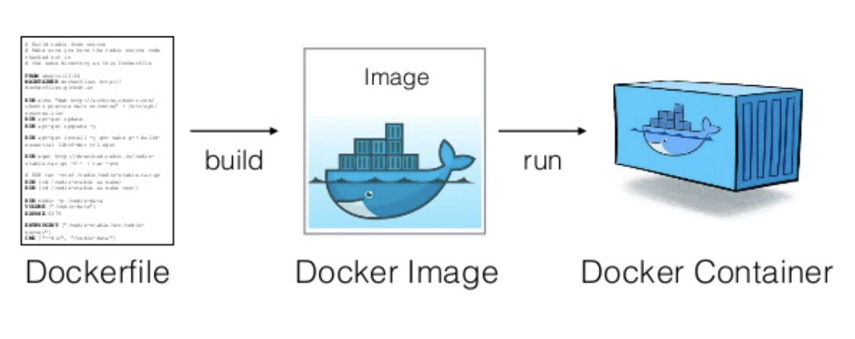
Images & Containers
Images – Read-only template with instructions (blueprint) for creating a Docker container
Built by Docker users , Stored in Docker Hub or Local Registry
Containers – Isolated Application Platform
Built from one or more images

Slide 6
Docker Registry
Docker Registry – Storage component of docker images
collection of different docker images with same name, that have different tags.
Tag is alphanumeric identifier of the image within a repository
public or private repository – e.g. Docker Hub, Google container Registry or you can host the docker registry by yourself
Docker Hub is a Docker Registry hosted by Docker.
For example see https://hub.docker.com/r/library/python/tags/ There are many different tags for the official python image, these tags are all members of the official python repository on the Docker Hub.

Slide 7
Install Docker
Install and run docker for Mac
https://docs.docker.com/docker-for-mac/install/
The installation provides Docker Engine, Docker CLI client, Docker Compose, Docker Machine, and Kitematic.
Install and run docker for windows
https://docs.docker.com/docker-for-windows/install/

Slide 8
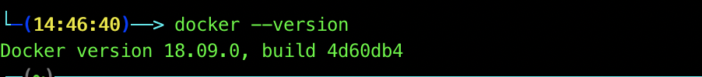
The whale in the top status bar indicates that Docker is running, and accessible from a terminal.
Click the whale (whale menu) to get Preferences and other options.
Select About Docker to verify that you have the latest version.
OR
Run docker --version and ensure that you have a supported version of Docker
Congratulations! You are up and running with Docker.

Slide 9
Some Useful Docker Commands
To pull a docker image from Docker hub:
$ docker pull <image-name:tag>
To run a image :
$ docker run <image-name:tag> or
$ docker run <image-id>
To list all the images in the system
$ docker images
To list all running containers
$ docker ps
To list all containers (including the ones not running )
$ docker ps –a
To stop a running container
$ docker stop <container-id>
To remove a stopped container
$ docker rm <container-id>
To remove a image
$ docker rmi <image-id>

Slide 10
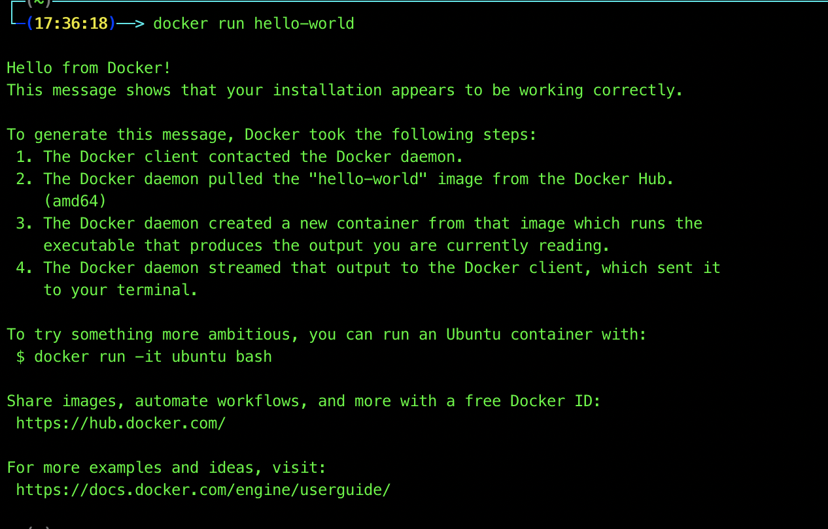
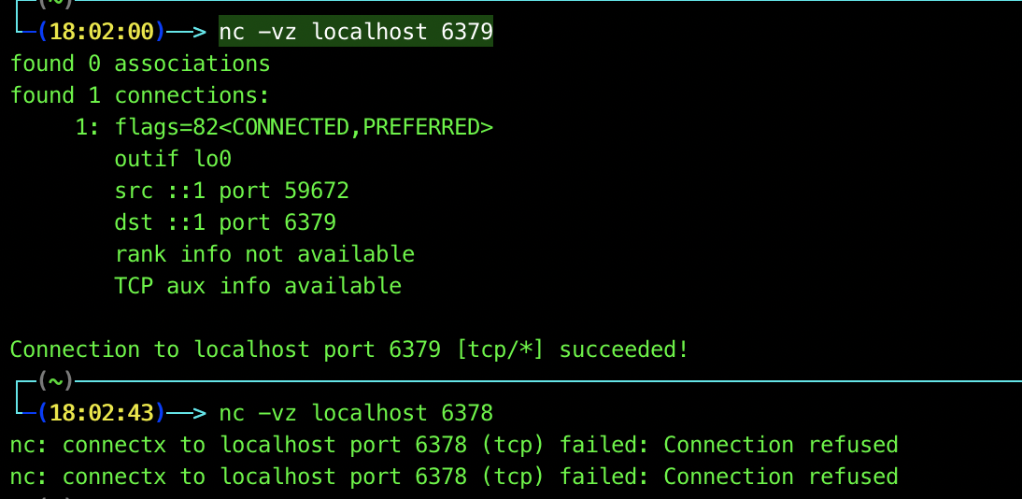
Docker image, hello world
hello-world
docker run hello-world
Access a container
docker run --name redis-server -d redis
Run commands inside a container
docker exec -it <container-name> bash
Docker expose port
docker run --name redis-server -d -p 6379:6379 redis
nc -vz localhost 6379

Slide 11
Docker compose
Compose is a tool for defining and running multi-container Docker applications
YAML file to configure your application’s services
Then, with a single command, you create and start all the services from your configuration
https://docs.docker.com/compose/

Slide 12
Redis & postgres
Redis is an open-source, networked, in-memory, key-value data store with optional durability.
https://docs.docker.com/samples/library/redis/
PostgreSQL is a powerful, open source object-relational database system that uses and extends the SQL language
https://docs.docker.com/samples/library/postgres/

