Slide 1



R tutorial
Alos Diallo

Slide 2
Why would you use R
Who has used R in the past?
It’s Free
It runs on all environments
It’s fully programmable
It’s designed to easily apply statistics to a dataset, and to easily generate plots
It can be used with other programming languages such as perl
It has a wide following
Notes:
If you have the same operation to perform multiple times you can create a script with R to do this!
R has packages developed specifically to analyze biological data
You can generally preform that task that you want with only a single line of code making it easy to pick up for the novice

Slide 3
Download and Install
Where do I get it?!
http://www.r-project.org/
http://lib.stat.cmu.edu/R/CRAN/
Which version should I install?!
The 64bit version if possible.

Slide 4
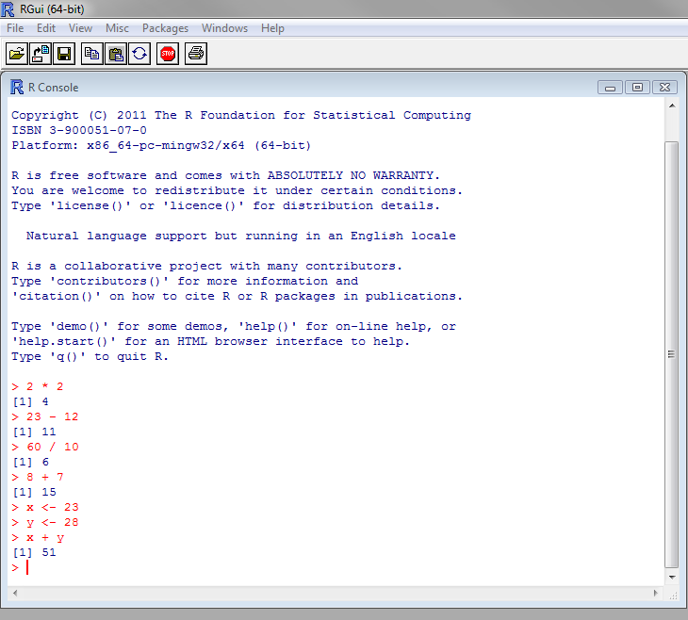
Interacting with R
You interact with R through the console, but you are not required to do so.
You can perform arithmetic operation just as you would with a calculator.
You can also assign values to a variable.
Give it a shot!
Notes:
Open the editor and lets try to use R

Slide 5
Getting to know the language
Expressions
Type anything at the prompt and R will evaluate it and print out the answer!
Lets try to use some simple math: 1 + 1
Lets try a string “Arr, matey!”(Don’t forget the quotes! Either single or double)
Lets try multiplication 6 * 9 (in R * is used for multiplication)
Logical Values
Some expressions return a logical value: TRUE of FALSE
3 < 4
2 + 2 == 5
T == TRUE
Variables
A variable is a sort of container for values
X <- 42
X = 42
X <- "Arr, matey!"
Now use the variable
Notes:
So we will go over a few things here expressions logical values(i.e. true false) and variables

Slide 6
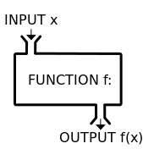
Getting to know the language: Functions
A function takes an input performs some operation on that input and returns a result.
R has built in functions, but you can also make your own.
For example try typing
sum(1,4,9)
rep(“happy”, times = 3)
If you’re not sure how to use a function type help(function name)
To see how you might use that function type example(function name)
Notes:
Most of the functions you will use in R, are built into the language.

Slide 7
Getting to know the language: Vectors
Vectors
A vector's values can be numbers, strings, logical values, or any other type, as long as they're all the same type. To make it place your list within c() which means combine ☺
c(1,3,4,6,8)
c(‘a’,’b’,’c’)
c(1,TRUE,”three”) What happened in this case? Try to access the values? What was different in this case from the first?
1:10
Sequences
You can create a sequence of numbers
N:M
For example try 5:9
Or using the sequence function seq(N,M)
seq(5,9)
You can change how the function is incremented as well for example seq(5,9,.5)
What if I want a particular element in my vector
Create a new vector sentence <- c('walk', 'the', 'plank’)
Type sentence[3]
Keep in mind that R does not start its indexes at 0!
You can change one of the values as well
sentence[3] <- “dog”
You can add to your vector
Sentence[4] <- “to”
You can use a vector within the square brackets to access multiple values.
For example sentence[c(1,3)]
Or sentence[2:4]
You can also set ranges of values; just provide the values in a vector.
sentence[5:7] <- c('the', 'poop', 'deck')
We can name the elements of a vector as well using the name function
ranks <- 1:3
names(ranks) <- c("first", "second", "third”)
Notes:
A vector is a collection of values
C stands for combine!

Slide 8
Getting to know the language: Vectors
Now see if you can set the value for the "third" rank to something other than 3 using the name rather than the position.
You can also use the names to access the vector's values. Try getting the value for the "first" rank:
Notes:
Solution to the first problem
> ranks
first second third
1 2 3
> ranks["third"] = 5
> ranks
first second third
1 2 5

Slide 9
Getting to know the language: Vectors
Solution to the first problem
> ranks
first second third
1 2 3
> ranks["third"] = 5
> ranks
first second third
1 2 5
Solution to the Second problem
> ranks["first"]
first
1

Slide 10
Getting to know the language: Vectors Barplot
The barplot function draws a bar chart with a vector's values. Lets make a new vector, and store it in the vesselsSunk variable.
vesselsSunk <- c(4, 5, 1)
barplot(vesselsSunk)
If you assign names to the vector's values, R will use those names as labels on the bar plot. Let's use the names assignment function again:
names(vesselsSunk) <- c("England", "France", "Norway")
barplot(vesselsSunk)
Notes:
Solution to the first problem
> ranks
first second third
1 2 3
> ranks["third"] = 5
> ranks
first second third
1 2 5

Slide 11
Getting to know the language: Vectors Math
Most arithmetic operations work just as well on vectors as they do on single values.
You can add a single value to a vector give it a shot!
a <- c(1,2,3)
a + 1
What happens when you divide or multiply the vector by some value?
a /2
a * 2
You can also add or subtract one vector from another
b <- c(4,5,6)
a + b
a - b

Slide 12
Getting to know the language: Vectors Plot exercises
The plot function takes two vectors, one for X values and one for Y values, and draws a graph of them
Let's draw a graph showing the relationship of numbers and their sine's
x <- seq(1, 20, 0.1)
y <- sin(x)
Now plot x and y using the plot function
Lets try another one
values <- -10:10
absolutes <- abs(values)
Now try running plot on the new data

Slide 13
Getting to know the language: Vectors NA Values
If you’re like me you will run into this issue all the time!
You try to carry out some function on your data and get [1] NA back! Now what do I do?!
Lets take a look with an example
a <- c(1, 3, NA, 7, 9)
sum(a)
[1] NA
Now try using the help function with sum
Try calling sum again, with na.rm set to TRUE:
sum(a,na.rm = TRUE)

Slide 14
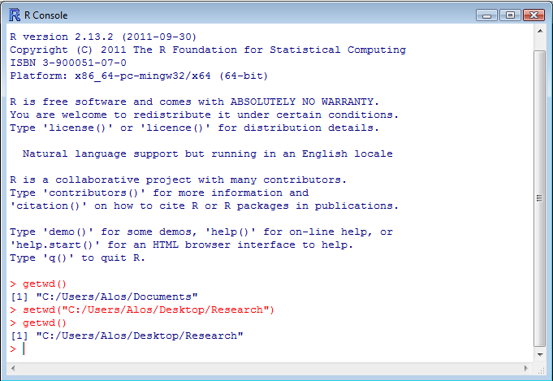
Finding and setting where you want R to look for your data
Find out where you are:
> getwd()
[1] "C:/Users/Alos/Desktop/R_data"
Telling R where you want it to look:
setwd("<new path>")
This will allow R to know where you data is.
Keep in mind that the \ is the other way!

Slide 15
Things to Keep in Mind
R can’t find my variable!
M does not = m, R is case sensitive
I don’t have that package!
Look here: http://cran.r-project.org/
You could also try:
install.packages("mypkg", dependencies = TRUE)
Or
R CMD INSTALL package-name.tar.gz
How do I use package a and what does it do?
Type ?package_name
Also remember you can type help(package_name)
R can’t find my data!
try to set your working directory by setwd()

Slide 16
Loading in your data
There are several ways to read in your data
Read.table: use when importing a table
Test_input <- read.table("d:/test.txt", header=T, sep="\t")
Scan: will convert your data to a string
x <- scan("d:/scan.txt")
You can tell R how your data is formatted as well for example
col.names: if you want to give your columns names
Sep: if you want to tell R how your data is separated

Slide 17
Helpful Information

Slide 18
Some basic functions in R
Mean
mean(dataset)
Median
median(dataset)
Standard Deviation
sd(dataset)
What is the smallest value in my dataset?
What is the largest value in my dataset?
Creating a list
Dataset = c(1,2,3,4,5)
Sort my data
sort(dataset)
How long is my dataset?
length(dataset)
What is the sum of my data?
sum(dataset)
How can I calculate variance?
var(dataset)
I have a large dataset how can I edit it?
fix(dataset)
How do I find out some info on my data?
summary(dataset)
How do I calculate pearson or spearman on my datasets?
cor(var1, var2, method = "spearman")
cor(var1, var2, method = "pearson")
How do I make a matrix?
M <- matrix( 1:6, nrow=2 )
M <- matrix( 1:6, ncol=3 )
How do I multiply 2 matrixes
a %*% b

Slide 19
Plotting in R
There are many options available to you with plot
The simplest is to just say:
plot(dataset)
What do you do if you have more then one line to plot?
Use lines
Lets look at a test example:
Create new vectors a and b
plot(c(2,10),c(1,15), xlab="test of x",ylab="Test of y")
lines(a,b, col="blue")
Why don’t we break it down.
c(2,10),c(1,15) :this provided the scale for our graph
Xlab, and ylab: These allow us to label the x and y axis
Lines : This allows us to add our data to the graph, you can add as many as you like
col: this allows us to change the color of our graph.
a,b : These are the variables being plotted.
You can also plot the points in place of the line by using points
points(x2, col="green") We would use a and b here
How do I add a trend line?
Lets say you have two sets x and y
First fit a line to the points:
myline.fit <- lm(y ~ x) in our case it is a and b!
Then draw the line using abline
abline(myline.fit)

Slide 20
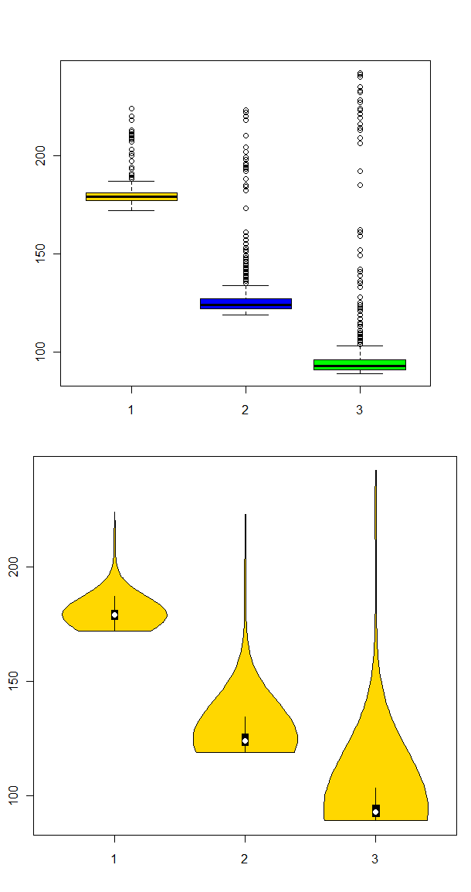
Box Plot
Just like with the normal plot
boxplot(a,b,c,col=(c("gold","blue","green")))
a,b,c are my datasets
col is used to set colors to the box plots
Violin plots are made in the same way but uses vioplot

Slide 21
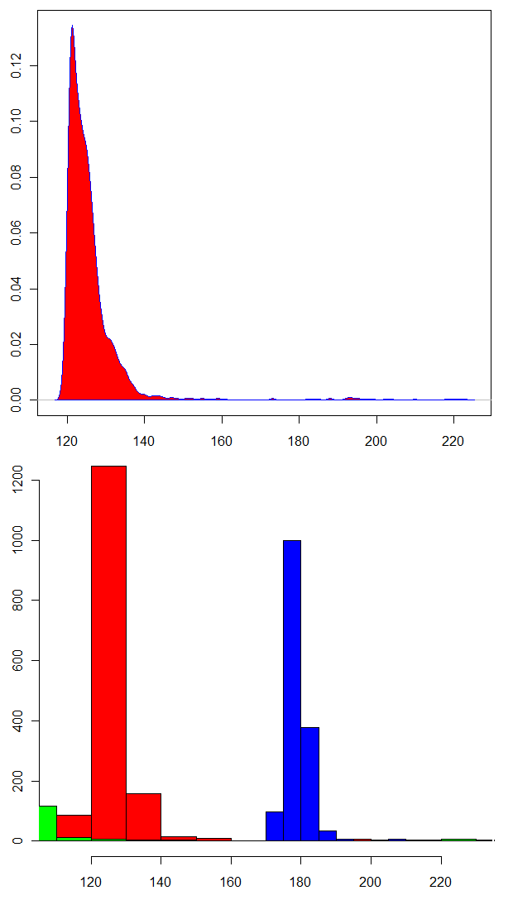
Histograms and Density plots
Density plots:
d <- density(dataset)
plot(dataset)
Filling the plot
polygon(d, col="red", border="blue")
Histograms:
Ex: hist(dataset,col="blue")
dataset: is the dataset used
Col: is how you change the color
Use add=TRUE to add more to the plot

Slide 22
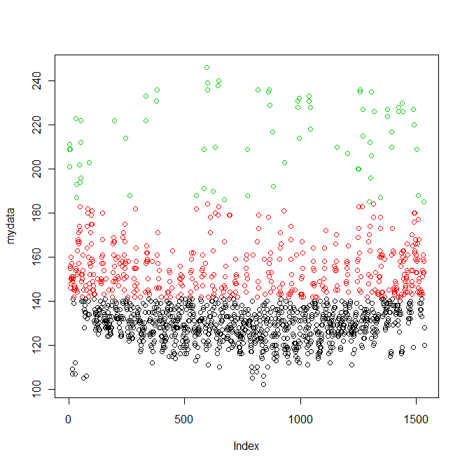
K-means
Clustering
Load the file:
mydata <- scan("1h6.txt")
Use Kmeans:
mydataK <- kmeans(mydata,3)
View Results:
mydataK
summary(mydataK)
Plot the results:
plot(mydata, col = mydataK$cluster)
You can also cluster data as a matrix as well

Slide 23
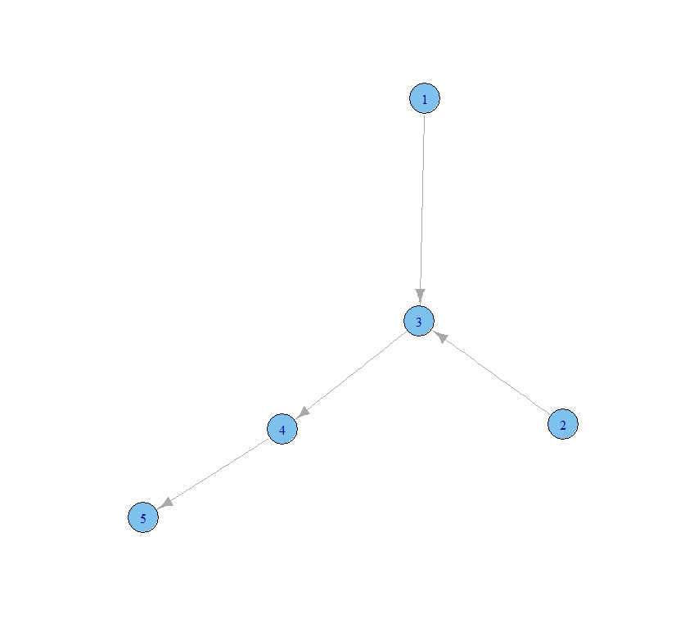
Network Visualization
Igrpah is a great package for this
Here is an example:
library(igraph) g <- graph( c(1,3,2,3,3,4,4,5) )
Then type Plot(g)

Slide 24
Output of your results
How do you output your result?
Write the result to a file:
Use write.table
write.table(result, file=“result.txt",sep = " \t",col.names = F, row.names = F)
Write the result to an excel file:
Use WriteXLS
library(WriteXLS)
http://cran.r-project.org/web/packages/WriteXLS/index.html)
Write the result to a csv file:
Use write.csv
Here is an example: write.csv(B,"R.csv")

Slide 25
Places to look
http://www.gardenersown.co.uk/Education/Lectures/R/index.htm#introduction
http://cran.r-project.org/doc/manuals/R-intro.html#Top
http://www.ats.ucla.edu/stat/R/
http://cran.r-project.org/

Slide 26
The End of Lecture 1

