Slide 1


R The Tutorial Class 2 Loops and Factors
Alos Diallo

Slide 2
Loops
Often you will want to carry out the same operation on all of the elements of your matrix. This is where loops really come in handy!
What is a loop?
You can think of it like an assembly line where you’re carrying out the same task over and over.
Notes:
Ask the group!

Slide 3
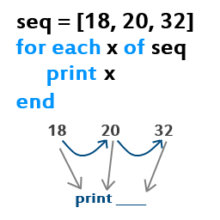
Loops
Since we have our treasure how can we use loops with it?!
In this example we will use for loops
Here is the general form
for (counter in vector) {commands}

Slide 4
Loops tutorial
Spending some time on our pirate ship our current captain Dread Pirate Roberts would like an easy way to look through all of the gold that we have plundered this year. Here's a vector with the values of our latest hauls:
pounds <- c(45000, 50000, 35000, 40000, 35000, 45000, 10000, 15000)
Notes:
Create a pounds vector

Slide 5
Loops tutorial
Now that we have our vector here is how we would use a loop to print each value out on the screen!
for(i in 1:length(pounds)){
print(pounds[i])
}
Create the following for loop ☺

Slide 6

Loops
Now that we are experts at creating for loops lets take a look back at our plate data ☺

Slide 7
Loops
In the last class we looked at using Standard Deviation(SD) and Standard Error, today we’re going to take a look at calculating z-scores.
Often you want to have some measure for determining if an event is rare or not, the z-score is a great measure for this because it tells you how many SD’s from the mean you are!

Slide 8
Loops
To convert our data to what are essentially distances we will need some help!
First we will need some data to play with!
Import your plate data using read.table()
Make sure that you say that the data is tab separated!
Make sure that you convert your data to a matrix
data <- as.matrix(data)
Calculate the mean() and sd() for the data
Notes:
Don't forget that the data is tab separated.

Slide 9
Results
image_data <- read.table("image_data.txt", sep="\t")
Image_data <- as.matrix(image_data)
mean_data <- mean(image_data)
sd_data <- sd(image_data)
Notes:
Bring up white board and go over 2 dimensional loops on the white board.

Slide 10
Loops
We will now want to create a blank matrix to hold our z-scores!
Create a blank matrix called z_score
Remember that the image data is a 32 by 48 matrix!

Slide 11
Results
z_score = matrix(0,32,48)

Slide 12

Loops
In the first example we were able to get by with 1 for loop well it’s time to KICK IT UP A NOTCH!!!
We will need 2 in our case one for the rows and one for the columns
And if we are going to calculate z-scores we will need the formula for that:
(Value – mean) / standard deviation
With that and the magic of the matrix I would like you to populate your z_score matrix with z scores ☺
You Can Do IT!

Slide 13
Results
for(i in 1:32){
for(j in 1:48){
z_score[i,j] <- (image_data[i,j] - mean_data)/sd_data
}
}

Slide 14
Factors
Often your data needs to be grouped by category: blood pressure by age range, accidents by auto manufacturer, and so forth. R has a special collection type called a factor to track these categorized values.
Notes:
Unlike naming vectors factors can take on numeric properties

Slide 15
Creating Factors
It's time to take inventory of the ship's hold. We'll make a vector with the type of booty in each chest.
To categorize the values, simply pass the vector to the factor function:
chests <- c('gold', 'silver', 'gems', 'gold', 'gems')
types <- factor(chests)
Notes:
First lets create a vector called chests
Then store the vector conversion in types

Slide 16
Creating Factors
There are a couple differences between the original vector and the new factor that are worth noting. Print the chests vector:
print(chests)
[1] "gold" "silver" "gems" "gold" "gems"
You see the raw list of strings, repeated values and all. Now print the types factor:

Slide 17
Creating Factors
print(types)
[1] gold silver gems gold gems
Levels: gems gold silver
Printed at the bottom, you'll see the factor's "levels" - groups of unique values. Notice also that there are no quotes around the values. That's because they're not strings; they're actually integer references to one of the factor's levels.

Slide 18
Creating Factors
Let's take a look at the underlying integers. Pass the factor to the as.integer function:
as.integer(types)
[1] 2 3 1 2 1
Notes:
What is going on here? Why do we see those numbers?

Slide 19
Creating Factors
You can get only the factor levels with the levels function:
levels(types)
[1] "gems" "gold" "silver”

Slide 20
Plotting Factors
You can use a factor to separate plots into categories. Let's graph our five chests by weight and value, and show their type as well. Lets create two vectors; weights will contain the weight of each chest, and prices will track how much the chests are worth.
Now, try calling plot to graph the chests by weight and value.
weights <- c(300, 200, 100, 250, 150)
prices <- c(9000, 5000, 12000, 7500, 18000)
plot(weights, prices)
Notes:
Please create two vectors weights and prices

Slide 21
Plotting Factors

Slide 22
Plotting Factors
We can't tell which chest is which, though. Fortunately, we can use different plot characters for each type by converting the factor to integers, and passing it to the pch argument of plot.
plot(weights, prices, pch=as.integer(types))
Notes:
What is in types?
What is pch?
!!! We had already created the types factor

Slide 23
Plotting Factors
Notes:
Neat hah!
So what is going on here?
Where do the symbols come from?

Slide 24
Plotting Factors
"Circle", "Triangle", and "Plus Sign" still aren't great descriptions for treasure, though. Let's add a legend to show what the symbols mean.
The legend function takes a location to draw in, a vector with label names, and a vector with numeric plot character IDs.
> legend("topright", c("gems", "gold", "silver"), pch=1:3)

Slide 25
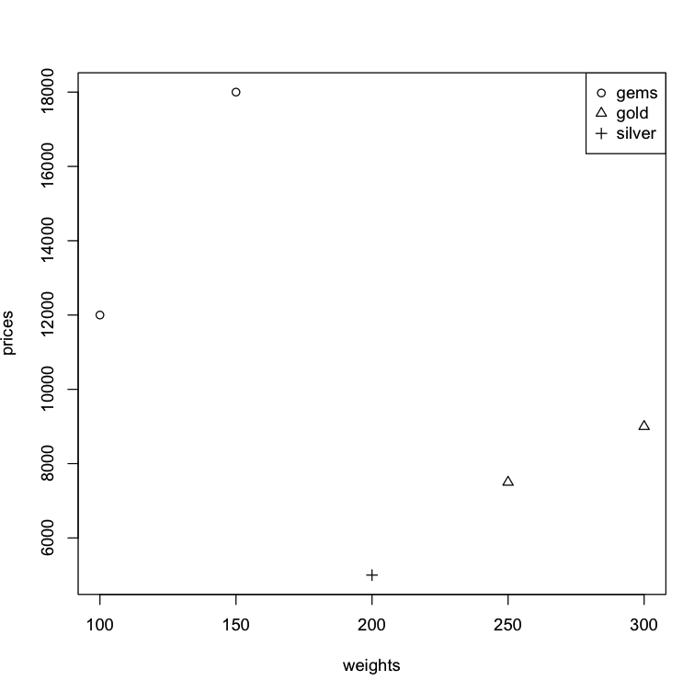
Plotting Factors

Slide 26
End of Lecture 2

