Slide 1
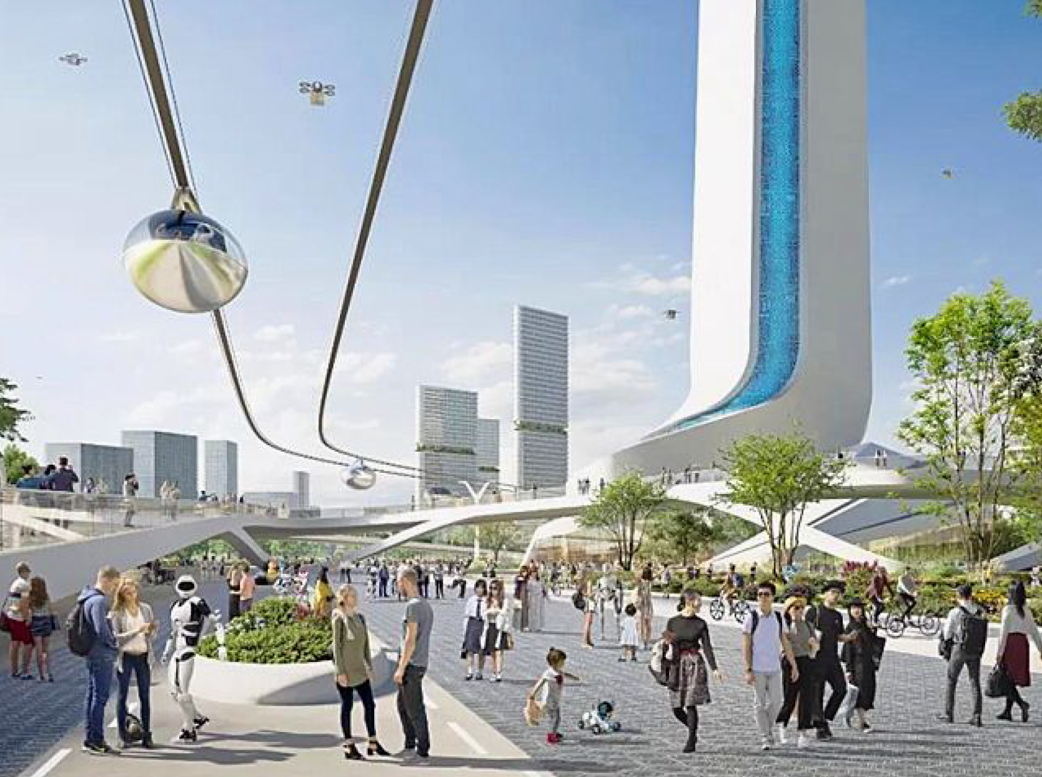
IOT Device
(Vehicle)
Smart City
IOT Device
(Vehicle)
IOT Device
(Robot)
People

