Slide 1
MARKET BASKET ANALYSIS

Slide 2
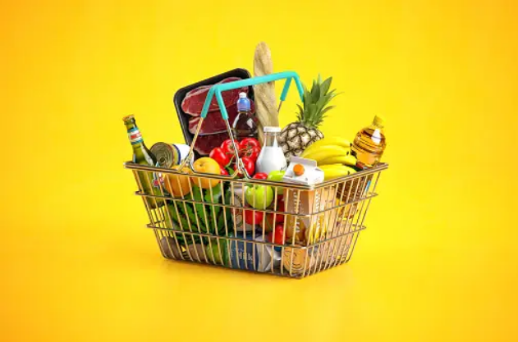
Prepared By : Loice Nguku
Date : 26/11/2023

Slide 3
PROJECT OVERVIEW
Market Basket is a technique used in retail to uncover associations between products.
Its purpose it to provide recommendation on product placement optimization and personalized marketing.
It can also identify products that can be placed side by side considering customer purchasing behavior.

Slide 4
OBJECTIVE OF THE PROJECT
The main objective of this project is to uncover customer behavior in the products that they purchase together.
This information can be used to provide patterns in customer purchasing behavior and improve on customer satisfaction.

Slide 5
DATASET OVERVIEW
The data contains 38765 rows and 3 columns namely member number,date and itemdescription.
The maximum member number is 5000 and the minimum 1000.
The most frequent item is whole milk with 2502 entries and the least is preservation products with 1 entry.

Slide 6
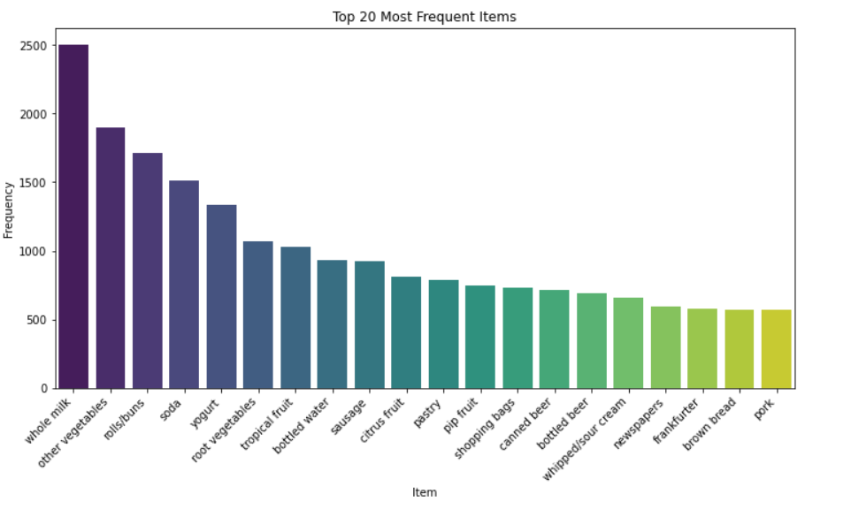
EDA

Slide 7
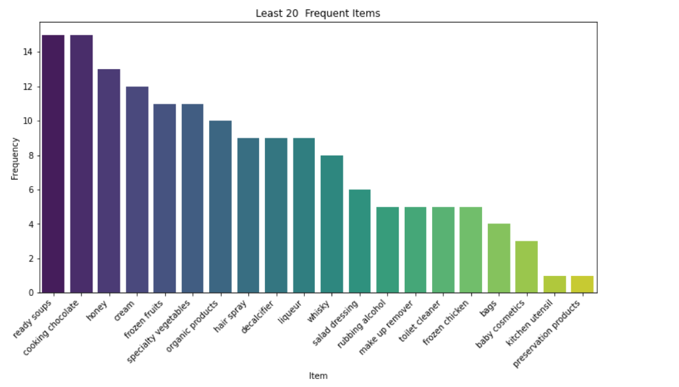
EDA

Slide 8
ASSOCIATON RULE
Association rule mining is popular in market basket analysis where it is used to uncover associations between products frequently purchased together.
An antecedent is the condition of whether a certain item is in he dataset and it leads to the consequent.
Result or item likely to occur if the antecedent is true.
The strength of an association rule is measured by several metrics such as the support,confidence,lift,leverage and conviction.

Slide 9
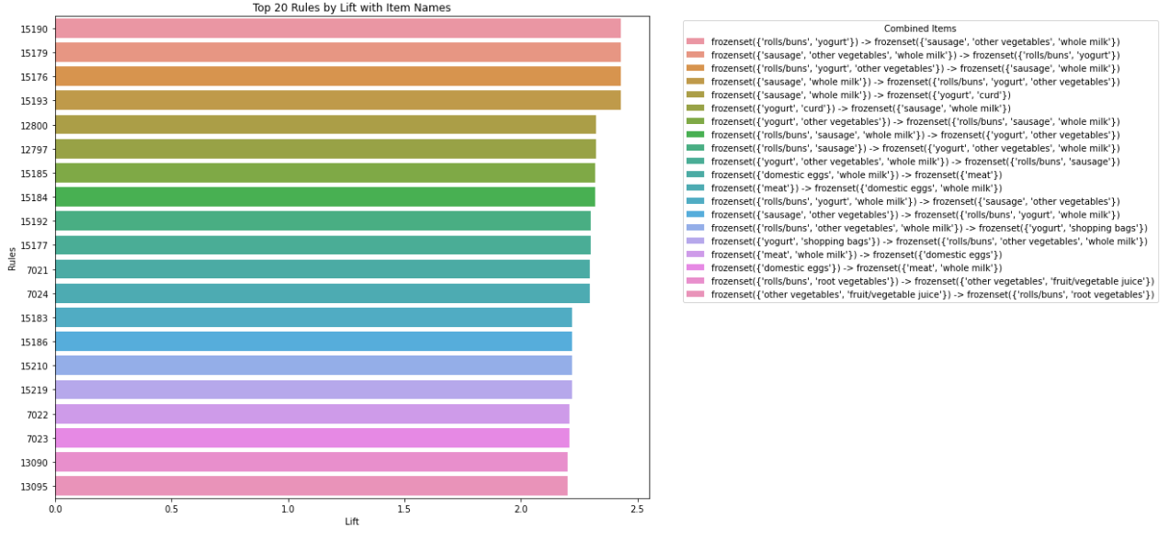
TOP 20 ASSOCIATION RULES

Slide 10
BI-DIRECTIONAL ASSOCIATIONS
Some items were discovered to have been bought together in both ways eg uht milk is bought together with cream cheese and also cream cheese is bought together with uht milk.
I did away with the duplicates to get a unique set of 167 items and their association rules.

Slide 11
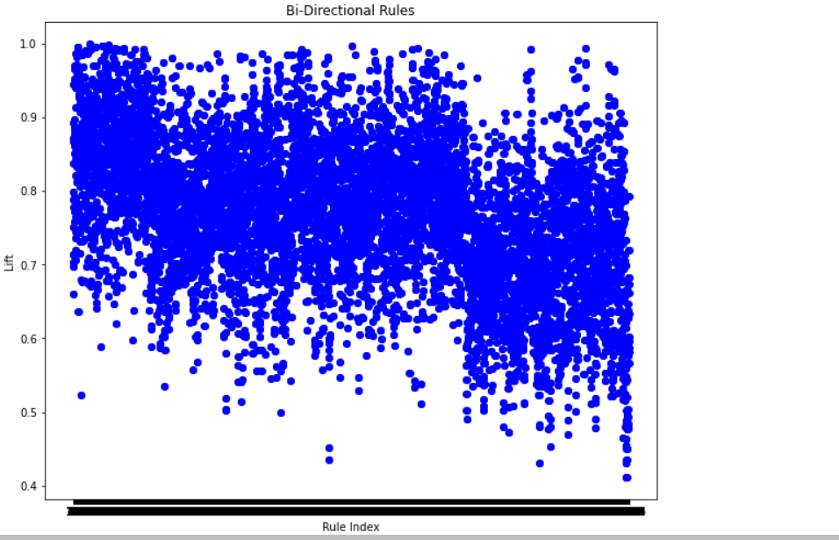

Slide 12
RECOMENDATIONS
According to the different lifts of the different items bought together,most drinks should be placed side by side as the top lifts were of dri ks bought together .Some of this include uht and bottled beer with a lift of 0.837804 which is the second highest and bottled water to uht milk with a lift of 0.787855.

Slide 13
CHALLENGES
Parameter Tuning:Choosing the support and confidence threshold.
Interpretability:Interpreting the generated rules especially when they are many is quite tedious.

Slide 14
CONCLUSION
The top 20 association rules suggest that most liquid items are bought together followed by liquid items and some snack that can be taken with it ie rolls/burns and yorghut appear a couple of times in the top 20 associations.
After careful study I would suggest that items that fall under the same category such as drinks should be placed side by side and right after that the items that can be drank with them ie rolls/buns.

