Slide 1
Data Science Final Project
Stock Price Prediction Based on the Amount of Five Ticks

Slide 2
Motivation
Taiwan Stock Exchange Corporation (TWSE) provides amount of five ticks (五檔) in bids and asks:
Other stock market didn’t reveal the amount of ticks in public, so five ticks in TWSE is a valuable information for the investors
The amount of five ticks represent the immediate status of traders
What’s the best price if you are going to buy the stock today?
Predict the stock price in the near future.
The bias will reduce if the prediction is done within short time
Notes:
http://www.twse.com.tw/zh/
台灣證交所

Slide 3
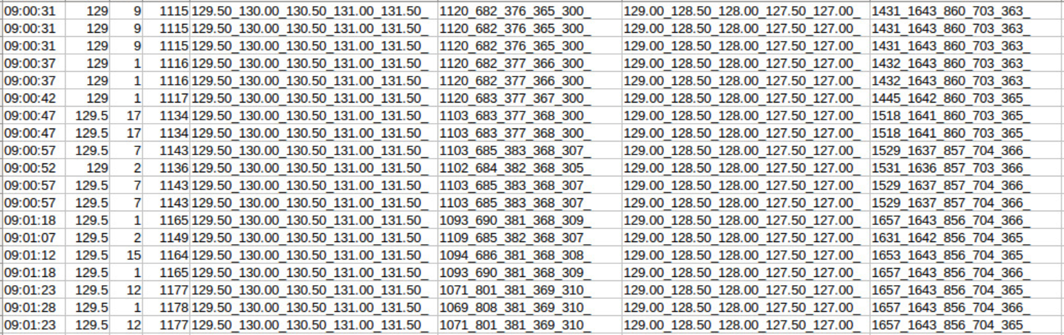
Data Format
時間 | 成交價 | 成交量 | 累計 | 最佳五檔（賣價） | 最佳五檔（賣量） | 最佳五檔（買價） | 最佳五檔（買量）

Slide 4
Approach
Preprocess
Eliminate repeat data, and padding loss data
Extract needed columns
Make the contents of each column consistent
Normalization on price value
Input = [價差, five_ticks_vector(bid), five_ticks_vector(ask)], len(input)=17
Models
Logistic Regression
CRNN
LTSM

Slide 5
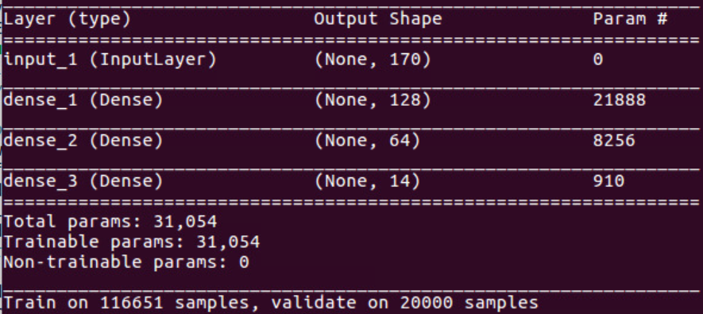
Logistic regression

Slide 6
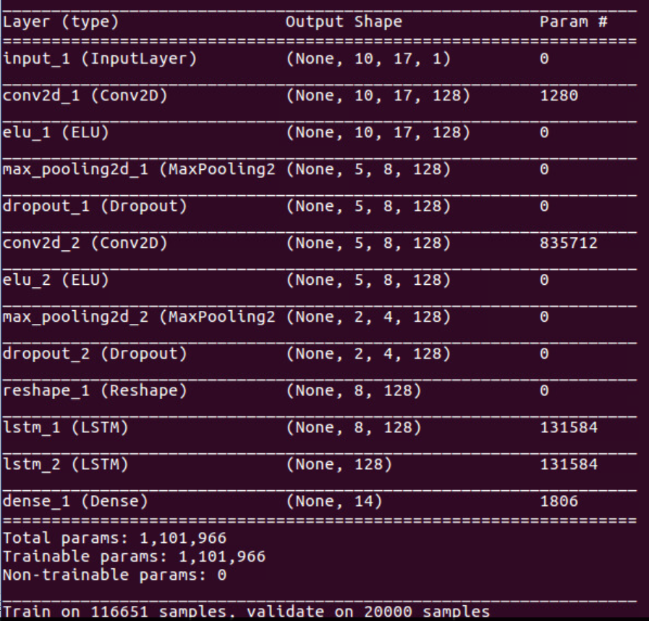
CRNN

Slide 7
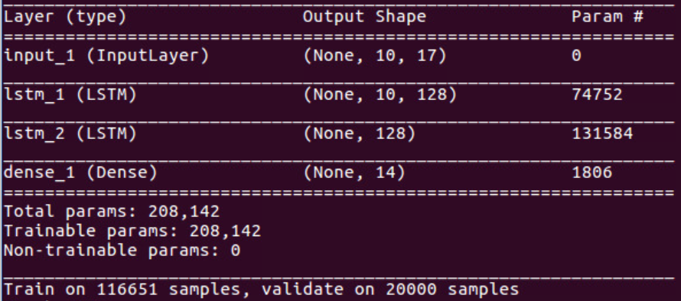
LSTM

Slide 8
Result (predict 2330)
Approach: Logistic regression, CRNN, LTSM
Evaluation metrics: Accuracy
 | Logistic regression | CRNN | LTSM
Accuracy | 0.6111 | 0.6715 | 0.6723

Slide 9
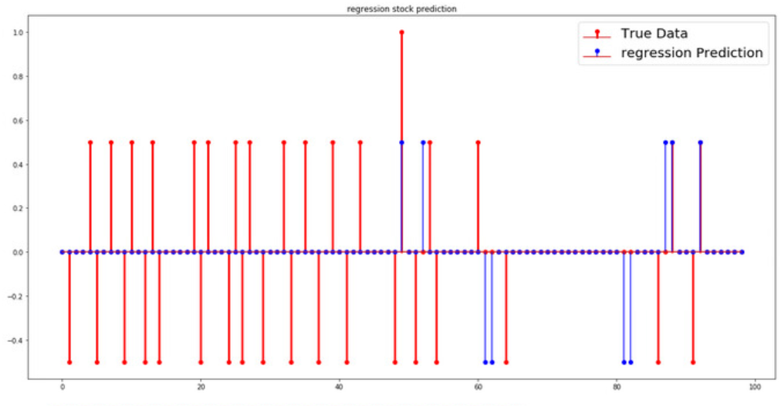
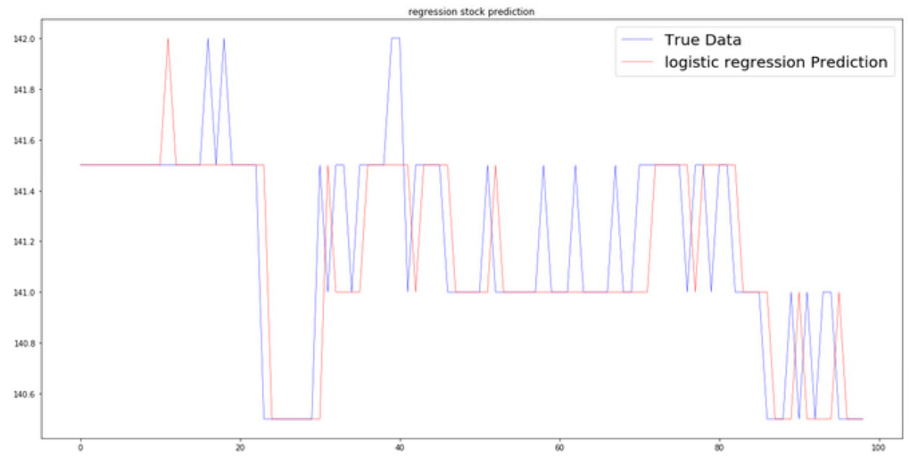
Result-2330 (Regression)

Slide 10
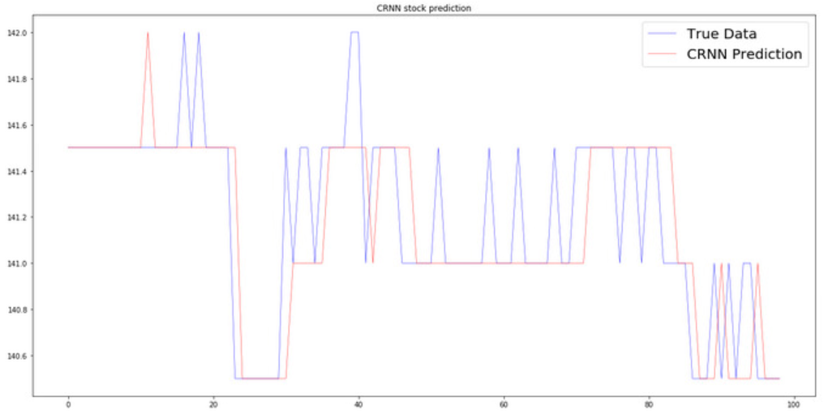
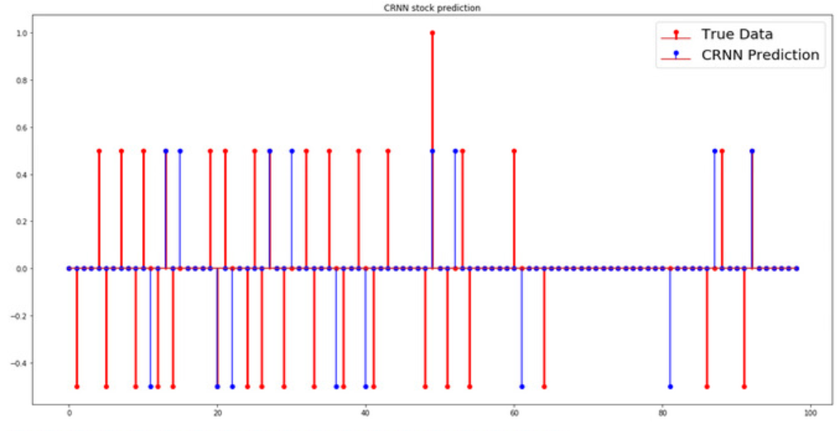
Result-2330 (CRNN)

Slide 11
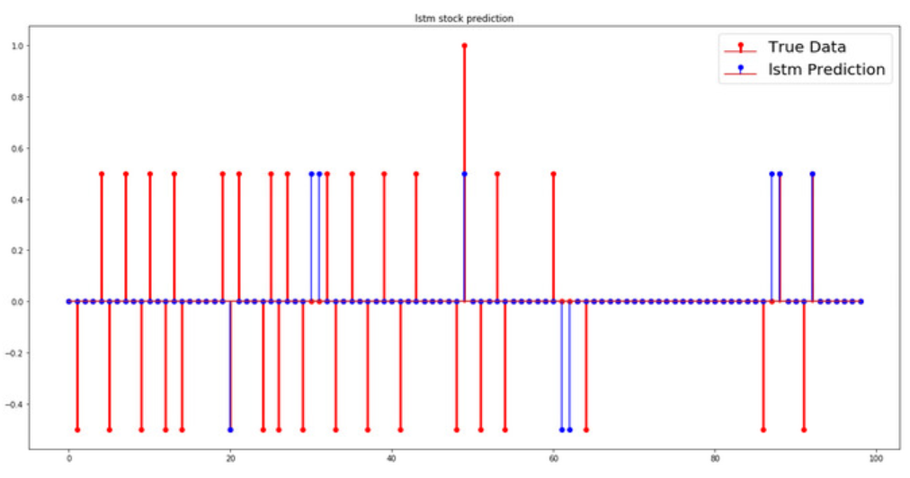
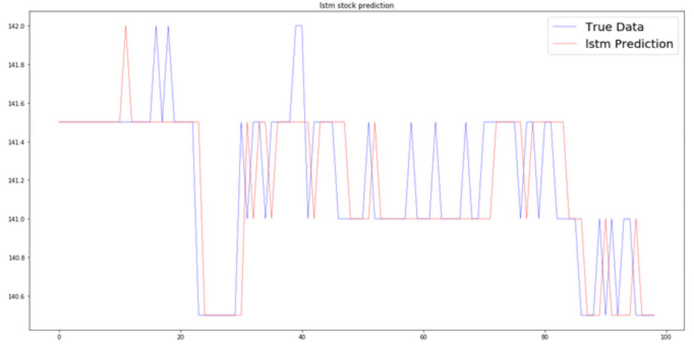
Result-2330 (LSTM)

Slide 12
To-do
Add other kinds of data (ex. 分點資訊, 外資, 主力進出) into input.
Threshold the price change if it acts like perturbation
Try to analysis more stock of different corporation

