Slide 2
Clean & Preprocess data
Ways to

Slide 3
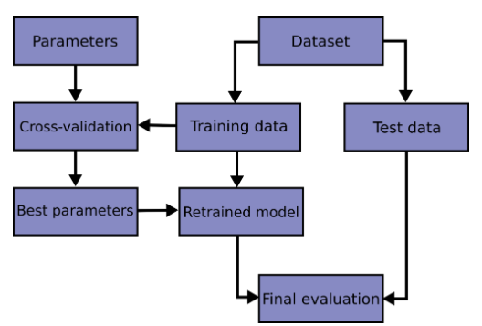
Training / Testing
Split the dataset in 2 parts (training 80% and testing 20%)
Train model on the training set + fine tune hyper parameters of the model through cross validation
Evaluation of the trained model on the testing set
Fine tuning hyperparameters

Slide 4


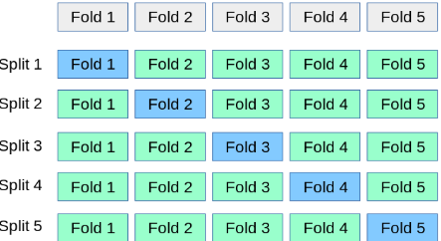
Training/Testing
How can we set the hyperparameters ? :
→ based on performances on test set
→ Using cross validation on train set with validation dataset

Slide 5
Training/Testing
Goal of ML : Get a model that learns well from the training set and which generalizes well
Faces 2 problems:
→ Overfitting (high variance, complex model)
→ Underfitting (high bias, simple model)
We want a model with low variance and low bias (trade off bias – variance)

Slide 6
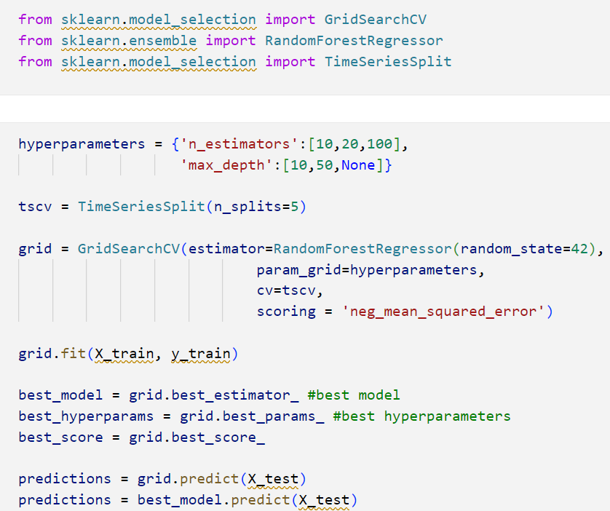
Code with Random
We have done the work of preprocessing data
1- We define the hyperparameters we want to test
2- Initialize the split we want to do
3- We use Grid Search CV to find the best hyperparamters by cross validation
4 – Get the best model and make predictions

