Slide 1

Version Control using GIT
Loide Jesus (INdT)
April, 2014

Slide 2
Summary
Conditions
Introduction
Git Basics
Git Branching
Git Rebase
References

Slide 3
Introduction
What is and Why should you care about it?
Version Control is a system that records changes to a file or set of files over time so that you can recall specific versions later
  Keep every version of your development project
  Allows to revert files (or the entire project) back to a previous state
  Compare changes over time
  See when and who introduced a issue
  Recovery easily lost or damaged files
What do you do when you want to recover past versions of a file?

Slide 4
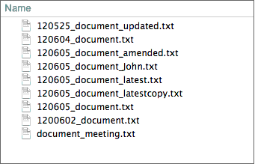
Introduction
Local Version Control
The most common way to do it is to save multiple files with different dates and file names.
This approach is very common because it is so simple, but it is also incredibly error prone. It is easy to forget which directory you’re in and accidentally write to the wrong file or copy over files you don’t mean to.

Slide 5

Introduction
Centralized Version Control Systems
There are a single server that contains all the versioned files, and a number of clients that check out files from that central place.
For many years, this has been the standard for version control.
  Such as CVS, Subversion or Perforce

Slide 6

Introduction
Distributed Version Control Systems
Clients don’t just check out the latest snapshot of the files: they fully mirror the repository.
  Such as Git, Mercurial, Bazaar or Darcs
If any server dies, and these systems were collaborating via it, any of the client repositories can be copied back up to the server to restore it
Allows you to collaborate with different groups of people in different ways simultaneously within the same project.

Slide 7

Introduction
A short history of Git
A reaction to licensing changes to BitKeeper.
Git was initially designed and developed by Linus Torvalds for Linux kernel development in 2005.
Linux development community developed their own tool based on some of the lessons they learned while using BitKeeper:
  Speed
  Simple design
  Strong support for non-linear development (thousand of parallel branches)
  Fully distributed
  Ability to handle large projects like the Linux kernel efficiently (speed and data size)

Slide 8
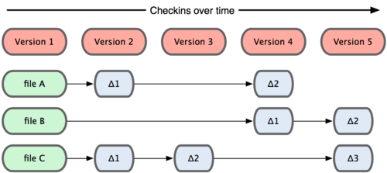
Introduction
Snapshots, not differences
The major difference between Git and any other VCS is the way Git thinks about its data. Conceptually, most other systems store information as a list of file-based changes.
  Keep a set of files and the changes made to each file over time.
Other systems tend to store data as changes to a base version of each file.

Slide 9

Introduction
Snapshots, not differences
Git thinks of its data more like a set of snapshots of a mini filesystem. Every time you commit, or save the state of your project in Git, it basically takes a picture of what all your files look like at that moment and stores a reference to that snapshot.
Git stores data as snapshots of the project over time

Slide 10

Introduction
Main thing to remember about Git
Three main states that your files can reside in:
  commited: data is safety stored in your local database
  modified: the file was changed but have not commited it to your database yet
  staged: the modified file in its current version was marked to go into your next commit snapshot

Slide 11

Git Basics
Getting a Git repository
There are two ways to create a local repository on your local machine:
  Create a brand new repository from scratch
  $ git init
  Cloning an existing remote repository onto your local machine.
  $ git clone <url>

Slide 12
Git Basics
Getting a Git repository
There are two ways to create a local repository on your local machine:
  Create a brand new repository from scratch
  $ git init
  Cloning an existing remote repository onto your local machine.
  $ git clone gitosis@spearhead.indt.org:/git-course.git
  $ git clone gitosis@10.60.100.158:/git-course.git

Slide 13
Git Basics
Introduce yourself
Define everything from user info to preferences to the behavior of a repository
  $ git config --global user.name <name>
  $ git config --global user.email <email>

Slide 14

Git Basics
Recording changes to the repository

Slide 15
Git Basics
Checking the status of your file
Determine which files are in which state
  $ git status

Slide 16
Git Basics
Checking the status of your file
Determine which files are in which state
  $ git status
  On branch master
  Your branch is up-to-date with 'origin/master'.
  nothing to commit (working directory clean)

Slide 17
Git Basics
Checking the status of your file
Change a file that was already tracked then run your status command again.
  $ git status
  On branch master
  Your branch is up-to-date with 'origin/master'.
  Changes not staged for commit:
  (use “git add <file>...“ to include in what will be committed)
  (use “git checkout -- <file>...” to discard changes in working directory)
  modified: README
  no changes added to commit (use “git add” and/or git commit -a)

Slide 18
Git Basics
Staging modified files
  $ git add README
  $ git status
  On branch master
  Your branch is up-to-date with 'origin/master'.
  Changes to be commited:
  (use “git reset HEAD <file>..” to unstage)
  modified: README

Slide 19
Git Basics
Commiting your changes
  $ git commit -m “Updating README”
  [master 463dc4f] Updating README
  1 file changed, 2 insertions(+)
  $ git log

Slide 20
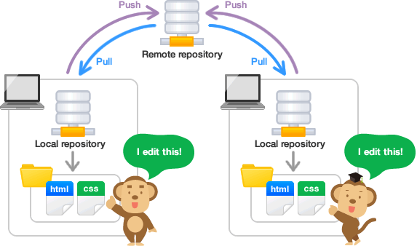
Git Basics
from your remotes
Pulling and pushing
Pulls down all the data from that remote project that you don't have yet: $ git pull [remote-name]
$ git pull --rebase [remote]
When you want to share your project, you have to push it upstream:
$ git push [remote-name] [branch-name]
$ git push origin master

Slide 21
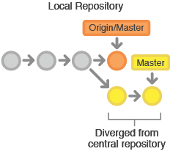
Git Basics
Managing conflicts
The remote repository represents the official project, so its commit history should be treated as immutable.
If a developer’s local commits diverge from the central repository, Git will refuse to push their changes because this would overwrite official commits.

Slide 22
Git Basics
Managing conflits
$ git pull origin master
remote: Counting objects: 5, done.
remote: Compressing objects: 100% (2/2), done.
remote: Total 3 (delta 0), reused 0 (delta 0)
Unpacking objects: 100% (3/3), done.
From http://github.com/git/loide/teste.git
*branch master -> FETCH_HEAD
Auto-merging README.txt
CONFLICT (content): Merge conflict in README.txt
Automatic merge failed; fix conflicts and then commit the result

Slide 23
Git Basics
Managing conflicts
When you open the modified file, you can see markers that have been added by Git to indicate conflicts in that section of the file.
  Upstream puppet modules (unmodified)
  Puppet modules for central platform
  To add a new module, use the add_module.sh script.
  <<<<<<<<<<< HEAD
  A puppet module for managing elasticsearch nodes
  =========
  Scripts to initialize webservices
  >>>>>>>>>>>> 17c860612953c0f9d88f313c8dfbf7d858e02e91

Slide 24
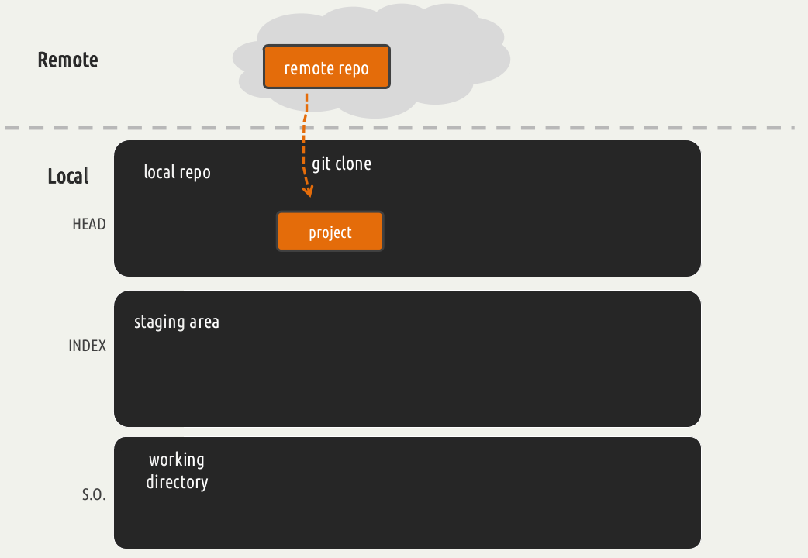
Git Basics
The Three States

Slide 25
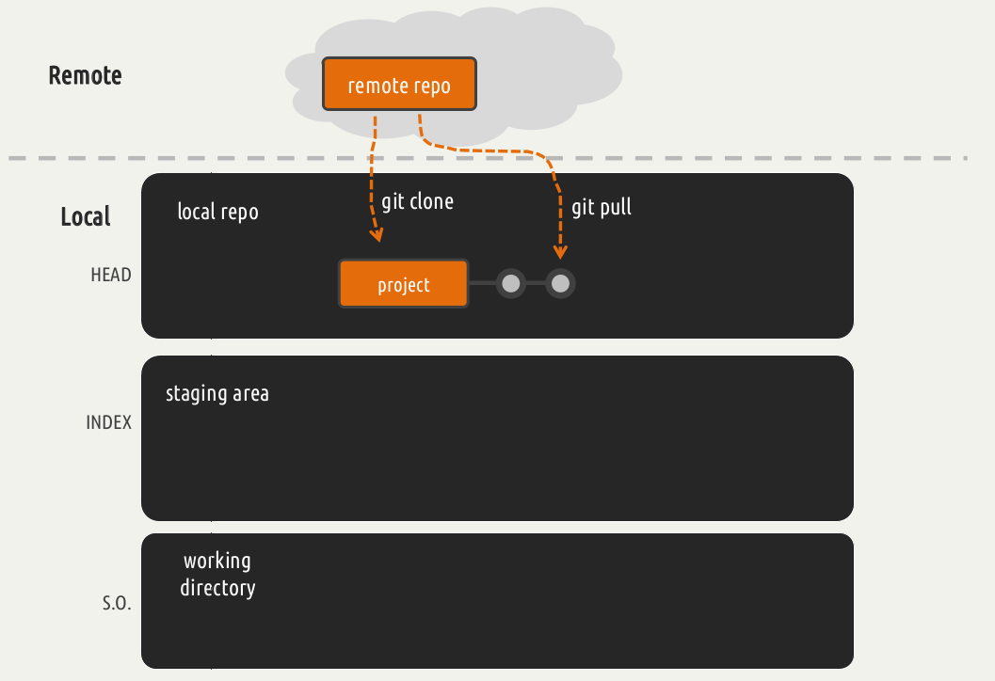
Git Basics
The Three States

Slide 26
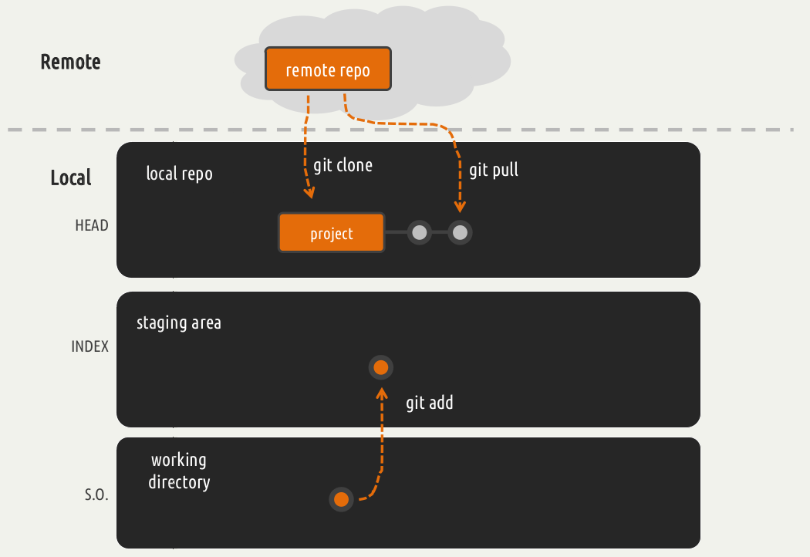
Git Basics
The Three States

Slide 27
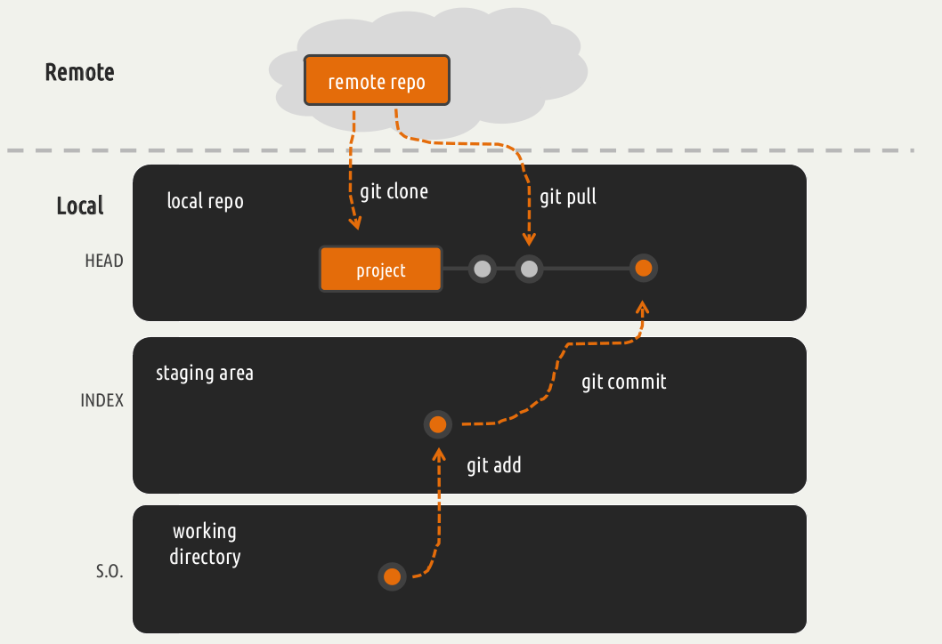
Git Basics
The Three States

Slide 28
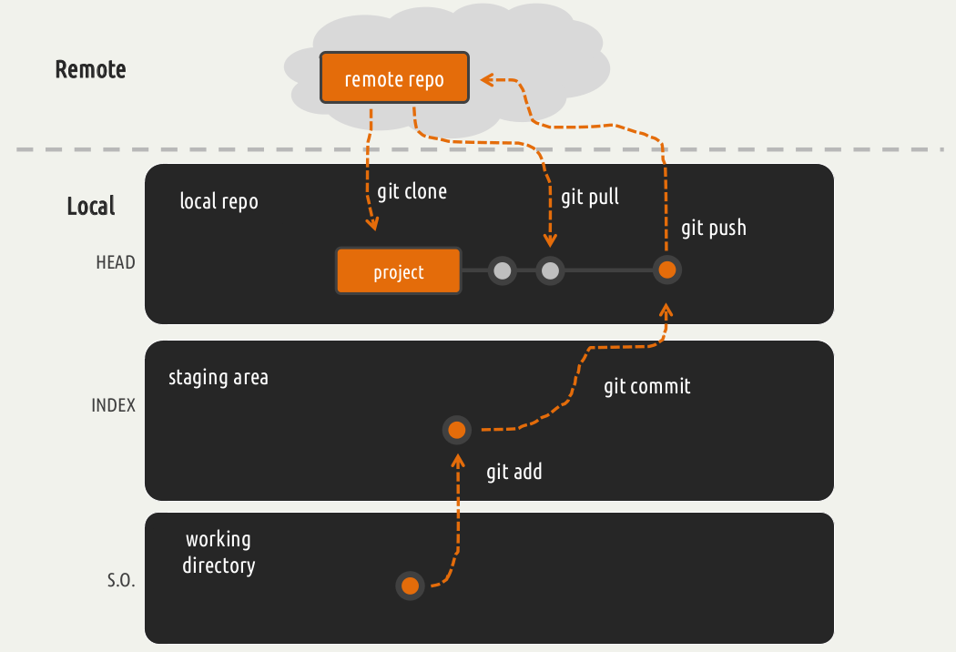
Git Basics
The Three States

Slide 29
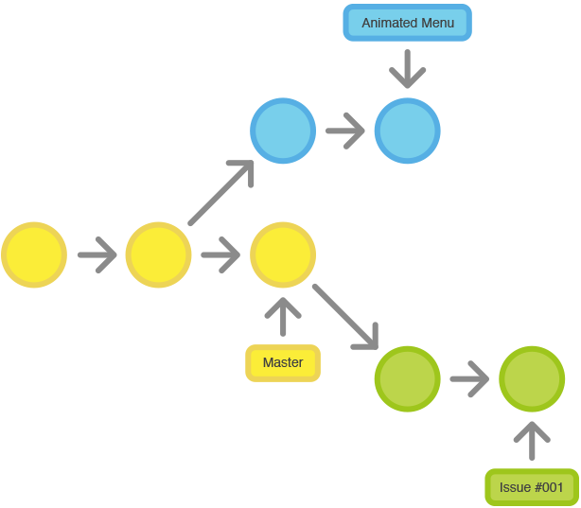
Git Branching
What Branching is?
Branch is essentially an independent line of development.

Slide 30
Git Branching
Why should I care about it?
You are working in a software project and create a copy of your development code on your local machine.
  You are working on a new feature
You receive a call that another issue is critical and you need a hotfix.
  What do you do?

Slide 31
Git Branching
Why should I care about it?
You are working in a software project and create a copy of your development code on your local machine.
  You are working on a new feature
You receive a call that another issue is critical and you need a hotfix.
  What do you do?
  1. Revert back to your production branch.
  2. Create a branch to add the hotfix.
  3. After it's tested, merge and push to remote repository.
  4. Switch back to your original story and continue working.

Slide 32
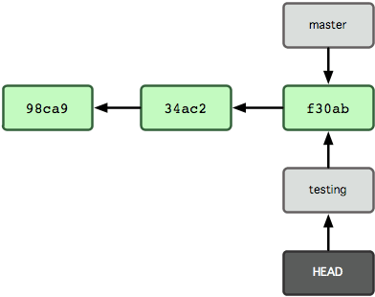
Git Branching
Basic Branching
Create a new branch and switch to it at the same time
  $ git checkout -b new-branch

Slide 33
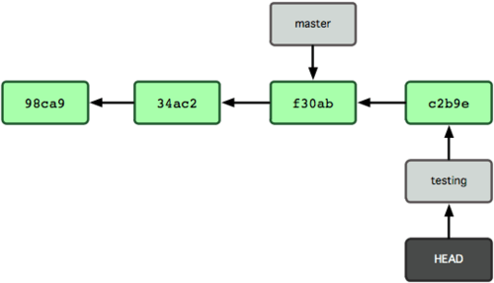
Git Branching
Basic Branching
Let's do another commit

Slide 34
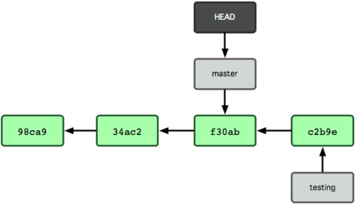
Git Branching
Basic Branching
Let’s switch back to the master branch
  $ git checkout master

Slide 35
Git Branching
Basic Branching
Merge into your master branch to deploy on production
  $ git checkout master
  $ git merge wip-hotfix

Slide 36
Git Branching
Basic Branching
Merge into your master branch to deploy on production
  $ git checkout master
  $ git merge wip-hotfix
  Updating f42c576..3a0874c
  Fast-forward
  README | 1 -
  1 file changed, 1 deletion(-)

Slide 37
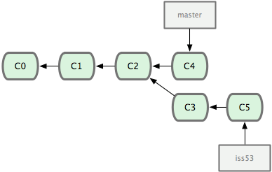
Git Branching
A branch can move forward independently

Slide 38
Git Branching
A branch can move forward indenpendently
Merge into your master branch to deploy on production
  $ git checkout master
  $ git merge iss53
  Auto-merging README
  Merge made by the 'recursive' strategy.
  README | 1 +
  1 file changed, 1 insertion(+)

Slide 39
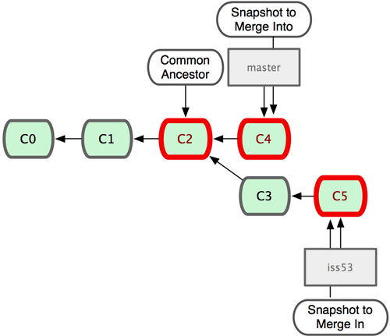
Git Branching
A branch can move forward indenpendently
Git does a simple three-way merge, using the two snapshots pointed to by the branch tips and the common ancestor of the two.

Slide 40
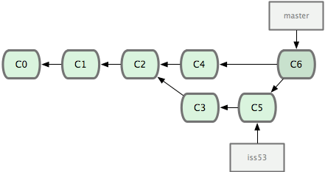
Git Branching
A branch can move forward independently
Git creates a new snapshot that results from this three-way merge and automatically creates a new commit that points to it.

Slide 41
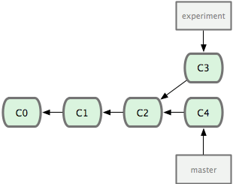
Git Rebase
The basic Rebase
You can see that you diverged your work and made commits on two different branches.

Slide 42
Git Rebase
The basic Rebase
Take all the changes that were committed on one branch and replay them on another one.
  $ git checkout experiment
  $ git rebase master

Slide 43
Git Rebase
The basic Rebase
Take all the changes that were committed on one branch and replay them on another one.
  $ git checkout experiment
  $ git rebase master
  First, rewinding head to replay your work on top of it...
  Applying: added staged command

Slide 44
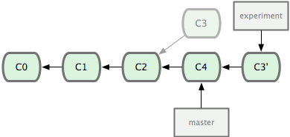
Git Rebase
The basic Rebase
Rebasing the changes introduced in C3 and C4

Slide 45
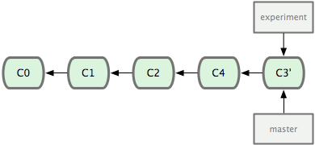
Git Rebase
The basic Rebase
At this point, you can go back to the master branch and do a fast-forward merge.
  $ git checkout master
  $ git merge experiment

Slide 46
References
Proposed Scenario
Chacon, S. “Pro Git”. Apress
  Available on http://git-scm.com/book
http://eagain.net/articles/git-for-computer-scientists/
http://try.github.io/levels/1/challenges/1

