Slide 1
Mirror Mirror On the Wall Who is the most Innovative of them All?
Group SSL 3.0
CS 5345

Slide 2
Problem

Slide 3
Approach

Slide 4
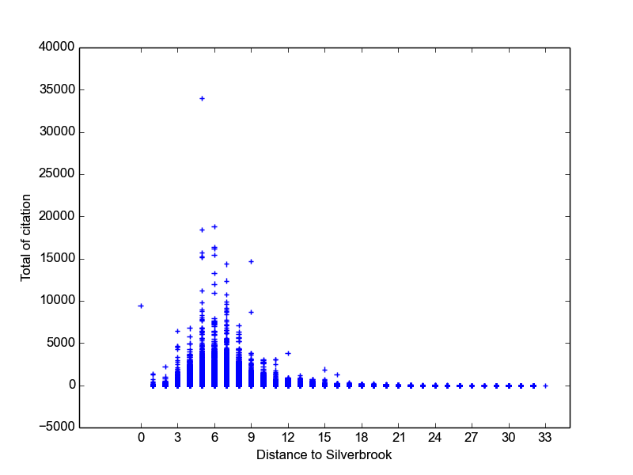
Results : Answer 1

Slide 5
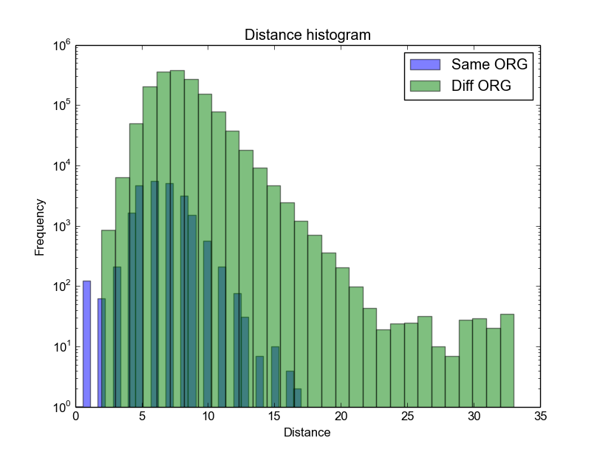
Results : Answer 2

Slide 6
Results : Answer 3

