Slide 1
Mirror Mirror On the Wall Who is the most Innovative of them All?
Shruti Tople (A0109720)
Shweta Shinde (A0109685)
Loi Luu (A00095481)

Slide 2
The Invention Network
Patent database
Plethora of information
Number of patents, Organizations, Inventors, Citations, Issue Year, Place, Category,

Slide 3
Behavior of Invention Network
Goal: Study various aspects of the network
Patent quantity and quality
Innovation impact
Collaboration dynamics
Herd behavior
Innovation per inventor
Innovation per organization

Slide 4
Problem
Q1: Reasons for being impactful
Is an inventor more impactful because he is closely connected to other impactful inventors in the patent social network?
Q2: Collaboration dynamics
Are inventors closely connected to an impactful inventor within or outside an organization?
Q3: Measuring innovation
Which organizations are leading the in- novation industry?

Slide 5
Our Metrics
Collaborative Distance
Shortest path to most innovative person
Inter and intra-organization
Innovation Impact
Degree centrality for a patent
Number of patents vs. Number of citations

Slide 6
Approach
A1: Reasons for being impactful
Innovation Impact vs. Collaborative Distance
A2: Collaboration Dynamics
Collaborative Distance vs. Organization
A3: Measuring Innovation
Innovation Impact vs. Organization

Slide 7
Graph Model I
Co-Inventor Network
I₁
Co-inventor
I₂
Nodes | 3421276
Edges | 13153732
Source node | Kia Silverbrook
∞ dist within org | 6217
∞ dist outside org | 1817586

Slide 8
Graph Model II
Citation Network
P₁
Cites
P₂
Nodes | 10842560
Edges | 53527305
Patents with 0 cit. | 1349956

Slide 9
Solution Overview
Graph 1: Shortest Path Distance
Collaborative distance between each inventor and Kia Silverbrook
Calculate distance of inventors within and outside his organization
Q1, Q2
Graph 2: Degree Centrality
Impact of each patent
Calculate impact of each inventor and org.
Q1, Q3

Slide 10
Evaluation Steps
Model generation
Shortest path and degree centrality on model
Calculations and co-relation
Analysis of results

Slide 11
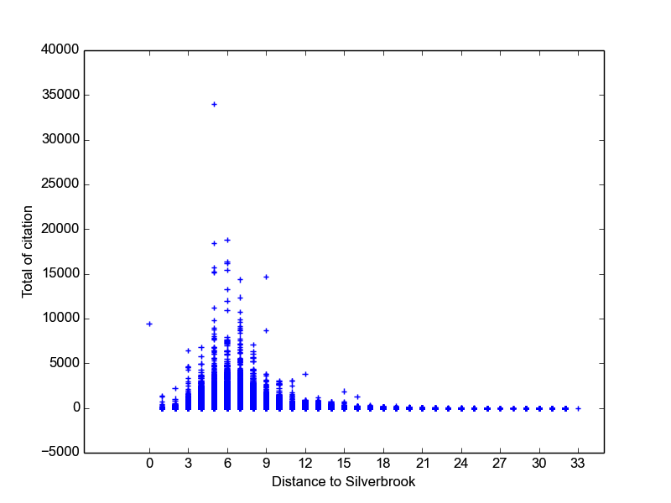
Answer 1: Closeness → Impact

Slide 12
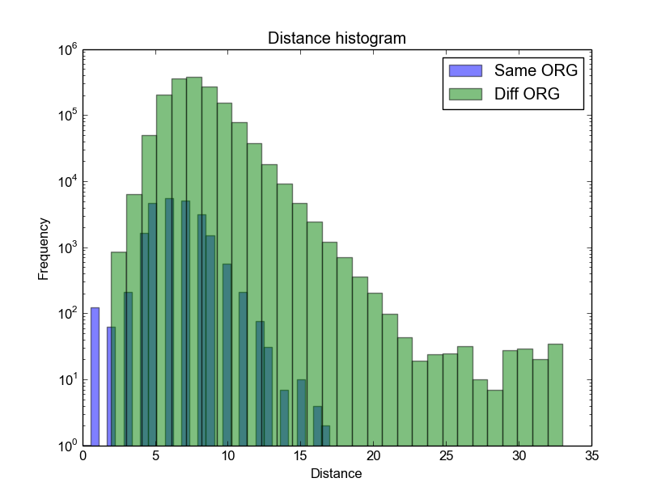
Answer 2: Org !→ Closeness

Slide 13
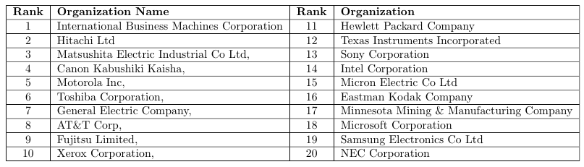
Answer 3: Impact → Innovation

Slide 14
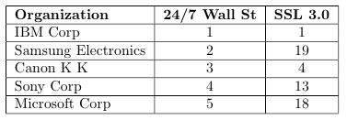
Validation
Quantiative Measure - 24/7 Wall Street
Qualitative Measure – Reuters Top 100 Innovators
41% intersection

Slide 15
Conclusion
Connectedness influences invention impact positively
Being in the same organization does not imply connectedness
Our metric fairly succeeds in measuring innovation

