Slide 1
Demystifying incentives in the consensus computer
Loi Luu, Jason Teutsch, Raghav Kulkarni, Prateek Saxena
National University of Singapore

Slide 2


Consensus computer
Decentralized network for computation
Some user posts a puzzle
Solved by someone, verified by all others
f(x)=y?
f(x)=y
f(x)=?
Consensus computer
f(x)=y?
f(x)=y?
f(x)=y

Slide 3
Cryptocurrencies as consensus computers
Bitcoin
f: verify transactions
Anyone can produce f via transaction script
Determines applications of cryptocurrencies
Input:
PreviousTX: ID of previous IX
Index: 0
scriptSig: Sign(PubKey), PubKey
Output:
Value: 5000000000
scriptPubKey: %take Signature and PubKey as params
checkif Hash(PubKey) = Payee's ID,
checkif Sign(PubKey) is valid
Specify the puzzle
1 BTC

Slide 4
Ethereum: Consensus computer with Turing complete language
Support Turing complete script
Can run arbitrary applications
Example
key-value registration on the blockchain
# Is the key not yet taken?
if !contract.storage[msg.data[0]]:
# Then take it!
contract.storage[msg.data[0]] = msg.data[1]
return(1)
else:
return(0) // Otherwise do nothing

Slide 5


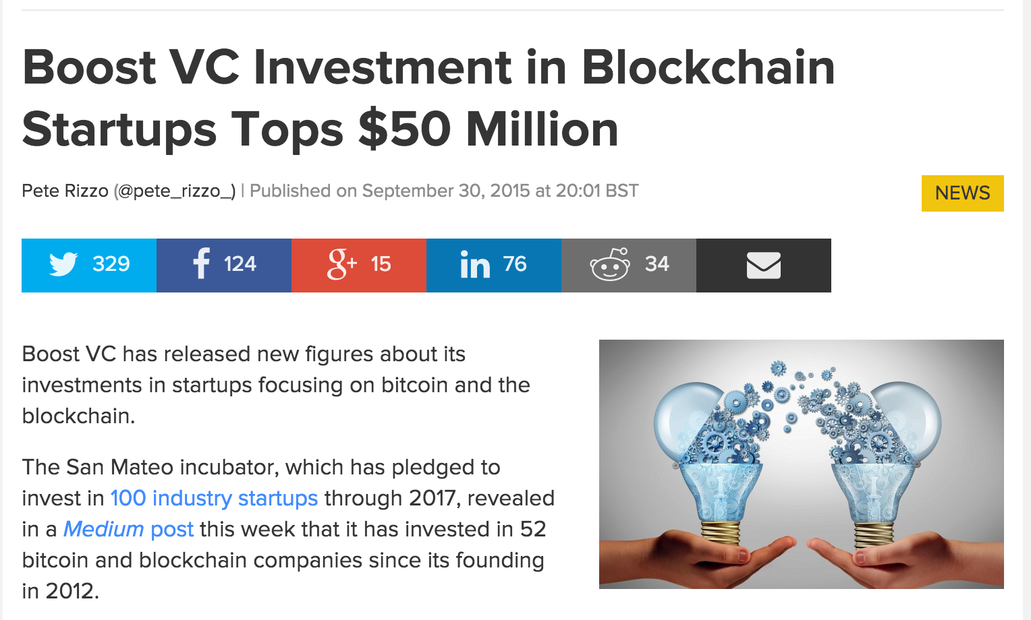
Why study consensus computers?

Slide 6
Problem: correctness of computation?
Assumption: Users always verify and accept only correct solutions
Users are under attack if they verify?
Users have incentive to skip?
Previous work
Focus on mining
Implement more applications on top of consensus computers
Rely on the assumption

Slide 7
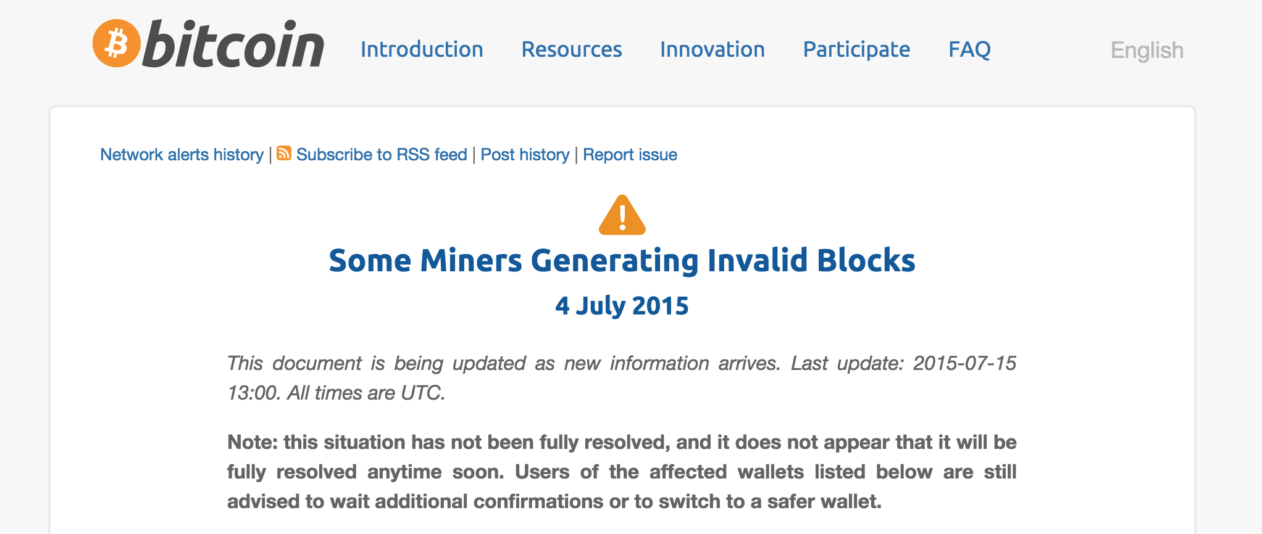
Oops!
5% miners mined an invalid block
Half the network hash rate was mining without fully validating blocks
Build new blocks on top of that invalid block.

Slide 8
Findings
The verification assumption is shaky!
Users are vulnerable to attacks
Rational users have incentive to skip verifications
Computation may be incorrect!

Slide 9
Contributions
Consensus computer may produce incorrect results
Verifier’s dilemma
Classes of computations can be performed correctly
Formalize the protocol used by consensus computers
Understand the incentive structure
Techniques to support more applications

Slide 10
Analyzing the Verification assumption

Slide 11
Background: Cryptocurrency mining
Being a miner
Join the network
Prepare a block
Include several TXs
Solve Proof-of-Work
Perform many SHA2 computations
Get the right to broadcast new blocks
Listen for new blocks
If receive a block from others, validate it
Verify all TXs
Run all scripts included in TXs
Extend the blockchain
When find a valid PoW
Broadcast
If it gets accepted, receive reward
Being a verifier

Slide 12
Incentives in cryptocurrencies
Incentive for miners
Block reward (e.g. 25 Bitcoins)
Transaction fees
There is no reward for verifiers!
Assumption
Users always validate other’s blocks

Slide 13
Attacks on verifiers

Slide 14
Resource exhaustion attack
Goal
Create expensive TXs which require more resources & time to verify
Damages
Waste other resources
Gain advantage in finding next blocks
Notes:
- Mention about the defense

Slide 15
Resource exhaustion attack in Bitcoin
Protection mechanism
Only allow basic arithmetic & crypto opcodes
Block size limit
Attacks in Bitcoin
CVE-2013-2292
Make users hash 19.1GB of data
Take 3 mins CPU time to run
Include as many TXs as possible
Verification time is increased
Notes:
- Mention about the defense

Slide 16
Users’ ill-fated choices
Verify
Not Verify
Mine valid blocks
Less advantage in next blocks
Others start ahead
Waste resource
More advantage in finding next blocks
Mine invalid blocks
Waste all efforts on invalid blocks
Verifier’s dilemma
Users do not know to do or skip the verification
Users have incentive to skip verification
TXs and computation on blockchain may be incorrect!

Slide 17
Resource exhaustion attack in Ethereum
Protection mechanism
Pay gas as transaction fee
Gas depends on opcodes
Attack observation
gas fee is credited to the block founder
Attacker = block founder?
Attack with 0-fee
The attack
Include expensive TXs
in its block
N = matrix_size
A = N*N input matrix
B = N*N input matrix
if msg.data[0] = 1:
C = get_matrix(msg.data[1])
if (C == A * B) //run O(N³)
sendReward()
Verifier’s dilemma applies to all consensus computers!
Notes:
- Mention about the defense

Slide 18
Incentivizing verification

Slide 19
Approach overview
Goal
Determine classes of computations can be performed correctly
Intuition
Limit advantage of skipping verification
Formulate the underlying protocol of consensus computers
Understand incentive structure

Slide 20

Consensus-based computation (CBC)
Employed by consensus computer
Compute f(x)
Consensus
Computer
y = f(x)
Problem
Giver (G)
Prover
(P)
Verify if y = f(x)
Do W_{b} work
to get reward
Verifier
(V)
Notes:
A consensus-based computation (CBC) protocol
G: Problem wants to compute for f() with input x
P: Prover proves that he has s s.t. s=f(x)
V: Verifier verifies if s=f(x) is correct
W_{blk}: work that V always does to get reward

Slide 21
Advantage of rational users
Def 1: Advantage of rational users w.r.t a TX:
adv(f) = W_{f} - W_{df}
W_{f}: amount of work to verify f
W_{df}: amount of work in deviated protocol
Generally adv(f) = W_{f} – O(1)
Def 2: Advantage to skip block verification
adv(blk) = =
Threat model:ε- rational users
Def 3:ε- rational users are honest if
adv(blk) ≤εW_{b}
deviate otherwise

Slide 22
Incentivize correct consensus computation
Lemma: Computation that requires less than εW_{b} is computed correctly by consensus computers of ε- rational users
Def 4:ε- Consensus computer requires at most εW_{b} in verifying a block
ε- consensus computer produces correct results w.r.t ε- rational users
Applications that require more than εW_{b} work?
Notes:
εvalue
Represents the acceptable “common good” work
Not straightforward to estimate, depends on
Net-worth of applications
The network properties
The incentive mechanism
Individual miner’s beliefs

Slide 23
Run more applications on ε-consensus computer: Correct computation
Split verification work into multiple TXs across multiple blocks
Each TX is correctly run by aε- Consensus computer
Advantage of rational miners is bounded
Correctness guaranteed
Latency is high
N = matrix_size
A = N*N input matrix
B = N*N input matrix
if msg.data[0] = 1:
C = get_matrix(msg.data[1])
if msg.data[0] > 1:
i, j = get_index(msg.data[0])
check_if (C[i][j] == A[i][] * B[][j]) //require to run O(N)
Each TX checks
one element

Slide 24
Run more applications on ε-consensus computer: Approximate computation
Probabilistic checking
Reduce TXs and latency
guarantee probabilistic correctness
Goal
Ensure y differs from f(x) by at most δ elements with at least probability of, say, 99%
Intuition
If a solution is incorrect, a random check will detect with some probability

Slide 25
Approximate computation in Ethereum
How to randomly sample?
Use next block hash as a random seed
Hard to control
High guarantee of randomness and fairness
N = matrix_size
A = N*N input matrix
B = N*N input matrix
counter = 0
if msg.data[0] = 1:
C = get_matrix(msg.data[1])
if msg.data[0] > 1:
blkHash= get_current_block_hash()
i, j = get_index(blkHash)
if (C[i][j] == A[i][] * B[][j])
if ++counter > THRESHOLD:
return OK
Else return WRONG-SOLUTION
Sample element to check
Accept solution if check enough samples

Slide 26
Other case studies
Correct consensus computation
GCD computation of large numbers
Dot product
Approximate consensus computation
Matrix multiplication
Sorting
k-coloring

Slide 27
Conclusion
Computation done by consensus computer is not guaranteed!
Verifier’s dilemma
Determine classes of computations can be executed correctly
Formalize the consensus computer protocol
Understand the incentive structure
Techniques to deploy large applications
Tradeoff between correctness & performance

Slide 28
Thank you
Q&A
Email: loiluu@comp.nus.edu.sg

Slide 29
Related work
Incentive incompatible in Bitcoin Mining
[LSPSB 15] On Power Splitting Games in Distributed Computation: The Case of Bitcoin Pooled Mining
[Eyal 15] The miner’s dilemma
Other Bitcoin attacks
[Rosen 11] Analysis of Bitcoin Pooled Mining Reward Systems
Pool hopping, Lie in wait attack
[EyalSi 13] Majority is not enough: Bitcoin mining is vulnerable
Selfish mining attack
[HKZG 15] Eclipse Attacks on Bitcoin’s Peer-to-Peer Network

Slide 30
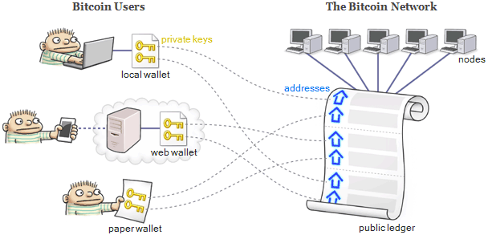
Ethereum system overview
TXs
TXs
Smart Contract
TXs

Slide 31
Steps to verify a block in Bitcoin
If block hash meets difficulty
One SHA256 computation
Merkle tree of N TXs is correctly constructed
O(N) SHA256 computations
If all TXs are valid: Depends on
Number of TXs
Logic in each TX
Currently in a Bitcoin block:
N=500-700 TXs
Verifying a normal TX requires 2 signatures, 2 SHA256
Verifying a Merkle tree is relatively cheap

Slide 32
Attack Bitcoin’s verfiers
Intuition: Bitcoin limits the TX size, but not the number of opcodes
Expensive opcode ~ easy opcode
SHA256, CheckSig, etc
What if a TX requires 10000 signatures verification?
The attack: CVE-2013-2292
Attacker includes multiple OP_Checksig in a block-size TX
Miners have to hash 19.1 GB of data to verify
Take relatively 190 seconds CPU-time
Expected time to find a block is only 10 mins

Slide 33
CBC in existing cryptocurrencies
In Bitcoin
G: sender of a TX
f: decides what a receiver has to do
P: receiver of a TX
proves the ownership of the address
V: miners
verify if receiver’s signature is valid
W_{blk} : solve PoW
In Ethereum
G can define more expressive problem f()
V may have to do more work

Slide 34
CBC in existing cryptocurrencies
Receiver of a TX
Sender of a TX
f: provide a correct signature
y: correct signature
Blockchain
Problem
Giver (G)
Prover
(P)
Verify if signature is correct
Solve PoW
Ethereum
G defines more expressive problems f()
V has to do more work
Miner
Verifier
(V)
Notes:
A consensus-based computation (CBC) protocol
G: Problem wants to compute for f() with input x
P: Prover proves that he has s s.t. s=f(x)
V: Verifier verifies if s=f(x) is correct
W_{blk}: work that V always does to get reward

Slide 35
ε-Consensus computer in existing cryptocurrencies
Goal: limiting εW_{b} work in verifying a block
Method: Limiting work in each TX to
In Ethereum
Leveraging the gas mechanism
In Bitcoin
Introduce TX size
Bound number of expensive opcodes
Only allow predefined standard TXs

Slide 36
gas_limit in Ethereum
Limit the gas in a block
Can be adjusted by miners
Let the “consensus” decide the gas_limit
Different miners have different thresholds for gas_limit
Raise gas_limit to above the gas required in the attack
Some miners are vulnerable

