Slide 1
Oyente: Making Smart Contracts Smarter
Loi Luu, Duc-Hiep Chu, Hrishi Olickel
Prateek Saxena, Aquinas Hobor
National University of Singapore, Yale-NUS College

Slide 2

Programming securely is hard
“Security can be no stronger than its weakest link”

Slide 3
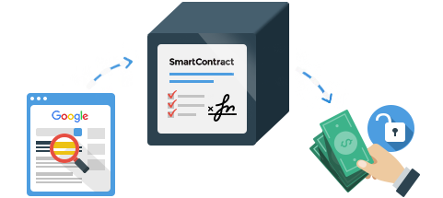
Programming Secure Smart Contracts is Harder
Smart contracts !=normal programs
  Self-executed
  One-shot programs
    Cannot patch
New language
  Solidity != JavaScript
  Serpent != Python

Slide 4
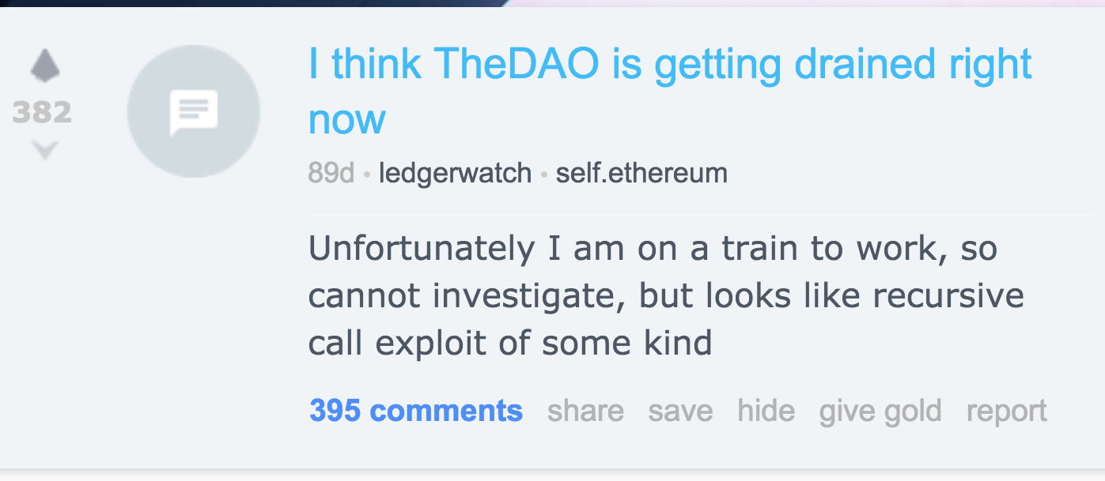
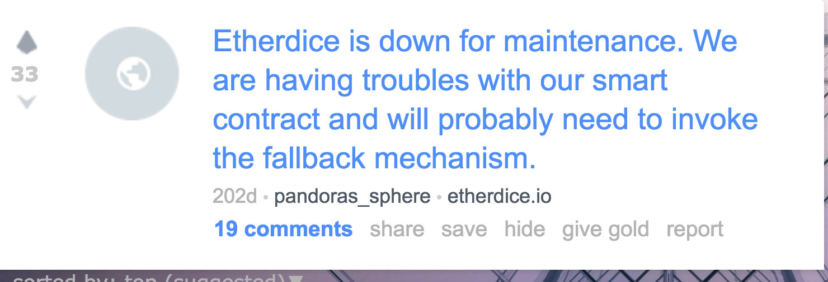
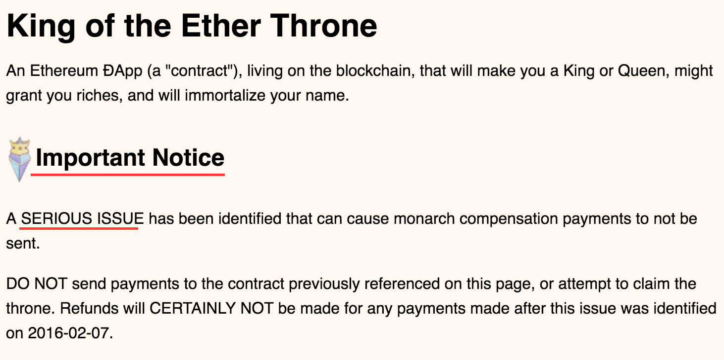

Slide 5
Questions?
Are there other bugs?
  Apart from call-stack and reentrancy?
How many contracts are vulnerable?

Slide 6
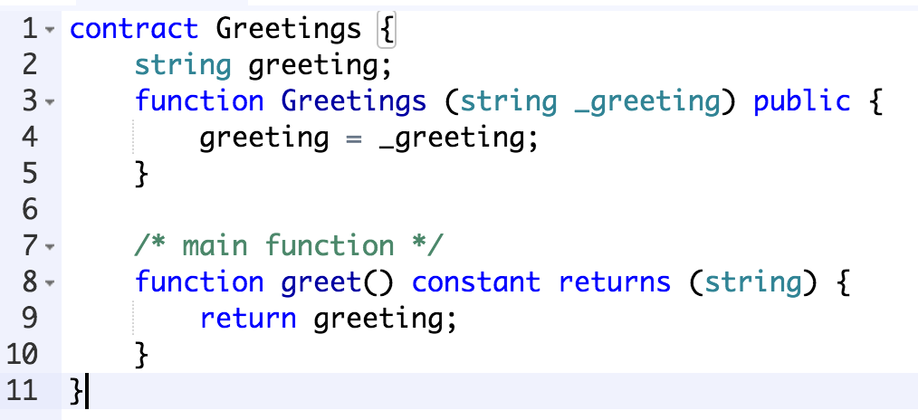
Challenges
Contracts code are not always available
Too many contracts
  Manual analysis is impossible
6060604052604051610250380380610250833981016040528........
PUSH 60
PUSH 40
MSTORE
PUSH 0
CALLDATALOAD
PUSH 100000000000...
SWAP1
DIV
.....

Slide 7
Contribution
Identify New Smart Contract Bugs
  Transaction Ordering Dependence (TOD)
  Timestamp Dependence
Oyente: An analyzer for smart contracts
  Use symbolic execution
  Detect all popular bugs
    TOD
    Timestamp dependence
    Reentrancy
    Mishandling exceptions (e.g. send)
  Flags 8836/ 19366 contracts as vulnerable
    As of May 2016

Slide 8
New Smart Contract Bugs
Transaction Ordering Dependence

Slide 9
Example: Puzzle Solver
PuzzleSolver Contract
Balance: 100
PuzzleSolver()
SetPuzzle
reward=100
Anyone can submit a solution to claim the reward
SubmitSolution(solution)
if isCorrect(solution):
Send(reward)
Owner can update the reward anytime
UpdateReward(newReward) reward=newReward

Slide 10
Scenario 1: Nothing happens
PuzzleSolver Contract
Random TXs
Balance: 100
PuzzleSolver()
SetDifficulty
reward=100
Block
Random TXs
Other TXs
Other TXs
SubmitSolution(solution)
if isCorrect(solution):
Send(reward)
Miners
UpdateReward(newReward) reward=newReward

Slide 11

Scenario 1: SubmitSolution is trigerred
+100
PuzzleSolver Contract
Balance: 100
Balance: 0
PuzzleSolver()
SetDifficulty
reward=100
Random TXs
Solution for Puzzle
Block
Random TXs
SubmitSolution
Other TXs
Other TXs
SubmitSolution(solution)
if isCorrect(solution):
Send(reward)
Miners
UpdateReward(newReward) reward=newReward

Slide 12

Scenario 2: Both SubmitSolution and UpdateReward are triggered
+0
PuzzleSolver Contract
Balance:100
Balance: 0
PuzzleSolver()
SetDifficulty
reward=100
Update Reward to $0!
Solution for Puzzle
Block
UpdateReward = 0
SubmitSolution
Other TXs
SubmitSolution(solution)
if isCorrect(solution):
Send(reward)
Other TXs
UpdateReward(newReward) reward=newReward
Miners

Slide 13
Transaction Ordering Dependence
Observed state != execution state
  The expectation of the state of the contract may not be true during execution.
  Miners decide the order of TXs
Can be coincidence
  Two transactions happen at the same time
Update Reward to $0!
Solution for Puzzle
Other TXs

Slide 14
Transaction Ordering Dependence
Observed state != execution state
  The expectation of the state of the contract may not be true during execution.
  Miners decide the order of TXs
Can be coincidence
  Two transactions happen at the same time
Can be malicious
  Saw the targeted TX from the victim
  Submit the second TX to update the reward
  Both TXs enter the race
Update Reward to $0!
Solution for Puzzle
Other TXs

Slide 15
New Smart Contract Bugs
Timestamp Dependence

Slide 16
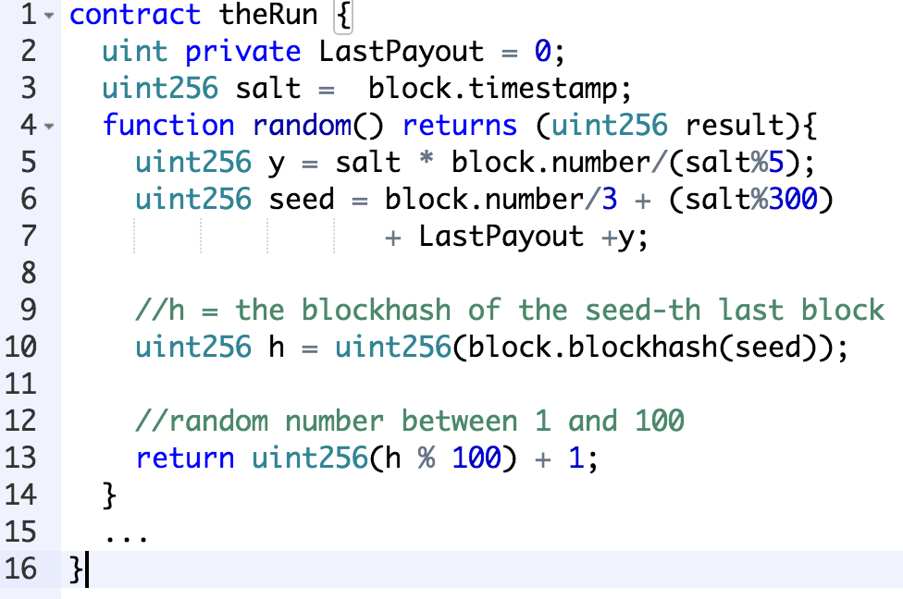
Contract: TheRun
randomness = F(timestamp)

Slide 17
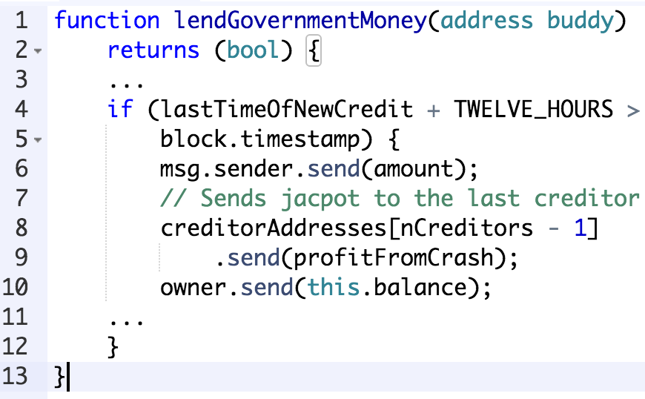
Contract: PonziGovernmentMental

Slide 18
Timestamp can be manipulated
Miners can vary the block timestamp
Bias the output of contract execution to their benefit
  Timed puzzles, time-based RNGs
block.timestamp <= now + 900 && block.timestamp >= parent.timestamp

Slide 19
Oyente: An Analyzer for Smart Contracts

Slide 20
Architecture
Based on symbolic execution
Have separate modules
  Can add more analysis separately
6060604052123123123528.....
ByteCode
CFG BUILDER
Visualizer
Ethereum
State
EXPLORER
CORE ANALYSIS
VALIDATOR
Z3 Bit-Vector Solver

Slide 21
Symbolic Execution
Inputs
Is there any value of x?
T
F
T
T
F
T
F
T
T
Symbolic
Formula
F
T
F
Theorem Prover
NO
YES
Control
Flow Graph
Execution Trace

Slide 22
What Can Oyente Do?
Detect Bugs In Existing Smart Contracts
  Run with 19, 366 contracts
  30 mins timeout per contract
Test generation
  Cover all possible paths of each program
T
F
T
F
F
T
F
T

Slide 23
Oyente is Open Source
https://github.com/ethereum/oyente
Future work
  Support more opcodes
  Handle loops
  Combine static and dynamic symbolic executions

Slide 24
More in the papers
Solutions for all bugs
  Semantic changes
Details of Oyente’s design
Some interesting statistics
  All smart contracts
  Evaluation results

Slide 25


Thanks!
loiluu@comp.nus.edu.sg
loi_luu

Slide 26

Path Exploration
T
T
T
Decision
Procedure
F
Negate
NO
YES
Execution Trace
What input executes a new path?
Notes:
Web application Platform brings us most services today!!
But, it is plagued with some of the most critical software vulns. today

