Slide 1
SCP: A Computationally Scalable Byzantine Consensus Protocol for Blockchains
Loi Luu, Viswesh Narayanan, Kunal Baweja, Chaodong Zheng, Seth Gilbert, Prateek Saxena
National University of Singapore

Slide 2
Bitcoin doesn’t scale
Hard coded parameters
1 block per 10 minutes
1 MB block size
7 TXs per second
Today
1-2 TXs per second
VISA: 10, 000 TXs per second

Slide 3
Our solution: SCP
Scale up throughput several orders of magnitude
Without degrading any security guarantee
Several blocks in each epoch
No. of blocks ≈ network computation capacity
Require minimum network bandwidth
Broadcast only one block header

Slide 4
Byzantine consensus problem
Problem
N nodes, f are malicious
Propose and agree on one value
Byzantine consensus for blockchains
Set of valid TXs per epoch
Block i-2
Block i-1
0/1
Block i
Notes:
Goals
All honest nodes agree on the value
Agreed value must be proposed by valid nodes

Slide 5
Classical byzantine consensus protocol
Intensive research
Can tolerate f < n/2
Assumption of known identity set
Bandwidth limited
O(n²) messages (e.g. PBFT)
Work for a small network (e.g n < 1000)

Slide 6
Nakamoto consensus protocol
Work for network of any size
Select leader by proof of work
Linear message complexity
Does not scale well in practice
One block per epoch
Bandwidth = O(block size)
Reparameterization is not a long term solution

Slide 7
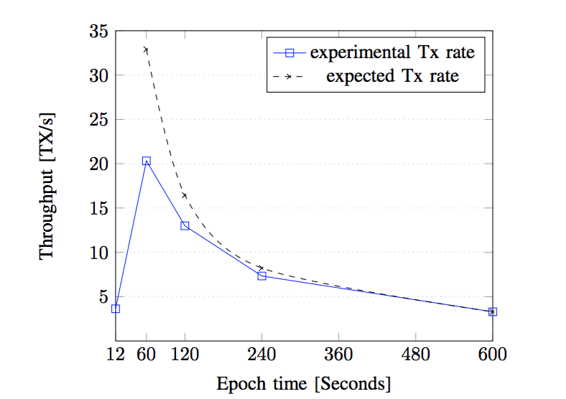
Reparameterization: reducing epoch time
Setup
Using Amazon EC2
Run over 5 regions
Results
TX rate increases
until some threshold
Drops at 12 second
epoch time

Slide 8
Problem
Secure & scalable consensus protocol
Compete with V ISA?

Slide 9
SCP overview
Adjust throughput based on network mining power
Split the network into several committees
Committees propose blocks in parallel
No. of committees ≈ F(network mining capacity)
Data needed for reaching consensus is minimal
Consensus data != transactional data
Verify block without block data
Selectively download block data

Slide 10

SCP protocol
1
2
Consensus Blk
101010101101
Data Blk
Blk Header
3
5
Data Blk
4
Notes:
Step 1: Solve PoW to establish identities
Step 2: Uniformly distribute identities into committees
No. of committees almost linearly depends on network mining power
Step 3: Committees propose data blocks in parallel
Run a byzantine consensus protocol between members
Step 4: Final committee unions all data blocks
Step 5: Final committee generates a shared random

Slide 11
Step 1: Identity establishment
Solve PoW
SHA2(EpochRandomness || IP || pubkey || nonce) < D
ID | PoW | IP | Pubkey
1 | 00001… | a.b.c.d | ABC…
2 | 00001… | a.b.c.e | DEF…
.. | … | … | ….

Slide 12
Step 2: Assigning committees
Randomly & uniformly distribute identities to committees
Based on the last k bits of PoW
ID | PoW
1 | 00001…00
2 | 00000…01
3 | 00000…10
4 | 00001…11
.. | …
00001…00
00000…10
…
00000…11
00001…01
…
Notes:
Adjusts number of committees frequently
Proportional to the network mining power
Similar to how Bitcoin adjusts the block difficulty

Slide 13
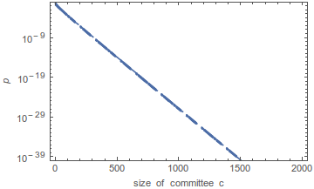
Size of a committee C
Decide the probability of majority honest
P(error) reduces exponentially with C
f = N/3, C = 400, p(error) ≈ 10⁻¹²
f = N/3, C = 100, p(error) ≈ 0.0004
Why majority honest within a committee?
Run practical authenticated BFT
Allow others to verify committee’s block without block’s data
At least 1 member is honest in any (C/2 + 1) members
Notes:
In c/2 + 1 members, at least one is honest
No adversary can propose an invalid block w.h.p
A block is valid if see c/2+1 signatures

Slide 14
Step 3: Propose a block within a committee
Run a classical Byzantine consensus protocol
Members agree & sign on one valid data block
No. of messages ≈ O(C²)
TX sets included in data blocks are disjoint
Include TXs with a specific prefix
Block | TX’s IDS
Data Block 1 | 00…
Data Block 2 | 01…
Data Block 3 | 10…
Data Block 4 | 11…
Notes:
Each block includes only TXs having IDs falling within a specific range

Slide 15
Step 4: Final committee unions all results
00001…00
Propose a consensus block
00000…00
…
Header of
Data Block 3
Header of Data Block 1
Header of
Data Block 2
00001…001
00000…10
00000…11
00000…101
00001…10
00001…11
…
…
…
Notes:
Final committee collects data blocks from others
Only download block headers
Block hash, committee members, signatures
Accept a block header if it has at least c/2 + 1 signatures
Build a consensus block within the final committee
Similar to the generating a data block
Committee members sign the agreed block hash
Only the consensus block’s header is broadcast to the network

Slide 16
SCP blockchain
Consensus block i-1
Consensus block i
Consensus block i+1
Data block 1
Data block 2
Data block 3

Slide 17
Step 5: Generate an epoch randomness
Goal
Generate a fresh randomness
Adversary cannot control or predict
Common approach: Use consensus block hash
Problem: adversary can predict the consensus block early
Our approach: Users can have different randomness
Commit R_{i} in SHA2(R_{i}) when join the committee
Agree on the consensus block
Broadcast the block header and R_{i}
Use any c/2 R_{i} as the epoch randomness

Slide 18


Implement a SCP-based cryptocurrency
Challenges
How to form committees efficiently
Too many new identities in each epoch
Epoch time may be long to prevent conflict
Double spending transactions
Without previous block data?
Input 0x123..
Input 0x123…

Slide 19
Forming committees efficiently
Approach: Reuse identities from previous epoch
Elect one new member and remove the oldest one
Number of new identities ≈ number of committees
1st Epoch
2nd Epoch
3rd Epoch
0
1
2
…
C-2
C-1
C
C+1

Slide 20
Avoid double spending
Approach:
Split double spending check into both miners and users (recipients)
Double spending
Checked by committee members
Checked by recipients*
Within a block
Across blocks
*: Proof-of-publication

Slide 21
Checking double spending across blocks
Merkle tree of TX inputs
An input is spent in a block
Proof of size log(N)
An input is not spent in a block
Proof of size 2*log(N)
Prove that 5 is not included?
All leaves are sorted

Slide 22
Checking double spending across blocks (2)
Sender proves that the TX’s input is not spent elsewhere
The proof of size L*log(N)
Can be optimized
Recipient checks by using only consensus block headers
Actively support SPV clients without a trusted third party
Support 1-confirmation TXs

Slide 23
Conclusion
SCP scales almost linearly with network mining capacity
More mining power, higher transaction rate
Reduced network bandwidth
Secure
Applicable to several applications
Cryptocurrency, decentralized database, etc

Slide 24
Q&A
Loi Luu
loiluu@comp.nus.edu.sg
www.comp.nus.edu.sg/~loiluu

Slide 25
Future work
Incentive structure
Incentivize committee members and other parties
Prevent DoS attack by sending invalid TXs
Users can send arbitrary TXs to the blockchain now
Rollback solution
P(error) != 0

Slide 26
Related work
Bitcoin-NG & Ghost
Allow more blocks
Does not separate consensus plane and data plane
Lighting network
Allows more micro transactions
Does not solve scalability problem
Sidechains
Good for experimenting new blockchains
Does not make Bitcoin scalable

Slide 27
Adjusts number of committees frequently
Similar to how Bitcoin adjusts the block difficulty
T: the expected epoch time
T’: the averaged epoch time of the most 1000 recent blocks
S: Current number of committees
S’: adjusted number of committees

Slide 28
Data Block 1
Previous Consensus Blk | Merkle root commitment of TXs
Block hash | No. of TXs
Committee signatures | Timestamp
Included TXs
Consensus Block
Previous Block Hash |  | Timestamp
Committee signatures |  | Global Merkle Root
Data block commitments
No. | Data Block’s hash | Merkle root of TXs
1 | 0x123abc… | …
2 | 0x123456… | …
Data Block 2
Previous Consensus Blk | Merkle root commitment of TXs
Block hash | No. of TXs
Committee signatures | Timestamp
Included TXs

Slide 29
SCP properties
Number of data blocks ≈ network mining power
Frequent adjustment of no. of blocks
Data broadcast to the network is minimal
Broadcast data is independent of block size
Secure against adaptive adversary w.h.p.
Can reparameterize c to secure against stronger adversary

