Slide 1


A Deeper Look into RowHammer’s Sensitivities Experimental Analysis of Real DRAM Chips and Implications on Future Attacks and Defenses
Lois Orosa Abdullah Giray Yağlıkçı
Haocong Luo Ataberk Olgun Jisung Park
Hasan Hassan Minesh Patel Jeremie S. Kim Onur Mutlu
Notes:
Hello, my name is Lois Orosa,
and I will be presenting our work
A Deeper Look into RowHammer’s Sensitivities: Experimental Analysis of Real DRAM Chips and Implications on Future Attacks and Defenses

Slide 2
The RowHammer Vulnerability
DRAM Subarray
Row 0
Row 0
Victim Row
Row 1
Row 1
Row 1
Victim Row
Row 2
Row 2
Row 2
Row 2
Row 2
Row 2
open
open
open
closed
closed
Aggressor Row
Row 3
Row 3
Row 3
Aggressor Row
Victim Row
Row 2
closed
Row 4
Row 4
Victim Row
Repeatedly opening (activating) and closing (precharging)
a DRAM row causes RowHammer bit flips in nearby cells
Notes:
I will start by introducing the Rowhammer vulnerability. To access data from a DRAM row, the memory controller has to activate [CLICK] and later precharge[CLICK] the row. However, rapidly activating [CLICK] and precharging [CLICK] a DRAM row can result in bit flips in physically adjacent rows. [CLICK]. This phenomenon is known as RowHammer. [CLICK] We refer to the rapidly accessed row as an aggressor row and the rows containing bit flips as victim rows. [CLICK]

Slide 3
Executive Summary
Motivation: Understanding RowHammer enables designing effective and efficient solutions, but no rigorous study demonstrates how vulnerability varies under different conditions
Goal: Provide insights into three fundamental properties of RowHammer that can be leveraged to design more effective and efficient attacks and defenses
DRAM chip temperature
The time that an aggressor row stays active
Victim DRAM cell’s physical location
Experimental study: 272 DRAM chips from four major manufacturers
Key Results: A RowHammer bit flip is more likely to occur
in a bounded range of temperature
if the aggressor row is active for longer time
in certain physical regions of the DRAM module under attack
Conclusion: Our novel observations can inspire and aid future work
Craft more effective attacks
Design more effective and efficient defenses
Notes:
Understanding RowHammer is critical to find effective and efficient solutions. However, no rigorous study demonstrates how this vulnerability varies under different conditions [CLICK]
In this work, our goal is to provide insights into three fundamental properties of RowHammer that can be leveraged to design more effective and efficient attacks and defenses.These three properties are [CLICK]
DRAM chip temperature, [CLICK]
The time that an aggressor row stays active [CLICK]
and victim DRAM cell’s physical location [CLICK]
In this study, we test 272 real DRAM chips of DDR3 and DDR4 modules from four major manufacturers [CLICK]
From our key results, we highlight that a RowHammer bit flip is more likely to occur [CLICK]
in a bounded range of temperature [CLICK]
if the aggressor row is active for longer time [CLICK]
And in certain physical regions of the DRAM module under attack [CLICK]
Based on our findings, we propose several improvements and show that our novel observations can inspire and aid future work on crafting more effective attacks and designing more effective and efficient defense mechanisms [CLICK]

Slide 4
Key Takeaways from Temperature Analysis
Key Takeaway 1
To ensure that a DRAM cell is not vulnerable to RowHammer,
we must characterize the cell at all operating temperatures
Key Takeaway 2
RowHammer vulnerability tends to worsen as DRAM temperature increases
However, individual DRAM rows can exhibit behavior different from the dominant trend
Notes:
Our first analysis investigates the relation between the RowHammer vulnerability and temperature. This analysis provides two key takeaways: [CLICK]
First, To ensure that a DRAM cell is not vulnerable to RowHammer, we must characterize the cell at all operating temperatures [CLICK]
Second, RowHammer vulnerability tends to worsen as DRAM temperature increases [CLICK]
However, individual DRAM rows can behave differently from the dominant trend [CLICK]

Slide 5
Impact of Temperature on DRAM Cells
no bit flips
bit flips
no bit flips
Vulnerable Temperature Range
Temperature
Lower
Bound
Upper
Bound
The fraction of vulnerable DRAM cells, experiencing bit flips at all temperature levels within their vulnerable temperature range
Mfr. A | Mfr. B | Mfr. C | Mfr. D
99.1% | 98.9% | 98.0% | 99.2%
OBSERVATION 1
Most DRAM cells are vulnerable to RowHammer throughout a continuous temperature range
Notes:
We observe that there exists [CLICK] a lower and [CLICK] an upper bound of temperature. [CLICK]
A DRAM cell experiences bit flips only within this bounded range[CLICK]
but we do not observe any bit flips out of this range [CLICK]
We call this range: vulnerable temperature range [CLICK]
This table shows the fraction of DRAM cells that experience bit flips at all temperature levels within their vulnerable temperature range
We observe that more than 98% of vulnerable cells across all four manufacturers exhibit this behavior [CLICK]
Therefore, we conclude that most DRAM cells are vulnerable to RowHammer throughout a continuous temperature range [CLICK]

Slide 6
Impact of Temperature on DRAM Cells
OBSERVATION 2
A significant fraction of vulnerable DRAM cells exhibit bit flips at all tested temperatures
29.8% of the cells in Mfr. D experience bit flips at all tested temperatures
bit flips
Vulnerable Temperature Range
Temperature
50°C
90°C
OBSERVATION 3
A small fraction of all vulnerable DRAM cells are vulnerable to RowHammer only in a very narrow temperature range
0.2% of the cells in Mfr. D experience bit flips only at 70°C
no bit flips
no bit flips
Temperature
70°C
Vulnerable Temperature Range
Notes:
We analyze the temperature levels at which a DRAM cell is vulnerable to RowHammer [CLICK]
We observe that a significant fraction of vulnerable DRAM cells exhibit bit flips at all tested temperatures [CLICK]
For example, almost 30% of the cells in Mfr. D experience bit flips at all tested temperatures, and We observe similar results in all manufacturers [CLICK]
We also observe that A small fraction of all vulnerable DRAM cells are vulnerable to RowHammer only in a very narrow temperature range [CLICK]
For example, 0.2% of the cells in Mfr. D experience bit flips only at 70 degrees celsius. and we also observe similar results for all manufacturers [CLICK]

Slide 7
Key Takeaways from Aggressor Row Active Time Analysis
Key Takeaway 3
As an aggressor row stays active longer,
victim DRAM cells become more vulnerable to RowHammer
Key Takeaway 4
RowHammer vulnerability of victim cells decreases
when the bank is precharged for a longer time
Notes:
Our next analysis investigates how the Rowhammer vulnerability varies based on aggressor row active time. This analysis provides two key takeaways: [CLICK]
First, As an aggressor row stays active longer, victim DRAM cells become more vulnerable to RowHammer [CLICK]
And second, RowHammer vulnerability of victim cells decreases when the bank is precharged for a longer time [CLICK]

Slide 8
Memory Access Patterns in Aggressor Row Active Time Analysis
Baseline access pattern:
Increasing aggressor row active time:
Increasing bank precharged time:
Row A is active
Row B is active
Row A is active
Row B is active
Time
Row A is active
Row B is active
Row A is active
Time
Aggressor row active time
Aggressor row active time
Aggressor row active time
Row A is active
Row B is active
Row A is active
Time
Bank precharged time
Bank precharged time
Bank precharged time
Notes:
To perform this analysis, we conduct two sets of experiments [CLICK]
In the baseline, we hammer rows A and B as frequently as possible [CLICK]
In the first set of experiments`, we increase the time that an aggressor row is active [CLICK],
And in the second set of experiments we increase the time that the bank is precharged [CLICK]

Slide 9
Increasing Aggressor Row Active Time
OBSERVATION 8
As the aggressor row stays active longer, more DRAM cells experience RowHammer bit flips and they experience RowHammer bit flips at lower activation counts
Baseline
Row Active Time
5x
-36%
Minimum Activation Count
to Observe a Bit Flip (HC_{first})
[More analysis and observations in the paper]
Notes:
We observe that as the aggressor row stays active longer, more DRAM cells experience RowHammer bit flips AND they experience RowHammer bit flips at lower activation counts [CLICK]
For example, when the aggressor row active time is 5x longer than the baseline, [CLICK] a DRAM row experiences RowHammer bit flips using a hammer count 36% smaller than the baseline [CLICK]

Slide 10
Key Takeaways from Spatial Variation Analysis
Key Takeaway 5
RowHammer vulnerability significantly varies
across DRAM rows and columns due to design-induced
and manufacturing-process-induced variation
Key Takeaway 6
The distribution of the minimum activation count to observe bit flips (HC_{first}) exhibits a diverse set of values in a subarray
but similar values across subarrays in the same DRAM module
Notes:
Our last analysis investigates how the RowHammer vulnerability varies based on a victim DRAM cell's physical location
This analysis provides two key takeaways. [CLICK]
First, The RowHammer vulnerability significantly varies across DRAM rows and columns due to both design induced and manufacturing process induced variation [CLICK]
Second, the distribution of the minimum activation count to observe a bit flip exhibits a diverse set of values within a subarray, But similar values across subarrays within a DRAM module [CLICK]

Slide 11
Spatial Variation across Rows
OBSERVATION 12
A small fraction of DRAM rows are significantly more vulnerable to RowHammer than the vast majority of the rows
Most Vulnerable 10%
-50%
DRAM Rows
Other 90%
Minimum Activation Count
to Observe a Bit Flip (HC_{first})
[More analysis and observations in the paper]
Notes:
We analyze the spatial variation of RowHammer across DRAM rows [CLICK]
We observe that A small fraction of DRAM rows are significantly more vulnerable to RowHammer than the vast majority of the rows [CLICK]
For example, The most vulnerable 10% of the rows experience bit flips at activation counts about [CLICK] half the minimum activation count to observe a bit flip of the other rows [CLICK]

Slide 12
Implications on Attacks and Defenses
Our observations can be leveraged to craft
more effective RowHammer attacks
Our observations can be leveraged to design more effective and efficient RowHammer defenses
Notes:
We believe that our observations can be leveraged [CLICK]
To craft more effective attacks [CLICK]
And to design more effective and efficient defenses.[CLICK]

Slide 13
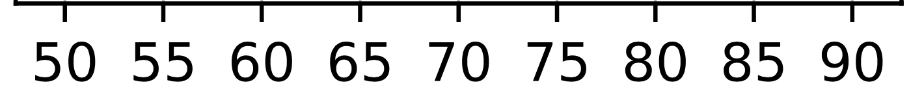
Attack Improvement: Making DRAM Cells More Vulnerable
An attacker can manipulate temperature to make the cells that store sensitive data more vulnerable
DRAM cells are vulnerable in a bounded temperature range
no bit flips
Vulnerable Temperature Range
no bit flips
Temperature
50°C
70°C
75°C
65°C
55°C
45°C
Heating up chip temperature
Cooling down chip temperature
[More Attack Improvements in the paper]
Notes:
This is an example of an attack improvement where the attacker manipulates the temperature of the DRAM module to increase the RowHammer vulnerability of the cells that store sensitive data [CLICK]
We observe that DRAM cells are vulnerable to RowHammer in a bounded temperature range [CLICK]
For example if this range is from 50 to 70 degrees celsius, an attacker can [CLICK]
heat up the chip if the current temperature is below 50 degrees [CLICK] Or cool down the chip if the current temperature is above 70 degrees celsius [CLICK]

Slide 14

Defense Improvement: Leveraging the variation across DRAM rows
90%
HC_{first} (Minimum activation count to observe a bit flip)
10%
$2×$HC_{first}
Aggressiveness can be reduced:
Breakdown of DRAM Rows
33% area reduction for BlockHammer [Yağlıkçı+, HPCA'21]
80% area reduction for Graphene [Park+, MICRO'20]
[More Defense Improvements in the paper]
Notes:
This is an example of an improvement for defense mechanisms that leverages the variation across rows [CLICK]
We observe that 90% of the rows do not experience bit flips until the activation count reaches the double Hcfirst of the 10% of the rows.[CLICK]
Therefore, we can reduce the aggressiveness of defense mechanisms for 90% of the rows, which can reduce the area overheads of state-of-the-art defense mechanisms: [CLICK] BlockHammer and [CLICK] Graphene, by 33 and 80%, respectively [CLICK]

Slide 15
Also in the paper
More temperature, aggressor row active time, and spatial variation analysis
16 total new observations and 6 key takeaways
3 total attack improvements
6 total defense improvements
Notes:
For more analysis, observations, attack improvements and defense improvements, please read our paper.

Slide 16
A Deeper Look into RowHammer’s Sensitivities Experimental Analysis of Real DRAM Chips and Implications on Future Attacks and Defenses
Lois Orosa Abdullah Giray Yağlıkçı
Haocong Luo Ataberk Olgun Jisung Park
Hasan Hassan Minesh Patel Jeremie S. Kim Onur Mutlu
Notes:
Thank you for your time. I am happy to answer any questions

Slide 17
A Deeper Look into RowHammer’s Sensitivities Experimental Analysis of Real DRAM Chips and Implications on Future Attacks and Defenses
20-min Talk
Lois Orosa Abdullah Giray Yağlıkçı
Haocong Luo Ataberk Olgun Jisung Park
Hasan Hassan Minesh Patel Jeremie S. Kim Onur Mutlu
Notes:
This concludes my talk . Thank you for your time and attention. For many more details, I invite you to read our MICRO 2021 paper.

Slide 18

DRAM Organization
Subarray
Bitline
DRAM Cell
Bank
Wordline
…
Chip I/O
. . .
DRAM Row
…
…
…
…
…
Row Buffer
DRAM Chip
DRAM Bank
DRAM Subarray
Notes:
This is a DRAM module, used as the main memory on many systems. [CLICK]
A DRAM module consists of multiple chips each of which contains multiple banks [CLICK]
Each bank is composed of multiple subarrays [CLICK]
And within each subarray, there is a two dimensional array of DRAM cells. [CLICK]
These cells are organized into rows that are selected using wordlines [CLICK]
And the cells are connected to a row buffer via bitlines [CLICK]

Slide 19
DRAM Organization and Operation
Bitline
DRAM Cell
Wordline
Wordline
Access transistor
…
DRAM Subarray
…
DRAM Cell
charge
leakage
paths
Capacitor
Bitline
…
…
…
…
Row Buffer
I/O Circuitry
Refresh: Restores the capacitor voltage with a time period called refresh window
Row Activation: Fetch the row’s content into the row buffer
Column Access: Read/Write a column in the row buffer
Precharge: Disconnect the row from the row buffer
Notes:
This is a simplified diagram of a DRAM cell, where the data is stored as capacitor voltage and accessed through the access transistor [CLICK]
A DRAM cell inherently exhibits several charge leakage paths [CLICK]
And requires to perform refresh operations to restore the capacitor voltage with a time period called refresh window.
[PAUSE]
To access a DRAM cell, [CLICK]
the memory controller must first open or activate the row to fetch the row’s data into the row buffer [CLICK]
The READ and WRITE requests targeting the row are serviced from the row buffer [CLICK]
After all requests are serviced from the row, the memory controller must close or precharge the row in order to begin accessing data from another row. [CLICK]

Slide 20
The RowHammer Vulnerability
DRAM Subarray
Row 0
Row 0
Victim Row
Row 1
Row 1
Row 1
Victim Row
Row 2
Row 2
Row 2
Row 2
Row 2
Row 2
open
open
open
closed
closed
Aggressor Row
Row 3
Row 3
Row 3
Aggressor Row
Victim Row
Row 2
closed
Row 4
Row 4
Victim Row
Repeatedly opening (activating) and closing (precharging)
a DRAM row causes RowHammer bit flips in nearby cells
Notes:
Due to an increase in cell-to-cell interference, as a result of aggressive technology node scaling, rapidly activating [CLICK] and precharging
[FORTH & BACK] a DRAM row can result in bit flips in physically adjacent rows [CLICK]
[FORTH & BACK] Continuing to access the same row results in even more failures in nearby rows. This phenomenon is known as RowHammer. [CLICK]
We refer to the rapidly accessed row as an aggressor row and the rows containing bit flips as victim rows.

Slide 21
Executive Summary
Motivation:
Denser DRAM chips are more vulnerable to RowHammer
Understanding RowHammer enables designing effective and efficient solutions, but no rigorous study demonstrates how vulnerability varies under different conditions
Goal: Provide insights into three fundamental properties of RowHammer that can be leveraged to design more effective and efficient attacks and defenses
DRAM chip temperature
The time that an aggressor row stays active
Victim DRAM cell’s physical location
Experimental study: 272 DRAM chips from four major manufacturers
Key Results: We provide 6 takeaways from 16 novel observations
A RowHammer bit flip is more likely to occur
in a bounded range of temperature
if the aggressor row is active for longer time
in certain physical regions of the DRAM module under attack
Conclusion: Our novel observations can inspire and aid future work
Craft more effective attacks
Design more effective and efficient defenses
Notes:
Now I will quickly summarize our work [CLICK]
Denser DRAM chips are more vulnerable to RowHammer [CLICK]
And Understanding RowHammer is critical to find effective and efficient solutions. However, no rigorous study demonstrates how this vulnerability varies under different conditions [CLICK]
In this work, our goal is to provide insights into three fundamental properties of RowHammer that can be leveraged to design more effective and efficient attacks and defenses These three properties are [CLICK]
DRAM chip temperature, [CLICK]
The time that an aggressor row stays active [CLICK]
and victim DRAM cell’s physical location [CLICK]
In this study, we test 272 real DRAM chips of DDR3 and DDR4 modules from four major manufacturers [CLICK]
Based on our analyses, we draw 6 key takeaway lessons from 16 novel observations. Among these, we highlight that [CLICK]
A RowHammer bit flip is more likely to occur [CLICK]
in a bounded range of temperature [CLICK]
if the aggressor row is active for longer time [CLICK]
And in certain physical regions of the DRAM module under attack [CLICK]
Based on our findings, we propose several improvements and show that our novel observations can inspire and aid future work on crafting more effective attacks and designing more effective and efficient defense mechanisms [END]

Slide 22
Outline
Motivation and Goal
Motivation and Goal
Experimental Methodology
Temperature Analysis
Aggressor Row Active Time Analysis
Spatial Variation Analysis
Implications on Attacks and Defenses
Conclusions
Experimental Methodology
Temperature Analysis
Aggressor Row Active Time Analysis
Spatial Variation Analysis
Implications on Attacks and Defenses
Conclusions
Notes:
This is the outline of the talk.

Slide 23
Outline
Motivation and Goal
Motivation and Goal
Experimental Methodology
Temperature Analysis
Aggressor Row Active Time Analysis
Spatial Variation Analysis
Implications on Attacks and Defenses
Conclusions
Experimental Methodology
Temperature Analysis
Aggressor Row Active Time Analysis
Spatial Variation Analysis
Implications on Attacks and Defenses
Conclusions
Notes:
Let me begin with our motivation and goal

Slide 24

Motivation
2020
More than 10X reduction
Manufactured Year
2014
Minimum Activation Count to Observe a Bit Flip
Defenses are becoming prohibitively expensive
A deeper understanding is needed
No rigorous experimental study on fundamental properties of RowHammer to find effective and efficient solutions
It is critical to gain insights into RowHammer and its fundamental properties
Notes:
RowHammer is a DRAM reliability and security problem [CLICK]
Denser DRAM chips are significantly more vulnerable to RowHammer, such that [CLICK]
the minimum activation count to observe a bit flip has reduced by more than an order of magnitude in less than a decade [CLICK]
Recent works have demostrated that many defense mechanisms are becoming prohibitively expensive for future DRAM chips [CLICK]
A deeper understanding of RowHammer is the key to overcome this challenge [CLICK]
However, no rigorous experimental study demonstrates a set of fundamental properties of RowHammer to find effective and efficient solutions [CLICK]
Therefore, to enable RowHammer-safe operation with future DRAM chips, it is critical to gain insights into RowHammer and its fundamental properties[CLICK]

Slide 25
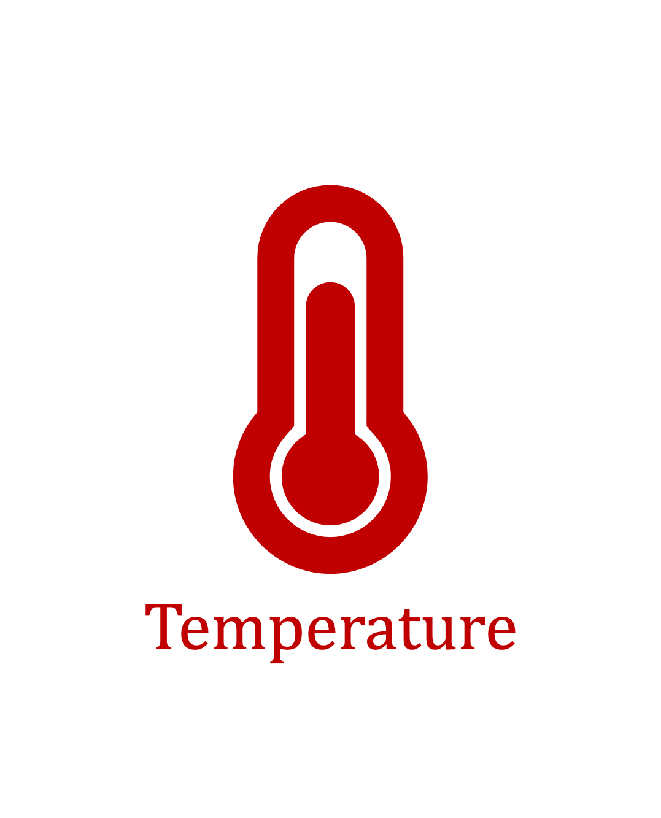


Our Goal
Provide insights into three fundamental properties

Temperature

Aggressor Row
Active Time

Victim DRAM Cell’s Physical Location
To find effective and efficient attacks and defenses
Notes:
Our goal in this work is to Provide insights into three fundamental properties of RowHammer:
Temperature [CLICK]
Aggressor row active time [CLICK]
Victim DRAM cell's physical location [CLICK]
By doing so we aim enabling research to find effective and efficient attacks and defenses [CLICK]

Slide 26
Outline
Motivation and Goal
Motivation and Goal
Experimental Methodology
Temperature Analysis
Aggressor Row Active Time Analysis
Spatial Variation Analysis
Implications on Attacks and Defenses
Conclusions
Experimental Methodology
Temperature Analysis
Aggressor Row Active Time Analysis
Spatial Variation Analysis
Implications on Attacks and Defenses
Conclusions
Notes:
Let me quickly explain our experimental methodology

Slide 27
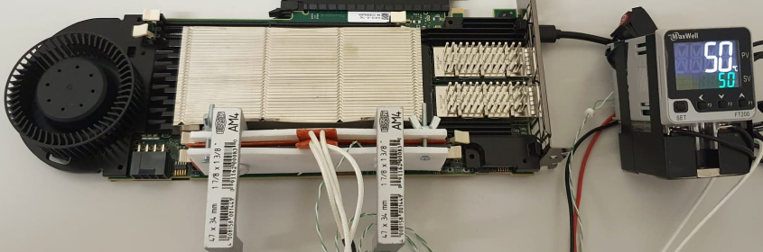
DRAM Testing Infrastructures
Two separate testing infrastructures
DDR3: FPGA-based SoftMC (Xilinx ML605)
DDR4: FPGA-based SoftMC (Xilinx Virtex UltraScale+ XCU200)
FPGA (w/SoftMC)
Host Machine
(via PCI-e)
Temperature
Controller
DRAM Module and Heater
DDR4 DRAM Testing Infrastructure
Fine-grained control over DRAM commands,
timing parameters and temperature (±0.1°C )
Notes:
We use two FPGA-based experimental setups for DDR3 and DDR4 DRAM modules, both programmed with a modified version of SoftMC [CLICK]
We control the chip temperature using a pair of heaters [CLICK] connected to a temperature controller [CLICK]
These infrastructures provide fine-grained control over DRAM commands, timing parameters, and temperature [CLICK]
=======

Slide 28
DRAM Testing Methodology
To characterize our DRAM chips at worst-case conditions:
Prevent sources of interference during core test loop
No DRAM refresh: to avoid refreshing victim row
No DRAM calibration events: to minimize variation in test timing
No RowHammer mitigation mechanisms: to observe circuit-level effects
Test for less than a refresh window (32ms) to avoid retention failures
Worst-case access sequence
We use worst-case access sequence based on prior works’ observations
For each row, repeatedly access the two physically-adjacent rows as fast as possible
Notes:
To characterize our DRAM chips at worst-case conditions we take two measures:
[CLICK] First, we prevent external sources of interference such that our tests can run consistently as desired and without interruptions. To achieve this we disable:
[CLICK] DRAM refresh to avoid refreshing victim rows during a RowHammer test,
[CLICK] DRAM calibration events to minimize variation in test timings
[CLICK] and RowHammer mitigation mechanisms to ensure that we can directly observe circuit-level bit flips
[CLICK] we also ensure that our tests complete in less than a refresh window to prevent retention failures from interfering with our results
[CLICK] Second, we issue the worst-case access sequence for inducing RowHammer bit flips based on observations from prior work
[CLICK] Using these observations, we test each row’s worst-case vulnerability to RowHammer by repeatedly activating the two physically-adjacent rows as fast as possible
=========

Slide 29
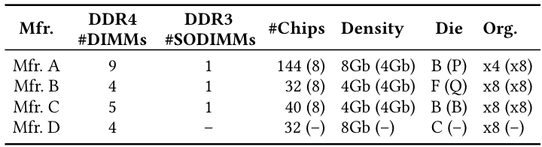
DRAM Chips Tested
Two DRAM standards
Mfr. | DDR4 DIMMs | DDR3 SODIMMs | # Chips | Density | Die | Org.
A (Micron) | 9 | 1 | 144 (8) | 8Gb (4Gb) | B (P) | x4 (x8)
B (Samsung) | 4 | 1 | 32 (8) | 4Gb (4Gb) | F (Q) | x8 (x8)
C (SK Hynix) | 5 | 1 | 40 (8) | 4Gb (4Gb) | B (B) | x8 (x8)
D (Nanya) | 4 | - | 32 (-) | 8Gb (-) | C (-) | x8 (-)
4 Major Manufacturers
272 DRAM Chips in total
Notes:
In our characterization, [CLICK]
we test 272 real DRAM chips [CLICK]
from four major manufacturers, [CLICK]
that implement DDR3 and DDR4 DRAM standards [CLICK]
and with different densities, die revisions, and chip organizations[CLICK]

Slide 30
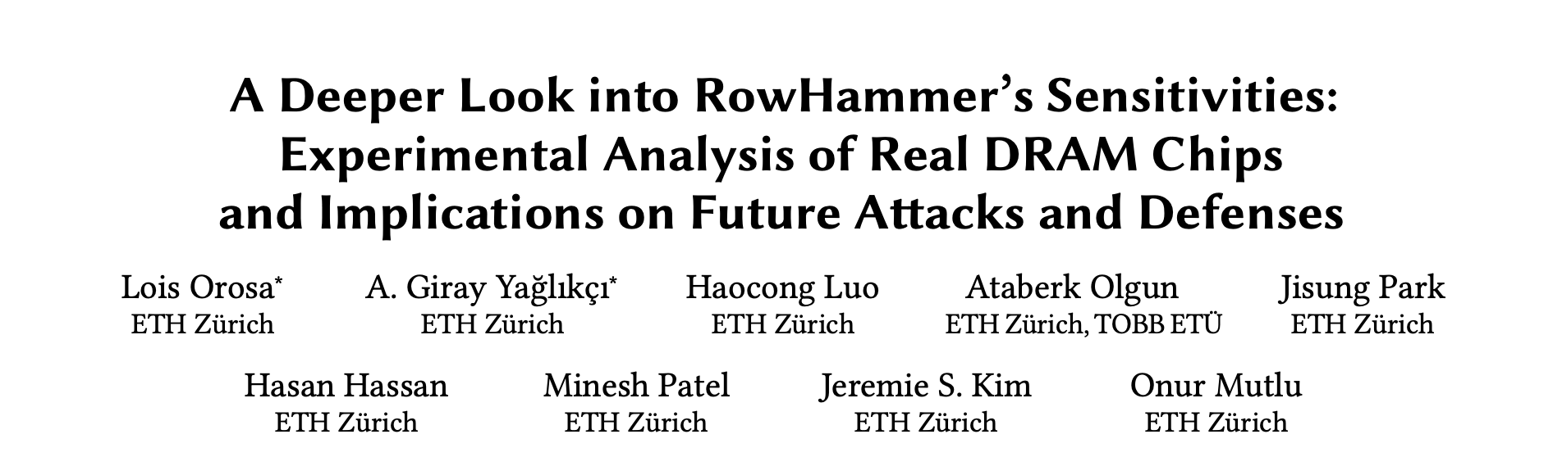
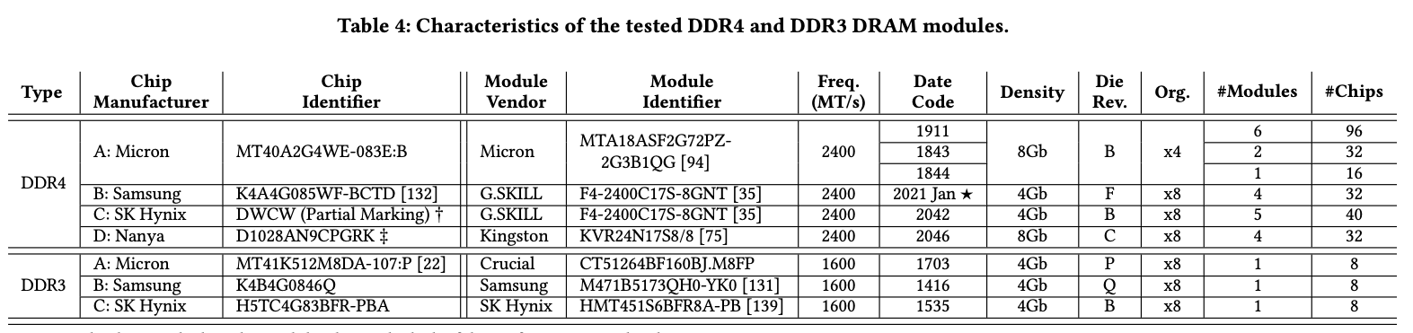
DRAM Chips Tested
Mfr. | DDR4 DIMMs | DDR3 SODIMMs | # Chips | Density | Die | Org.
A (Micron) | 9 | 1 | 144 (8) | 8Gb (4Gb) | B (P) | x4 (x8)
B (Samsung) | 4 | 1 | 32 (8) | 4Gb (4Gb) | F (Q) | x8 (x8)
C (SK Hynix) | 5 | 1 | 40 (8) | 4Gb (4Gb) | B (B) | x8 (x8)
D (Nanya) | 4 | - | 32 (-) | 8Gb (-) | C (-) | x8 (-)
272 total DRAM chips tested
Four major DRAM manufacturers
DDR3 and DDR4 DRAM standards
Different densities, die revisions and chip organizations
Notes:
We provide more details about the chips we test in extended arxiv version of the paper [CLICK]

Slide 31
Outline
Motivation and Goal
Motivation and Goal
Experimental Methodology
Temperature Analysis
Aggressor Row Active Time Analysis
Spatial Variation Analysis
Implications on Attacks and Defenses
Conclusions
Experimental Methodology
Temperature Analysis
Aggressor Row Active Time Analysis
Spatial Variation Analysis
Implications on Attacks and Defenses
Conclusions
Notes:
Let's begin with our first analysis: temperature

Slide 32
Key Takeaways from Temperature Analysis
Key Takeaway 1
To ensure that a DRAM cell is not vulnerable to RowHammer,
we must characterize the cell at all operating temperatures
Key Takeaway 2
RowHammer vulnerability tends to worsen as DRAM temperature increases
However, individual DRAM rows can exhibit behavior different from the dominant trend
Notes:
This analysis provides two key takeaway lessons: [CLICK]
First, To ensure that a DRAM cell is not vulnerable to RowHammer, we must characterize the cell at all operating temperatures [CLICK]
Second, RowHammer vulnerability tends to worsen as DRAM temperature increases [CLICK]
However, individual DRAM rows can behave differently from the dominant trend [CLICK]

Slide 33
Impact of Temperature on DRAM Cells
no bit flips
bit flips
no bit flips
Vulnerable Temperature Range
Temperature
Lower
Bound
Upper
Bound
The fraction of vulnerable DRAM cells, experiencing bit flips at all temperature levels within their vulnerable temperature range
Mfr. A | Mfr. B | Mfr. C | Mfr. D
99.1% | 98.9% | 98.0% | 99.2%
OBSERVATION 1
Most DRAM cells are vulnerable to RowHammer throughout a continuous temperature range
Notes:
We analyze the temperature levels a DRAM cell is vulnerable to RowHammer [CLICK]
We observe that there exists [CLICK] a lower and [CLICK] an upper bound of temperature [CLICK]
A DRAM cell experiences bit flips only within this bounded range[CLICK]
but we do not observe any bit flips out of this range [CLICK]
We call this range: vulnerable temperature range [CLICK]
This table demonstrates the fraction of DRAM cells that experience bit flips at all temperature levels within their vulnerable temperature range
We observe that more than 98% of vulnerable cells across all four manufacturers exhibit this behavior [CLICK]
Therefore, we conclude that most DRAM cells are vulnerable to RowHammer throughout a continuous temperature range [CLICK]

Slide 34
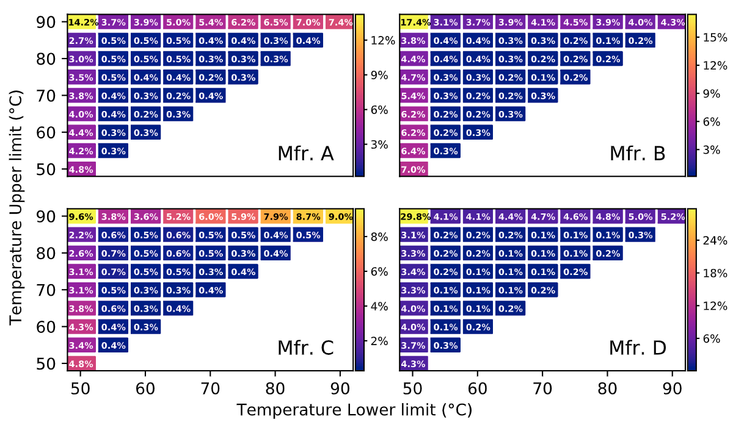
Impact of Temperature on DRAM Cells
Vulnerable from 70°C to 85 ° C
Fraction of Vulnerable DRAM Cells
Upper Bound (°C)
Vulnerable
from 55°C to 60°C
Lower Bound (°C)
Different DRAM cells are vulnerable to RowHammer within specific temperature ranges
Notes:
This figure shows the population density of cells, clustered based on their vulnerable temperature range. The x-axis and y-axis show the lower bound [CLICK] and the upper bound [CLICK] of a DRAM cell’s vulnerable temperature range [CLICK]
The color-scale and the percentage values show the fraction of cells for a given temperature range [CLICK]
For example, 0.4% of the cells are vulnerable to RowHammer only between 55 and 60 degrees Celsius [CLICK],
while 0.5% of the cells experience bit flips only between 70 and 85 degrees Celsius [CLICK]
We conclude that different DRAM cells are vulnerable to RowHammer within specific temperature ranges [CLICK]

Slide 35
Impact of Temperature on DRAM Cells
Upper Bound (°C)
29.8% of the cells experience bit flips at all tested temperatures
Lower Bound (°C)
OBSERVATION 2
A significant fraction of vulnerable DRAM cells exhibit bit flips at all tested temperatures
Notes:
Here are the results for all four manufacturers.
We make two observations from this figure. [CLICK]
First, we observe that a significant fraction of vulnerable DRAM cells exhibit bit flips at all tested temperatures For example, almost 30% of cells from manufacturer D experience bit flips at all temperatures we tested, [CLICK]

Slide 36
Impact of Temperature on DRAM Cells
Upper Bound (°C)
0.2% of the cells experience bit flips only at 70°C
Lower Bound (°C)
OBSERVATION 3
A small fraction of all vulnerable DRAM cells are vulnerable to RowHammer only in a very narrow temperature range
Notes:
Second, we observe that [CLICK]
a small fraction of the cells from all four manufacturers are vulnerable to RowHammer only in a very narrow temperature range. [CLICK]
For example, 0.2% of the cells from manufacturer D experience bit flips only at 70C. [CLICK]

Slide 37
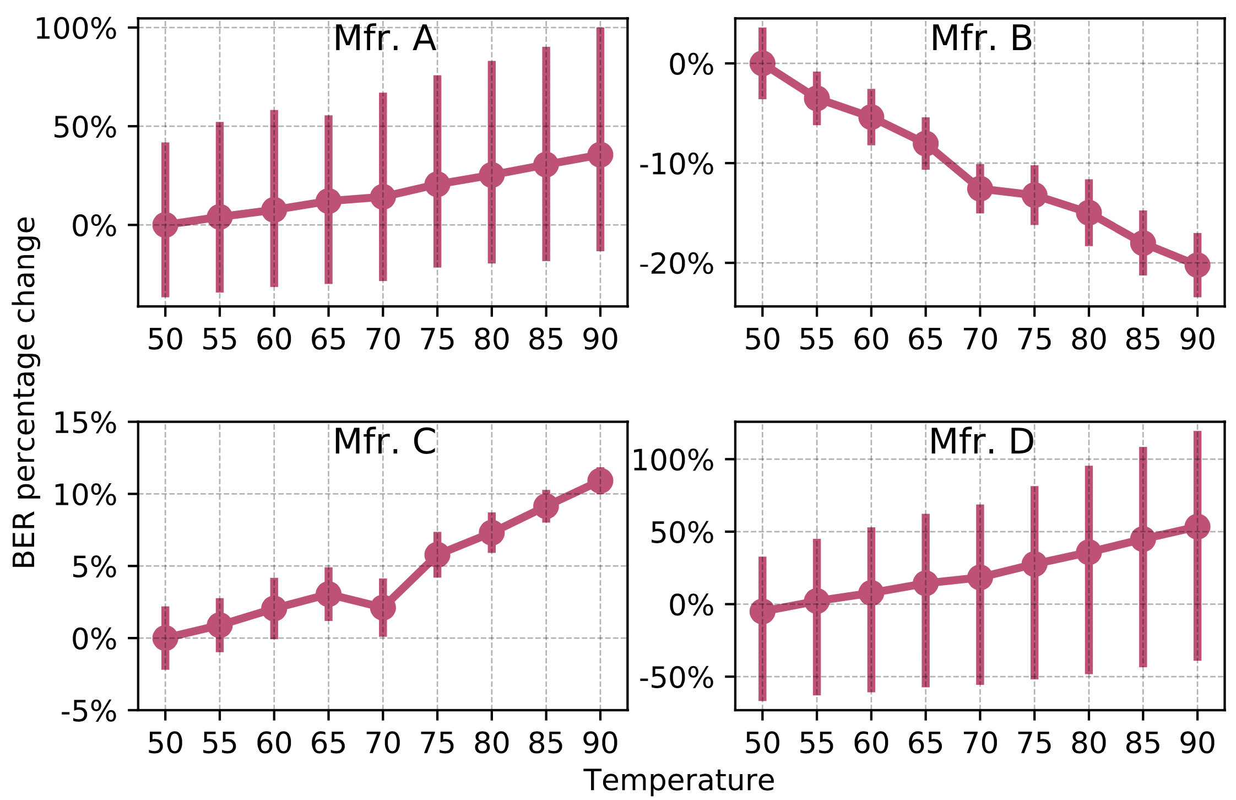
Impact of Temperature on DRAM Rows
Variation in
Bit Flip Counts
per DRAM Row
Temperature (°C)
More cells experience bit flips as temperature increases
Notes:
Next, we study the impact of temperature on DRAM rows. The figure shows how the number of bit flips in the victim row changes as temperature increases.[CLICK]
The x-axis shows the increasing temperature [CLICK] and y-axis reports the variation in bit flip counts normalized to the mean value at 50°C. [CLICK]
We observe that more cells experience a bit flip with increasing temperature, [CLICK]

Slide 38
Impact of Temperature on DRAM Rows
Variation in Bit Flip Counts per DRAM Row
Temperature (°C)
OBSERVATION 4
A DRAM row’s bit error rate can either increase or decrease with temperature depending on the DRAM manufacturer
Notes:
We repeat this analysis for all four manufacturers [CLICK]
We observe that the bit error rate increases with temperature in modules from three manufacturers, [CLICK]
While it exhibits an opposite trend in modules from manufacturer B. We hypothesize that this happens due to different characteristics of charge trap error mechanisms in different manufacturers. Please refer to our full paper for more details [CLICK]
Our main observation from this figure is that A DRAM row’s BER can either increase or decrease with temperature depending on the DRAM manufacturer [CLICK]

Slide 39
Also in the Paper
The minimum activation count at which a victim row experiences a bit flip (HC_{first}) when temperature changes:
OBSERVATION 5
DRAM rows can show either higher or lower HC_{first}
when temperature increases
OBSERVATION 6
HC_{first} tends to generally decrease
as temperature change (ΔT) increases
OBSERVATION 7
The HC_{first} change (ΔHC_{first}) tends to be larger
as temperature change (ΔT) increases
Notes:
In the paper, we also analyze the variation in HCfirst, the minimum activation count at which a victim row experiences a bit flip, and make three observations from this analysis[CLICK]
First, just like BER, DRAM rows can show either higher or lower HC_{first} when temperature increases [CLICK]
Second, Hcfirst tends to generally decrease as delta temperature increases [CLICK]
And third, delta Hcfirst tends to be larger as delta temperature increases [CLICK]

Slide 40
Also in the Paper
The minimum activation count at which a victim row experiences a bit flip (HC_{first}) when temperature changes:
KEY OBSERVATION 5
DRAM rows can show either higher or lower HC_{first}
when temperature increases
KEY OBSERVATION 6
HC_{first} tends to generally decrease
as temperature change (ΔT) increases
KEY OBSERVATION 7
The HC_{first} change (ΔHC_{first}) tends to be larger
as temperature change (ΔT) increases
Notes:
Please refer to the full paper for these analyses

Slide 41
Outline
Motivation and Goal
Motivation and Goal
Experimental Methodology
Temperature Analysis
Aggressor Row Active Time Analysis
Spatial Variation Analysis
Implications on Attacks and Defenses
Conclusions
Experimental Methodology
Temperature Analysis
Aggressor Row Active Time Analysis
Spatial Variation Analysis
Implications on Attacks and Defenses
Conclusions
Notes:
Next we investigate the variation in RowHammer vulnerability with the time that an aggressor row stays active

Slide 42
Key Takeaways from Aggressor Row Active Time Analysis
Key Takeaway 3
As an aggressor row stays active longer,
victim DRAM cells become more vulnerable to RowHammer
Key Takeaway 4
RowHammer vulnerability of victim cells decreases
when the bank is precharged for a longer time
Notes:
This analysis provides two key takeaways: [CLICK]
First, As an aggressor row stays active longer, victim DRAM cells become more vulnerable to RowHammer [CLICK]
And second, RowHammer vulnerability of victim cells decreases when the bank is precharged for a longer time [CLICK]

Slide 43
Memory Access Patterns in Aggressor Row Active Time Analysis
Baseline access pattern:
Increasing aggressor row active time:
Increasing bank precharged time:
Row A is active
Row B is active
Row A is active
Row B is active
Time
Row A is active
Row B is active
Row A is active
Time
Aggressor row active time
Aggressor row active time
Aggressor row active time
Row A is active
Row B is active
Row A is active
Time
Bank precharged time
Bank precharged time
Bank precharged time
Notes:
To perform this analysis, we conduct two sets of experiments [CLICK]
In the baseline, we hammer rows A and B as frequently as possible [CLICK]
In the first set of tests, we increase the time that an aggressor row is active [CLICK],
And in the second set of experiments we increase the time that the bank is precharged [CLICK]

Slide 44
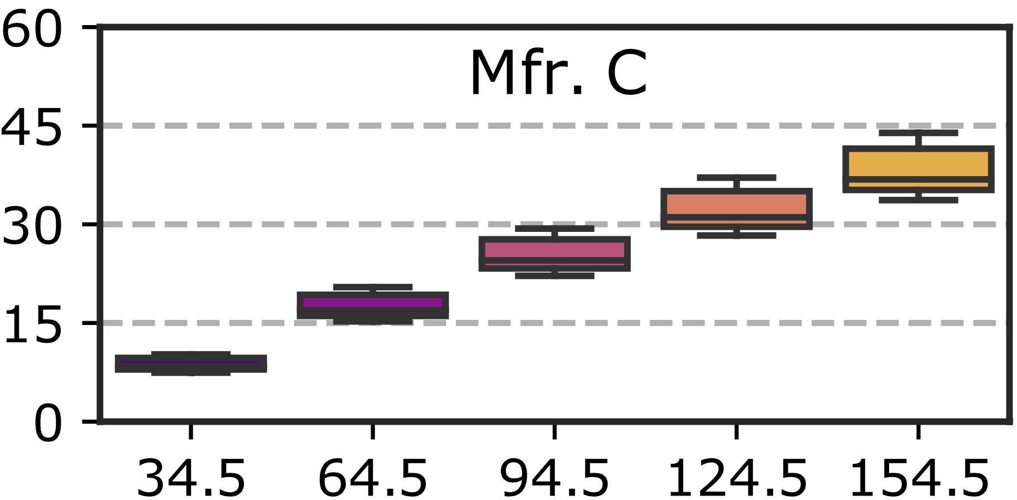
Increasing Aggressor Row Active Time
Number of Bit Flips
per DRAM Row
Aggressor Row Active Time (ns)
As the aggressor row stays active longer, more DRAM cells experience RowHammer bit flips
Notes:
This plot demonstrates how [CLICK]
bit error rate varies [CLICK]
when aggressor row active time increases [CLICK]
We observe that: As the aggressor row stays active longer, more DRAM cells experience RowHammer bit flips [CLICK]

Slide 45
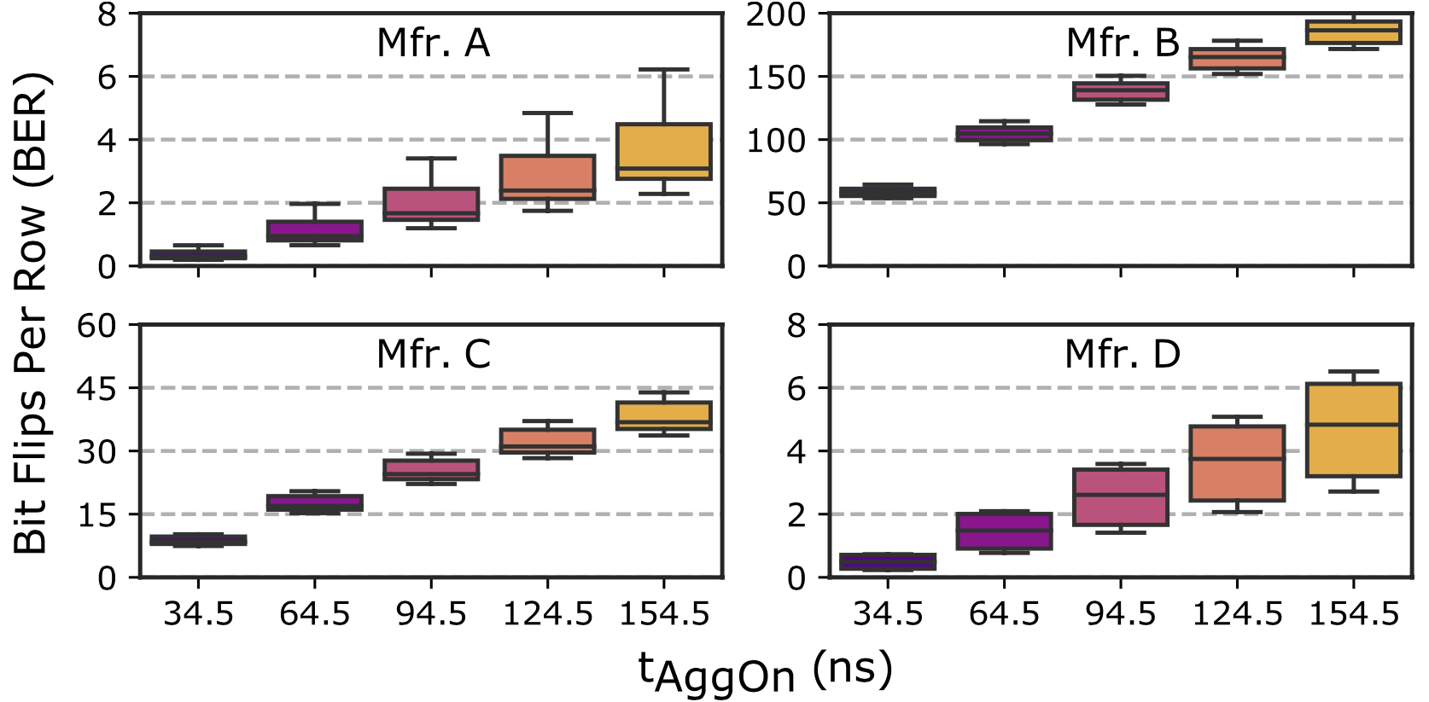
Increasing Aggressor Row Active Time
Number of Bit Flips
per DRAM Row
Aggressor Row Active Time (ns)
As the aggressor row stays active longer, more DRAM cells experience RowHammer bit flips
Notes:
We observe the same trend on modules from all four manufacturers [CLICK]

Slide 46
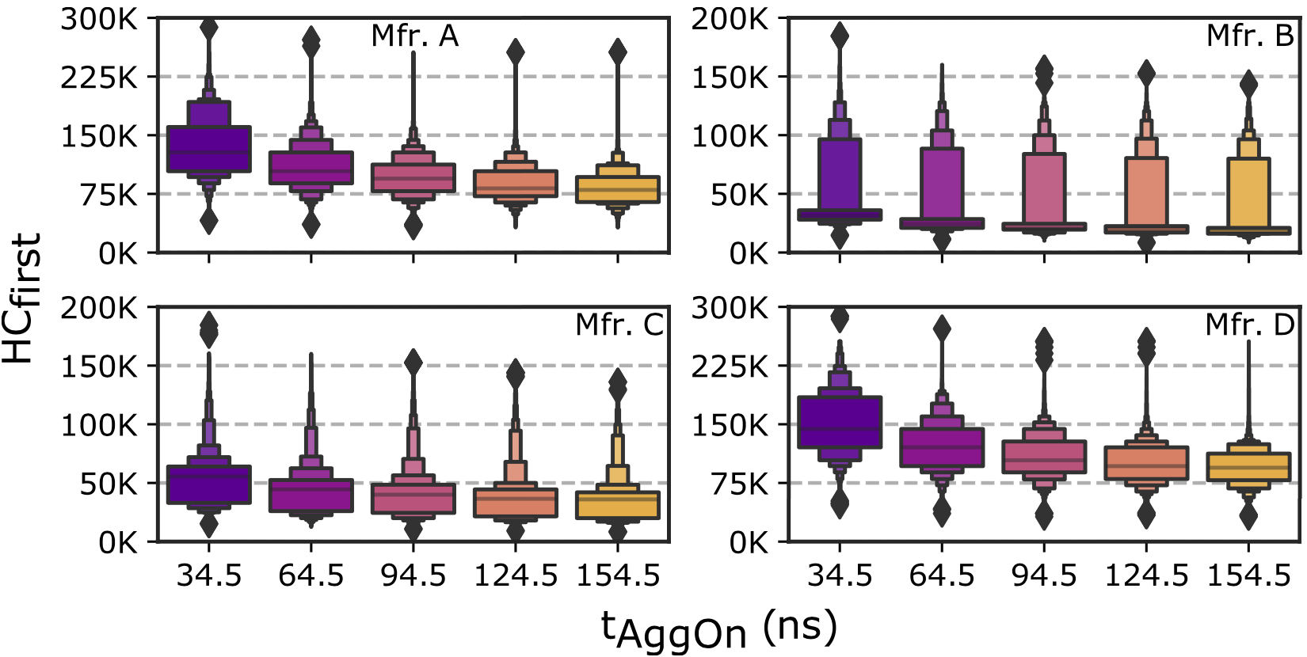
Increasing Aggressor Row Active Time
Minimum Activation Count
to Observe a Bit Flip (HC_{first})
Aggressor Row Active Time (ns)
Fewer activations are required to cause RowHammer bit flips when aggressor rows stay active for longer time
Notes:
In this plot, we investigate the variation in Hcfirst, [CLICK]
the minimum activation count to observe a bit flip [CLICK]
With increasing aggressor row active time [CLICK]
We observe that DRAM cells experience bit flips at smaller activation counts when aggressor rows stay active longer [CLICK]

Slide 47
Increasing Aggressor Row Active Time
Minimum Activation Count
to Observe a Bit Flip (HC_{first})
Aggressor Row Active Time (ns)
OBSERVATION 8
As the aggressor row stays active longer, more DRAM cells experience RowHammer bit flips and they experience RowHammer bit flips at lower activation counts
Notes:
We observe the same trend on modules from all four manufacturers [CLICK]
Based on our observations on the bit error rate and Hcfirst, we conclude that: as the aggressor row stays active longer, more DRAM cells experience RowHammer bit flips AND they experience RowHammer bit flips at lower activation counts [CLICK]

Slide 48
Also in the Paper
The variation in aggressor row active time’s effects across DRAM rows and the effect of increasing bank precharged time
OBSERVATION 9
As the aggressor row stays active longer, the RowHammer vulnerability consistently worsens across tested DRAM rows
OBSERVATION 10
As the bank stays precharged longer, fewer DRAM cells experience RowHammer bit flips and they experience RowHammer bit flips at higher activation counts
OBSERVATION 11
As the bank stays precharged longer, the RowHammer vulnerability consistently reduces across tested DRAM rows
Notes:
In the paper, we also investigate the variation in aggressor row active time’s effects across DRAM rows and the effect of increasing bank precharged time. We make three observations from this analysis: [CLICK]
First, as the aggressor row stays active longer, the RowHammer vulnerability consistently worsens across all tested DRAM rows [CLICK]
Second, as the bank stays precharged longer, fewer DRAM cells experience RowHammer bit flips, and they experience bit flips at higher activation counts [CLICK]
Third, this reduction in RowHammer vulnerability is also consistent across all tested DRAM rows [CLICK]

Slide 49
Also in the Paper
The variation in these behaviors across DRAM rows and the effect of increasing bank precharged time
KEY OBSERVATION 9
As the aggressor row stays active longer, the RowHammer vulnerability consistently worsens across tested DRAM rows
KEY OBSERVATION 10
As the bank stays precharged longer, fewer DRAM cells experience RowHammer bit flips and they experience RowHammer bit flips at higher activation counts
KEY OBSERVATION 11
As the bank stays precharged longer, the RowHammer vulnerability consistently reduces across tested DRAM rows
Notes:
Please refer to the full paper for these analyses

Slide 50
Outline
Motivation and Goal
Motivation and Goal
Experimental Methodology
Temperature Analysis
Aggressor Row Active Time Analysis
Spatial Variation Analysis
Implications on Attacks and Defenses
Conclusions
Experimental Methodology
Temperature Analysis
Aggressor Row Active Time Analysis
Spatial Variation Analysis
Implications on Attacks and Defenses
Conclusions
Notes:
Our third analysis is about spatial variation

Slide 51
Key Takeaways from Spatial Variation Analysis
Key Takeaway 5
RowHammer vulnerability significantly varies
across DRAM rows and columns due to design-induced
and manufacturing-process-induced variation
Key Takeaway 6
The distribution of the minimum activation count to observe bit flips (HC_{first}) exhibits a diverse set of values in a subarray
but similar values across subarrays in the same DRAM module
Notes:
In this analysis, we investigate how the RowHammer vulnerability varies based on a victim DRAM cell's physical location
We have two key takeaways from this analysis. [CLICK]
First, The RowHammer vulnerability significantly varies across DRAM rows and columns due to both design induced and manufacturing process induced variation [CLICK]
Second, the distribution of HCfirst exhibits
- a diverse set of values within a subarray
- But similar values across subarrays within a DRAM module [CLICK]

Slide 52
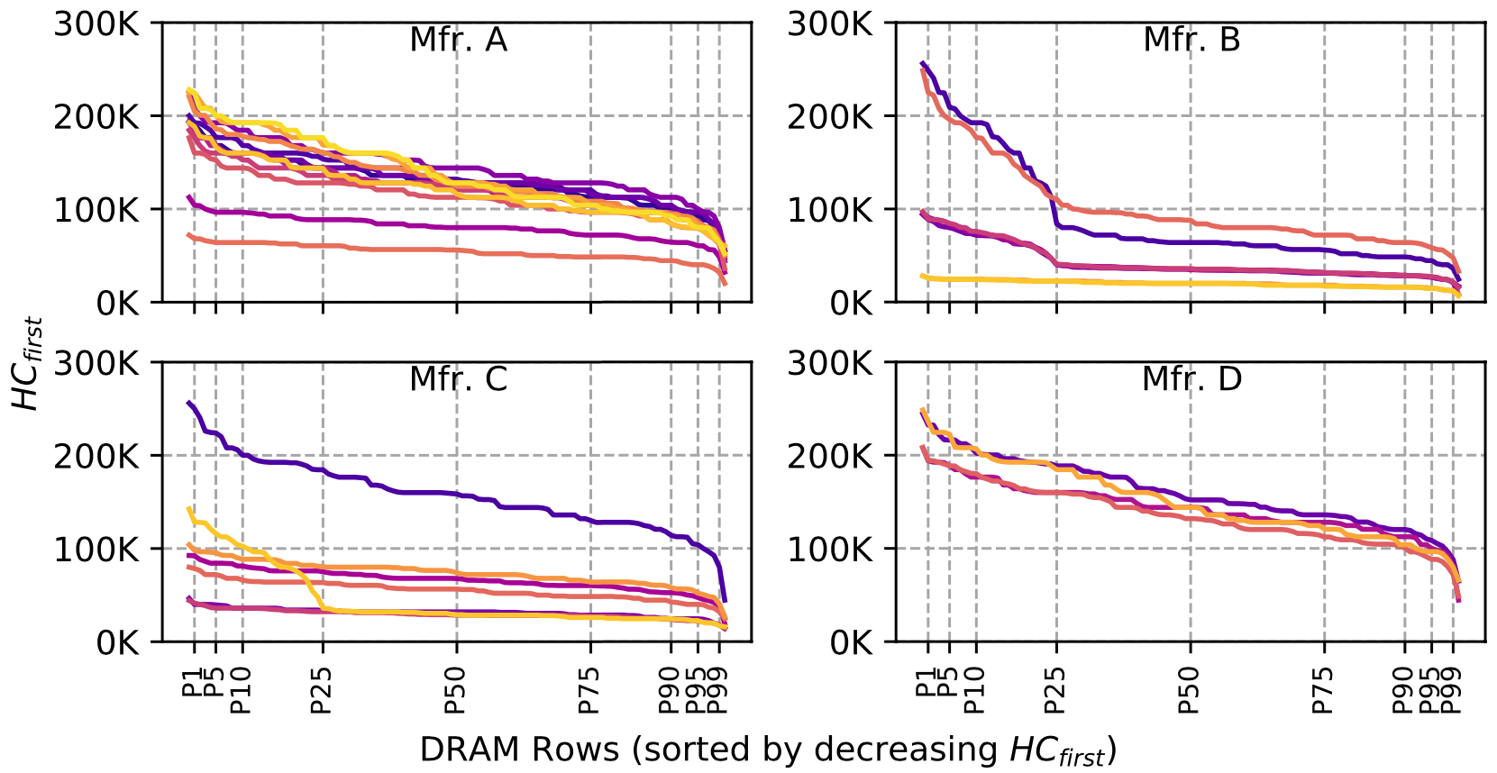
Spatial Variation across Rows
The minimum activation count to observe bit flips (HC_{first}) across DRAM rows:
Minimum Activation Count
to Observe a Bit Flip (HC_{first})
DRAM Rows (sorted by reducing HC_{first})
The RowHammer vulnerability
significantly varies across DRAM rows
Notes:
To do this analysis, we first investigate how Hcfirst, [CLICK]
the minimum activation count to observe bit flips, varies [CLICK]
across different DRAM rows sorted by reducing Hcfirst value on the x-axis.
Each curve in this plot represents a different DRAM module [CLICK]
We observe that Hcfirst values and thus the RowHammer vulnerability significantly varies across DRAM rows, as we highlight [CLICK]

Slide 53
Spatial Variation across Rows
Min. Activation Count
to Observe a Bit Flip (HC_{first})
DRAM Rows (sorted by reducing HC_{first})
The RowHammer vulnerability
significantly varies across DRAM rows
Notes:
This significant variation can be observed on modules from all four manufacturers

Slide 54
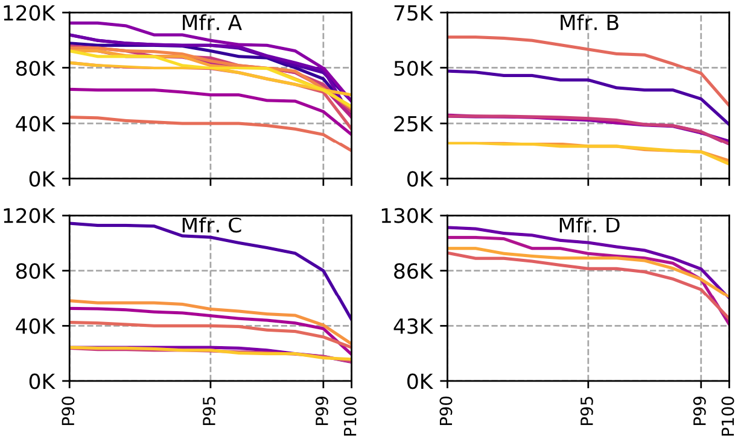
Spatial Variation across Rows
Minimum Activation Count
to Observe a Bit Flip (HC_{first})
DRAM Rows (sorted by reducing HC_{first})
OBSERVATION 12
A small fraction of DRAM rows are significantly more vulnerable to RowHammer than the vast majority of the rows
Notes:
Zooming into the most vulnerable DRAM rows, [CLICK]
We observe that the most vulnerable 10% of the rows experience bit flips at activation counts about half the Hcfirst of the other rows [CLICK]
Therefore, we conclude that a small fraction of DRAM rows are significantly more vulnerable to RowHammer than the vast majority of the rows [CLICK]

Slide 55
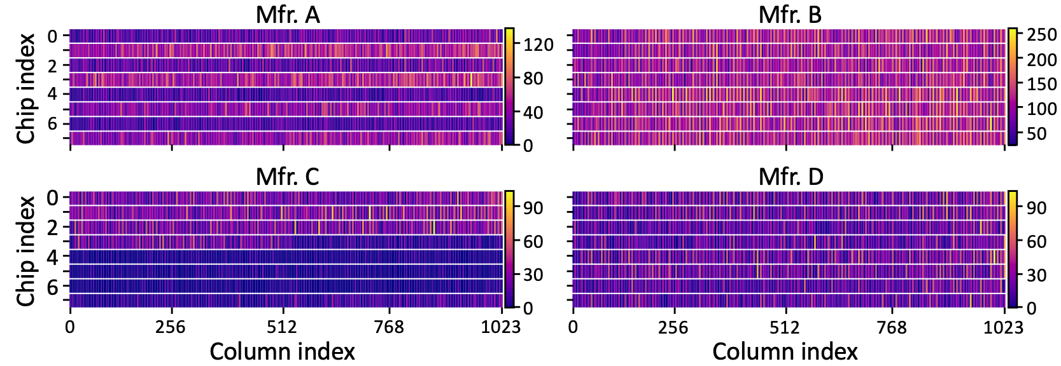
Spatial Variation across Columns
Number of Bit Flips in a Column
Chip ID
Column Index
OBSERVATION 13
Certain columns are significantly more vulnerable
to RowHammer than other columns
Notes:
To investigate how the RowHammer vulnerability varies across columns, we generate a heatmap plot of [CLICK]
bit error rates [CLICK]
across columns [CLICK]
and chips [CLICK]
We observe that bit errors concentrate on certain DRAM columns more than others, implying that certain columns are significantly more vulnerable to RowHammer than other columns [CLICK]

Slide 56
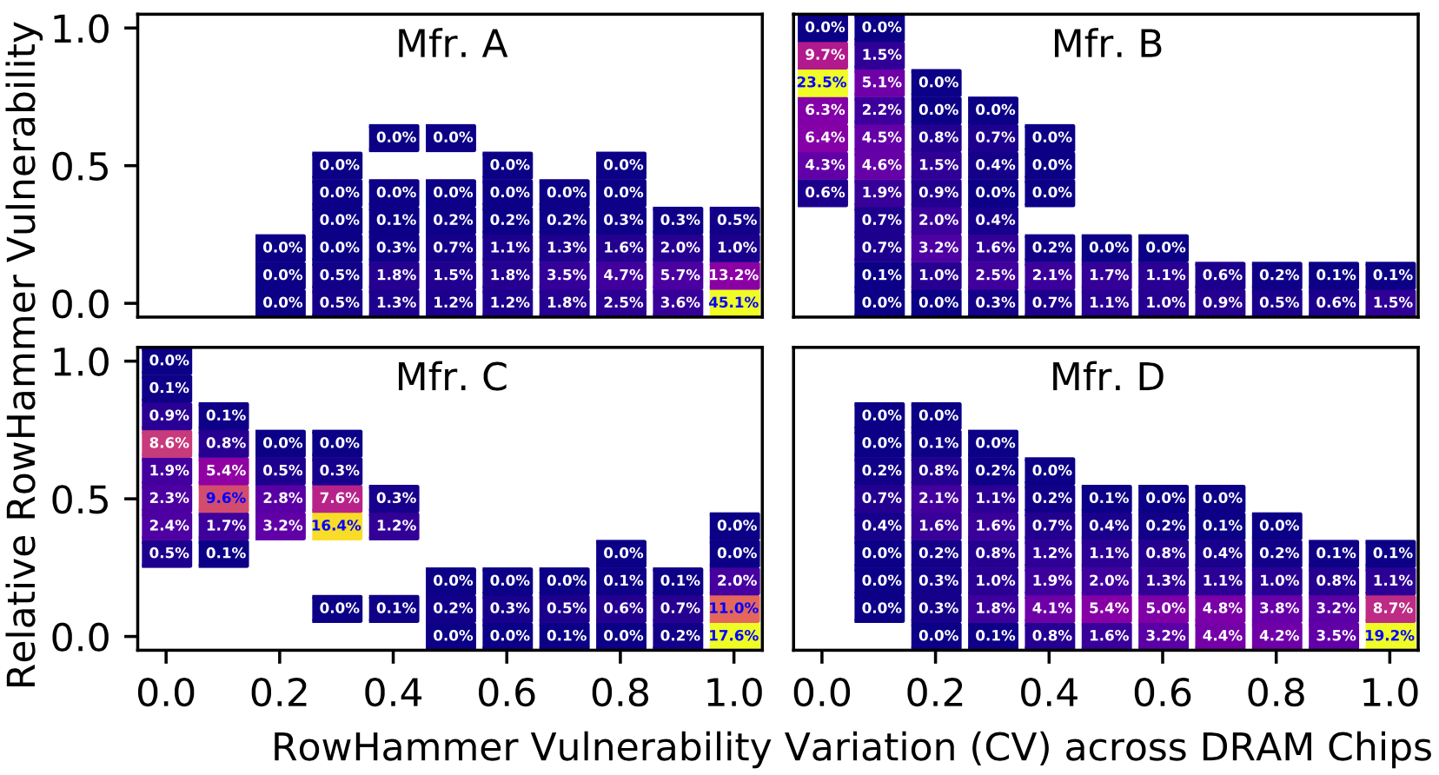
Spatial Variation across Columns
High RowHammer vulnerability across all chips
→design-induced variation
16.7%
1.0
0.5
0.0
Worse RowHammer Vulnerability
30.6%
0.0 0.2 0.4 0.6 0.8 1.0
Larger Variation across DRAM Chips
High variation in vulnerability across chips
→ manufacturing-process-induced variation
Notes:
To further investigate the variation across columns and chips, we cluster each DRAM column based on [CLICK]
its RowHammer vulnerability on average across DRAM chips [CLICK]
and the variation in its vulnerability across DRAM chips
This plot shows the population density of DRAM columns exhibiting a level of RowHammer vulnerability and variation across chips
For example, [CLICK] 16.7% of DRAM columns exhibit a high RowHammer vulnerability across all chips, indicating design-induced variation across columns [CLICK]
In contrast, 30.6% of DRAM columns exhibit a high variation in their RowHammer vulnerability across chips, indicating manufacturing-process-induced variation [CLICK]

Slide 57
Spatial Variation across Columns
50.8%
16.7%
Worse RowHammer Vulnerability
59.8%
30.6%
29.1%
Larger Variation across DRAM Chips
OBSERVATION 14
Both manufacturing process and design
affect a DRAM column’s RowHammer vulnerability
Notes:
Here we see the same analysis for four manufacturers [CLICK]
We observe that there exist columns with very low or very high variation across chips from all four manufacturers [CLICK]
Based on this analysis, we conclude that both manufacturing process and design affect a DRAM column’s RowHammer vulnerability [CLICK]

Slide 58
Also in the Paper
The minimum activation count at which a victim row experiences a bit flip (HC_{first}) across rows in a subarray and across subarrays in a DRAM module:
OBSERVATION 15
The most vulnerable DRAM row in a subarray
is significantly more vulnerable
than the other rows in the subarray
OBSERVATION 16
HC_{first} distributions of subarrays within a DRAM module
are significantly more similar to each other
than those of subarrays from different modules
Notes:
In the paper, we also analyze the variation across rows in a subarray and across subarrays in a DRAM module. We make two observations from this analysis [CLICK]
First, The most vulnerable DRAM row in a subarray is significantly more vulnerable than the other rows in the subarray [CLICK]
Second, HC_{first} distributions of subarrays within a DRAM module are significantly more similar to each other than those of subarrays from different modules [CLICK]

Slide 59
Also in the Paper
The minimum activation count at which a victim row experiences a bit flip (HC_{first}) across rows in a subarray and across subarrays in a module:
KEY OBSERVATION 15
The most vulnerable DRAM row in a subarray
is significantly more vulnerable
than the other rows in the subarray
KEY OBSERVATION 16
HC_{first} distributions of subarrays within a DRAM module
are significantly more similar to each other
than those of subarrays from different modules
Notes:
Please refer to the full paper for these analyses

Slide 60
Outline
Motivation and Goal
Motivation and Goal
Experimental Methodology
Temperature Analysis
Aggressor Row Active Time Analysis
Spatial Variation Analysis
Implications on Attacks and Defenses
Conclusions
Experimental Methodology
Temperature Analysis
Aggressor Row Active Time Analysis
Spatial Variation Analysis
Implications on Attacks and Defenses
Conclusions
Notes:
Now, I will explain the implications of our observations on future attacks and defenses

Slide 61
Implications on Attacks and Defenses
Our observations can be leveraged to craft
more effective RowHammer attacks
Our observations can be leveraged to design more effective and efficient RowHammer defenses
Notes:
We believe that our observations can be leveraged [CLICK]
To craft more effective attacks [CLICK]
And to design more effective and efficient defenses.
In the following slides, I will explain several examples for these implications [CLICK]

Slide 62
Attack Improvement 1: Making DRAM Cells More Vulnerable
An attacker can manipulate temperature to make the cells that store sensitive data more vulnerable
DRAM cells are vulnerable in a bounded temperature range
no bit flips
Vulnerable Temperature Range
no bit flips
Temperature
50°C
70°C
75°C
65°C
55°C
45°C
Heating up chip temperature
Cooling down chip temperature
Notes:
In the first example for an attack improvement, the attacker manipulates the DRAM module’s temperature to increase the RowHammer vulnerability of the cells that store sensitive data [CLICK]
We observe that DRAM cells are vulnerable to RowHammer in a bounded temperature range [CLICK]
that we call vulnerable temperature range [CLICK]
For example, let this range be from 50 to 70 degrees celsius for the victim cells
To attack the cells within their vulnerable temperature range, an attacker can [CLICK]
heat up the chip if its current temperature is below 50 [CLICK]
Or cool down the chip if its current temperature is above 70 degrees celsius [CLICK]

Slide 63
Attack Improvement 2: Temperature-Dependent Trigger
Identify abnormal increase in temperature to attack a data center during its peak hours
Precisely measure the temperature to trigger an attack exactly at the desired temperature
76.6%
of the cells*
1.
70 °C
Temperature
0.4%
of the cells*
2.
0.4%
of the cells*
70 °C
70 °C
Temperature
Temperature
*Example fraction values from Mfr. C
Notes:
In the second attack example, the attacker uses RowHammer to understand the DRAM chip’s current temperature [CLICK]
As an example, more than 76% of the vulnerable cells experience bit flips above 70 degrees Celsius for Mfr C. Focusing on these cells, an attacker can identify abnormal operating conditions that might occur in a data center during its peak hours. This information can be used to trigger an attack when the data center is under pressure[CLICK]
If it is important to measure temperature precisely, the attacker can focus on a smaller set of vulnerable cells that experience bit flips only in a narrow temperature range. For example, 0.4% of vulnerable cells experience bit flips only at 70 degrees Celsius in Mfr C. Using these cells, the attacker can precisely detect the temperature and trigger an attack accordingly [CLICK]

Slide 64
Attack Improvement 3: Bypassing Defenses with Aggressor Row Active Time
Activating aggressor rows as frequently as possible:
Row A is active
Row B is active
Row A is active
Time
Keeping the aggressor rows active for a longer time:
Row A is active
Row B is active
36% reduction in HC_{first}
Time
Reduces the minimum activation count to induce a bit flip by 36%
Bypasses defenses that do not account for this reduction
Notes:
In the third example, an attacker can leverage the effect of aggressor row active time [CLICK]
In this scenario, instead of activating aggressor rows as frequently as possible, [CLICK]
the attacker can keep the aggressor rows active for longer time [CLICK]
Based on our analyses, HCfirst reduces by 36% on average with the proposed access pattern
With this reduction, an attacker can bypass RowHammer defenses that do not account for this reduction [CLICK]

Slide 65
Defense Improvements
Example 1: Leveraging the variation across DRAM rows
Example 2: Leveraging the variation with temperature
A DRAM cell experiences bit flips within a bounded temperature range
A row can be disabled within the row’s vulnerable temperature range
90%
HC_{first}
10%
Aggressiveness can be reduced:
33% area reduction for BlockHammer [Yağlıkçı+, HPCA'21]
$2×$HC_{first}
80% area reduction for Graphene [Park+, MICRO'20]
Breakdown of DRAM Rows
no bit flips
Vulnerable Temperature Range
no bit flips
Temperature
Disable RowA
Disable RowB
Temperature
Notes:
I will also explain two improvements for defense mechanisms in this slide, but you can find more in the paper [CLICK]
The first improvement leverages the variation across rows [CLICK]
We observe that 90% of the rows do not experience bit flips until the activation count reaches the double Hcfirst of the 10% of the rows.[CLICK]
Therefore, we can reduce the aggressiveness of defense mechanisms for 90% of the rows, which can reduce the area overheads of state-of-the-art defense mechanisms: [CLICK] BlockHammer and [CLICK] Graphene, by 33 and 80%, respectively [CLICK]
The second example leverages the variation in RowHammer vulnerability with temperature [CLICK]
We show that DRAM cells experience bit flips in bounded temperature ranges [CLICK]
To avoid bit flips, A DRAM row can be disabled when its cells are vulnerable to RowHammer at the current operating temperature [CLICK]

Slide 66
More Defense Implications in the Paper
Leveraging the similarity across subarrays in a DRAM module can reduce the module’s profiling time for RowHammer errors
Monitoring and limiting the aggressor row active time from the memory controller can reduce the RowHammer vulnerability and make defenses more efficient
ECC schemes can target the non-uniform bit error distribution caused by design-induced variation across DRAM columns
Cooling DRAM chips can reduce overall bit error rate
Notes:
We propose more defense improvements in the paper that I will briefly mention in this slide [CLICK]
First, Leveraging the similarity across subarrays in a DRAM module can reduce the module’s profiling time for RowHammer errors
Second, Monitoring and limiting the aggressor row active time from the memory controller can reduce the RowHammer vulnerability and make defenses more efficient
Third, ECC schemes can target the non-uniform bit error distribution caused by design-induced variation across DRAM columns
Fourth, Cooling DRAM chips can reduce overall bit error rate

Slide 67
More Defense Implications in the Paper
Leveraging the similarity across subarrays in a DRAM module to speed up profiling the module for RowHammer errors
Monitoring and limiting the aggressor row active time from the memory controller can reduce the RowHammer vulnerability and the defense cost
An ECC scheme can target the non-uniform bit error distribution caused by design-induced variation across DRAM columns
Cooling DRAM chips can reduce overall bit error rate
Notes:
Please refer to our full paper for more details on both attack and defense improvements

Slide 68
Outline
Motivation and Goal
Motivation and Goal
Experimental Methodology
Temperature Analysis
Aggressor Row Active Time Analysis
Spatial Variation Analysis
Implications on Attacks and Defenses
Conclusions
Experimental Methodology
Temperature Analysis
Aggressor Row Active Time Analysis
Spatial Variation Analysis
Implications on Attacks and Defenses
Conclusions
Notes:
To conclude,

Slide 69
Conclusion
Motivation:
Denser DRAM chips are more vulnerable to RowHammer
Understanding RowHammer enables designing effective and efficient solutions, but no rigorous study demonstrates how vulnerability varies under different conditions
Goal: Provide insights into three fundamental properties of RowHammer that can be leveraged to design more effective and efficient attacks and defenses
DRAM chip temperature
The time that an aggressor row stays active
Victim DRAM cell’s physical location
Experimental study: 272 DRAM chips from four major manufacturers
Key Results: We provide 6 takeaways from 16 novel observations
A RowHammer bit flip is more likely to occur
in a bounded range of temperature
if the aggressor row is active for longer time
in certain physical regions of the DRAM module under attack
Conclusion: Our novel observations can inspire and aid future work
Craft more effective attacks
Design more effective and efficient defenses
Notes:
Denser DRAM chips are more vulnerable to RowHammer [CLICK]
And Understanding RowHammer is critical to find effective and efficient solutions. However, no rigorous study demonstrates how this vulnerability varies under different conditions [CLICK]
In this work, our goal is to provide insights into three fundamental properties of RowHammer that can be leveraged to design more effective and efficient attacks and defenses These three properties are [CLICK]
DRAM chip temperature, [CLICK]
The time that an aggressor row stays active [CLICK]
and victim DRAM cell’s physical location [CLICK]
In this study, we test 272 real DRAM chips of DDR3 and DDR4 modules from four major manufacturers [CLICK]
Based on our analyses, we draw 6 key takeaway lessons from 16 novel observations. Among these, we highlight that [CLICK]
A RowHammer bit flip is more likely to occur [CLICK]
in a bounded range of temperature [CLICK]
if the aggressor row is active for longer time [CLICK]
And in certain physical regions of the DRAM module under attack [CLICK]
Based on our findings, we propose several improvements. We believe and hope that our novel observations will inspire and aid future work on crafting more effective attacks and designing more effective and efficient defense mechanisms [END]

Slide 70
A Deeper Look into RowHammer’s Sensitivities Experimental Analysis of Real DRAM Chips and Implications on Future Attacks and Defenses
BACKUP SLIDES
Lois Orosa Abdullah Giray Yağlıkçı
Haocong Luo Ataberk Olgun Jisung Park
Hasan Hassan Minesh Patel Jeremie S. Kim Onur Mutlu
Notes:
This concludes my talk . Thank you for your time and attention. For many more details, I invite you to read our MICRO 2021 paper.

Slide 71
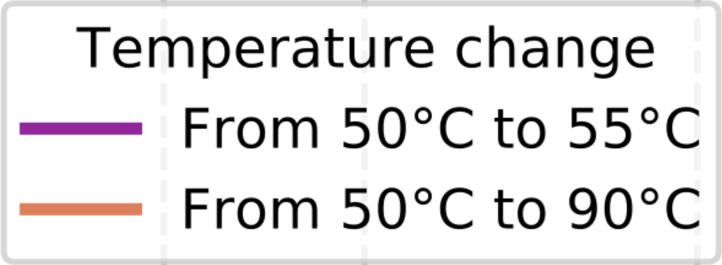
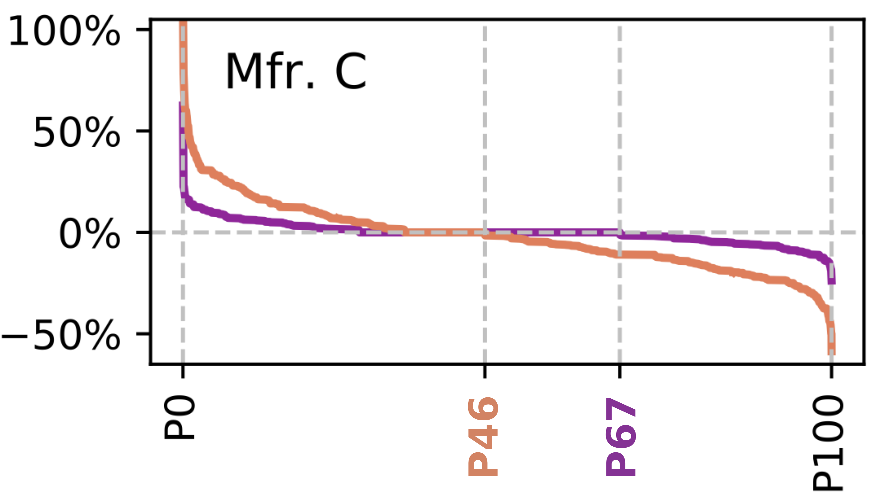
Distribution of the Change in HC_{first}
Percentage Change in
Minimum Activation Count
to Observe a Bit Flip (HC_{first})
Less Vulnerable
More Vulnerable
Rows Ordered by HC_{First} change
Notes:
This figure shows the distribution of the change in HCfirst, which is the minimum activation count to observe a bit flip. The purple line indicates how HCfirst changes when changing the temperature from 50 to 55 celsius degrees, and the orange line indicates how HCfirst changes when the temperature increases from 50 to 90 Celsius degrees [CLICK]
The y-axis shows the percentage change in in HCfirst. Positive percentage changes indicate that the cell is less vulnerable to RowHammer when the temperature increases, and a negative percentage change indicates that the cell is more vulnerable when the temperature increases [CLICK]
The x-axis shows the vulnerable cells ordered from most positive to most negative temperature change [CLICK]
For each curve, we mark the x- axis point at which the curve crosses the y = 0% line. This represents the percentile of rows whose vulnerability decreases [CLICK]

Slide 72
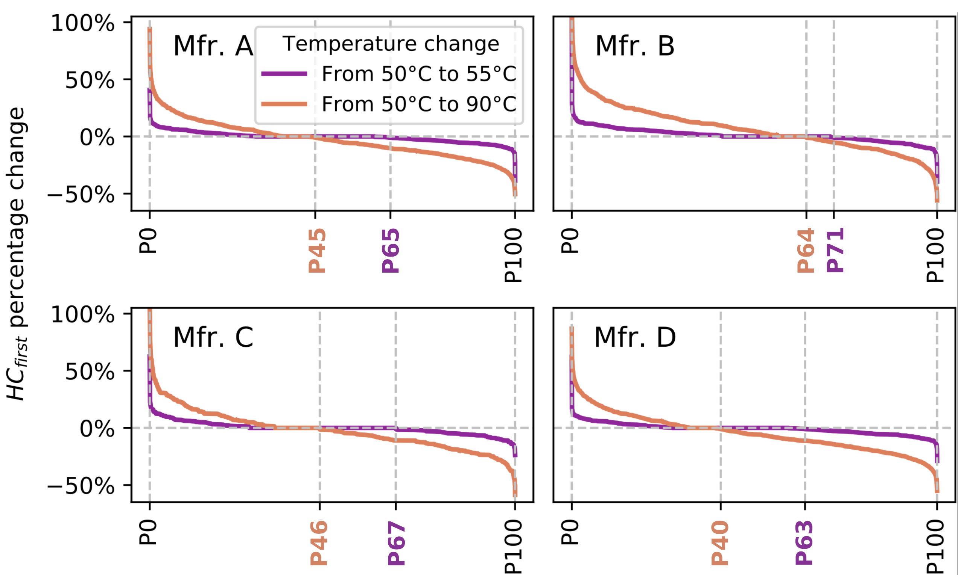
Distribution of the Change in HC_{first}
OBSERVATION 5
DRAM rows can show either higher or lower HC_{first}
when temperature increases
Notes:
Here are the results for all four manufacturers.
We make three observations from this figure. [CLICK]
First, we observe that a DRAM rows can show either higher or lower HCfirst when temperature increases [CLICK]
For example, in manufacturer C, some DRAM cells show higher HCfirst, and other show lower HCfirst [CLICK]

Slide 73
Distribution of the Change in HC_{first}
OBSERVATION 6
HC_{first} tends to generally decrease
as temperature change (ΔT) increases
Notes:
Second, [CLICK]
We observe that HCfirst tends to generally decrease as temperature change (ΔT) increases [CLICK]
The figure shows that, for all manufacturer, the percentage of cells that are more vulnerable to RowHammer increases, when comparing the temperature change from 50 to 55C to the temperature change from 50 to 90C [CLICK]

Slide 74
Distribution of the Change in HC_{first}
OBSERVATION 7
The HC_{first} change (ΔHC_{first}) tends to be larger
as temperature change (ΔT) increases
Notes:
And third, [CLICK]
We observe thatThe HCfirst change tends to be larger as temperature change increases [CLICK]
The figure shows that, for all manufacturer, when increase the temperature change from 50-55C to 50-90C, the absolute changes values increase [CLICK]

Slide 75
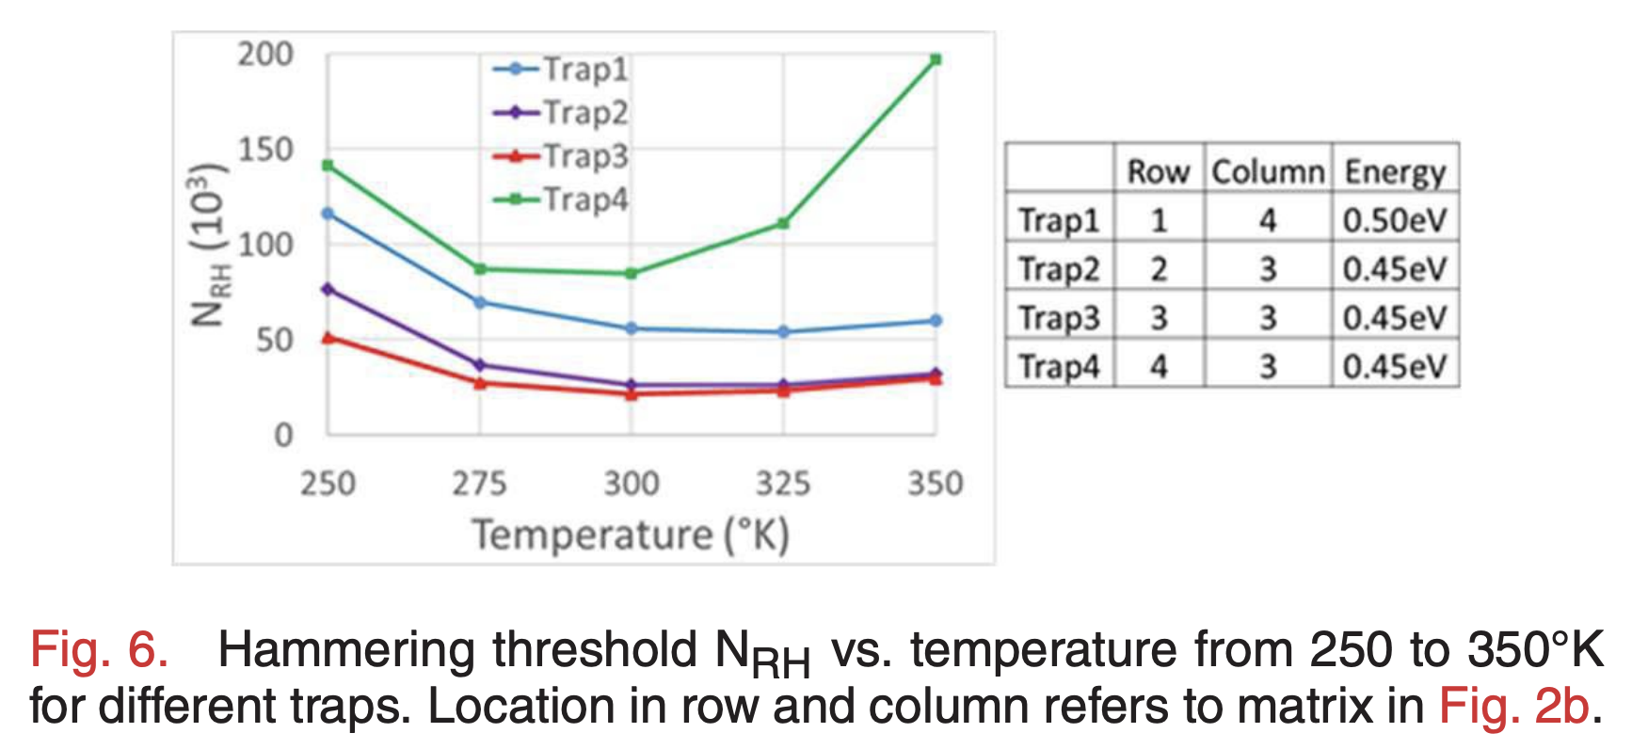
Circuit-Level Justification Temperature Analysis
We hypothesize that our observations are caused by the non-monotonic behavior of charge trapping characteristics of DRAM cells
3D TCAD model [Yang+, EDL'19]
HC_{first} decreases as temperature increases, until a temperature inflection point where HC_{first} starts to increase as temperature increases
A cell is more vulnerable to RowHammer at temperatures close to its temperature inflection point
Notes:
And third, [CLICK]
We observe thatThe HCfirst change tends to be larger as temperature change increases [CLICK]
The figure shows that, for all manufacturer, when increase the temperature change from 50-55C to 50-90C, the absolute changes values increase [CLICK]

Slide 76
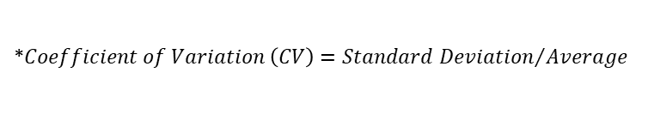
Increasing Aggressor Row Active Time (t_{AggOn})
Bit Error Rate
HC_{first}
OBSERVATION 8
As the aggressor row stays active longer,
more DRAM cells experience RowHammer bit flips and
they experience RowHammer bit flips at lower hammer counts
We analyze how the coefficient of variation* values for BER and HC_{first} change across rows when the aggressor row stays active longer
OBSERVATION 9
RowHammer vulnerability consistently worsens
as t_{AggOn} increases across all tested DRAM rows**
*$Coefficient of Variation \left(CV\right)={Standard Deviation}/{Average}$
** Please refer to the full paper for coefficient of variation-based (CV) analysis
Notes:
These plots demonstrate how bit error rate [CLICK]
And Hcfirst changes with increasing aggressor row active time for all four manufacturers [CLICK]
We observe a significant increase in bit error rates [CLICK]
And a significant decrease in Hcfirst with the increasing aggressor row active time [CLICK]
Therefore, we conclude that: As the aggressor row stays active longer, more DRAM cells experience RowHammer bit flips AND they experience RowHammer bit flips at lower hammer counts [CLICK]
We also analyze the relative standard deviation (or coefficient of variation) of both metrics with increasing active time in the paper [CLICK] and conclude that RowHammer vulnerability consistently worsens as the aggressor row active time increases across all DRAM rows we tested [CLICK]
Jeremie's method of explaining on one figure and showing all in the next slide
one observation per slide
write hcfirst openly
just flash hcfirst

Slide 77
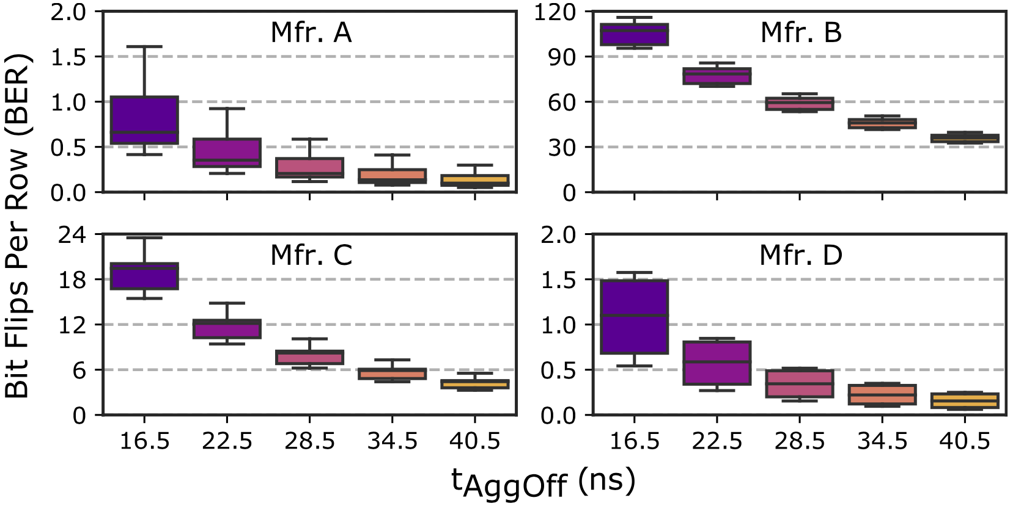
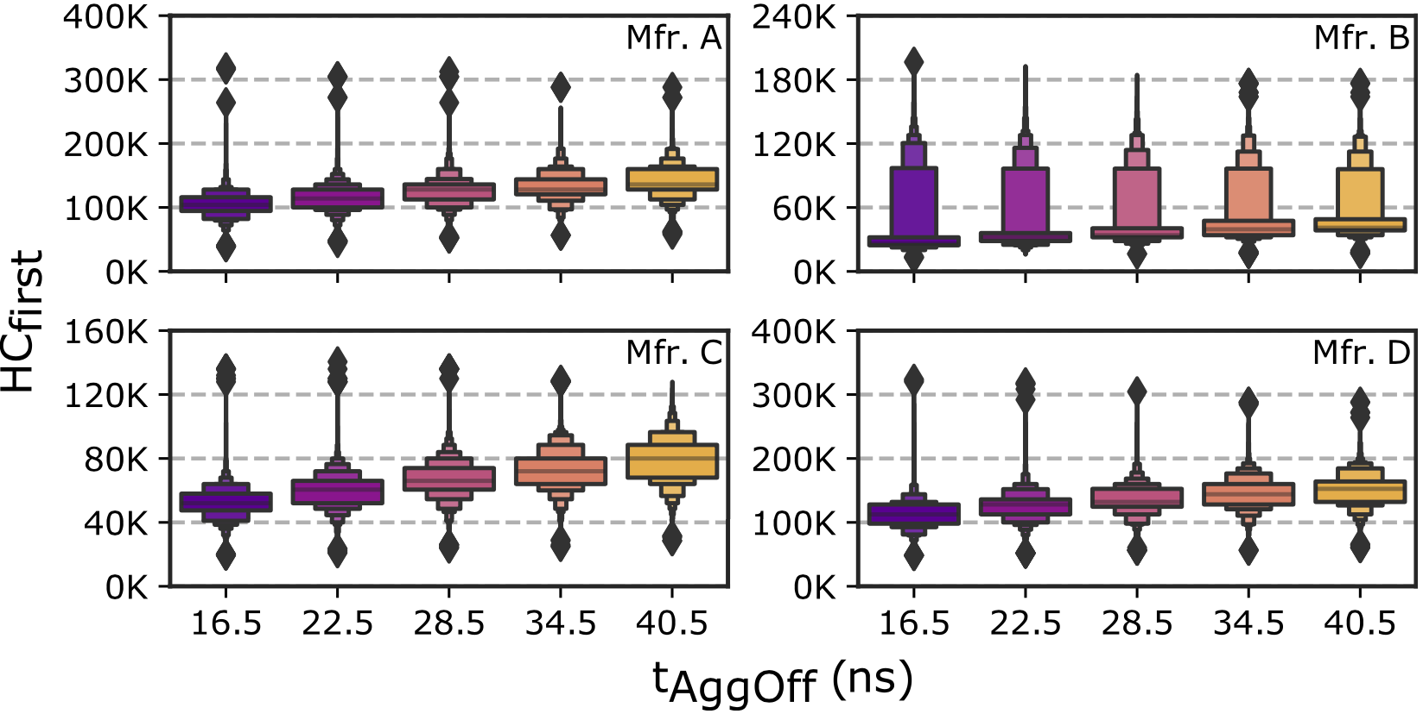
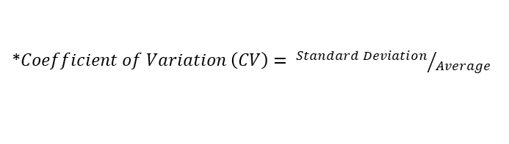
Increasing Bank Precharged Time (t_{AggOff})
Bit Error Rate
HC_{first}
OBSERVATION 10
As the bank stays precharged longer, fewer DRAM cells
experience RowHammer bit flips and they experience RowHammer
bit flips at higher hammer counts
We repeat the coefficient of variation* analysis for BER and HC_{first} change across rows when the bank stays precharged longer
OBSERVATION 11
RowHammer vulnerability consistently reduces
as t_{AggOff} increases across all tested DRAM rows**
*$Coefficient of Variation \left(CV\right)= {Standard Deviation}/{Average}$
** Please refer to the full paper for coefficient of variation-based (CV) analysis
Notes:
Similarly, these plots demonstrate how bit error rate [CLICK]
And Hcfirst changes with increasing the bank’s precharged time [CLICK]
We observe that bit error rates significantly decrease [CLICK]
And Hcfirst values increase as the bank’s precharged time increases [CLICK]
Therefore, as the bank stays precharged longer, fewer DRAM cells experience RowHammer bit flips and they experience RowHammer bit flips at higher hammer counts [CLICK]
We also analyze the relative standard deviation (or coefficient of variation) of both metrics with increasing the bank's precharged time in the paper [CLICK] and conclude that RowHammer vulnerability consistently reduces as the bank’s precharged time increases [CLICK]
can be more inthe paper slide

Slide 78
Circuit-Level Justification Aggressor Row Active Time Analysis
Two possible circuit level justifications for RowHammer bit flips:
Electron injection in the victim cell [Walker+, TED'21][Yang+, TDMR'16]
Wordline-to-wordline cross-talk noise between aggressor and victim rows that occurs when the aggressor row is being activated [Ryu+, IEDM'17][Walker+, TED'21]
We hypothesize that increasing the aggressor row’s active time (𝑡_{𝐴𝑔𝑔𝑂𝑛}) has a larger impact on exacerbating electron injection to the victim cell, compared to the reduction in cross-talk noise due to lower activation frequency. Thus, RowHammer vulnerability worsens when 𝑡_{𝐴𝑔𝑔𝑂𝑛} increases
Increasing a bank’s precharged time (𝑡_{𝐴𝑔𝑔𝑂ff}) decreases RowHammer vulnerability because longer 𝑡_{𝐴𝑔𝑔𝑂ff} reduces the effect of cross-talk noise without affecting electron injection (since 𝑡_{𝐴𝑔𝑔𝑂n} is unchanged).
Notes:
And third, [CLICK]
We observe thatThe HCfirst change tends to be larger as temperature change increases [CLICK]
The figure shows that, for all manufacturer, when increase the temperature change from 50-55C to 50-90C, the absolute changes values increase [CLICK]

Slide 79
Spatial Variation across Rows
HC_{first} worst-to-best ratio in this range: P100/P90
Minimum Activation Count
to Observe a Bit Flip (HC_{first})
Hc_{first} Worst-to-Best Ratio
DRAM Rows (sorted by reducing HC_{first})
Manufacturers
OBSERVATION 12
A small fraction of DRAM rows
are significantly more vulnerable to RowHammer
than the vast majority of the rows
Notes:
Zooming into the most vulnerable DRAM rows, We compare the HCfirst of the most vulnerable row [CLICK]
to the minimum HCfirst in 90th percentile of rows [CLICK]
This boxplot shows [CLICK] the distribution of this ratio [CLICK] across DRAM modules for each manufacturer
We observe that the most vulnerable 10% of the rows experience bit flips at activation counts about half the Hcfirst of the other rows [CLICK]
Therefore, we conclude that a small fraction of DRAM rows are significantly more vulnerable to RowHammer than the vast majority of rows [CLICK]

Slide 80
Spatial Variation across Columns
We analyze BER variation across DRAM columns
OBSERVATION 13
Certain columns are significantly more vulnerable
to RowHammer than other columns
Notes:
To investigate how the RowHammer vulnerability varies across columns, we generate a heatmap plot of bit error rates across columns [CLICK] and chips [CLICK]
We observe that bit errors concentrate on certain DRAM columns more than others, implying that certain columns are significantly more vulnerable to RowHammer than other columns [CLICK]
define color scale
remove the first sentence

Slide 81
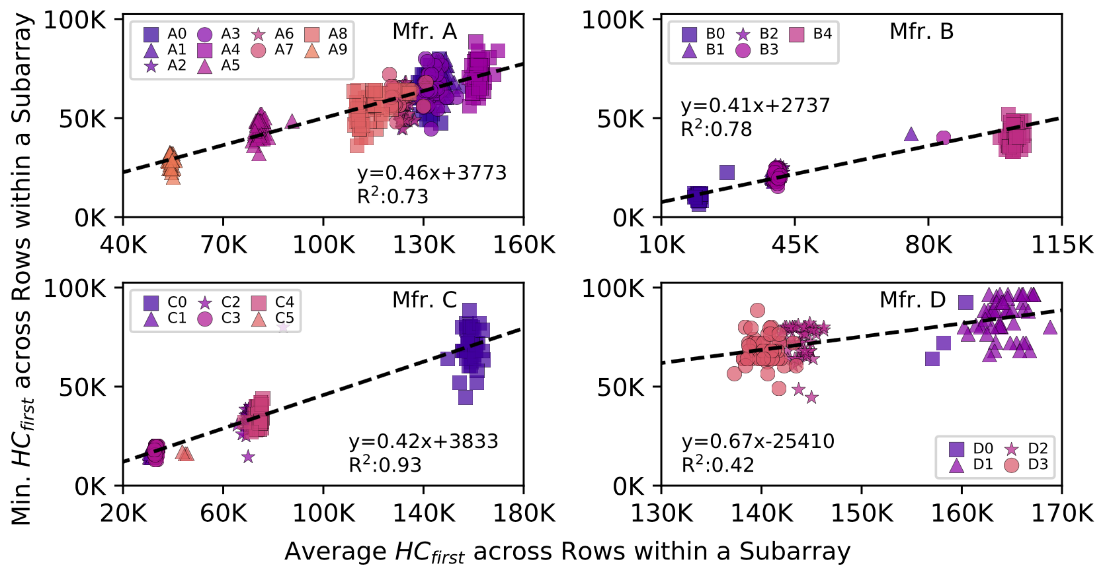
Spatial Variation across Subarrays
OBSERVATION 15
The most vulnerable DRAM row in a subarray
is significantly more vulnerable
than the other rows in the subarray
Notes:
Next we investigate how the RowHammer vulnerability varies across DRAM subarrays in a DRAM module
Subarrays are marked in terms of the average [CLICK] and the minimum [CLICK] HCfirst values they exhibit across DRAM rows that they contain [CLICK]
We observe that the minimum Hcfirst in a subarray is about the half of the average Hcfirst in a subarray [CLICK]
Therefore, we conclude that The most vulnerable DRAM row in a subarray is significantly more vulnerable than the other rows in the subarray [CLICK]
avoid highlighting the linear regression
slope of the curve is approx .5

Slide 82
Spatial Variation across Subarrays
OBSERVATION 16
HC_{first} distributions of subarrays within a DRAM module
are significantly more similar to each other
than those of subarrays from different modules
* We analyze the similarity between Hcfirst distributions of different subarrays based on Bhattacharyya distance in the paper
Notes:
In this plot, each marker style represents subarrays in a different DRAM module [CLICK]
We observe that subarrays within a DRAM module exhibit more similar Hcfirst values to each other, compared to subarrays in different DRAM modules [CLICK]
and we verify this observation based on Bhattacharyya distance analysis in the paper [CLICK]

Slide 83
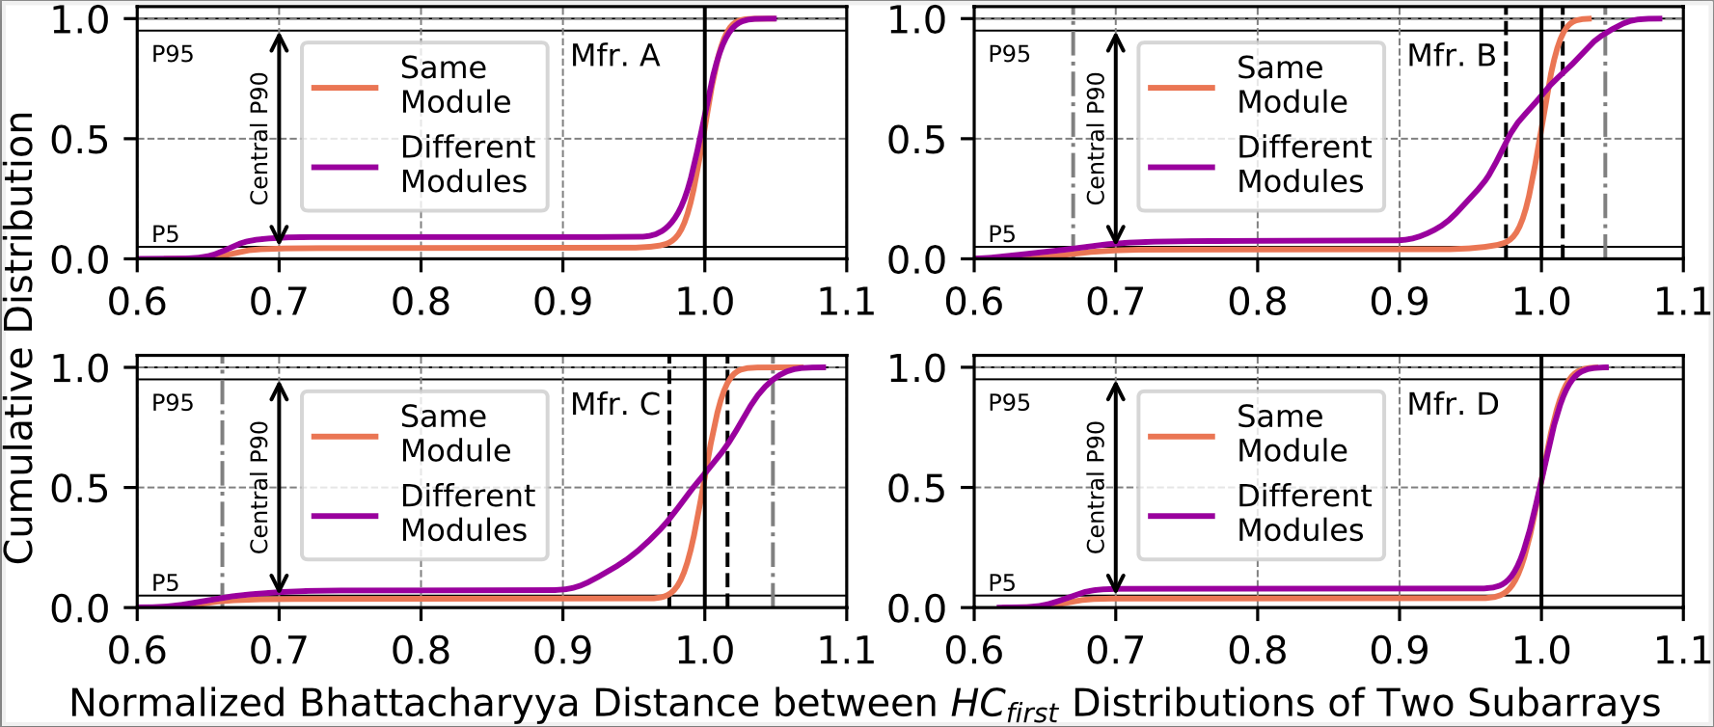
Spatial Variation across Subarrays Bhattacharyya Distance Analysis
Different
Identical
Different
HC_{first} distributions of subarrays within a DRAM module exhibit significantly more similarity to each other
than HC_{first} distributions of subarrays from different modules
Notes:
To investigate these similarities more, we compare the similarity of HCfirst distributions between subarrays from the same module [CLICK]
And from different modules [CLICK]
This plot shows the cumulative distribution of this similarity in terms of normalized Bhattacharyya distance (BD)
A normalized BD of 1.0 [CLICK]
indicates that two distributions are identical, while [CLICK]
two distributions exhibit more difference as the normalized BD takes larger or smaller values than 1.0 [CLICK]
Especially in manufacturers B and C, we observe a significant difference between normaized BD values of subarray within the same module and subarrays in different modules [CLICK]
Therefore, we conclude that HC_{first} distributions of subarrays within a DRAM module exhibit significantly more similarity to each other than HC_{first} distributions of subarrays from different modules

Slide 84
Circuit-Level Justification Spatial Variation Analysis
Variation across rows, columns, and chips:
Manufacturing process variation causes differences in cell size and bitline/wordline impedance values, which introduces variation in cell reliability characteristics within and across DRAM chips
Design-induced variation causes cell access latency characteristics to vary deterministically based on a cell’s physical location in the memory chip (e.g., its proximity to I/O circuitry)
Similarity across subarrays:
Cell’s access latency is dominated by its physical distance from the peripheral structures (e.g., local senseamplifiers and wordline drivers) within the subarray, causing corresponding cells in different subarrays to exhibit similar access latency characteristics
Notes:
And third, [CLICK]
We observe thatThe HCfirst change tends to be larger as temperature change increases [CLICK]
The figure shows that, for all manufacturer, when increase the temperature change from 50-55C to 50-90C, the absolute changes values increase [CLICK]

Slide 85
Example Attack Improvements
Aggressor Row Active Time
The attacker can reduce HC_{first} (by 36%) by performing (10-15) additional READ commands targeting the aggressor row to bypass RowHammer defenses that do not account for this reduction
These observations can be leveraged
to craft more effective RowHammer attacks
Notes:
As another improvement, an attacker can leverage the observation that increasing aggressor row's active time reduces HCfirst [CLICK]
The attacker can exploit this observation to reduce Hcfirst by 36% on average, by performing [CLICK]
10 to 15 additional column accesses to an aggressor row, [CLICK]
This way, an attacker can bypass RowHammer defenses that do not account for this reduction in Hcfirst [CLICK]
We believe that these observations can be leveraged to craft more effective RowHammer attacks [CLICK]
HCfirst is cut
what do arrows mean?
avoid using hcfirst
draw the attack pattern and emphasize bypassing

