Slide 1


BlockHammer Preventing RowHammer at Low Cost by Blacklisting Rapidly-Accessed DRAM Rows
Abdullah Giray Yağlıkçı
Minesh Patel Jeremie S. Kim Roknoddin Azizi
Ataberk Olgun Lois Orosa Hasan Hassan Jisung Park
Konstantinos Kanellopoulos Taha Shahroodi
Saugata Ghose* Onur Mutlu
*
Notes:
Hello, my name is Giray and this is a short summary of BlockHammer

Slide 2
Problem and Key Idea in a Nutshell
Motivation: RowHammer is a worsening DRAM reliability/security problem
Problem: Mitigation mechanisms provide limited support for DRAM chips
Scalability with worsening RowHammer vulnerability Existing RowHammer mitigation mechanisms become prohibitively expensive when applied to increasingly vulnerable DRAM chips [J.S. Kim+, ISCA 2020]
Compatibility with commodity DRAM chips Existing mechanisms rely on proprietary information that is not available for all commodity DRAM chips
Key Idea: Selectively throttle memory accesses that may cause RowHammer bit flips
Notes:
RowHammer is a worsening DRAM reliability and security problem [CLICK]
However, state-of-the-art RowHammer mitigation mechanisms face limitations supporting current and future commodity DRAM chips because of two challenges [CLICK]
First, they cannot scale efficiently with worsening RowHammer vulnerability[CLICK]
Second, they are not compatible with commodity DRAM chips as they rely on proprietary information [CLICK]
To overcome these two challenges, our key idea is to SELECTIVELY throttle memory accesses that may cause RowHammer bit flips

Slide 3
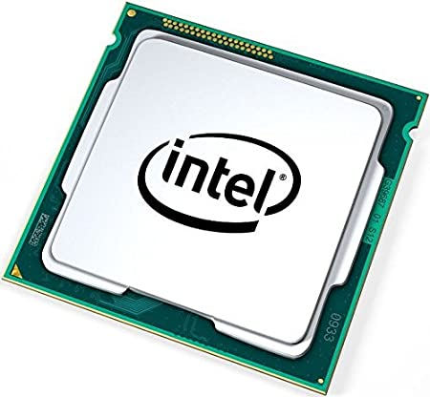
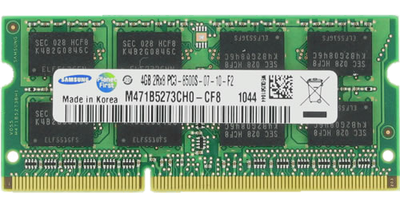
Major Problem with Past RowHammer Mitigations
A RowHammer attack hammers Row A
Existing mechanisms detect the attack
Refresh rows A+1 and A-1
Bit flips still may occur due to unknown DRAM-internal row mapping
Row A+1
Row A-1
Victim
Rows
Row A
Physical
Row Layout
Existing RowHammer mitigation mechanisms need to know proprietary DRAM-internal row address mapping
Notes:
Assume that an attacker hammers a row to induce bit flips in its nearby rows [CLICK]
Existing RowHammer defenses detect the attack [CLICK]
And try refreshing the nearby rows [CLICK]
However, the DRAM chip can internally map these row addresses to different physical rows [CLICK]
And thus bit flips may still occur[CLICK]
To avoid this, existing mechanisms need to know proprietary DRAM-internal row address mapping [CLICK]

Slide 4

BlockHammer: Practical Throttling-based Mechanism
A RowHammer attack hammers Row A
BlockHammer detects a RowHammer attack using area-efficient Bloom filters
BlockHammer selectively throttles accesses from within the memory controller
Bit flips do not occur
BlockHammer can optionally inform the system software about the attack
Row A
Physical
Row Layout
BlockHammer is compatible with commodity DRAM chips
No need for proprietary info of or modifications to DRAM chips
Notes:
In contrast, BlockHammer does not need this information [CLICK]
It detects an attack using area-efficient Bloom filters [CLICK]
And selectively throttles the attack’s memory accesses from within the memory controller [CLICK]
Due to throttling, the row’s activation count cannot reach critical levels, and no bit flip occurs [CLICK]
BlockHammer can optionally inform the system software about the attack for higher-level countermeasures [CLICK]
BlockHammer achieves all of these without needing proprietary information of or modifications to commodity DRAM chips, thereby overcoming the compatibility challenge[CLICK]

Slide 5
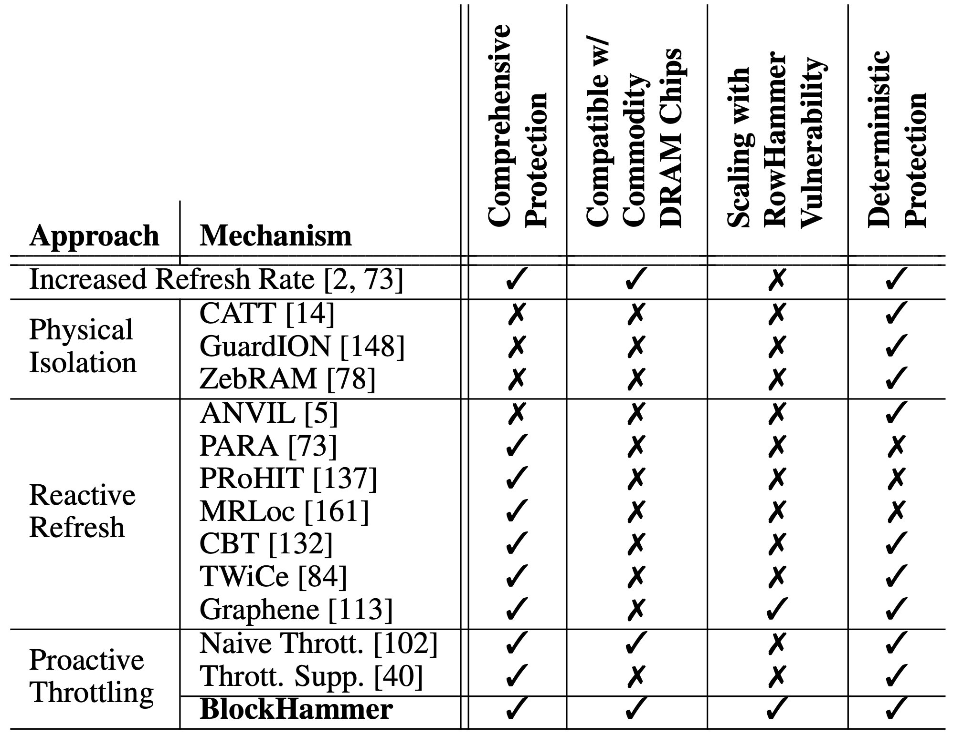
Evaluation
Scalability with Worsening RowHammer Vulnerability:
Competitive with (less than 0.6% performance and energy overhead) state-of-the-art mechanisms when there is no RowHammer attack
Superior performance (71% speedup) and DRAM energy (32% reduction) when a RowHammer attack is present
Evaluation of 14 mechanisms representing four mitigation approaches
Comprehensive Protection
Compatibility with Commodity DRAM Chips
Scalability with RowHammer Vulnerability
Deterministic Protection
BlockHammer is the only solution that addresses all four desirable properties
Four mitigation approaches
Notes:
BlockHammer scales well with worsening RowHammer such that [CLICK]
It is competitive with state-of-the-art mechanisms WHEN There is NO ROWHAMMER ATTACK in the system [CLICK]
and it provides SIGNIFICANTLY HIGHER performance and LOWER dram energy consumption WHEN a RowHammer attack is present. [CLICK]
We evaluate 14 mechanisms representing all four high-level RowHammer mitigation approaches for four desirable properties [CLICK]
comprehensive protection [CLICK]
compatibiltiy with commodity DRAM chips [CLICK]
scalability with worsening RowHammer vulnerability [CLICK]
and deterministic protection. [CLICK]
We show that BlockHammer is the only mechanism that satisfies all of them. [CLICK]

Slide 6

More in the Paper
Using area-efficient Bloom filters for RowHammer detection
Security Proof
Mathematically represent all possible access patterns
No row can be activated high-enough times to induce bit-flips
BlockHammer prevents many-sided attacks
TRRespass [Frigo+, S&P’20]
U-TRR [Hassan+, MICRO’21]
BlackSmith [Jattke+, S&P’22]
Half-Double [Kogler+, USENIX Security’22]
System Integration
BlockHammer can detect RowHammer attacks with high accuracy and inform system software
Measures RowHammer likelihood of each thread
Hardware complexity analysis
Full Paper
Notes:
The full paper has more information about[CLICK]
Bloom filter-based area-efficient RowHammer detection[CLICK]
A mathematical security proof, showing that BlockHammer deterministically prevents RowHammer bit flips [CLICK]
How BlockHammer prevents new and emerging many-sided attacks [CLICK]
An optional system integration for reporting detected attacks to system software with high accuracy [CLICK]
And a hardware complexity analysis [CLICK]

Slide 7

Summary
BlockHammer is the first work to practically enable throttling-based RowHammer mitigation
BlockHammer is implemented in the memory controller (no proprietary information of / no modifications to DRAM chips)
BlockHammer is both scalable with worsening RowHammer and compatible with commodity DRAM chips
BlockHammer is open-source along with six state-of-the-art mechanisms: https://github.com/CMU-SAFARI/BlockHammer
Source
Notes:
In summary, BlockHammer is the first work to practically enable throttling-based RowHammer mitigation and [CLICK]
it is implemented solely in the memory controller without requiring proprietary information of or modifications to DRAM chips [CLICK]
It overcomes both scalability and compatibility challenges [CLICK]
To further aid future research and development, we make BlockHammer’s source code freely and openly available

Slide 8

BlockHammer Preventing RowHammer at Low Cost by Blacklisting Rapidly-Accessed DRAM Rows
Abdullah Giray Yağlıkçı
Minesh Patel Jeremie S. Kim Roknoddin Azizi
Ataberk Olgun Lois Orosa Hasan Hassan Jisung Park
Konstantinos Kanellopoulos Taha Shahroodi
Saugata Ghose* Onur Mutlu
Full Talk
Full Paper
Source
*
Notes:
Thank you for listening! Please refer to our full talk and full paper for more details.

Slide 9
BlockHammer Preventing RowHammer at Low Cost by Blacklisting Rapidly-Accessed DRAM Rows
Backup Slides
Notes:
This concludes my talk . Thank you for your time and attention. For many more details, I invite you to read our HPCA 2021 paper.

Slide 10
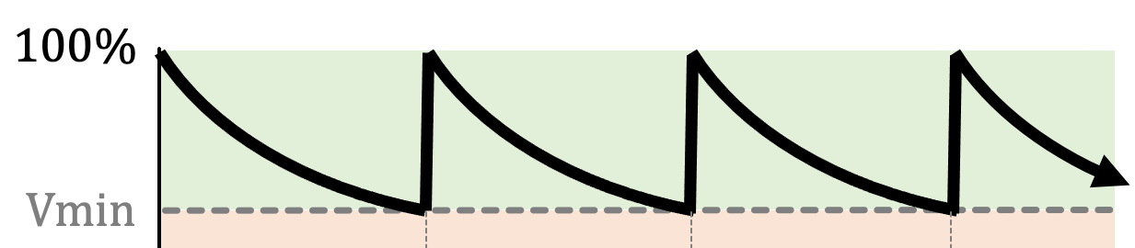
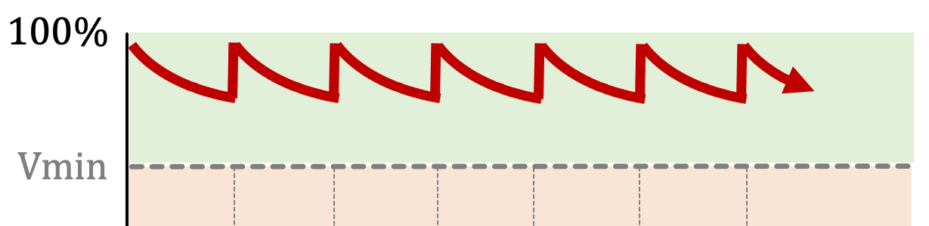

Mitigation Approaches with Worsening RowHammer Vulnerability
Increased refresh rate
Physical isolation
Reactive refresh
Proactive throttling
REF-to-REF time further reduces
Even fewer activations can fit
DRAM Bank
Aggressor Row
Isolation Rows
Isolation Rows
Larger distance
more isolation rows
Victim Rows
DRAM Bank
Refresh more frequently
Refresh more rows
Victim rows
Aggressor row
Victim rows
Refresh more frequently
Refresh more rows
More aggressively throttles row activations
Notes:
As DRAM chips become more vulnerable to RowHammer
[CLICK] Increased refresh rate requires refreshing all rows more frequently and it is not sustainable due to large number of rows that need to be refreshed.
[CLICK] Physical isolation requires allocating more isolation rows
[CLICK] Reactive refresh needs refreshing more potential victim rows more frequently
[CLICK] Proactive throttling slows down the system further more.

Slide 11
Scalability with Worsening RowHammer Vulnerability
DRAM chips are more vulnerable to RowHammer today
RowHammer bit-flips occur at much lower activation counts (more than an order of magnitude decrease):
139.2K [Y. Kim+, ISCA 2014]
9.6K [J. S. Kim+, ISCA 2020]
RowHammer blast radius has increased by 33%:
9 rows [Y. Kim+, ISCA 2014]
12 rows [J. S. Kim+, ISCA 2020]
In-DRAM mitigation mechanisms are ineffective [Frigo+, S&P 2020]
Newer chips require more aggressive RowHammer mitigation mechanisms
Existing mechanisms become prohibitively expensive [J.S. Kim+, ISCA 2020]
RowHammer is a more serious problem than ever
Defenses should scale with worsening RowHammer
Notes:
The first challenge is scalability with worsening RowHammer vulnerability
[CLICK] Recent works show that DRAM chips became more vulnerable to RowHammer in the last decade.
[CLICK] RowHammer bit-flips can occur in much lower activation counts
[CLICK] and hammering a row can disturb more rows than before.
[CLICK] And furthermore, in-DRAM mitigation mechanisms are shown to be ineffective.
[CLICK] Therefore, RowHammer is a more serious problem than ever today.

Slide 12
Mitigation Approaches with Worsening RowHammer Vulnerability
Increased refresh rate
Physical isolation
Reactive refresh
Proactive throttling
REF-to-REF time further reduces
Even fewer activations can fit
DRAM Bank
Aggressor Row
Mitigation mechanisms face the challenge of scalability with worsening RowHammer
Isolation Rows
Isolation Rows
Larger distance
more isolation rows
Victim Rows
DRAM Bank
Refresh more frequently
Refresh more rows
Victim rows
Aggressor row
Victim rows
Refresh more frequently
Refresh more rows
More aggressively throttles row activations
Notes:
Therefore, scalability with worsening RowHammer vulnerability is an active challenge for all mitigation approaches.

Slide 13
Compatibility with Commodity DRAM Chips
Application
Level
Virtual Memory Address
Visible within
the Processor
System
Level
Physical Memory Address
Memory
Controller
DRAM Bus Addresses
(Channel, Rank, Bank Group, Bank, Row, Col)
DRAM
Chip
In-DRAM
Mapping
Physical Rows and Columns
Notes:
To understand this challenge, we need to revisit how memory addresses are mapped to DRAM cells through several abstraction levels.
[CLICK] Virtual memory addresses are used in application level.
[CLICK] Then, typically the system software translates virtual addresses to physical addresses
[CLICK] A physical memory address is mapped to addresses of DRAM channel, rank, bank, row, and column.
[CLICK] So far all these address translations are visible within the processor.
[CLICK] However, additional to these, logical row and column addresses are mapped to physical rows and columns WITHIN the DRAM chip which is NOT visible to the rest of the system.

Slide 14
Compatibility with Commodity DRAM Chips
Vendors apply in-DRAM mapping for two reasons:
Design Optimizations: By simplifying DRAM circuitry to provide better density, performance, and power
Yield Improvement: By mapping faulty rows and columns to redundant ones
In-DRAM mapping scheme includes insights into chip design and manufacturing quality
In-DRAM mapping is proprietary information
Notes:
DRAM vendors apply in-DRAM mapping for two reasons.
[CLICK] to enable circuit design optimizations to meet density, performance, and power constraints
[CLICK] and for improving yield by mapping faulty rows and columns to redundant ones
[CLICK] Therefore, in-DRAM mapping includes insights into CHIP DESIGN and MANUFACTURING QUALITY.
[CLICK] and that’s why, it is PROPRIETARY information.

Slide 15
RowHammer Mitigation Approaches
Increased refresh rate
Physical isolation
Reactive refresh
Proactive throttling
REF-to-REF time reduces
Fewer activations can fit
DRAM Bank
Aggressor Row
Isolation Rows
Victim Rows
DRAM Bank
Victim Rows
Aggressor Row
Victim rows
Identifying victim and isolation rows requires
proprietary knowledge of in-DRAM mapping
Fewer activations can be performed
Notes:
Unfortunately, physical isolation and reactive refresh need this proprietary information to identify which rows to isolate or refresh.

Slide 16
BlockHammer Overview of Approach
RowBlocker
Tracks row activation rates using area-efficient Bloom filters
Blacklists rows that are activated at a high rate
Throttles activations targeting a blacklisted row
AttackThrottler
Identifies threads that perform a RowHammer attack
Reduces memory bandwidth usage of identified threads
No row can be activated at a high enough rate to induce bit-flips
Greatly reduces the performance degradation
and energy wastage a RowHammer attack inflicts on a system
Notes:
BlockHammer consists of two mechanisms [CLICK] RowBlocker [CLICK] and AttackThrottler.
RowBlocker [CLICK] tracks ROW ACTIVATION RATES using area-efficient Bloom filters
[CLICK] BLACKLISTS rows that are activated at a high rate
[CLICK] THROTTLES (or enforces a certain delay between) activations targeting a blacklisted row.
[CLICK] By doing so, RowBlocker ensures that NO ROW can be activated at a high enough rate to induce RowHammer bit-flips.
[CLICK] AttackThrottler IDENTIFIES threads that try activating blacklisted rows.
[CLICK] and reduces their memory bandwidth consumption by throttling their memory requests.
[CLICK] By doing so, AttackThrottler greatly reduces the performance degradation and energy wastage a RowHammer attack inflicts on a system.

Slide 17
Evaluation BlockHammer’s Hardware Complexity
We analyze six state-of-the-art mechanisms and BlockHammer
We calculate area, access energy, and static power consumption*
Mitigation |  | SRAM | CAM | Area |  | Access Energy | Static Power
Mechanism |  | KB | KB | mm² | %CPU | pJ | mW
BlockHammer
PARA [73]
ProHIT [137]
MRLoc [161]
CBT [132]
TWiCe [84]
Graphene [113]
Mitigation |  | SRAM | CAM | Area |  | Access Energy | Static Power
Mechanism |  | KB | KB | mm² | %CPU | pJ | mW
BlockHammer |  | 51.48 | 1.73 | 0.14 | 0.06 | 20.30 | 22.27
PARA [73] |  | - | - | <0.01 | - | - | -
ProHIT [137] |  | - | 0.22 | <0.01 | <0.01 | 3.67 | 0.14
MRLoc [161] |  | - | 0.47 | <0.01 | <0.01 | 4.44 | 0.21
CBT [132] |  | 16.00 | 8.50 | 0.20 | 0.08 | 9.13 | 35.55
TWiCe [84] |  | 23.10 | 14.02 | 0.15 | 0.06 | 7.99 | 21.28
Graphene [113] |  | - | 5.22 | 0.04 | 0.02 | 40.67 | 3.11
N_{RH}=32K
BlockHammer is low cost and competitive
with state-of-the-art mechanisms
*Assuming a high-end 28-core Intel Xeon processor system with 4-channel single-rank DDR4 DIMMs with a RowHammer threshold (NRH) of 32K
Notes:
We analyze and compare BlockHammer's hardware complexity
with six state-of-the-art RowHammer mitigation mechanisms, namely
PARA, ProHIT, MRLoc, CBT, TWiCe, and Graphene.
[CLICK] we calculate hardware complexity in terms of AREA, ACCESS ENERGY, and STATIC POWER consumption for a RowHammer threshold of 32K,
which is a realistic assumption for current DRAM chips
[CLICK] We observe that BlockHammer is LOW COST and competitive with state-of-the-art RowHammer mitigation mechanisms

Slide 18
Evaluation BlockHammer’s Hardware Complexity
Mitigation |  | SRAM | CAM | Area |  | Access Energy | Static Power
Mechanism |  | KB | KB | mm² | %CPU | pJ | mW
BlockHammer |  | 51.48 | 1.73 | 0.14 | 0.06 | 20.30 | 22.27
PARA [73] |  | - | - | <0.01 | - | - | -
ProHIT [137] |  | - | 0.22 | <0.01 | <0.01 | 3.67 | 0.14
MRLoc [161] |  | - | 0.47 | <0.01 | <0.01 | 4.44 | 0.21
CBT [132] |  | 16.00 | 8.50 | 0.20 | 0.08 | 9.13 | 35.55
TWiCe [84] |  | 23.10 | 14.02 | 0.15 | 0.06 | 7.99 | 21.28
Graphene [113] |  | - | 5.22 | 0.04 | 0.02 | 40.67 | 3.11
BlockHammer |  | 441.33 | 55.58 | 1.57 | 0.64 | 99.64 | 220.99
PARA [73] |  | - | - | <0.01 | - | - | -
ProHIT [137] |  | x | x | x | x | x | x
MRLoc [161] |  | x | x | x | x | x | x
CBT [132] |  | 512.00 | 272.00 | 3.95 | 1.60 | 127.93 | 535.50
TWiCe [84] |  | 738.32 | 448.27 | 5.17 | 2.10 | 124.79 | 631.98
Graphene [113] |  | - | 166.03 | 1.14 | 0.46 | 917.55 | 93.96
Mitigation |  | SRAM | CAM | Area |  | Access Energy | Static Power
Mechanism |  | KB | KB | mm² | %CPU | pJ | mW
BlockHammer |  | 51.48 | 1.73 | 0.14 | 0.06 | 20.30 | 22.27
PARA [73] |  | - | - | <0.01 | - | - | -
ProHIT [137] |  | - | 0.22 | <0.01 | <0.01 | 3.67 | 0.14
MRLoc [161] |  | - | 0.47 | <0.01 | <0.01 | 4.44 | 0.21
CBT [132] |  | 16.00 | 8.50 | 0.20 | 0.08 | 9.13 | 35.55
TWiCe [84] |  | 23.10 | 14.02 | 0.15 | 0.06 | 7.99 | 21.28
Graphene [113] |  | - | 5.22 | 0.04 | 0.02 | 40.67 | 3.11
Mitigation |  | SRAM | CAM | Area |  | Access Energy | Static Power
Mechanism |  | KB | KB | mm² | %CPU | pJ | mW
BlockHammer |  |  |  |  | 0.06 | 20.30 | 22.27
PARA [73]
ProHIT [137]
MRLoc [161]
CBT [132] |  |  |  |  | 0.08 |  | 35.55
TWiCe [84] |  |  |  |  | 0.06 |  | 21.28
Graphene [113] |  |  |  |  | 0.02 | 40.67 | 3.11
BlockHammer |  |  |  |  | 0.64 | 99.64 | 220.99
PARA [73]
ProHIT [137]
MRLoc [161]
CBT [132] |  |  |  |  | 1.60 |  | 535.50
TWiCe [84] |  |  |  |  | 2.10 |  | 631.98
Graphene [113] |  |  |  |  | 0.46 | 917.55 | 93.96
N_{RH}=32K
10x
5x
10x
N_{RH}=1K
23x
20x
35x
23x
15x
30x
30x
BlockHammer’s hardware complexity scales more efficiently than state-of-the-art mechanisms
Notes:
To understand how hardware complexity scales with worsening RowHammer vulnerability,
[CLICK] we repeat the analysis for a RowHammer threshold of 1K, which is projected for future DRAM chips.
[CLICK] We compare how the complexity of each mechanism changes in terms of
[CLICK] chip area,
[CLICK] access energy,
[CLICK] and static power consumption.
[CLICK] We observe that BlockHammer’s hardware complexity scales more efficiently than state-of-the-art RowHammer mitigaiton mechanisms.

Slide 19
Evaluation Performance and DRAM Energy
Cycle-level simulations using Ramulator and DRAMPower
System Configuration:
Single-Core Benign Workloads:
22 SPEC CPU 2006
4 YCSB Disk I/O
2 Network Accelerator Traces
2 Bulk Data Copy with Non-Temporal Hint (movnti)
Randomly Chosen Multiprogrammed Workloads:
125 workloads containing 8 benign applications
125 workloads containing 7 benign applications and 1 RowHammer attack thread
Processor | 3.2 GHz, {1,8} core, 4-wide issue, 128-entry instr. window
LLC | 64-byte cacheline, 8-way set-associative, {2,16} MB
Memory scheduler | FR-FCFS
Address mapping | Minimalistic Open Pages
DRAM | DDR4 1 channel, 1 rank, 4 bank group, 4 banks per bank group
RowHammer Threshold | 32K
Notes:
We conduct cycle-level simulations using RAMULATOR and DRAMPOWER to evaluate the performance and DRAM energy consumption.
[CLICK] We simulate a realistic system with a DDR4 DRAM module.
[CLICK] We use single-core workloads from four benchmarks in our simulations.
22 SPEC benchmarks, 4 disk I/O memory access traces from YCSB benchmark suite, 2 memory access traces collected from a network accelerator chip, and 2 synthetic traces that mimic bulk data copy with non-temporal hint.
[CLICK] We randomly combine these workloads to create two types of eight-core multiprogrammed workloads:
[CLICK] workloads that contain eight benign applications
[CLICK] and workloads that contain seven benign applications along with one thread performing RowHammer attack.

Slide 20
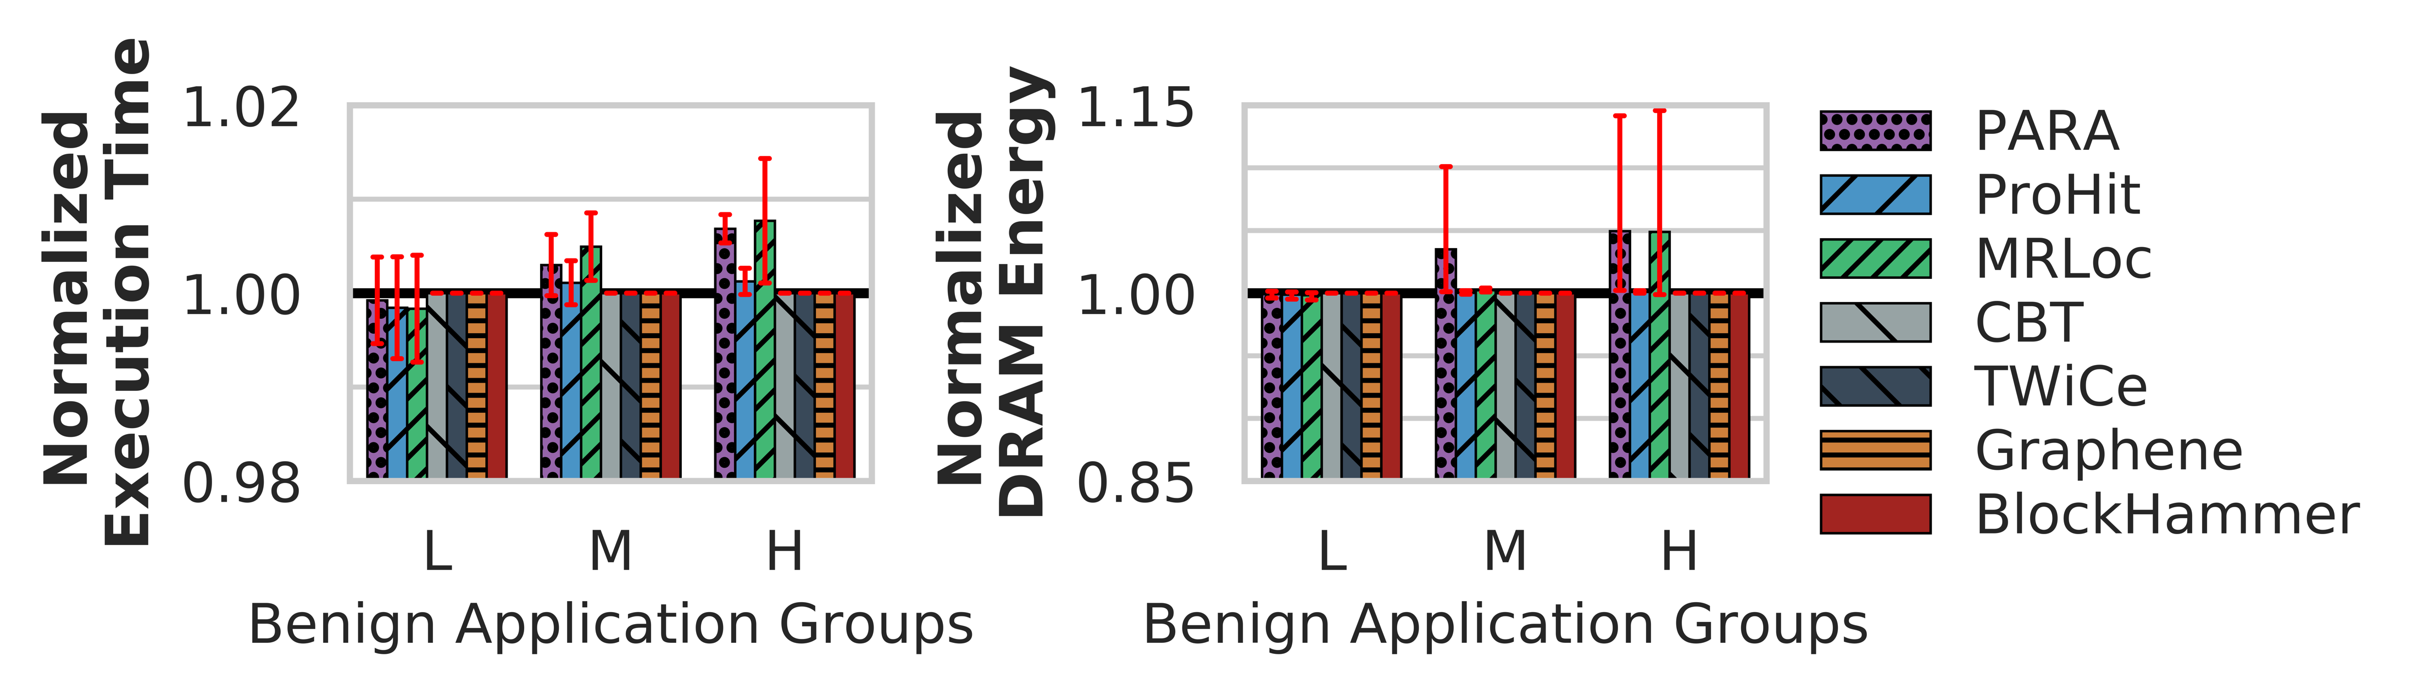
Evaluation Performance and DRAM Energy
We classify single-core workloads into three categories based on row buffer conflicts per thousand instructions
No application’s row activation count exceeds BlockHammer’s blacklisting threshold (N_{BL})
0.0
1.0
5.0
RBCPKI
Low (L)
Medium (M)
High (H)
BlockHammer does not incur performance or DRAM energy overheads for single-core benign applications
Notes:
We start with evaluating for single-core benign workloads.
[CLICK] We classify single-core workloads into three categories based on their Row Buffer Conflicts per Kilo Instruction
[CLICK] We evaluate the performance and DRAM energy consumption for BlockHammer and six state-of-the-art RowHammer mitigation mechanisms.
[CLICK] We observe that no application’s row activation count exceeds BlockHammer’s blacklisting threshold.
[CLICK] Therefore, BlockHammer does not change the performance or DRAM energy consumption for single-core benign applications.

Slide 21
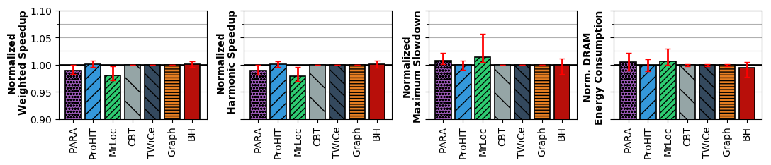
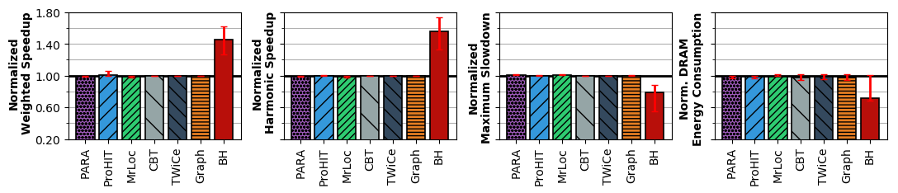
Evaluation Performance and DRAM Energy
System throughput (weighted speedup)
Job turnaround time (harmonic speedup)
Unfairness (maximum slowdown)
DRAM energy consumption
No
RowHammer
Attack
BlockHammer introduces very low performance (<0.5%) and DRAM energy (<0.4%) overheads
RowHammer
Attack
Present
BlockHammer significantly increases benign application performance (by 45% on average)
and reduces DRAM energy consumption (by 29% on average)
Notes:
We evaluate these RowHammer mitigation mechanisms and BlockHammer for eight-core multiprogrammed workloads
[CLICK] when there is no RowHammer attack.
[CLICK] and when there is a RowHammer attack present.
[CLICK] We use four metrics in this evaluation to demonstrate
[CLICK] the system throughput,
[CLICK] job turnaround time,
[CLICK] unfairness,
[CLICK] and DRAM energy consumption.
[CLICK] When there is no attack in the system, BlockHammer introduces very low performance and DRAM energy overheads.
[CLICK] When there is an attack present in the system,
BlockHammer significantly increases benign application performance
and reduces DRAM energy consumption.

Slide 22
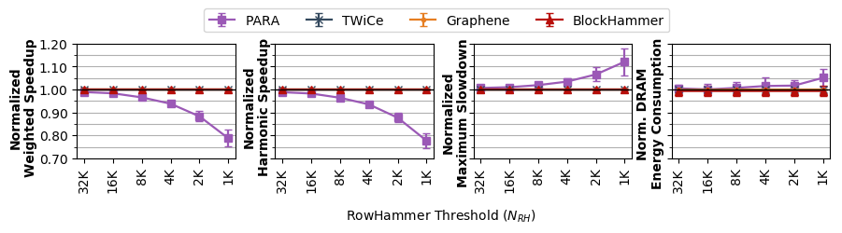
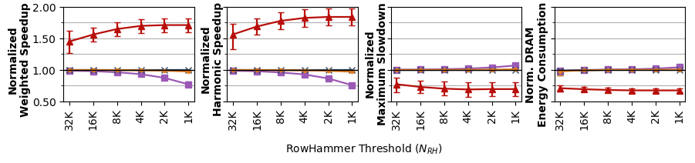
Evaluation Scaling with RowHammer Vulnerability
System throughput (weighted speedup)
Job turnaround time (harmonic speedup)
Unfairness (maximum slowdown)
DRAM energy consumption
No RowHammer
Attack
BlockHammer’s performance and energy overheads remain negligible (<0.6%)
RowHammer
Attack Present
BlockHammer scalably provides much higher performance (71% on average)
and lower energy consumption (32% on average) than state-of-the-art mechanisms
Notes:
We conduct a scalability study with worsening RowHammer vulnerability.
[CLICK] again for the cases where there is no RowHammer attack
[CLICK] and when there is a RowHammer attack present.
We scale the RowHammer threshold from 32K down to 1K.
[CLICK] Here are the results for system throughput
[CLICK] job turnaround time
[CLICK] unfairness
[CLICK] and DRAM energy consumption
[CLICK] We observe that BlockHammer's performance and energy overheads remain negligible even when RowHammer threshold is scaled downto 1K
[CLICK] and BlockHammer scalably provides much higher performance and lower energy consumption than state-of-the-art mechanisms when there is a RowHammer attack present.

