Slide 1




CODIC A Low-cost Substrate for Enabling Custom in-DRAM Functionalities and Optimizations
Lois Orosa
Yaohua Wang Mohammad Sadrosadati Jeremie Kim
Mines Patel Ivan Puddu Haocong Luo Kaveh Razavi
Juan Gómez-Luna Hasan Hassan Nika Mansouri Ghiasi
Saugata Ghose Onur Mutlu
ISCA 2021
Notes:
Hello, My name is Lois Orosa, and I will be presenting CODIC A low-cost substrate for enabling custom in-DRAM functionalities and optimizations =click=

Slide 2
Executive Summary
Problem: The timing of internal DRAM operations is fixed, which hinders the potential of DRAM for implementing new functionalities and optimizations
Goal: Provide control over DRAM internal circuit timings to enable new functionalities and optimizations
CODIC substrate:
Key idea: Enable fine-grained control of fundamental DRAM internal circuit timings that control key basic components in the DRAM array (e.g., wordline, sense amplifier, precharge logic)
We propose and evaluate two CODIC variants: 1) CODIC-sig generates signature values, and
2) CODIC-det generates deterministic values
CODIC variants have low latency (i.e, ~25ns)
CODIC-based Physical Unclonable Functions (PUFs):
A PUF generates signatures unique to a device due to the unique physical variations of the device
Key idea: Use CODIC-sig to generate unique signatures that can uniquely identify a DRAM device
2x faster than the best state-of-the-art DRAM PUF
CODIC-based Cold Boot Attack Prevention Mechanism:
Cold Boot Attack: The attacker physically removes the DRAM module from the victim system and places it in a system under their control to extract secret information
Key idea: Destroy all data at power-on using CODIC
Does not incur any latency or energy at runtime, and it is 2.0x lower latency and 1.7x lower energy than the best state-of-the-art mechanisms during DRAM power-on
Conclusion:
CODIC can be used for implementing very efficient security applications
CODIC can enable new DRAM functionalities, and reliability, performance, and energy optimizations
2
Notes:
I will start with the executive summary =click= The problem is that the timing of internal DRAM operations is fixed, which hinders the potential of DRAM for implementing new functionalities and optimizations =click= Our goal in this paper is to provide control over DRAM internal circuit timings to enable new functionalities and optimizations =click= To this end, we propose CODIC substrate =click= The key idea of CODIC substrate is to enable fine-grained control of fundamental DRAM circuit timings that control key basic components in the DRAM array, such as the wordline or the sense amplifier =click= We propose and evaluate two CODIC variants: CODIC-sig generates signature values =click= and CODIC-det generates deterministic values =click= All CODIC variants have low latency. Using CODIC, we propose two applications in the security domain that improve the state-of-the-art =click= First, a CODIC-based physical unclonable function (or PUF). =click= A PUF generates signatures unique to a device due to the unique physical variations of the device (also called process variation) =click= The key idea of our CODIC-based PUF is to use CODIC-sig to generate unique signatures that can uniquely identify a DRAM device =click= Our evaluation shows that our CODIC-sig PUF performs 2x faster than the best state-of-the-art DRAM PUF =click= The second application we propose and evaluate is a CODIC-based cold boot attack prevention Mechanism =click= In a cold boot attack, the attacker physically removes the DRAM module from the victim system and places it in a system under their control to extract secret information =click= Our key idea is to destroy all data at power-on using CODIC =click= Our mechanism does not incur any latency or energy at runtime, and it is 2x lower latency and 1.7x lower energy than the best state-of-the-art mechanisms during DRAM power-on =click= we conclude that =click= CODIC can be used for implementing very efficient security applications, and =click= CODIC can enable new DRAM functionalities, and reliability, performance, and energy optimizations

Slide 3
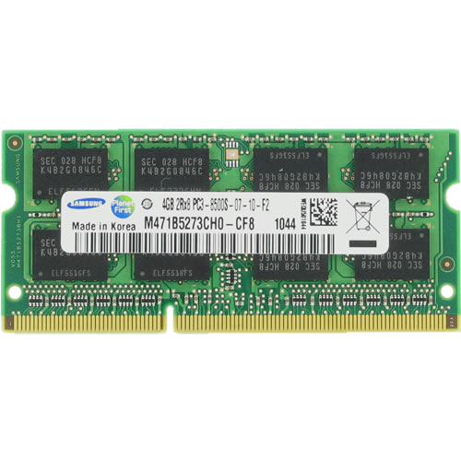
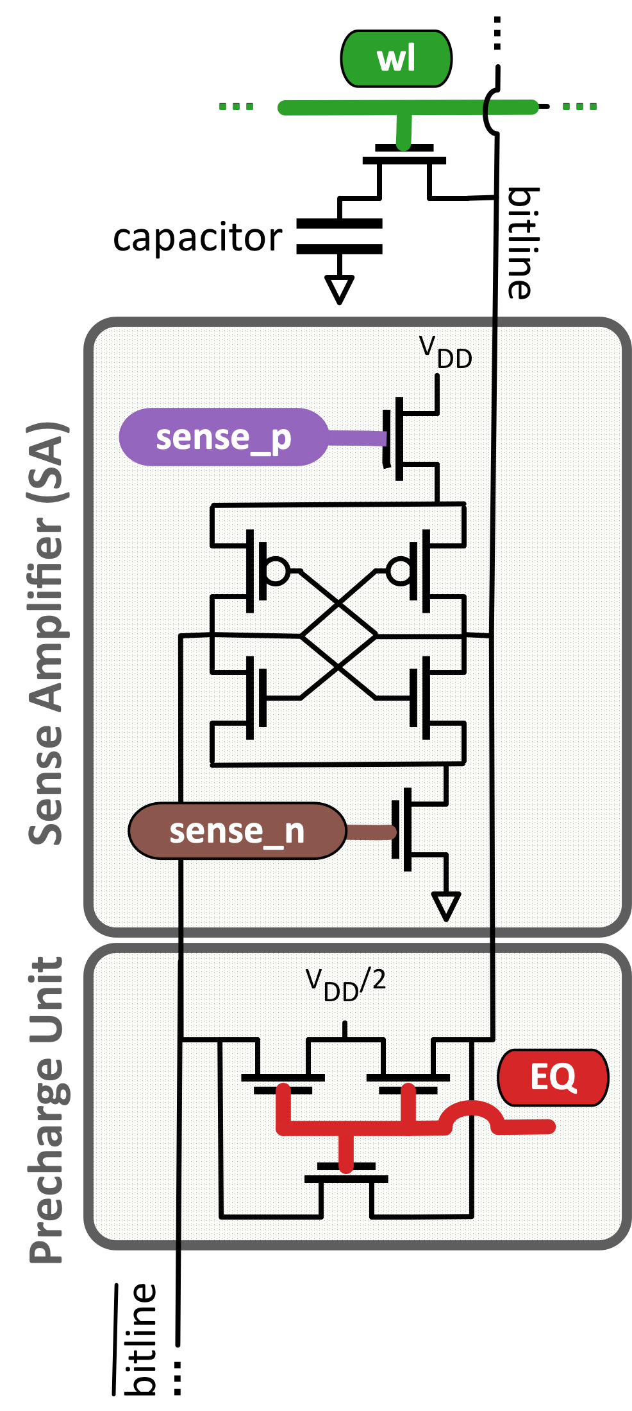
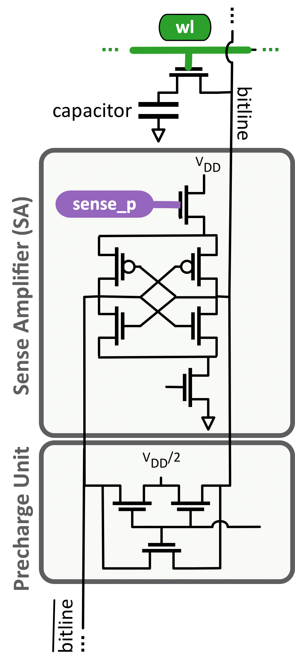
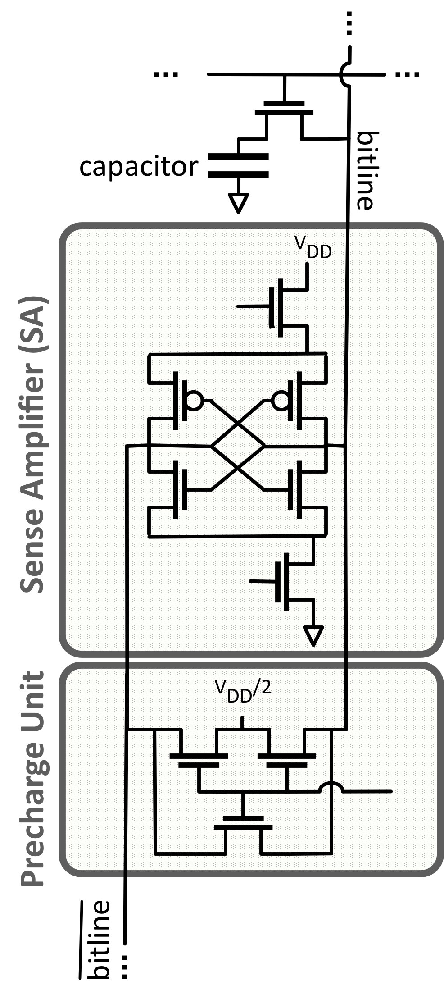
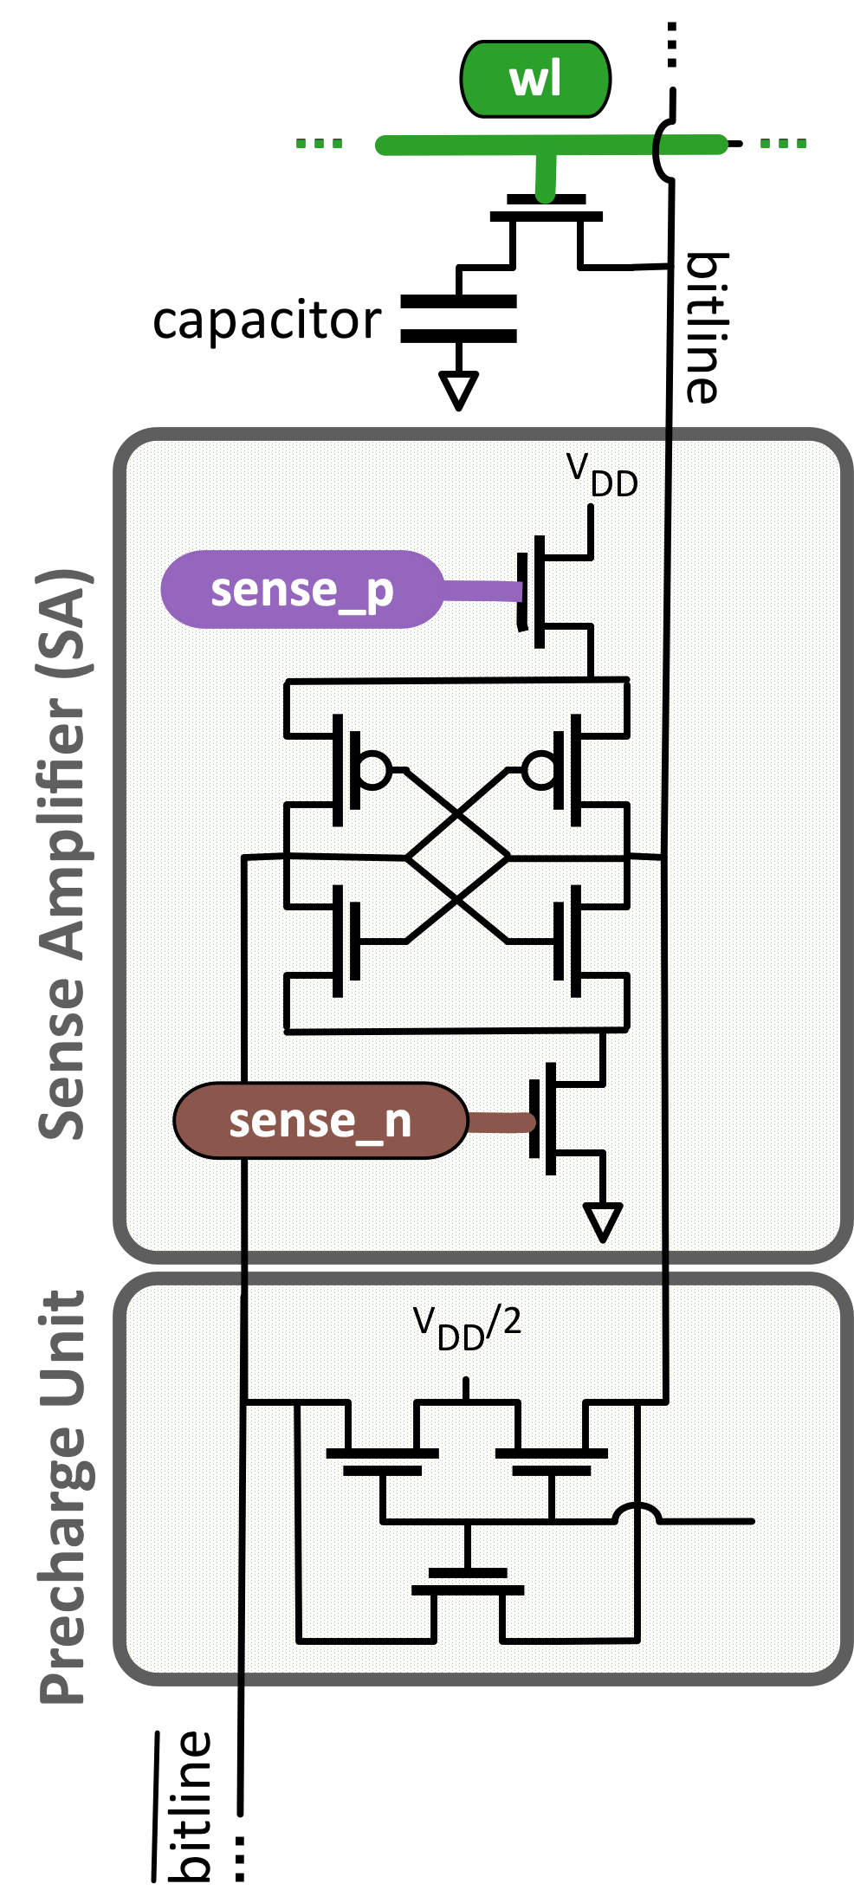
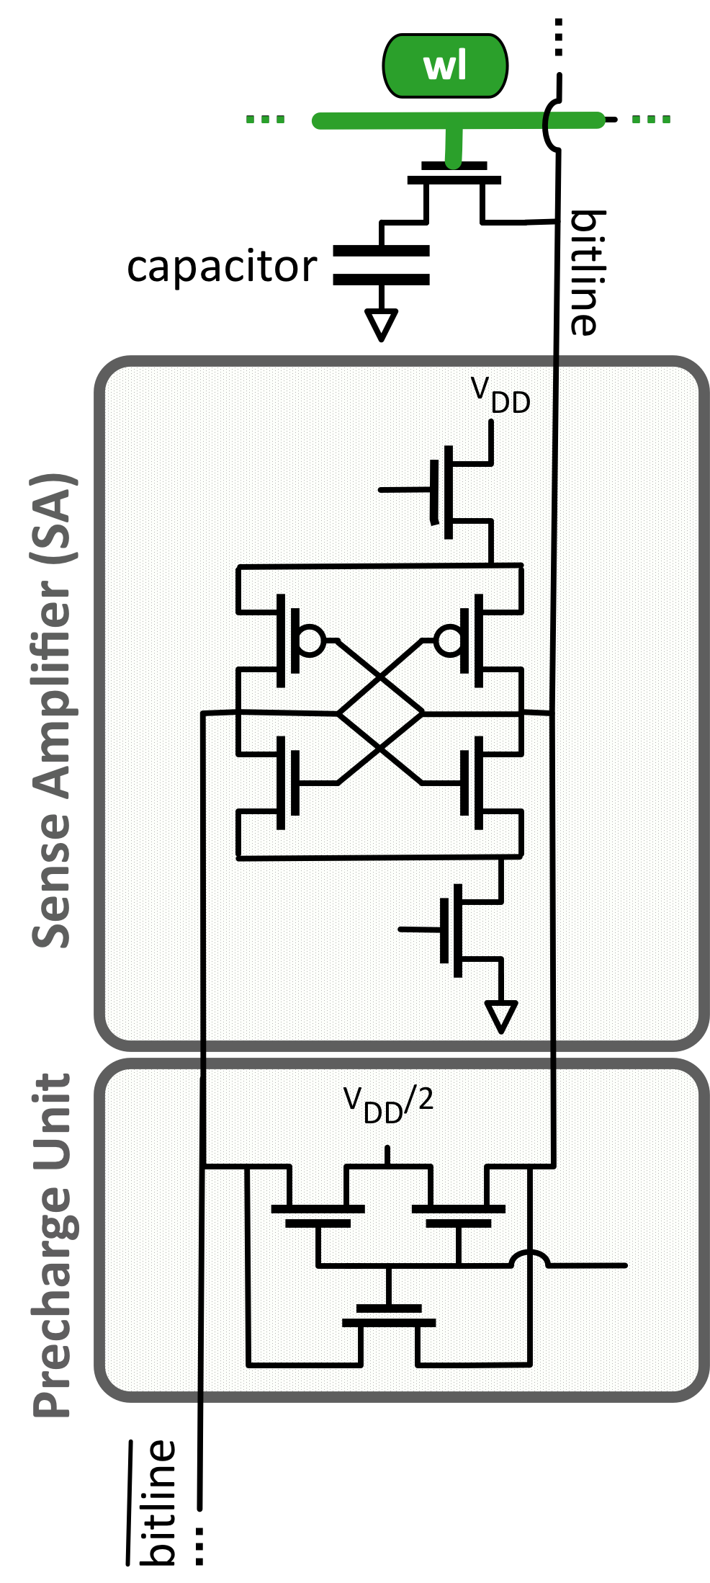
DRAM Organization & Signals
bitline
DRAM Cell
wordline
…
…
…
…
…
…
Row Buffer
DRAM Bank
wl controls the access transistor that connects the cell capacitor to the bitline
sense_p controls the PMOS amplifier in the SA
sense_n controls the NMOS amplifier in the SA
EQ controls the precharge unit that sets the bitline to the precharge voltage
3
Notes:
I will provide some DRAM background first.
=click=
DRAM is organized hierarquically. A rank is composed of multiple DRAM chips =click= that work in lockstep
== click
Each DRAM chip is composed of several banks. Each bank is composed of multiple two-dimensional arrays of DRAM cells =click= , organized into rows of cells that are selected using a wordline, and the cells are connected to a rowbuffer via bitlines
=click=
Each bitline of the array is connected to a sense amplifier in the row buffer that senses an amplifies the content of the DRAM cell, =click= and a precharge unit that prepares the bitline for the next access. The behavior of the sense amplifier, precharge unit and DRAM cell is orchestrated by internal DRAM signals. There are four fundamental internal DRAM signals that control specific circuit timings =click= First, the wordline signal controls the transistor that connects the cell capacitor to the bitline =click= Second, the sense_p signal controls the PMOS amplifier in the sense amplifier =click= Third, the sense_n signal controls the NMOS amplifier in the sense amplifier=click= And fourth, the EQ signal controls the precharge unit that sets the bitline to preecharge voltage =click=

Slide 4
Motivation
Many recent works change timings between DRAM commands
Have fixed DRAM internal circuit timings
Our work explores the potential of controlling internal DRAM circuit timings
Enables more aggressive performance, reliability, and energy optimizations
Enables new functionalities
May open new areas of research
4
Notes:
=click= Many recent works change timings between DRAM commands, but =click= they have fixed DRAM internal circuit timings. =click= Our work explores the potential of controlling internal circuit timings, which has 3 main benefits =click= First, it enables more aggressive performance, reliability, and energy optimizations, =click= Second, it enables new functionalities, =click= and third, it may open new areas of research

Slide 5


CODIC Substrate
CODIC substrate enables greater control over DRAM internal circuit timings
CODIC can change the timing of four fundamental internal DRAM signals with fine granularity
Allow a large number of different CODIC variants
In the paper we show two other CODIC variants
CODIC can be used in many applications
Variant 1: CODIC-sig
Generates digital signatures that depend on process variation
Key idea: Amplify a DRAM cell that we set to the precharge voltage
Raise 1) the wordline signal , and 2) the precharge signal
Result: the final value of the cell is the precharge voltage
In the next activate command, the SA generates a signature value that depends on truly-random process variation
5
Notes:
=click= CODIC substrate enables greater control over DRAM internal circuit timings =click= via changing the timing of four fundamental DRAM signals with fine granularity, =click= which allows a large number of different CODIC variants.=click= One of these variants is is CODIC-sig, which generates digital signatures that depend on process variation =click= The key idea is to amplify a DRAM cell that we set to the precharge voltage =click= Our mechanism operates by raising the wordline signal first, and the precharge signal next=click= As a result, the final value of the cell is the precharge voltage =click= In the next activate command the sense amplifier generates a signature value that depends on uncontrollable, truly-random manufacturing process variation that perturbs the sensed voltage on the bitline. =click= In the paper we also propose and evaluate two other CODIC variants. =click= CODIC can be used in many applications. We propose and evaluate two applications in the security domain =click=

Slide 6
Application 1: PUF
A Physical Unclonable Function (PUF) generates signatures unique to a device due to the unique physical variations of the device
PUFs are typically used to authenticate or identify a device
A PUF maps a unique input (i.e., challenge) to a unique output (i.e., response)
CODIC-sig can generate signature values that can be used as a PUF
Characteristics of CODIC-sig PUF:
CODIC-sig has short evaluation latency
Repeatable PUF responses without relying on a filtering mechanism
CODIC-sig is resilient to temperature changes, i.e., changing the temperature does not influence much the repeatability of the PUF responses
CODIG-sig responses do not depend on the content of DRAM
6
Notes:
The first application is a DRAM PUF =click= A Physical Unclonable Function (or PUF) generates signatures unique to a device due to the unique physical variations of the device =click= PUFs are typically used to authenticate or identify a device =click= A PUF maps a unique input (also called challenge) to a unique output (also called response) =click= CODIC-sig can generate signature values that can be used as a PUF. =click= Our CODIC-sig PUF has four main characteristics =click= First, it has short evaluation latency =click= Second, it produces repeatable PUF responses without relying on a filtering mechanism =click= Third, it has state-of-the-art resilience to temperature changes, such that changing the temperature does not influence much the repeatability of the PUF responses =click= and Fourth, CODIC-sig responses do not depend on the content of DRAM =click=

Slide 7
Methodology and Key Results Evaluation Time
We evaluate quality and performance of CODIC-sig PUF
Evaluation of 72 real DDR3L (low power) DRAM chips and 64 real DDR3 DRAM chips
CODIC-sig PUF is more effective
than state-of-the-art DRAM PUFs at providing
very similar responses to the same challenge
CODIC-sig provides better uniqueness
across responses to different challenges
than the state-of-the-art DRAM PUFs
CODIC-sig PUF is 1.8x faster than
the best state-of-the-art DRAM PUF
7
Notes:
=click= We evaluate the quality and the performance of CODIC-sig PUF compared to state-of-the-art DRAM PUFs. =click= In our evaluation we use 72 real DDR3 low power DRAM chips and 64 real DDR3 DRAM chips. We observe three key results. =click= First, CODIC-sig PUF is more effective than the state-of-the DRAM PUFs at providing very similar responses to the same challenge, which is a desirable characteristic of a good PUF. =click= Second, CODIC-sig provides better uniqueness across responses to different challenges than the state-of-the-art DRAM PUFs, which is also a desirable characteristic of a good PUF, =click= and Third, CODIC-sig PUF is 1.8x faster than the best state-of-the-art DRAM PUF =click=

Slide 8
Application 2: Cold Boot Attacks
A cold boot attack is a physical attack on DRAM that involves hot-swapping a DRAM chip and reading out the contents of the DRAM chip on another system
Cold boot attacks are possible because the data stored in DRAM is not immediately lost when the chip is powered-off
Observation: It is possible to protect from cold boot attacks
by deleting the entire memory content
during DRAM power-on
Key idea: A low cost in-DRAM mechanism based on CODIC
that destroys all DRAM content
during DRAM power-on (Self-destruction)
8
Notes:
Using CODIC, we also propose a prevention mechanism for cold boot attacks =click= A cold boot attack is a physical attack on DRAM that involves hot-swapping a DRAM chip and reading out the contents of the DRAM chip on another system =click= In a cold boot attack, the attacker first disables the power and then transfers the DRAM to another system =click= We observe that it is possible to protect from cold boot attacks by deleting the entire memory content during DRAM power-on =click= based on this observation, we propose Self-destruction, a low cost in-DRAM mechanism based on CODIC that destroys all DRAM content during DRAM power-on =click=

Slide 9
Methodology and Key Results
We evaluate latency overheads of self-destruction at power-on, implemented with
CODIC
TCG (a software-based approach)
LISA-clone, which copies bulk data in-DRAM [Chang+, HPCA’16]
RowClone, which copies bulk data in-DRAM [Seshadri, MICRO’13]
We evaluate power, performance, and area overhead of CODIC self-destruction compared to full main memory encryption
Comparison points: ChaCha-8 and AES-128 in a Intel Atom N280
CODIC destroys the entire content of DRAM during power-on at least 2x faster than the state-of-the-art
CODIC has no processor area overhead, and no performance and power overhead at runtime
9
Notes:
=click= We evaluate the latency overheads of self-destruction at power-on, implemented with =click= CODIC variants =click= A software-based approach proposed by the trusted computing group (or TCG) =click= LISA-clone, which destroys data by copying bulk data in-DRAM =click= and Rowclone, which also copies bulk data in DRAM to destroy data = click= We also evaluate power, performance and area overhead of CODIC self-destruction compared to full memory encryption, =click= using ChaCha-8 encryption, and using AES-128 encryption in a low power Intel atom N280. We make two key conclusions =click= First, CODIC destroys the entire memory content of DRAM during power-on at least 2x faster than the state-of-the-art, =click= and Second, CODIC has no processor are overhead, and no performance and power overhead at runtime =click=

Slide 10
CODIC A Low-cost Substrate for Enabling Custom in-DRAM Functionalities and Optimizations
Lois Orosa
Yaohua Wang Mohammad Sadrosadati Jeremie Kim
Mines Patel Ivan Puddu Haocong Luo Kaveh Razavi
Juan Gómez-Luna Hasan Hassan Nika Mansouri Ghiasi
Saugata Ghose Onur Mutlu
ISCA 2021
Notes:
Thank you, to learn more about CODIC, please take a look at our full presentation, and read our paper at ISCA 2021

Slide 11
Backup

Slide 12
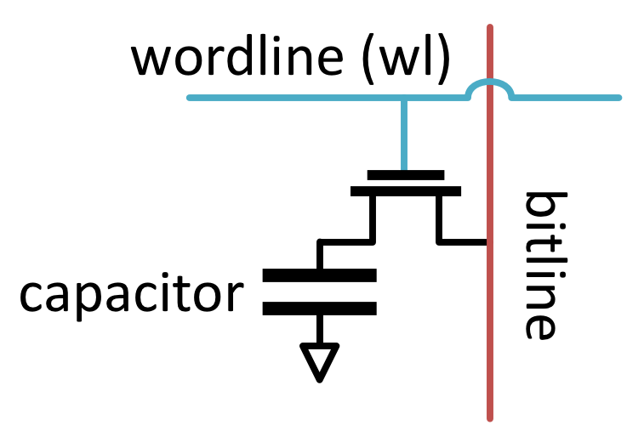
DRAM Organization
bitline
DRAM Cell
Bank
wordline
Chip I/O
…
…
DRAM Cell
…
…
…
…
Row Buffer
SA₀
SA₁
…
SA_{N-1}
DRAM Chip
DRAM Bank
Sense Amplifiers (SAs)
12
Notes:
=click=
DRAM is organized hierarquically. A rank is composed of multiple DRAM chips =click= that work in lockstep
== click
Each DRAM chip is composed of several banks
=click=
Each bank is composed of multiple two-dimensional arrays of DRAM cells, organized into rows of cells that are selected using a wordline, and the cells are connected to a rowbuffer via bitlines
=click=
Each DRAM Cell is composed of a capacitor that stores information in terms of charge, and an access transistor to connect the capacitor to the bitline
=click=
Each bitline of the array is connected to a sense amplifier in the row buffer that senses an amplifies the content of the DRAM cell =click=

Slide 13
Internal DRAM Signals
wl controls the access transistor that connects the cell capacitor to the bitline
sense_p controls the PMOS amplifier in the SA
sense_n controls the NMOS amplifier in the SA
EQ controls the precharge unit that sets the bitline to V_{dd}/2
13
Notes:
The behavior of the sense amplifier and DRAM cell is orchestrated by internal DRAM signals. There are four fundamental internal DRAM signals that control specific circuit timings =click= First, the wordline signal controls the access transistor that connects the cell capacitor to the bitline =click= Second, the sense_p signal controls the PMOS amplifier in the sense amplifier =click= Third, the sense_n signal controls the NMOS amplifier in the sense amplifier=click= And fourth, the EQ signal controls the precharge unit that sets the bitline to half-V_{dd}

Slide 14

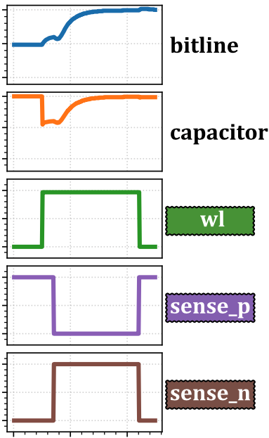




DRAM Operation - Activate
DRAM controller can issue 4 main memory commands
ACTIVATE: Activates the DRAM row containing the data
is raised to share the charge between the cell and the bitline
and are raised to sense and amplify the small charge in the cell
READ: Reads a column of data from the RB
WRITE: Writes a column of data into DRAM
1
1
2
2
14
Notes:
=click= The DRAM memory controller can issue 4 main memory commands =click= The first command is the activate command, which activates the DRAM row that contains the data. =click= The activate command requires raising 3 internal signals in two steps =click= First, the wordline signal is raised to share the charge between the DRAM cell and the bitline =click= and second, the sense_n and sense_p signals are raised to sense and amplify the small charge in the cell =click= the second command is the READ command, which reads a column of data from the row buffer =click= the third command is the write command, which writes a column of data into DRAM =click=

Slide 15
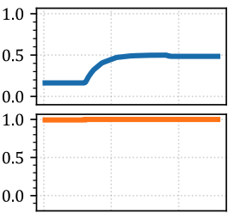
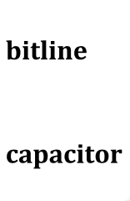
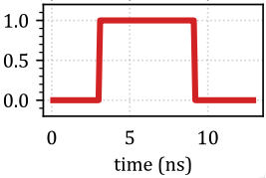

DRAM Operation - Precharge
DRAM controller can issue 4 main memory commands
PRECHARGE: Prepares all bitlines for a subsequent ACTIVATE command to a different row
is raised for setting the bitline to the precharge voltage level (V_{DD}/2)
15
Notes:
=click= and the forth command is the precharge command, which prepares all bitlines for a subsequent ACTIVATE command to a different row =click= The signal involved in a PRECHARGE command is EQ, =click= which is raised for setting the bitline to the precharge voltage level (or half-Vdd) =click=

Slide 16
Limitations of Recent Works
Many recent works change timings between DRAM commands
Have fixed DRAM internal circuit timings
Limitations of fixed DRAM internal circuit timings
Chosen at design time and cannot be modified
Conservative internal circuit timings to ensure reliable operation
Memory controller does not have any knowledge or control over the internal implementations of DRAM commands
16
Notes:
=click= Many recent works change timings between DRAM commands, but =click= they have fixed DRAM internal circuit timings. =click= There are at least three limitations of fixed DRAM internal circuit timings =click= First, They are chosen at design time and cannot be modified =click= Second, DRAM manufacturers use conservative internal circuit timings to ensure reliable operation, =click= and Third, the memory controller does not have any knowledge or control over the internal implementation of DRAM commands =click=

Slide 17
Controlling DRAM Circuits
Our work explores the potential of controlling internal DRAM circuit timings
Enables more aggressive performance, reliability, and energy optimizations
Enables new functionalities
May open new areas of research
17
Notes:
=click= In this work we propose controlling internal circuit timings, which has 3 main benefits =click= First, it enables more aggressive performance, reliability, and energy optimizations, =click= Second, it enables new functionalities, =click= and third, it may open new areas of research

Slide 18
Goals
Enable new and enhance existing
DRAM commands and optimizations
by providing a low-cost substrate that enables fine-grained control over DRAM internal circuit timings
Design new security mechanisms that
have strong security and high performance
by using the CODIC substrate
18
Notes:
Our goal in this paper is twofold =click= First, enable new and enhance existing DRAM commands and optimizations by providing a low-cost substrate that enables fine-grained control over DRAM internal circuit timings, =click= and Second, design new security mechanisms that provide stronger security and higher performance than previous mechanisms by using the CODIC substrate =click=

Slide 19
Overview
CODIC substrate enables greater control over DRAM internal circuit timings
CODIC is an efficient and low-cost way to enable new functionalities and optimizations in DRAM
CODIC controls four key signals that orchestrate DRAM internal circuit timings
wordline (wl): Connects DRAM cells to bitlines
sense_p and sense_n: Trigger sense amplifiers
EQ: Triggers the logic that prepares a DRAM bank for the next access
19
Notes:
=click= CODIC substrate enables greater control over DRAM internal circuit timings =click= CODIC is an efficient and low-cost way to enable new functionalities and optimizations in DRAM =click= CODIC controls four key signals that orchestrate DRAM internal circuit timings =click= the wordline signal that connects the DRAM cells to the bitlines =click= the sense_p and sense_n signals that trigger the sense amplifiers, =click= and the EQ signal that triggers the logic that prepares a DRAM bank for the next access =click=

Slide 20
CODIC Variants
CODIC can trigger and disable internal DRAM signals in a fine-grained manner
Time steps of 1ns, within a time window of 25ns
Large number of possible timing combinations that allow 300⁴ different CODIC variants
We demonstrate and evaluate two CODIC variants
CODIC-sig: Generates digital signatures that depend on process variation
CODIC-det: Generates deterministic values
20
Notes:
=click= Our CODIC substrate Can trigger and disable internal DRAM signals in a fine-grained manner =click= with time steps of 1ns, and within a time window of 25ns =click= CODIC enables a large number of possible timing combinations that allows 300 to the four different CODIC variants =click= In this paper, we demonstrate and evaluate two variants of CODIC =click= First, CODIC-sig, which generates digital signatures that depend on process variation, =click= and Second, CODIC-det, which generates deterministic values =click=

Slide 21
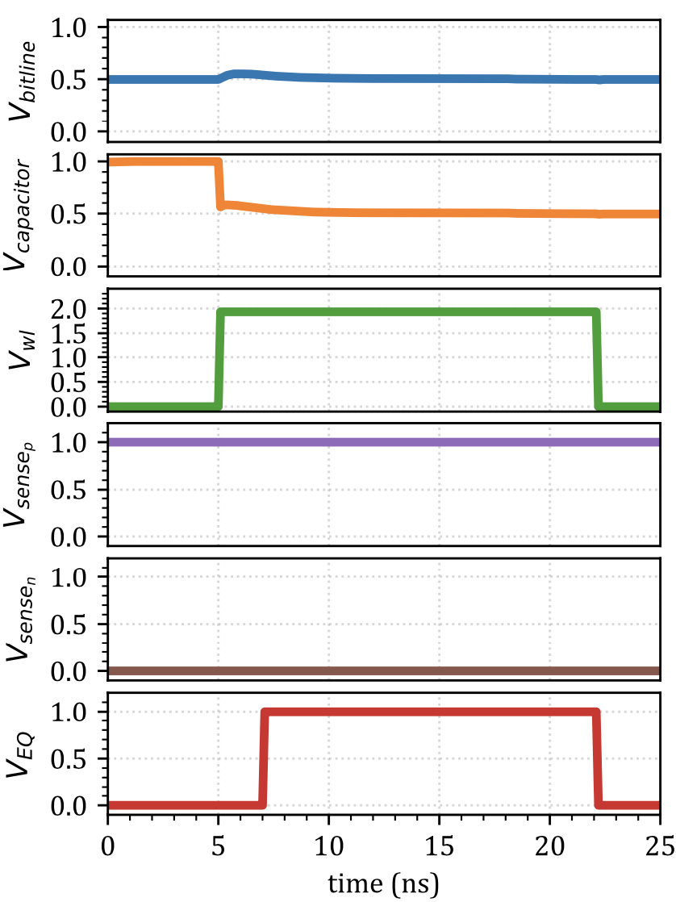
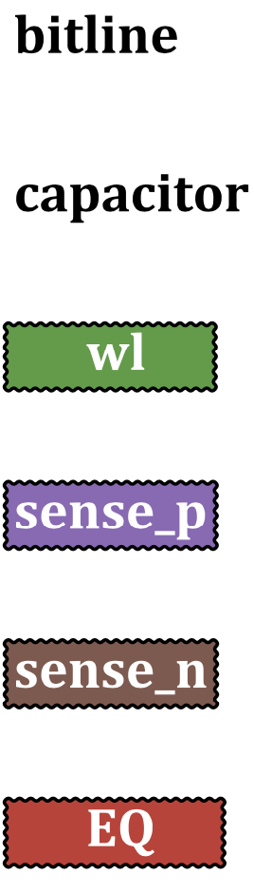
CODIC-sig
Value = V_{dd}
CODIC-sig generates digital signatures that depend on process variation
Key idea: Amplify a DRAM cell that we set to the precharge voltage (V_{dd}/2)
Mechanism:
Capacitor is initially set to 0 or V_{dd}
Raise the wordline signal ( )
Raise the precharge signal ( )
Result: the final value of the cell is the precharge voltage (V_{dd}/2)
Value = V_{dd}/2
5ns
7ns
In the next activate command, the SA generates a signature value that depends on truly-random process variation
21
Notes:
=click= CODIC-sig generates digital signatures that depend on process variation =click= The key idea is to amplify a DRAM cell that we set to the precharge voltage =click= Our mechanism works as follow =click= First, The capacitor is initially set to 0, or Vdd like in the example of the Figure =click= Second, CODIC-sig raises the wordline signal =click= and Third, CODIC-sig raises the precharge signal =click= As a result, the final value of the cell is the precharge voltage =click= In the next activate command the sense amplifier generates a signature value that depends on uncontrollable, truly-random manufacturing process variation that perturbs the sensed voltage on the bitline =click=

Slide 22
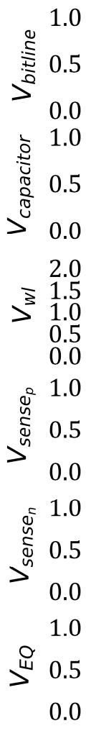
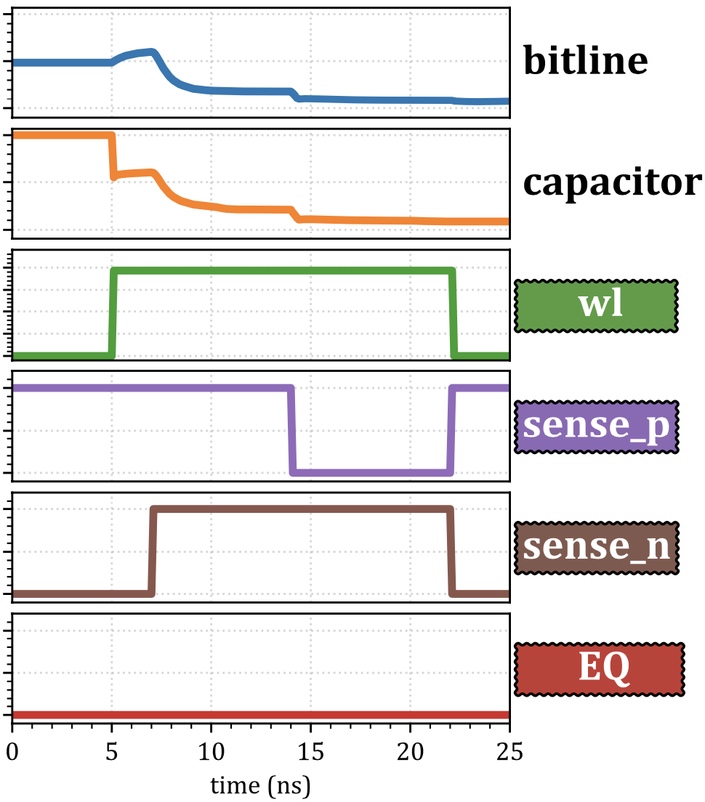
CODIC-det
CODIC-det generates deterministic values
Key idea: Activate and
with a delay between them
Mechanism:
Capacitor is initially set to 0 or V_{dd}
Raise the wordline
To generate 0, raise:
To generate 1, raise:
Value = V_{dd}
Value = 0
5ns
14ns
7ns
Result: CODIC-det generates a 0 or 1 value deterministically
22
Notes:
=click= CODIC-det generates deterministic values = click= the key idea is to activate the sense_n and sense_p signals with a delay between them =click= Our mechanism works as follow =click= First, the capacitor is initially set to 0 or Vdd, like in the example of the figure =click= Second, CODIC-det raises the wordline =click= and Third, to generate a 0 value, =click= CODIC raises the sense_n signal first, and after some delay, =click= it raises the sense_p signal next . To generate a 1 value, =click= CODIC raises the signals in the opposite order: first, it raises the sense_p signal, and after some delay, it raises the sense_n signal =click= As a result, CODIC-det generate a zero or a one value deterministically =click=

Slide 23
Also in the Paper…
An optimization of CODIC-sig to achieve lower latency [1,2]
A new CODIC variant (CODIC-sigsa) that generates digital signatures without destroying the content of DRAM [2]
Details about the hardware implementation and the low area overhead (~1% per mat) [1,2]
Details about the minimal changes to the DDRx interface [1,2]
[1] Orosa+, “CODIC: Low-Cost Substrate for Enabling Custom In-DRAM Functionalities and Optimizations”, ISCA 2021
[2] Orosa+, “CODIC: Low-Cost Substrate for Enabling Custom In-DRAM Functionalities and Optimizations”, arXiv 2021
23
Notes:
In the paper we also show =click= an optimization of CODIC-sig that achieves lower latency =click= a new CODIC variant that generates digital signatures without destroying the content of DRAM =click= more details about the hardware implementation and the low area overhead =click= and more details about the minimal changes to the DDR interface =click=

Slide 24



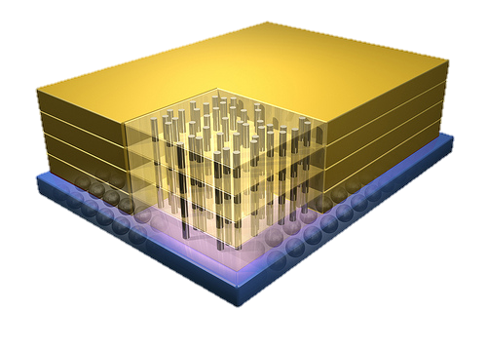
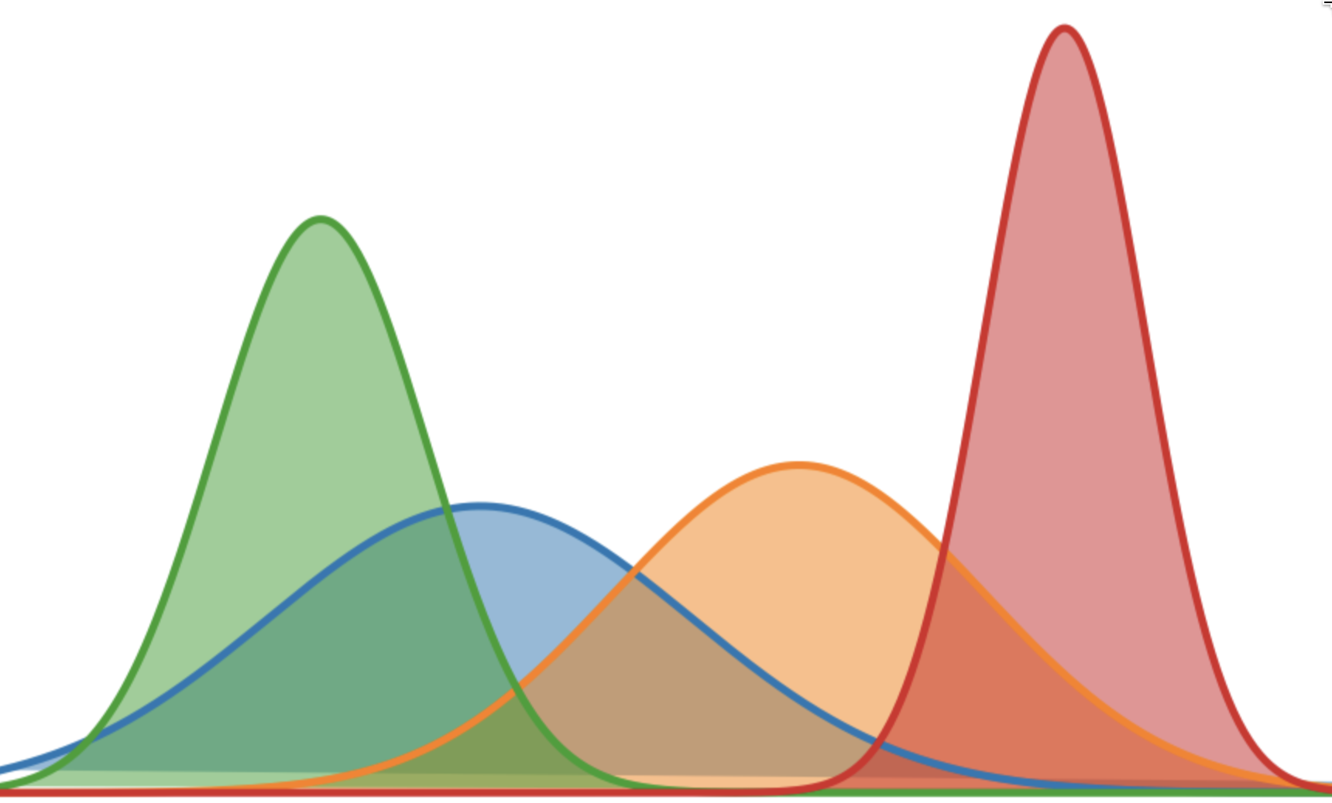
Applications of CODIC
CODIC can be used in many applications
We use CODIC to design two new applications in the security domain
A CODIC-based Physical Unclonable Function (PUF)
A CODIC-based Cold Boot Attack Prevention Mechanism
Custom
optimizations
Accurate DRAM
Characterization
Processing-In-Memory
(PIM)
Security
Memory Controller
24
Notes:
=click= CODIC can be used in many applications. For example =click= security applications =click= custom DRAM latency and energy optimizations for adapting to environmental conditions, and =click= mitigating process variation effects. =click= Accurate DRAM characterization, =click= reliably enforcing the usage of reduced memory controller timing parameters, =click= and also to enable more robust processing in memory implementations in real chips =click= In this paper, we use CODIC to design two new applications in the security domain that outperform the best state-of-the-art mechanisms =click= First, A CODIC-based Physical Unclonable Function, or PUF, =click= and Second, a CODIC-based Cold Boot Attack Prevention Mechanism =click=

Slide 25
Application 1: PUF
A Physical Unclonable Function (PUF) generates signatures unique to a device due to the unique physical variations of the device
PUFs are typically used to authenticate or identify a device
A PUF maps a unique input (i.e., challenge) to a unique output (i.e., response)
Limitations of state-of-the-art DRAM PUFs:
Long evaluation times
Require heavy filtering mechanisms to deal with inherently noisy DRAM PUF responses
Responses to the same challenge exhibit high variation with temperature changes
Data dependency on data stored in the evaluated DRAM region
25
Notes:
Our first application is a physical unclonable function =click= A Physical Unclonable Function (or PUF) generates signatures unique to a device due to the unique physical variations of the device =click= PUFs are typically used to authenticate or identify a device =click= A PUF maps a unique input (also called challenge) to a unique output (also called response) =click= State-of-the-art DRAM PUFs have four main limitations =click= First, Long evaluation times, =click= Second, Require heavy filtering mechanisms to deal with inherently noisy DRAM PUF responses =click= Third, Responses to the same challenge exhibit high variation with temperature changes, =click= and Fourth, the PUF responses depend on the data stored in the evaluated DRAM region =click=

Slide 26
CODIC-sig PUF
CODIC-sig can generate signature values in DRAM that can be used as a PUF
By amplifying a DRAM cell that we set to the precharge voltage
Characteristics of CODIC-sig PUF:
CODIC-sig has short evaluation latency
Repeatable PUF responses without relying on a filtering mechanism
CODIC-sig is resilient to temperature changes, i.e., changing the temperature does not influence much the repeatability of the PUF responses
CODIG-sig responses do not depend on the content of DRAM
26
Notes:
We propose CODIC-sig PUF =click= CODIC-sig can generate signature values in DRAM that can be used as a PUF =click= by amplifying a DRAM cell that we set to the precharge voltage =click= CODIC-sig PUF has four main characteristics =click= First, it has short evaluation latency =click= Second, it produces repeatable PUF responses without relying on a filtering mechanism =click= Third, it has state-of-the-art resilience to temperature changes, such that changing the temperature does not influence much the repeatability of the PUF responses =click= and Fourth, CODIC-sig responses do not depend on the content of DRAM =click=

Slide 27
Application 2: Cold Boot Attacks
A cold boot attack is a physical attack on DRAM that involves hot-swapping a DRAM chip and reading out the contents of the DRAM chip on another system
The attacker first disables the power and then transfers the DRAM to another system
Cold boot attacks are possible because the data stored in DRAM is not immediately lost when the chip is powered-off
Data in DRAM is stored in capacitors, and the data can remain in the cells long enough for it to be stolen
This data retention effect can be even more significant at low temperatures
27
Notes:
Our second application is a prevention mechanism for cold boot attacks =click= A cold boot attack is a physical attack on DRAM that involves hot-swapping a DRAM chip and reading out the contents of the DRAM chip on another system =click= In a cold boot attack, the attacker first disables the power and then transfers the DRAM to another system =click= Cold boot attacks are possible because the data stored in DRAM is not immediately lost when the chip is powered-off =click= this is because Data in DRAM is stored in capacitors, and the data can remain in the cells long enough for data to be stolen =click= This data retention effect can be even more significant at low temperatures =click=

Slide 28
CODIC Self-Destruction
Observation
It is possible to protect from cold boot attacks
by deleting the entire memory content
during DRAM power-on
Self-destruction: A low cost in-DRAM mechanism based on CODIC that destroys all DRAM content
during DRAM power-on
Key Idea
28
Notes:
We propose a CODIC-based cold boot attack prevention mechanism. =click= we observe that it is possible to protect from cold boot attacks by deleting the entire memory content during DRAM power-on =click= based on this observation, we propose Self-destruction, a low cost in-DRAM mechanism based on CODIC that destroys all DRAM content during DRAM power-on =click=

Slide 29
How Does It Work?
Self-destruction is implemented completely within DRAM
It does not require the intervention of the memory controller
Can use CODIC-sig or CODIC-det variants to destroy data
Uses a dedicated circuit within DRAM that issues CODIC commands back-to-back to all DRAM rows
Parallelizes commands across banks and enforces JEDEC* standard timings
Destroys the entire memory content at power-on
During self-destruction, the DRAM chip does not accept any memory commands to ensure the atomicity of the process
Does not introduce any performance or energy overheads at runtime
* JEDEC Solid State Technology Assn., “JESD79-3F: DDR3 SDRAM Standard”, July 2012
29
Notes:
=click= Self-destruction is implemented completely within DRAM =click= and it does not require the intervention of the memory controller. =click= Self-destruction can use CODIC-sig or CODIC-det variants to destroy data =click= it uses a dedicated circuit within DRAM that issues CODIC commands back-to-back to all DRAM rows =click= , parallelizes commands across banks, and enforces JEDEC standard timing parameters. =click= Self-destruction destroys the entire memory content at power-on, =click= and during its operation, the DRAM chip does not accept any memory commands to ensure the atomicity of the process. =click= Because Self-destruction executes only at power-on, it does not introduce any performance or energy overheads at runtime =click=

Slide 30
Experimental Setup
We evaluate quality and performance of CODIC-sig PUF
Evaluation of 72 real DDR3L (low power) DRAM chips and 64 real DDR3 DRAM chips
Customized memory controller built with SoftMC [Hasan+, HPCA 2017][https://github.com/CMU-SAFARI/SoftMC]
We cannot implement CODIC-sig in commodity DRAM chips
Requires changing the timings of EQ and wordline signals to set the cell to V_{dd}/2
We emulate CODIC-sig behavior in real DRAM chips
We set the cell to V_{dd}/2 via not refreshing DRAM rows for 48h
We activate the cell to generate the signature value
30
Notes:
=click= we evaluate the quality and performance of CODIC-sig PUF =click= using 72 real low power DDR3 DRAM chips and 64 real DDR3 DRAM chips =click= we use a customized memory controller built with SoftMC =click= We can not implement CODIC-sig in commodity DRAM chips, =click= because it requires changing the timings of EQ and wordline signals to set the cell to half-Vdd =click= To be able to reproduce the values generated by CODIC-sig, we emulate its behavior in real DRAM chips =click= to do so, We First set the cell to half-V_{dd} via not refreshing DRAM rows for 48 hours, =click= and second, we activate the cell to generate the signature value =click=

Slide 31
Metrics
We use Jaccard indices to measure
Similarity of two responses from the same memory segment (Intra-Jaccard)
Uniqueness of two responses from different memory segments (Inter-Jaccard)
An ideal PUF should have
Intra-Jaccard indices close to 1
Inter-Jaccard indices close to 0
0.0
0.5
1.0
Jaccard
31
Notes:
To evaluate the quality of the DRAM PUFs =click= We use Jaccard indices as a metric to measure =click= the Uniqueness of two responses from different memory segments, also called Inter-Jaccard, =click= and the Similarity of two responses from the same memory segment, also called Intra-Jaccard =click= An ideal PUF should have =click= Intra-Jaccard indices close to one, =click= and Inter-Jaccard indices close to zero =click=

Slide 32
Comparison Points
CODIC-sig PUF
No filter: Robust responses in most cases (99.72%)
Filter: Always robust responses by using 5 PUF responses to compose the final response
DRAM Latency PUF generates responses by reducing the activation latency (tRCD = 2.5ns)
No filter: Non-robust responses
Filter: 100 PUF responses to compose the final response
PreLatPUF generates responses by reducing the precharge latency (tRP = 2.5ns)
No filter: Robust responses in most cases (96.92%)
Filter: Always robust responses by using 5 PUF responses to compose the final response
32
Notes:
=click= We use two configurations for our CODIC-sig PUF =click= First, a configuration with no filter, which generates robust responses in more than 99% of the cases =click= and Second, a configuration with a filtering mechanism that evaluates the PUF 5 times to compose the final response, which returns robust responses in all evaluated cases =click= We compare our CODIC-sig to the DRAM Latency PUF, which generates responses by reducing the activation latency =click= we could not get robust responses without a filter, =click= so we use a filtering mechanism that evaluates the PUF 100 times to compose the final response =click= We also compare our CODIC-sig PUF to PreLatPUF, which generates responses by reducing the precharge latency. We use the same two configurations as in CODIC-sig, =click= first, a configuration with no filter that generates robust responses in more than 96% of the cases =click= and Second, a configuration with a filtering mechanism that evaluates the PUF 5 times to compose the final response =click=

Slide 33
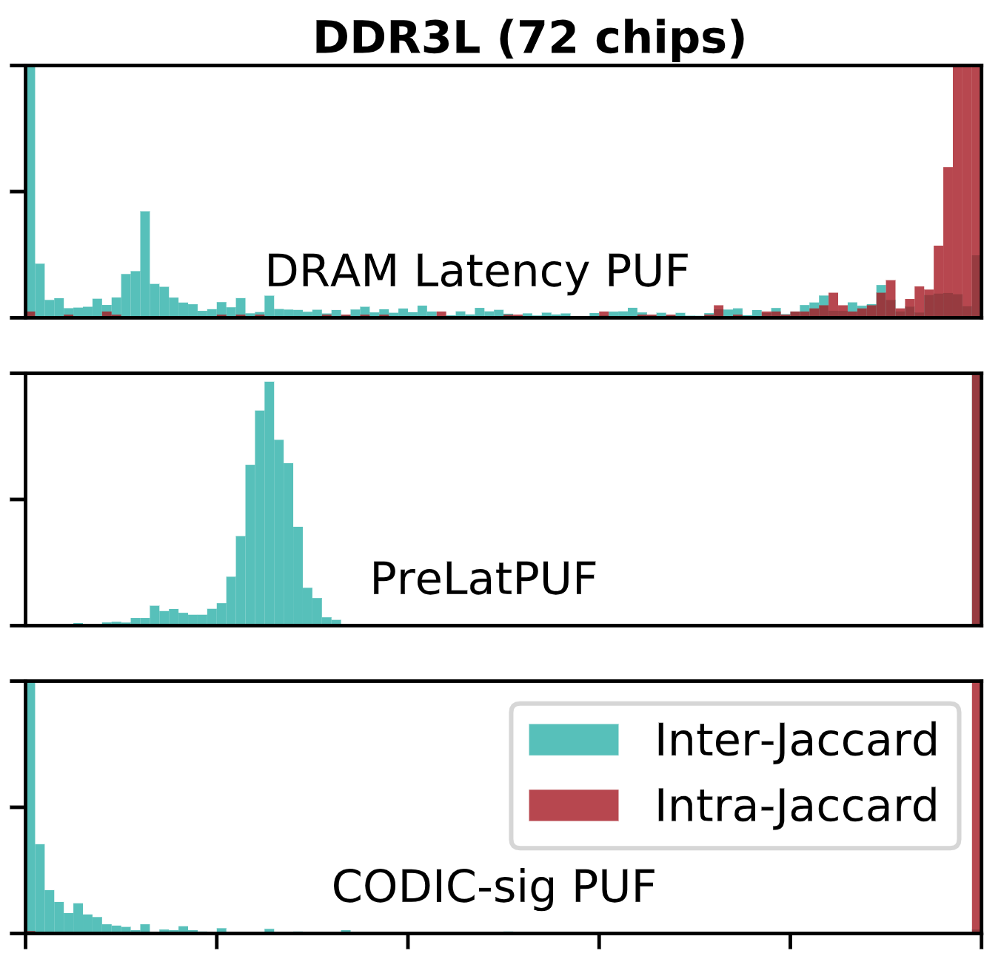




Results - Jaccard Index
Disperse Inter-Jaccard
index
Intra-Jaccard index
close to 1
DRAM Latency PUF
Inter-Jaccard index
far from 0
PreLatPUF
Intra-Jaccard index
is 1.0 with more than
99% probability
Inter-Jaccard index
close to 0
CODIC-sig PUF
CODIC-sig PUF is very effective at providing
very similar responses to the same challenge
CODIC-sig maintains uniqueness across responses
to different challenges
33
Notes:
This figure shows the quality results for 72 low power DDR3 DRAM chips. The figure shows the inter- and intra-jaccard indices of DRAM Latency PUF, PreLatPUF, and CODIC-sig PUF. =click= We can observe that DRAM latency PUF has the intra-jaccard indices close to one, which indicates that responses to the same challenge are similar =click= Intra-jaccard indices for PreLatPUF and CODIC-sig PUF are 1 with more than 99% probability, which indicates that responses to the same challenge are the same in most cases
=click= For the inter-jaccard indices, we can observe that they are pretty disperse for the DRAM latency PUF, and some of them are concentrated far from zero, which indicates that the uniqueness of PUF responses could be improved =click= the inter-jaccard indices for PreLatPUF are concentrated pretty far from zero, which also indicates that the uniqueness of PUF responses could be improved =click= and the inter-jaccard indices for our CODIC-sig PUF are pretty concentrated around zero, which demonstrate that their responses are more unique than the state-of-the-art DRAM PUFS =click= We conclude that CODIC-sig PUF is very effective at providing very similar responses to the same challenge, =click= and that CODIC-sig PUF maintains uniqueness across responses to different challenges

Slide 34
Results - PUF Evaluation Time
DRAM Latency PUF
PreLatPUF
w/(w/o) filter
CODIC-sig PUF
w/(w/o) filter
88.2 ms
7.95 (1.59) ms
4.41 (0.88) ms
20x
100x
1.8x
1.8x
CODIC-sig PUF is 1.8x faster than
the best state-of-the-art DRAM PUF
34
Notes:
This table shows the evaluation time of DRAM Latency PUF, PreLatPUF, and CODIC-sig PUF. For DRAM latency PUF we show results with the filter only, and for PreLatPUF and CODIC-sig PUF we show results with and without the filter. We observe that =click= CODIC-sig PUF with filter is 20x faster than DRAM Latency PUF, =click= CODIC-sig PUF without filter is 100x faster than DRAM Latency PUF =click= CODIC-sig PUF with filter is 1.8x faster than PreLatPUF with filter, and =click= CODIC-sig PUF without filter is 1.8x faster than PreLatPUF without filter =click= We conclude that the evaluation time of CODIC-sig PUF is 1.8x faster than the best state-of-the-art DRAM PUF =click=

Slide 35
Also in the Paper...
We evaluate 64 DDR3 chips that show similar quality results as DDR3L (low power) chips
CODIC-sig PUF is resilient to temperature changes (more so than other PUFs)
CODIC-sig PUF passes all 15 NIST randomness tests
CODIC-sig PUF is very robust to aging
35
Notes:
In the paper =click= we also show quality results for 64 DDR3 DRAM chips that show similar results as the low power DDR3 DRAM chips =click= we show that CODIC-sig PUF is resilient to temperature changes (more so than other PUFs) =click= we shows that CODIC-sig PUF passes all 15 NIST randomness tests =click= and we show that CODIC-sig PUF is very robust to aging =click=

Slide 36
Experimental Setup
We evaluate latency overheads of self-destruction at power-on, implemented with
CODIC: CODIC-det or CODIC-sig variants
TCG: Issues regular write commands from the memory controller, as proposed by the Trusted Computing Group (TCG)
LISA-clone: Copies bulk data in-DRAM [Chang+, HPCA’16]
RowClone: Copies bulk data in-DRAM [Seshadri, MICRO’13]
We evaluate power, performance, and area overhead of CODIC self-destruction compared to full main memory encryption
ChaCha-8
AES-128
Ramulator DRAM simulator [Kim+, CAL’15] [https://github.com/CMU-SAFARI/ramulator]
DRAMPower [Chandrasekar+][http://www.drampower.info]
36
Notes:
=click= We evaluate the latency overheads of self-destruction at power-on, implemented with =click= CODIC variants =click= A mechanism that issues regular write commands from the memory controller, as proposed by the trusted computing group (or TCG) =click= LISA-clone, which destroys data by copying bulk data in-DRAM =click= and Rowclone, which also copies bulk data in DRAM to destroy data = click= We also evaluate power, performance and area overhead of CODIC self-destruction compared to full memory encryption, =click= using ChaCha-8 encryption, =click= and using AES-128 encryption =click= we use RAMULATOR DRAM simulator to evaluate performance =click= and we use DRAM power for evaluating energy =click=

Slide 37
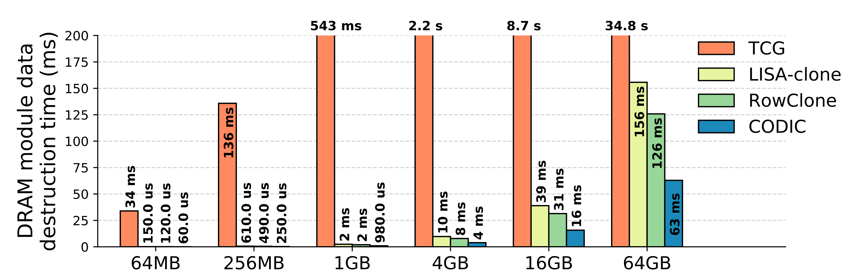
DRAM Destruction Time
552.7x
2.5x
2.0x
CODIC destroys the entire content of DRAM at least 2x faster than the state-of-the-art
37
Notes:
This figure shows the destruction time of all data in a DRAM module, for different DRAM capacities. The orange bars represent the destruction time of self-destruction mechanism using a software-based TCG destruction approach, the yellow bars represent a self-destruction mechanism using LISA-clone, the green bars represent a self-destruction mechanism using RowClone, and the blue bars represent a self-destruction mechanism using our CODIC substrate = click= we observe that, for a 4GB DRAM module, CODIC performs 552 times faster than TCG =click= 2.5 times faster than LISA-clone, =click= and 2 times faster than RowClone =click= We conclude that Self-destruction using CODIC destroys the entire content of DRAM 2 times faster than the best state-of-the-art mechanism

Slide 38
CODIC vs. Encryption
Full main memory encryption provides strong security guarantees at the cost of additional energy consumption and complexity
Comparison points: ChaCha-8 and AES-128 in a Intel Atom N280
Overhead
CODIC Self-d
ChaCha-8
AES-128
~0%
~0%
~0%
Performance
~0%
~0%
~0%
Power
~17%
~12%
~0%
~12%
~0%
~17%
~0.0%
~1.3%
Processor Area
~0.0%
~0.9%
~1.3%
~0.9%
~1.1%
~0.0%
~1.1%
~0.0%
~0.0%
DRAM Area
~0.0%
CODIC has no performance and power overhead at runtime
CODIC has no processor area overhead, and 1.1% DRAM area overhead
38
Notes:
We also compare CODIC Self-destruction to memory encryption approaches =click= Full main memory Encryption provides strong security guarantees at the cost of additional energy consumption and complexity =click= We compare CODIC to chacha-8 and to AES-128 encryption in a low-cost Intel Atom N280 processor =click= The table shows the runtime performance overhead, the runtime power overhead, the processor area overhead, and the DRAM area overhead of the three mechanisms. We make four observations. =click= First, the three mechanisms have negligible performance overhead at runtime =click= Second, the runtime power overhead of CODIC is negligible, =click= while it is 17% for Chacha, and 12% for AES, which is very significant in low-cost processors, =click= Third, CODIC has negligible processor area overhead =click= while ChaCha and AES has approximately 1% area overhead. =click= and Fourth, CODIC has close to 1% DRAM area overhead, =click= while ChaCha and AES have negligible DRAM area overhead=click= We conclude that CODIC has no performance and energy overhead at runtime, =click= and CODIC has no processor area overhead, and close to 1% DRAM area overhead

Slide 39
Also in the Paper...
We propose and evaluate another security application that accelerates secure deallocation with CODIC [2]
[2] Orosa+, “CODIC: Low-Cost Substrate for Enabling Custom In-DRAM Functionalities and Optimizations”, arXiv 2021
39
Notes:
In the paper =click= we also propose and evaluate another security application that accelerates secure deallocation with CODIC =click=

Slide 40
Backup

Slide 41
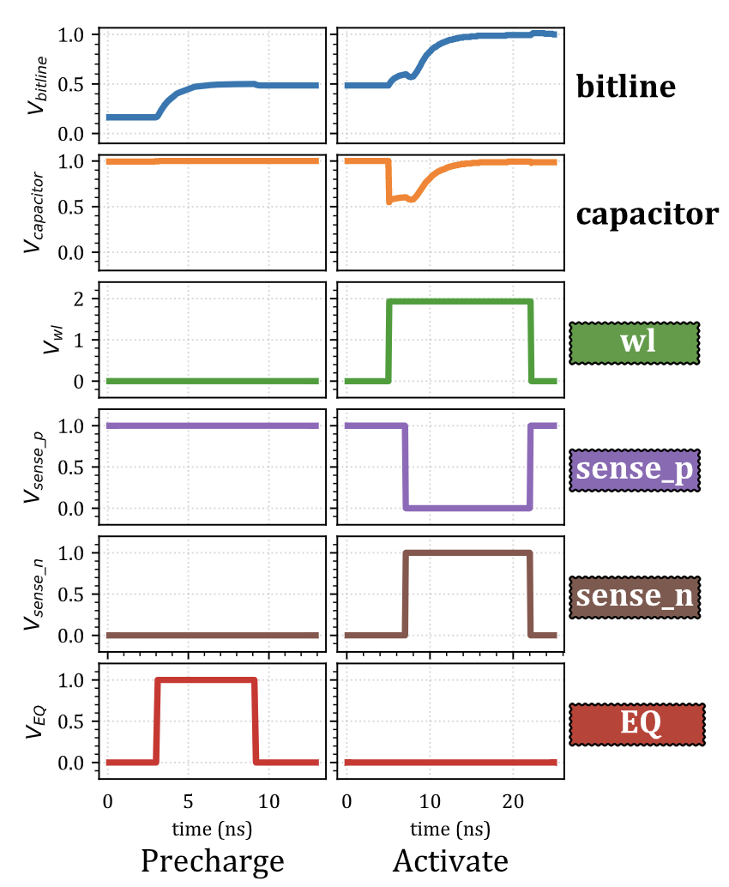
Precharge & Activate
41

Slide 42
Optimization of CODIC-sig
Observation: that CODIC-sig can set the voltage of the DRAM capacitor to V_{dd}/2 very quickly
Key idea: terminate the wl and signals earlier to reduce the latency of the command, without sacrificing reliability
Result: same result as CODIC-sig, with lower latency
Value = V_{dd}/2
42

Slide 43
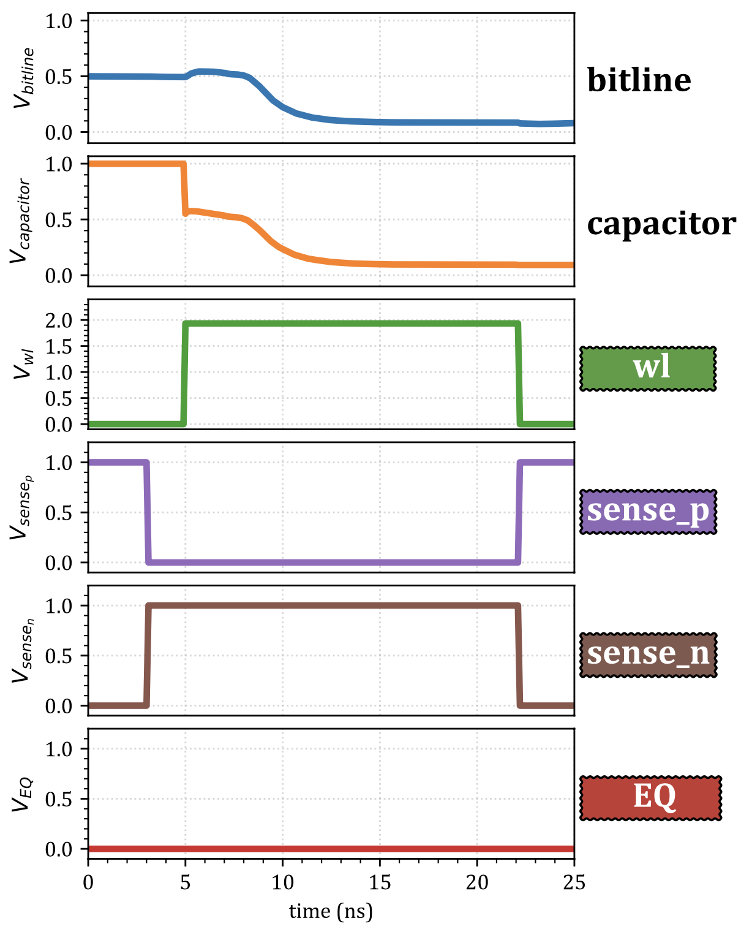
CODIC-sigsa
CODIC-sigsa
CODIC-sigsa generates digital signatures that depend on process variation
Key idea: Sense and amplify a precharge bitline (V_{dd}/2) that is not connected to the DRAM cell
Mechanism:
Capacitor is initially set to 0 or V_{dd}
Raise and
Raise
Result: the final value a signature value that depends on truly-random process variation
Value = V_{dd}
Value = 0
5ns
3ns
43
43

Slide 44
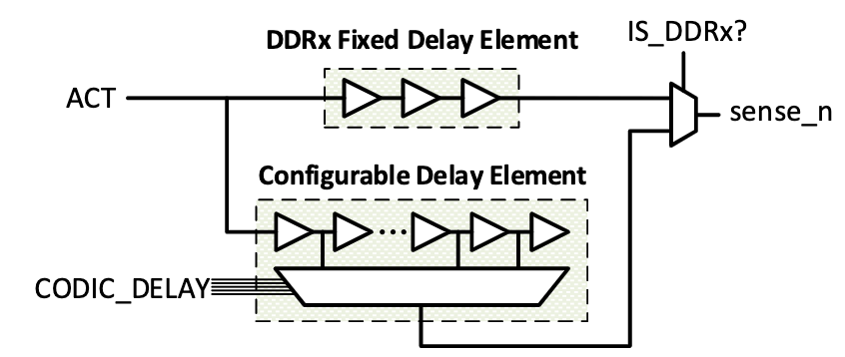
Hardware Implementation
Configurable delay To implement the fine-grained configurable control of the timing interval between DRAM internal circuit control signals
Delay element using the 22nm PTM transistor model in SPICE
Each buffer stage has a propagation delay of approximately 1ns at the output of the multiplexer
Total DRAM hardware area overhead is 1.1%
44

Slide 45
Changes to DDRx Interface
New DRAM command to the DDRx interface to leverage the CODIC substrate
We can integrate the new command in the JEDEC standard specification without extra cost
There is reserved space in the standard for including new commands
4 dedicated10-bit mode registers (MRs) in DRAM
Used to store the timings of the 4 internal timing signals that CODIC can modify
CODIC uses the existing mode register set (MRS) command defined in the DDRx specification to change the contents of its MR
45

Slide 46
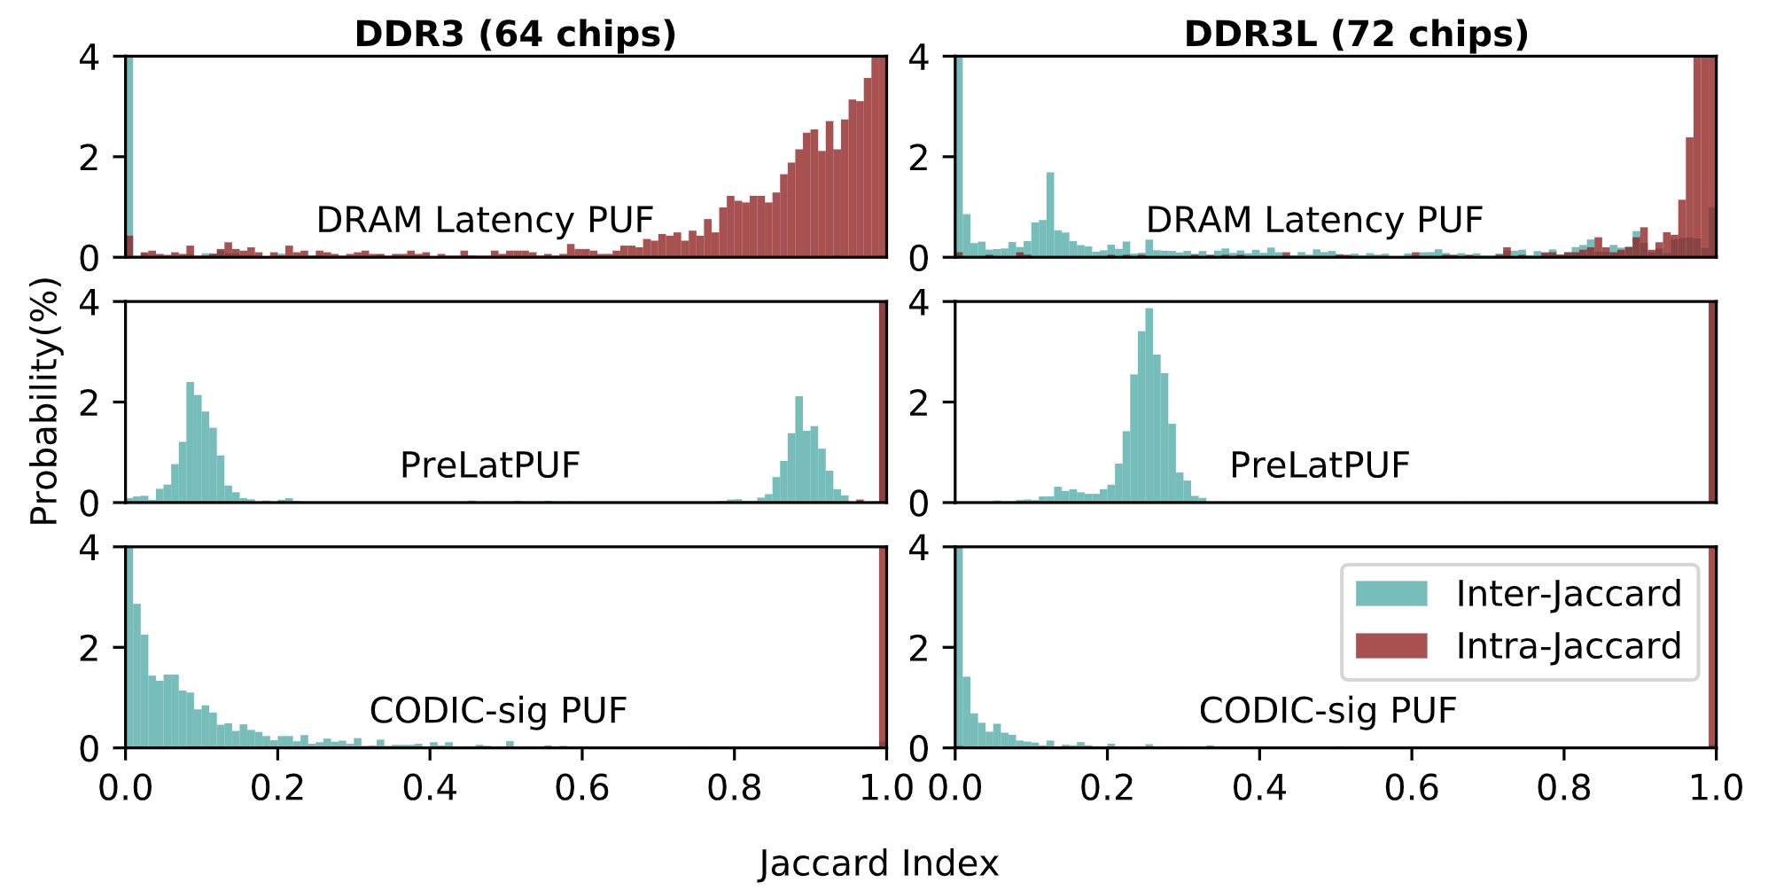
CODIC-sig PUF – DDR3 Jaccard
46

Slide 47
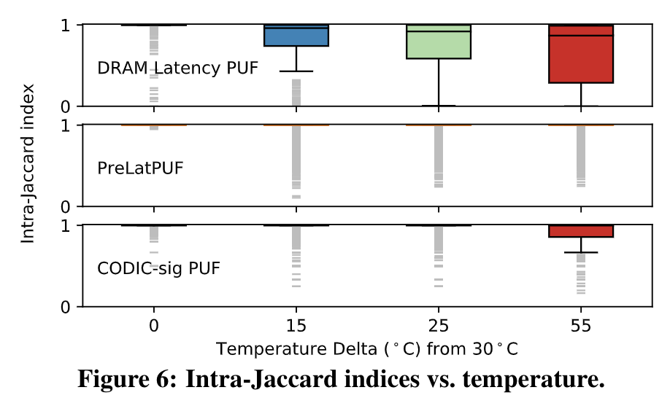
CODIC-sig PUF – Temperature
47

Slide 48
CODIC-sig PUF – Aging
We use accelerated aging techniques to artificially age our DRAM chips
We artificially age the DRAM chips by operating them at 125C degrees running stress tests for 8 hours.
We observe from our experiments that CODIC-sig PUF is robust to aging
Most PUF responses are the same before and after aging
48

Slide 49
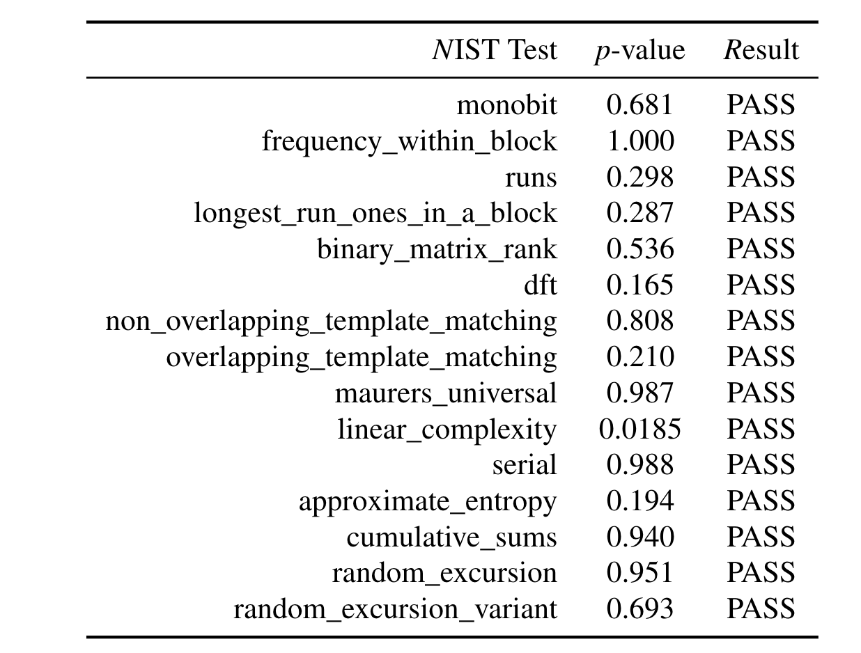
CODIC-sig PUF – NIST Tests
49

Slide 50
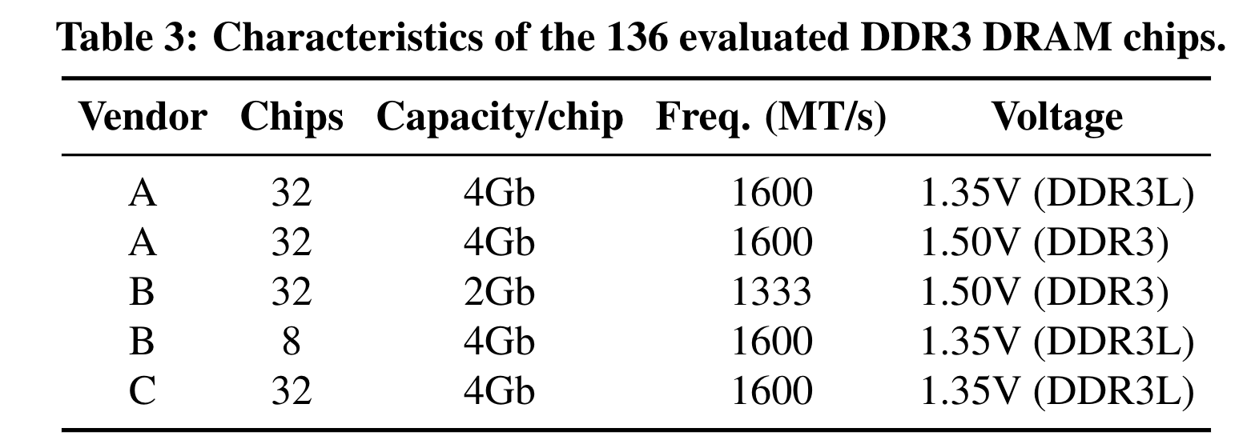
Evaluated DDR3 DRAM Chips
50

Slide 51
App. 3: Secure Deallocation
Modern applications do not immediately erase data from memory when it is no longer needed
The Operating System (OS) physically erases the data in a memory region when the program deallocates the memory region
Only when the physical memory is required for allocating new data
Sensitive data could remain in memory for an indefinite amount of time
Secure deallocation is a technique that resets data in memory to zero at the moment of deallocation
Reduces the time that critical data is vulnerable to attacks
CODIC enables the implementation of secure deallocation with very low latency, energy, and area overhead
51

Slide 52
Methodology (Sec. Deallocation)
We evaluate latency and energy overheads of secure deallocation, implemented with
Baseline: fills memory with zero values using common memory write instructions
CODIC: CODIC-det or CODIC-sig variants
LISA-clone: Copies bulk data in-DRAM [Chang+, HPCA’16]
RowClone: Copies bulk data in-DRAM [Seshadri, MICRO’13]
Ramulator DRAM simulator [Kim+, CAL’15] [https://github.com/CMU-SAFARI/ramulator]
Pin Instrumentation tool for generating traces [Luk+, PLDI’05]
Bochs full-system emulator to generate memory traces that include Linux kernel page allocations and deallocations [http://bochs.sourceforge.net/]
DRAMPower [Chandrasekar+][http://www.drampower.info]
52

Slide 53
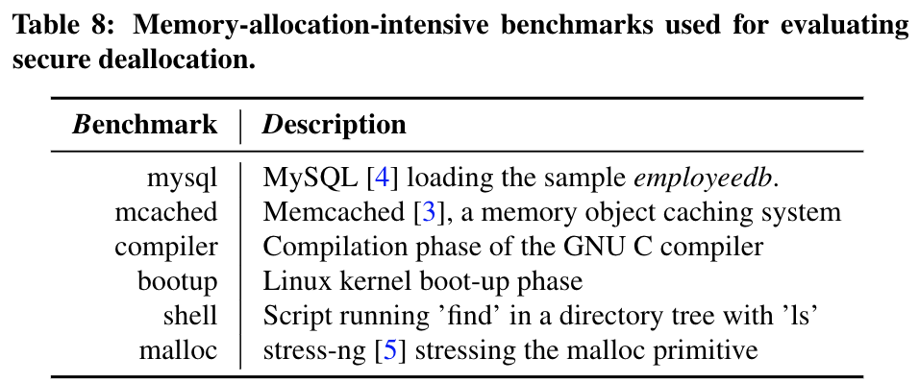
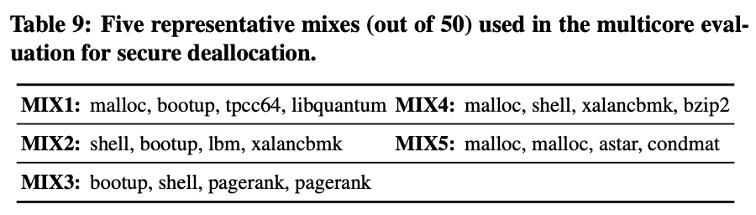
Benchmarks (Sec. Deallocation)
53

Slide 54
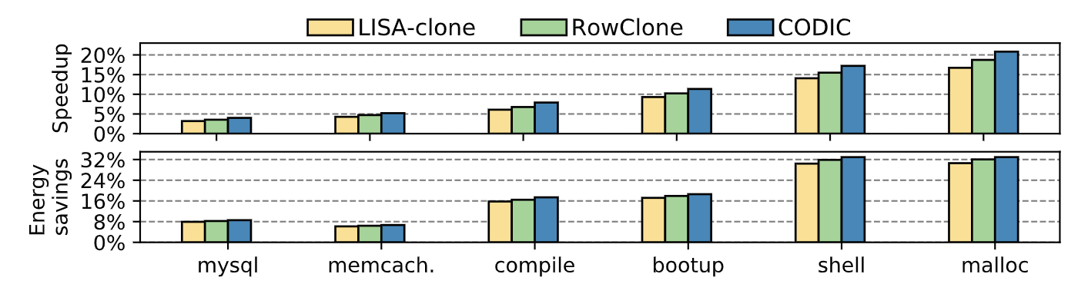
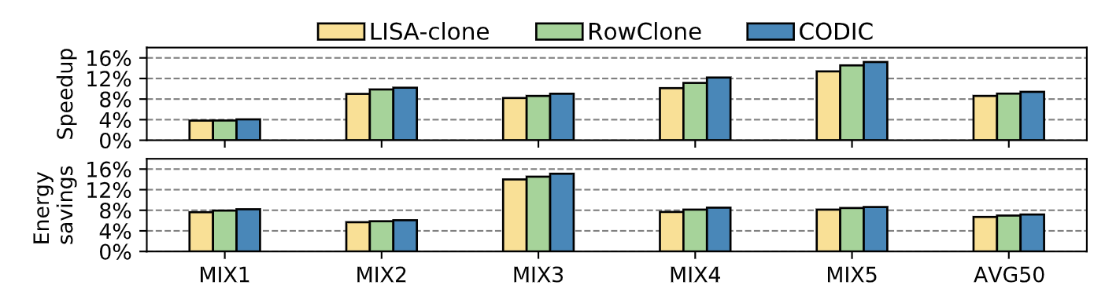
Sec. Dealloc. Latency & Energy Results
Single core
4-core
54

