Slide 1







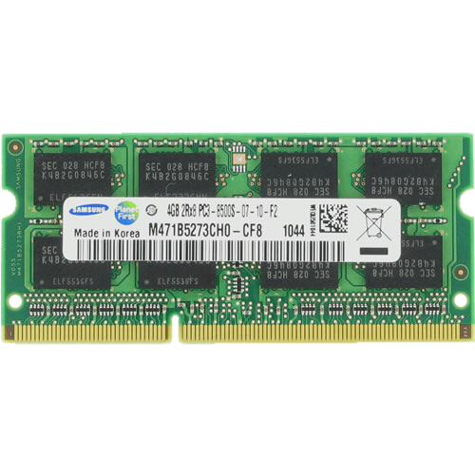
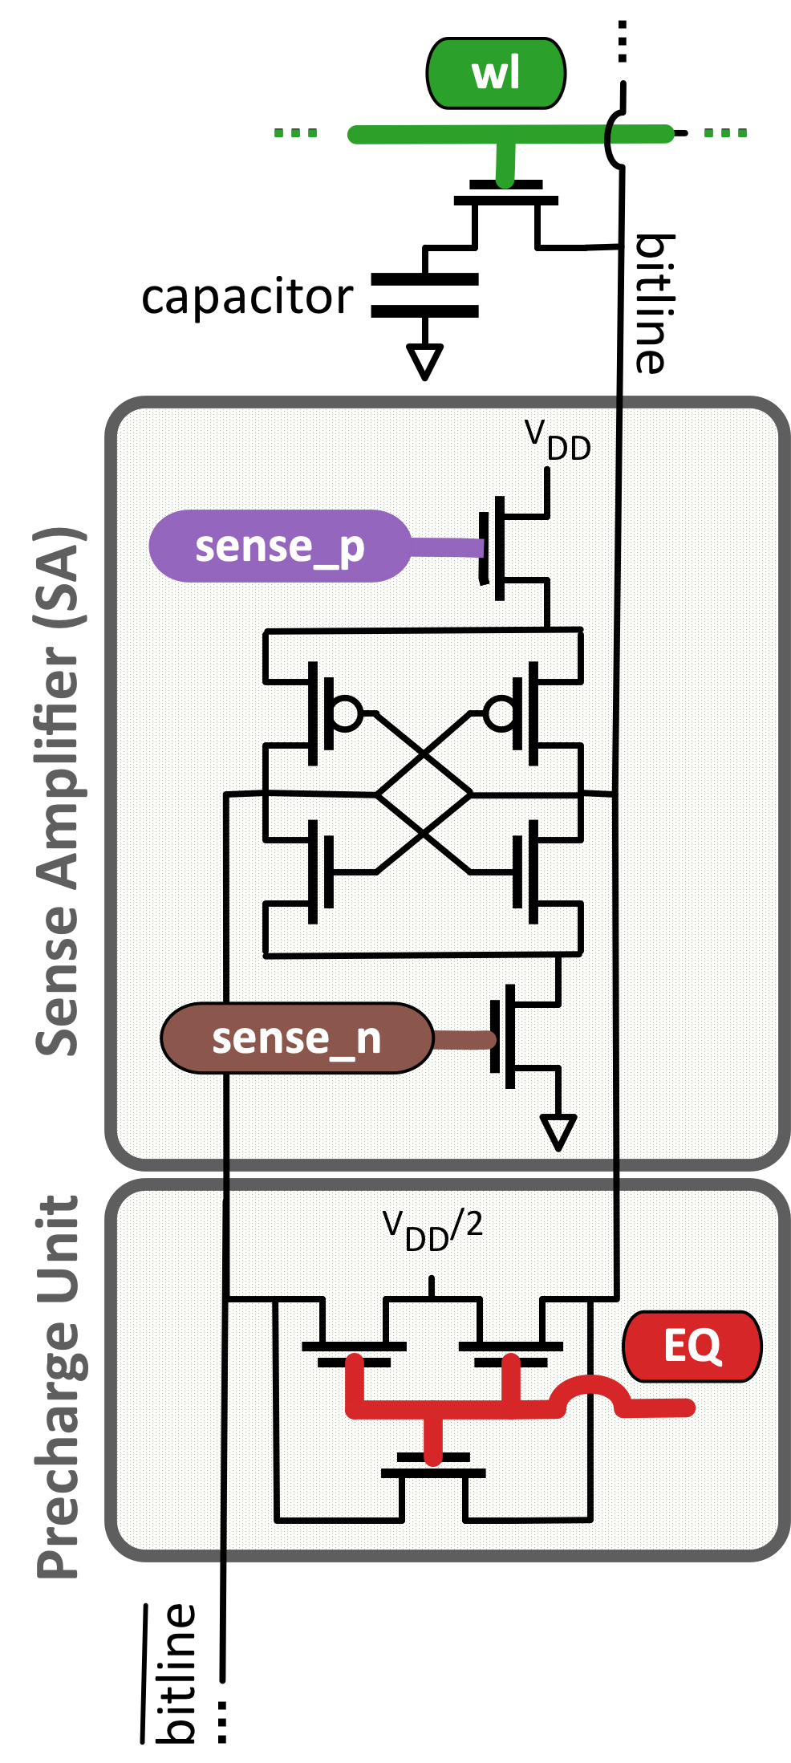

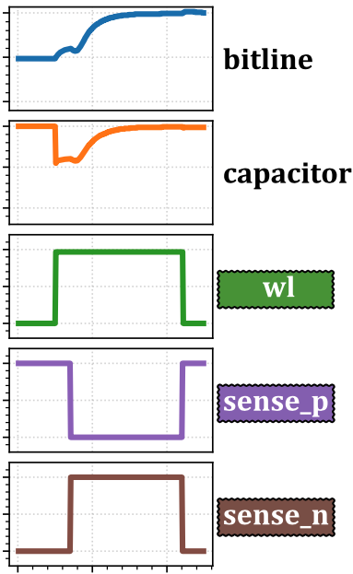
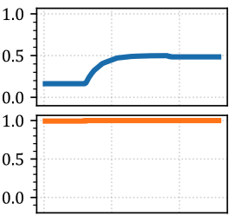
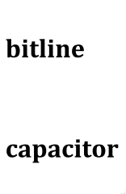
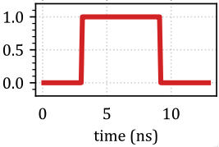

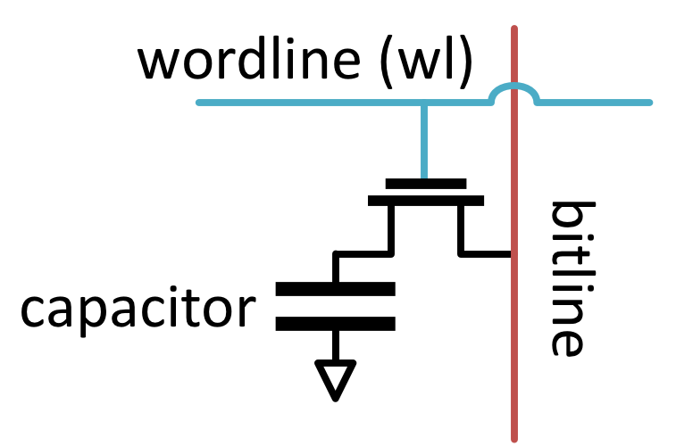





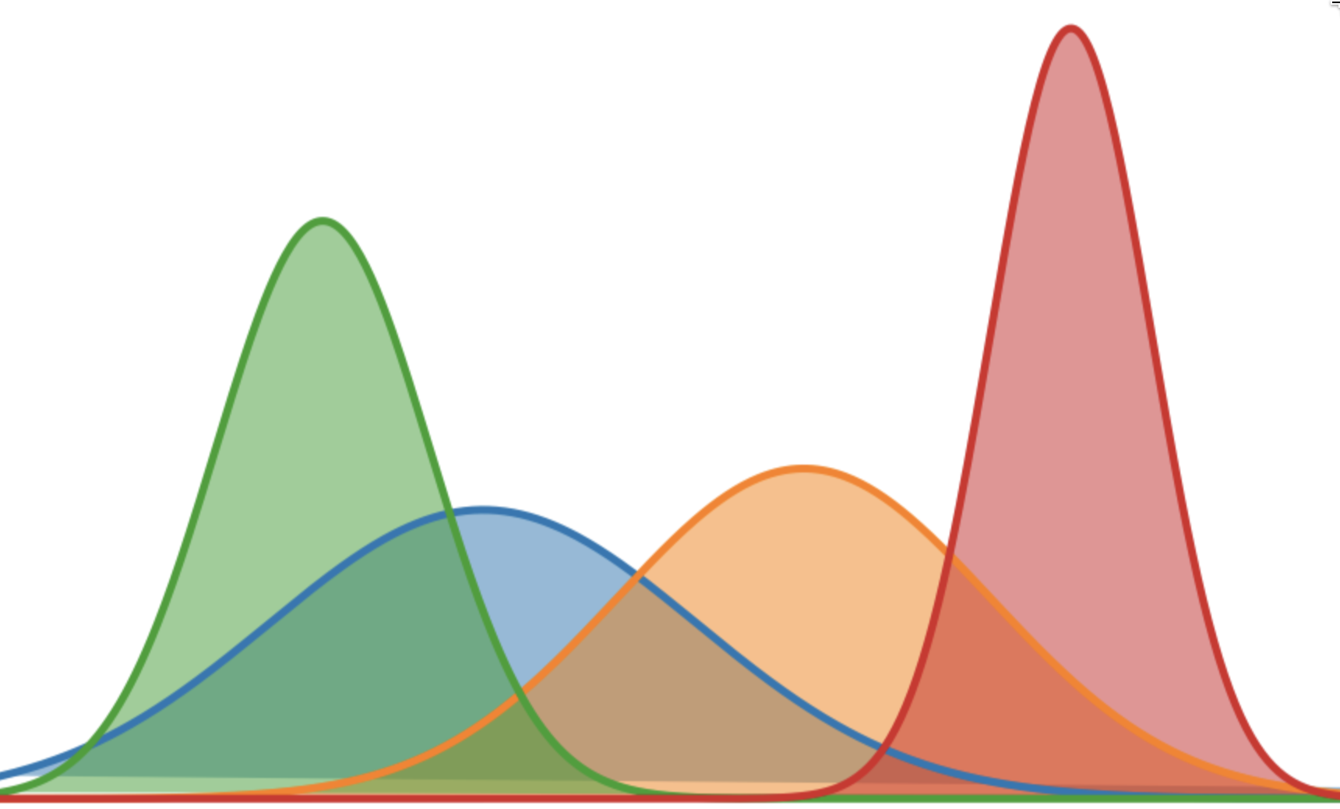
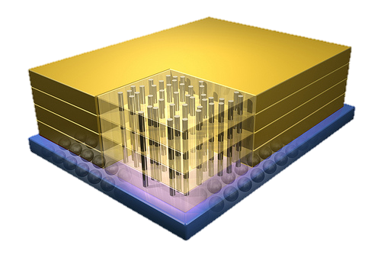




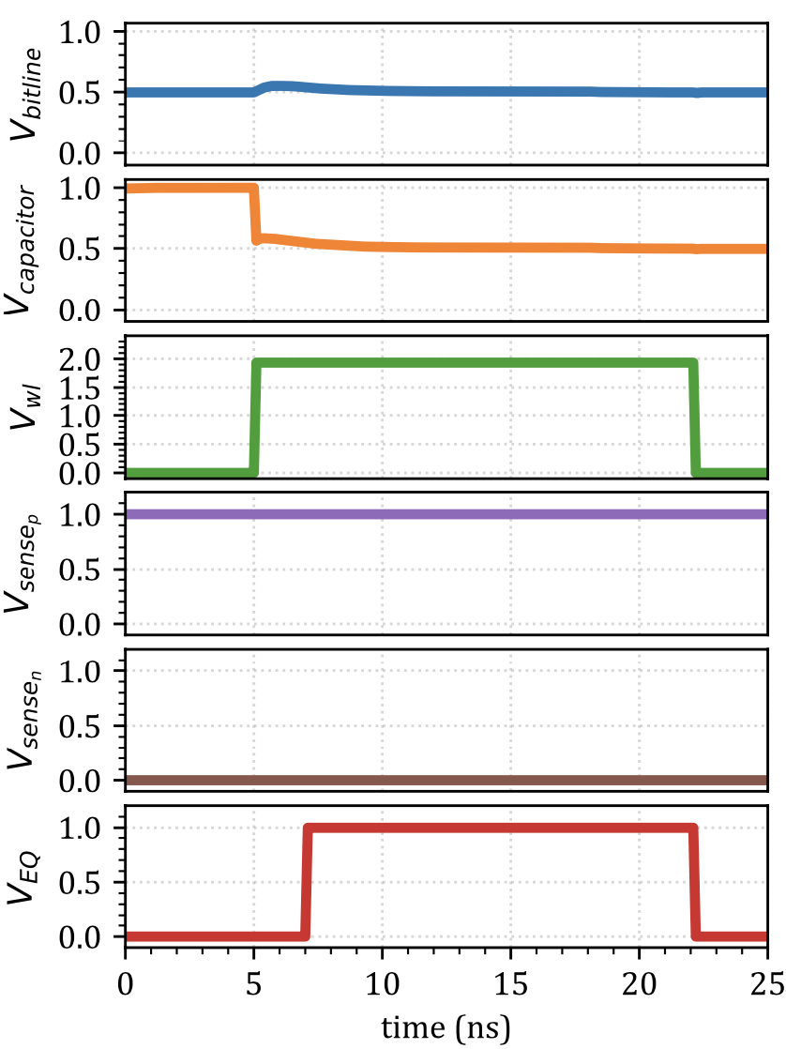
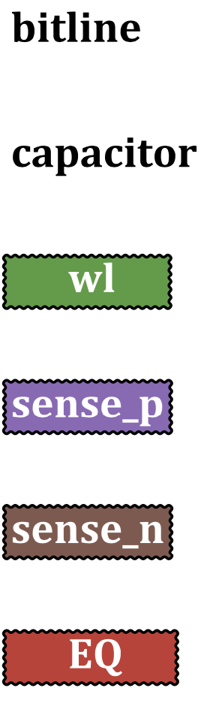
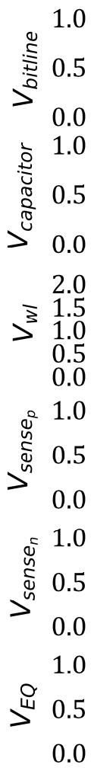
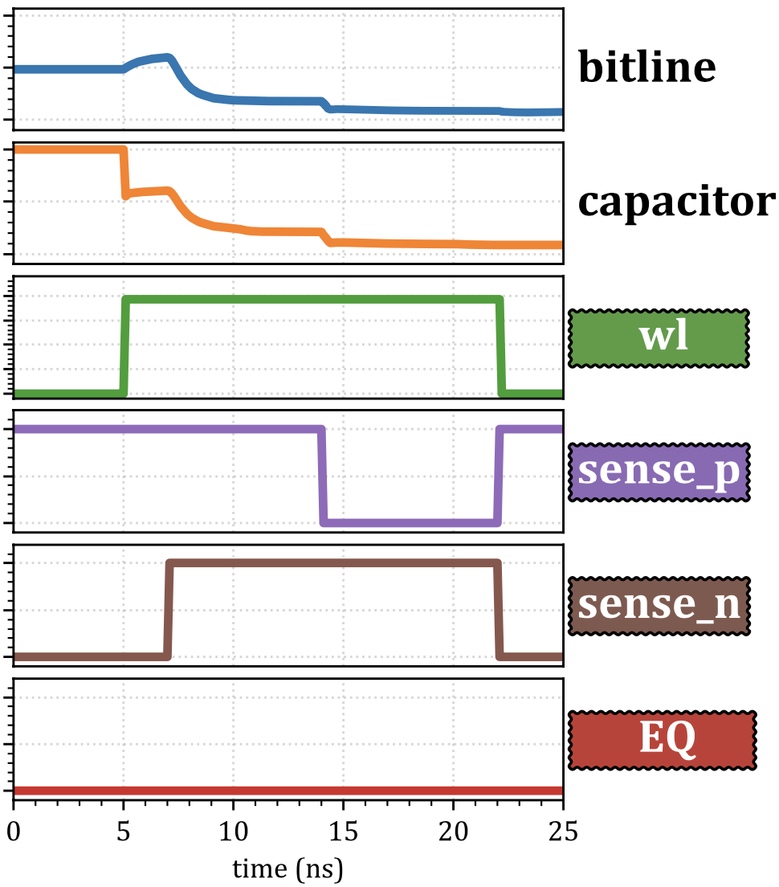
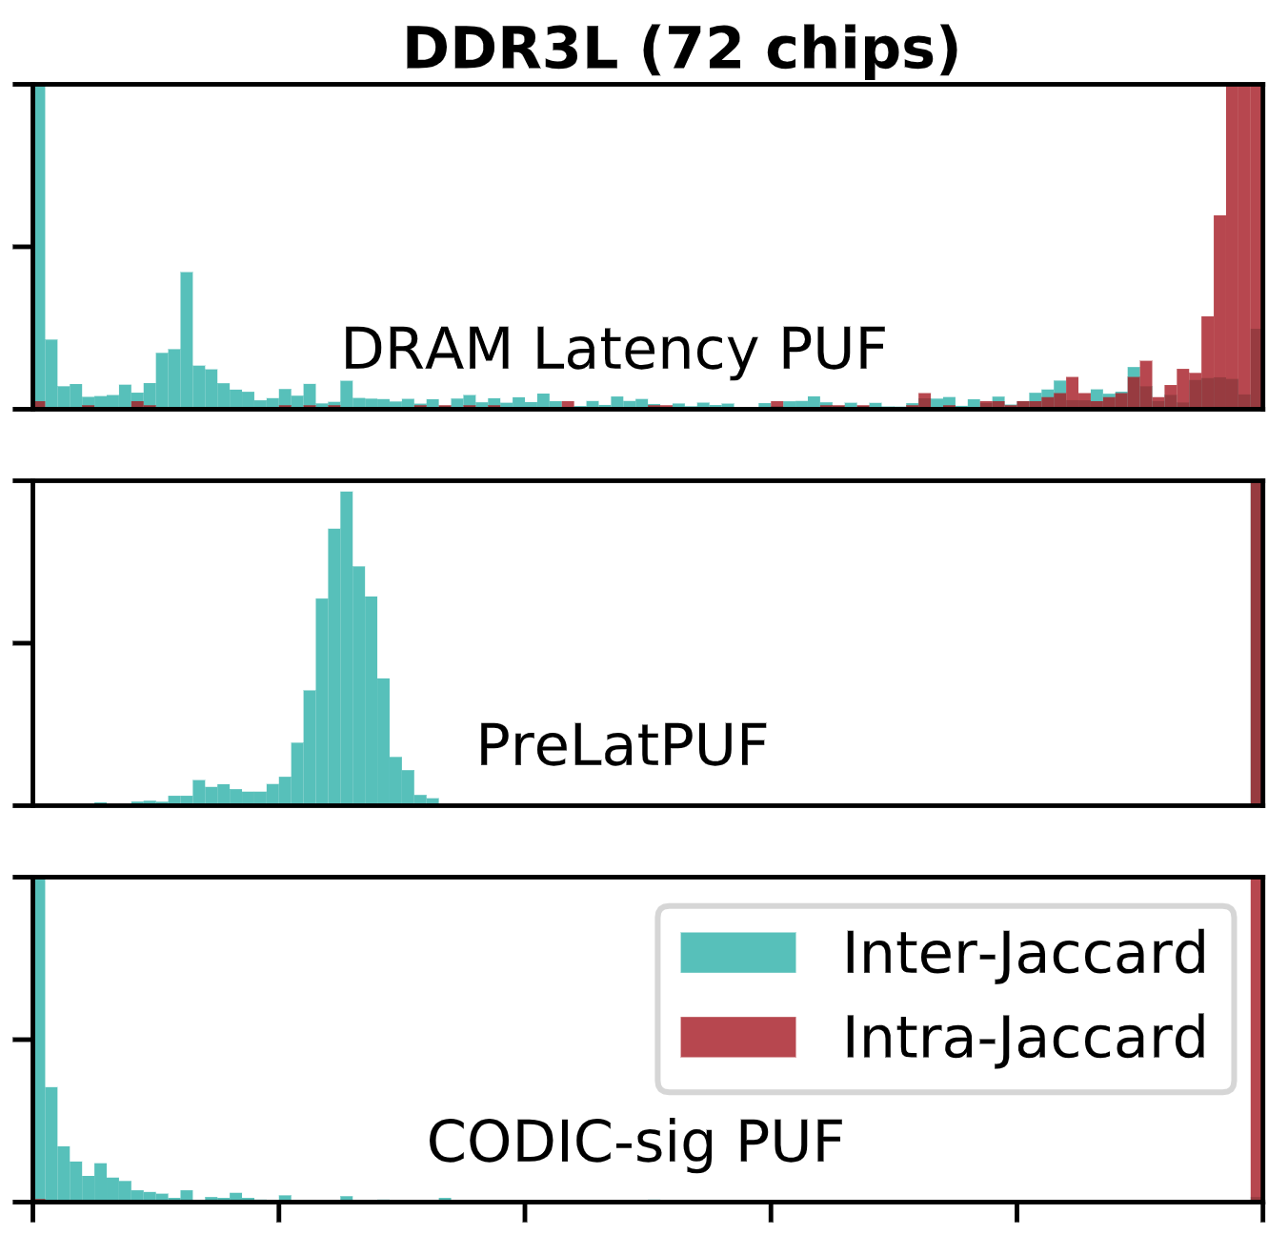

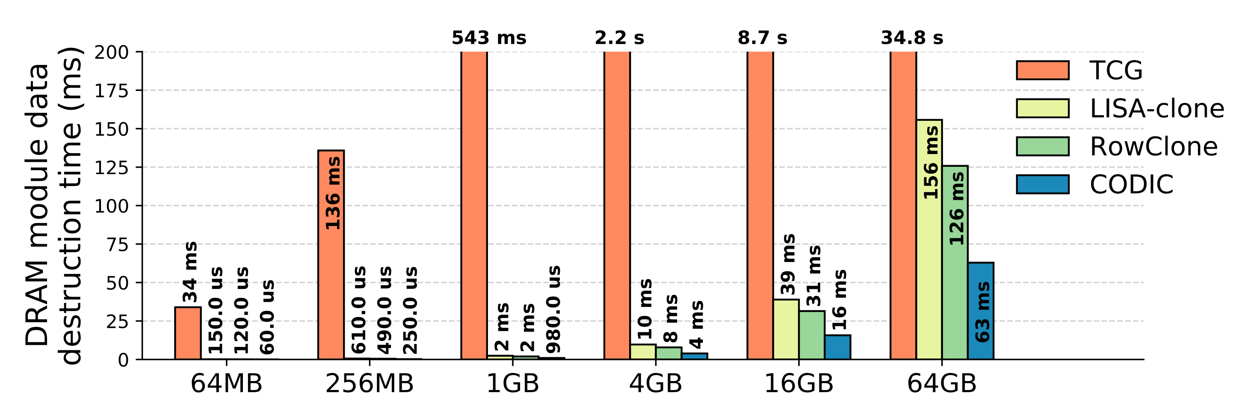

CODIC: A Low-cost Substrate for Enabling
Custom in-DRAM Functionalities and Optimizations
Lois Orosa^{1,2}, Yaohua Wang³, Mohammad Sadrosadati¹, Jeremie Kim¹, Minesh Patel¹,Ivan Puddu¹,
Haocong Luo¹, Kaveh Razavi¹, Juan Gómez-Luna¹, Hasan Hassan¹,
Nika Mansouri Ghiasi¹, Saugata Ghose^{4,} and Onur Mutlu¹
1
2
3
4
1: DRAM Background
2: Motivation
DRAM Organization
Internal DRAM Signals
sense_n controls the NMOS amplifier in the SA
EQ controls the unit that sets the bitline to V_{dd}/2
wl controls the transistor that connects the cell capacitor to the bitline
sense_p controls the PMOS amplifier in the SA
Limitations of fixed DRAM internal circuit timings
Chosen at design time and cannot be modified
Conservative internal circuit timings to ensure reliable operation
Memory controller does not have any knowledge or control over the internal implementations of DRAM commands
Potential of controlling internal DRAM circuit timings
Enables more aggressive performance, reliability, and energy optimizations
Enables new functionalities
May open new areas of research
Bank
bitline
DRAM Cell
ACTIVATE
DRAM Operations
wordline
PRECHARGE
Chip I/O
…
…
…
…
…
…
Row Buffer
3: Goal
DRAM Chip
DRAM Bank
…
Prepares all bitlines
for a subsequent
ACTIVATE command
to a different row
Enable new and enhance existing DRAM commands and optimizations by providing a low-cost substrate that enables fine-grained control over DRAM internal circuit timings.
Design new security mechanisms that have strong security and high performance by using the CODIC substrate.
SA₀
SA₁
SA_{N-1}
DRAM Cell
Sense Amplifiers (SAs)
Activates the DRAM row containing the data
4: CODIC
5: Applications of CODIC
CODIC substrate enables greater control over DRAM internal circuit timings
CODIC is an efficient and low-cost way to enable new functionalities and optimizations in DRAM
CODIC controls four key signals that orchestrate DRAM internal circuit timings
CODIC can be used in many applications:
Security
Custom Optimizations
Accurate DRAM Characterization
Processing-In-Memory (PIM)
We use CODIC to design two new applications in the security domain:
CODIC-sig
We demonstrate and evaluate two CODIC variants:
CODIC-sig generates digital signatures that depend on process variation
Key idea: Amplify a DRAM cell that we set to the precharge voltage (V_{dd}/2)
Mechanism:
Capacitor is initially set to 0 or V_{dd}
Raise the wordline signal ( )
Raise the precharge signal ( )
Result: the final value of the cell is the precharge voltage (V_{dd}/2)
CODIC-det
CODIC-det generates deterministic values
Key idea: Activate and with a delay between them
Mechanism:
Capacitor is initially set to 0 or V_{dd}
Raise the wordline
To generate 0, raise 1) , 2)
To generate 1, raise 1) , 2)
Result: CODIC-det generates a 0 or 1 value deterministically
Application 1: PUF
Application 2: Cold Boot Attacks
CODIC-sig can generate signature values in DRAM that can be used as a Physical Unclonable Function (PUF)
Signatures are unique to a device due to the unique physical variations of the device
Typically used to authenticate or identify a device
Characteristics of CODIC-sig PUF:
CODIC-sig has short evaluation latency
Repeatable PUF responses without relying on a filtering mechanism
CODIC-sig is resilient to temperature changes, i.e., changing the temperature does not influence much the repeatability of the PUF responses
CODIG-sig responses do not depend on the content of DRAM
A cold boot attack is a physical attack on DRAM that involves hot-swapping a DRAM chip and reading out the contents of the DRAM chip on another system
The attacker first disables the power and then transfers the DRAM to another system
Cold boot attacks are possible because the data stored in DRAM is not immediately lost when the chip is powered-off
Data in DRAM is stored in capacitors, and the data can remain in the cells long enough for it to be stolen
This data retention effect can be even more significant at low temperatures
Value = V_{dd}
Value = V_{dd}
Value = V_{dd}/2
Value = 0
5ns
5ns
14ns
CODIC-detz
6: Experimental Setup
Observation: It is possible to protect from cold boot attacks by deleting the entire memory content during DRAM power-on
Key Idea: A low cost in-DRAM mechanism based on CODIC that destroys all DRAM content during DRAM power-on
7ns
7ns
Evaluation of 72 real DDR3L (low power) DRAM chips and 64 real DDR3 DRAM chips
SoftMC FPGA-based infrastructure
7: PUF Evaluation
8: Cold Boot Attack Evaluation
9: Future Work and Conclusion
Metric: Jaccard indices to measure similarity or uniqueness
Future Research Directions
Security applications
Accelerate Secure deallocation
Accurate control of failure mechanisms used in existing DRAM-based True Random Number Generators (TRGNs)
Reduce de effectiveness of RowHammer attacks
Custom DRAM latency/energy applications
- Adapt to environmental conditions
Mitigate process variation effects
Accurate DRAM characterization
3. Processing in Memory (PIM)
Enable the implementation of robust PIM approaches (e.g., RowClone, Ambit)
DRAM Latency PUF
CODIC-sig PUF is very effective at very similar responses to the same challenge
PreLatPUF
CODIC-sig PUF maintains uniqueness across responses to different challenges
CODIC-sig destroys the entire content
of DRAM at least 2x faster
than the state-of-the-art
552.7x
CODIC-sig PUF
2.5x
2.0x
Similar responses to the same challenge
Uniqueness across responses
CODIC vs. Full Memory encryption
Overhead
CODIC Self-d
ChaCha-8
AES-128
~0%
~0%
~0%
DRAM Latency PUF
PreLatPUF
w/(w/o) filter
CODIC-sig PUF
w/(w/o) filter
Performance
~0%
~0%
~0%
Power
~17%
~12%
~0%
~12%
~0%
~17%
~1.3%
Conclusion:
CODIC can be used for implementing very efficient security applications
CODIC Can enable new DRAM functionalities, and reliability, performance, and energy optimizations
~0.0%
Processor Area
~0.0%
~0.9%
~1.3%
88.2 ms
7.95 (1.59) ms
4.41 (0.88) ms
~1.1%
~0.9%
~0.0%
~1.1%
~0.0%
~0.0%
DRAM Area
~0.0%
CODIC has no performance and power overhead at runtime
CODIC-sig PUF is 1.8x faster than the best state-of-the-art DRAM PUF
CODIC has no processor area overhead, and 1.1% DRAM overhead

